Slide 1
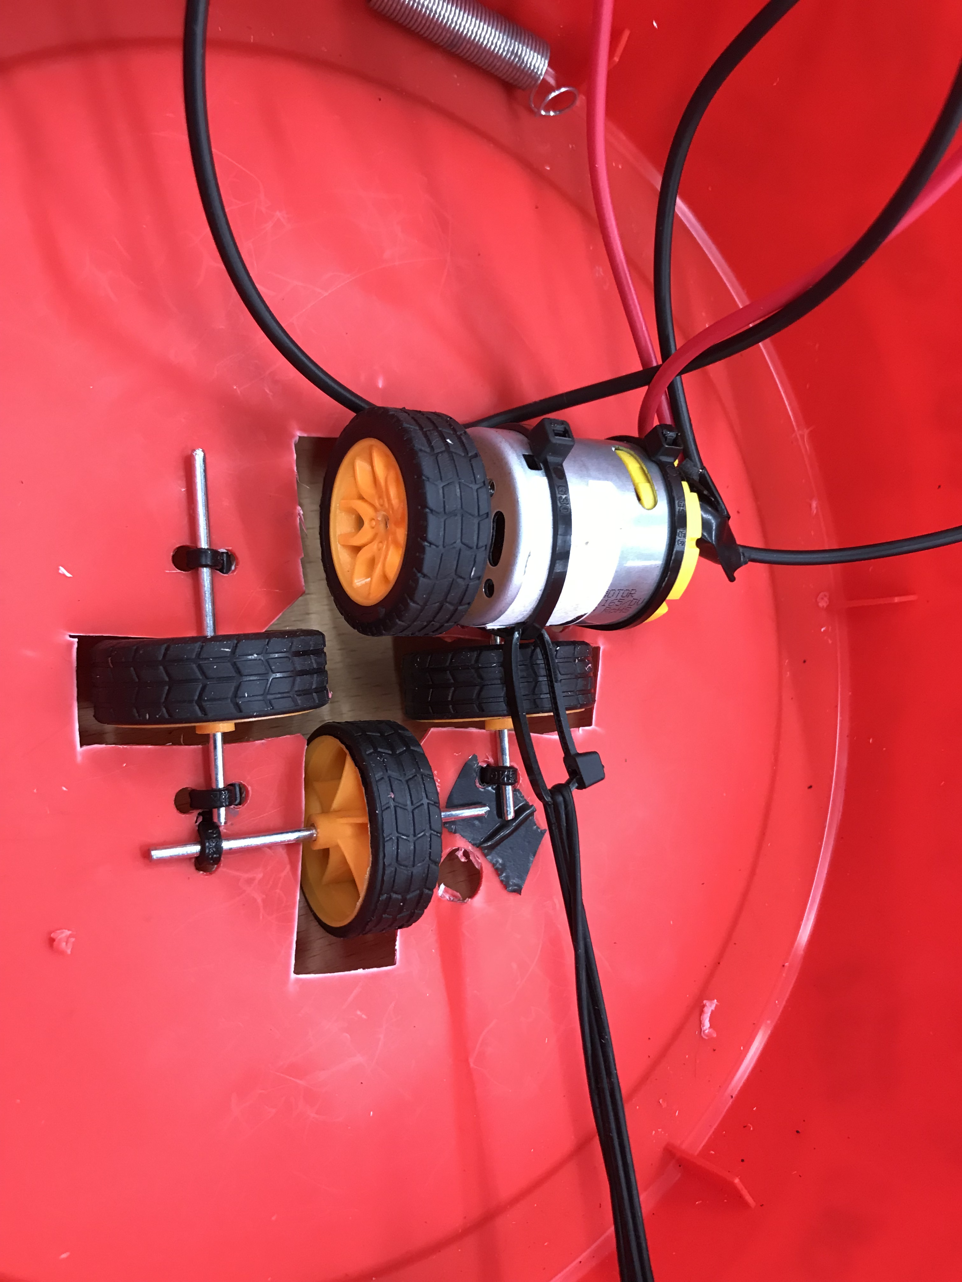
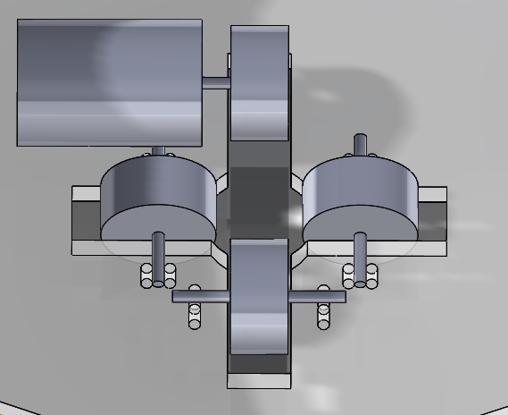
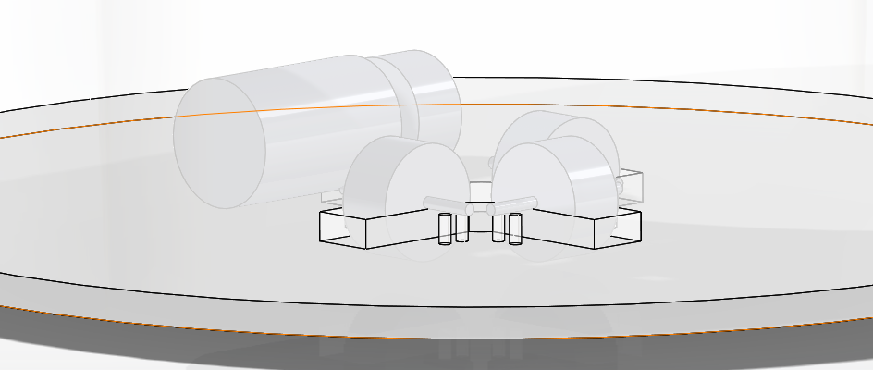
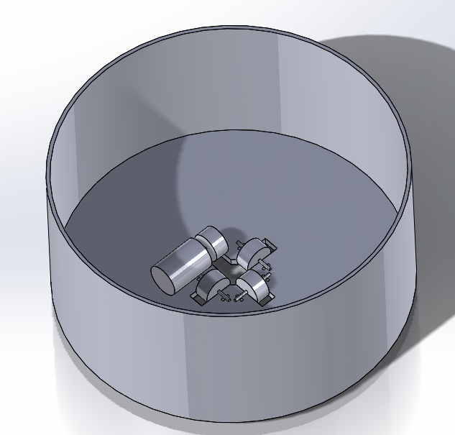
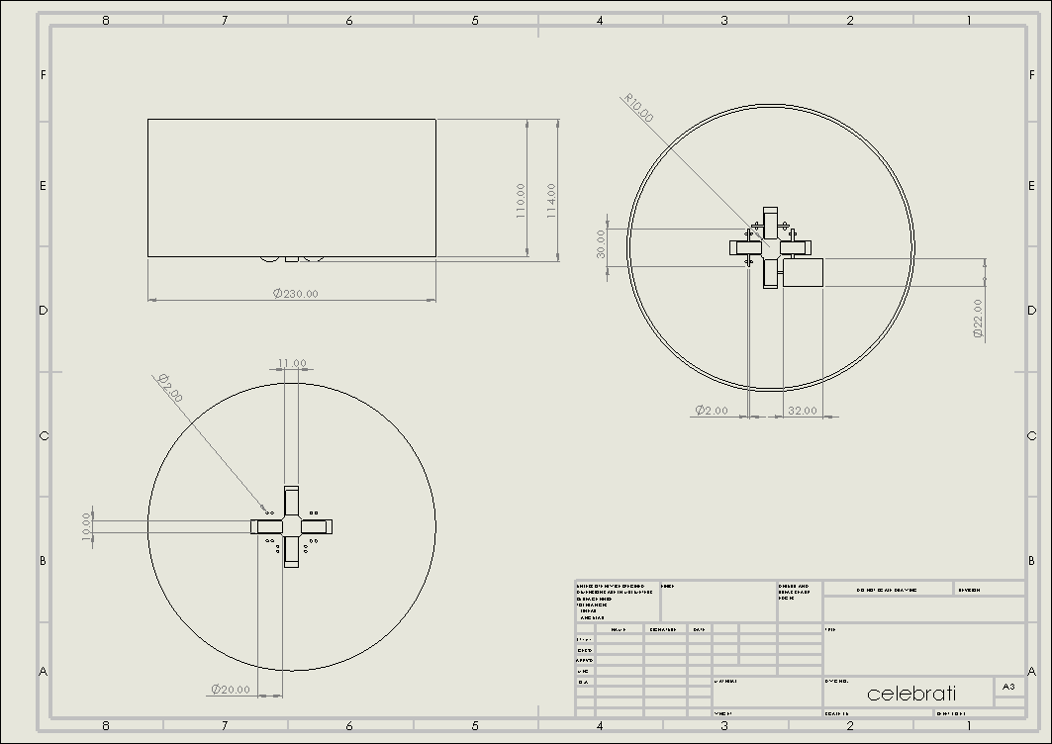


Group G Pipe Climbing challenge ‘Celebrati’
By Omaira Hernandez 1802664, Peter Olliffe 1806692,
Wesley Patrick 1701708, Daniel Wilcox 1802007
Introduction
Our task was to plan, design, produce, test and compete with a pipe climber. We were set a budget of £25 and given 13 weeks to complete the work.
We had to produce a device that climbs 2 metres on the outside of the pipe without any support. The device had to be within a 200mm radius and be less than 300mm tall and not mark the pipe on its journey.
Features and systems
For the electronics, a 9V system has been used to give the motor enough voltage therefore torque to climb the pipe. A torquey motor gives enough force to lift the climber and the attached chain to the top of the pipe. Once at the top a Double Pole Double Throw switch is thrown reversing the polarity of the motor to reverse back down the pipe to complete the challenge.
Our frame has rigidity from a plastic food container. This is stronger than gluing straight sides of plastic and was easier and therefore quicker to produce. Another benefit of the container is its mass as we aim to reduce as much weight as possible.
We used four rubber wheels to have stability and to apply traction to the one driving wheel. We aligned the wheels tighter than the copper pipe so the frame would bend applying tension in a set up similar to a diaphragm spring. This therefore improves traction with the driving wheel helping it up the pipe.
Team roles
Daniel Wilcox was assigned as team leader during the first meeting and was appointed to specialise in electronics
Wesley Patrick decided to work on the chassis and frame of the climber as a focus and produced the model and drawings
Omaira Hernandez chose the optimum material for the device
Pete Olliffe worked on the mechanism and method of fixing the product to the copper pipe.
Principles used
One of the main principles we rely on is friction. We are applying load to the driving wheel using springs. This increases friction with the wheel and pipe so the torque is converted through the wheel and onto the pipe to lift the device.
We are not relying on gravity to return to the starting position as we will reverse back down the pipe in a controlled manor instead of letting the device fall.
Modelling and Technical Drawing
To produce out models and technical drawings we used the software, Solidworks. All dimensions are in mm and the model is fully defined in the drawing.
School of Engineering

