Slide 1
Callie bailey

Slide 2
Gross profit
1300/9000 * 100 = 14.4%
1390/8500 * 100 = 16.35%

Slide 3
Net Profit
75/9000 * 100 = 0.83%
31/8500 * 100 = 0.36%

Slide 4

roce
75 + 9/1041 * 100 = 8.07%
31 + 8/1768 * 100 = 2.21%

Slide 5


Total asset turnover
9000 / 1041 = 8.65
8500 / 1768 = 4.81

Slide 6
Working capital turnover
9000 / 441 = 20.41
8500 / 1118 = 7.60

Slide 7

Current ratio
1099 / 658 = 1.67
1907 / 789 = 2.42

Slide 8
Quick ratio
1099 – 600 / 658 = 0.76
1097 – 880 / 789 = 1.3

Slide 9
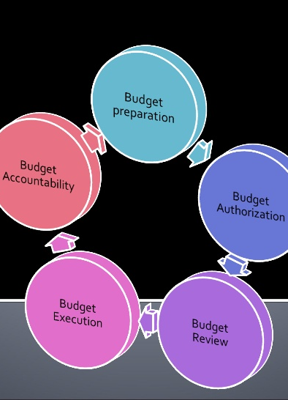
debtor days
459 * 365 / 9000 = 18.62
990 * 365 / 8500 = 42.51

Slide 10

CREDITOR DAYS
560 * 365 / 7300 = 28 DAYS
690 * 365 / 7000 = 35.97 DAYS

Slide 11
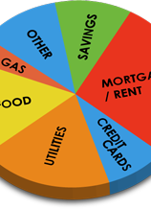
DEBT RATIO
658 + 100 / 600 + 1099 = 0.45
789 + 100 / 650 + 1907 = 0.35

Slide 12

INTEREST COVER
75 + 9 / 9 = 9.33
31 + 8 / 8 = 4.88

