Slide 1
“Svitlo Beauty Studio” Business Presentation
Student: Diana Tomyn
Student ID: 2428865
Enterprise & Entrepreneurship (LCLM4006)
Lecturer: Charles Obinwa

Slide 2
Table of Contents
1. Introduction
• Who I am
• Purpose of the presentation
2. Overview of the Business Idea
• Business concept
• Services
• Market need
3. Legal Format & Management Structure
• Legal structure of the business
• Roles and responsibilities
4. PESTEL Analysis
• Key external factors
• Impact on business strategy
5. Marketing & Promotion Strategy
• Target market
• Positioning
• Promotion activities
6. Funding Requirements & Financial Plan
• Funding needed & sources
• Startup, fixed & variable costs
• Cash flow forecast
• Break-even point

Slide 3

Introduction
Who am I?
Diana Tomyn – founder of Svitlo Beauty Studio
What I aim to achieve!
Present the business idea, market need, legal structure, and financial plan to show that the startup is realistic and sustainable

Slide 4
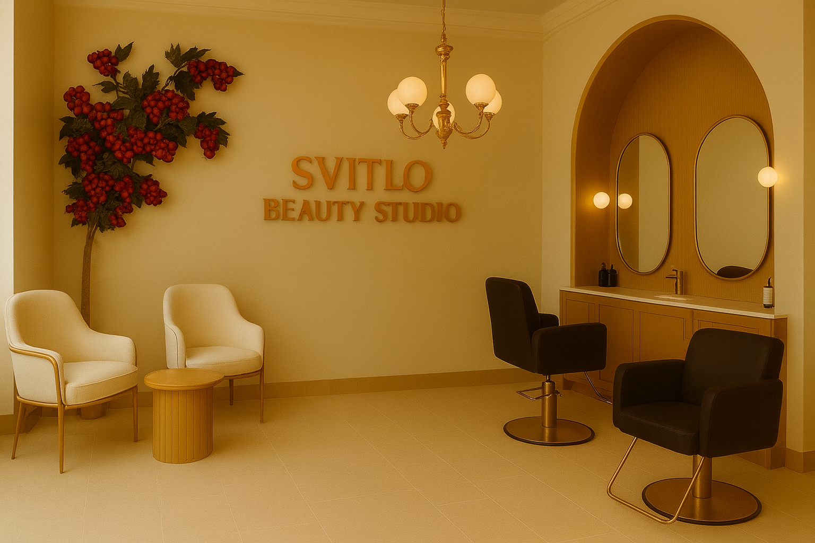
Overview of the Business Idea
Business Idea
Svitlo Beauty Studio is a beauty salon in East Londo, offering hair, nail, make-up, eyebrow and lash services.
Provides synchronous treatments, where two services can be done at the same time
(manicure + pedicure, hair styling + make-up).
Retail of selected haircare, skincare and nail products.
“Svitlo” = “light” in Ukrainian. A salon that combines Ukrainian light and modern London style, created to highlight natural beauty with warmth and elegance.
Market Need
high-quality beauty services.
multiple treatments in one visit.
clean, modern and comfortable environment.

Slide 5

Legal Format
Operates as a Private Limited Company (Ltd).
This gives the owner limited liability and protects personal money.
This format works well for a salon with self-employed specialists, product sales and plans for future growth.

Slide 6
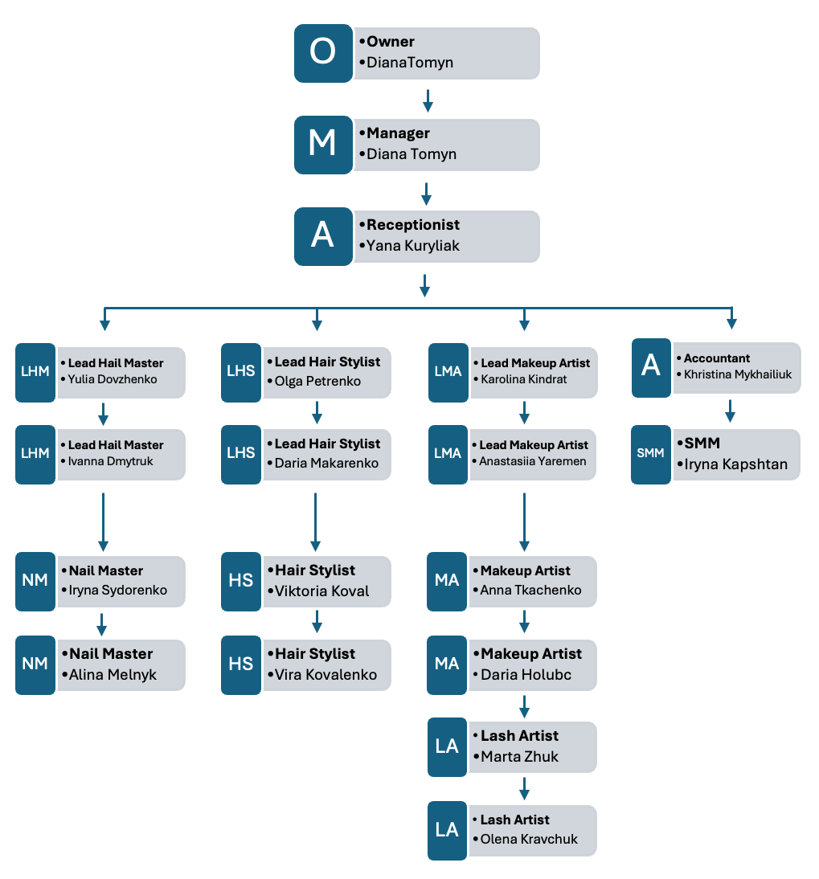
Management Structure

Slide 7
Pestel Analysis
Political
UK rules for salons (hygiene, licensing, waste)
Brexit makes some products harder or more expensive to import
Technological
Online booking, digital payments and social media are essential
Modern equipment helps improve service quality
Environmental
Clients prefer eco-friendly and cruelty-free products
Salons must dispose of chemical and beauty waste properly
Legal
Beauty salons must follow health & safety, data protection, employment and insurance rules
Economic
Strong demand for beauty services in London
High rent and inflation increase business costs
Strong competition in the London beauty market
Social
People care more about self-care and looking good
Clients want quick and convenient appointments
Services needed for women, men and children

Slide 8
Marketing Strategy
Unique Selling Points
Synchronous services
Ukrainian-inspired design and atmosphere
Eco-friendly and cruelty-free products
High hygiene and sterilisation standards
Marketing Strategies
Instagram & TikTok promotion
Collaboration with local bloggers
Google Maps visibility and reviews
Discount bundles for the opening month
Loyalty and referral programmes
Free drink + branded cookie
Clients share photos and tag the salon
Target Market
Women and men
Busy professionals, teenagers, students
Parents with children (age 2+)
Customer Segments
Time-conscious clients
Families with children who want safe services
Loyal customers

Slide 9
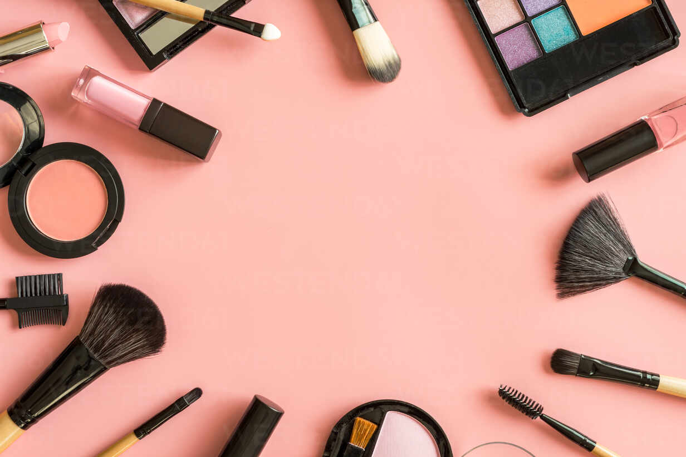
Funding Requirements and Allocation
Total Funding Required
£35,000 is required to launch Svitlo Beauty Studio.
Funding Sources
£20,000 – personal savings
£15,000 – investor support

Slide 10
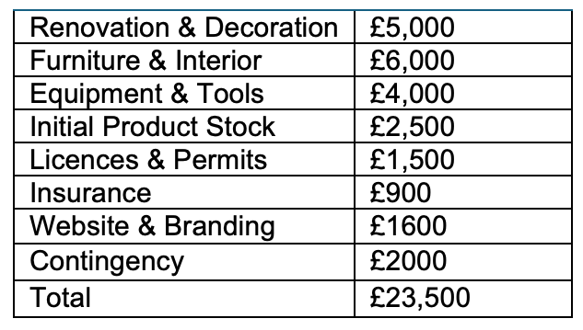
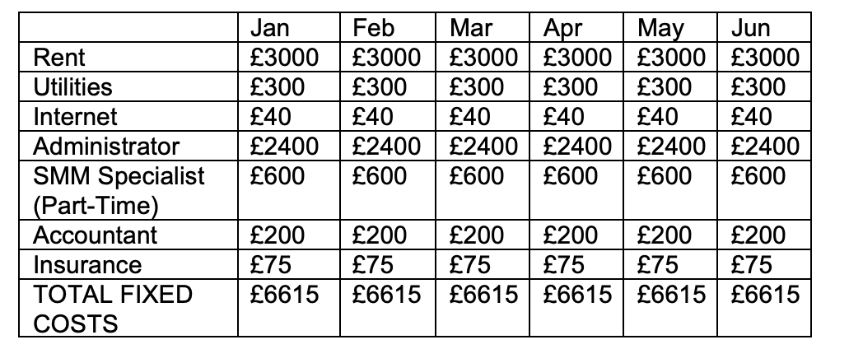
The salon uses a 60/40 commission system
60% stays with the salon to cover costs
40% goes to the beauty specialist
Startup Cost
Fixed Cost

Slide 11
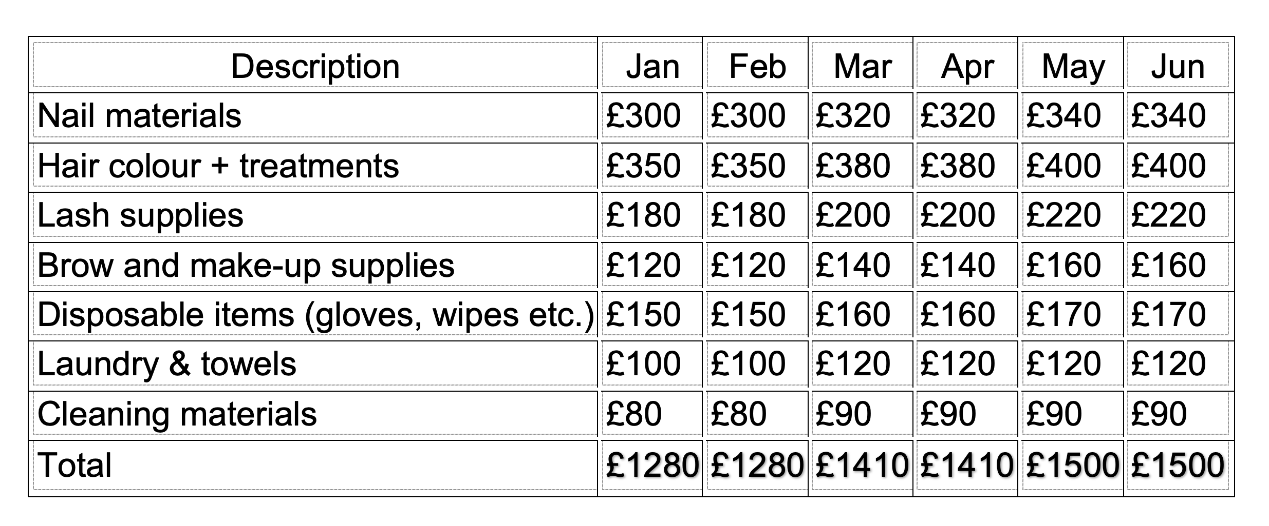
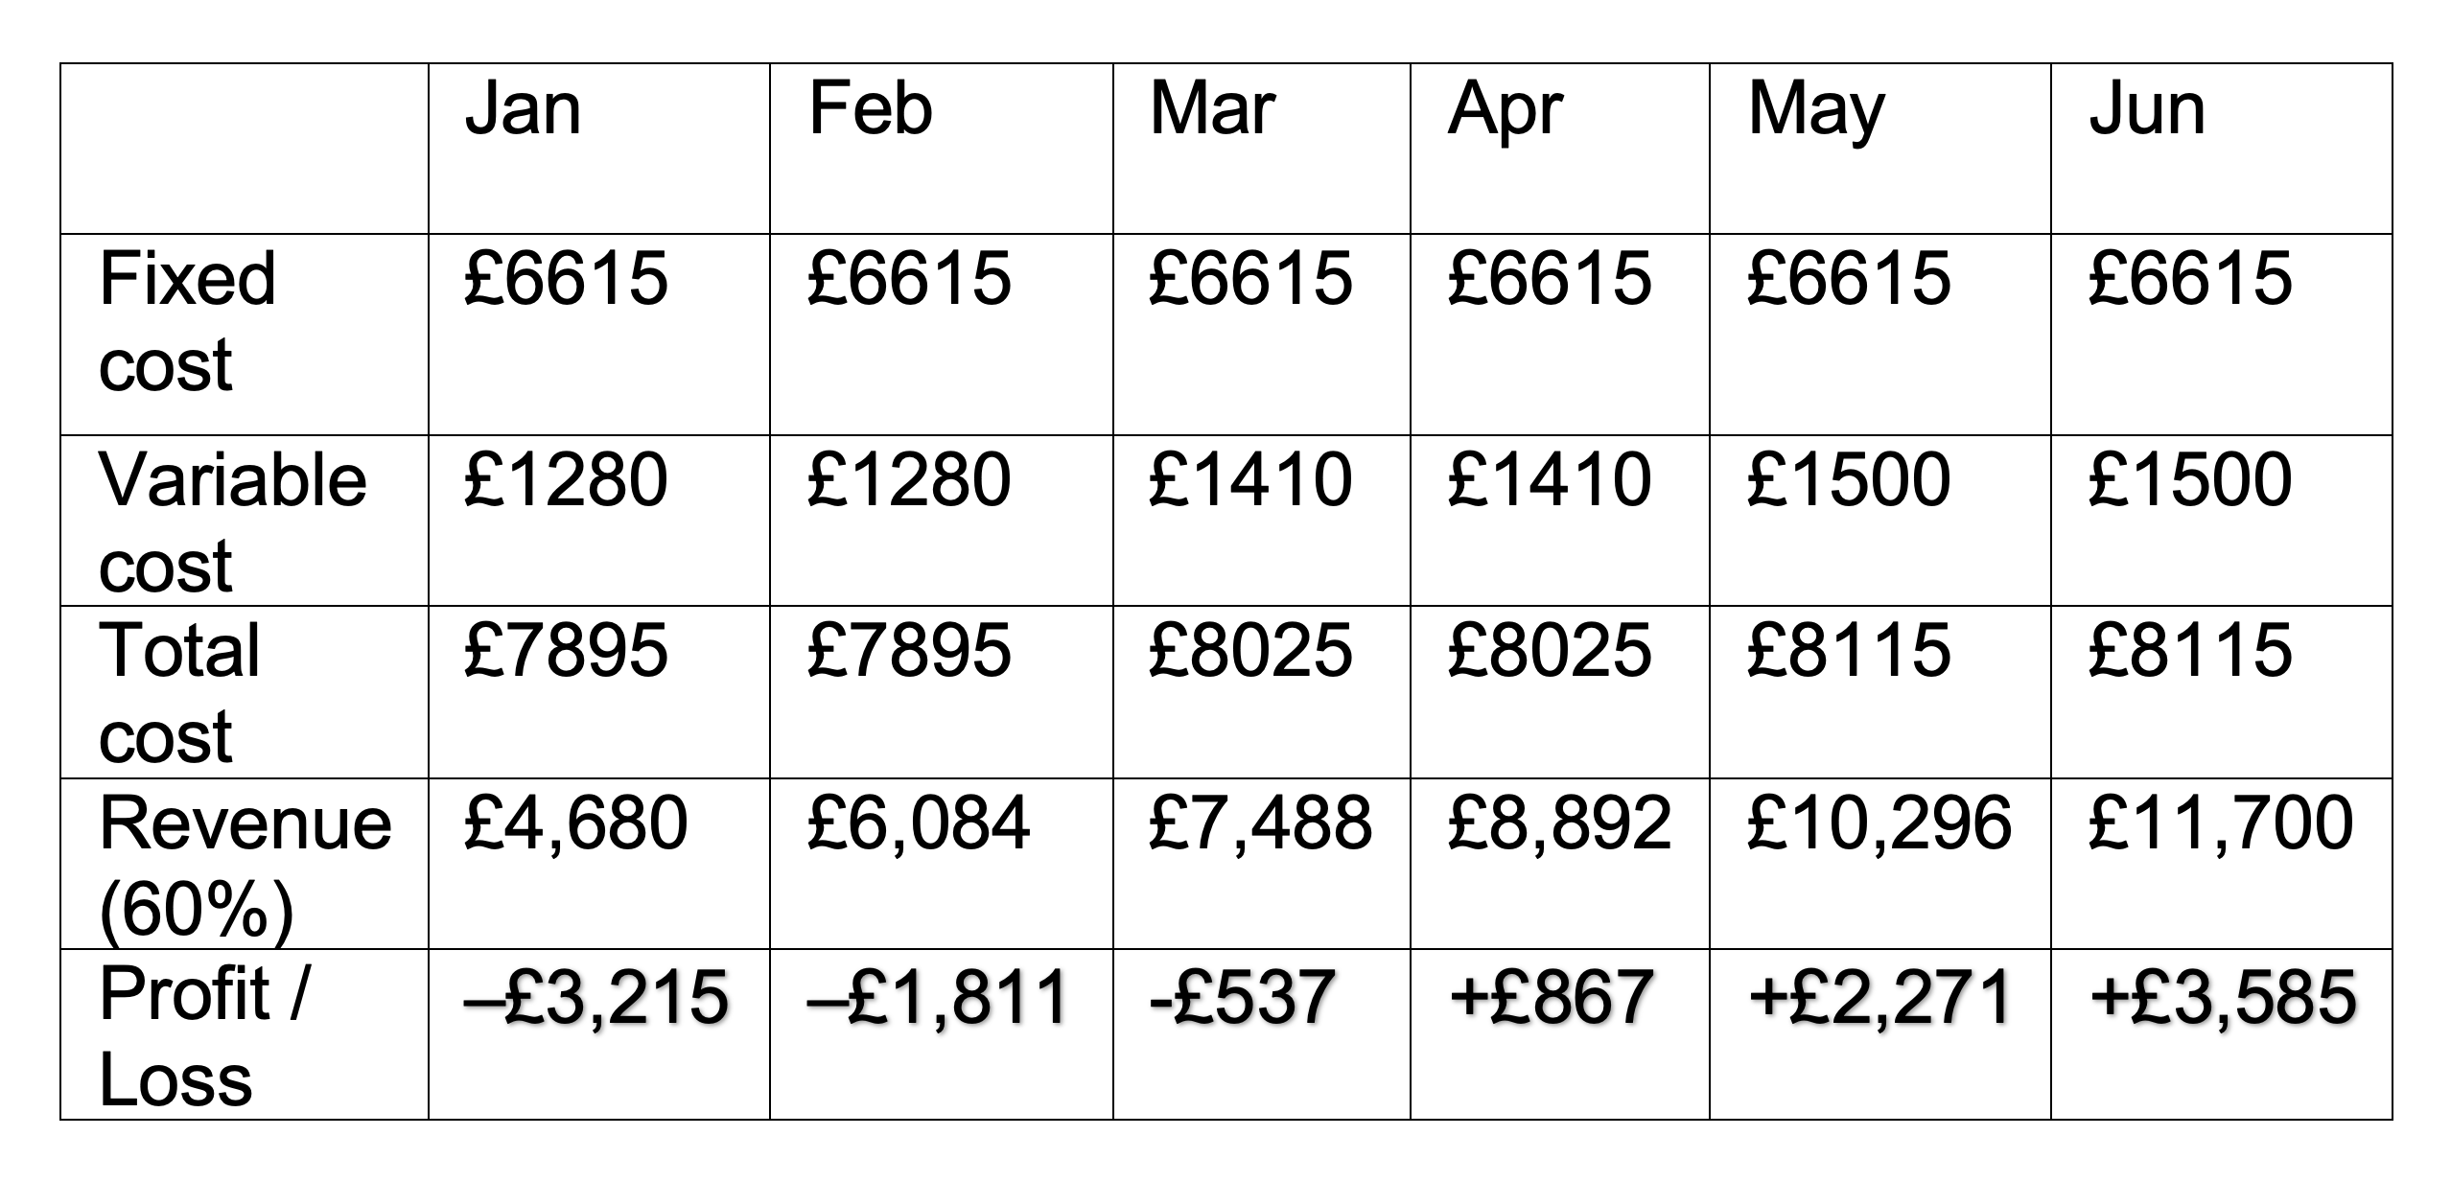
Variable Cost
Cash Flow Forecast
Investment needed:
£23,500 + £3,215 + £1,811+ £537 = £29,063

Slide 12
Any questions?
Thank you!

