Slide 1



MANAGEMENT
MANAGEMENT
Group Presentation by
Nasir
Touhid
Sujon
Shafi

Slide 2
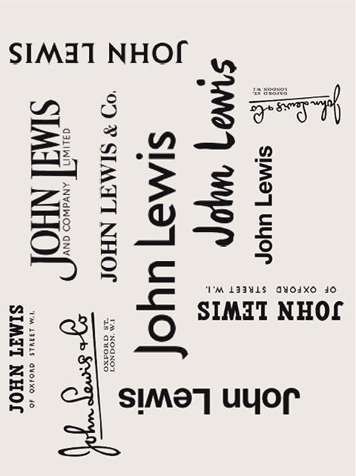
Jhon Lewis is a chain of high end departmental store throughout the United Kingdom. The first Jhon Lewis store was open 1864 in oxford street, London.
Jhon spedan Lewis son of Jhon Lewis was the founder of Jhon Lewis Partnership in 1929. There are 51 stores in United Kingdom.
Jhon Lewis Partnership is the UK’s largest retailer where employee gets share from profit. The company main strength is trust among all the employees.

Slide 3
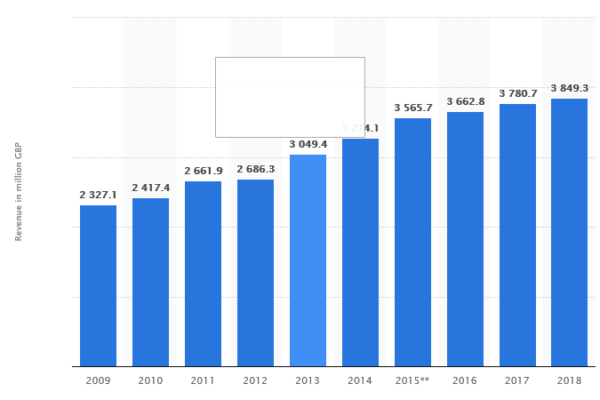

In this chart we can see Annual sales revenue of John Lewis in the United Kingdom (UK) from 2009 to 2018 (in million GBP)
(https://www.statista.com/statistics/420216/john-lewis-revenue-uk-united-kingdom/)

Slide 4

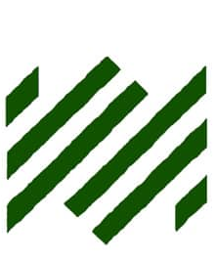
Task 1
“Knowledge Management is the systematic process and strategy for finding, capturing, organizing, refine and presenting data, information and knowledge for a specific purpose and to serve a specific organization or community.”
D J. King. (US Department of State)
Available at: https://smallwarsjournal.com/documents/kingdj.pdf

Slide 5
Task 1
"Knowledge management is a discipline that promotes an integrated approach to identifying, capturing, evaluating, retrieving, and sharing all of an enterprise's information assets. These assets may include databases, documents, policies, procedures.”
Management-Explained-122649,
Available at: http://www.kmworld.com/Articles/Editorial/What-Is/What-is-KM-Knowledge-

Slide 6
❖ knowledge Management is “Organisation intelligence quotient” (OIQ). KM helps and improves organisation Origination IQ. It makes the Organisation smarter. KM makes organisation smarter by improving Situational awareness to all the people of organisation. All the business or organisation has some issue like competitor, legal issues, regulatory issues, staff, suppliers issues. KM helps to make right and better decision for organisation.
Own knowledge and understanding what Knowledge Management

Slide 7
❖ Knowledge Management system basically deals and helping the organisation to become smarter and keeping organisation up to date.
❖ KM is getting and transferring the right knowledge to the right person at the right time.
❖ KM aim is to create value and power and process to refine the knowledge assets to meet business or organisational goal.
KM
Strategy
org. culture
Technology
corporate policies
org. processes
Leadership

Slide 8
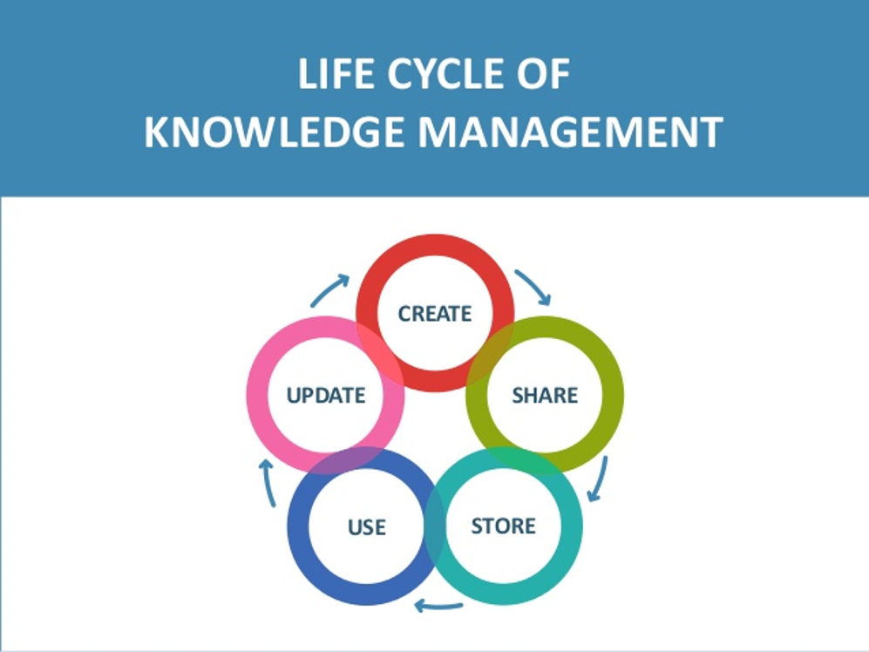

Slide 9
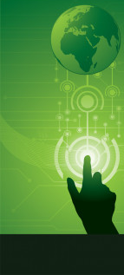
1. Better and faster decision making:
Delivering relevant information at the time of need through structure, products, demand and supports (Garfield, 2014) are always been successful to make a better decision.
Benefits of
Knowledge
Management
Task 2
2. Information Technology:
The power of Social Media plays an important role in KM system as it enables employees to collaborate, connect and rapidly access to experts and information. ( Deloitte., 2019).

Slide 10
3. Employee growth and development:
A good KM helps to continue staff training for growth and developing service.
4. Better product and service:
Helping the business to make decisions based on collective knowledge and expertise. (NIBUSINESSINFO.CO.UK, 2019).
Benefits of
Knowledge
Management
Task 2
5. Business intelligence:
To understand their company’s competitors, the marketplace and customers. (Brown, 2017).

Slide 11
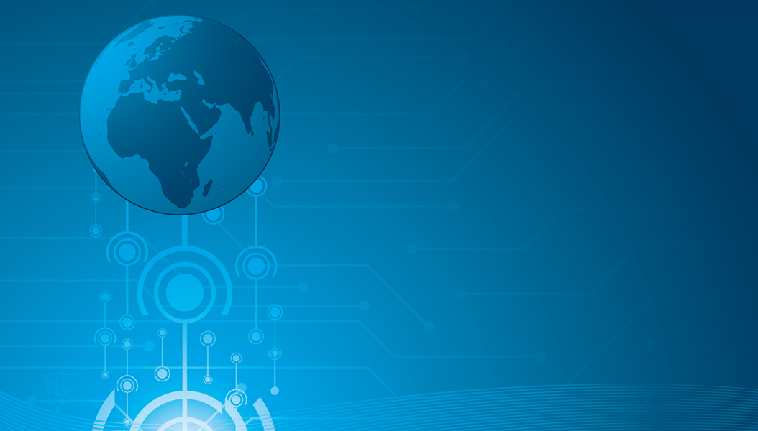
Task 2
Drawbacks of KM system:
❖ Sharing knowledge: Status or position gap.
❖ Implementation of technologies:
The modern technology is complex to get into the brain of an average worker.
❖ Training and development:
Training workers to use KM systems is costly.

Slide 12
Task 2
Drawbacks of KM system
❖ Stakeholders:
Earning customers and suppliers trust
Communication
Concerns
Involvement in the business
❖ Productivity:
Lack of communication cannot collaborate right product information for improvement.

Slide 13


Task 2
Benefits of KM system in Amazon:
One portal: One-stop shopping.
Personalization. The more we use the site, the better it knows us.
Crowdsourcing. Amazon builds knowledge and awareness in users.
Feedback. Feedbacks allows Amazon to improve its services and the product companies to improve their products. (Rosenberg, 2014).

Slide 14
Task 2
Benefits of KM system in Amazon:
Stakeholders:
Secure
Quick
Personalised
Customer experience
Create jobs and businesses.

Slide 15
Task 2
Drawbacks of KM system in Amazon:
1. Membership:
Amazon KM is offering prime membership.
2. Employees growth:
Disadvantage of Amazon KM system is not giving job guarantee after the season.
3. Impact on high street:
Amazon’s KM system is capable to ensure that, the item will be delivered in as quickly as 2 days which is bad for the local economy. (Ayres, 2016).

Slide 16
Task 2
Drawbacks of KM system in Amazon:
Stakeholders:
Amazon Prime
Limited option
Market share
Credit option
Free delivery

Slide 17
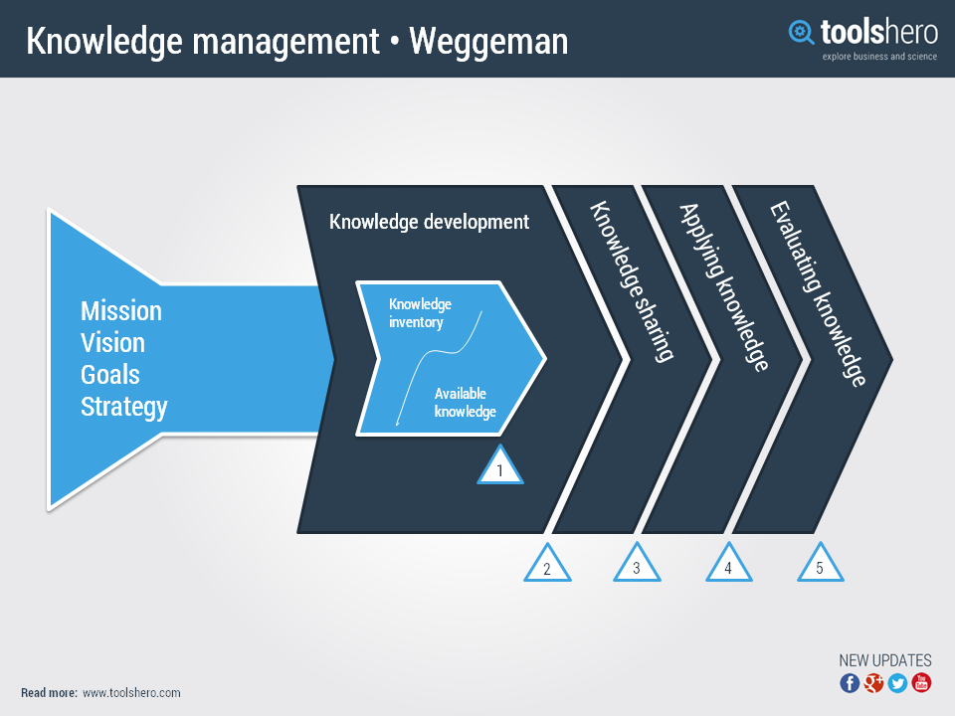

Slide 18
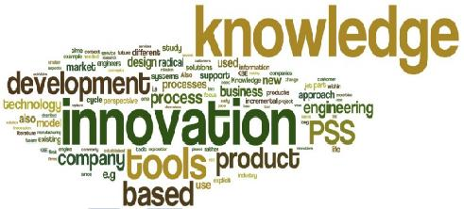
Knowledge Development
John Lewis knowledge development inventory comes from their own staff.
John Lewis’s 76 thousands staffs are all permanent partner of the organisation.
As the employee’s have first-hand experience dealing with the customer, they understand customer need better than anyone else, therefore they are able to recommend changes for improvement to their senior managers.
.
(The Guardian, 2012)

Slide 19

Knowledge Sharing
John Lewis developing knowledge through their partners and customer service, who are dealing with customer face to face, and recording the feedback.
  Partners ask customers what they want and what they think, and records the findings. Once the information is gathered, and analysed the processes and culture is altered according to findings. (smatar.com, 2013)

Slide 20

Applying Knowledge
The benefit of applying knowledge to an organisation is that when the organisation move to new areas, such as online selling, they can apply that knowledge gained from dealing with customer face to face and not let the standard slip.
(marketingweek.com, 2019)

Slide 21

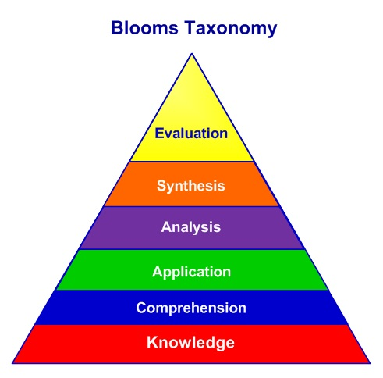
Evaluating Knowledge
We know by DK, SK & AK benefits the organisation, because JL has performed exceptionally well compared to the rivals, Tesco, M&S and Sainsbury.
John Lewis staff earn substantially more than their rival staff, when bonus is added to their wage package at the end of the year, sometimes equivalent to nine week pay.
However in some department John Lewis need to act quicker to implement changes, in this fast moving world.
(marketingweek.com, 2019)

Slide 22

Conclusion
Task 4
John Lewis Staff and same as shop workers at rival chains but the year end bonus significant top up.
❖ The end of the bonuses
❖ Percentage partnership
This benefit allows the employees/owners to put their heart in, to drive this retail organisation successfully towards UK’s no.1 retail outlet.
The employee/owner sector delivers estimated 4% of financial success annually in John Lewis, this contribution is growing. This helps by looking ahead and trying to predict what the world might be like in 2028 (100 years), we are able to make better decisions now about how we run our business for the beneﬁt of Partners, customers and society.

Slide 23
Recommendations
Task 4
❖ Against a challenging backdrop with subdued consumer demand, both Waitrose and John Lewis achieved positive like-for-like sales growth and Partnership gross sales increased. Their overall number of customers grows in Waitrose and in John Lewis. The number of higher spending ‘Best’ customers grew in Waitrose and edged backwards in John Lewis. It been tracked like this because the organisation wants their new propositions to appeal most best to their customers.

Slide 24
Recommendations
Task 4
❖ John Lewis are having strong years, outperforming the market and growing market share in Fashion, Home, and Electricals & Home Technology. They also grew sales, operating profit, customer numbers and our Net Promoter Score. Their performance can reflects their relentless focus on putting customers at the heart of what they say and do by offering them products that they cannot buy anywhere else, delivering hassle free shopping experiences and inspiring and delighting them through in-shop experiences.

