Slide 1

Declaration
I have used Grammarly which is an AI tool to rectify any grammatical mistakes from this study. Other than this, I confirm that I have not used any AI too in the research and creation of this assignment. I confirm that I have not presented any AI generated materials as my own work. I also confirm I have copies of my draft, notes and other resources I used, which I may be asked to provide in evidence.
BMIH6007- International Meetings Management for the Hotel Industry
MYTHIC WALES 2025: STORYTELLING AS STRATEGY
Module Lead: Kathryn Flynn
Student name: Mihaela Costache
Student ID: 2246360

Slide 2


Introduction
Mythic Wales 2025 is a 3-day immersive B2B storytelling summit for MICE professionals, fusing business conferencing with Welsh myth, language, and cultural identity.
The event supports Year of Croeso by showcasing Wales as a destination where historical tales combine with contemporary hospitality (Visit Wales, 2025).
The event will combine keynote sessions with live folklore performances, cultural networking, and digital storytelling labs.

Slide 3

The event takes place in South Wales
where it combines:
Event Theme
Digital storytelling for destination branding
The strategic MICE-cultural fusion of Mythic Wales uses storytelling as an emotional and place-based branding tool (Morgan, Pritchard and Pride, 2007).
The event showcases Wales’ unique cultural identity through immersive storytelling and myth-inspired programming (Williams, 2010) which provides international planners with an authentic destination experience based on identity and tradition.
Live performances of Celtic legends
Business panels on emotional engagement in tourism

Slide 4


Target Market
ICCA (2023) reports that 73% of buyers require authentic cultural context in event design, and the global business travel market will reach $1.4 trillion by 2026 according to GBTA (2022)
Target Market:
  MICE professionals & Destination Management Companies (25–65)
  Experiential marketing managers
  Digital travel media (Kotler and Lee, 2016)
Origin: North America, Scandinavia, DACH, Asia-Pacific

Slide 5
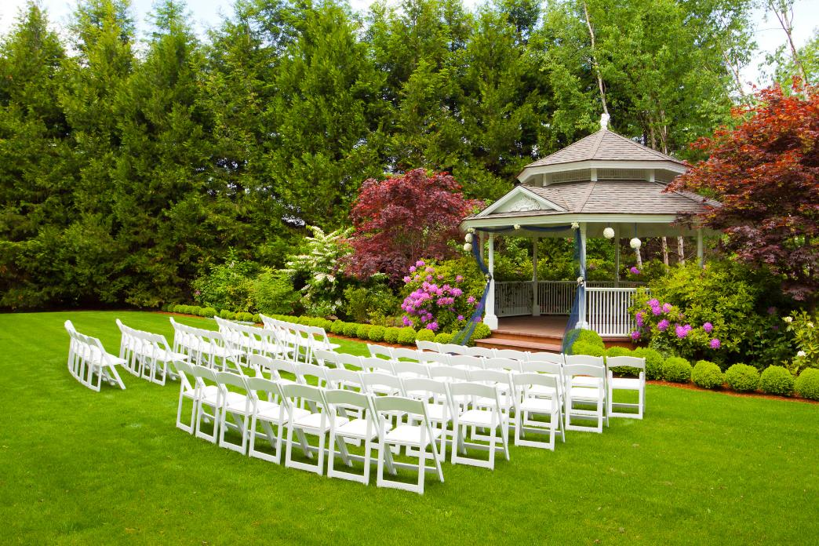
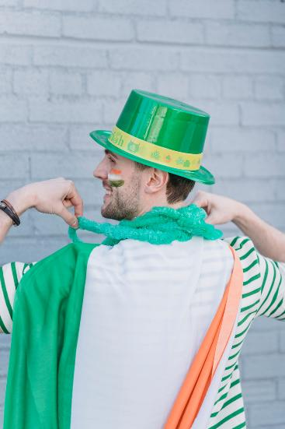
Demand:
  Post-pandemic surge in meaningful event experiences
  Global rise in cultural narrative marketing (Clampet, 2023)
Supply:
  Wales has deep cultural capital and low storytelling saturation in MICE
  High-quality venues (Castell Coch, St. Fagans); Gov Wales (2023), Museum Wales (2025).
Competition:
  Ireland’s Storytelling Festival (domestic)
  Scotland’s Burns-themed MICE packages (Creative Scotland, 2024)

Slide 6
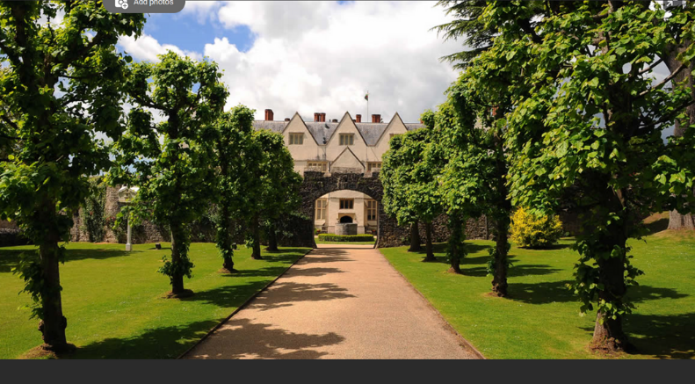
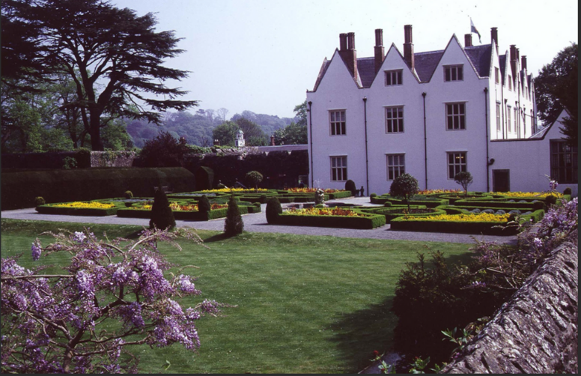
Proposed Venue
St Fagans National Museum of History, Cardiff
  Indoor and outdoor storytelling spaces
  High accessibility (Cardiff Airport, train links)
  Authentic Welsh setting for myth-based theming
  Existing AV and event infrastructure (Museum Wales, 2025).

Slide 7



)
(Kulshreshtha, Sharad Kumar, 2023)
Operational Resources
Staff & Resources:
  Event team (planners, cultural liaisons, bilingual hosts)
  AV/tech support (for hybrid streams) (Kulshrestha, 2023)
  Performers (bardic artists, folklore experts)
  Resources: staging, tents, interpreter headsets, wellness lounges (Bowdin et al., 2023)
The involvement of local storytellers musicians and craftspeople enriches visitor experiences while creating direct economic benefits for the host community which supports sustainable event practices and destination development goals (Getz and Page, 2019).

Slide 8



Projected Income:
  Ticket Sales (150 x £300): £45,000
  Sponsorship: £15,000
  Welsh Gov. Cultural Tourism Grant: £20,000
  Total Revenue: £80,000
Financial Feasibility
Projected Costs:
  Venue: £10,000
  Production & AV: £15,000
  Talent/Performers: £8,000
  Staffing: £10,000
  Marketing: £7,000
  Catering: £5,000
  Total Costs: £55,000
Projected Surplus: £25,000
(Tum et.al, 2020)

Slide 9
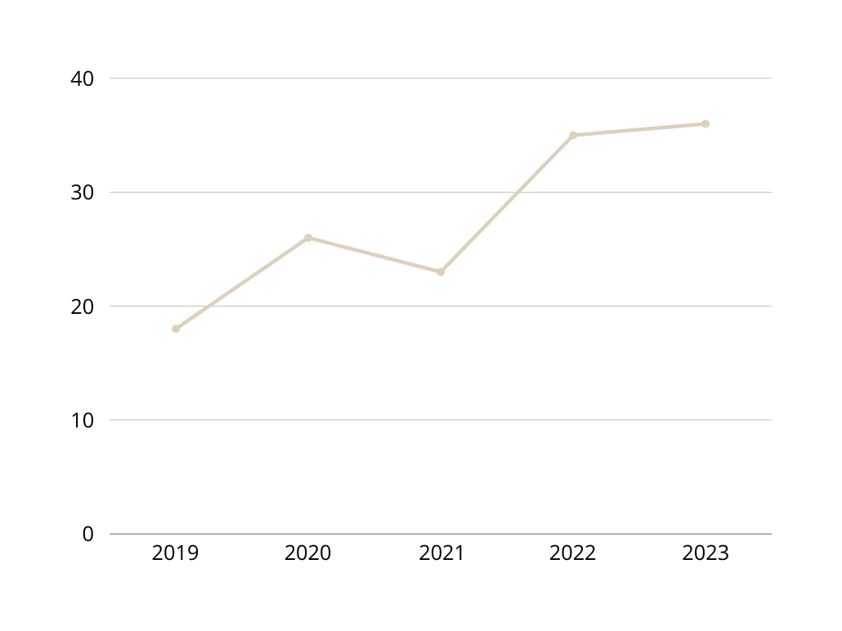
Marketing Strategy
  Story-driven social media campaign: #MythicWales2025
  AR filters on Instagram/TikTok inspired by Welsh mythology (Evans, 2021).
  Email campaigns to international MICE networks
  Collaborations with Lonely Planet, MICEbook, and Celtic Life Intl. Source: MICEbook (2025), Celtic Life International (2025), Lonely Planet (2025).

Slide 10
SWOT ANALYSIS
  Strengths: Original theme, strong heritage assets, market demand
  Weaknesses: Niche appeal may limit audience reach (Weinstein, 2013)
  Opportunities: International press interest, digital spin-offs
  Threats: Weather, transport strikes, political uncertainty (e.g. visa barriers) (Evans, 2024).

Slide 11
Management Considerations & Strategic Control
  Risk Management: The implementation of backup indoor venues together with performer contracts and event insurance will protect against weather disruptions and transport strikes according to O'Toole (2011).
  Sustainability & CSR: The event supports sustainable practices through its implementation of low-carbon transport solutions and locally sourced catering and digital ticketing and Welsh language preservation initiatives (Jones, 2014).
  Stakeholder Engagement: Visit Wales along with sponsors suppliers and cultural partners will receive regular updates to maintain aligned expectations and accountability (Freeman, 1984).
  The event follows all UK licensing requirements and accessibility standards and insurance regulations and will provide visa information to international conference attendees.
  The evaluation metrics will include digital feedback surveys and social media reach through hashtag engagement and delegate satisfaction KPIs after the event.

Slide 12



Conclusion
The Year of Croeso 2025 will benefit from the culturally distinct and financially sound event concept of Mythic Wales.
The event has been strategically designed to attract international attention and enhance Wales’ global positioning within the MICE and cultural tourism sectors.
The event has a strong foundation in pre-event feasibility covering market demand, operational logistics and funding strategy and is well prepared to move confidently into the implementation phase.

Slide 13
References
Bowdin, G., McDonnell, I., Harris, R., O’Toole, W., Allen, J. and Leo Kenneth Jago (2023). Events Management. [online] Routledge. doi:https://doi.org/10.4324/9781003044963. (Accessed 04 May 2025).
Celtic Life International. (2025). Celtic Life International. [online] Available at: https://celticlifeintl.com/. (Accessed 04 May 2025).
Clampet, J. (2023). State of Travel 2023. [online] Skift. Available at: https://skift.com/insights/state-of-travel-2023/ [Accessed 8 May 2025].
Creative Scotland (2024). Scottish International Storytelling Festival 2024 Programme Announced. [online] Creative Scotland. Available at: https://www.creativescotland.com/news-stories/latest-news/archive/2024/09/scottish-international-storytelling-festival-2024-programme-announced [Accessed 8 May 2025].
Evans, D. (2021). Social Media Marketing. A G Printing & Publishing.
Evans, N.G. (2024). Strategic Management for Tourism, Hospitality and Events. 3rd ed. Taylor & Francis.
Freeman, R.E. (1984). Strategic Management: a Stakeholder Approach. Cambridge: Cambridge University Press.
GBTA. (2022). Global Business Travel Spending is Coming Back, but Recent Headwinds Push Anticipated Full Recovery Into 2025 and 2026 - Global Business Travel Association - GBTA. [online] Available at: https://www.gbta.org/global-business-travel-spending-is-coming-back-but-recent-headwinds-push-anticipated-full-recovery-into-2025-and-2026/. (Accessed 30 April 2025).
Getz, D. and Page, S.J. (2019). Event studies : theory, research, and policy for planned events, 3rd edition. New York: Routledge, Taylor & Francis Group.
Gov Wales. (2023). Castell Coch venue hire | Cadw. [online] Available at: https://cadw.gov.wales/visit/venue-hire/commercial-hire-events/castell-coch-venue-hire [Accessed 8 May 2025].
Jones, M. (2014) Sustainable Event Management: A Practical Guide. 2nd edn. Abingdon: Routledge.
Kotler, P. and Lee, N. (2016). Social marketing : changing behaviors for good. Thousand Oaks: Sage Publications, Inc.
Kulshreshtha, S.K. (2023). Managing Festivals for Destination Marketing and Branding. IGI Global.
Lonely Planet (2025). Lonely Planet | Travel Guides & Travel Information. [online] Lonely Planet. Available at: https://www.lonelyplanet.com/. (Accessed 30 April 2025).
ICCA. (2023). Public Abstract - 2022 ICCA Business Analytics. [online] Available at: https://www.iccaworld.org/global-industry-news/post/public-abstract-2022-icca-business-analytics/. (Accessed 30 April 2025)
MICEbook (2025). Pushing the Boundaries: Where Next for Incentive Travel? - micebook. [online] micebook. - powered by micebook. Available at: https://micebook.com/blog/2025/02/04/pushing-the-boundaries-where-next-for-incentive-travel/ [Accessed 8 May 2025].
Morgan, N., Pritchard, A. and Pride, R. (2007). Destination Branding. Routledge.
Museum Wales. (2025). Wedding Venue for Hire at St. Fagans, Cardiff. [online] Available at: https://museum.wales/stfagans/hire/wedding/ [Accessed 8 May 2025].
O’Toole, W. (2021). Events Feasibility and Development. Routledge.
Tum, J. et al. (2020) Management of Event Operations. Routledge.
Visit Wales. (2025). Wales is celebrating a Year of Croeso, a Welsh welcome for visitors. [online] Available at: https://traveltrade.visitwales.com/useful-information/toolkit/year-of-croeso. (Accessed 01 May 2025)
Weinstein, A. (2013). Handbook of Niche Marketing. Routledge.
Williams, J. (2010). A history of Wales : derived from authentic sources. Cambridge: Cambridge University Press.

