Slide 1

FFION LIMITED
Financial Management for Hotel Industry
Lecture: Dale Clarke
Student name :Madalina-Andreea Popa
Student number:1815001
Student email:1815001student@.uwtsd.ac.uk

Slide 2


Table of Contents
Introduction
Financial analysis
Financial Trend Analysis
Knowledge from Ratio Analysis
Benefit and limitation of Ratio Analysis
Conclusion
References

Slide 3

Introduction
The organisation FFION Ltd is an enterprise operating within the hospitality industry managing a portfolio of the hotels in the Northern Ireland and UK.
This report has been prepared as the company’s accountant for the UK region and analyses its financial information form its financial statements .
Notes:
Financial statement analysis is a significant aspect in all organisational contexts. It is necessary since it provides substantial information to a company’s shareholders in their decision-making. At the same time, it facilitates the evaluation of the current positioning of a company’s finances while analysing its creditworthiness. In such a manner, financial statement analysis is significant within organisations and helps their external stakeholders in a number of ways. The organisation Ffion Ltd is an enterprise operating within the hospitality industry managing a portfolio of hotels in the Northern Ireland and in UK. This report has been prepared as the company’s accountant for the UK region and analyses its financial information from its financial statements. Trends have been analysed in it through calculation of financial ratios while evaluating the fluctuations in them during the years 2017 and 2018. At the same time, the benefits of the tourism and hotel industry for using ratio analysis along with its associated limitations for aiding decision-making have been considered as well.

Slide 4
Financial Analysis
Ratio | 2017 | 2018
Gross Profit | 2100/9000*100=23.3 | 1850/9500*100=19.47
Net profit | 623/9000*100=6.92 | 307/9500*100=3.23
ROCE | 623+10/2684*100=23.58 | 307+9/3014*100=10.48
Total Assets Turnover | 9000/2684=3.35 times | 9500/3014=3.15 times
Working Capital Turnover | 9000/984=9.15 | 9500/1264=7.52
Current Ratio | 1839/855=2.15 | 2152/888=2.43
Quick Ratio | 1839-700/855=1.33 | 2152-750/888=1.58
Debtor Days | 649*365/9000=26.32 | 870*365/9500=33.43
Creditor Days | 660*365/6500=37.06 | 690*365/7700=32.71
Debt Ratio | 855+150/1839+1700=0.28 | 888+150/2152+1750=0.27
Interest cover | 623+10/10=63.3 | 307+9/9=35.1
Notes:
Financial analysis can be defined as the procedure used for the analysis and review of financial statements in an organisation for making improved economic decisions (Maynard, 2017). It acts as the medium through which financial data is simplified through methodologically classifying the data within financial statements. In the words of Williams and Dobelman (2017), one of the most efficient tools for performing financial analysis of an enterprise is the ratio analysis. In the above section, the financial analysis of Ffion Ltd has been conducted by the medium of applying profitability, gearing and liquidity ratios -

Slide 5
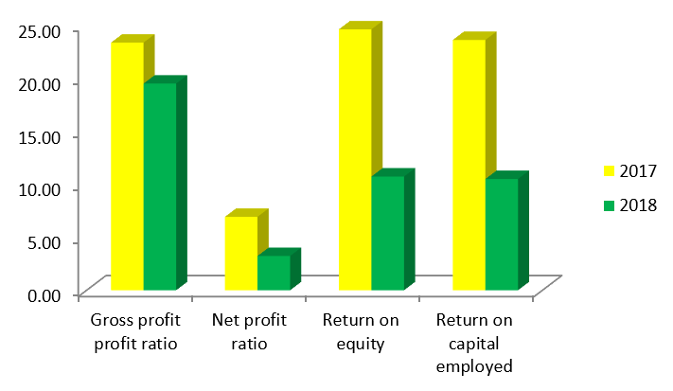
Financial Analysis Trends
Profitability
Notes:
The analysis of the trends in the profitability ratios of Ffion Ltd indicate that considerable decreases have occurred in the hotel chain’s profits. While the gross profit ratio has lowered by 16.54%, the net profit ratio has decreased by 53.32%. This indicates that the earnings of the hotel chain relative to its sales have largely decreased. On the contrary, the returns from equity have decreased by 56.40% while returns from capital employed have decreased by 55.54%. This indicates that the earnings of the hotel chain have also largely decreased based upon its equity and capital employed returns.

Slide 6
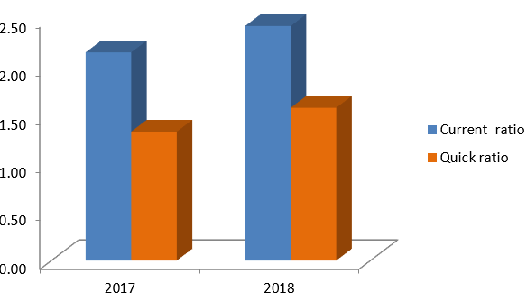
Financial Trends Analysis
Liquidity
Notes:
The analysis of the trends in the liquidity ratios of Ffion Ltd indicate that improvements have taken place in both the liquidity ratios. The current ratio has increased between 2017 and 2018 by 12.67% while the quick ratio has increased by 18.52%. Thus, it can be found that there has been an improvement in the liquid position of the hotel chain. This improvement is seen not only in terms of its capacity of clearing current debts with current assets but also in its capacity of clearing current debts with liquid assets. Thus, the trend analysis shows good liquidity within Ffion Ltd.

Slide 7
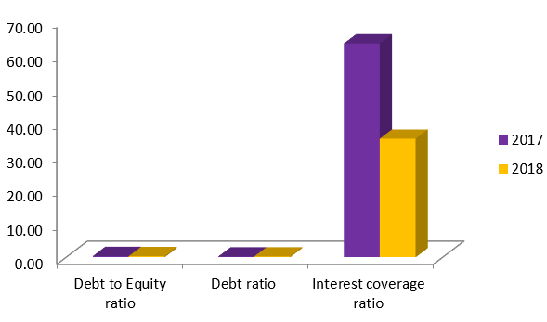
Financial Trends Analysis
Gearing
Notes:
The analysis of the trends in the gearing ratios of Ffion Ltd indicate positive results in case of the solvency based upon equity and the solvency based upon assets. This is because the debt equity ratio shows improvement by 8.62% and debt ratio shows improvement by 6.32%. In case of these two ratios, as the ratios decrease, the solvency increase. However, in case of the interest coverage ratio, the trend shows that the hotel chain has had a decrease of 44.53% in its interest coverage, which quite considerable. It is an indication that the Ffion Ltd’s burden of debts has increased between the years 2017 and 2018, thereby increasing the possibilities of the hotel chain in facing bankruptcy.

Slide 8
Knowledge from Ratio Analysis
On the other hand, Kayathiri Bai and Buvaneshwaran (2015) mentioned that ratio analysis within the hotel management industry in the verification of the potential opportunities of investment for the potential investors within the hotel management industry.
The fluctuations taking place within them help in understanding the consistency within the financial positions of the companies in the industry.
Inconsistencies can be identified through considering the fluctuations and the loopholes in financial performance can be found
Notes:
Similar to all other industries, it is also necessary for the hotel management industry to conduct and perform its financial analysis. According to Arif et al. (2016), it is essential for the hotel management industry to have an in-depth understanding of their ratios while evaluating their fluctuations. This is done through the medium of analysis of information present within their financial statements. The understanding of ratio analysis assists in the revelation of financial strengths along with weaknesses. On the other hand, Kayathiri Bai and Buvaneshwaran (2015) mentioned that ratio analysis within the hotel management industry in the verification of the potential opportunities of investment for the potential investors within the hotel management industry.
The understanding of the liquidity ratios within the hotel management industry provides its stakeholders with information relating to its ability of meeting all sorts of short-term obligations. These ratios also help the industry in the maintenance of optimal working capital required for its operations. On the other hand, the understanding of the gearing ratios within the hotel industry provides its stakeholders in evaluation of the long-term solvency of the sector (Gemar et al., 2019). They are enabled to determine how well companies within the industry can be meeting their debt obligations for the long run and the chances of bankruptcy.
Similarly, the understanding of the profitability ratios within the hotel management industry helps stakeholders in understanding of the business’s ability in generating earnings. This helps in analysing if the profit earnings are high or low based on which decisions are made. The fluctuations taking place within them help in understanding the consistency within the financial positions of the companies in the industry. They also help in understanding the consistency in their financial earnings and overall financial performance. Inconsistencies can be identified through considering the fluctuations and the loopholes in financial performance can be found. Thus, in this manner, having understanding of ratios along with their fluctuations is necessary for hotel management and this can be ensured from analysis of information present in financial statements.

Slide 9
Benefits and Limitation of Ratio Analysis
Benefits
Ratio analysis helps in the summarisation of financial statements into numerical figures that are comparative (Muritala, 2018).
Ratios simplify the accounting statements of companies in the tourism and hotel industry, resulting to financial efficacy, solvency, profitability and others.
Limitations
Ratio analysis is historical in nature and fails to provide current financial conditions of a company.
At the same time, there are often limitations within financial statements of a company (Faello, 2015).
Notes:
According to Ben Aissa and Goaied (2016), ratio analysis holds a pivotal role within the tourism and hotel industry in terms of decision-making. However, the application of ratio analysis comprises of a number of benefits along with limitations. The following are the common benefits of ratio analysis when it comes to aiding decision-making in the tourism and hotel industry -
Ratios simplify the accounting statements of companies in the tourism and hotel industry, resulting to financial efficacy, solvency, profitability and others. This helps in making effectual decisions on the improvement of all these aspects of financial performance within the companies in the industry.
Ratio analysis helps in the summarisation of financial statements into numerical figures that are comparative (Muritala, 2018). This helps the management in contrasting and analysing financial position and the outcomes of their decisions. As a result, the disproval or validation of their decisions can be derived from it and further decisions operating, financing and investing decisions can be made effectually through it.
They also help in the identification of the problem areas in an organisation and bring the management’s attention to them. This in turn leads to facilitating decision-making on such areas and helping it in financial problem solving.
Budget decisions within the industry can also be made through ratio analysis. It is because ratio analysis leads to the estimation of a company’s future activities depending upon past performances and results achieved.
However, in addition to the above benefits, the following limitations are also associated with ratio analysis for aiding decision-making in the industry -
Ratio analysis is historical in nature and fails to provide current financial conditions of a company. As a result, it might often turn out as an ineffectual means of decision-making on a company’s future.
At the same time, there are often limitations within financial statements of a company (Faello, 2015). These in turn have an effect over the quality of the company’s ratio analysis, which might leading to ineffectual decision-making.
There is also a lack of standard in terms of comparing ratios. Ideal ratios do not have any fixed standards using which their effectiveness or drawbacks can be analysed. As a result, decisions might be ineffectually made.
Ratio analysis entirely ignores the qualitative aspects of the financial performance within a company. It considers only quantitative aspects. However, qualitative aspects often end up affecting the financial performance of a company. Consequently, decision-making on improving financial performance might not be appropriate.
All decisions within the Ffion Ltd are needed being taken considering these limitations, as they might be turning out as ineffectual for the hotel chain in the long run.

Slide 10
Conclusion
Thus, from this study, it can be concluded that financial statement analysis is essential for the tourism and hotel industry.
In order to improve the profitability of the company, Ffion Ltd is in immediate requirement of expansion to new and developing marketplaces, enlarging its productivity, lowering costs while improving efficacy.
Conversely, to improve the interest coverage, it requires decreasing its operational expenditures, clearance of certain level of debts in it while decreasing the amount of borrowings.
Notes:
Thus, from this report, it can be concluded that financial statement analysis is essential for the tourism and hotel industry. The analysis of Ffion Ltd’s financial statements indicates differing results. The trends indicate that there has a considerable level of decrease within the profitability ratios of the company. This shows that the company is doing poorly in terms of financial earnings and this might be having considerable effects over it in the future years. On the contrary, there has been considerable improving in the liquidity ratios of Ffion Ltd along with its debt ratio and debt to equity ratio. However, the interest coverage ratio, which is a gearing ratio, shows negative results since it has had a considerable decrease. Therefore, it can be concluded from the report that Ffion Ltd is doing well in terms of liquidity along with equity-based and asset-based solvency. In order to improve the profitability of the company, Ffion Ltd is in immediate requirement of expansion to new and developing marketplaces, enlarging its productivity, lowering costs while improving efficacy. Conversely, to improve the interest coverage, it requires decreasing its operational expenditures, clearance of certain level of debts in it while decreasing the amount of borrowings.

Slide 11
References :
Arif, T.M.H., Noor-E-Jannat, K. and Anwar, S.R., 2016. Financial Statement and Competitiveness Analysis: A Study on Tourism & Hospitality Industry in Bangladesh. International Journal of Financial Research, 7(4), pp.180-189.
Barrow, C(2001) Financial Management for the Small Business(5th Ed.) London: The Sunday Times
Ben Aissa, S. and Goaied, M., 2016. Determinants of tourism hotel market efficiency. International Journal of Culture, Tourism and Hospitality Research, 10(2), pp.173-190.
Faello, J., 2015. Understanding the limitations of financial ratios. Academy of Accounting and Financial Studies Journal, 19(3), p.75.
Gemar, G., Soler, I.P. and Guzman-Parra, V.F., 2019. Predicting bankruptcy in resort hotels: a survival analysis. International Journal of Contemporary Hospitality Management, 31(4), pp.1546-1566.
Kayathiri Bai, B. and Buvaneshwaran, V., 2015. A comparative study of profitability analysis of selected hotel industries.
Maynard, J., 2017. Financial accounting, reporting, and analysis. Oxford University Press.
Milauskas, S(2003) Taking the Mystery out of financial Ratios , Journal of forestry.101 (1)p.4
Muritala, T.A., 2018. An empirical analysis of capital structure on firms’ performance in Nigeria. IJAME.
Williams, E.E. and Dobelman, J.A., 2017. Financial statement analysis. World Scientific Book Chapters, pp.109-169.

Slide 12


