Slide 1
BMTP
Global Destinations
Wales to the World

Slide 2

Today’s Session
Introduction to Wales to the World Campaign
World Media Awards Travel & Tourism Winner
World Media Awards - Grand Prix Winner
Tim Cymru Approach
Strategy

Slide 3
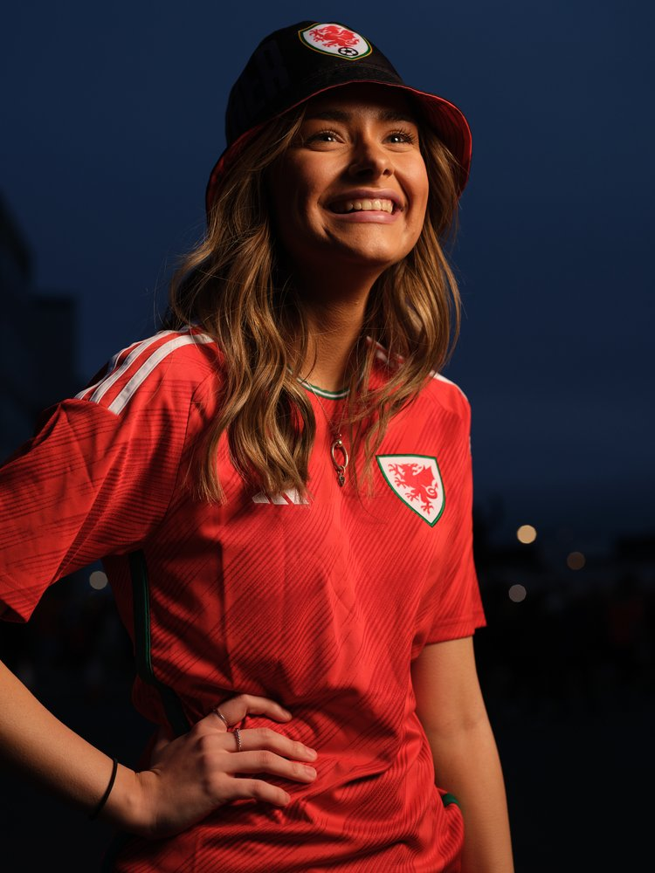
Wales to the World Campaign
Showcased Brand Cymru Wales to the World
International Brand of Welsh Government
Suite of Films Showing Authentic Voice of Wales
Team Wales Partnership of 24 Organisations
Wales to Broadway Event in New York
Content Driven
Cultures & Values in an Integrated Campaign
Progressive nation with so much to offer
“We can’t wait to visit Wales”

Slide 4

Collaborative Approach
Collective Stakeholders
Agency Partners
Third Sector
Grass Root Community
Strategic Approach
Part of a Long Term Strategy
Raise Profile of Wales
Use of Ryan Reynolds & Rob McElhenney – Wrexham
Giant Bucket Hat in Middle of Doha
Laura McAllister – Wales Ambassador
Sharing Stories from the Heart of Our Nation is the Next Chapter

Slide 5


Won the World Cup of the Pitch
Catalyt
Cymru to World Stagr
Values
Language
Music
Bucket Hat
Noel Mooney CEO FAW (2022)

Slide 6
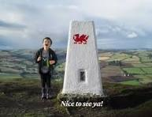
Tactical Approach
Share Values of Wales
Ambassadors including Colin Jackson
Diversity
Small Nation of 3m
Impact of 1st World Cup for 64 years

Slide 7
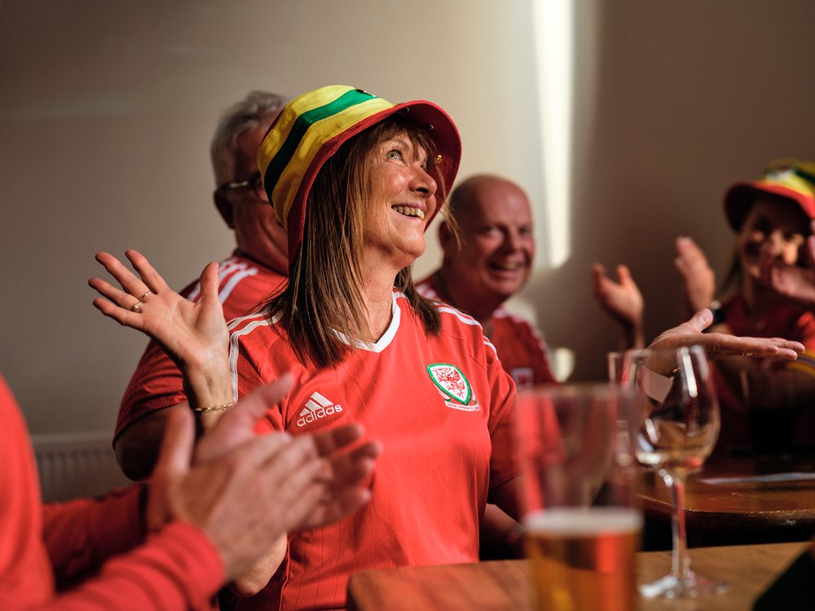
Global Marketing Campaign
Welsh Government Programme of Activities in Qatar
Drakesford
Showcase Best of Wales
Introduce the Nation on the Global Stage
Introduce Nation to New Audiences
Lleisiau Ambassador Team – Sports Star & Chef

Slide 8
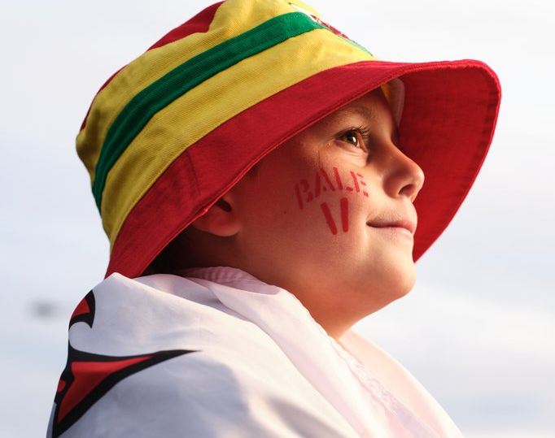
Raise Profile
Promoting Diversity, Inclusivity & respect for Human Rights
Unique Opportunity
Football & Beyond
Enhanced Global Marketing Campaign
Focus on Core Target Markets
USA & Key European Markets
Promote Wales as Open, Progressive Nation
Great place to do Business & Visit

Slide 9

Focus
People of Wales
Warm Welcoming Country
Real, Natural & Colloquial Feel
Everyone’s Welcome
Wherever you are from there’s a place for you.
Series of films showing people of Wales inviting the World to Wales
Shows People, Culture, Community & Landscape
Diverse Country Welcoming the World

Slide 10
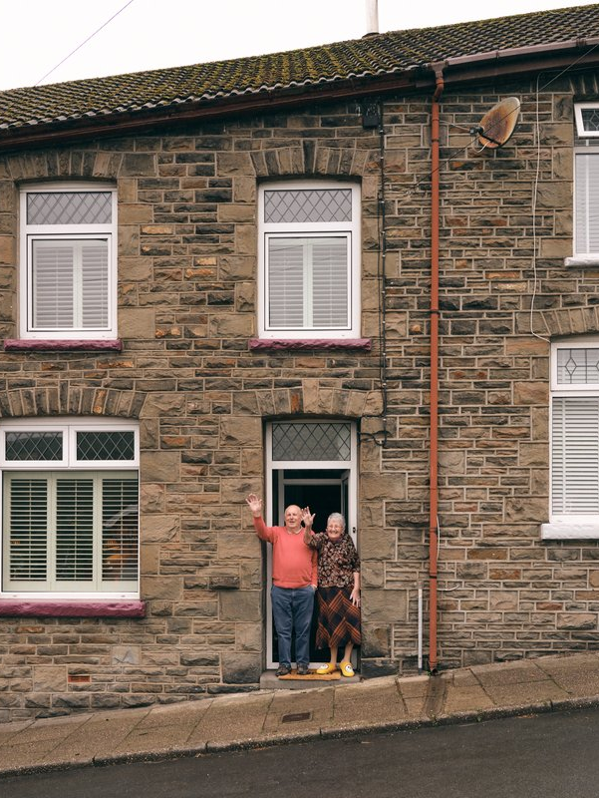
Welsh Government Plans
Comprehensive plan to Promote an Open & Progressive Wales
Values
Target – Global Audience of 5m
Unique Opportunity to Showcase Nation
Create Lasting Legacy
Introducing Wales to World – Learn about Culture & People
Storytelling
Authentic Voices
Feel Part of what’s going on in Wales

Slide 11
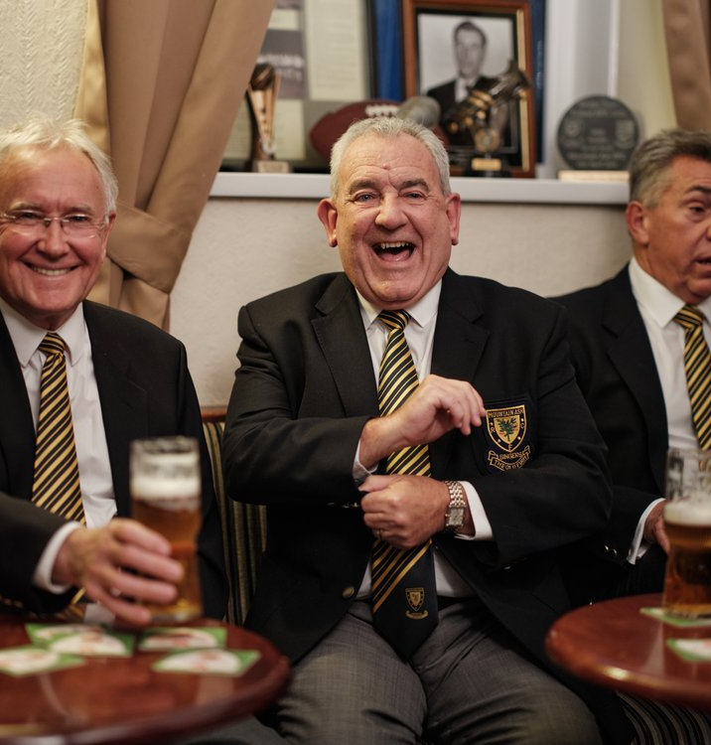
Proactively use Place in the World Cup
Promote Strong Welsh Values
Passionate about Human Rights & Workers Rights
Free to live as Authentic Self
LGBTQ+
Political & Religious Freedom
Inclusive Education
Fair Work

Slide 12
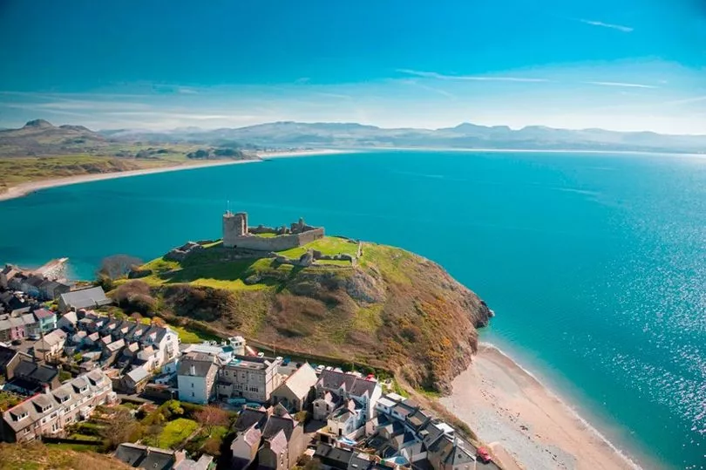
Promote Wales
Obligation to explain Values
Promoting National Values
Distinctive Welsh Prescence
Exhibitions
Recognise Wales as a Nation & Society with Values
Diverse representation of Artists and Cultural Organisations
Share Wales unique Culture Globally
Broad choce of artists from rappers to brass bands!

Slide 13
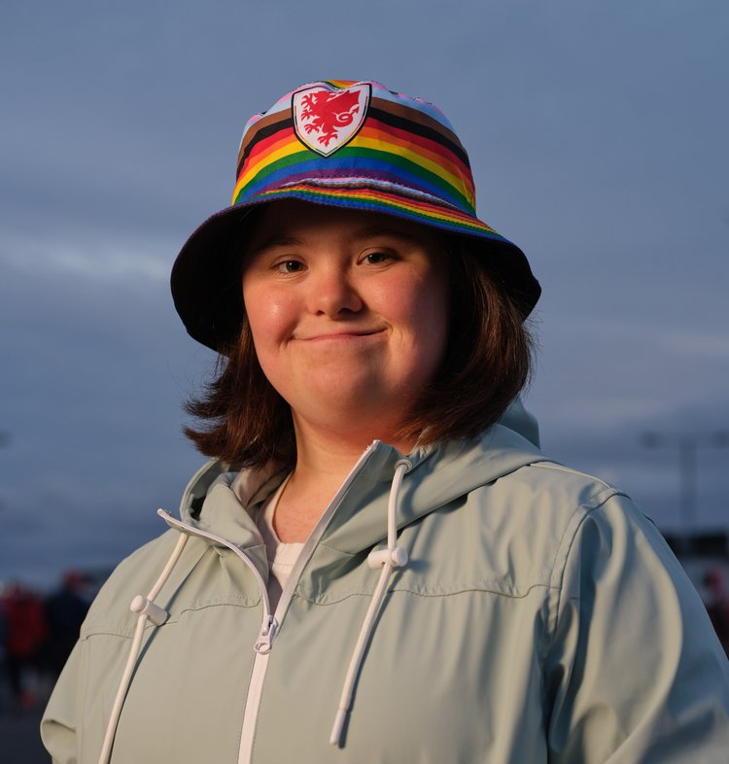
Representing Young People
Future Generations Act Links
Urdd
Culture Squad
Experiences to extend Horizons
Build Self Confidence
Wales Cultural Sqaud
Diplomacy
Raise Profile of Wales and make connections to share values & Interests

Slide 14
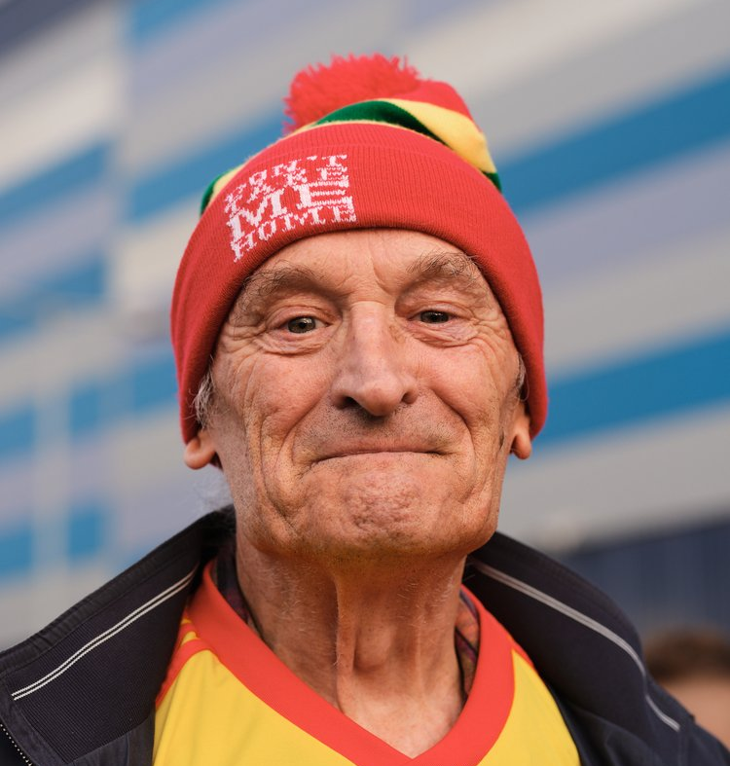
Does this represent Destination Marketing?
Is it an Exemplar of Global Best Practice?
Impacts on International Visitors?
Impacts on Wales as a Global Destination?
Impacts on Wales Sense of Place?
2023 Global Tourism Impacts?
Impacts on Qatar Airways?

Slide 15
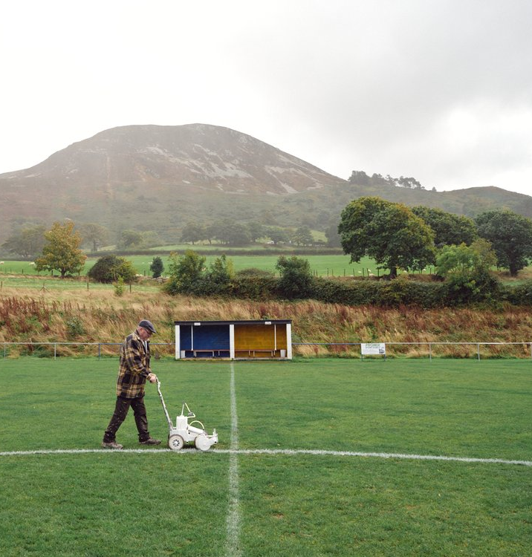
Session Review
Global Impacts of the Campaign?
Impacts on Destination Marketing?
Impacts on Developing a Sense of Place Marketing
Impacts on Qatar Wales relationship?
Relaunch of Qatar Airways from Wales?

