Slide 1

MODULE TITLE: INTRODUCTION TO BUSINESS
MODULE CODE: LCBB4014
ASSESSMENT TITLE: COMPONENT 1 - PRACTICAL: GROUP PRESENTATION (3-4 INDIVIDUALS)
STUDENT NAME: IOANA-ALINA SIMON

Slide 2
TABLE OF CONTENTS
Slide 1: Title
Slide 2: Table of Contents
Slide 3: Introduction
Slide 4: Company Overview of BMW Group
Slide 5: SWOT Analysis
Slide 6: PEST Analysis
Slide 7: Impact of Globalisation
Slide 8: Impact of Globalisation
Slide 9: Impact of Globalisation
Slide 10: Influence of Innovation
Slide 11: Influence of Innovation
Slide 12: Recommendations
Slide 13: Recommendations
Slide 14: Conclusion
Slide 15: Reference List

Slide 3
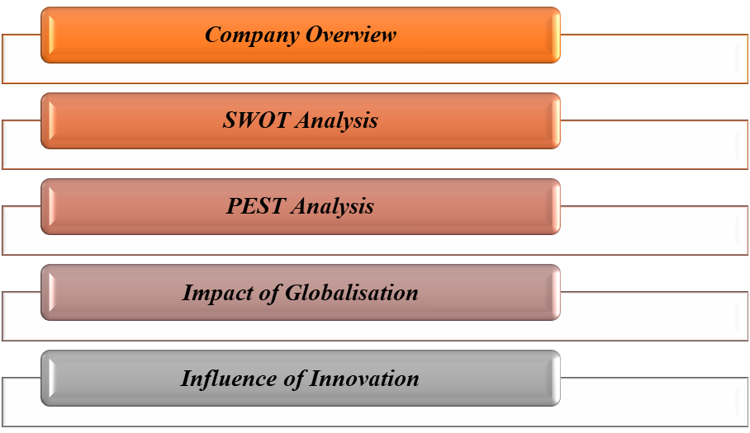
INTRODUCTION
The multinational automotive firm known as the BMW Group has been chosen to showcase the effectiveness of its current globalisation and innovation policies.
The current technological and economic conditions of the British market are going to be examined here.
Figure 1: The overall structure of the Presentation on the BMW Group
Notes:
The multinational automotive firm known as the BMW Group has been chosen for this presentation to showcase the effectiveness of its current globalisation and innovation policies. The presentation also showcases the current strengths and weaknesses of the BMW Group, which has motivated the organisational leadership to modify its current internationalisation techniques in emerging countries of Asia and Europe. The current technological and economic conditions of the British market are going to be examined in this presentation, which can help the BMW Group adopt adequate innovative policies.

Slide 4
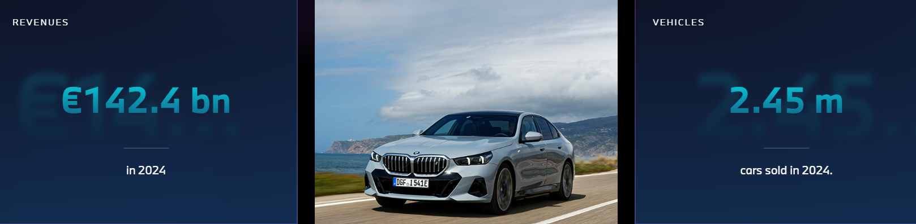
COMPANY OVERVIEW OF BMW GROUP
The BMW Group and its automated operations were first established in 1916.
In 2024, the automotive firm generated nearly 125.23 billion pounds of annual profits (BMW Group, 2025a).
BMW Group has become a popular name in the luxury car industry around the world.
Figure 2: Annual Growth of the BMW Group
(Source: BMW Group, 2025a)
Notes:
The BMW Group and its automated operations were first established in 1916, aiming to create quality and affordable vehicles for the local population of Germany. In 2024, the automotive firm generated nearly 125.23 billion pounds of annual profits through selling high-quality cars to global customers through forging an adequate brand reputation (BMW Group, 2025a). Currently, the BMW Group has become a popular name in the luxury car industry around the world through delivering adequate competition to contemporary firms such as Ford Motors and Rolls-Royce in the UK marketplace.

Slide 5
SWOT ANALYSIS
Table 1: SWOT Analysis of the BMW Group
Notes:
The dominant global market presence and strong brand reputation are major strengths of the BMW Group that have allowed the automotive corporation to gain the trust of diverse customers in the UK market. In 2024, the BMW Group will be operational in nearly 140 international markets, which is indicative of the strong brand reputation in foreign countries and their population (BMW Group, 2025a). However, the new BMW iX3 model of the automotive firm was able to lower its carbon productivity rate by only 35% which further signifies a more robust eco-friendly policy for BMW (BMW Group, 2025b). Hence, the UK leadership of BMW needs to enhance its current waste management policies to further reduce its current emission rate to positively influence the surrounding environment.

Slide 6
PEST ANALYSIS
Table 2: PEST Analysis of Great Britain
Notes:
The growing war between Ukraine and Russia has increased the electricity and gas prices in the UK by almost 97% since 2022. The BMW group and its UK operational costs can also experience a substantial increase because of heightened energy costs in the local marketplace (GOV UK, 2023). On the other hand, the current inflation on regular products in the UK has also been recorded to be around 3.8% indicating increased purchasing power among local consumers (Clark, 2025). Therefore, it can be addressed that the BMW group can greatly benefit from the high purchasing power of UK customers for endorsing its luxury vehicle line.
In 2025, almost 138,000 UK employees procured new and lucrative job offers from the local market, indicating a highly experienced labour force (Parliament UK, 2025). The BMW Group can also procure an experienced employee base for maintaining its UK vehicle manufacturing operations. Around 88% of British corporations have successfully incorporated AI systems in key management operations to increase operational efficiency in different departments (ONS, 2025). Therefore, the UK division of the BMW group can employ suitable AI systems in key car manufacturing operations to enhance the quality of its local product line.

Slide 7
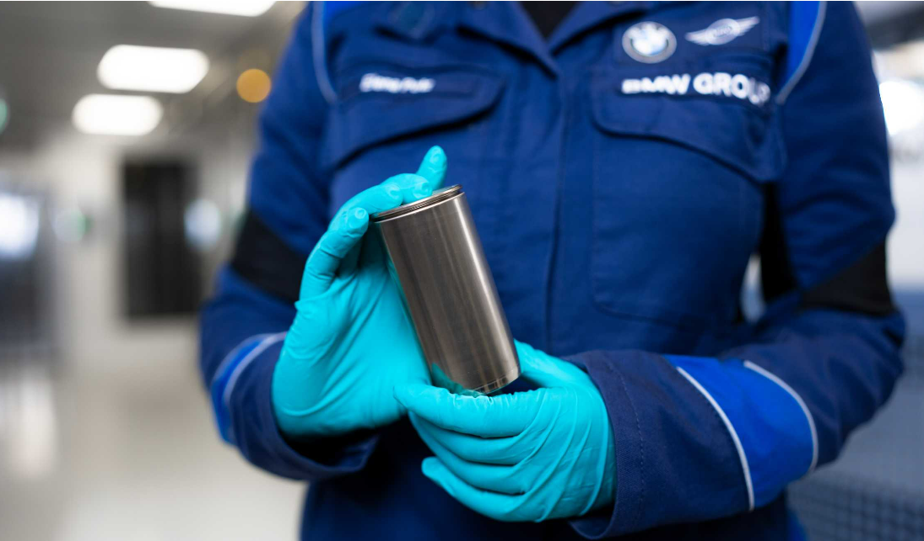
IMPACT OF GLOBALISATION
The administrative body of BMW is highly dependent on local suppliers for locating suitable semiconductor materials.
For instance, within various US development sites, the BMW Group has invested nearly 1.7 billion pounds in 2022 (BMW Group, 2023).
almost 532.17 million pounds has also been invested by the BMW Group for creating an advanced assembly centre in the local US market (BMW Group, 2023).
Figure 3: The dependence of the BMW towards the regional supply line
(Source: BMW Group, 2023)
Notes:
The administrative body of BMW is highly dependent on local suppliers for locating suitable semiconductor materials for its vehicular products in the US and the UK markets. For instance, within various US development sites, the BMW Group has invested nearly 1.7 billion pounds in 2022 (BMW Group, 2023). On the other hand, almost 532.17 million pounds has also been invested by the BMW Group for creating an advanced assembly centre in the local US market (BMW Group, 2023). Therefore, the current globalisation policies of the BMW Group have allowed its US leadership to ensure optimal transparency while sourcing raw materials from local suppliers to maintain the car assembly line.

Slide 8
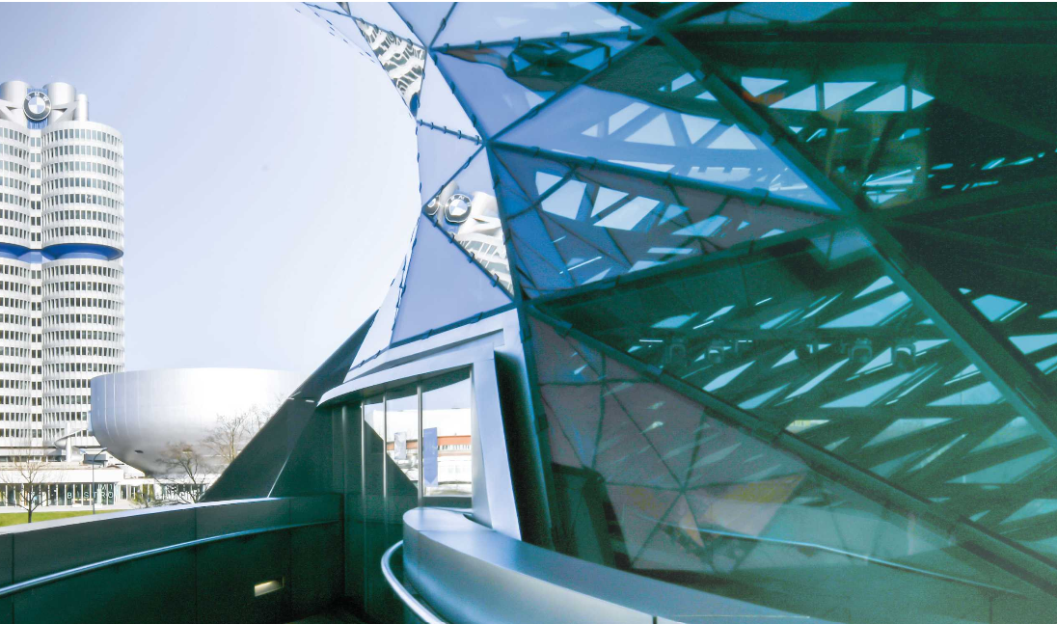
IMPACT OF GLOBALISATION
The expansion in the emerging nations of Asia, such as Indonesia and the Indian subcontinent.
In Q1 of 2024, BMW and its global administration experienced an almost 13% increase in organisational profitability in the Asian marketplace (BMW Group, 2025c).
Figure 4: The BMW Group operations in the Asian continent
(Source: BMW Group, 2025c)
Notes:
The expansion in the emerging nations of Asia, such as Indonesia and the Indian subcontinent, has allowed the BMW Group to increase its profitability margin in the global landscape. In Q1 of 2024, BMW and its global administration experienced an almost 13% increase in organisational profitability because of increased sales in the Asian marketplace (BMW Group, 2025c). Therefore, the market expansion policy of the BMW leadership into the Asian continent has proven to be instrumental towards heightened BEV sales performance and steady income growth in 40 years.

Slide 9
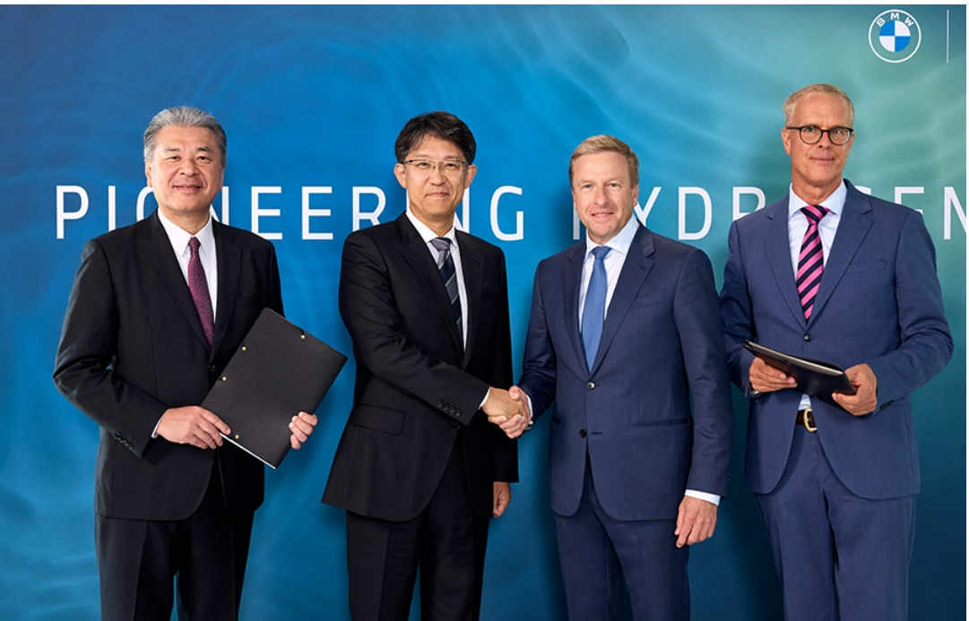
IMPACT OF GLOBALISATION
The global leadership of Toyota Motors and the BMW Group have cultivated a mutually beneficial business partnership.
By 2028, the mass production of fuel cell electric vehicles (FCEV) can also be achieved by the BMW group.
Figure 5: The partnership between the BMW Group and Toyota Motors
(Source: Toyota, 2024)
Notes:
The global leadership of Toyota Motors and the BMW Group have cultivated a mutually beneficial business partnership for enhancing the automotive fuel system in their organisational products. By 2028, the mass production of fuel cell electric vehicles (FCEV) can also be achieved by the BMW group with the help of current Toyota engineers for ensuring quality of the 3rd Gen fuel cell system (Toyota, 2024). The annual carbon production of the current BMW cars can also be greatly lowered with the help of FCEV engines for achieving optimal fuel efficiency.

Slide 10
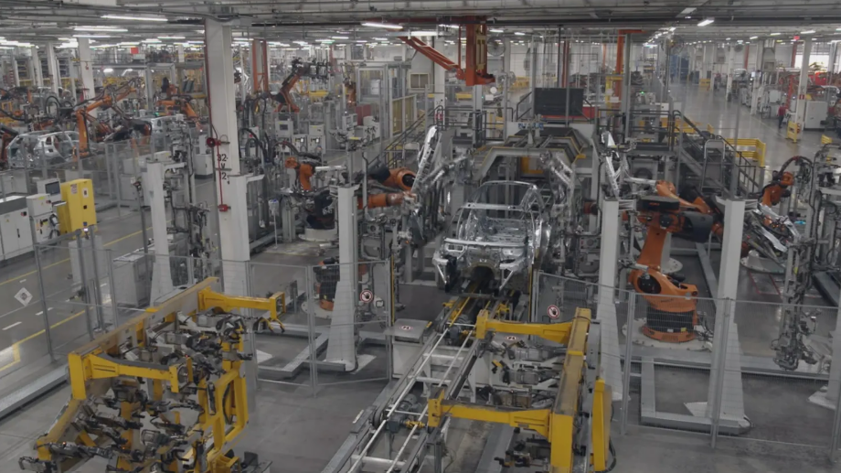
INFLUENCE OF INNOVATION
The manufacturing division of BMW instigated the use of emerging technology such as artificial intelligence within its current assembly line.
The 8 million square feet of the automated production house of BMW in North Carolina is known for delivering around 60% of all car products (Callahan, 2023).
Figure 6: The smart assembly line of the BMW Group in North Carolina
(Source: Callahan, 2023)
Notes:
The manufacturing division of BMW instigated the use of emerging technology such as artificial intelligence within its current assembly line to increase the quality of its organisational vehicles. The 8 million square feet of the automated production house of BMW in North Carolina is known for delivering around 60% of all car products to the customers in the United States (Callahan, 2023). As a result, the introduction of AI systems in the manufacturing endeavours of the BMW Group has allowed its local workforce to easily meet the US market demands for providing quality products.

Slide 11
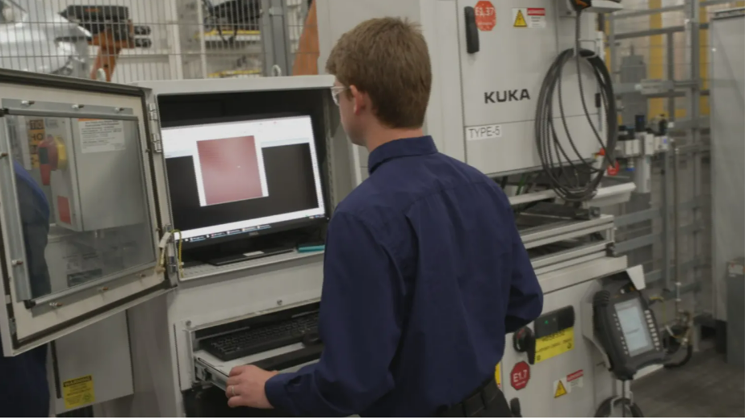
INFLUENCE OF INNOVATION
The R&D department of BMW has also made significant strides towards creating autonomous car products.
By 2033, the overall sales of BMW’s autonomous vehicles are projected to reach a market value of nearly 53.22 billion pounds (Callahan, 2023).
Figure 7: The automated car design by the BMW Group
(Source: Callahan, 2023)
Notes:
The R&D department of BMW has also made significant strides towards creating autonomous car products for its global customers to deliver a personalised travel experience. By 2033, the overall sales of BMW’s autonomous vehicles are projected to reach a market value of nearly 53.22 billion pounds, which further showcases the effectiveness of AI-powered vehicular services for meeting the needs of global users (Callahan, 2023). Hence, the creation of AI-based autonomous vehicles is a massive innovative undertaking by the BMW Group that can help diversify its foreign customer base in maintaining sustainable business growth.

Slide 12
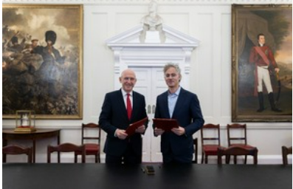
RECOMMENDATIONS
The UK leadership of BMW needs to showcase its current innovation plan for autonomous vehicles for procuring strategic partners in the United Kingdom.
In present times almost 1.5 billion pounds of market revenue have been invested by foreign companies in Great Britain (GOV UK, 2025).
Figure 8: The current state of strategic partnership in the UK industry
(Source: GOV UK, 2025)
Notes:
The UK leadership of BMW needs to showcase its current innovation plan for autonomous vehicles for procuring strategic partners from the UK marketplace such as Rolls Royce that are interested in investing in future technologies. In present times almost 1.5 billion pounds of market revenue have been invested by foreign companies in Great Britain for developing mutually beneficial business collaborations (GOV UK, 2025). Therefore, the procurement of UK-based local partners needs can help the BMW Group towards increasing investment towards its autonomous vehicular technology for maintaining brand relevance in the British marketplace.

Slide 13

RECOMMENDATIONS
The enhancement of BMW’s carbon mitigation plan needs to be considered by its UK leadership.
Solar power has proven to be a viable policy allowing for the reduction of GHG emission by almost 54% (Poynting, 2025).
Figure 9: The introduction of solar power usage in the UK industry
(Source: Poynting, 2025)
Notes:
The enhancement of BMW’s carbon mitigation plan needs to to be considered by its UK leadership for achieving the Net Zero initiative instigated by the British government within 2030. The motivation by the UK governmental entities towards local industry in using alternative energy sources such as Solar power have proven to be a viable policy allowing for the reduction of GHG emission by almost 54% (Poynting, 2025). Therefore, the use of solar power energy sources can help the UK branch of the BMW Group to gradually lower its carbon footprint for enhancing brand stature in foreign markets of EU and Asia.

Slide 14

CONCLUSION
BMW has been operational in multiple continents including in the UK and Indonesia.
The improvement of BMW's current carbon reduction policies have also been suggested in this presentation that can help the automotive firm achieve the net zero goal.
Figure 10: The BMW Group and its global operations
(Source: BMW Group, 2025a)
Notes:
Based on the above findings, it can be concluded that the BMW has been operational in multiple continents including in the UK and Indonesia allowing the automotive company to gain a positive reputation. The presentation also showcases the current AI-powered manufacturing processes and automated car technologies for its target customers in the UK and the US for increasing vehicle sales volume. The improvement of BMW's current carbon reduction policies have also been suggested in this presentation that can the BMW Group achieve the net zero goal established by the British government for elevating environmental factors.

Slide 15
REFERENCE LIST
BMW Group (2023) Local for local: BMW Group relies on regional supply chain to expand e-mobility in North America, BMW Group Available at: https://www.press.bmwgroup.com/global/article/detail/T0432898EN/local-for-local:-bmw-group-relies-on-regional-supply-chain-to-expand-e-mobility-in-north-america?language=en#:~:text=Electricity%20for%20production%20of%20the,for%20Purchasing%20and%20Supplier%20Network.&text=Oliver%20Zipse%2C%20Chairman%20of%20the,create%20about%20300%20new%20jobs. (Accessed: 09 November 2025)
BMW Group (2025a) Introducing the BMW Group., BMW Group Available at: https://www.bmwgroup.com/en/company.html (Accessed: 10 November 2025)
BMW Group (2025b) Responsibility and Sustainability, BMW Group Available at: https://www.bmwgroup.com/en/sustainability.html (Accessed: 10 November 2025)
Callahan, J. (2023) ‘How BMW uses A.I. to make vehicle assembly more efficient’, CNBC Available at: https://www.cnbc.com/2023/07/21/how-bmw-uses-ai-to-make-vehicle-assembly-more-efficient.html (Accessed: 08 November 2025)
Clark, D. (2025) Inflation rate for the Consumer Price Index (CPI) in the United Kingdom from January 2015 to September 2025, Statista Available at: https://www.statista.com/statistics/306648/inflation-rate-consumer-price-index-cpi-united-kingdom-uk/ (Accessed: 09 November 2025)
GOV UK (2023) Ukraine conflict and impacts on UK energy, GOV UK Available at: https://www.energy.gov/sites/default/files/2024-02/057.%20Energy%20%26%20Climate%20Intelligence%20Unit%20_%20Ukraine%20conflict%20and%20impacts%20on%E2%80%A6.pdf (Accessed: 10 November 2025)
GOV UK (2025) New strategic partnership to unlock billions and boost military AI and innovation, GOV UK Available at: https://www.gov.uk/government/news/new-strategic-partnership-to-unlock-billions-and-boost-military-ai-and-innovation (Accessed: 08 November 2025)
ONS (2025) Management practices and the adoption of technology and artificial intelligence in UK firms: 2023, ONS Available at: https://www.ons.gov.uk/economy/economicoutputandproductivity/productivitymeasures/articles/managementpracticesandtheadoptionoftechnologyandartificialintelligenceinukfirms2023/2025-03-24 (Accessed: 09 November 2025)
Parliament UK (2025) UK labour market statistics, Parliament UK Available at: https://commonslibrary.parliament.uk/research-briefings/cbp-9366/ (Accessed: 09 November 2025)
Poynting, M. (2025) ‘What is net zero and is the UK on track to achieve it?’, BBC Available at: https://www.bbc.com/news/articles/cx238yyr40qo (Accessed: 08 November 2025)
Toyota (2024) Toyota Motor Corporation and BMW Group Strengthen Collaboration Towards the Advancement of a Hydrogen Society, Statista Available at: https://global.toyota/en/newsroom/corporate/41463649.html (Accessed: 08 November 2025)

