Slide 1


HAMSTRING strain
Notes:
Today I am going to talk to you about hamstring strains

Slide 2
Content
Introduction to hamstring strain
Anatomy
Epidemiology
Mechanisms
Risk Factors
Signs & symptoms
Diagnosis
Management
Treatment
Healing process & time frame
Notes:
By the end of this powerpoint HOPEFULLY you will learn the anatomy of the hamstring muscles, Epidemiology, mechanisms of injury, risk factors associated with hamstring injuries, signs & symptoms, injury diagnosis, how to manage a hamstring injury appropriately, the healing process involved in the injury plus injury time frame, treatment and return to play.

Slide 3
Introduction to hamstring strain
Muscle Strain – Excessive load leading to overstrain of myofibrils, hence potential strain or possible rupture
Hamstring injuries can include strain or tear to tendon or one of the hamstring muscles at the back of thigh
Can potentially be career threatening
Strains most common cause of hamstring pain
Significance of RTP depends on severity
Ranged between 18-60 days in elite level football players.

Slide 4
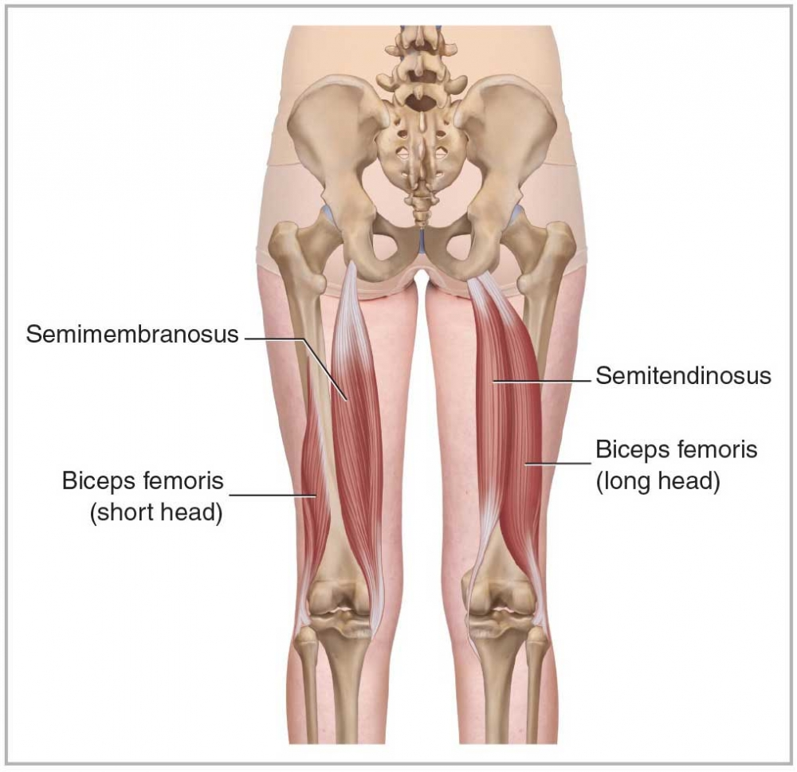
Anatomy
3 Main muscles
Semimembranosus -
O - Superio-lateral aspect of ischial tuberosity
I - Posterior aspect of
medial tibial condyle
A - Knee flexion and assists hip extension
Biceps femoris -
O (Long head) - superio- medial aspect of ischial tuberosity
(Short head) – Lateral lip of linea aspera
I - Upper part of fibular head
Semitendinosus -
O - Superio-medial aspect of ischial tuberosity
I - Upper part of medial aspect of tibial shaft (Pes anserinus)
Notes:
Every muscle except for the BF short head come from the IT.
Semimembranosus Inserts to posterior aspect of medial tibial condyle.
BF insert to the upper part of fibular head
Semitendinosus inserts to the upper part of medial aspect of tibial shaft

Slide 5

Epidemiology
In a series of international track and field competitions from 2007 to 2015, muscle injury represented 41% of all injuries hamstring was the most commonly affected muscle group (Macdonald et al., 2019)
Most common injury in professional football, accounting for 12% of all injuries (Ekstrand et al., 2011)
A rate of 5-6 hamstring strain injuries per club per season has been observed, resulting in 90 days total injury time per club (Woods et al., 2002)
15-21 matches missed per club per season on average
Acute hamstring strains have been found to be more common in field sports (football and field hockey) than in court sports (basketball, volleyball) (Dalton et al., 2015)
More common in preseason (Dalton et al., 2015)
Male athletes are 64% more likely to sustain an acute hamstring strain than female athletes (Cross et al., 2013)
Notes:
During a series of international track & field competitions from 2007-2015,

Slide 6
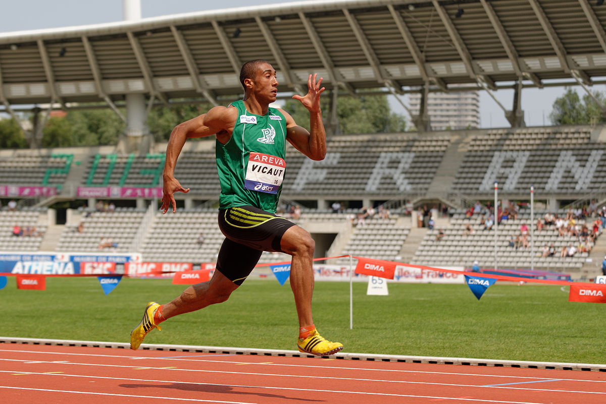
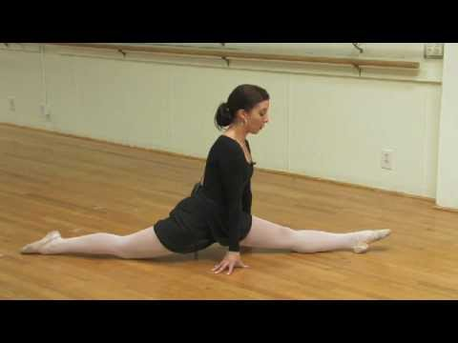
Mechanisms
Hamstring injuries are common in sports requiring kicking, high-speed running and sprinting and are a significant cause of missed training and matches (Askling et al., 2012)
Can also occur during maximal stretching
Mechanisms distinguished by type 1 and type 2 injury situations.
V
Type 1
Type 2

Slide 7
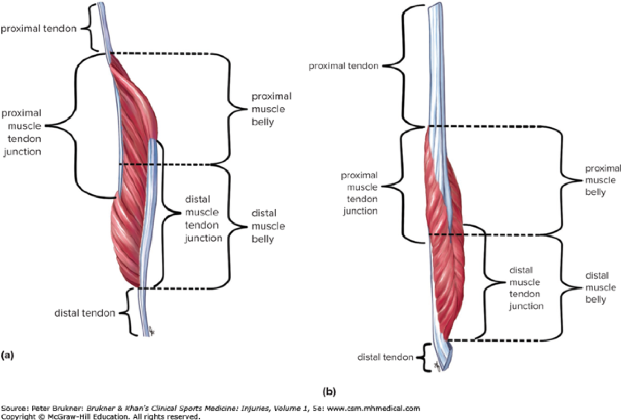
TYPE 1
Most common hamstring strain, occur during high-speed running (Askling et al., 2014)
Usually involve the long head of BF
Most commonly at proximal muscle-tendon junction
Biomechanical studies suggest hamstrings most vulnerable during the terminal swing phase of sprinting
Require shorter rehabilitation period than type 2

Slide 8
TYPE 2
Occur during movements leading to extensive lengthening of the hamstring in hip flexion combined with knee extension
Such as high kicking, slide tackle and forward split
Usually located close to the ischial tuberosity and involve the proximal free tendon of semimembranosus (Askling et al., 2013)
Injury site closer to the IT, reported longer rehab period

Slide 9
Risk factors
Need to consider -
Level of activity – has there been a change in training?
Possibly increased workload – during pre season
Increased weight or force during gym sessions
Limited stretching
Overstretching

Slide 10
Occupation/Lifestyle
Factors outside of sport can be influential
Sitting for long periods
Repetitive bending from different jobs
Excessive working hours – insufficient break periods
Poor ergonomic design – overstretching, twisting, sudden movements

Slide 11
Signs & Symptoms
Sudden onset of pain
Moderate to severe pain
Symptoms are persistent
Disabling – difficult walking, unable to run
Local haematoma, bruising
Marked local tenderness
Slump test negative
May have gluteal trigger points
May have abnormal lumbar spine/Anterior pelvic tilt

Slide 12
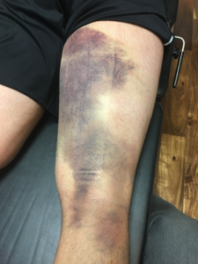
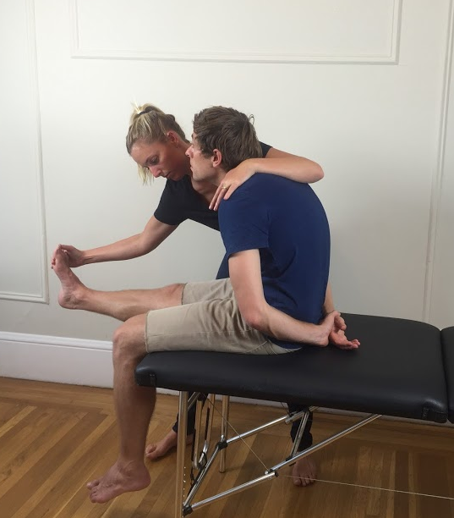
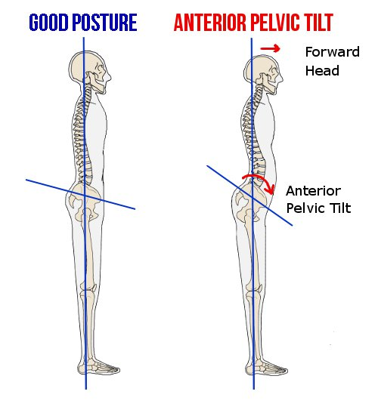
Signs & Symptoms
Local Haematoma & bruising
Possible LS abnormality
Slump test to determine hamstring strain

Slide 13
Diagnosis
Physical exam. The doctor will check your thigh for swelling, tenderness, and bruising. ...
MRI - If you have a severe injury, you might get an MRI
Ultrasound - An ultrasound is another test that produces a detailed image of your muscles.
X-ray.

Slide 14
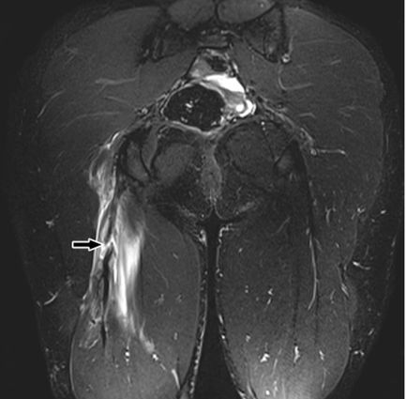
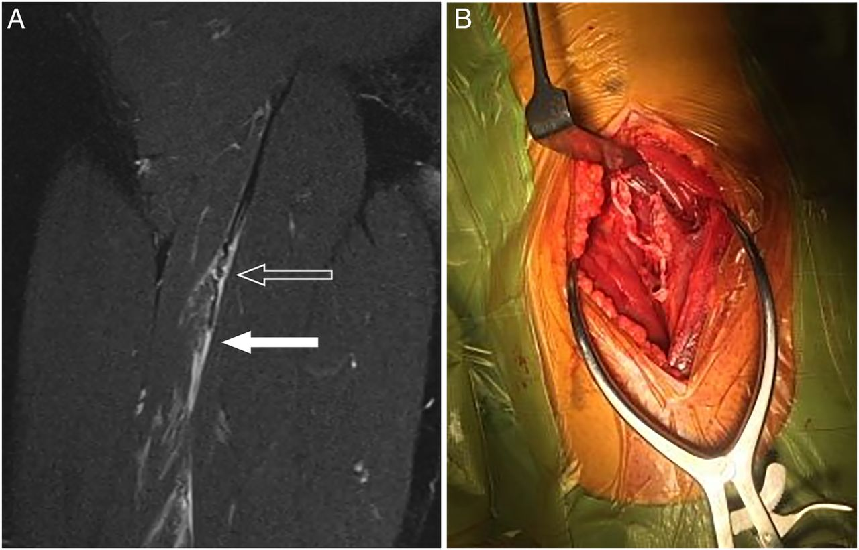
Diagnosis
Appearance of injury at intramuscular BF tendon
Longitudinal splitting of the intramuscular tendon of hamstring

Slide 15
Management
A structured and targeted diagnostic and rehabilitation approach is recommended to improve outcomes after hamstring injury:
RICE
Medical therapy
Criteria for progression to next phase
Muscle activation
Stretching
Manual Therapy
Strengthening
Functional progression
Notes:
Functional progress - Single leg balancing with no equipment then progress to balance board (single leg RDLs SL leg press and pistol squats)
Early commencement of running once individual can reach 50% pace without symptoms running may progressed up to 100m.
Plyometric drills (box squats/split squats)
Specific sport related drills in final stages (drills should simulate as closely as possible the original mechanism of injury)

Slide 16
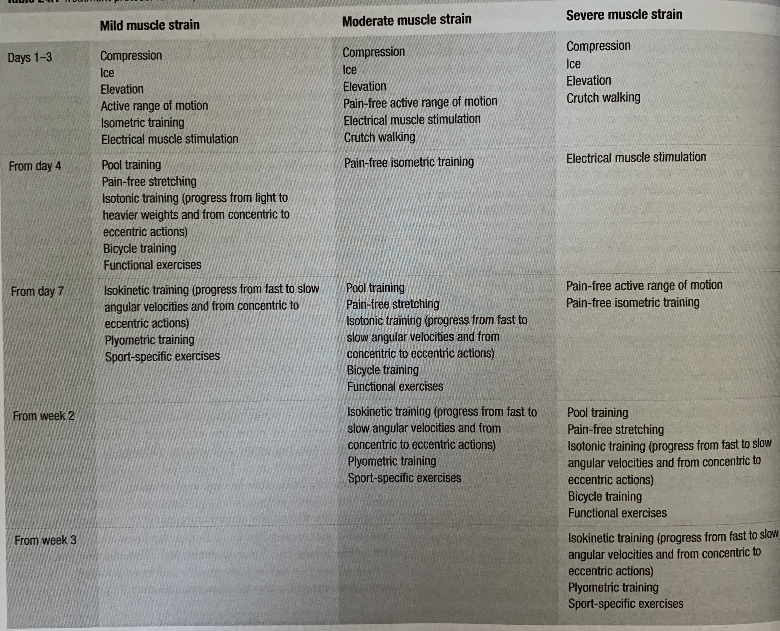
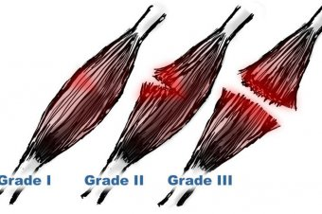
TREATMENT
Treatment protocol for mild, moderate and severe muscle strains
MILD (GRADE 1)
MODERATE (GRADE 2)
SEVERE (GRADE 3)
(Kolt and Snyder-Mackler, 2007)
Notes:
At days 1-3 for all injury grades begins with compression, ice

Slide 17
Healing Process
Time | Activity
6/24h | Fragmentation of injured fibres begin. Macrophages appear
1-4 days | Fibroblasts appear. At 2d Macrophages become most dominant inflammatory cell
5-7 days | Leucocytes & macrophages decrease. Myotubes grown in between damaged basal lamina. Collagen scar tissue seen in large muscle injuries
8-11 days 10 days | Tensile strength reaches near normal Large number of phagocytes (Marcophages) at site of injury
14 days | Maturation of myotubes into myofibres complete
18 days | Cross-striated muscle fibres appear
6 weeks | Contraction ability is 90% of normal, scar tissue volume decreases.
Notes:
Here I have highlighted different phases through the process and as you can see fragmentation of injured fibres begin and macrophages appear during the first 6-24h
After 8-11 days tensile strength reaches near normal
After 6 weeks you will see that the contraction ability of the muscle is 90% of normal and scar tissue volume has decreased.

Slide 18
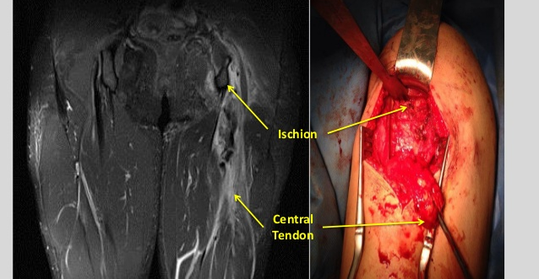
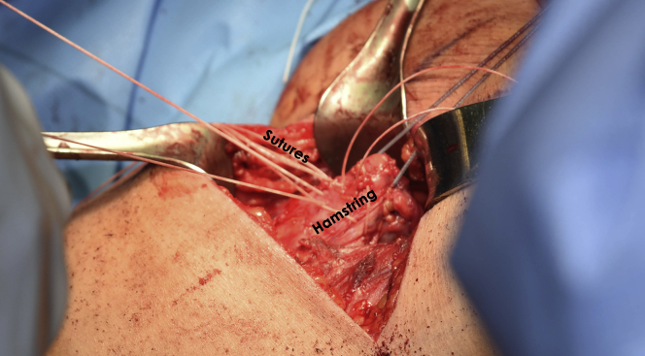
Surgery
Surgery of the Biceps Femoris
Surgical appearance of intramuscular tendon repair
Surgery to the hamstring involving 5 anchors placed then sutures through the tendon.
Notes:
Read slide as it is

Slide 19

Thank YOU for listening
ANY QUESTIONS ???

Slide 20
References
Askling, C.M., Tengvar, M., Tarassova, O. and Thorstensson, A. (2014). Acute hamstring injuries in Swedish elite sprinters and jumpers: a prospective randomised controlled clinical trial comparing two rehabilitation protocols. British journal of sports medicine, 48(7), pp.532-539.
Askling, C.M., Tengvar, M. and Thorstensson, A. (2013). Acute hamstring injuries in Swedish elite football: a prospective randomised controlled clinical trial comparing two rehabilitation protocols. British journal of sports medicine. 47(15) pp.953-959.
Askling, C.M., Malliaropoulos, N. and Karlsson, J. (2012). High-speed running type or stretching-type of hamstring injuries makes a difference to treatment and prognosis.
Cross, K.M., Gurka, K.K., Saliba, S., Conaway, M. and Hertel, J. (2013). Comparison of hamstring strain injury rates between male and female intercollegiate soccer athletes. The American journal of sports medicine, 41(4), pp.742-748.
Dalton, S.L., Kerr, Z.Y. and Dompier, T.P. (2015). Epidemiology of hamstring strains in 25 NCAA sports in the 2009-2010 to 2013-2014 academic years. The American journal of sports medicine, 43(11), pp.2671-2679.
Ekstrand, J., Hägglund, M. and Waldén, M. (2011). Epidemiology of muscle injuries in professional football (soccer). The American journal of sports medicine, 39(6), pp.1226-1232.

Slide 21
Ekstrand, J., Lundqvist, D., Davison, M., D’Hooghe, M. and Pensgaard, A.M. (2019). Communication quality between the medical team and the head coach/manager is associated with injury burden and player availability in elite football clubs. British Journal of Sports Medicine, 53(5), pp.304-308.
Green, B., Bourne, M.N. and Pizzari, T. (2018). Isokinetic strength assessment offers limited predictive validity for detecting risk of future hamstring strain in sport: a systematic review and meta-analysis. British journal of sports medicine. 52(5) pp.329-336.
Kolt, G. and Snyder-Mackler, L. (Eds) (2007). Physical therapies in sport and exercise. 2nd Edition. Elsevier Health Sciences.
Macdonald, B., McAleer, S., Kelly, S., Chakraverty, R., Johnston, M. and Pollock, N. (2019). Hamstring rehabilitation in elite track and field athletes: applying the British Athletics Muscle Injury Classification in clinical practice. British journal of sports medicine. 53(23) pp.1464-1473.
Pollock, N., Patel, A., Chakraverty, J., Suokas, A., James, S.L. and Chakraverty, R. (2016). Time to return to full training is delayed and recurrence rate is higher in intratendinous (‘c’) acute hamstring injury in elite track and field athletes: clinical application of the British Athletics Muscle Injury Classification. British journal of sports medicine. 50(5) pp.305-310.
Woods, C., Hawkins, R., Hulse, M. and Hodson, A. (2002). The Football Association Medical Research Programme: an audit of injuries in professional football—analysis of preseason injuries. British journal of sports medicine. 36(6) pp.436-441.

