Slide 1

The use of Contemporary Technologies in Health and Social Care

Slide 2
Learning Outcomes
Identify
Identify and critically analyse current issues facing the health and social care sector.
Understand
Understand the role of technology in addressing key challenges in health and social care.
Familiarise
Familiarise with health and social care blogs and research to gain insight into the sector.
Write
Write a well-structured, professional blog post on a health and social care topic.

Slide 3

Recap on Health and Social Care in the UK

Slide 4
Key issues facing UK H&SC
Workforce shortages: Impact on care delivery and patient outcomes. (NHS England report a vacancy rate of 6.0% (25,632 vacancies) as of 31 March 2025)
Funding challenges: How budget cuts affect services.
Health inequalities: Disparities in healthcare access and outcomes. The Marmot Review 10 Years On highlights widening health inequalities post-COVID-19
Impact of COVID-19: The long-term effects on services and delivery.
Can you think of any other issues?
What do you think is the most pressing issue in health and social care today?
(NHS England, 2025a; NHS England, 2025b)
Notes:
This slide introduces some of the biggest pressures currently affecting health and social care in the UK.
Discuss how workforce shortages can impact patient safety, waiting times, and staff wellbeing.
Highlight that funding challenges affect both NHS and social care services, especially community support.
Briefly explain health inequalities and how some groups experience poorer health outcomes than others.
You could ask students why they think COVID-19 still affects services today.
Encourage discussion around which issue students believe is most urgent and why.

Slide 5
Issues facing UK H&SC cont…
Choose one to look into – what are the reasons? What are the sources?
Delayed Discharges (Bed Blocking)- In 2024, over 13,000 patients per day faced delays in hospital discharge.
Bureaucratic Barriers (obstacles in the system e.g. complex administrative processes, rules, or regulations)
NHS performance pressures: Emergency departments are seeing record attendances, exceeding 2.2 million per month
Notes:
Explain that delayed discharges are often called bed blocking and can create pressure across the whole NHS system.
Discuss how shortages in social care placements or home support can delay patients leaving hospital
Briefly explain bureaucratic barriers and how excessive paperwork or complicated systems can slow services down.
Highlight how increasing demand on A and E departments creates stress for staff and longer waiting times for patients.
Encourage students to think about the root causes behind these issues.

Slide 6
Issues facing UK H&SC cont…
Choose one to look into – what are the reasons? What are the sources?
Ageing Population
Mental Health Services Strain
Social Care Funding Gap
Integration of Health and Social Care
Rise in Chronic Conditions
Technological Barriers
Care Home Sector Crisis
Lack of Support for Family Carers
Notes:
Use this slide as a continuation of the previous discussion activity.
Ask students to choose one issue and think about what is causing it.
Encourage them to consider factors such as funding, staffing, ageing population, government policy, or public health trends.
Prompt students to think about where information comes from, such as NHS reports, government statistics, charities, or research articles.
Prepare students to begin linking these challenges to technology solutions later in the lecture.

Slide 7
How can we Address these Issues?
Increase Funding for Health and Social Care: Allocate more resources to the sector, ensuring adequate funding for both NHS services and social care to reduce waiting times and improve service delivery.
Promote Integration of Health and Social Care: Develop more seamless systems that connect health and social care services, improving communication, collaboration, and patient care continuity.
Encourage Technology Adoption and Innovation: Support digital health tools and technologies, improve digital literacy among staff, and ensure data security to enhance patient care and reduce operational inefficiencies.
Notes:
This slide introduces possible solutions to current pressures within health and social care.
Explain that increasing funding could improve staffing, reduce waiting times, and strengthen community care services.
Discuss the importance of integrating health and social care so services work together more effectively.
Highlight how technology can support communication, patient care, and efficiency.
You could ask students whether technology should be seen as a support tool or a replacement for some services.

Slide 8
How Can We Address These Issues?
The COVID-19 pandemic accelerated NHS digital transformation. NHS App usage rose by 80% between 2020 and 2024.
Over 33 million users are now registered for the NHS App, accessing services like digital prescriptions and records.
The NHS Long Term Workforce Plan (2023) emphasises digital tools to address staffing pressures and enhance patient access.
(Gov.UK, 2025; NHS England, 2023)
Notes:
Explain that COVID-19 accelerated digital transformation across the NHS very quickly.
Discuss how the NHS App became more widely used for appointments, prescriptions, and accessing records.
Highlight that digital tools are now viewed as part of the solution to workforce pressures and patient access.
Encourage students to think about the benefits of digital healthcare but also who might struggle to access these services.
This is a useful transition into digital inclusion and exclusion.
According to the UK Gov, effective use of the NHS App stops 1.5 million hospital appointments being missed, with 87% of hospitals now offering services through NHS App

Slide 9

Digital Age
Commonly referred to as the ‘digital era or age’ people are immersed within a vast array of digital technologies.
The Covid 19 Pandemic accelerated digitalisation. How?
Society has become increasingly dependent on digital technology.
(José et al., 2021; Selwyn and Facer, 2014; Redshaw, 2019)
Notes:
Introduce the idea of the digital age and how technology is now part of everyday life.
Explain that people increasingly rely on digital systems for communication, shopping, banking, education, and healthcare.
Ask students how COVID-19 accelerated digitalisation.
Possible examples include remote working, online learning, virtual GP appointments, and digital communication with family members.
Highlight that although technology has many benefits, not everybody has equal access or confidence using it.

Slide 10
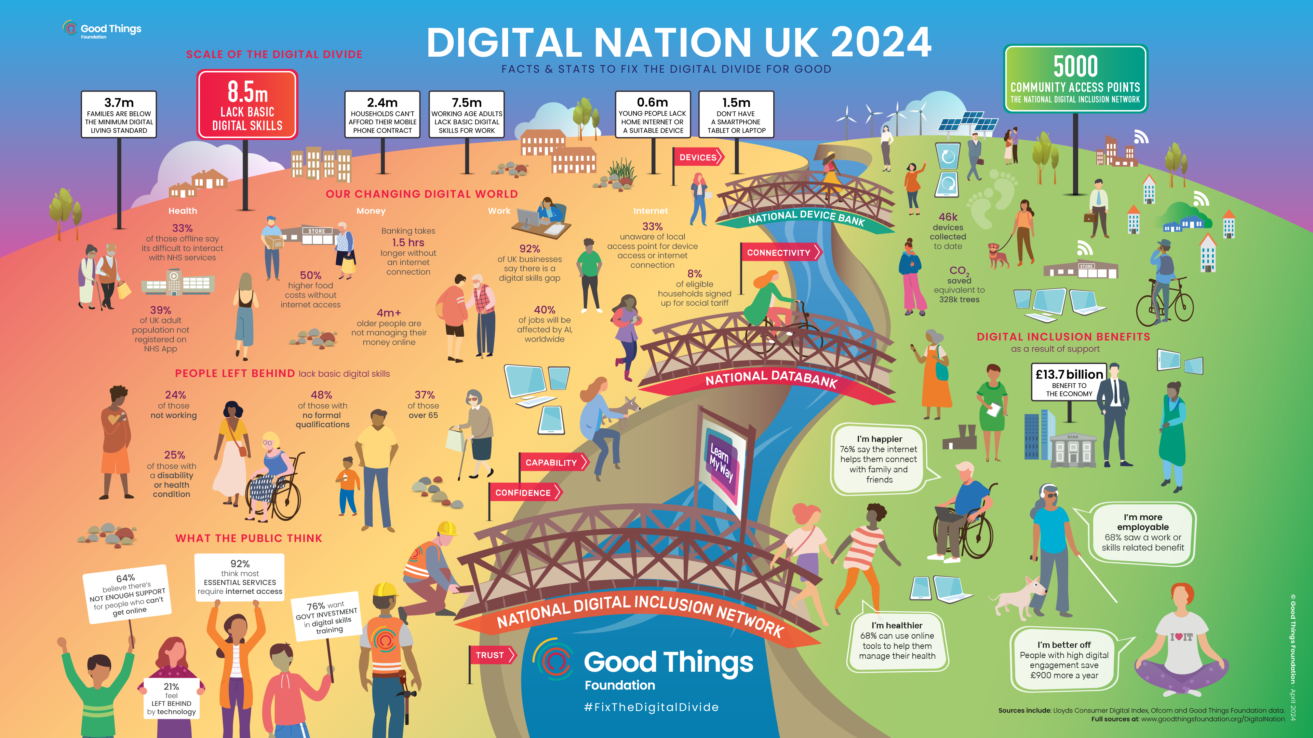
(GTF, 2024)
Notes:
This infographic highlights the digital divide in the UK and shows that digital exclusion still affects many people.
Draw attention to the number of people lacking basic digital skills or internet access.
Highlight groups more likely to experience exclusion, such as older adults, people on low incomes, and some disabled individuals.
Discuss how digital exclusion can affect access to healthcare services such as the NHS App or online appointments.
Point out the positive impacts of digital inclusion, including improved health, confidence, social connection, and employment opportunities.
You could ask students why digital inclusion is now considered a public health issue rather than just a technology issue.

Slide 11

Digital Exclusion
7% of UK adults are digitally excluded, lacking internet access or digital skills
Age and socioeconomic status continue to influence digital exclusion, with 21% of those over 65 having no internet access at home
23% of young people in receipt of free school meals lack home broadband
No access at all to the internet was more prevalent amongst food bank users, at 16%, than the general population.
Strong links were found between poverty risk factors and families living below a publicly-defined household benchmark – the Minimum Digital Living Standard.
And the impacts go beyond income:
44% of people without any internet access, and referred to food banks, reported being severely socially isolated
(Good Things Foundation, 2024; Ofcom, 2025; Trussell 2023 )
Notes:
Explain that digital exclusion means some people cannot fully access digital services because of cost, skills, confidence, or lack of internet access.
Highlight that older adults and people on lower incomes are more likely to experience exclusion.
Discuss how digital exclusion can create further inequalities in healthcare access.
Point out that exclusion can also increase loneliness and social isolation.
You could ask students whether healthcare services are becoming too dependent on technology for some groups.

Slide 12

Digital Inclusion within Health and Social Care
According to the NHS, the incorporation of digitalisation can be crucial to achieving:
physical and mental wellbeing
prevention
self-care
shared care and shared decision making
long term condition management
appropriate use of urgent and emergency care
https://digital.nhs.uk/about-nhs-digital/corporate-information-and-documents/digital-inclusion/digital-inclusion-in-health-and-social-care
Notes:
This slide focuses on the benefits of digital inclusion within healthcare.
Explain that digital tools can support prevention, self care, and long term condition management.
Discuss how patients can become more involved in their own care through shared decision making and access to information.
Highlight examples such as health apps, online appointments, wearable technology, and remote monitoring.
Remind students that digital inclusion is not only about technology availability but also confidence, skills, and support.

Slide 13
Challenges of Digital Inclusion within H&SC
Workforce Shortages
Telehealth platforms improve access to care in underserved or rural areas, bridging geographical gaps.
Mobile health apps provide resources and support for self-management of chronic conditions, especially for disadvantaged populations.
Impact of COVID-19
Virtual consultations and remote monitoring tools reduced the need for in-person visits, keeping both patients and healthcare providers safe.
AI-driven predictive models help hospitals manage patient flows, ensuring resources are effectively allocated during peak times.
Notes:
Explain that technology can help address workforce shortages by improving access to care.
Discuss how telehealth can support people living in rural or underserved areas.
Highlight how mobile health apps can support people with long term conditions to manage their health independently.
When discussing COVID-19, explain how virtual consultations reduced infection risks and protected both staff and patients.
Briefly introduce AI in healthcare and how predictive systems can support hospital planning and patient flow management.

Slide 14
Challenges of Digital Inclusion within H&SC
Health Inequalities
Telehealth platforms improve access to care in underserved or rural areas, bridging geographical gaps.
Mobile health apps provide resources and support for self-management of chronic conditions, especially for disadvantaged populations.
Impact of COVID-19
Virtual consultations and remote monitoring tools reduced the need for in-person visits, keeping both patients and healthcare providers safe.
AI-driven predictive models help hospitals manage patient flows, ensuring resources are effectively allocated during peak times.
Notes:
This slide links digital inclusion to reducing health inequalities.
Explain that technology can improve access to healthcare for disadvantaged groups when used appropriately.
Discuss how remote consultations can remove barriers such as travel, mobility, or geographical isolation.
Highlight that digital tools can support earlier intervention and ongoing condition management.
Encourage students to consider whether technology reduces inequalities for everyone or whether some groups may still be excluded.

Slide 15

Electronic Health Records
Personal health records (PHR’s) were traditionally paper based:
Electronic Health Records: (HER’s) or Electronic Personal Health Records: (EPHR,s):
offer the opportunity for……
Empowerment
Increased accessibility
Promote digital literacy
Assist H+SC professionals to work collaboratively
Increase productivity in both NHS and SC sector.
(The Health Foundation, 2024; Nuffield Trust, 2007)
Notes:
Explain that health records were traditionally paper based, which could make information sharing slow and inefficient.
Introduce Electronic Health Records and Electronic Personal Health Records as digital systems that store patient information securely.
Discuss how these systems can empower patients by giving them greater access to their own health information.
Highlight that digital records can improve communication between professionals and support joined up care.
You could ask students what risks or concerns people may have about electronic records.

Slide 16
Electronic Health Records
The NHS is rolling out Shared Care Records (ShCRs) across all regions, with adoption exceeding 70% of England’s population.
NHS App supports electronic prescriptions and appointment bookings, enhancing self-management.
(NHS Digital, 2024; The Health Foundation, 2024)
Notes:
Explain that Shared Care Records allow different healthcare services to access relevant patient information more easily.
Discuss how this can improve continuity of care and reduce duplication of assessments or tests.
Highlight how the NHS App supports self management through appointments, prescriptions, and access to records.
Encourage students to think about the balance between convenience and concerns around privacy or cybersecurity.

Slide 17

Testimony on EPHR
(2min.53secs)
Notes:
Ask students to watch the short testimony and consider the personal impact of Electronic Personal Health Records.
Encourage them to think about how digital records may improve communication, accessibility, and patient experience.
After the video, invite a brief discussion on the benefits and possible concerns linked to EPHRs.

Slide 18

(1min 55 secs)
Notes:
Ask students to watch the video and identify examples of how digital technology is transforming healthcare services.
Encourage students to consider both the opportunities and challenges of increasing digitalisation within the NHS.
Following the video, discuss how digital systems may affect patients, professionals, and future healthcare delivery.

Slide 19
Telehealth and Telemedicine
In simple terms, Telehealth or Telemedicine can be considered as providing healthcare remotely using digital technology
Transferring medical data
Consultations
Monitoring diagnosis
Treatment and Education
Notes:
Introduce telehealth and telemedicine as forms of remote healthcare using digital technology.
Explain that these systems became much more common during and after COVID-19.
Briefly discuss examples such as video consultations, remote monitoring, and sharing medical information electronically.
Highlight how technology can improve convenience and access to care for some patients.

Slide 20
Telehealth and Telemedicine
Telehealth: The use of digital technologies to deliver health-related services and information remotely. This encompasses a broad range of services, including clinical care, health education, public health initiatives, and administrative functions.
Telemedicine: A subset of telehealth that specifically refers to the remote delivery of clinical healthcare services, such as consultations, diagnoses, and treatment, using telecommunications technology.
Key Difference between these…
Scope: Telehealth covers a wide array of remote healthcare services beyond clinical interactions, including educational and administrative activities. In contrast, telemedicine is confined to remote clinical services.
(NHS England, 2014; NHS England, no datea; NHS England, no dateb)
Notes:
Explain the difference between telehealth and telemedicine.
Highlight that telehealth is the broader term and includes education, administration, and public health support.
Explain that telemedicine focuses specifically on remote clinical care such as consultations and treatment.
Encourage students to think about examples they may have seen or used themselves, such as GP telephone appointments or online consultations.
You could briefly discuss advantages and possible limitations of remote healthcare.

Slide 21

Telehealth and Telemedicine
NHS App registrations grew from 15 million in 2020 to over 33 million in 2024 and approaching 40 million at the end of 2025
NHS:
NHS App
NHS login
e-prescription services.
Notes:
Explain that use of the NHS App has increased significantly since the pandemic.
Discuss how the NHS App supports services such as appointment booking, prescriptions, and access to records.
Highlight that digital healthcare is becoming more common within everyday NHS practice.
Encourage students to think about whether increased digital access improves healthcare for everybody equally.

Slide 22
Telehealth and Telemedicine
The Covid-19 pandemic accelerated the development and adoption of digital technologies to delivery health services widely and efficiently.
Streamline/ Triage
Free space for acute conditions within hospitals
Prevent infection transmissions
Virtual consultations rose by over 250% during the pandemic
Notes:
Explain that COVID-19 rapidly accelerated the use of digital healthcare services across the NHS.
Discuss how virtual consultations helped reduce infection transmission and eased pressure on hospitals.
Highlight that remote consultations also supported triage and prioritisation of urgent cases.
You may wish to note that virtual consultations increased sharply during the pandemic and remain widely used today, although exact percentages vary depending on the source and healthcare setting.
Encourage students to consider both the long term benefits and possible limitations of remote healthcare delivery.

Slide 23





Health Apps
Notes:
1. NHS App- A secure platform that allows users to access a range of NHS services. Features include booking GP appointments, ordering repeat prescriptions, viewing medical records, and managing organ donation preferences.
2. Sleepio- A digital sleep improvement program that uses cognitive behavioral therapy techniques to help individuals overcome poor sleep and insomnia. The program is personalized and can be accessed online, providing tools to improve sleep patterns.
3. My Fitness Pal- A popular fitness and nutrition tracking app. It helps users log their food intake, track calories, and set goals for weight loss or healthy living. The app integrates with various fitness devices and apps for comprehensive health tracking.
4. Apple Health- A built-in iOS app that consolidates health data from iPhone, Apple Watch, and third-party apps. It tracks steps, sleep, heart rate, and other health metrics, providing users with a centralized view of their health.
5. Apple Fitness+ A subscription service offering guided workouts and meditations led by trainers. It integrates with the Apple Watch to track workout performance and display metrics in real time.

Slide 24

Immersive Technology
AR - Augmented Reality: technology to superimpose digital elements (such as sounds, images, models, visualisation) to the world we see using a tablet, or a smartphone camera.
Virtual Reality is an immersive, three-dimensional, computer-generated environment which can be explored and interacted with by a person.
Mixed Reality is the merging of real and virtual worlds to produce new environments where both physical and digital objects co-exist and interact in real time. Mixed reality could be used for…
Physical rehabilitation: Patients recovering from injuries could use MR to engage in exercises within a virtual environment, allowing for real-time feedback and a more immersive recovery experience.
Training for medical staff: MR could be used to simulate complex medical procedures, allowing staff to practice in a risk-free, interactive setting.
Notes:
Introduce immersive technology as digital experiences that combine virtual and real world environments.
Briefly explain the difference between augmented reality, virtual reality, and mixed reality.
Discuss how these technologies are increasingly being used within healthcare education and rehabilitation.
Highlight examples such as virtual training simulations for staff and rehabilitation exercises for patients.
Encourage students to think about the benefits of practising skills in a safe virtual environment before working with real patients.

Slide 25

Immersive Technology Application
(3min. 26 seconds)
Notes:
Ask students to watch the video and think about how immersive technology can support healthcare education and training.
Encourage them to consider the benefits of simulation based learning for both students and professionals.
After the video, discuss how immersive technology may improve confidence, communication, and practical skills within healthcare settings.

Slide 26

Artificial Intelligence and Dementia
(7min. 17 seconds)
Notes:
Ask students to watch the video and consider how artificial intelligence may support people living with dementia.
Encourage students to think about both the opportunities and ethical considerations linked to AI in healthcare.
Following the video, discuss whether technology can enhance independence, safety, and quality of life for individuals with dementia.

Slide 27
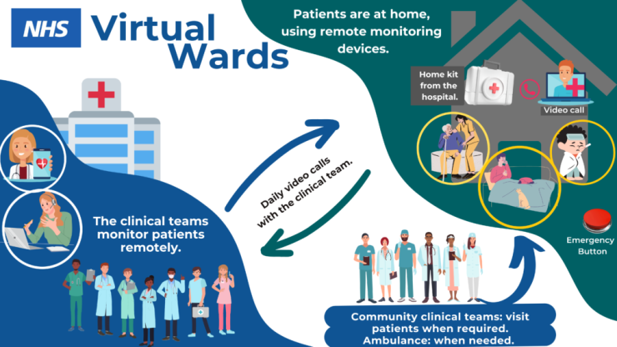
Virtual Wards
These provide hospital-level care remotely, allowing patients to be monitored at home using digital tools.
In community care, virtual wards reduce hospital admissions, support early discharge, and enhance care continuity by integrating hospital and community services.
“Hospital at home services” is the wording now commonly used across the NHS.
Current NHS data suggests there are now over 12,000 virtual ward beds operating across England
NHS England » Virtual wards (3min)
(NHS, 2022)
Notes:
Introduce virtual wards as a growing example of digital healthcare innovation within the NHS.
Explain that patients can receive hospital level monitoring and treatment safely at home through remote monitoring devices, apps, and regular clinical contact.
Discuss how virtual wards may reduce pressure on hospitals, support earlier discharge, and improve patient comfort and independence.

Slide 28
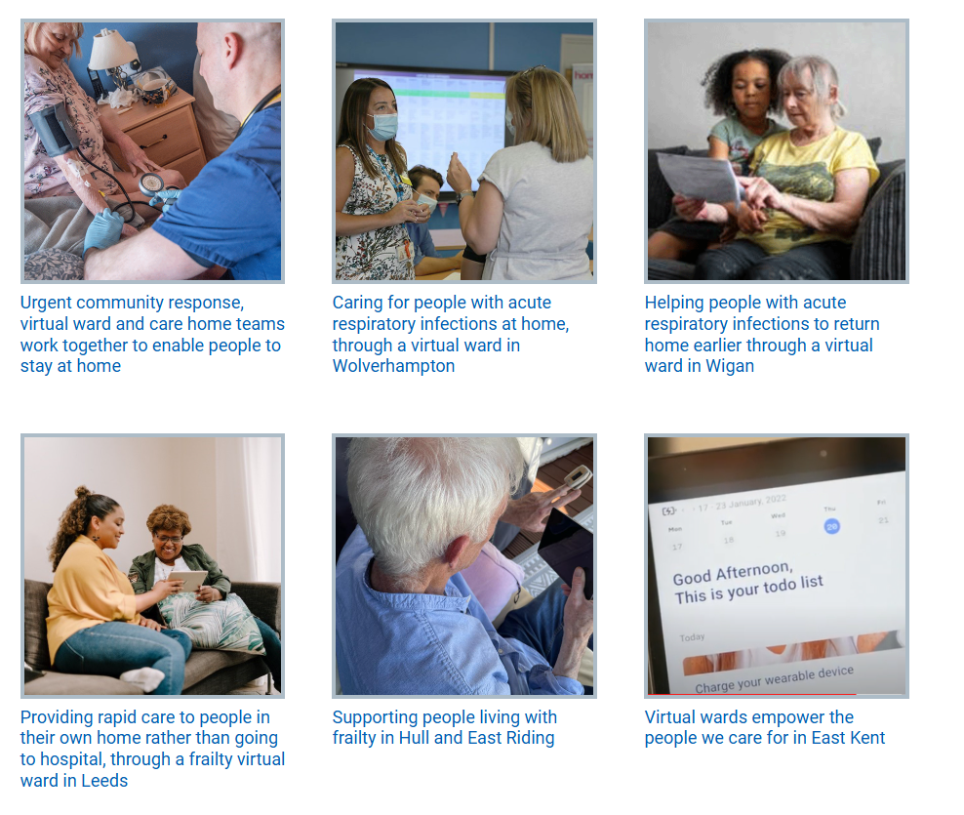
Virtual Wards
-Case Studies
NHS England » Virtual wards
Virtual wards :: Birmingham and Solihull ICS
Notes:
Ask students to explore the different virtual ward examples shown on the slide.
Encourage discussion around how digital healthcare can support different patient groups, including older adults, respiratory patients, and individuals living with frailty.
You could also ask students to consider whether virtual wards may improve patient experience compared to traditional hospital admission.

Slide 29

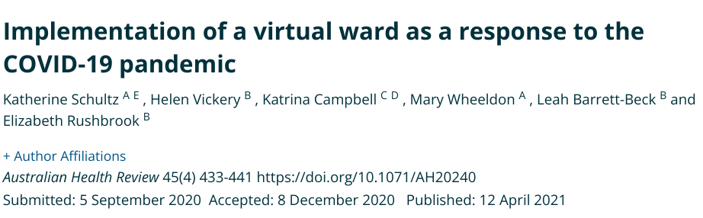
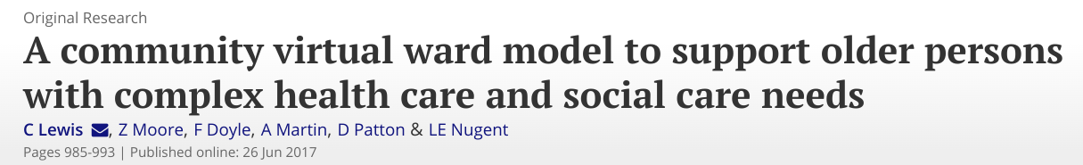
Virtual Wards
Recent NHS data continues to show increasing use of virtual wards across England, particularly following the COVID 19 pandemic.
Notes:
Use this slide to highlight the growing research evidence surrounding virtual wards and hospital at home models.
Discuss how research has explored patient outcomes, admission avoidance, early discharge, and support for older adults with complex needs.
Encourage students to think critically about both the benefits and limitations of delivering care remotely.
Research has shown their effectiveness in managing conditions such as COPD, heart failure, diabetes, pneumonia, and COVID-19.

Slide 30

Virtual Wards
The NHS target was to provide 50,000 virtual ward beds by 2025 (40-50 beds per 100,000 people).
Has this been achieved?
Look online and find out how many virtual ward beds there are currently
You could look at the following site Statistics » Virtual Ward
Why do you think there has not been more progress?
Notes:
Use this slide as a discussion activity.
Ask students to explore current NHS virtual ward statistics and consider why progress may have been slower than expected.
Encourage discussion around potential barriers such as workforce shortages, funding pressures, digital exclusion, staff training, and patient confidence in remote care.
You could also ask students whether they believe virtual wards are a sustainable long term solution for the NHS.

Slide 31

Activity 2- Case Study
In small groups…
Look at the case study for Mr Jones
Consider the questions provided and discuss in your groups
Feedback to the class
You will find details on this activity in the week 4 tile on the Moodle page

Slide 32
From Digital Healthcare to Digital Identity
The Digital Professional
Health and social care is becoming increasingly digital
Professionals now communicate, learn, network, and share information online
Employers increasingly consider digital professionalism and online presence
Social media and digital platforms can positively or negatively impact careers
Building a professional online reputation is now an important employability and professional practice skill
Notes:
Throughout this session we have explored how digital technology is transforming health and social care practice, from electronic health records and telehealth to virtual wards and artificial intelligence.
However, digitalisation does not only affect patient care and healthcare systems. It also affects us as current and future professionals.
Health and social care professionals are increasingly expected to communicate, learn, network, and engage professionally online. Employers may also review an individual’s online presence when considering recruitment and professional suitability.
This means that developing a positive digital identity and maintaining professional behaviour online has become an important part of employability, professionalism, and public trust within health and social care.

Slide 33

Building an Online Reputation
Notes:
“We are now moving from digital healthcare systems to thinking about our own digital identity and professionalism online.”

Slide 34
Building an Online Reputation
Phillips and Ellinas (2014) advocates that people need to apply the ‘three Cs’ when attempting to develop their online reputation.
Clarity
Focus on key messages you want to share online
Consistency
Apply consistent imagery and information across digital platforms)
Care
Present yourself honestly, respectfully, and authentically online
Notes:
This slide introduces the idea that building an online reputation is not accidental. It often requires individuals to think carefully about how they present themselves online.
The ‘Three Cs’ model encourages people to think about:
what they communicate,
whether their online presence is consistent,
and how they behave professionally online.
This is particularly important within health and social care, where professionalism, trust, and public confidence are essential.
Do you think employers should look at a person’s social media before offering them a job?

Slide 35

What is a Blog?
A blog is a type of website or online platform where individuals or groups regularly share content, ideas, reflections, or updates.
Blogs are usually written in a conversational style and can focus on personal experiences, professional knowledge, or specific topics of interest.
Blogs are typically organised in reverse chronological order, with the most recent posts appearing first.
Blogs come in different types and can serve different purposes, such as:
Personal blogs: Sharing personal experiences, hobbies, or opinions.
Business blogs: A tool for marketing, sharing product updates, or engaging with customers.
Niche blogs: Focused on specific topics (like technology, travel, or current context within a sector).
Professional blogs: Used to showcase expertise and knowledge, often by individuals or organisations in a specific industry.
Notes:
Blogs are now widely used across many industries, including health and social care, education, business, and healthcare communication.
They can be used professionally to:
share knowledge,
reflect on experiences,
discuss current issues,
and build a professional online presence.
Within this module, blogging also helps develop communication, reflection, and employability skills.

Slide 36

How can Blogs be Useful?
The main goal of a blog is to engage readers, provide value, and sometimes encourage conversation through comments. It’s also a great way to share information, attract an audience, and even monetize the content through ads, affiliate links, or sponsored posts
Students can build an online reputation through reading blogs by:
Engaging with Quality Content: Regularly read reputable blogs and professional articles to stay informed and show professional growth.
Sharing Professional Insights: Post key insights from blogs on LinkedIn or Twitter to showcase knowledge.
Commenting and Participating: Contribute thoughtful comments to discussions on blogs to increase visibility.
Writing their Own Blog: Share personal blog posts or articles based on learning, experience or professional interests to establish a voice.
Networking with Influencers: Follow and engage with industry leaders to build connections and credibility.
Notes:
This section links closely to employability and digital professionalism.
Blogs allow students and professionals to demonstrate:
communication skills,
reflection,
awareness of current issues,
and professional engagement.
They can also help individuals develop confidence in expressing ideas and building a professional identity online.
Within this module, the blog task in the C1 portfolio (task 3) is designed to help you begin developing these skills in a professional and reflective way.

Slide 37






Quality H&SC Blogs – 30 minutes Reading Activity
Let's explore the following health and social care blogs
Make a note of topics of interest to you and your career
Do you follow these organisations on Linkedin?

Slide 38

Blog Structure
A blog will have 4 elements:
Title/ Headline
Introduction
Main Body
Conclusion
A good blog should be informative, engaging, and easy to read
Notes:
Although blogs are more informal than academic essays, they still need structure and a clear purpose.
Blogs are a useful way of developing communication and academic writing skills in a more engaging and creative format.
When creating a blog, students should:
develop a clear overall theme,
stay focused on that topic throughout,
and consider using imagery, graphs, or charts to support written content.
Because blogs are often shorter than essays, visual elements can help improve reader engagement and presentation.
On the next slide there are several examples of successful blogs. I would like you to look at one example and think about:
the structure,
writing style,
use of visuals,
and how the author engages the reader.
Blogexamples: https://www.buzzlogic.com/blogging/examples-successful-blogs/
https://www.blogtyrant.com/blog-post-style/
Research one.

Slide 39
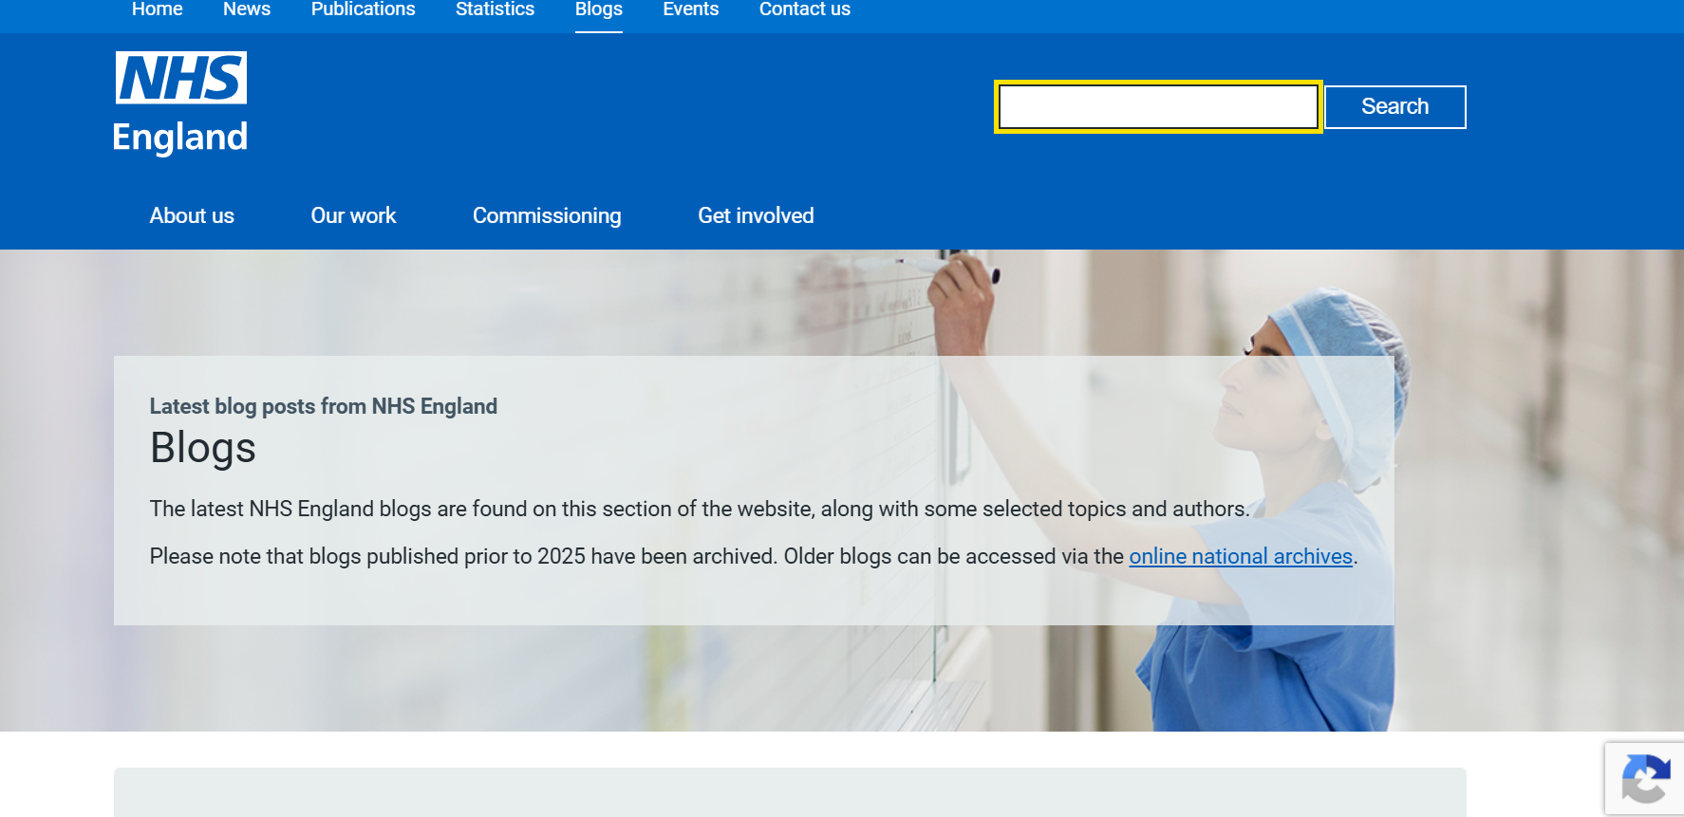
Blog Examples
How to structure the perfect blog:
https://www.blogtyrant.com/blog-post-style/
Blog examples:
https://www.championingsocialcare.org.uk/blog/
While reviewing the examples, consider:
How is the blog structured? - What makes it engaging? - How are visuals used? Is the tone formal or conversational?
Notes:
These examples are here to help you understand what a blog looks and feels like in practice.
The first link provides guidance on how to structure a blog effectively, including layout, headings, and reader engagement.
The second link contains examples of professional blogs linked to health and social care.
As you explore the examples, think about:
how the writer engages the reader,
how the information is organised,
and how visuals and formatting are used to support the content.
Remember, your Task 3 blog should be professional and informative, but it should also feel engaging and readable rather than overly academic.”

Slide 40

Vlogging
Since the development of digital platforms like YouTube, vlogging (Video Blog) as been an accessible and creating method of providing informative information in creative ways.
Personal insight to your life
Insight to practice
Platform to share experiences
Platform to raise awareness
Notes:
Vlogging, or video blogging, has become increasingly popular through platforms such as YouTube, TikTok, and Instagram.
Unlike traditional written blogs, vlogs allow individuals to communicate ideas through video, making the content feel more personal and engaging.
In health and social care, vlogging can be used to:
raise awareness of important issues,
share lived experiences,
reflect on professional practice,
and educate wider audiences in an accessible way.
However, it is important to remember that professional boundaries and confidentiality must always be maintained when discussing healthcare-related topics online.
You may already consume vlogging content without realising it, particularly through short-form videos on social media

Slide 41


Podcasts
What is a podcast?
A podcast is an audio programme, just like Talk Radio, but you subscribe to it on your smartphone and listen to it whenever you like.
Purpose:
To entertain its audience.
Listeners might want to hear updates and breakdowns of current events
Podcasts Types:
Conversational ( Informal and topics are organically generated)
Narrative nonfiction (Long-form story telling)
Scripted fiction (Fictional entertainment such as TV and movies; episodic nature)
Repurposed content (repacking existing content)
Notes:
Podcasts are a popular way of sharing information, opinions, and discussions through audio.
They can support learning by helping people stay informed about current issues, professional practice, and developments within health and social care.
Many healthcare professionals and organisations now use podcasts to discuss topics such as mental health, wellbeing, policy, and patient experiences.
When listening to podcasts, it is important to think critically about whether the information is reliable and evidence-based.

Slide 42


Task 3-Blog
Each of the seven tasks will be combined and submitted to form the Portfolio for Assessment 1
Each student will need to think of a current topic or issue within the HSC sector and use an online platform to inform a specific target audience.
Students should present their findings in a Blog.
This should be approx 400-words in length.
You can include images/diagrams to support your claims.
You will find a more detailed copy of this task in the Week 4 Tile.

Slide 43
References
Gov. UK (2025) Major NHS App expansion cuts waiting times Available at: https://www.gov.uk/government/news/major-nhs-app-expansion-cuts-waiting-times (Accessed: 27 May 2025).
Good Things Foundation (2024) Digital inclusion: What the main UK datasets tell us Available at: What We Know About Digital Inclusion | Good Things Foundation (Accessed: 27 May 2025).
Hitchings, R. (2020) The impact of Covid-19 on the use of digital technology in the NHS. London: Nuffield Trust.
National Health Service (2022) Why Digital Inclusion Matters to Health and Social Care. Available at: https://digital.nhs.uk/about-nhs-digital/corporate-information-and-documents/digital-inclusion/digital-inclusion-in-health-and-social-care (Accessed: 30 May 2024).
NHS England (2025) NHS Vacancy Statistics (and previous NHS Vacancies Survey) Available at: https://digital.nhs.uk/data-and-information/publications/statistical/nhs-vacancies-survey (Accessed: 30 March 2025).
NHS England (2023) NHS Long Term Workforce Plan. Available at: https://www.england.nhs.uk/long-read/nhs-long-term-workforce-plan/ (Accessed: 30 May 2025).
NHS England (2014) Technology Enabled Care Services (TECS). Available at: https://www.england.nhs.uk/wp-content/uploads/2014/12/TECS_FinalDraft_0901.pdf (Accessed: 29 May 2025).
NHS England (no datea) Digital Transformation and the Application of Technology. Available at: https://www.england.nhs.uk/ahp/greener-ahp-hub/specific-areas-for-consideration/digital-transformation-and-the-application-of-technology/ (Accessed: 29 May 2025).
NHS England (no dateb) Remote Consulting. Available at: https://www.england.nhs.uk/long-read/remote-consulting/ (Accessed: 29 May 2025).

Slide 44
References
Ofcom (2025) Adults’ Media Use and Attitudes. Available at: https://www.ofcom.org.uk/research-and-data/media-literacy-research/adults/adults-media-use-and-attitudes (Accessed: 30 May 2025).
Olla, P. and Tan, J. (2009) Mobile Health Solutions for Biomedical Applications. London: Information Science Reference
Pagliari, C. Detmer, D. and Singleton, P. (2007) ELECTRONIC PERSONAL HEALTH RECORDS. London: Nuffield Trust.
PHILLIPS, S. and ELLINAS, S., 2014. Chapter 06: Building your reputation online. London: Kogan Page Ltd.
Spencer J and Oung C (2020) ‘How has lockdown affected general practice and where do we go from here?’. Nuffield Trust blog. Available at: www.nuffieldtrust.org.uk/news-item/how-has-lockdown-affectedgeneral-practice-and-where-do-we-go-from-here. (Accessed: 30 May 2024).
Statista (2024) Percentage of Global Population Accessing the Internet From 2019 to 2023, By Gender Available at: https://www.statista.com/statistics/1362981/share-of-internet-users-worldwide-by-gender/#:~:text=As%20of%202023%2C%20the%20share,male%20users%20was%2062%20percent. (Accessed: 25 May 2024).
The Health Foundation (2024) Which technologies offer the biggest opportunities to save time in the NHS? Available at: https://www.health.org.uk/publications/long-reads/which-technologies-offer-the-biggest-opportunities-to-save-time-in-the-nhs (Accessed: 30 May 2024).
Trussell (2023) Hunger in the UK Available at: https://cms.trussell.org.uk/sites/default/files/wp-assets/2023-The-Trussell-Trust-Hunger-in-the-UK-report-web-updated-10Aug23.pdf (Accessed: 30 May 2025).
UN. (2023) Widening Digital Gap between Developed, Developing States Threatening to Exclude World’s Poorest from Next Industrial Revolution, Speakers Tell Second Committee Available at: https://press.un.org/en/2023/gaef3587.doc.htm (Accessed: 30 May 2024).
Welsh Government (2019) Digital 30: A strategic framework for post-16 digital learning in Wales. Available at: https://gov.wales/sites/default/files/publications/2019-06/digital-2030-a-strategic-framework-for-post-16-digital-learning-in-wales.pdf (Accessed: 30 May 2024).

