Slide 1

An evaluation of the Cardiff Bay Barrage EIA process
Milo Fleming
University of Wales Trinity St David
1902803

Slide 2
Introduction
The mission statement for the regeneration programme was “to put Cardiff on the global map as a superlative maritime city which will stand comparison with any city in the world, therefore enhancing the economic well being and image of Cardiff and Wales as a whole” (CBDC, 1996).
An Environmental Impact Assessment (EIA) was required as a legal obligation to reduce and mitigate the potential impact on the natural environment and its wildlife (Toro et al., 2013).

Slide 3
EIA Process
A basic explanation of an environmental impact assessment can be outlined as ”The process of predicting and evaluating the effects of an action, or series of actions, on the environment, then using the conclusions as a tool in planning and decision making (Pritchard, 1996).
In terms of enabling sustainable development there is a wide variety of studies upon its effectiveness (Glasson., 1999, IEMA., 2011, Morgan., 2012, Loomis and Dziedzic., 2018).

Slide 4
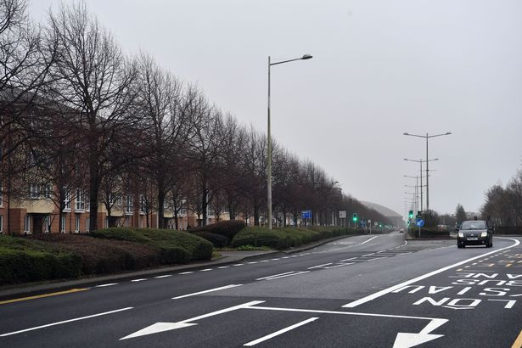
Areas of potential improvement for the Cardiff Bay Barrage EIA project – Public Participation
There is an acceptance that if the public are involved in the early stages of the planning process then the EIA may be more effective (Glucker et al.,2013).
The road to nowhere- Lloyd George Avenue looking towards the Wales Millennium centre

Slide 5
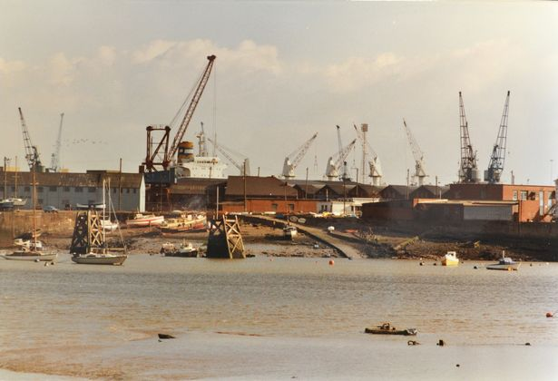
Areas of potential improvement for the Cardiff Bay Barrage EIA project – The loss of Redshank populations
The high level of mudflats in Cardiff Bay were of vital importance to Redshank populations in supporting their food and energy requirements.
An analysis of biometric data exposed the fact that adult Redshank from Cardiff Bay had a problem in maintaining their body condition in the first winter after barrage construction (Burton et al. 2001b).
Cardiff Bay mudflats prior to barrage construction.

Slide 6
Conclusion
Lack of consultation of key stakeholders in the Butetown area has resulted in a disconnect both psychologically and economically from the rest of the city.
Internationally important numbers of Redshank knowingly displaced with no alternative feeding site.

Slide 7
References
Burton, N.H.K., Rehfisch, M.M. & Clark, N.A. (2001b) The Effect of the Cardiff Bay Barrage on Waterfowl Populations. 12. Distribution and Movement Studies, August 2000 - May 2001. BTO Research Report No. 266 to the County Council of the City and County of Cardiff.
CBDC. 1996. Cardiff Bay Barrage Alternative Mitigation Measures - Steering Group Conclusions. Report to Cardiff Bay Development Corporation.
Glasson, J., Therivel, R. & Chadwick, A. 1999. Introduction to Environmental Impact Assessment: 2nd Edition. Spon Press, London, UK.
Glucker, A, N., Driessen, P, P, J., Kolhoff, A., Runhaar, H, A, C., 2013. Public participation in environmental impact assessment: why, who and how? Environmental Impact Assessment Review, 43, 104-111.
IEMA; 2011. Special Report – The state of environmental impact assessment practice in the UK. The Institute of Environmental Management and Assessment [online]. Available at: https://www.iema.net/assets/uploads/Special%20Reports/iema20special20report20web.pdf
Morgan, R, K., 2012. Environmental Impact assessment: the state of the art. Impact assessment and project appraisal, 30(1), 5-14 [online].
Loomis, J, J. and Dziedzic, M., 2018. Evaluating EIA systems ‘effectiveness: a state of the art. Environmental Impact Assessment Review, 68, 29-37.
Pritchard, D.E. 1996. Environmental Impact Assessment: Towards guidelines for adoption under the Ramsar Convention. In: Proceedings of Technical Session A o f the 6th Meeting o f the Conference o f the Contracting Parties (Vol. 10/12 a), March 1996, Brisbane, Australia. The Ramsar Convention Bureau, Gland, Switzerland.
Toro, J., Requena, I., Duarte, O., and Zamorano, M. (2013) ‘A Qualitative Method Proposal to Improve Impact Assessment’ Environ. Impact Assess. Rev. 43, 9-20.

