Slide 1
AROMATHERAPY
Presented by- Siriol Thomas
Student number- 1810030

Slide 2
Aromatherapy History-
According to (Davies, P, 1995) Aromatherapy dates back to the most ancient roots of healing practices of humankind. Essential oils have been used for thousands of years before the technique of distilling oils was discovered.
Archeologists had found traces of many plants known of medicinal value in the burial places and living sites of early humans. The earliest discovery of the oils were found in leaves, berries and roots that were gathered for food which made sick people feel better and it was noticed to heal wounds.
A physician known as Hippocrates, from the island of Kos in Greece ‘ The father of medicine’ states that ‘ The way to health is to have an aromatic bath and scented massage every day’. He studied logic, geometry, metaphysics, philosophy, astronomy and medicine and created important written records describing over 800 plants and their effects on the human body as his legacy.
( DAVIES, P, 1995)

Slide 3
How the essential oils are used-
According to (Thomas, B, 1995) the most common way to use essential oils is to inhale them, both for their scent and therapeutic properties. They are also used in diffusers and humidifiers as well as on the skin.
Oils can be used for skin care and massage in a variety of ways. The essential oils are diluted with a carrier oil, then the blend can be applied to the skin. The areas of concentration would be muscular pain, tightness and tension areas on the body.
Oils are said to be beneficial on pressure points such as temples, wrists, stomach, feet and the third eye. Essential oil molecules are so small that when they are applied to the skin, they are able to pass through the strateum corneum ( the outer layer of the epidermis), from there the oil molecule passes through the dermis, into the capillaries and then in to the bloodstream.
Inhaling the oils also has a direct effect on the body as some part of the oil is absorbed by inhaling through to the lungs and then will enter the bloodstream.
(Thomas, B, 1995)

Slide 4
Therapies using essential oils according to Cancer Research UK-
Holistic Aromatherapy- Aromatherapy massage is an important form of application using different techniques incorporating several essential oils that are blended with carrier oils.
Medical Aromatherapy- is the second largest form of aromatherapy which originates in herbal medicine and is mostly practiced in Germany and France. It is growing popularity in the United Kingdom. Internal use of oils is more common in medical aromatherapy.
Olfactory Aromatherapy- This treatment involves inhaling essential oils. Cancer research states that a simple inhalation has resulted in increased emotional wellness, calmness, relaxation and rejuvenation of the body.
Psycho-aromatherapy- In this treatment, certain types of moods and emotions can be created through the use of oils, promoting relaxation, invigoration or a memory. Inhaling the oils with this therapy is done through the infusion in a room with the patient.
(Cancer Research, 2018)

Slide 5
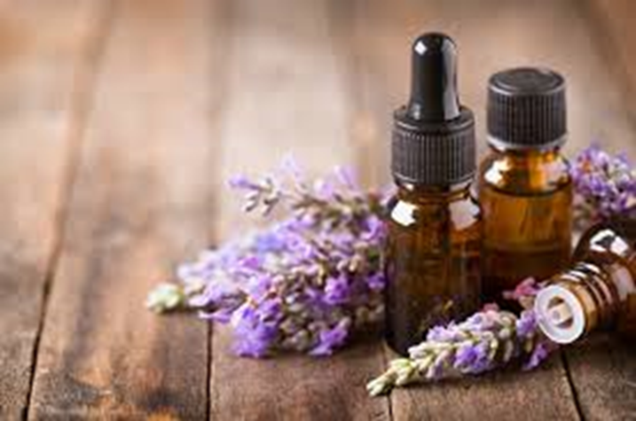
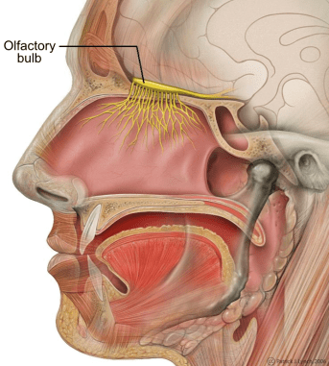
Aromatherapy-
According to (Thomas, B, 1995), Many people go to have aromatherapy massage to help with relaxation and to de-stress. Cancer research has found that aromatherapists can also use oils for patients with cancer, the belief is that aromatherapy can boost well-being. It can also relieve stress and help to refresh the body.
Aromatherapists believe that essential oils work because of the chemicals in the oils. These bind with receptors in the part of the brain that links to smell (the Olfactory bulb located in the nasal cativity), which in turn has a effect on the emotional centre of the brain called the ( limbic system ) ( Thomas, B, 1995).
According to (Worwood, V A. 1990), Regularly used oils are Lavender, Rosemary, Eucalyptus, Camomile, Peppermint, Ylang Ylang, Jasmine, Lemon and Geranium. Through the medium of massage, the oils absorb through the skin and then go through to the bloodstream.

Slide 6
Governing bodies of Aromatherapy-
International Federation of Aromatherapists ( IFA, 1985 )- The IFA are a governing body that provide a register for qualified and regulated aromatherapists who are involved in evidence-based practice for the safety of the public.
Complementary & Natural Healthcare Council (CNHC, 2018)- This governing body was set up to protect the public by providing a UK voluntary register of health practitioners with support from the government. CNCH state that their register has been approved as an Accredited Register by the Professional Standards Authority for Health and Social Care.
Certified Oil suppliers-
Neil’s Yard Remedies (1981) are the UK's first certified natural health and beauty company, as well as the first sellers of certified essential oils.
Aromatherapy Training
According to National Careers Service, training to become an aromatherapist involves completing a Level 2 or Level 3 Diploma in Complementary Therapies course that usually takes around 9 months to complete including practical experience.

Slide 7
Research carried out by MCS Labs
Research carried out by MCS Labs has shown that the essential oil blend produced by the Chuckling Goat company in Ceredigion has lab tested the oil and found that it kills all MRSA ( Methicillin- resistant Staphylococcus Aureus) which is a bacterium that causes infections in different parts of the body, and the oil is also effective against ecoli and salmonella at a dilution of 0.5%, (MCS Laboratories Limited).
The active ingredients of this blend of essential oils are lemongrass, clove, rosemary, eucalyptus, cinnamon and lemon, (Jones S N, 2015).
The blend was developed by the owner of the Chuckling Goat when her husband became seriously ill with MRSA. Two weeks after starting using the essential oil blend her husband was swabbed completely clear of MRSA, (Jones S N, 2015).
(Mayo Clinic Staff, 1998-2020)

Slide 8
References
https://canyonranchinstitute.org/aromatherapy-courses-uk/ - Aromatherapy bottles. Image page 5
https://i2.wp.com/human-memory.net/wp-content/uploads/2019/12/olfactory-bulb.png?w=743&ssl=1 – Olfactory bulb. Image page 5
Neil’s yard remedies (1981). Aromatherapy essential oils.[online] Available at: https://www.nealsyardremedies.com/ .[Accessed 4/03/2020]
The Chuckling Goat.(2008). The Gut Health Experts.[online] Available at: https://www.chucklinggoat.co.uk/
International Federation of Aromatherapists.(1985) Professional Body for Aromatherapists. [online] Available at: https://ifsroma.org/en_GB/home
Complementary & Natural Healthcare Council. (2018). CNHC Register. [online] Available at: https://www.cnhc.org.uk/
Jones S N (2015). Secrets from chuckling goat:How a heard of goats saved my family and started a business that became a natural health phenomenon. Paperback. Publisher: Hay House.
Worwood, V A.(1990). The Fragrant Parmacy. A complete guide to Aromatherapy & Essential oils. Publisher: Macmillan London Ltd edition published 1990.
Cancer Research.(2018). Aromatherapy.[Accessed 31/01/2020] [online] at:Cancerresearchuk.org
Davies, P.(1995). Aromatherapy AN A-Z. New Revised and Enlarged Edition. Publisher- The C.W. Daniel Company LTD. Essex.
Fisk,C (2017). Hippocrates Medicine, Herbal Medicine used by Hippocrates.[online] Available at: https://www.hippocratesmedicine.com/home [Accessed 19/3/20]
Thomas B (1995). Bartram's Encyclopedia of Herbal Medicine. Robinson London. Publisher: Constable publishers
Mayo clinic staff.(1998-2020). MRSA.[Accessed 31/01/2020] [online] at: mayoclinic.org
National careers service. Aromatherapist.[online] Available at: nationalcareers.gov.uk/job-profiles/aromatherapist [Accessed 19/3/20]

