Slide 1
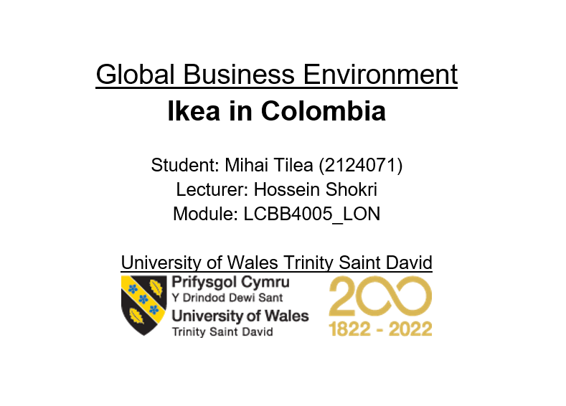

Slide 2
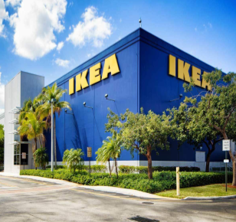
Introduction
In order to succeed in new and emerging markets, companies must be agile and adaptable. IKEA, a British company, is considering expanding into Colombia, a developing country with a challenging economic environment.
The research analyses IKEA's Colombian market entry considerations. Political, economical, social, technical, legal, and environmental aspects are involved.
The research also analyses market possibilities and obstacles using PESTLEPorter's Five Forces, and Hofstede's cultural dimensions.

Slide 3
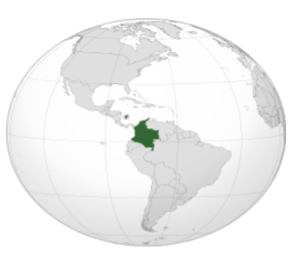
A brief introduction to the selected developing country- Columbia
Colombia is home to over 50 million people in South America. It is the fourth largest country in South America, and its landscapes range through tropical woods to the Caribbean and Pacific beaches.
Colombia's cultural mosaic is the result of centuries of influence from several groups including indigenous peoples, Afro-Columbians, and the Spanish.
Colombia has made considerable steps towards peace and security in recent years despite political turbulence, drug-related violence, and military battles in the past.
The country's economy is expected to grow to $323 billion by 2020, making itthe fourth largest in Latin America
Colombia may be rich in natural resources including oil, coal, and gold.

Slide 4
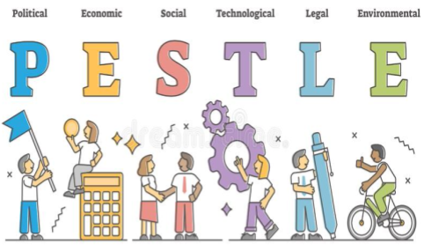
PESTLE
Political: Politically, after decades of internal conflict, Colombia has made significant progress towards peace and stability in recent years, However, there are also concerns about political stability due to corruption and the existence of illegal armed groupings.
Economic: High inequality, a big informal sector, and low productivity poses significant challenges to Colombia's growing economy. The country's economy is very sensitive fluctuations in global commodity prices due to its reliance on commodity exports.
Social: Companies doing business in Colombia should respect the country's diverse people and its unique set of customs. While poverty and inequality have decreased, access to education and healthcare have increased substantially in recent years.
Technological: Colombia has made significant technical advancements in recent years. Especially with respect to internet availability and research and development funding. However, there are still areas that need improv, as it is with digital literacy and access to technology in rural Apolitical Economic areas.
Legal: Because of the complexity of Colombia's legal system, businesses should investigate the country thoroughly before establishing operations there. Even if intellectual property protection laws in the nation have strengthened considerably in recent years, corruption is still a serious concern.
Environmental: Colombia is a significant environmental component since it is home to many plants and animal species. There have been significant t improvements in environmental protection in recent years, but the country is still vulnerable to severe dangers eluding deforestation and illegal mining.

Slide 5
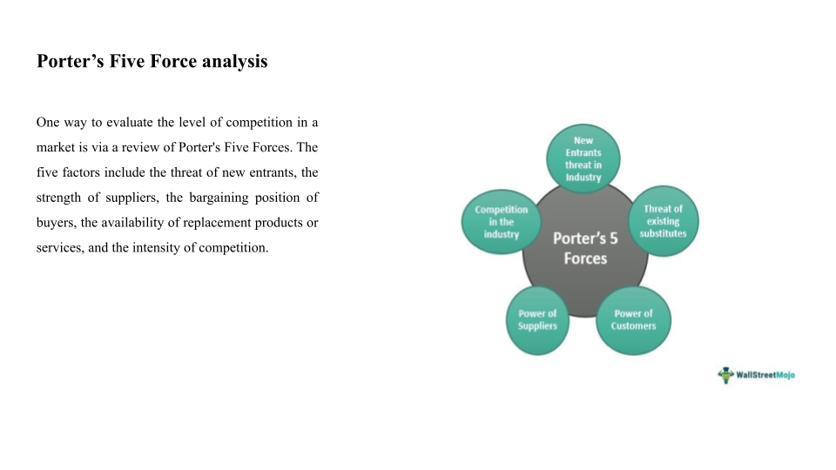

Slide 6
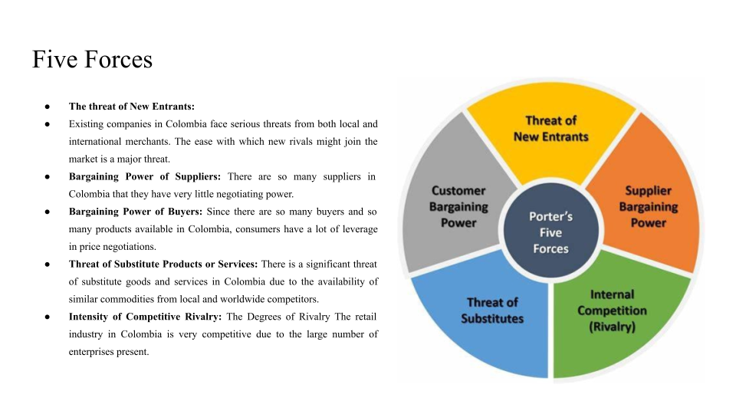

Slide 7
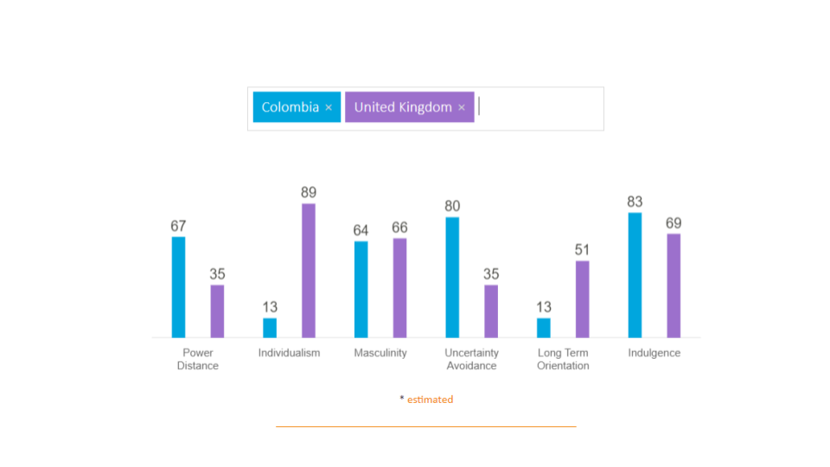

Slide 8
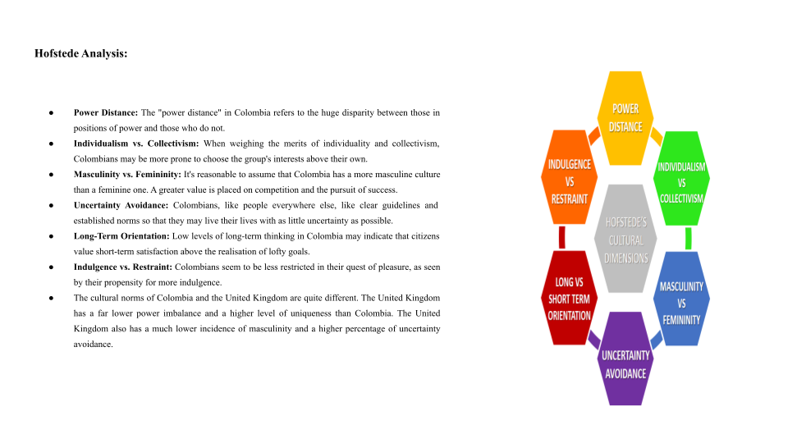

Slide 9
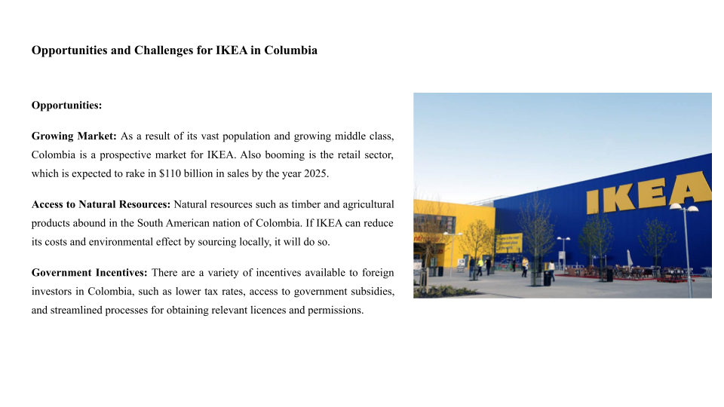

Slide 10
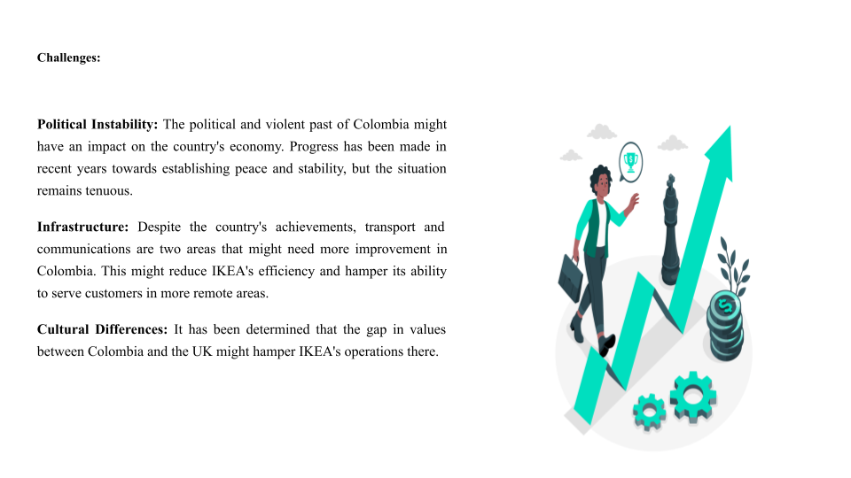

Slide 11
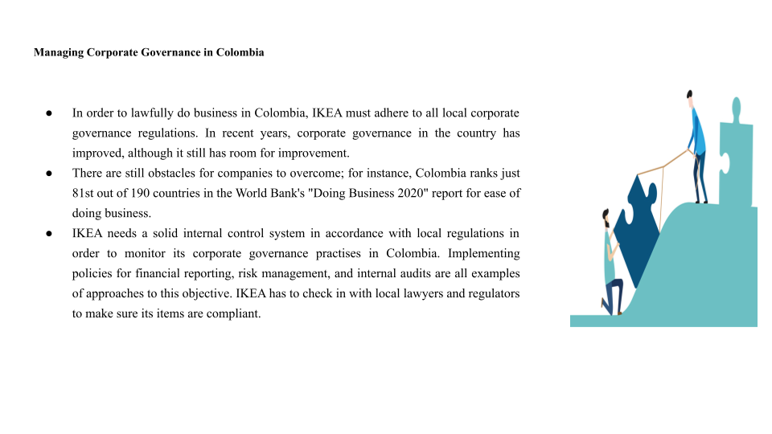

Slide 12
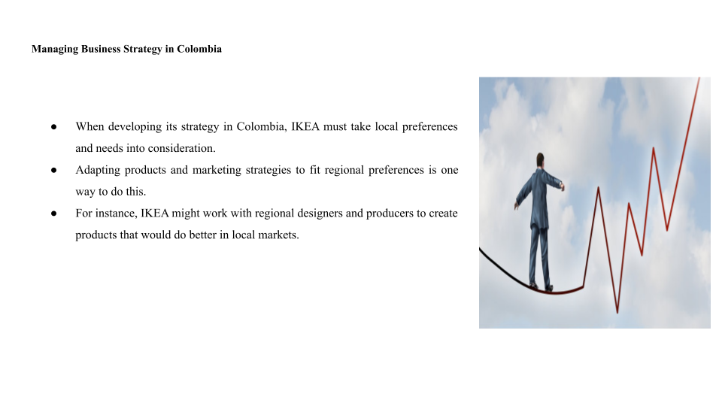

Slide 13
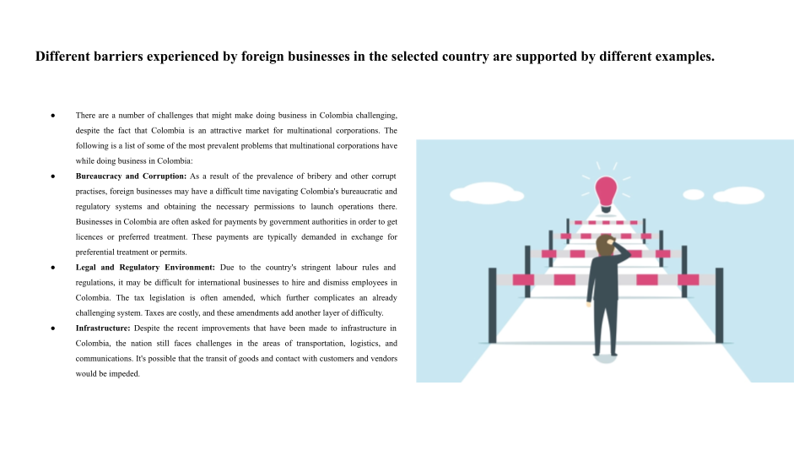

Slide 14
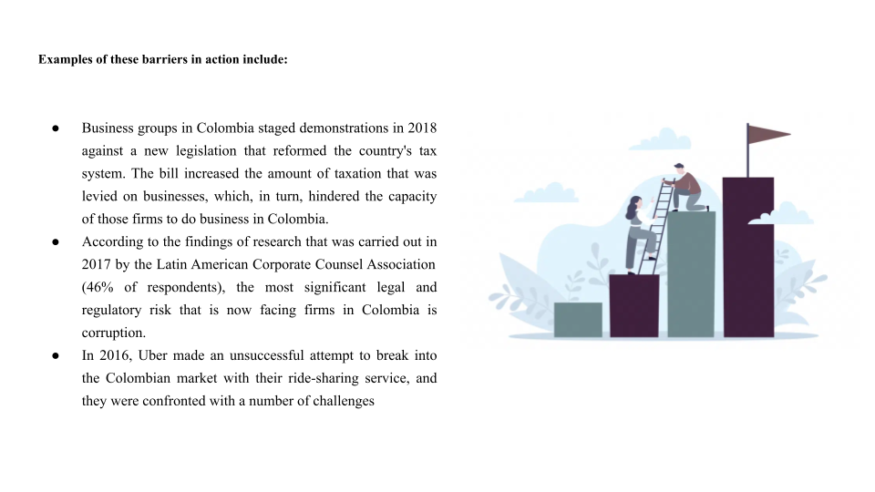

Slide 15
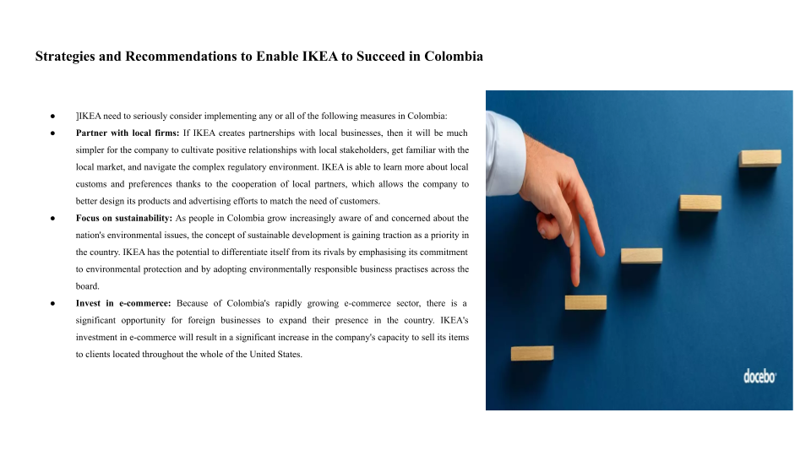

Slide 16


