Slide 1
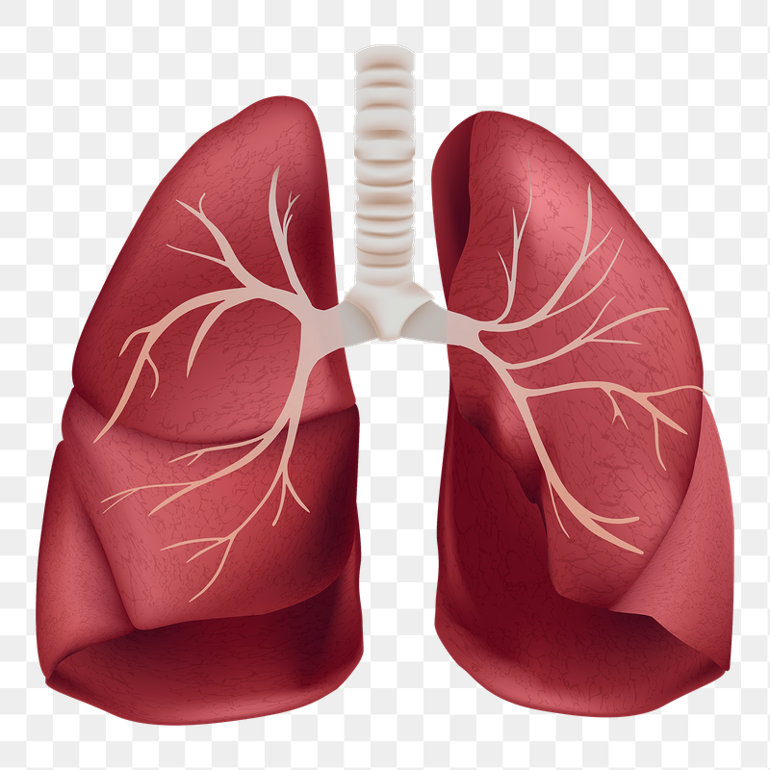

Module: BMHP5003
Assessment: Introduction to Physiology
Lecture: Olusegun Awolaran
Topic: Stage 2A Lung Cancer
Student Name: Anabela Mendes
Student Number: 2124257
American Society of Clinical Oncology.(2019).
Notes:
Lung cancer typically doesn't cause signs and symptoms in its earliest stages. Signs and symptoms of lung cancer typically occur when the disease is advanced.

Slide 2
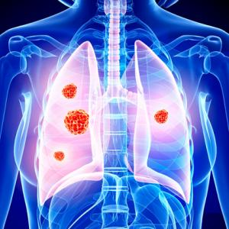
Introduction:
I will be discussing Patient A who has been diagnosed with stage 2A lung cancer
Patient A is a smoker
He is around 49 years
He is mechanic
Patient A is a Male
This Photo by Unknown Author is licensed under CC BY
Notes:
Lung cancer is a type of cancer that begins in the lungs. Your lungs are two spongy organs in your chest that take in oxygen when you inhale and release carbon dioxide when you exhale

Slide 3
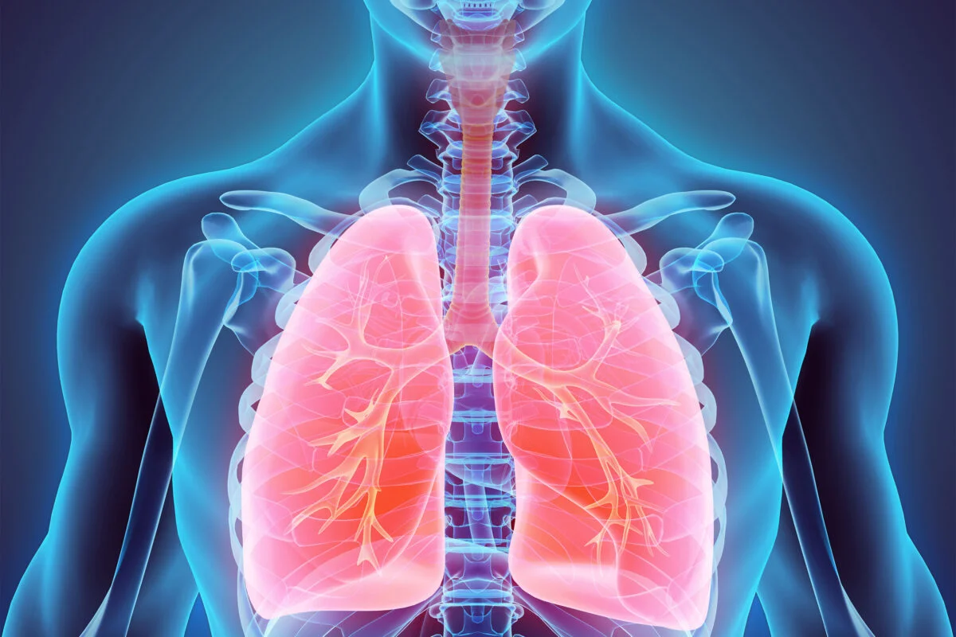
Anatomy and Physiology
Lung cancer start in the cells lining
Bronchioles or alveoli
Pleura surrounds the lungs
Stage 2A lung cancer is between 4cm and 5cm in size
there are no cancer cells in any lymph nodes.
American Society of Clinical Oncology.(2019).
Notes:
Lung cancers typically start in the cells lining the bronchi and parts of the lung such as the bronchioles or alveoli. A thin lining layer called the pleura surrounds the lungs. The pleura protects your lungs and helps them slide back and forth against the chest wall as they expand and contract during breathing

Slide 4
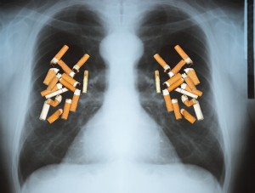
Questionnaire
Patient A is a heavy smoker
Patient A parent’s pass away from lung cancer age of 50
Losing weight
Coughing
Shortness of breath
Anxiety
Depression, traumatic stress
This Photo by Unknown Author is licensed under CC BY-ND

Slide 5
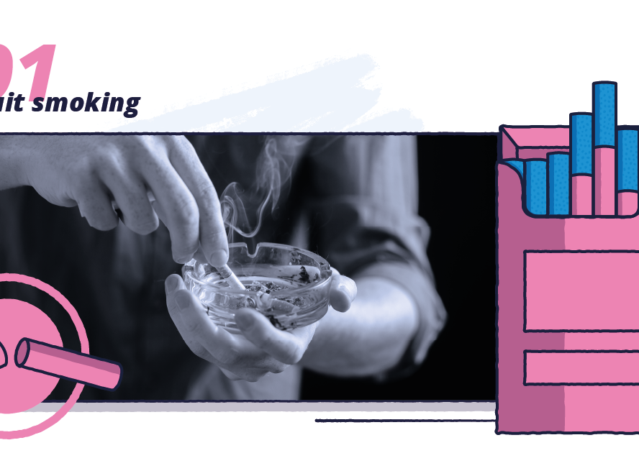
Lifestyle health-related information of the patient
After the consultation, we find out Patient A finishes one pack of cigarettes in a day
Patient A told us all his Family are smokes
Notes:
People with lung cancer can experience shortness of breath if the cancer grows to block the major airways. Lung cancer can also cause fluid to accumulate around the lungs, making it harder for the affected lung to expand fully when you inhale

Slide 6
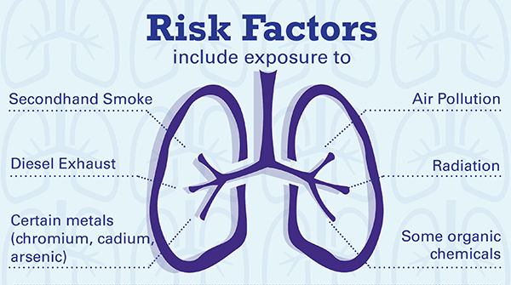
Health Risks
Patient A expose to petrol and diesel
Heavy smoker
expose to Radiation
expose to fast food
Notes:
Patient with lung cancer can experience shortness of breath if cancer grows to block the major airways. Lung cancer can also cause fluid to accumulate around the lungs, making it harder for the affected lung to expand fully when you inhale

Slide 7

Recommendations
NHS recommends annual screening
NHS recommends to Stop Smoking
Daily Exercise 3 to 4 days a week Running, swimming, walking or skipping
NHS recommends Healthy eating
chicken, fish, nuts, beans, eggs
fruits and vegetables

Slide 8

Conclusion
Patient A has lung cancer because his cancer is in the early stage, he can still have a healthy life
We recommended he quit smoking and do more exercise.

Slide 9
References
NHS Choices (2019). Symptoms - Lung cancer. [online] Nhs. Available at: https://www.nhs.uk/conditions/lung-cancer/symptoms/. (Accessed: 23 March 2023).
Anon, (2019). 5 Healthy Habits That Help You During Lung Cancer Treatment. [online] Available at: https://www.hopkinsmedicine.org/health/wellness-and-prevention/5-healthy-habits-that-help-you-during-lung-cancer-treatment. (Accessed: 23 March 2023).
‌Cancerresearchuk.org. (2017). Stage 2 | Lung cancer | Cancer Research UK. [online] Available at: https://www.cancerresearchuk.org/about-cancer/lung-cancer/stages-types-grades/stage-2. (Accessed: 23 March 2023).
‌Mayo Clinic (2021). Lung Cancer - Symptoms and Causes. [online] Mayo Clinic. Available at: https://www.mayoclinic.org/diseases-conditions/lung-cancer/symptoms-causes/syc-20374620. ‌(Accessed: 23 March 2023).
NHS (2021). Physical Activity Guidelines for Adults Aged 19 to 64. [online] nhs.uk. Available at: https://www.nhs.uk/live-well/exercise/exercise-guidelines/physical-activity-guidelines-for-adults-aged-19-to-64/. (Accessed: 28 March 2023).

