Slide 1
Payments in Construction
Zoe Morgan

Slide 2
What we’ll cover
Introduction
Construction Act
Contract sum analysis
Payment notice
Payments to nominated sub-contractors
Interim valuation
Provisional sums
Activity schedule
Certificate of making good defects
Final certificate
Practical completion
Retention

Slide 3
Introduction
In general terms, 'payment' is the transfer between parties of some form of value (such as funds, services, assets) in an agreed exchange. This can be for goods, services or to fulfil a legal obligation such as a debt. The most common form of payment involves money
The payee (the party being paid) generally has the right to specify the method of payment they will accept from the payer (the party that is paying). The payee may decide that they will accept a part/discounted payment

Slide 4
Construction Act
On 1 May 1998, Part II of the Housing Grants, Construction & Regeneration Act 1996 came into force in England and Wales.
On 1 October 2011, Part II of the Housing Grants, Construction and Regeneration Act 1996 was amended in England and Wales, by the Local Democracy, Economic Development & Construction Act 2009 (Part 8).
THE AMENDED ACT CAME INTO FORCE ON:
1 October 2011 in England and Wales 1 November 2011 in Scotland 14 November 2012 in Northern Ireland
The Act provides a mandatory framework for the following two issues within all qualifying construction contracts – note: it does not apply to labour-only, supply-only or consumer contracts:
1. Payment; and, 2. Disputes - adjudication If the contract is non-compliant with the Act, the accompanying regulations then replace the non-compliant provisions.

Slide 5
Construction Act
These provisions include:
The right to be paid in interim, periodic or stage payments.
The right to suspend (or part suspend) performance for non-payment and to claim costs and expenses incurred and extension of time resulting from the suspension.
Pay when certified clauses are not allowed, and the release of retention cannot be prevented by conditions within another contract.

Slide 6
Construction Act
In addition, there are specific provisions in relation to the procedures for making payments.
The client must issue a payment notice within five days of the date for payment, even if no amount is due. Alternatively, if the contract allows, the contractor may make an application for payment, which is treated as if it is the payment notice.
The client must issue a pay less notice if they intend to pay less than the amount set out in the payment notice, setting out the basis for its calculation.
The notified sum is payable by the final date for payment.
If the client (or specified person) fails to issue a payment notice, the contractor may issue a default payment notice. The final date for payment is extended by the period between when the client should have issued a payment notice and when the contractor issued the default payment notice. If the client does not issue a pay less notice, they must pay the amount in the default payment notice.

Slide 7
Payments in Construction
In the construction industry, payment can be the source of a great deal of controversy. Not only are the sums involved very large, and the duration of projects very long, but the total amount payable tends to change over time. In addition, contractors, subcontractors and suppliers face considerable risk when pricing construction projects, and optimistic pricing or late payments can quickly cause cash flow problems.
As a result, payments are often be the source of disputes which can ultimately lead to a breakdown in relationships and even project or business failure.

Slide 8
Agreed cost
The cost of the contract is agreed within the tender process
Tender process includes going out to the construction market and getting the ‘best price’ for the job
Once the cost is agreed this is often referred to as the ‘contract sum’.
The contract sum is not usually a fixed price.

Slide 9
What effects the ‘contract sum’
Variations: Most contracts will contain provision for the architect or contract administrator to issue instructions to vary the design, quantities, quality, sequence or working conditions - NEC
Relevant events: A relevant event may be caused by the client (for example failure to supply goods or instructions), or may be a neutral event (such as exceptionally adverse weather) and may result in a claim for loss and expense by the contractor - JCT
Provisional sums: These are allowances for a specific element of the works that is not defined in enough detail for tenderers to price.
Fluctuations: A mechanism for dealing with inflation on projects.
Payments to nominated sub-contractors or nominated suppliers.
Statutory fees.
Payments relating to opening-up and testing the works.
Depending on the nature of the contract therefore, prices may be referred to as; fixed, firm, guaranteed maximum price, target cost, lump sum, measurement, open book, and so on.

Slide 10
Payment Notice
Your subcontractor has submitted an application for £17,242.00
Their order value is only £11,000.00
Of this application there at £7,000.00 worth of variations
£10,242 are made up from prelims, contract works and materials on site

Slide 11
Assessing variations
Alterations to the design.
Alterations to quantities.
Alterations to quality.
Alterations to working conditions.
Alterations to the sequence of work.

Slide 12
Variations included in the application
£750 – Increased measure of cladding
£500 – 12 hour day works for ‘standing time’. Work area not available
£1,750 – Water damage to materials stored from water ingress
£2,000 – Additional EPDM from new drawings issued
£1,500 – Boxing in electric cable adjacent to the building
£500 – Additional labour

Slide 13
Assessing the measured works
When assessing the measured works the subcontractor will typically claim a percentage of the works that have they’ve completed.
An element of the application will include the ‘preliminaries’ – These are usually the most difficult aspect to measure
Prelims are made up of the subcontractors over heads & profits
Materials on site

Slide 14
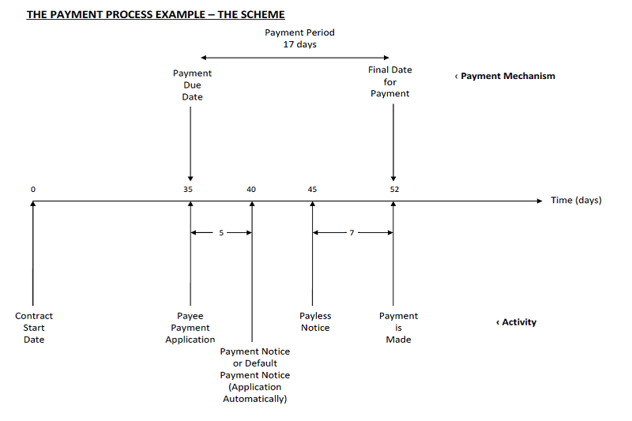
Create your own payment notice

Slide 15
Payments to nominated sub-contractors
A nominated subcontractor is when a Client requests the main contractor to employee the nominated subcontractor to carry out an element of the works under the main contract
The main contractor is not liable for the performance of the nominated subcontractor. It is the Clients responsibility to have a guarantee / warranty

Slide 16
Payments to nominated subcontractors
When the nominated sub-contractor works are being carried out, the client’s cost consultant will periodically value their work and the amount properly due is then shown as a separate amount on interim certificates. This amount is also notified to the nominated sub-contractor
It’s then the duty of the main contractor to pay the nominated subcontractor

Slide 17
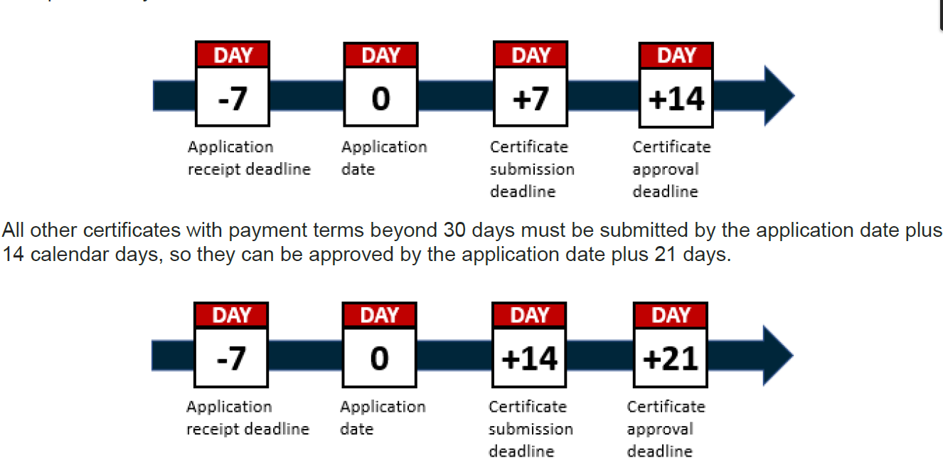
REFRESH!
The Construction Act was put in place to have better system in place with payments and adjudication

Slide 18
REFRESH!!
How to assess an application – how an application is set out
What is measured works?
What are preliminaries?
What are materials on site?
What are variations?

Slide 19
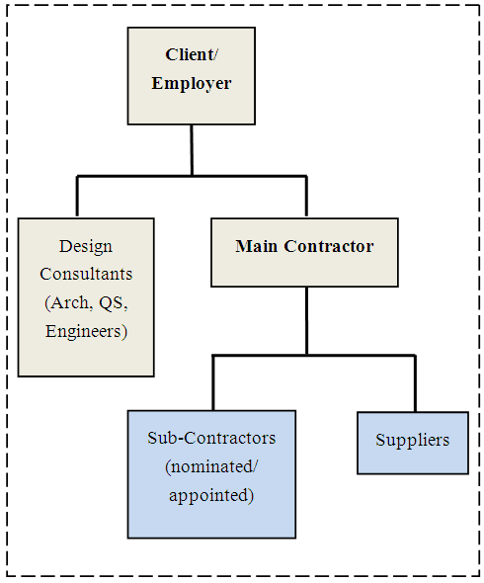
Flow Chart of Systems

Slide 20
Interim Valuations
The main contractor prepares the interim valuation and submits to the Client
It is checked and signed off by the client's contract administrator who often delegates the task to a cost consultant. This usually involves visiting the site and checking that the work has been carried out, either by measurement or by visual inspection.
Calculations can be based on:
Activity schedules assessed in terms of percentage achieved or completion of the activity.
Milestones reached on a pre-agreed programme.
Measurement against a bill of quantities.
Stage payments against calendar dates.

Slide 21
Interim Valuations
Works packages. That is, work executed by the contractor that is in full accordance with the contract.
Preliminaries. That is, set up and dismantling costs (only incurred once) and running costs such as insurance and electrical consumption (that will occur regularly), as well as staff and management costs, overhead and profit (which can amount to 50% of the overall cost of preliminaries).
Variations. These elements should only be paid after the work has been undertaken, based on the rules for valuing variations in the contract.

Slide 22
Interim Valuations
Extension of time (EOT) and / or loss and expense. Payment entitlement is only due upon delay that is solely caused by the client or items of risk that fall to the client Concurrent delay where the contractor has part liability may lead to an extension of time and relief of liquidated and ascertained damages but not entitle the contractor to additional payment.
Special payments for off-site goods and materials. Such payments might apply on large items of manufacture prior to site installation but only when such payment has been pre-agreed. Such items might include transformers, chillers, lifts, prefabricated units or expensive cladding systems.

Slide 23
Interim Valuations
Provisional sums. These are the substitution of agreed costs for any items in the contract documents that were provisional and therefore subject to negotiation and resolution after further and better particulars were available upon which to fix a price
As provisional sums are replaced by valuations of the work actually done as the project progresses, the contract sum may increase or decrease. In addition, depending on the degree to which the works that the provisional sum relates to can be defined at the tender stage, the actual works that are undertaken may affect the contractor’s programming, planning and pricing preliminaries:
Defined provisional sums are those which have been described in sufficient detail that the contractor is expected to have made allowance for them in their programming, planning and pricing preliminaries.

Slide 24
Interim Valuations
In the case of Midland Expressway Ltd v Carillion Construction Ltd & Others, Court of Appeal Civil Division, 15 June 2006, Lord Justice May suggested that:
The term 'provisional sum' is generally well understood in the construction industry. It is used in pricing construction contracts to refer either to work which is truly provisional, in the sense that it may or may not be carried out at all, or to work whose content is undefined, so that the parties decide not to try to price it accurately when they enter into their contract.
A provisional sum is usually included as a round figure guess. It is included mathematically in the original contract price but the parties do not expect the initial round figure to be paid without adjustment. The contract usually provides expressly how it is to be dealt with. A common clause in substance provides for the provisional sum to be omitted and an appropriate valuation of the work actually carried out to be substituted for it. In this general sense, the term 'provisional sum' is close to a term of art but its precise meaning and effect depends on the terms of the individual contract.

Slide 25
Activity Schedule
The NEC3 ECC Guidance Notes offers some help by providing the following explanation for Main Option A:
An activity schedule is a list of activities prepared by the Contractor which he expects to carry out in Providing the Works. When it has been priced by the Contractor, the lump sum for each activity is the Price to be paid by the Employer for that activity. The total of the Prices is the Contractor’s price for providing the whole of the works, including for all matters which are at the Contractor’s risk.

Slide 26
Activity Schedule
Relationship to the Accepted Programme
Clause 31.4 states:
The Contractor provides information which shows how each activity on the Activity Schedule relates to the operations on each programme which he submits for acceptance.
It is not necessary for the items in the programme to mimic exactly the items in the Activity Schedule; there may be more activities on the Activity Schedule than on the programme or vice versa.
What is important (and by way of 31.4 is a contract obligation), in order to make assessment of compensation events and financial forecasting easier, is there should be correlation between the programme and the Activity Schedule and that this should be kept up to date.

Slide 27
Activity Schedule
Use under Option A
The Activity Schedule is a much more important document under Option A than Option C as, under Option A, it directly effects the timing and amount of payment to the Contractor, having a significant effect on his cash flow.
The sum due to the Contractor in each assessment period is the Price for Work Done to Date which under Option A is defined at 11.2 (27):
The Price for Work Done to Date is the total of the Prices for
each group of completed activities and
each completed activity which is not in a group.
A completed activity is one which is without Defects which would either delay or be covered by immediately following work.
As can be seen, payment to the Contractor for work under an activity only becomes due when the whole of that activity is complete. There is no provision for part payment.
Accordingly, the more activities included within the schedule, the better for the Contractor’s cash flow.

Slide 28
What is a defect?
Defects can be 'patent' or 'latent’
During the defects liability period, the client reports any defects that arise to the contract administrator who decides whether they are defects in the works (i.e. works that are not in accordance with the contract), or whether they are in fact maintenance issues. If the contract administrator considers that they are defects, then they may issue instructions to the contractor to make good the defects within a reasonable time

Slide 29
Patent Defect
In any event, such defects should be rectified before a certificate of practical completion is issued. This can put the contract administrator in a difficult position, where both the contractor and the client are keen to issue the certificate (so that the building can be handed over) Issuing the certificate under these circumstances could render the contract administrator liable for problems that this causes, for example, in the calculation of liquidated damages.

Slide 30
Latent Defect
Latent defects are less obvious to the eye
Usually caused by failure in design, workmanship or materials
For example;
Defective basement tanking allowing water penetration.
Inadequate wind-posts or wall ties causing movement damage to walls.
Under-strength concrete or misplaced reinforcement allowing movement damage to the structure.
Inadequate foundations causing subsidence of the building.

Slide 31
Making good of defects
Once practical completion has been certified, the defects liability period begins (now called the 'rectification period' in Joint Contracts Tribunal (JCT) contracts). Typically, the defects liability period is six to twelve months
The Client will usually have a representative who’ll control the defects – can also be known as ‘snags’
It is the duty of the contractor to make good of the defects and not the client

Slide 32
Making good of defects
If the contractor does not rectify the defects within the time scale (usually 12 months) then the contractor can usually be in breach of contract
It is important to note that the defects liability period is not a chance to correct problems apparent at practical completion, it is a period during which the contractor may be recalled to rectify defects which appear. If there are defects apparent before practical completion, then these should be rectified before a certificate of practical completion is issued.

Slide 33
Making good of defects
Defects are works that have not been carried out in accordance with the contract. Defects which are discoverable before the end of the defects liability period are described as 'patent defects'. Defects which could not have been discovered during the defects liability period are known as 'latent defects' (for example, a problem with foundations which have been covered up and does not become apparent until several years later when settlement causes cracks to appear).

Slide 34
Final Certificate
The final certificate is certification by the contract administrator that a construction contract has been fully completed. It is issued at the end of the defects liability period and has the effect of releasing all remaining money due to the contractor, including any remaining retention.
The value of the final certificate will be based on the final account agreed by the cost consultant and the contractor. This means that all patent defects must have been remedied, all adjustments to the contract sum must have been agreed and all claims settled.

Slide 35
Practical Completion
Practical completion is not defined in the standard JCT suite of building contracts but the works are generally considered to be practically complete when there are no outstanding defects (except for minor items or snagging) and the building can be put to its intended use.

Slide 36
Practical Completion
Both contractually and practically the date of practical completion is important as it typically means that:
the contractor no longer has exclusive possession of the site;
the contractor’s obligation to insure the works comes to an end;
the contractor’s liability for liquidated damages for delay ends;
time starts running in respect of the rectification period;
the contractor becomes entitled to part (often half) of the retention.

Slide 37
Practical Completion
Documentation that should be issued to the client on certification of practical completion might include:
A draft building owner's manual.
A building user's guide.
The health and safety file.
The building log book.
A construction stage report.

