Slide 1
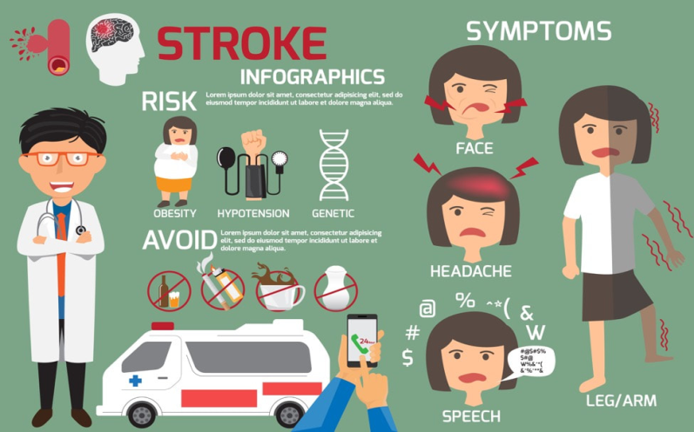
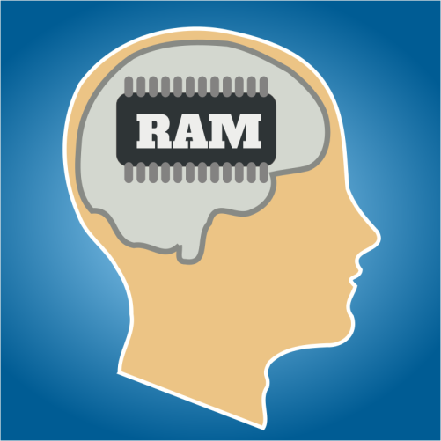
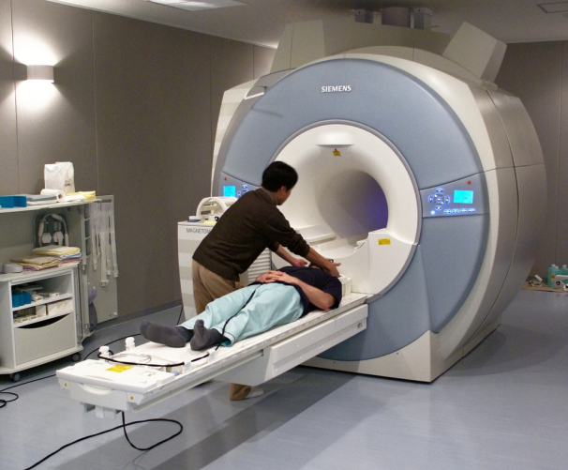
ECAP6004- Critically review ONE journal
article selected in the field of
the Neuroscience of Memory
Altered functional connectivity in patients with post stroke memory impairment: A resting fMRI study Liu et al (2017)
Biological and cognitive neuroscience
Rachel Griffiths

Slide 2
Critical Evaluation
Background
Liu et al (2017) used 27 Healthy controls and 27 post stroke memory dysfunction patients gathered from the Fujan University of Traditional medicine subsidiary Rehabilitation hospital
Justified their small sample size based on availability of participants who met the criteria .
Lakens (2022) states that sample size based on resource constraints is one approach to support smaller sample sizes as the cost of study needs to be considered and the availability to relevant data.
Andrade (2020) larger sample size is not always accurate as they can demonstrate statistical significance in small differences when this may not be the case and given that liu et al 2017 research is of a particular group of patients with post-stroke memory dysfunction then this lower sample size can be justified.
However, Budiu & Moran (2021) recommend 40 participants in quantitative studies to demonstrate statistical power and if sample sizes are smaller than this number for example if 28 participant take part confidence levels need to be dropped to 90% with a desired marginal error of 15% for good precision with medium risk. However liu et al (2017) used 27 participant with PMD along with 27 healthy control groups for comparative data.
Around 66% of stroke patients experience issues with cognitive functioning (Lie etal 2017)
Post memory stroke dysfunction (PMD) is the most prevalent impairment which impacts motor functioning and difficulties in understanding and follow instruction.
lead to life long disability which reduces quality of life and increases mortality rates.
Liu et al (2017) aim to identify the changes in the functional organisation of the default mode network (DMN) and the Dorsal attention network (DAN)of patient with post-stroke memory dysfunction (PMD).

Slide 3
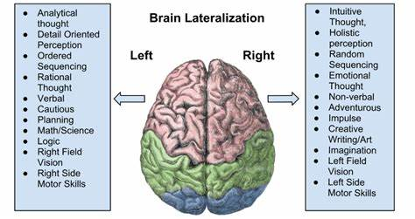
In Liu et al (2017)
The data collection was limited to patients with right hemisphere (RH) damage.
No clarification clarify why RH was chosen for investigation
May be due to other research which has found that right-hemisphere (RH) damage is more severe than left-hemisphere (LH) damage (Long et al, 2012)
(RH) damaged patients have impairment in:
Verbal language and coherent language production
Cannot tell the the difference between humour and other pragamatic information (Long et al, 2012).
Long et al(2012) state that Both hemispheres represent verbal information differently.
Memory word list tasks have revealed that episodic memory is encoded in both hemispheres
LH is responsible for word meaning retention (abstract and categorical )
RH retains the physical form of words so encoding (object in memory)
Liu et al (2017) investigated each participant at different stages within a 12 month period since having a stroke.
However, some cognitive functioning may improve with time one study cant se these differences
Greater activity seen in patients who have recently had a stroke .
Recommendation: More than one fMRI of investigation on each participant would be more reliable (Long et al, 2012, Liu et al, 2017)

Slide 4


Mini-mental status examination
The MMSE (General cognitive functioning test) was administered for both control groups.
PMD patients scored (21) it was just 6 less than the healthy control group which was(27)
this small difference between the scores could indicate that this test fails to consider other factors such as age, education and cultural background influences on test (Slavych, 2019)
In addition, it suggest it is not as accurate as Wechsler Memory scale test as the MMSE recognises obvious memory loss signs but not subtle memory loss symptoms.
Nonetheless, it is easily accessible and only takes 10 minutes to complete and it is available in a few different languages (Slavych, 2019).
In Liu et al (2017) study the HC group scored 27 therefore deemed normal cognition whereas the PMD group scored 21 falling into the 21-24 category which is indicative of MILD dementia. Therefore this can be criticised as it would suggest that cognition in PMD patients Is relatively good whereas the WMS test indicate significant differences between HC and PMD pts (Caceres, 2024)

Slide 5
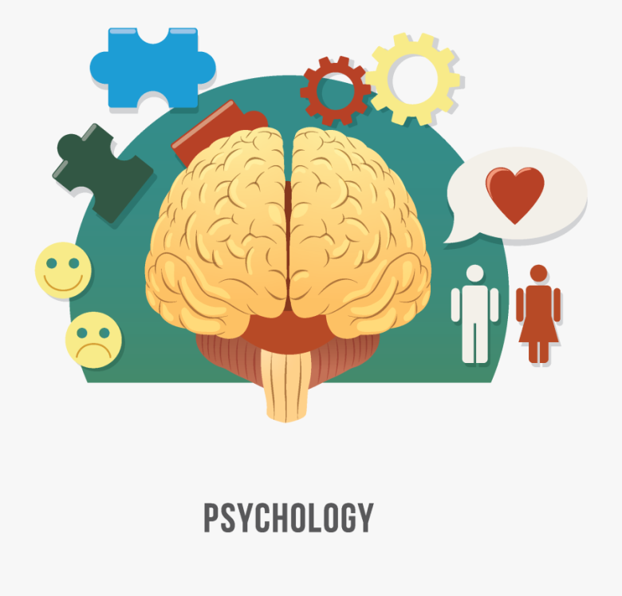
To add, Hilsabech et al (2015) compared the the Brief Cognitive Status Exam BCSE to that of the Mini-Mental State Examination. They concluded That BCSE cognitive screening is more effective than the MMSE at identifying cognitive impairment in; dementia sufferers, cognitive impairment, no dementia and no cognitive impairment which were consistent with Bouman et al (2014) findings.
However, , cognitive screening tests are designed for:
the over 60’s group but also used on younger groups
lead to lower sensitivity results for detecting cognitive impairment.
suggest that the small differences between the HC group (27) and PMD (21) in Liu et al (2017) may be down to the age group or it lacks sensitivity in picking up on cognitive impairment
Therefore a BCSE exam may have been a better alternative for the control groups of their study as they are using cognitive impairment patients not dementia patients.

Slide 6
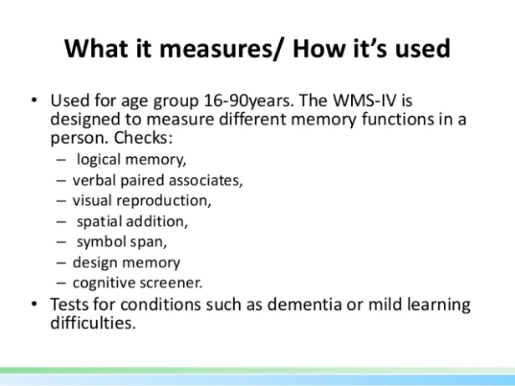
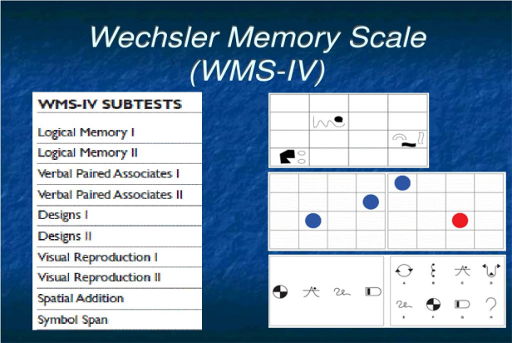
Wechsler memory scale
Liu et al (2017) used the Wechsler Memory Scale test to measure memory function:
used an older out-dated version.
Liu et al (2017) WMS investigated direct memory using digit span tests:
short term memory using picture recognition, visual production, associative learning, touch memory and comprehension test.
long term memory was measured using forward and backward recite digit tests.
The latest edition of WMS would have provided more reliable results as they include performance validity tests: crucial for providing confidence while limiting financial costs and limiting time restraints. (Kent et al, 2010 & Lee et al 2023)
However, further research of PVT inclusion in clinical settings is needed to further support its confidence and validity (Soble et al, 2019)

Slide 7
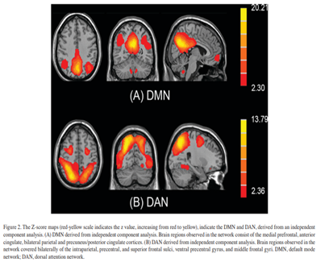
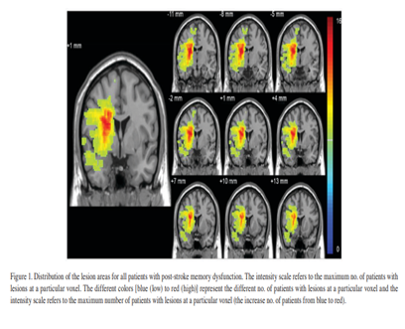
fMRI - Functional Magnetic Resonance Imaging
Currently a reliable method for analysing brain activity during cognitive tasks (Kimberley, 2008)
fMRI indirectly measures BOLD signals (blood oxygenated level dependent). (Wandshchneider & Koepp (2016)
It has been widely used for investigating dementia as research has demonstrated significantly lower volume in entorhinal cortices (37%) and hippocampus volume (27%) compared to healthy adults with a mild cognitive impairment. (Wandshchneider & Koepp (2016)
Difficulties in diagnosing Alzheimer's disease in over 80 year olds - normal age deficits or Alzheimer's disease, fMRI is avoided in NICE clinical diagnostic guidelines (Sullivan et al, 2018).
It requires around an hour of patients time and
It is also more costly than a CT scan and may be tolerated less as it takes longer, it is also noisy and may make a person feel claustrophobic (Queensland private Healthcare, 2024)

Slide 8
Functional magnetic resonance imaging (fmRI)
Investigations into the reliability of fMRI amongst impaired patients have been limited therefore Kimberley (2008) carried out a systematic study to explore fMRI among stroke patients.
moderate to high reliability using this method for stroke patients.
A number of factors can affect the reliability of fMRI such as a compromised cardiovascular system, for example blood pressure levels, cholesterol, diet, foods and drinks higher in sugar and caffeine, Medication can also affect responses to fMRI or increase brain activity (Kimberley, 2008; Yang, 2019; Parent et al, 2011; Sjuls & Specht, 2022).
Yang (2019) found:
Participants who consumed caffeine had shorter delays and lower standard deviations compared to the non-caffeine group
This demonstrates the vasoconstriction effect of caffeine which increases blood pressure.
close interaction in brain areas with a “vascular effect coincided with brain areas that showed a significant neural effect”
Parent et al (2011) found:
Glucose affects fMRI activation in the left parrahipocampal cortex which is linked to episodic memory processes of encoding and retrieval
Greater activity was also seen in dorsolateral prefrontal cortex which is responsible for semantic elaborative process and successful episodic memory encoding.
Sjuls & Specht (2022) stated that resting fMRI can provide conflicting results.
investigated arterial Blood Pressure, Body Mass, Haematocrit and glycated haemoglobin which may be responsible for the variability amongst healthy individuals.
concluded that Blood Pressure and Body mass can cause variability in BOLD signal .
This susceptibility to these factors are seen in previous and current studies and may be the reason for low replicability.

Slide 9
How drugs affect fMRI scans
Liu et al (2012)
Excluded participants with other pathologies from their study.
Failed to consider that post stroke patients are usually prescribed a number of medications to prevent any further strokes for example , anti coagulants, diuretics, beta-blockers, Blood thinners and even anti-depressants.
In Liu et al 2017 study there was no mention of what medications each of the participants were taking and how this may have affected the activity seen in Fmri .
Wandschneider & Koepp, 2016 found that Pharmaco-Fmri studies
found that there is a low signal change as a result of drugs in FMRI specifically in task related fMRI, as drugs cause an interaction affect where patterns seen in patients on certain medications have similar results to those who do not take medication.
Levetiracetam a drug used for epilepsy exhibited task deactivation in the diseased temporal lobe.
The more of the drug that was taken the more activity was seen in the left middle temporal gyrus and in the left temporal lobe epilepsy in verbal task and in the right hippocampus and right temporal lobe.
This suggests this medication restores normal fMRI activation levels which were seen in the healthy control group and this also suggests that this medication is an effective treatment for this disease. However, if this is the case with other drugs the fmri may show these activations and results will demonstrate better task performance making it difficult to differentiate drug effect from the stroke damage effects (Wandschneider & Koepp, 2016).

Slide 10
Conclusion
In summary Liu et al (2017) investigated stroke memory dysfunction patients with right hemispheric damage. A general cognitive test MMSE was given to both control groups PMD and healthy control group however it failed to consider other factors which may have been responsible for scorings there was no means of determining whether lower scoring was due to age or education level or stroke. It is recommended that the BCSE may have been a better cognitive test for stroke patients,
The Wechsler memory scale test was given to both groups although PMD patients scored significantly lower in all of the working memory tests. However, Liu et al (2017) used the older version of this test and it would have been wise to use the updated fourth addition Wechsler scale as it has been updated to improve scoring (Kent, 2020).
Liu et al (2017) investigated each patient once during recovery, whereas ,it would have been better to have investigated each patient more than once during the different stages of recovery as Liu et al’s (2017) approach does not account for those who will recover some of their memory dysfunctions.
Although fMRI is a common updated method of exploring brain activities during cognitive tasks studies have indicated that there is limited research on the reliability of fMRI amongst impaired patients with brain tumours, stroke and multiple sclerosis as many of the studies in the literature investigate dementia and Alzheimer’s (Kimberley, 2008).

Slide 11
References
Andrade, C. (2020). Sample size and its importance in research. Indian Journal of Psychology Medicine, 42, 02-3. https://journals.sagepub.com/doi/pdf/10.4103/IJPSYM.IJPSYM_504_19
Bouman, Z., Hendriks, M. P. H., Aldenkamp, A. P., & Kessels, R. P. C. (2015). Clinical validation of the WMS-IV-NL brief cognitive status exam (BCSE) in older adults with MCI or dementia. International Psychogeriatrics, 27(2), 221–229. doi:10.1017/S1041610214001471
Budiu, R & Moran, K. (2021). 40 Participants is an appropriate number for most quantitative studies but there are cases when you can recruit fewer. https://www.nngroup.com/articles/summary-quant-sample-sizes/#:~:text=In%20most%20cases%2C%20we%20recommend,40%20participants%20for%20quantitative%20studies.
Caceres, V. (2024). What does your MMSE score mean?. https://www.caring.com/examinations/what-does-your-mmse-score-mean#:~:text=The%20answers%20are%20scored%2C%20and%20that%20score%20suggests,lower%20scores%20signal%20more%20severe%20cases%20of%20dementia.
Erdodi, L. A., & Lichtenstein, J. D. (2017). Invalid before impaired: an emerging paradox of embedded validity indicators. The Clinical Neuropsychologist, 31, 1029–1046. doi:10.1080/13854046.2017.1323119

Slide 12
Fowler, S. B., & Lapp, V. (2019). Sample size in quantitative research: Sample size will affect the significance of your research. American Nurse Today, 14(5), 61+. https://link.gale.com/apps/doc/A592663691/AONE?u=anon~6b202536&sid=bookmark-AONE&xid=89c9a61c
Hilsabeck, R.C., Holdnack, J.A., Munro Cullum, C., Drozdick, L.W., Edelstein, B., Fiske, A.,Lacritz, L., McCoy, K.J.M., Wahlstrom D. (2015). The Brief Cognitive Status Examination (BCSE): Comparing Diagnostic Utility and Equating Scores to the Mini-Mental State Examination (MMSE). Archives of Clinical Neuropsychology,30(5), 458–467. https://doi.org/10.1093/arclin/acv037
Iannetti, G. D., & Wise, R. G. (2007). BOLD functional MRI in disease and pharmacological studies: room for improvement? Magnetic Resonance Imaging, 25(6), 978–988. https://doi.org/10.1016/j.mri.2007.03.018
Kent, Phillip. (2020). The Wechsler Memory Scale: A Guide for Clinicians and Researchers. 10.4324/9781003027348.
Kimberley, T. J., Khandekar, G., & Borich, M. (2008). fMRI reliability in subjects with stroke. Experimental brain research, 186(1), 183–190. https://doi.org/10.1007/s00221-007-1221-8
Lakens, D. (2022). Sample Size Justification. Collabra Psychology, 8(1).http://dx.doi.org/10.1525/collabra.33267
Lee, S. C., Chien, T. H., Chu, C. P., Lee, Y., & Chiu, E. C. (2023). Practice effect and test-retest reliability of the Wechsler Memory Scale-Fourth Edition in people with dementia. BMC geriatrics, 23(1), 209. https://doi.org/10.1186/s12877-023-03913-2
Liu, J., Wang, Q., Liu, F., Song, H., Liang, X., Lin, Z., Hong, W., Yang, S., Huang, J., Zheng, G., Tao, J., & Chen, L. D. (2017). Altered functional connectivity in patients with post-stroke memory impairment: A resting fMRI study. Experimental and therapeutic medicine, 14(3), 1919–1928. https://doi.org/10.3892/etm.2017.4751

Slide 13
Long, D. L., Johns, C. L., & Jonathan, E. (2012). Hemispheric differences in the organization of memory for text ideas. Brain and language, 123(3), 145–153. https://doi.org/10.1016/j.bandl.2012.08.006
Parent, M.B., Krebs-Kraft, D.L., Ryan, J.P., Wilson, J.S., Harenski, C., Hamann, S. (2011). Glucose administration enhances Fmri brain activation and connectivity related to episodic memory encoding for neutral and emotional stimuli. Neuropsychologia, 49(5), 1052-1066. https://doi.org/10.1016/j.neuropsychologia.2011.02.013
Queensquare private healthcare. (2024). Patient guide. https://queensquare.com/wp-content/uploads/Having-an-fMRI-Scan-A-Patient-Guide.pdf
Sauro, J & Lewis, J. (2016).. Quantifying the User Experience: Practical Statistics for User Research. Elsevier.
Slavych, B. (2019). Pros and Cons of Various Screening Tools for Dementia. https://leader.pubs.asha.org/do/10.1044/pros-and-cons-of-screening-tools-for-assessing-dementia/full/#:~:text=Advantages%20of%20the%20MMSE%20include%20brevity%20and%20ease,as%20age%2C%20education%2C%20and%20cultural%20background%20affect%20scores.
Soble, J. R., Bain, K. M., Bailey, K. C., Kirton, J. W., Marceaux, J. C., Critchfield, E. A., McCoy, K. J. M., & O'Rourke, J. J. F. (2019). Evaluating the accuracy of the Wechsler Memory Scale-Fourth Edition (WMS-IV) logical memory embedded validity index for detecting invalid test performance. Applied neuropsychology. Adult, 26(4), 311–318. https://doi.org/10.1080/23279095.2017.1418744
Sullivan, V., Majumdar, B., Richman, A., & Vinjamuri, S. (2012). To scan or not to scan: neuroimaging in mild cognitive impairment and dementia. Advances in Psychiatric Treatment, 18(6), 457–466. doi:10.1192/apt.bp.110.008813
Turner R. (2016). Uses, misuses, new uses and fundamental limitations of magnetic resonance imaging in cognitive science. Philosophical transactions of the Royal Society of London. Series B, Biological sciences, 371(1705), 20150349. https://doi.org/10.1098/rstb.2015.0349

