Slide 1




ACADEMIC SKILLS
UNIVERSITY OF WALES TRINITY SAINT DAVID
https://www.uwtsd.ac.uk/

Slide 2


  Team Members
  Code of Conduct
  A short Story About Tesco
  Interesting Facts About Tesco
  Overview of Tesco Organization
  Purpose and services of company
  Current business situation
  Pandemic situation
  Recommending two strategies
  Conclusion
  Refrences
READ MORE
www.uwtsd.ac.uk/

Slide 3

Team
Members
  Denisa Orosanu
  Izabela Stanescu
  Shamim Uddin
  Ionica Toader
READ MORE

Slide 4

  Integrity
  Accountability
  Collaboration
  Pursuit of Excellence
READ MORE
https://www.uwtsd.ac.uk/

Slide 5

  We respect all team members by giving them the opportunity to research and express their views on the related topic;
  Organisational cooperation through active participation and pre-completion of the project;
  Maintain a friendly work environment through active communication to achieve our teamwork goals.
Read More
https://www.uwtsd.ac.uk/

Slide 6


  We take responsibility for our shared tasks and ensure that our project is completed successfully and meet its deadlines.
  Izabela and Denisa worked effectively to find source material on our topic and write references.
  Shamim and Ionica worked to filter the information and prepare the format of the presentation.
  The entire team worked to add final information to the slides.
Read More
https://www.uwtsd.ac.uk/

Slide 7


  Smooth collaboration by keeping a simple language while communicating;
  Working in a organised and collaborative manner with others, by actively engaging to complete the project on time.

Slide 8

  Ensuring we have a compelling, positive vision with clear goals on the project;
  Keep it simple and ensuring our goals are attainable;
  Encouraging the team to be open and creative with our ideas;
  Motivate the team to achieve the goals.
Read More
https://www.uwtsd.ac.uk/

Slide 9



A Short Story About Tesco

Slide 10


Did You Know That.........

Slide 11

  Has 4,000 shops in the UK, and approximately 7,000 shops internationally;
  420,000 people worldwide are employed by Tesco;
  Tesco's internet sales have increased by 48% by 2022;
  Tesco's sales increased 1.3 billion over the last fiscal year;
  Tesco is the 15th most profitable retailer in the world.

Slide 12
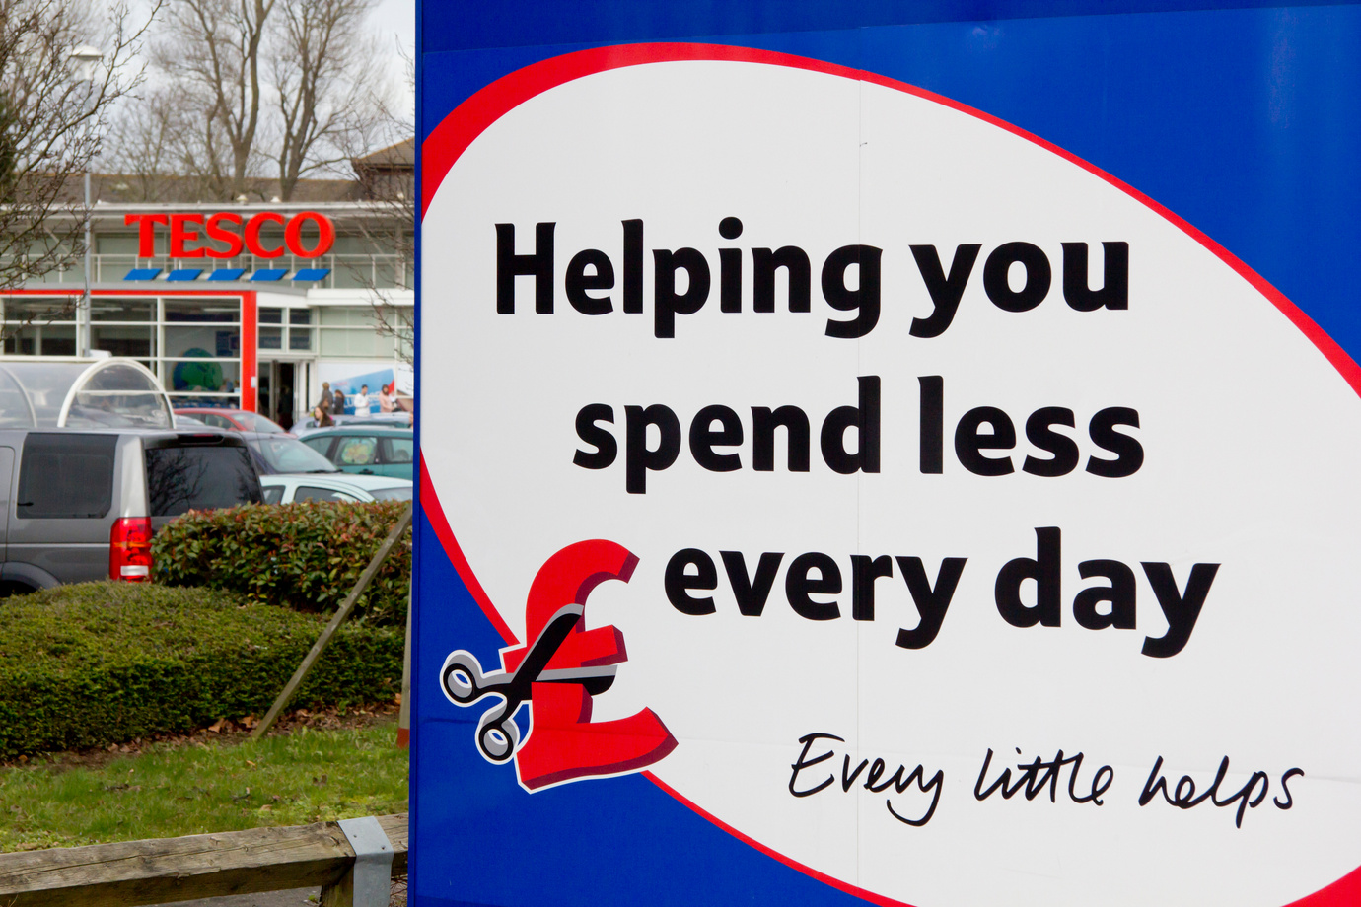
  Tesco is mainly recognised as a multinational retailer established to serve a wide range of products at very competitive prices and services to consumers while operating in the dynamic market;
  With more than 330,000 employees in 3,146 stores, it is the UK's largest retailer in terms of sales and the country's largest private employer.
OVERVIEW OF COMPANY

Slide 13
Core Purpose Of The Company
"Serving our customers, communities and planet a little better every day.
Serving our customers, communities and planet a little better every day means we always keep customers at the heart of what we do, while also reflecting our responsibilities to the communities we serve and to society more broadly."
Source:www.tesco.com

Slide 14

Core Purpose Of
TESCO
Tesco's core value is to always specify the highest quality products to satisfy consumers and achieve long-term goals. We also provide the best products with reasonable value to maintain consumer loyalty.
Read More
https://www.uwtsd.ac.uk/

Slide 15

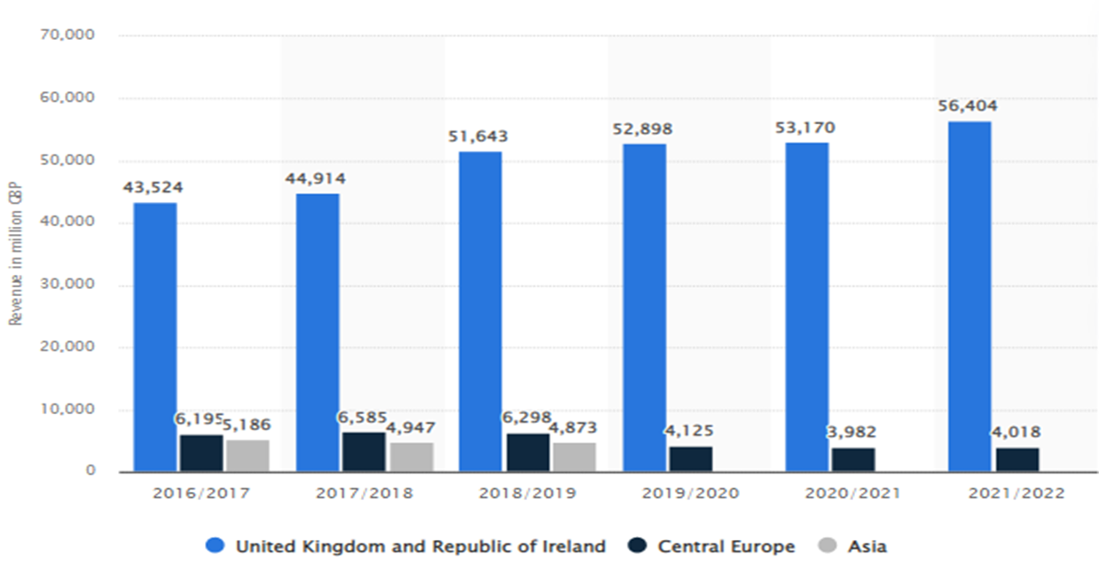
Current business situation
  Currently the company is operating at high-level providing the customers with products at low- prices. This allows them to remain competitive while operating in the dynamic environment.
  During 2021-2022 the annual revenue earned by the company was around 56 billion British pounds.

Slide 16
Current business situation
  Since Covid19 pandemic the revenue has risen from 53 to 56 billion pounds;
  Also expanding its range of products helps in retaining the loyal consumer market hence more profits and keeping high the competitiveness with the other supermarkets.
  From 2021 to 2022 the company had an increase in ROI with 3.6%.

Slide 17
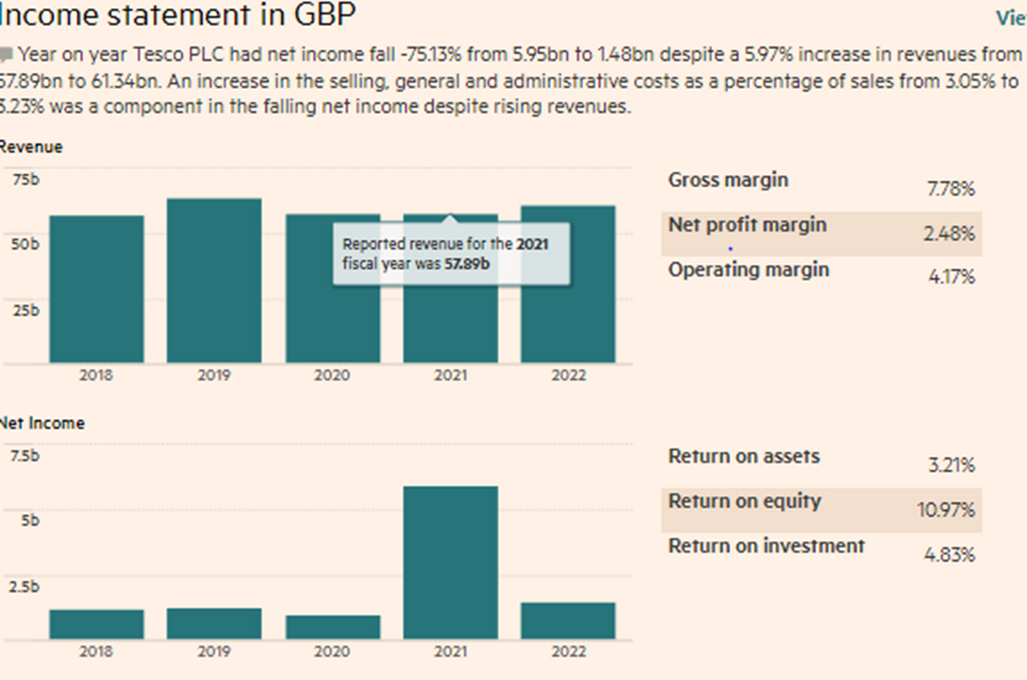
PANDEMIC SITUATION
  During pandemic the company gained revenue of around 53 billion British pounds.
  While working to keep consumers satisfied during the pandemic, the company raised around 77% from the online sales of groceries delivered to customers at home.
READ MORE
https://www.uwtsd.ac.uk/

Slide 18


There is always room for improvement...:)
Two Potential Strategies To Increase Sales

Slide 19

Strategies:
01
CONNECT WITH CONSUMERS
02
HIRE THE RIGHT PEOPLE
Customers drive the success of any business, which is why it's so important to observe how they interact with your brand, what their needs are and therefore find options to improve your service/products and align with their expectations.
Organisations must collect feedback from its consumers and gain knowledge about their needs;
Find a way to continuously show you value their opinion.
Attitude is the most important. Traditionally, companies have been hiring from the perspective of hiring talented people. However, it is important for salespeople to recognise that good people are the result of good education. Therefore, when considering hiring a team, it is important to look for skills and personality traits that will allow someone to embrace your training and coaching efforts. This can include high emotional intelligence, a “capable” attitude, or a deep love for collaboration. Allow some extra time when building the ideal candidate persona.

Slide 20
Conclusion
In conclusion, Tesco is on a continuous rise and pays close attention to consumers to ensure they sell a wide range of products that meet their needs and requirements.
Tesco also proves that it can easily adapt to new changes in the fast-paced environment during difficult times by maintaining the same high-quality products and highly competitive prices compared to other supermarkets.

Slide 21


Slide 22
REFERENCES
Beaton-Wells, C. and Paul-Taylor, J., 2018. A code of conduct for supermarket-supplier relations: has it worked?. Australian Business Law Review, 46(1). pp.6-31.
Das Nair, R. and Landani, N., 2021. New approaches to supermarket supplier development programmes in Southern Africa. Development Southern Africa .38(1). pp.4-20.
Sattlegger, L., 2021. Making food manageable–Packaging as a code of practice for work practices at the supermarket. Journal of Contemporary Ethnography. 50(3). pp.341-367.
Cai, M., Tindal, S., Tartanoglu Bennett, S. and Velu, J., 2021. ‘It’s like a war zone’: Jay’s liminal experience of normal and extreme work in a UK supermarket during the COVID-19 pandemic. Work, Employment and Society.35(2). pp.386-395.

