Slide 1
Cynllunio ac Asesu’r Dysgu
ECAD4008C

Slide 2
Beth yw asesu?
Asesu yw'r broses o gasglu, cofnodi, defnyddio ac adrodd ar wybodaeth am gyrhaeddiad a chyflawniad plentyn wrth ddatblygu gwybodaeth, sgiliau ac agwedd.
Beth yw eich profiadau o asesu (fel dysgwr)?
Notes:
Explore the meaning of assessment. Many aspects to the process from gathering to reporting.
Ask students for their experiences of assessment.

Slide 3
Asesu yw'r broses o gasglu, cofnodi, defnyddio ac adrodd ar wybodaeth am gyrhaeddiad a chyflawniad plentyn wrth ddatblygu gwybodaeth, sgiliau ac agwedd.
Sut?
Beth ydy’r gwahaniaeth?
Notes:
Key points here
How the info is gathered really distinguishes between types of assessment (formative/summative) and learners’ experiences
Ask learners to consider difference between attainment and achievement
Ensure that students understand this significant difference in vocabulary.

Slide 4
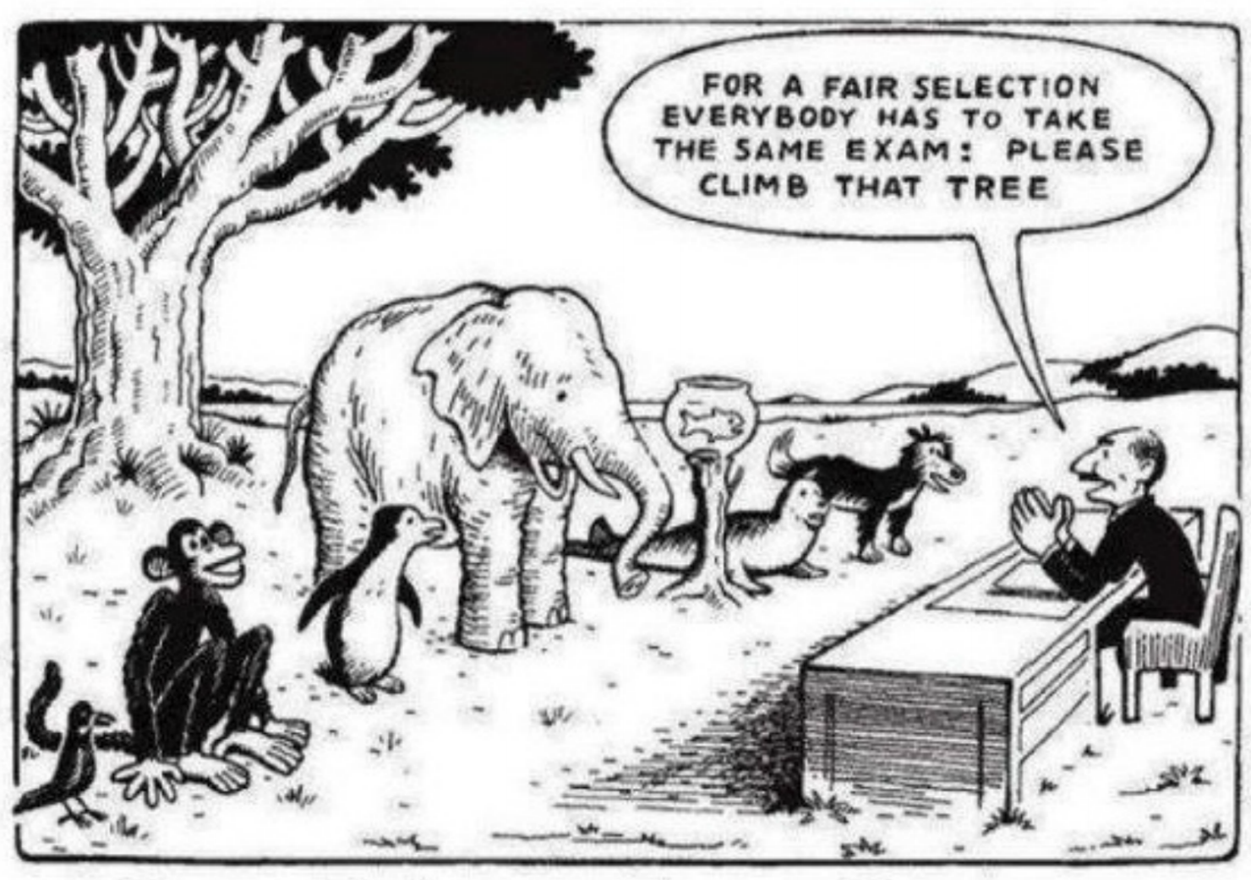
Notes:
Share famous cartoon!

Slide 5
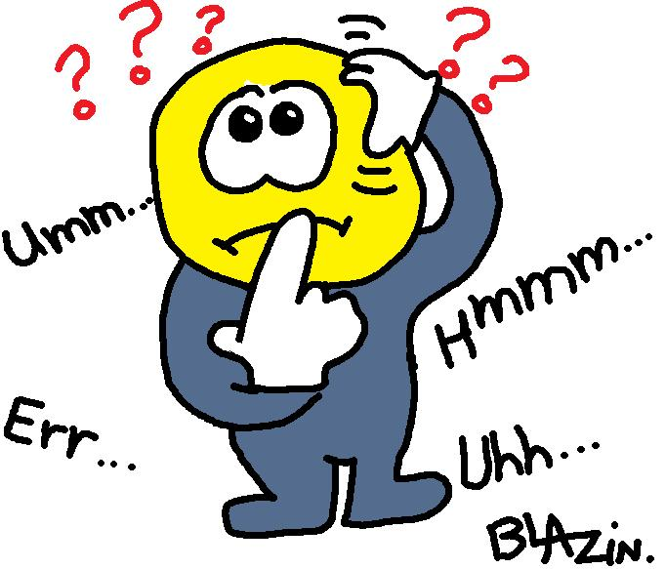
Ydy cynnal profion yn ffordd da o asesu disgyblion?

Slide 6
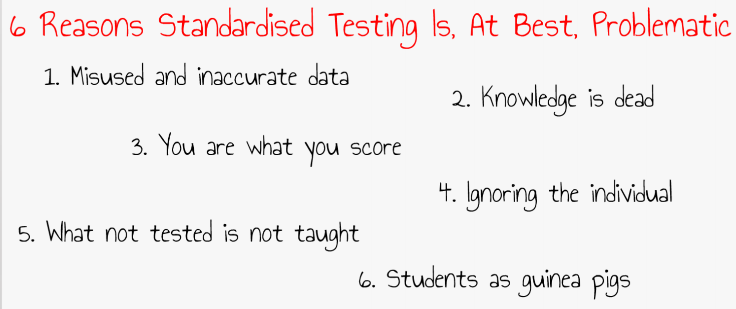
Notes:
Ask students to consider the 6 potential reasons why standardised testing could be problematic for us within education.
You could use chat, hands up, a Padlet or breakout rooms at this point.
On return, get feedback.
Then finish this slide with a 2 min discussion exploring weather ALL standardised testing is bad? In what circumstances is it helpful?

Slide 7
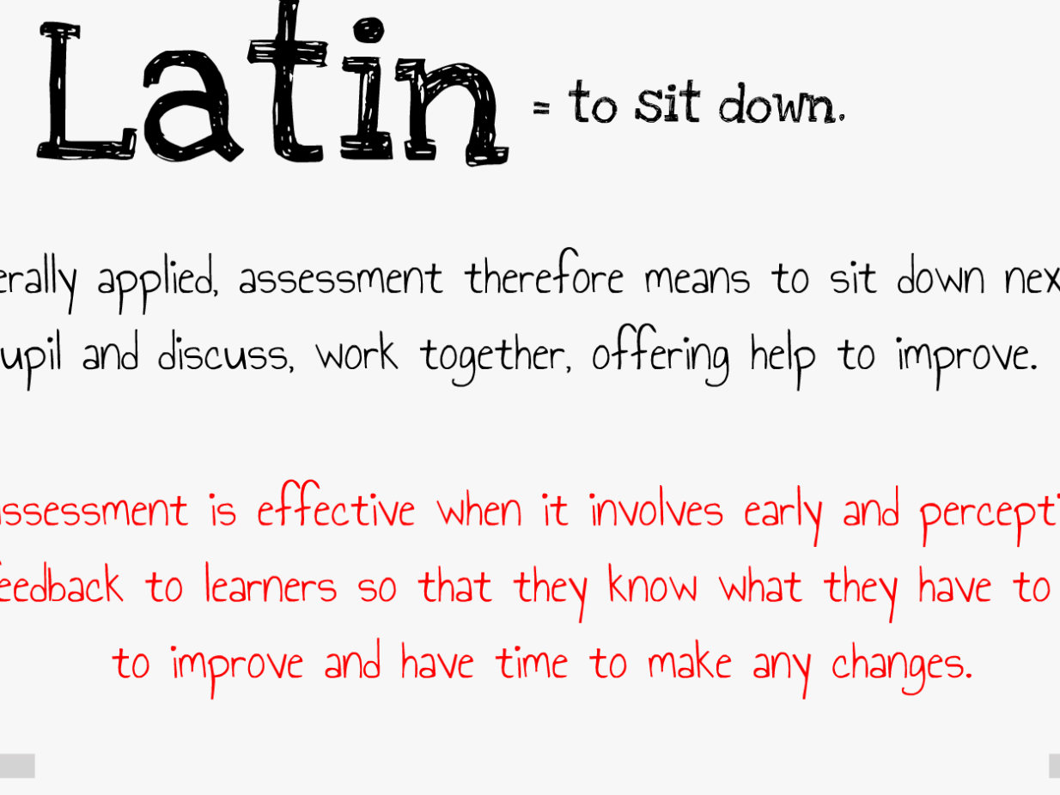
Lladin
Notes:
Read slide and highlight the fact that actually our pedagogy is currently a million miles away from the Latin root of the word ASSESSMEMT.
The red wording is VERY IMPORTANT. Discuss and take time to unpack with group.

Slide 8
Asesiad crynodol - asesiad yn cael ei ddefnyddio i wirio'r hyn a ddysgwyd
Asesiad ffurfiannol - defnyddir asesiad i lywio'r hyn y gellir ei wneud i gefnogi dysgu
Ar gyfer pwy gellir defnyddio’r gwahanol ffurfiau?
Ym mha ffyrdd y gellir eu defnyddio?
Notes:
Slide says it all…you may have covered many answers to the questions in previous discussions.

Slide 9
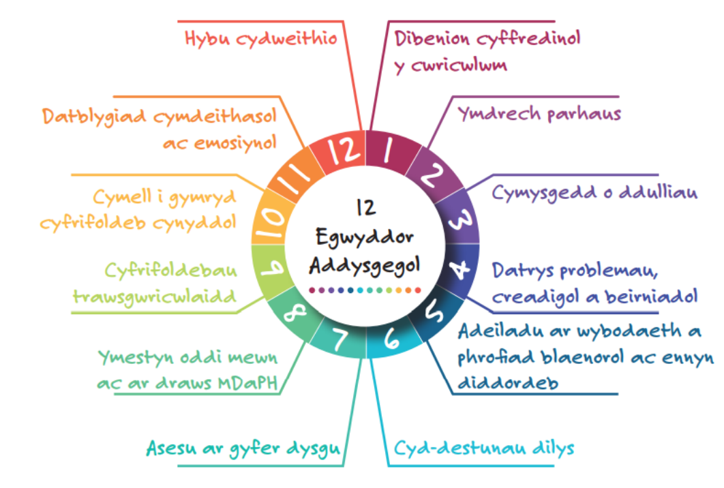
(Donaldson, 2015, tt.64-70)

Slide 10
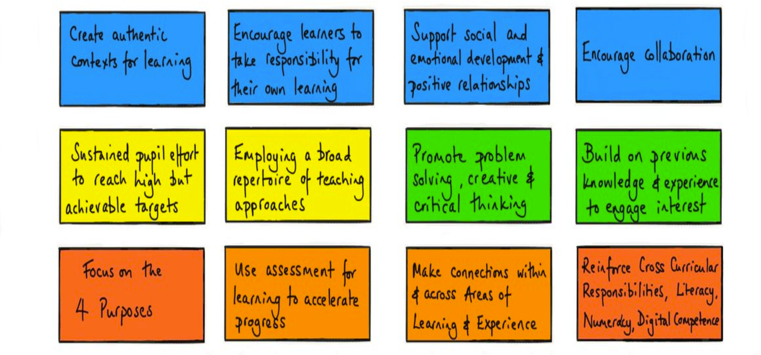
(Donaldson, 2015, tt.64-70)
Notes:
Ask the students if they know what they are looking at here?
12 pedagogical principles of the new curriculum.
Identify ”Use Assessment for Learning to accelerate learning”. Unpack and focus on the word accelerate.

Slide 11

Asesu ar gyfer Dysgu
Asesu ar gyfer Dysgu yw'r broses o geisio a dehongli tystiolaeth i'w defnyddio gan ddysgwyr a'u hathrawon, i benderfynu ble mae dysgwyr yn eu dysgu, ble mae angen iddynt fynd nesaf, a sut orau i'w cael yno.
Grwp Diwygio Asesu/ The Assessment Reform Group (2002)
Notes:
Learners, are, to go next, get them there

Slide 12
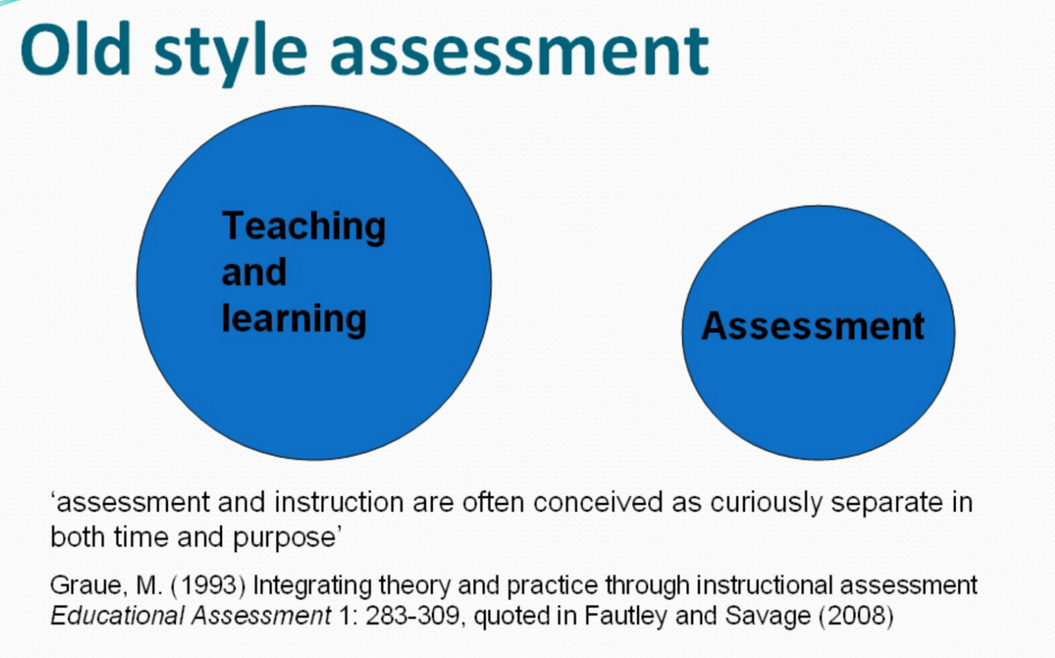
Hen ffordd o asesu
Addysgu a dysgu
Asesu
Notes:
Slide says it all. Reiterate that assessment used to be a separate process from the teaching and learning. Summative in nature. Test of topics and themes at the end etc.

Slide 13
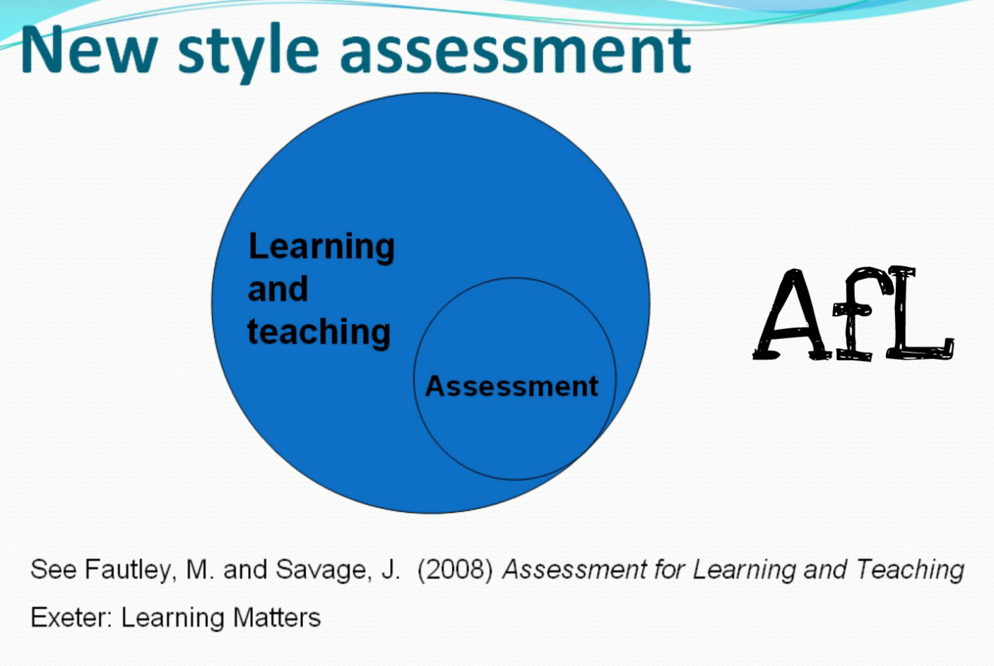
Math newydd o asesu
Dysgu
ac Addysgu
AagD
Asesu
Notes:
Highlight that AfL is during the act of production. Within the teaching and learning experience…part of the learning process not separate.

Slide 14
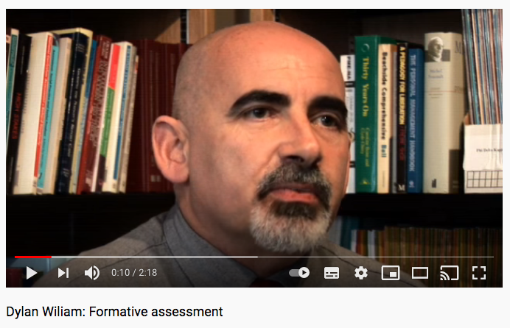
https://www.youtube.com/watch?v=sYdVe5O7KBE
Notes:
Watch and discuss.

Slide 15
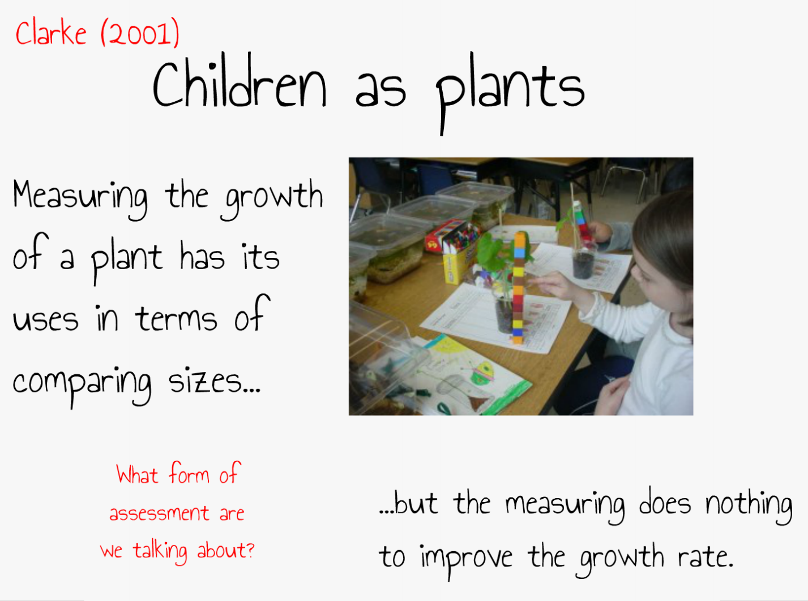
Notes:
This analogy is great for checking the students understanding ‘during the act of learning’ in this lecture!
We are talking about SUMMATIVE (AOL) here.

Slide 16
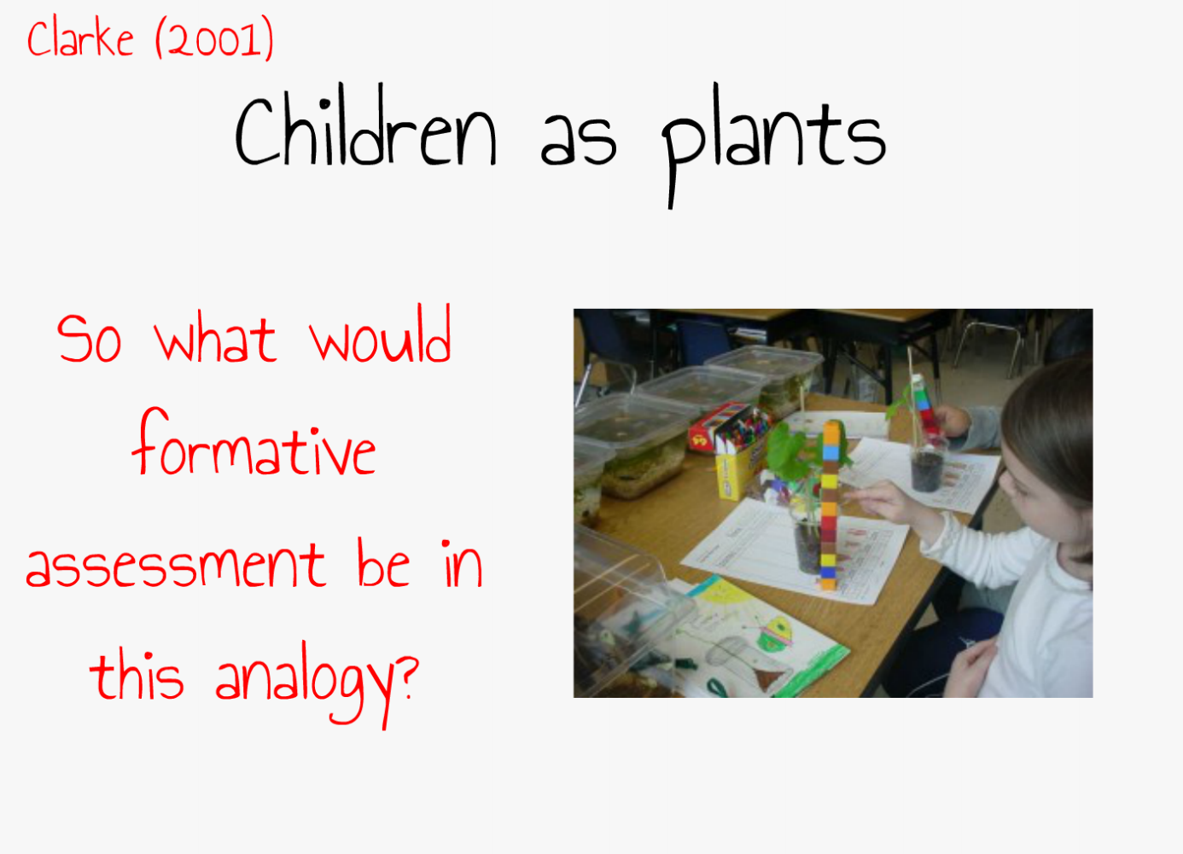
Notes:
Feeling the soil…it’s dry (Finding out where the plant is)….it needs some water! (Identifying what is required next)….watering the plant (Giving it what is needs next)
Refer back to the definition they completed earlier for the three simple steps noted.

Slide 17
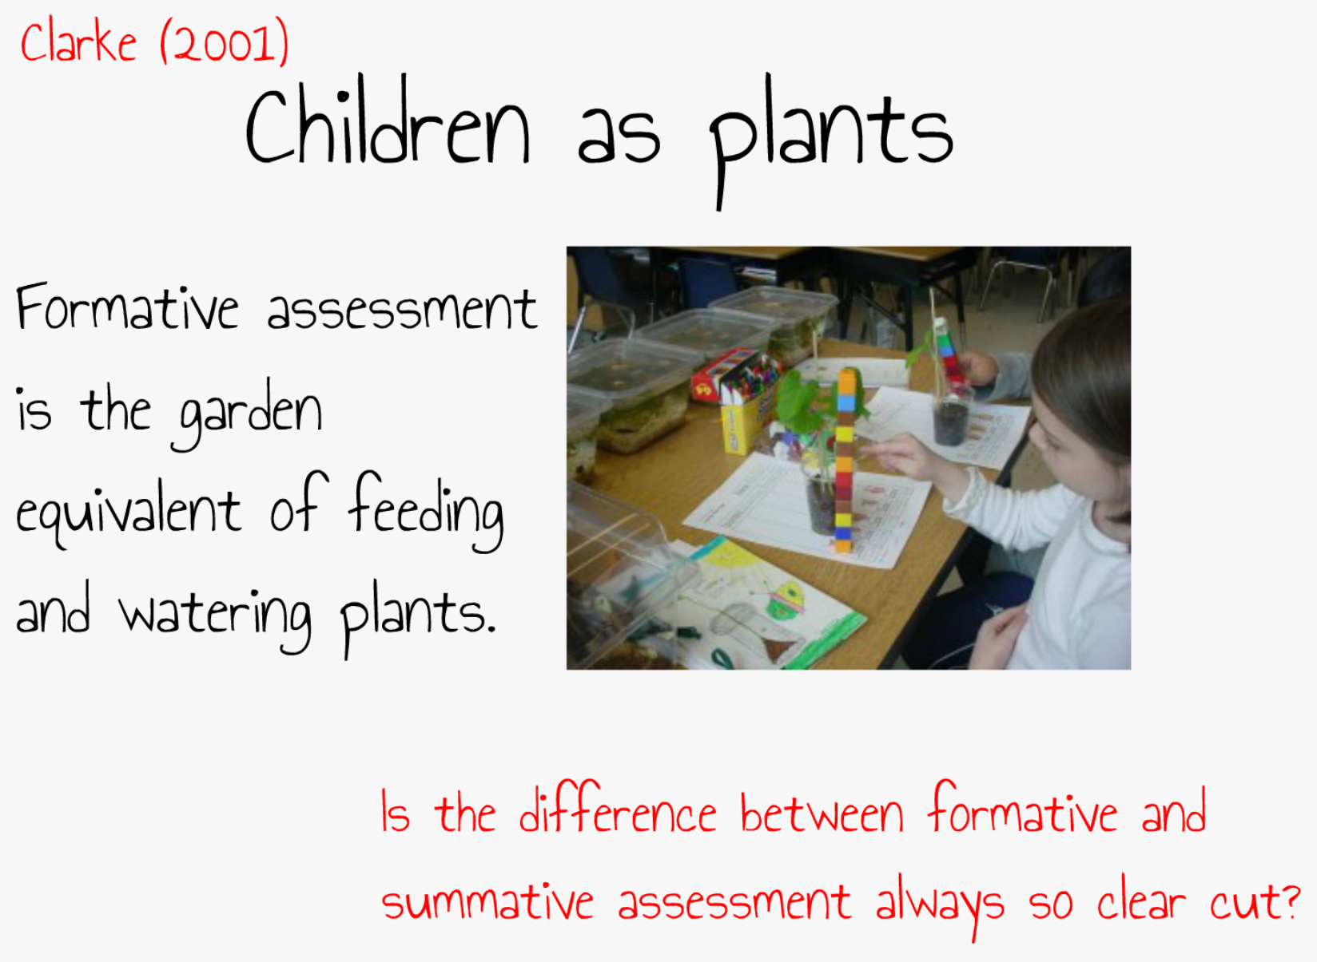
Notes:
Great question to ask in red!

Slide 18
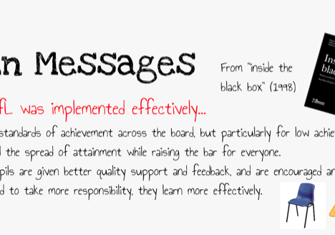
Notes:
Background info for you.
Dylan Wiliam and Paul Black were the first to publish the concept of AfL.
From Kings College London
Their influential report “Inside the black box” utilised over 250 studies from over a 9 year period. Each study utilised a control group and these were taken from across a wide discipline field.
AfL was identified as the major means of raising standards…especially for lower attaining pupils.
They identified that too much teaching time was teacher led instruction and this was to the detriment of student reflection.
They found that teachers often didn’t provide constructive feedback to make improvements.

Slide 19
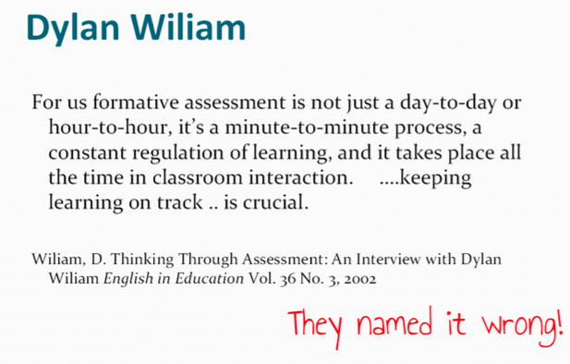
Notes:
Dylan wiliam has famously said that he wished he hadn’t named is AfL but instead “Good teaching!”

Slide 20
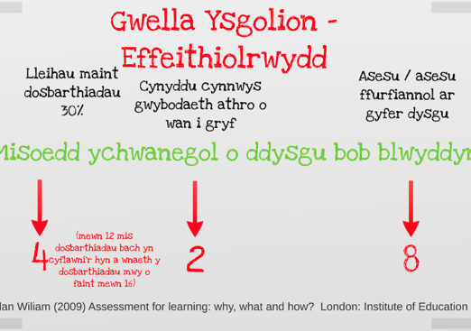
Notes:
Highlight the fact that effectively utilising a wide range of AfL strategies gives us the added value of 8 months additional learning per year!

Slide 22
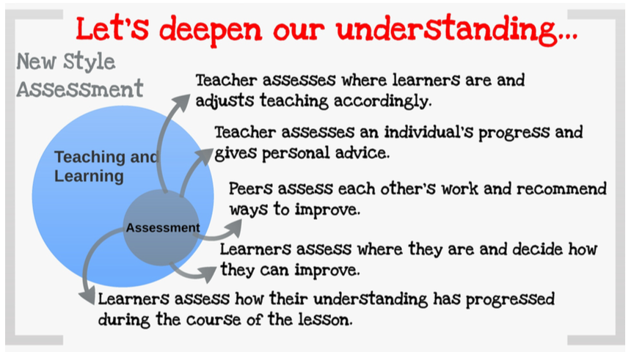
Notes:
Explore further what new style assessment actually looks like in the classroom. Discuss each in tern and highlight the different roles that each stakeholder has within the learning experience. From teacher AfL to pupil and peer AfL.

Slide 23
Y Pedwar prif elfen sydd angen ystyried wrth Asesu ar gyfer Dysgu (AaGD)
Rhannu Meini Prawf Llwyddiant | Cwestiynu effeithiol | Adborth effeithiol | Hunan asesu ac Asesu Cyfoed
Bydd dysgwyr yn gwybod beth sy'n gwneud eu gwaith yn dda | Mae pob dysgwr yn mynd ati i feddwl am atebion i gwestiynau da, agored | Mae adborth parhaus yn cadw'r dysgu ar y trywydd iawn | Mae dysgwyr yn elwa o arfarnu gwaith ei gilydd.
Bydd y dysgwyr yn gwybod ble maen nhw a'r cam nesaf, yn unol â'r meini prawf | Mae dysgwyr yn esbonio syniadau i'w gilydd, gan atgyfnerthu eu dysgu a'u dealltwriaeth | Mae dysgwyr yn gweithredu ar yr adborth yn y fan a'r lle. Mae dysgwyr yn cymryd y cam nesaf | Mae dysgwyr yn dod yn fwy annibynnol yn raddol trwy ddysgu sut i hunanasesu.
Notes:
Introduce the idea that there are FOUR elements to AfL. We can almost think of these as buckets to put our different AfL strategies into. We are looking for a balanced approach and all should be present within our teaching regularly to ensure we reap the benefits of effective AfL implementation.
Ask the students for examples of AfL strategies and where they might fit from their experiences to date. This could be a breakout 5-10 min activity.

