Slide 1
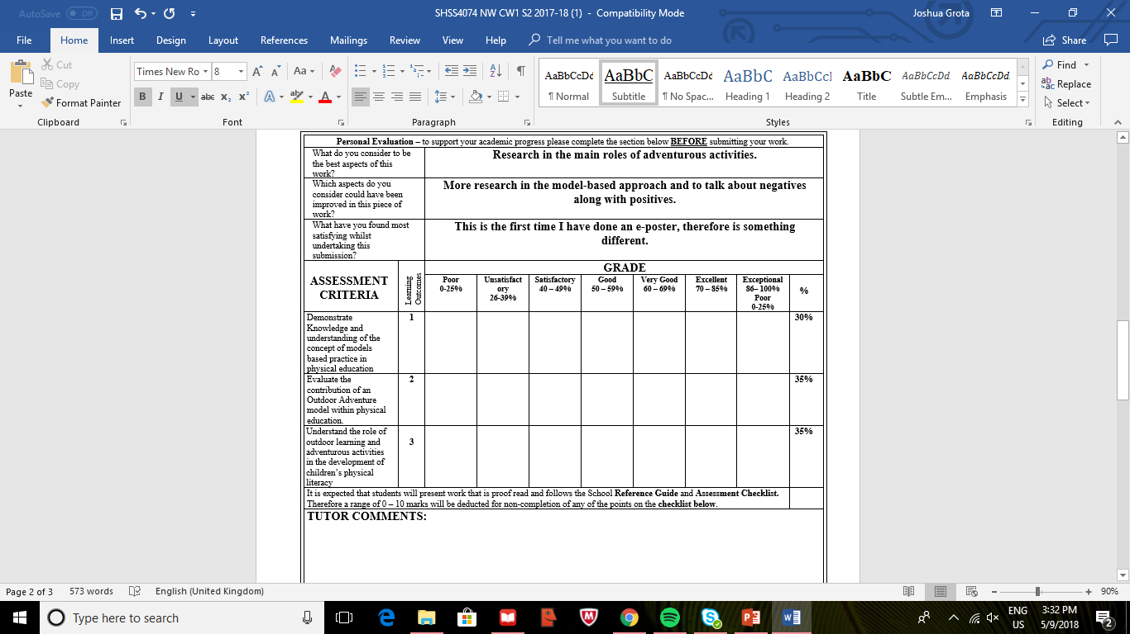
School of Sport, Health & Outdoor Education
Assessment Feedback Sheet
Student No./Name: 1601135/Joshua Grota
Module: Adventure & Challenge In The Curriculum
Module Code: SHSS4074

Slide 2
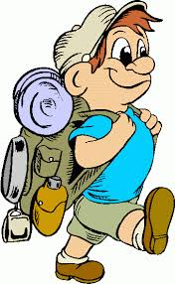
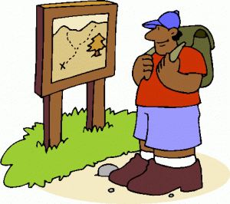


Role of Adventure &
Outdoor for Pupils
“We can be in no doubt that the existence and persistence of this ‘school subject’ has been a problem for the philosophy of education or, at least, for the analytical philosophy popular in the UK from the middle of the twentieth century.” (Kirk, 2013)
Adventurous activities contain the
skills of problem solving,
communication, leadership and teamwork and often have an outdoor living and
learning focus.
Skills that are acquired or can be developed:
Problem–solving
Safety and how to respect the environment
Reading a compass, map or instructions
Tying a rope or constructing a shelter
Complimentary pedagogical models for physical education
Direct Instruction
Personalised System for Instruction
Cooperative Learning
Sport Education
Peer Teaching
Inquiry Teaching
Tactical Games
Teaching Personal and Social Responsibility
“children need physical literacy and unstructured outdoor activity” (Active for Life)
Cooperative Learning - ‘students learning with, by and for each other’ (Metzler 2011, 237)

Slide 3
Reference List
Andy Williams & Nalda Wainwright (2016) A new pedagogical model for adventure in the curriculum: part one – advocating for the model, Physical Education and Sport Pedagogy, 21:5, 481-500,
Andy Williams & Nalda Wainwright (2016) A new pedagogical model for adventure in the curriculum: part two – outlining the model, Physical Education and Sport Pedagogy, 21:6, 589-602,
Casey, A. 2012. “Models-based Practice: Great White Hope or White Elephant?” Physical Education and Sport Pedagogy 17 (4): 1– 17.
David Kirk (2013) Educational Value and Models-Based Practice in Physical Education, Educational Philosophy and Theory, 45:9, 973-986.
Department for Children, Education, Lifelong Learning and Skill (2008) Physical Education in The National Curriculum for Wales. Welsh Assembly Government.
Kirk, D. 2010. Physical Education Futures. Oxon: Routledge.
Metzler, M. W. 2011. Instructional Models for Physical Education. 3rd ed. Scottsdale: Holcomb Hathaway

