Slide 2
ECEY4001/C
Human Development
Lecture 7 – Effective Communication

Slide 3

Task

Slide 4

Why?

Slide 5
Why?
Why?
Share
Direct
Learn
Socialise
Help others
Enquire

Slide 6
Key factors of effective communication?
Using Mentimeter, what do you think are key factors in effective communication?

Slide 7
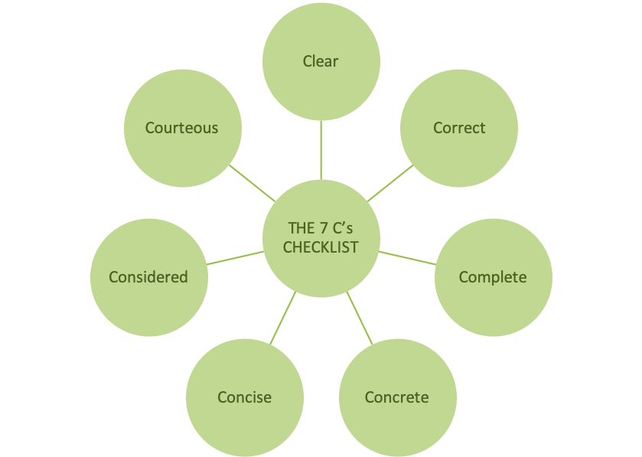
Checklist
(Sourced: WorldofWork, 2021)

Slide 8
Types of Communication

Slide 9
Types of Communication
Verbal
Non-verbal
Written
Listening
Visual
Formal/Informal

Slide 10
Communicating with who?

Slide 11
Communicating with who?
Children
Parents and families
Staff
Communities
Wider School/ Setting
Other professionals?
Multiagencies

Slide 12
Children
Early and on a regular basis
Start conversations
Provide time
Attention
Commentate
Be positive

Slide 13
Children
Schedule time to talk
Be honest
No interruptions
Use it everywhere
Praise
Slowly and clearly
Role model

Slide 14
Strategies
Circle time
Questionnaires
Mind maps
Visual timetables
Story time
Song time

Slide 15
Parents and families
Open
Honest
Inclusive
Available and accessible
Responsive
Break down boundaries or misconceptions

Slide 16
Strategies
Diaries
Noticeboards
Newsletters
Digital updates (WhatsApp, Facebook, etc)
Learning Journals (Seesaw)
Parent forums/committees
Drop off and collection
Parent consultations
Events, stay and plays etc

Slide 17
Staff
Open and honest
Regular
Formal and informal
Recorded
Inclusive
Listening
Empowered
Engaging
Informed

Slide 18
Strategies
Staff meetings
Appraisals and supervisions
Noticeboard
Surveys
Social events
Social Media

Slide 19
Community, wider school/ setting, other professionals, multiagency
Open and welcoming
Sharing
Professional
Inclusive
Positive
Connections

Slide 20
Strategies
Stakeholder meetings
Newsletters
Social events
Social Media

Slide 21

Game

Slide 22
Barriers
EAL
Hearing impairment
Visual impairment
Additional Learning Needs (ALN)

Slide 23
Task
You will look at different Scenarios in the next slide and discuss how you will respond, who to communicate and how.
Notes:
Scenarios

Slide 24
Task
A child has been bitten on the face
A child has fallen off a bike and injured her arm
A child has successfully navigated the transition from the outside to inside without getting upset for the first time since starting
A child has headlice

Slide 25
Transitions
Build relationships
Trust
Kindness
Respect
Parents know their children best
Two way
Meet needs

Slide 26
Strategies
Settling in sessions
Stay and play
All about me
Home visits
Digital tours
Transition books
Transitional object
Show and tell

Slide 27
Reflect
In pairs or small groups, think about and discuss your own communication skills
Consider how your setting ensures effective communication among stakeholders

Slide 28
Models of communication
3 types
Linear – one way, feedback is not included, often used to communicate to large numbers of people
Transactional –two way, feedback is included, the feedback continues the communication
Interactional models – newer modes of communication, such as social media and AI

Slide 29
Models of communication
Linear
Aristotle’s Model
Lasswell’s Model
Shannon-Weaver Model
Berlo’s S-M-C-R Model
Transactional
Barnlund’s Transactional Model
Dance’s Helical Model
Interactional
Osgood-Schramm Model
Westley and Maclean Model

Slide 30
Remember
Open
Two way
Adaptive/ Flexible
Ongoing
Available
Builds relationships and trust

Slide 31
Further Reading
Kapur, R. (2020) The Models of Communication. Available at https://www.researchgate.net/publication/344295651_The_Models_of_Communication (Accessed: 22nd September 2022).

Slide 32
References
Cobley, P. and Schulz, P. (2013) Theories and models of communication. Berlin: Walter De Gruyter.
World of Work (2021) The seven 7’s of communication. Available at: https://worldofwork.io/2019/07/the-7-cs-of-communication/ (Accessed: 22nd September 2022)

