Slide 1
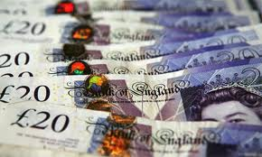
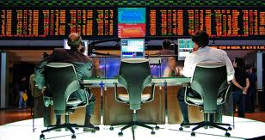

Marx, Money and Markets

Slide 2
Key Themes
Money and markets
  Fetishisation, and the ways they obscure social relations
Money
  What does money do?
  How do different societies treat money?
Is money transformative, or incorporated?
  Disembedded and Embedded economic activities
Moralities of money
Formalist – Substantivist Debate

Slide 3
Money
What is Money?
  Durable
  Portable
  Common medium of exchange
  Standardised
  Abstraction – reflects value, labour, raw materials
  Measurement
  Alienable
  Symbolic – no intrinsic value

Slide 4
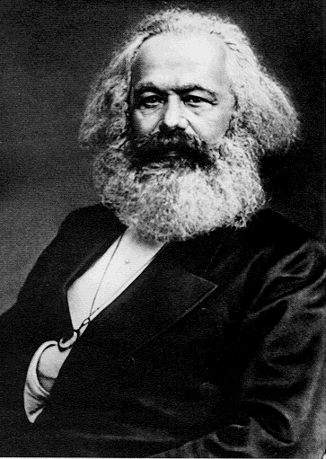
Defining Commodities: Marx
A commodity is a product of ‘congealed’ human labour time which has monetary value or exchange value
This is based on market transactions.
Commodities are also things that have use value in that they are desirable and/or because they have a particular function.
Money and commodities come to be valued in terms of their exchange value rather than their use value

Slide 5
Fetishisation
Marx sees commodities as becoming fetishised within a capitalist system
  commodities themselves come to oppress the people who create them
Commodities and money come to be treated as organic, living things and are imbued with magical power and agency
This mystifies the way the accumulation of capital is dependent on exploitative social relations
The belief that money has its own natural power to reproduce itself.

Slide 6
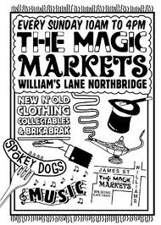

Slide 7
Intrinsic Value
Allows us to believe that a £50 note is intrinsically worth £50,
  rather than seeing this value as the product of the human labour invested into the production of the commodity.
What becomes important in a capitalist economy is that the seller can trade a £50 note for £50 worth of goods from the buyer,
  the exchange can occur in an abstract manner
Under capitalism, social relations and co-existence between people become largely transactions in terms of money and commodities

Slide 8
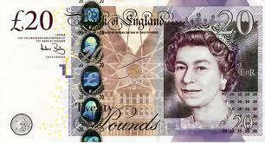
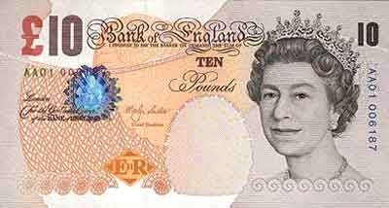
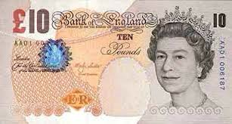

Slide 9
Fetisihization: We don’t see all the labour relations that produce a product
i.e. we don’t see all the people in commodity chains and networks (or the working conditions and according to Marx, their exploitation).
All we see is a price and a product.
The relations of production are hiddeb and obscured by the market.

Slide 10

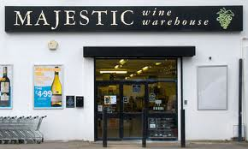

Slide 11




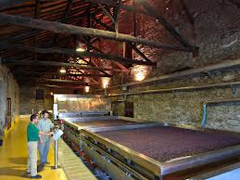

Slide 12


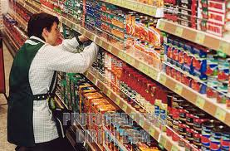


Slide 13
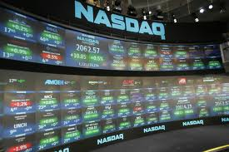
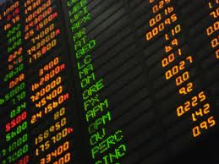
The Market Obscures……

Slide 14
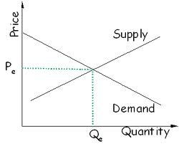
Abstract Models not People

Slide 15
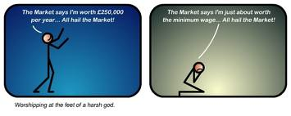
‘The Market’ is bestowed with agency

Slide 16
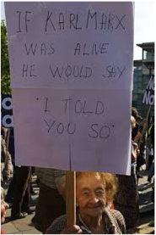
Marxism, Capitalism & Money
Concerned with historical change and material conditions
The acquisition of capital as a means to an end
With wage labour, producers become alienated from the goods they produce
Price = congealed labour

Slide 17
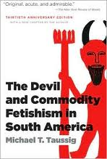


Slide 18
Marxist Theory Applied: Taussig
Impact of capitalism among Colombian peasantry
Wage labour is seen as unnatural and is associated with the devil
The Baptism of Money and the belief that the bill will return
Commodity Fetishism : imbuing inanimate objects with agency
Hides the relations of production

Slide 19
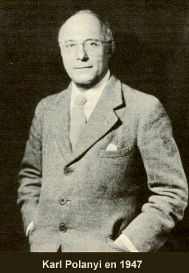
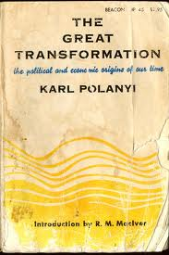
Polanyi ‘The Great Transformation’

Slide 20
Formalist-Substantivist Debate
Formalist
Economic / Market Transactions disembedded from social relations
Applied to Western, industrial, capitalist societies
‘Formal’ economic theory
Rational, calculating maximisation of resources
Substantivist
Economic activity embedded in social relations
  And non-market institutions
  E.g. kinship and religion
Livelihoods, managing resources
Couldn’t apply Western economic models to ‘the Rest’

Slide 21
Money’s Transformative Power?
Making money is against nature and socially self-destructive (Aristotle)
Money as ‘Great Transformation’ (Polanyi)
Simmel is slightly more ambiguous
  Creates an expanded circle of trust
  Source of moral danger
  Promotes individualism
  Undermines community

Slide 22
Bohannan & Bohannan;
Tiv Economy (1968)
The Tiv (Nigeria)
‘Spheres of Exchange’
1st Sphere: Subsistence
  Yams, grains, vegetables, household items, utensils
2nd Sphere: Wealth
  Brass Rods, Cattle, White Cloth & Slaves
3rd Sphere: Marriageable Female Kin

Slide 23
Distinct Spheres of Exchange
The spheres are kept distinct
No equivalence between the spheres; non-exchangeable
“Each sphere is a different universe of objects” (1968:227)
Defines & maintains relations, but also facilitates the accumulation of wealth by a small group
However, money breaks these boundaries; objects between the spheres become interchangeable

Slide 24
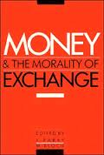
Moral Money?
Money is embedded and incorporated into local systems of meaning
Potentially not as transformative and destructive
Challenges the notion that money alienates
Have anthropologists fetishised money?

Slide 25

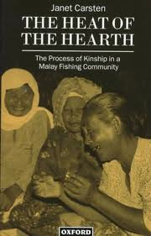
J. Carsten ‘Cooking Money’
Malay Fisherman and their wives
Money is transformed by women at home
Depolluted and de-individualised:
  embedded with kinship and incorporated into social relations
  Invested with morality
Production into reproduction
Gender roles; men produce money, women handle it

Slide 26
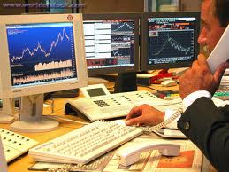
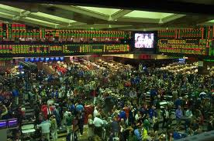
Zaloom, Ambiguous Numbers
Chicago Stock Exchange
Shift from open-outcry pit to trading screen
The technology influences knowledge and traders’ practices
Personal transactions and kinship relations
Decisions are not abstracted, calculating and rational
  The role of emotion, sociality and physicality

Slide 27

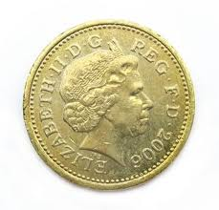
Hart, Heads and Tails

Slide 28
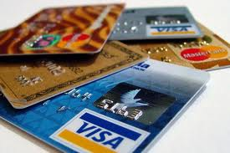
New Forms of Money

Slide 29


Slide 30
New Forms of Money
What type of relations do these new forms create?
With who?
Is the role of the state being diminished?
Which nation-state is present when we consider the Euro or dollar, for example?
Is money becoming, or seeming to become, even more abstract and disembedded from social relations.
  How are new forms of money embedded?

Slide 31
To think about….
The argument to counter the notion that money transforms social relations
  Consider the ethnography
    Bohannan and Bohannan Carsten, Hart
    Sociality, embedded economic transactions
  Consider theories of money and the way money and markets have been conceptualised
    Marx, Polanyi

