Slide 1






BUSINESS PROPOSAL PRESENTATION
FreshFuel: Healthy and Sustainable Takeaway Business Plan
Presented by:
Zaffar Hussain
Student ID number: 2436275
Module : Enterprise and Entrepreneurship
Module code: LCLM4006
Lecture: Dr Chung Lai Johnny Wan
Notes:
Good morning/afternoon everyone. My name is _________, and today I will present my business idea called FreshFuel, which is a healthy and sustainable takeaway food business. This presentation is part of the Enterprise and Entrepreneurship module, LCLM4006. The aim of this business is to provide healthy, affordable, and convenient meals for students and young professionals who want better alternatives to traditional fast food. In this presentation, I will explain the business idea, the products offered, the target market, key external factors affecting the business, the marketing strategies we will use to attract customers, and finally the funding required to start the business.

Slide 2

Business Idea Overview
  FreshFuel is a healthy takeaway business designed to provide nutritious and convenient meals for busy urban consumers who want healthier alternatives to traditional fast food.
  The business focuses on offering freshly prepared meals made from high-quality ingredients, ensuring both taste and nutritional value for customers seeking balanced diets.
  The takeaway operates from a commercial kitchen located in Stratford, East London, an area with a high concentration of university students and office workers.
  FreshFuel operates primarily as a takeaway and delivery service, allowing customers to collect meals or order through online food delivery platforms such as Deliveroo and Uber Eats.
  The business aims to combine affordability, convenience, and sustainability to create a competitive advantage within the growing health-focused food market
Notes:
FreshFuel is a healthy takeaway business that focuses on providing fresh and nutritious meals. Today, many people have busy lifestyles and do not always have time to cook healthy food at home. Because of this, they often rely on fast food, which is usually unhealthy. FreshFuel aims to solve this problem by offering quick, affordable, and healthy meals that customers can easily buy and take away. The business will operate from a commercial kitchen in Stratford, East London, which is a busy area with many students and office workers. Customers will be able to either pick up their meals directly or order online through food delivery platforms such as Uber Eats and Deliveroo. The main goal of FreshFuel is to make healthy eating easy, convenient, and accessible for everyone.

Slide 3
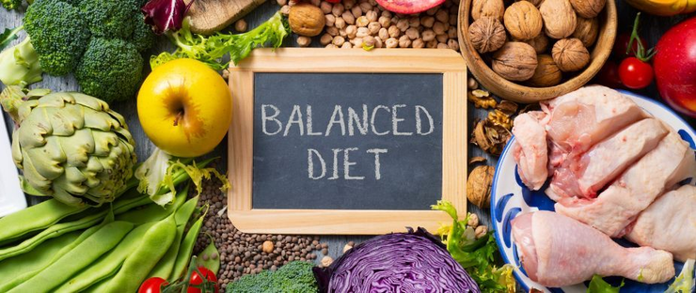
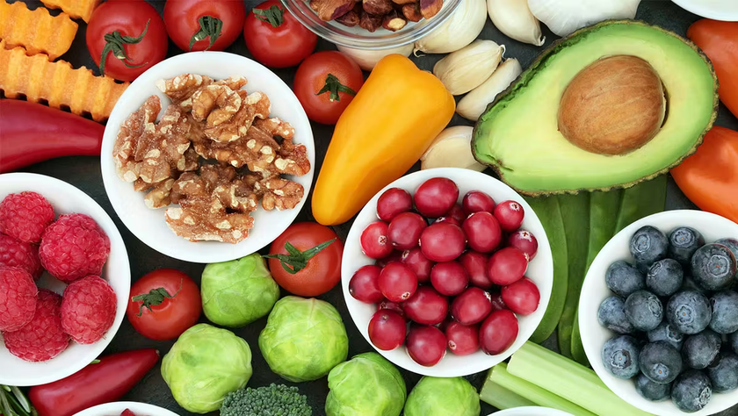
Products and Services
  FreshFuel offers a menu focused on nutritious meals designed for customers who want healthy food options that are quick and convenient.
  The core menu includes fresh salads prepared with seasonal vegetables, providing balanced meals that are rich in vitamins and nutrients.
  • Grain bowls are also offered, combining whole grains, proteins, and vegetables to create filling and healthy meal options for customers seeking energy and nutrition.
  Low-calorie hot meals will be prepared daily to provide warm meal options while maintaining healthy nutritional standards.
  Fresh smoothies made with fruits and natural ingredients will complement the meal options and provide refreshing and nutritious beverages.
  Meals will be priced between £6 and £9 to ensure affordability, particularly for students and young professionals.
Notes:
FreshFuel will offer a range of healthy and delicious food options. The menu will include fresh salads, which are made with vegetables, grains, and protein sources such as chicken or eggs. Another option will be grain bowls, which are nutritious meals that combine healthy grains, vegetables, and proteins to provide energy and balanced nutrition. FreshFuel will also offer healthy wraps, which are convenient meals that customers can easily eat on the go. In addition, there will be low-calorie hot meals that are prepared daily to provide warm and satisfying food options. The menu will also include fresh smoothies, made with fruits and natural ingredients. The price of meals will range from £6 to £9, which makes the food affordable for students and young professionals.

Slide 4
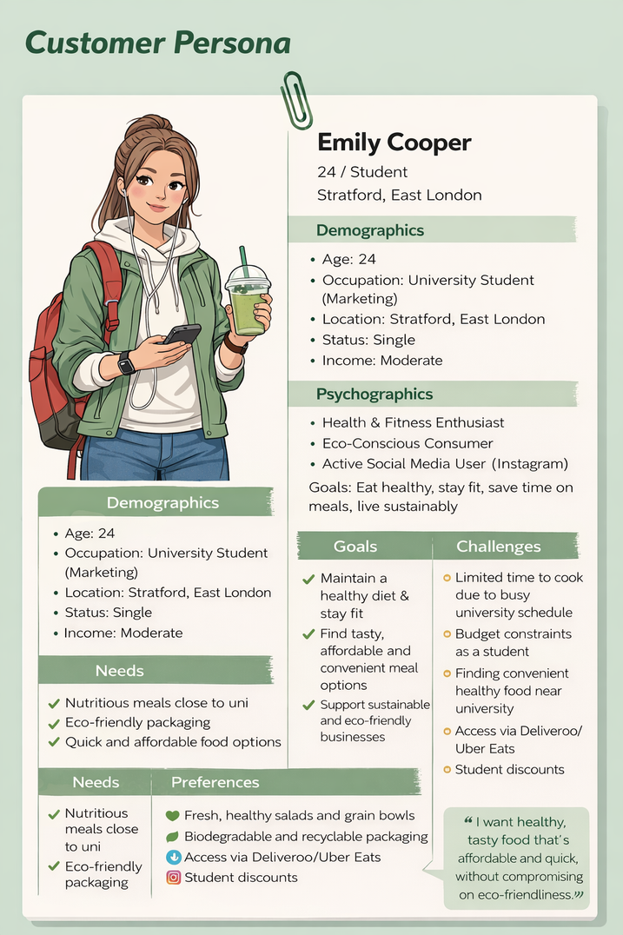
Target Market
  Young professionals working in offices around Stratford also represent an important customer segment because they frequently require convenient takeaway meals during working hours.
  The target age group for the business is between 18 and 30 years old, as research indicates that this demographic shows strong interest in healthier eating habits.
  Health-conscious individuals who actively seek nutritious food options will also form part of the target customer base.
  Stratford is considered a strategic location because the area includes universities, residential buildings, offices, and retail centres that create strong potential demand.
Fig: Customer persona: Emily Cooper
Notes:
The main target customers for FreshFuel are students and young professionals. Many students have busy academic schedules and limited budgets, so they often look for affordable and convenient meals. Young professionals who work in offices nearby also need quick and healthy meal options during lunch breaks or after work. The main age group targeted by FreshFuel is between 18 and 30 years old, because research shows that younger consumers are increasingly interested in healthy lifestyles. Stratford is a good location for the business because it has many universities, offices, and residential areas, which means there is a large number of potential customers. By focusing on this target market, FreshFuel can meet the needs of people who want healthy food but also need convenience and affordability.

Slide 5
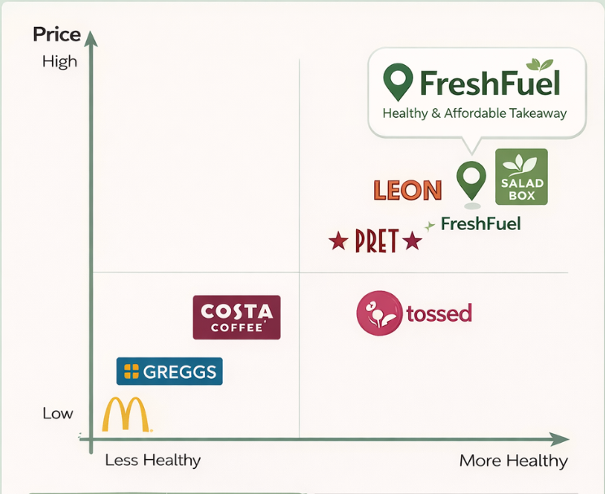
Unique Selling Proposition
  FreshFuel differentiates itself from traditional fast-food outlets by focusing on nutritious meals that support healthier lifestyles.
  The business offers freshly prepared meals each day, ensuring food quality and freshness for customers.
  Affordable pricing allows customers, particularly students, to access healthy meals without paying premium prices.
  Sustainable packaging is used for all meals and beverages, reducing environmental impact and supporting environmentally responsible consumption (Kumar et al., 2025).
  FreshFuel’s menu design balances taste, nutrition, and convenience, allowing customers to enjoy healthy food while maintaining busy lifestyles.
Fig: Competitor positioning map for healthy food
Notes:
FreshFuel has several features that make it different from traditional fast-food businesses. First, the business focuses on healthy and nutritious meals, which helps customers maintain a balanced diet. Second, FreshFuel uses fresh ingredients that are prepared daily, which ensures better quality and taste. Another important feature is the use of eco-friendly packaging. Many customers today are concerned about environmental issues, so using sustainable packaging helps reduce waste and support sustainability. FreshFuel also offers affordable pricing, which makes healthy food more accessible for students. By combining health, sustainability, convenience, and affordability, FreshFuel creates a strong competitive advantage.

Slide 6

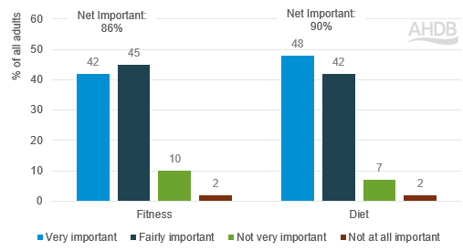
PESTEL Factor: Social
  Social trends increasingly support healthier eating habits as consumers become more aware of the importance of balanced diets.
  Many people are now actively seeking healthier alternatives to traditional fast food due to concerns about obesity and lifestyle diseases (Adamson, 2025).
  Younger consumers in particular are interested in food that supports both physical health and overall wellbeing.
  Urban lifestyles often involve limited time for cooking, increasing demand for convenient takeaway options that remain healthy.
  FreshFuel responds to these social trends by offering nutritious meals that meet the expectations of health-conscious consumers.
Fig: Consumer attitudes on diet and fitness; Source: (Adamson, 2025)
Notes:
One important external factor that supports this business is social change. Today, many people are becoming more aware of the importance of healthy eating and maintaining a balanced lifestyle. Health problems such as obesity and lifestyle diseases have encouraged people to choose healthier food options. At the same time, many people live busy lives and do not have time to cook healthy meals. Because of this, there is increasing demand for quick, healthy takeaway food. FreshFuel responds directly to this social trend by providing nutritious meals that are easy and convenient to buy.

Slide 7
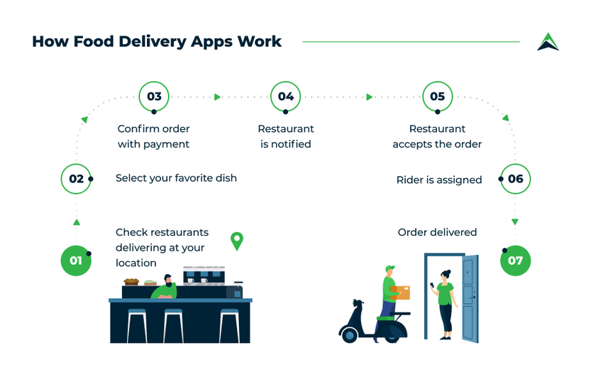
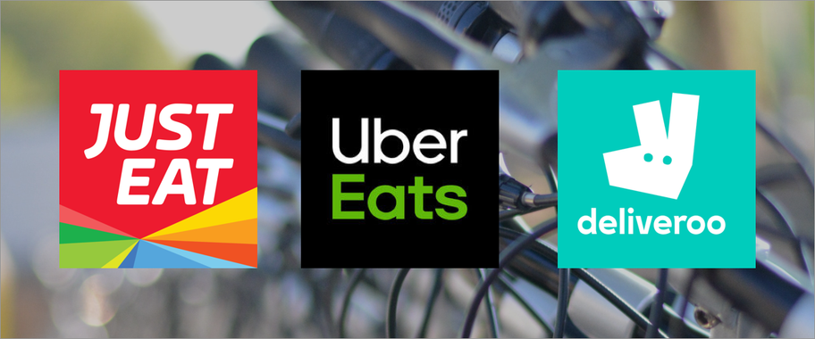
PESTEL Factor: Technological
  Technology plays an important role in helping small businesses reach customers and promote their products effectively.
  FreshFuel will utilise social media platforms such as Instagram to promote its meals and communicate with potential customers.
  Online delivery platforms such as Deliveroo and Uber Eats will allow the business to reach a wider customer base beyond walk-in customers (Lord et al., 2022).
  Digital marketing enables the business to target specific customer groups, particularly younger consumers who frequently use social media platforms
Notes:
Technology also plays an important role in supporting this business. Many customers today prefer ordering food online instead of visiting restaurants. FreshFuel will use online delivery platforms such as Uber Eats and Deliveroo, which allow customers to easily order meals from their smartphones. Social media platforms such as Instagram will also be used to promote the business. Through Instagram, FreshFuel can share photos of meals, promotions, and customer feedback. Using technology helps the business reach more customers and makes it easier for people to discover and order FreshFuel meals.

Slide 8
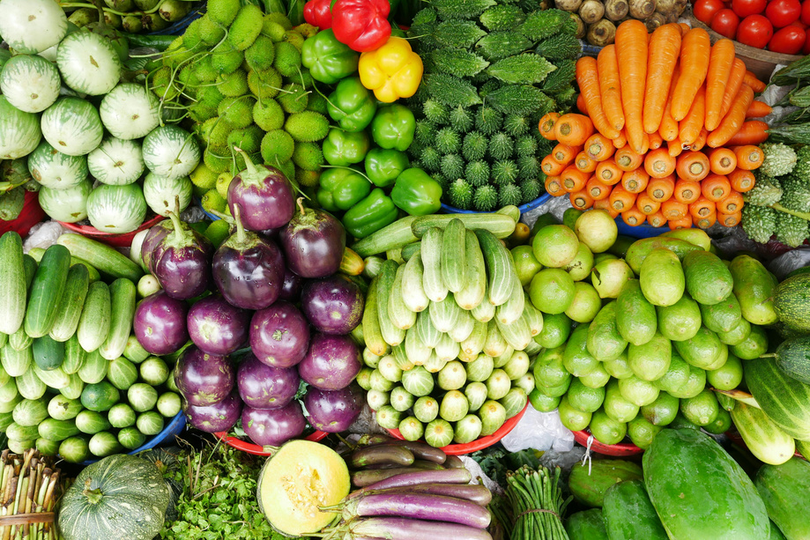
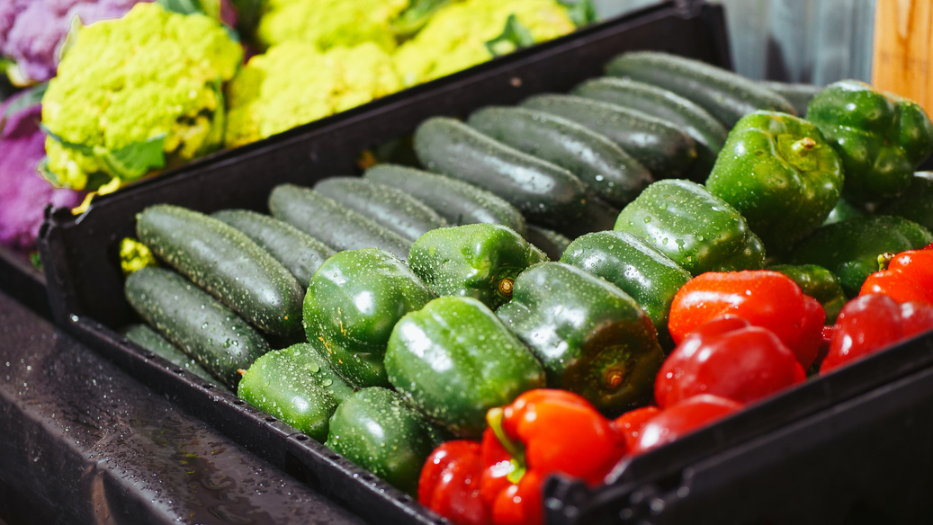
PESTEL Factor: Environmental
  Environmental sustainability is becoming an increasingly important consideration for consumers when choosing food businesses.
  Many customers prefer companies that adopt environmentally responsible practices such as reducing plastic waste.
  FreshFuel addresses this issue by using biodegradable and recyclable packaging materials for all takeaway meals.
  Sustainable packaging helps reduce environmental impact while also strengthening the brand’s ethical image.
  By integrating sustainability into its operations, FreshFuel aligns with growing consumer demand for environmentally friendly businesses.
Notes:
Another important factor is environmental awareness. Many consumers today prefer businesses that follow sustainable and environmentally friendly practices. Plastic waste and environmental pollution are major concerns worldwide. FreshFuel will address this issue by using biodegradable and recyclable packaging materials. This helps reduce environmental impact and also improves the brand image of the business. Customers who care about sustainability will be more likely to support businesses that take environmental responsibility seriously.

Slide 9
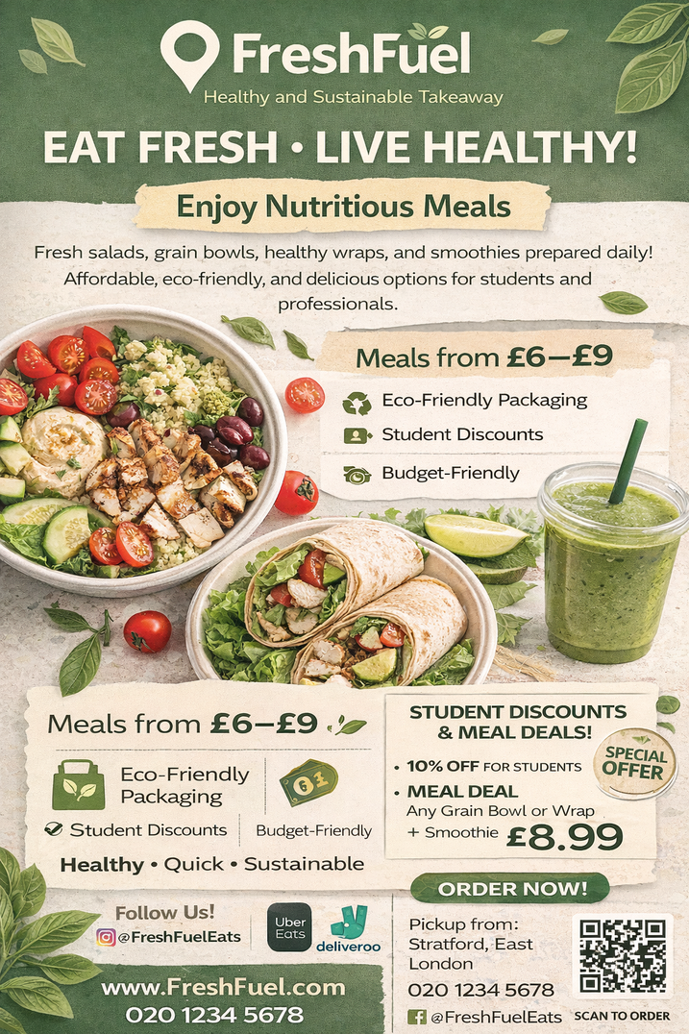
Marketing Strategies
Marketing Strategy 1 – Social Media Marketing (Instagram)
  Use Instagram to promote FreshFuel meals through attractive food photos and short videos.
  Run targeted Instagram ads to reach students and young professionals in Stratford.
  Share daily menu updates, promotions, and customer reviews to increase engagement.
  Encourage user-generated content and feedback to build brand awareness.
Marketing Strategy 2 – Local Marketing & Student Promotions
  Distribute flyers and posters in universities, gyms, and coworking spaces.
  Offer student discounts and meal deals to attract first-time customers.
  Partner with local gyms and university societies to promote healthy eating.
  Provide meal bundle offers and referral promotions to encourage repeat purchases.
Notes:
FreshFuel will use two main marketing strategies to reach customers. The first strategy is social media marketing. Instagram will be used to share photos and videos of meals, daily menu updates, and promotional offers. Because many students and young people use Instagram, this platform is effective for reaching the target audience. The second strategy is local marketing. Flyers and posters will be placed in universities, gyms, and coworking spaces to attract nearby customers. FreshFuel will also offer student discounts and meal deals, which encourage people to try the food and become regular customers. These marketing strategies will help build awareness and attract customers to the business.

Slide 10
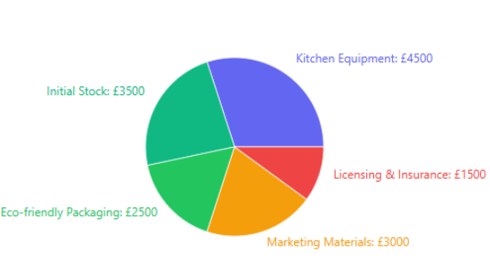
Funding Requirements
  FreshFuel requires approximately £15,000 in start-up funding to establish the business and begin operations.
  The funding will be obtained through a UK Government Start-Up Loan, which provides financial support for new small businesses.
  A large portion of the investment will be allocated to kitchen equipment required to prepare meals safely and efficiently.
  Initial ingredients and food inventory will also require funding to ensure the business can operate immediately after launch.
  Marketing expenses will support promotional campaigns that introduce the brand to potential customers.
  Licensing, insurance, and regulatory compliance costs are necessary to ensure the business meets food safety and legal requirements.
Fig: Initial Start-Up Costs; Source: FreshFuel Business Plan (Author, 2026)
Notes:
The funding will be obtained through a UK Government Start-Up Loan, which provides financial support for new small businesses. A large portion of the investment will be allocated to kitchen equipment required to prepare meals safely and efficiently. Initial ingredients and food inventory will also require funding to ensure the business can operate immediately after launch. Marketing expenses will support promotional campaigns that introduce the brand to potential customers. Licensing, insurance, and regulatory compliance costs are necessary to ensure the business meets food safety and legal requirements.

Slide 11
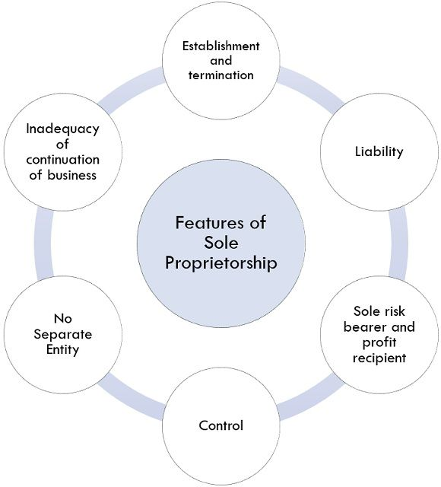
Legal Status and Management Structure
Legal Status – Sole Trader
FreshFuel will operate as a sole trader business, where the business is owned and managed by one individual.
This structure is common for small start-up businesses because it is simple and flexible to manage.
Benefits
• Easy and inexpensive to set up - minimal legal paperwork and registration requirements.
• Full control of business decisions - the owner can quickly respond to market changes.
• All profits belong to the owner, providing strong financial motivation.
• Simple financial management and taxation compared with limited companies.
Management Structure
The business will be owner-managed, meaning the owner will oversee daily operations, purchasing, marketing and customer service while hiring part-time kitchen staff as the business grows.
Notes:
FreshFuel will operate as a sole trader business. This means that the business is owned and managed by one individual who is responsible for all business decisions. The sole trader structure is suitable for small start-up businesses because it is easy to establish and requires less administrative work compared with a limited company. It also allows the owner to keep all profits and maintain full control over operations. Initially, the owner will manage daily activities, and part-time staff may be hired later as the business expands.

Slide 12
Conclusion
  FreshFuel provides a healthy and sustainable takeaway solution for students and young professionals in Stratford.
  The business offers nutritious meals at affordable prices while using eco-friendly packaging to support environmental sustainability.
  Strong social trends toward healthy eating create a growing market opportunity for the business.
  Effective marketing through social media and local promotions will help FreshFuel reach its target customers.
  With a clear business concept, strategic marketing plan, and £15,000 start-up funding, FreshFuel has strong potential for growth and long-term success.
Notes:
To conclude, FreshFuel is a healthy takeaway business designed to meet the needs of modern consumers. The business offers nutritious meals that are affordable, convenient, and environmentally friendly. There is growing demand for healthier food options, especially among students and young professionals. FreshFuel will use social media promotion and local marketing strategies to reach its target customers. With a clear concept, strong market demand, and a reasonable start-up cost of £15,000, the business has strong potential for success. FreshFuel aims to make healthy eating easier and more accessible while also supporting sustainability. Thank you for listening.

Slide 13
References
  Adamson, V. (2025). Consumer attitudes show health is all about balance | AHDB. [online] Ahdb.org.uk. Available at: https://ahdb.org.uk/news/consumer-insight-consumer-attitudes-show-health-is-all-about-balance.
  Kumar, V., Ram, D.K., Sahu, G., Sahu, N.K. and Verma, S.K. (2025). Sustainable Modifications in Food Packaging: A Comprehensive Review of Biodegradable Material Revolutions. Applied Food Research, [online] p.101385. doi:https://doi.org/10.1016/j.afres.2025.101385
  Lord, C., Bates, O., Friday, A., McLeod, F., Cherrett, T., Martinez-Sykora, A. and Oakey, A. (2022). The sustainability of the gig economy food delivery system (Deliveroo, UberEATS and Just-Eat): Histories and futures of rebound, lock-in and path dependency. International Journal of Sustainable Transportation, [online] 17(5), pp.1–13. Available at: https://doi.org/10.1080/15568318.2022.2066583.

