Slide 1

Student name: Jessica Maribel Gomez Nivelo
Student number: 2428006
Lecturer’s name: Farah Wiita
LCHS4010
Psychology in Health and Social Care
Acknowledgement of the use of AI tools (read the statements below and delete/amend as appropriate)
I confirm that I have not used any AI tools in the research and creation of this assignment. I confirm that I have not presented any AI generated materials as my own work.

Slide 2
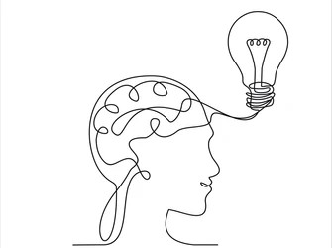
Presentation Overview
Helping Jenny to develop through the Attachment Theory of Bowlby.
Presentation explores developmental effect of caring responsibilities to sixteen year old Jenny.
Analysis uses Attachment Theory by Bowlby in order to comprehend the issues of emotional development.
Scenario touches on the outcome of a long time care giving after the death of father.
Suggested strategies should help Jenny to maintain her health and proper psychological growth.

Slide 3
Introduction to the Situation of Jenny.
Jenny is 16 and mother with health challenges has her as primary care-giver.
The death of father within a span of five years brought about some role changes in the family.
Jenny does domestic chores such as cooking, shopping, cleaning and administration.
Mother suffers mobility problems, forgetfulness as well as episodes of low mood that are persistent.
The social, emotional, and psychological development of Jenny can be affected by caring.

Slide 4

Bowlby’s Attachment Theory
Attachment Theory was a theory created by a psychologist known as John Bowlby in the 1950s.
Theory revolves around emotional attachment between the children and the main caregivers (Khadka, 2022).
A secure attachment is established when the caregivers are capable of always ensuring safety, support, and responsiveness.
The working models that are formed during early relationships direct future relationships and behaviour.
The experiences related to attachment play a significant role in the emotional control, confidence, and human relations (Psenka, 2025).

Slide 5
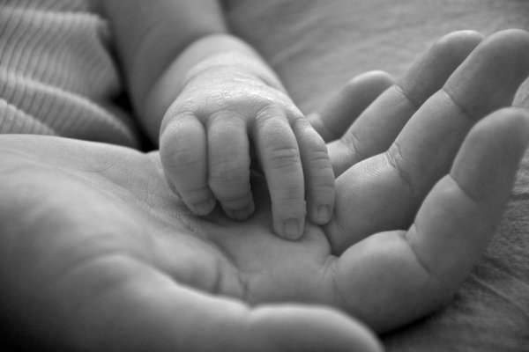
Attachment Theory and Early Development.
Childhood relationships have an effective impact on emotional security and developmental psychological growth (Bergen, 2022).
Children need regular care giving in order to build trust, safety and emotional stability.
Anxiety, insecurity and emotional problems may also be caused by disruptions in providing care.
Clinging facilitates stability, self-reliance, social functioning, and favorable self-judgment.
Adolescents still shape their healthy developmental outcomes on the emotional support networks.

Slide 6

Associating the Attachment Theory with the case of Jenny.
The loss of father may have affected Jenny in that her secure attachment and ability to feel were interfered with.
Jenny took up the responsibility of a caregiver which turns the roles in the parent-child relationships the other way round.
Higher responsibility can reduce the chance of normal social development of the adolescent.
Emotional stress can affect Jenny in terms of self-esteem, identity building and health.
The absence of regular emotional support may make one susceptible to mental problems.

Slide 7
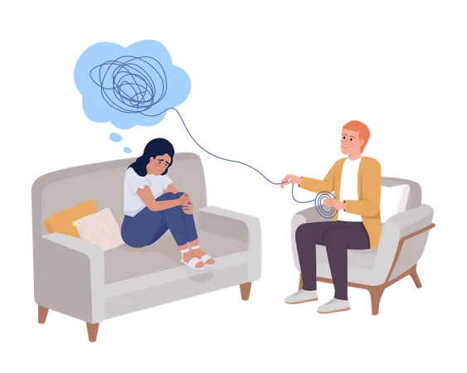
Strategies and Interventions to Support Jenny.
Offer support services to young carers which include emotional advice and peer support.
School counseling may assist Jenny to vent her emotions and overcome emotional pressure (Elliott, 2025).
The social services can help in providing respite care that will lessen the load on Jenny in terms of caregiving.
The identity development and future education might be aided by mentoring programmes.
Community resources can enhance community circles around Jenny and her mother (Mosley and Tew, 2026).

Slide 8
Biological and Environmental Influences on Development ‘(Nature and Nurture)’
Adolescence is the period of hormonal and neurological transformations of feelings and behaviour.
Long-term stress can affect sleep cycle, focus, and mental health (Uccella et al., 2023).
Caring roles, financial issues, and minor social opportunities are some of the environmental pressures (Bhushan and Gorovoy, 2026). Positive relations with teachers or other mentors would facilitate resilience and coping.
Favorable environments can counter adverse developmental effects of the chronic stress of care giving

Slide 9

Key Strengths Bowlby’s Attachment Theory
Explains the significance of early emotional relationships in a very clear manner.
Extensively used in health, social care and child development practice.
Helps professionals are aware of emotional after-effects of interrupted family relations(Psenka, 2025).
Helps to develop interventions, which enhance supportive and secure relationships.
The attachment theory has a lot of principles that are backed by extensive research evidence (Tang et al., 2023).

Slide 10

Critical Evaluation Bowlby’s Theory
Attachment theory explains how early caregiver relationships affect emotional development.
It highlights the importance of stable, supportive care in childhood and adolescence.
It mainly focuses on early childhood and may overlook social, economic, or cultural factors.
For Jenny, social services, school, and community support are also important.
The theory is useful but should be considered alongside wider social and environmental factors.

Slide 11
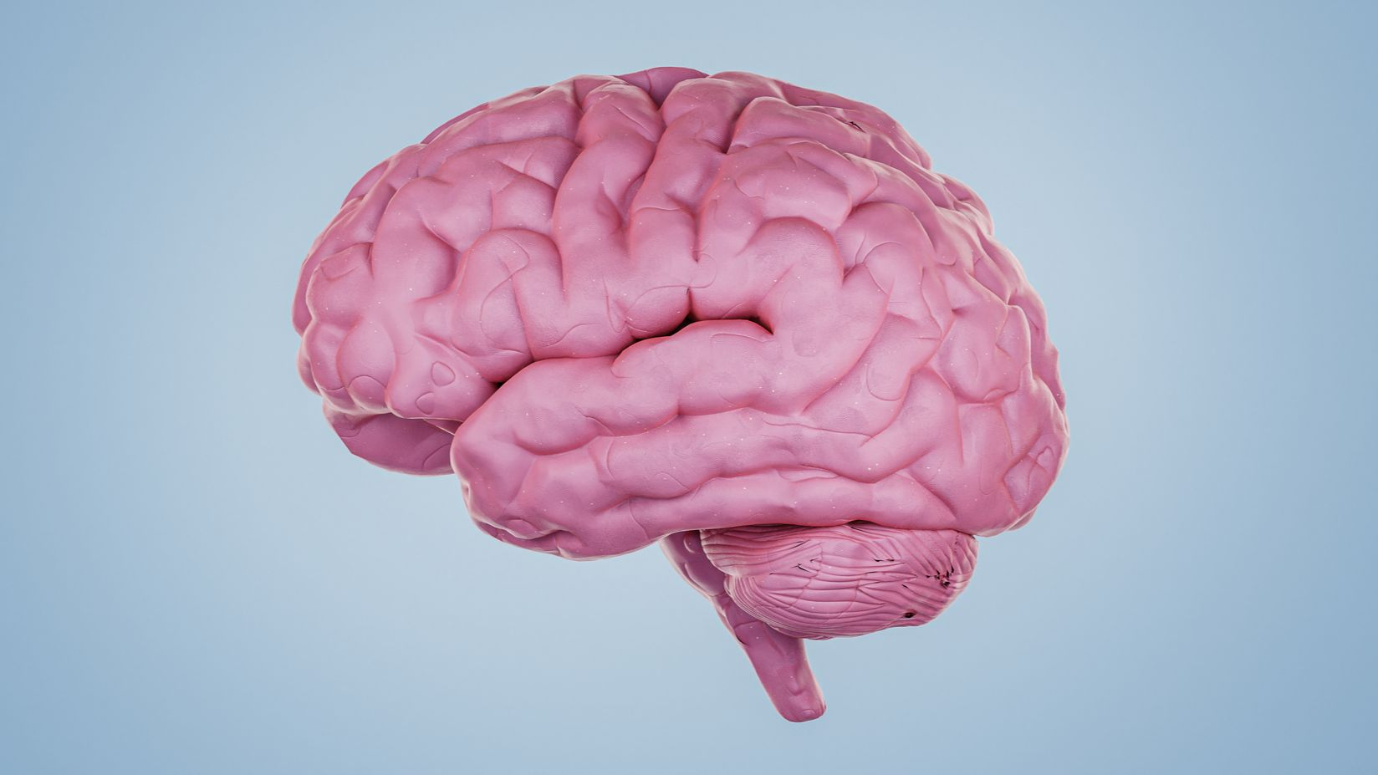
Conclusion
Caring responsibilities during adolescence can significantly affect emotional and psychological development.
Bowlby’s Attachment Theory helps explain how the loss of a parent and role reversal may disrupt emotional security and wellbeing.
Jenny’s caregiving role may increase stress, reduce social opportunities and influence identity development.
Support systems such as counselling, respite care and mentoring can help reduce caregiving pressure.
Positive relationships with teachers, professionals and community services can strengthen resilience.
Although Attachment Theory explains emotional development, biological, social and environmental factors also influence outcomes.

Slide 12
References
Bhushan, B. and Gorovoy, S., 2026. Sleep in families: Dynamics, challenges, and possible solutions. In Sleep and Health (pp. 141-153). Academic Press.
Bergen, D., 2022. Developing attachment: the theoretical work of John Bowlby and Mary Ainsworth. In Theories of Early Childhood Education (pp. 118-127). Routledge.
Elliott, J.S., 2025. Respite Care Services and the Experiences of Unpaid Adult Child Alzheimer’s Caregivers
Khadka, C., 2022. The evolution of attachment theory: From Bowlby to modern perspectives. TUTA Journal, pp.125-140.
Psenka, J., 2025. “It's the Aftermath. It's the After Effects. It's the Ripple Effect.” A Phenomenological Approach to Navigating Community Mass Gun Violence (Master's thesis, The Chicago School of Professional Psychology).
Psenka, J., 2025. “It's the Aftermath. It's the After Effects. It's the Ripple Effect.” A Phenomenological Approach to Navigating Community Mass Gun Violence (Master's thesis, The Chicago School of Professional Psychology).
Tang, Y., Li, S., Ma, L., Zheng, Y. and Li, Y., 2023. The effects of mother-father relationships on children’s social-emotional competence: The chain mediating model of parental emotional expression and parent-child attachment. Children and Youth Services Review, 155, p.107227
Uccella, S., Cordani, R., Salfi, F., Gorgoni, M., Scarpelli, S., Gemignani, A., Geoffroy, P.A., De Gennaro, L., Palagini, L., Ferrara, M. and Nobili, L., 2023. Sleep deprivation and insomnia in adolescence: implications for mental health. Brain sciences, 13(4), p.569.

