Slide 1


OPNET Modeler
Emerging Network Technology

Slide 2
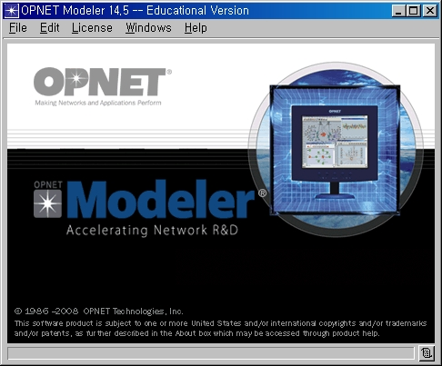
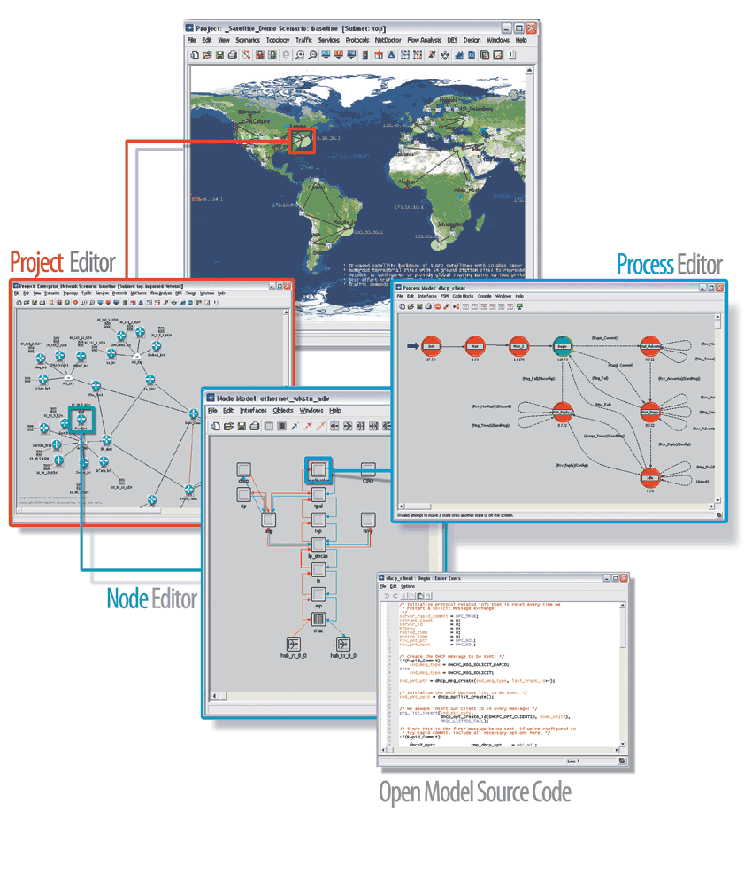

Slide 3
What is Modeler
An environment for building protocols and device models.
An environment to plan changes by illustrating how the networked environment will perform.
An environment that includes hundreds of pre-built models, used to study performance changes of your network: organizational scaling, technology changes, and application deployment.

Slide 4
Questions and Goals
Questions to be answered in the OPNET Modeler Class
  What does Modeler do?
  How can it help me?
  How easy is it to use?
  How can I get started?
Goals
  Learn what problems can be solved with Modeler
  Learn how to use the Modeler software in a hands-on environment
  Use Modeler to solve real problems

Slide 5
Aim & Expectations
The aim of this class is to give students hands-on leaning experience to create real life scenario in a simulation environment using OPNET Modeler and to introduce many features of modeler.
Prerequisites:
  Ability to program in C or C++ or at least be comfortable in reading/understanding C or C++ code
  Basic understanding of networks
  For basic information, see
  http://compnetworking.about.com/library/glossary/blglossary.htm
  http://www.whatis.com

Slide 6
Content
For this semester we are aiming to cover most of the following:
Introduction OPNET Technologies History Service and support Practical application Features of the Project Editor (lab) Building your first network (lab) Modeling Framework Other editors (labs) General simulation methodology | Evens and event list concepts Node modeling & labs Process Modeling & labs Collecting Scalar statistics Scalar statics lab | Modeling large networks Importing Topology and Traffic Wireless Modeling & Labs OPNRT Debugger labs Publishing & animation labs Overview of Modules

Slide 7
About OPNET
OPNET stands for Optimized Network Engineering Tools
Created by OPNET Technologies, Inc., which was founded in 1986
OPNET addresses the following aspects of communications networks:
  Application performance management
  Planning
  Engineering
  Operations
  Research and development

Slide 8

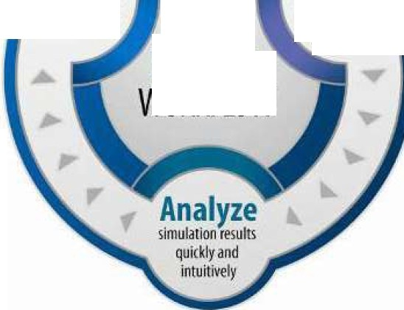
About OPNET Modeler for Network R&D
OPNET Modeler® is the de-facto industry standard for:
  Network R&D
  Modeling and simulation
OPNET Modeler is used by:
  Defense organizations around the world
  Leading network equipment manufacturers
  Universities noted research organizations and consortia
Supports a broad scope of studies including:
  Designing wired and wireless protocols and technologies
  Testing and demonstrating equipment designs in realistic scenarios before production
  Planning mobile network deployments that accurately incorporate terrain effects
  Incorporating communications effects into wargaming
Protocols, devices, and technologies
Wired and wireless networks of realistic scale
OPNET
MODELER
WORKFLOW

Slide 9
Network R&D Portfolio Solution
Modeler
Modeler Wireless Suite
Modeler Wireless Suite for Defense

Slide 10
About OPNET Modeler
Corporate Overview
  Founded in 1986
  Publicly traded (NASDAQ: OPNT)
  HQ in Bethesda, MD
  Approximately 600 employees
  Worldwide presence through direct offices and channel partners
Best-in-Class Solutions and Services
  Application Performance Management
  Network Performance Management
  Network Research and Development (R&D)
Broad Customer Base
  Corporate Enterprises
  Government Agencies/DoD
  Service Providers
  Network Equipment Manufacturers

Slide 11
Companies that uses OPNET
Alcatel-Lucent Alion Science and Technology Aperto Networks AutoNetworks Technologies, Ltd. Avaya BAE Systems Ball Solutions Group Booz Allen Hamilton CACI Federal Systems Cisco Systems DISA Defence Communication Services Agency UK Defence Science & Technology Org. Australia EADS Eagan McAllister Associates Eagle Alliance Ericsson French Nat'l Inst. for Transport & Safety Research Fujitsu Generic Systems Sweden AB Georgia Tech Research Institute Halliburton | Halliburton Harrison Corporation Hewlett Packard Hitachi Ltd. Honeywell Huawei Hughes Network Systems IBM Global Services Innovative Wireless Technologies lnternap MIT Lincoln Labs MITRE NASA National Communications System National Geospatial Intelligence Agency National Institute of Standards and Tech. NEC Northrop Grumman NTL Oak Ridge National Lab Panasonic Philips Raytheon Research in Motion Ltd. RF Monolithics | Ricoh Company, Ltd. SAIC Samsung Sandia National Labs SELEX Communications Spa Space & Naval Warfare Sys. Command Sparta Stellaris Networks Syracuse Research Corporation Systems Planning & Analysis, Inc. Telenor Tenacity Solutions Inc Textron U.S. Air Force U.S. Army U.S. Army Research Lab U.S. Central Command U.S. Coast Guard U.S. Department of Homeland Security U.S. Marine Corps U.S. Military Academy U.S. Naval Research Lab (NRL) U.S. Navy

Slide 12
Key Differentiating Features
Fastest discrete event simulation engine among leading industry solutions.
Hundreds of protocols and vendor device models with code
Scalable simulation environment including support for parallel and distributed simulation
Integrated GUI-based debugging and analysis
Open interface for integrating external object files, libraries, and other simulators

Slide 13
OPNET Modeler Wireless Suite
Design advanced wireless protocols and next-generation technologies including:
  WI-FI (802.11)
  WiMAX (802.16)
  LTE (Long Term Evolution) [Cellular]
  Satellite
Predict protocol and application performance
Plan mobile network deployments that accurately incorporate wireless propagation impairments
Evaluate the effects of Propriety o customized antenna patterns in a network.

Slide 14
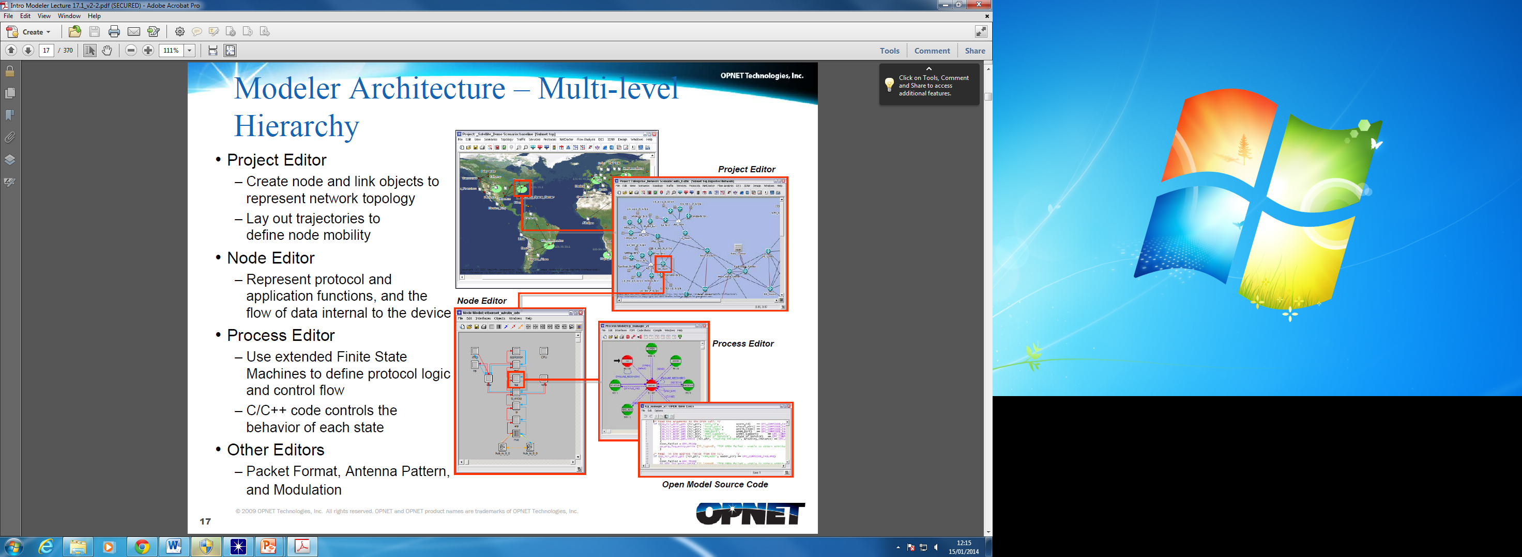
Modeler Architecture – Multi-level Hierarchy
Projector Editor
  Create node and link objects to represent network topology
  Lay out trajectories to define node mobility
Node Editor
  Represent protocol and application functions, and the flow of data internal to the device
Process Editor
  Use extend finite state machines to define protocol logic and control flow
  C/C++ code controls the behaviour of each state
Other Editors
  Packet format, Antenna Pattern, and Modulation

Slide 15
Hierarchical Modelling

Slide 16
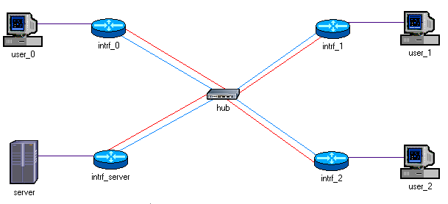
Network Level
You can compose subnets, nodes in the network model

Slide 17
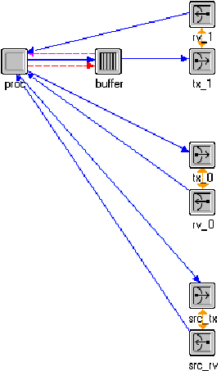
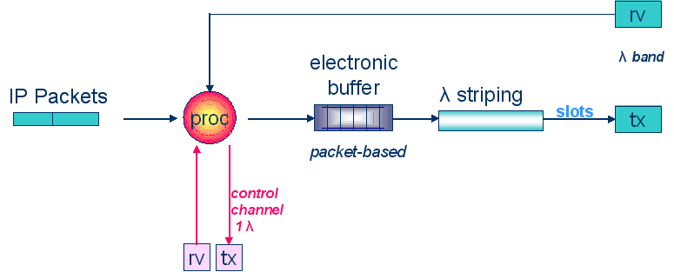
Node Level
New node models can be created to perform certain functions.
Better draw a logical connection before the implementation in the OPNET

Slide 18
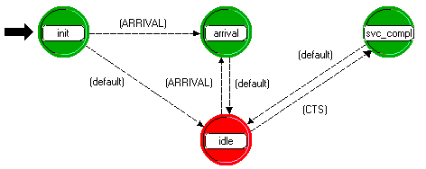
Process Level
Process models are the sub-parts of the node model which uses C/C++ to edit.

Slide 19
Profile Configuration
You can set up different profiles in one project, each of which refers to one type of activity regarding to one application.
For client-server architecture
  Server → configure the supported services
  Client → configure the supported profiles

Slide 20
Application Configuration
Application Configuration block defines what applications are supported in the project.
In most cases, we set it into default.
The default applications supported by OPNET are:
  Email
  Database
  Video Conference
  Voice over IP
  FTP

Slide 21
Model Libraries
The library comprises of the following and more:
Standard
  150+ built-in protocol and vendor device models including:
    Transport: TCP (ECN, New Reno, Reno, SACK, Tahoe), UDP
    Network & Routing: BGP, EIGRP, HAIPE, IGRP, IP, OSPF, OSPFv3, RIP, RIPng
    MAC: 802.1p, ATM, Ethernet (802.3a,i,j,u,y,z,ab,ac,ad,ae), Spanning Tree, VLAN
    Wireless: MANET (AODV, DSR, GRP, OLSR, OSPFv3, TORA), Mobile 1Pv4, Mobile
    1Pv6, TDMA, WLAN (802.11a,b,e,g,n), ZigBee
    Vendor devices: Alcatei-Lucent, Cisco, Extreme, Foundry, HP, IBM, Intel, Juniper, Motorola, NEC, Nortel, Sun
Specialized
  Selected protocolmodels available separately
  1Pv6, MPLS, PNNI, UMTS, and WiMAX
JCSS, formerly NETWARS (for DoD and approved contractors)
  100+ military protocoland device models available through the JCSS program
  Compatible with all Modeler solutions
  Satellites and earth terminals, encryption devices, multiplexers, tactical radios, etc.
Contributed
  Models contributed by OPNET users
  1,000+ universities using OPNET software and 25,000+ academic users
Model Development Consortiums
  Consortium of prominent organizations that jointly guide modeldevelopment
  WiMAX(802.16e), LTE
Complete list: www.opnet.com/support/des_model_library/

Slide 22
Scalable Wireless Modeling and Simulation
Wireless effects simulated include:
  RF propagation
  Interference and Jamming
  Transmitter/Receiver characteristics
  Node mobility include handover
  Interconnection with wired transport networks
All warless characteristics seamlessly integrated with higher layer models
Fully customizable and modular transceiver pipeline framework
Import supported for terrain data in DTED, USGS DEM, and OpenFlight formats
Full suite of propagation models including:
  CCIR, Free space, Hata, Longley-Rice, Tirem v3 and v4, Walfisch-Ikegami

Slide 23
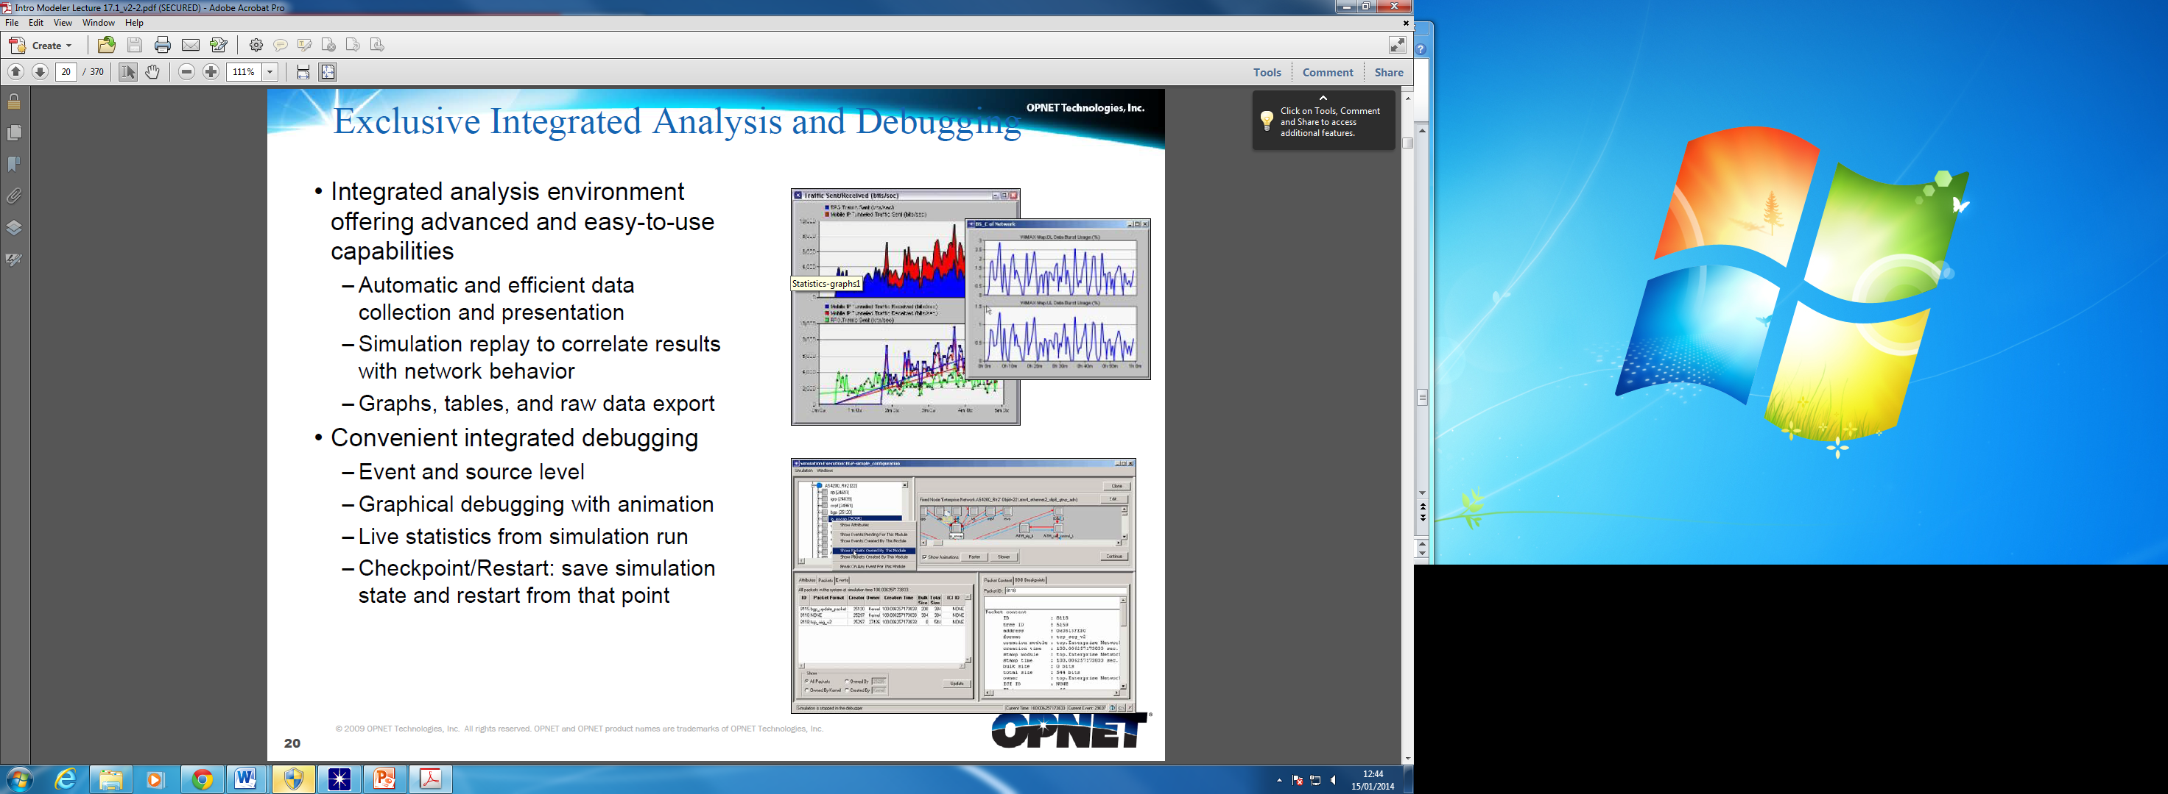
Integrated Analysis and Debugging
Integrated analysis environment offering advanced and easy-to-use capabilities
  Automatic and efficient data collection and presentation
  Simulation replay to correlate results wit network behaviour
  Graphs, tables, and raw data export
Convenient integrated debugging
  Event and source level
  Graphical debugging with animation
  Live statistics from simulation run
  Checkpoint/restart: save simulation state and restart from that point.

Slide 24
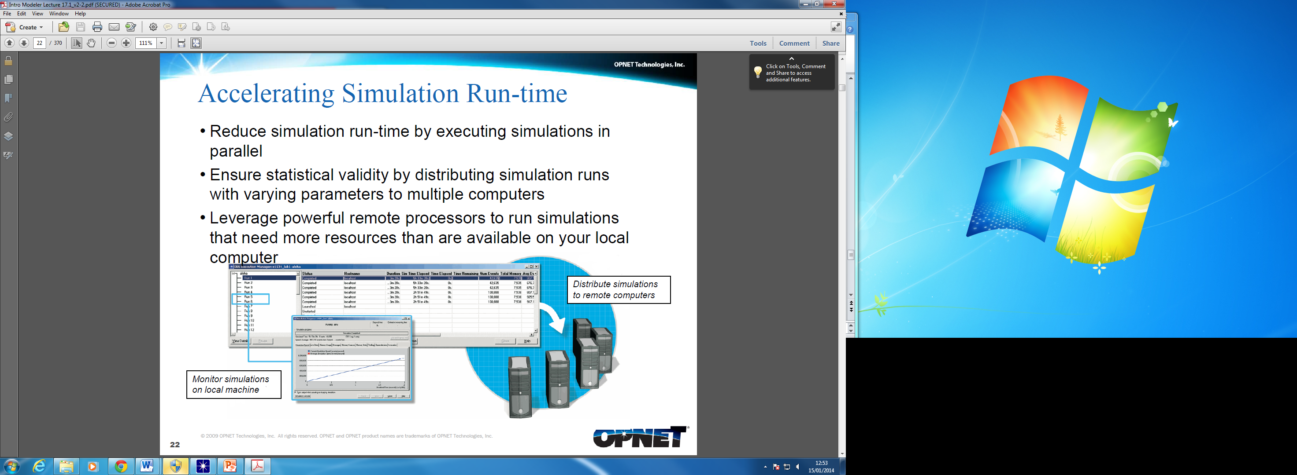
Accelerating Simulation Run-time
Reduce simulation run-time by executing simulations in parallel
Ensure statistical validity by distributing simulation runs with varying parameters to multiple computers
Leverage powerful remote processors to run simulations that need more resources than are available on your local Computer

Slide 25
Co-Simulator
Co-simulation enables users to leverage other specialized simulators with OPNET Modeler and get the “best of both worlds"
Co-simulate OPNET with other simulators using:
  High-Level Architecture (HLA)
  Co-simulation API
  Extensible Transceiver Pipeline (e.g., co-simulation with MATLAB)
Co-simulate with multiple software platforms including:
  Naval Systems Simulator
  AGI Satellite ToolKit (STK)
  MAK VR Forces
  Mathworks MATLAB
  US Army OneSAF
  Motorola Wireless Valley
  Custom FoF/SAF simulators

Slide 26
Integrating Live Network and Application Behaviour
Leverage the Real Application Simulation Module (RASM) to:
  Capture packet traces of live applications in a production or test environment
  Craft new application models by architecting transaction flows
Utilize the System-in-the-Loop module to:
  Connect live network hardware or software applications to an OPNET discrete event simulation
  Analyze the effects of a live system on an OPNET simulation or vice versa
  Assess application performance over any infrastructure model

Slide 27
Customising the OPNET Environment with OPNET Development Kit (ODK)
Create product extensions
Construct custom applications/integrations
Create specific workflows to facilitate model configuration, enable selective Modeler functionality, etc.
Tailor network visualization and user interface
Example: ODK can be used to customize the OPNET Modeler GUI so that new menu items appear when a network scenario is invoked

Slide 28
Getting help with OPNET
Online Help (F1)
  Very helpful!!
  Comprehensive
  Easy to use
OPNET website → user support → Online Forum
  Needs subscription
www.opnet.com

Slide 29
Questions

Slide 30
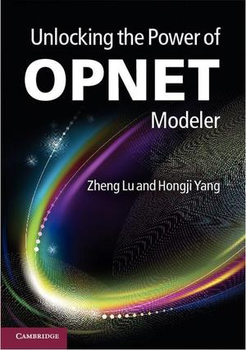
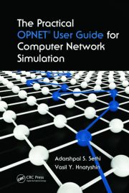
Reading List
OPNET Online Documentation!
Unlocking the Power of OPNET Modeler, Zheng Lu and Hongji Yang, Cambridge University Press, 2012. Available in Owen’s Library.
The Practical OPNET User Guide for Computer Network Simulation, Adarshpal S. Sethis, Vasil Y. Hnatyshin, CRC Press, 2013. Available in Owen’s Library.
A fundamental C/C++ programming manual or reference book, which can be borrowed from the library.

Slide 31
Features of the Project Editor

Slide 32
Overview
Project Editor:
  Workflow
  More Details of the Project Workspace
    Map Backgrounds
    Zooming
    Threshold Value
    Annotation Palette
    Project Workspace {Lab}
  Models
    Deriving and Creating New Devices {Lab}
  Object Attributes
    Client-Server Configuration Example
  Statistics
  Product Documentation

Slide 33
Project and Scenarios
Modeler uses a Project-and-Scenario approach to modeling networks.
A Project is a collection of related network scenarios in which each explores a different aspect of network design. All projects contain at least one scenario.
A Scenario is a single instance of a network. Typically, a scenario presents a unique configuration for the network, where configuration can refer to aspects such as topology, protocols, applications, baseline traffic, and simulation settings.

Slide 34
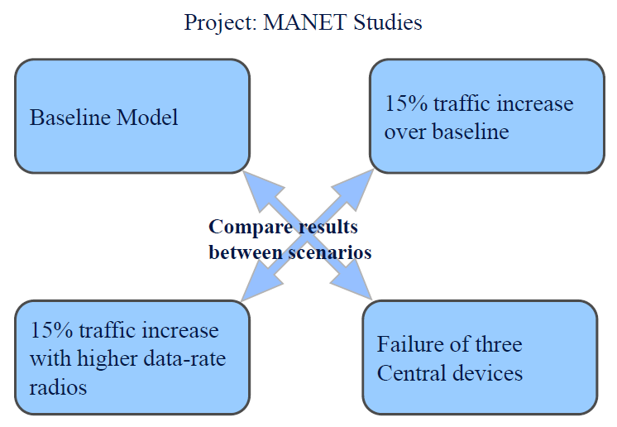
Projects and Scenarios

Slide 35

The Project/Scenario Workflow
Create project
Create baseline scenario
  Import or create topology
  Import or create traffic
  Choose results and reports to be collected
  Run simulation
  View resuIts
Duplicate scenario
  Make changes
  Re-run simulation
  Compare results
Iterate

Slide 36
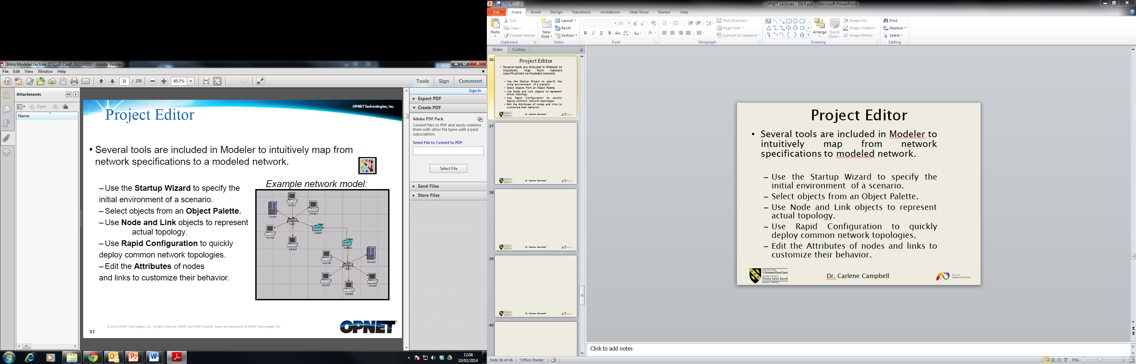
Project Editor
Several tools are included in Modeler to intuitively map from network specifications to modeled network.
  Use the Startup Wizard to specify the initial environment of a scenario.
  Select objects from an Object Palette.
  Use Node and Link objects to represent actual topology.
  Use Rapid Configuration to quickly deploy common network topologies.
  Edit the Attributes of nodes and links to customize their behavior.

Slide 37
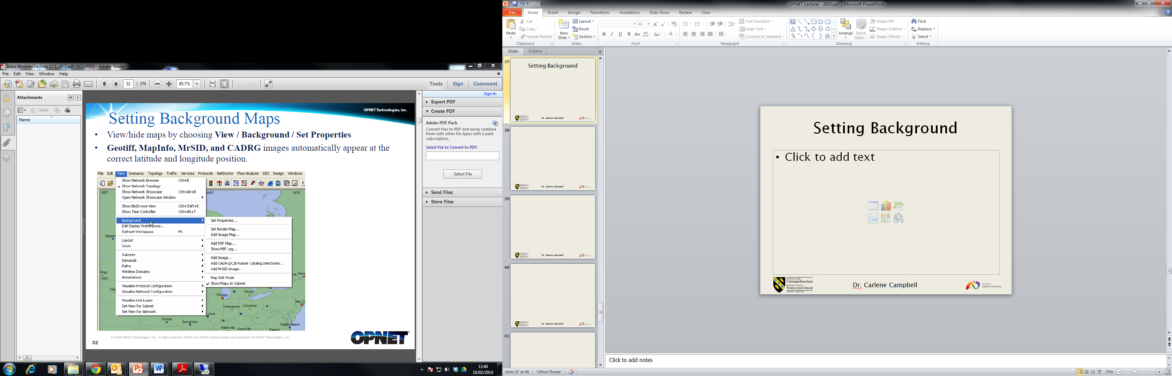
Setting Background

Slide 38
Zooming and Panning
Zooming can be performed with the scroll wheel on your mouse:
  To zoom in, turn the scroll wheel forward or use the Page Down button.
  To zoom out, push the scroll wheel backward or use the Page Up button.
The "Zoom to Window" feature allows you to return to the original magnification level
You can right-click in the workspace and choose
  "Zoom to Selection" to zoom in on a selected object
  "Zoom to All" to zoom to all objects in the subnet
  "Zoom In"
  "Zoom Out"
  "Zoom to Window" to zoom to the full subnet view
To pan, hold down the scroll wheel and drag the mouse pointer. Optionally, hold down the right and left mouse buttons and drag the mouse pointer.

Slide 39
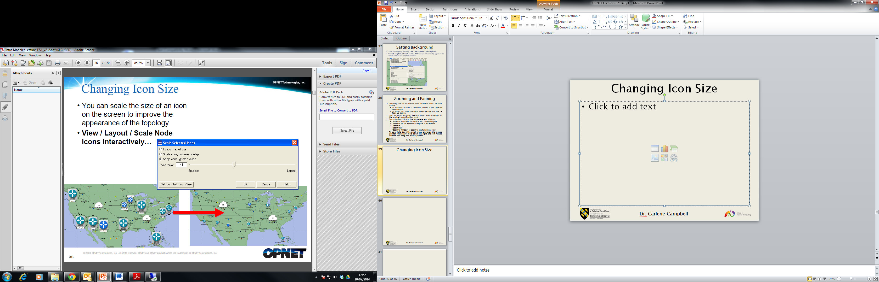
Changing Icon Size

Slide 40
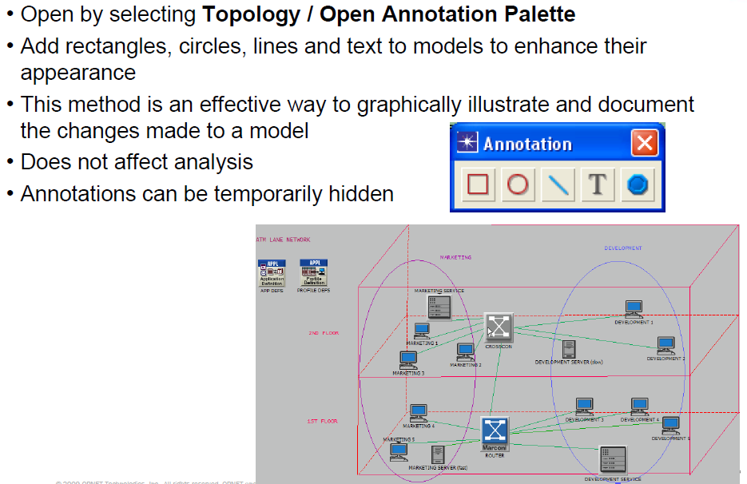
Annotation Palette

Slide 41
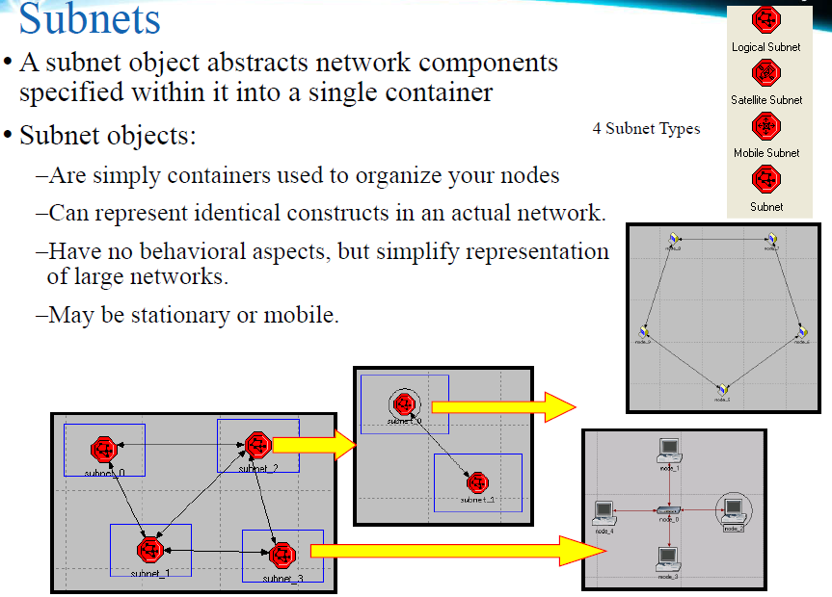

Slide 42
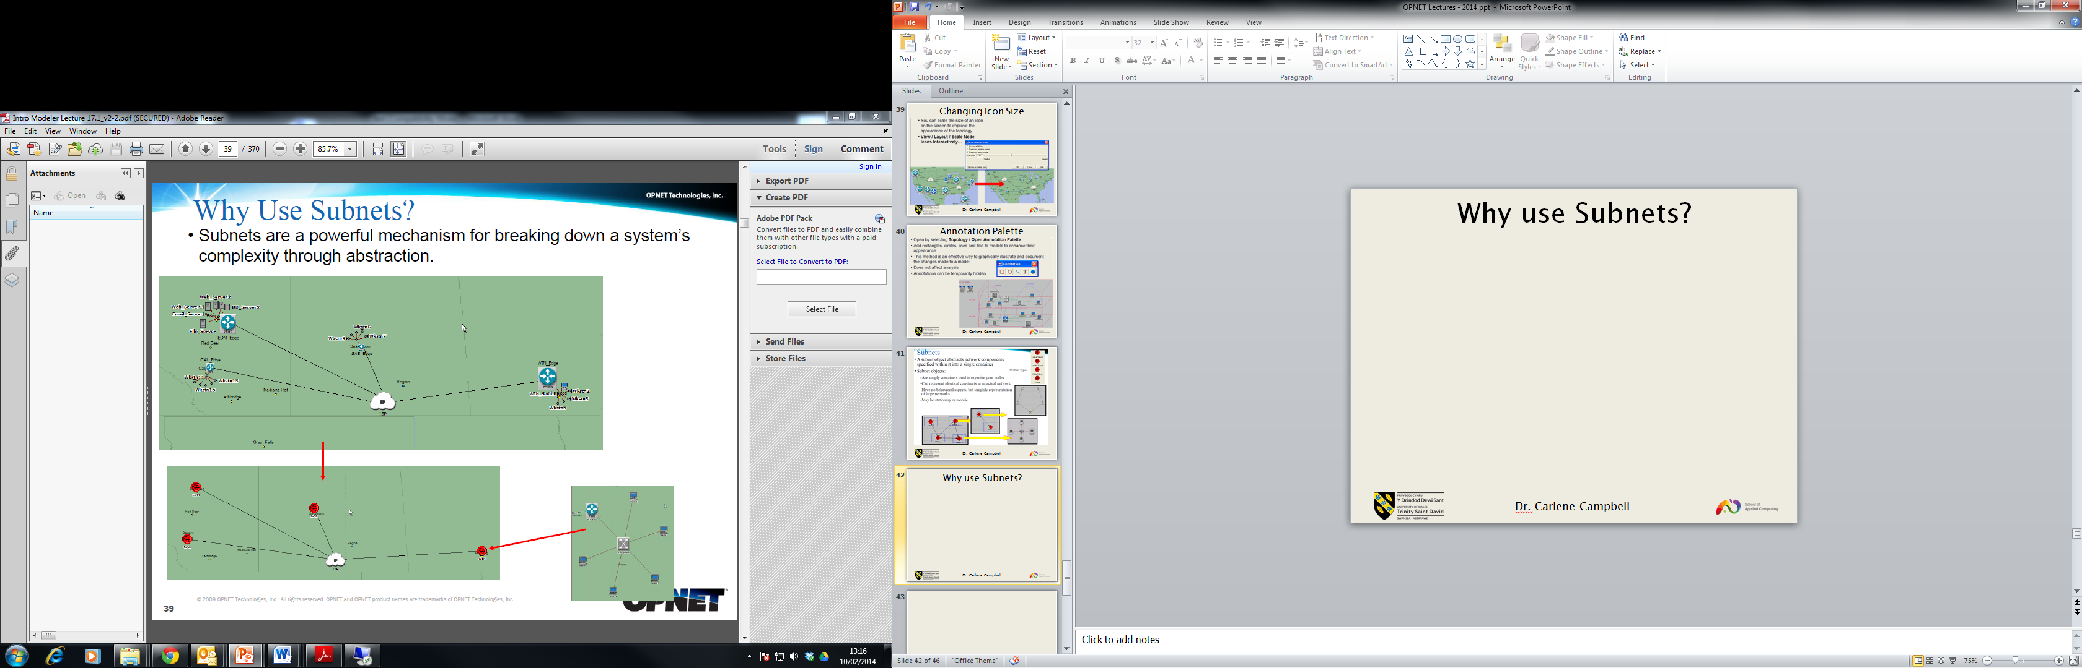
Why use Subnets?

Slide 43
Object Hierarchy
Subnets represent various network components in a single object. This object could contain various LAN, node, and link models.
LANs represent a local area network abstracted into a single node.
Nodes represent servers, workstations, switches, gateways or any other physical devices associated with communication networks.
Links represent the physical links between nodes.

Slide 44
Model Library
Models are created using published protocol standards and other widely used vendor implementations.
  IEEE Specifications (e.g., 802.1q, 802.3, 802.11, etc.)
  ANSI Standards (e.g., X3.139, T1.513, etc.)
  ATM Forum Specifications (e.g, UNI 3.1, TM 4.0, etc.)
  RFC Documents (e.g., RFC-793, RFC-1058, RFC-1771, etc.)
  Vendor Technologies (e.g., VLAN tagging, EIGRP, etc.)

Slide 45
Model Library Component
The "Model Library" contains a variety of objects used for creating networks
  Traffic generators (workstations, servers, stations, etc.)
  Network devices (hubs, bridges, switches, routers, etc.)
  Links (SONET, PPP, FDDI, 10BaseT, ISDN, xDSL, etc.)
  Vendor device models (Cisco Systems, 3Com, Nortel, Lucent, HP, etc.)
These models are ready-to-use to create networks and predict performance behavior.

Slide 46
Model Naming Convention
OPNET's standard model suite uses a specific naming convention for its node models:
<protoco/n>...<protoco/n >_<function>_<modifier>
<protocoln> is an abbreviation that specifies a particular protocol that is supported within the model. The variable n represents the number of protocol interfaces within that model.
<function> is an abbreviation that indicates the general function of the node, e.g. gateway, workstation, server.
<modifier> indicates the level of derivation of the model.

Slide 47
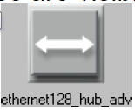
Model Naming Convention (cont.)
Levels of derivation (<modifier> value)
  adv: advanced model. All node attributes are available and attribute values are set to their defaults.
  int: intermediate model. Attributes that are unlikely to be changed are hidden and typical values are applied to the visible attributes.
  Models with no value for modifier are derived from intermediate models. Additional attributes are hidden and only attributes needed for parametric studies are visible.
Example: ethernet128_hub_adv
  This model represents a hub with 128 Ethernet interfaces. Since it is an advanced model, all the model's attributes are visible and editable.

Slide 48
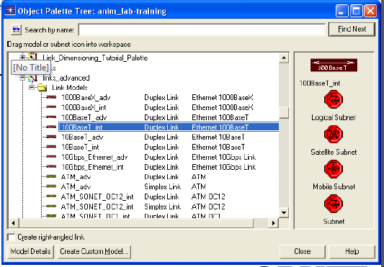
Choosing Link Models
An appropriate link must be chosen to match interfaces on connected devices.
  Data rate, protocol, and number of available interface are the requirements that must be met.
Link model naming convention:
  <protocol>_<modifier>
Example:
  1OOBaseT_ int

Slide 49
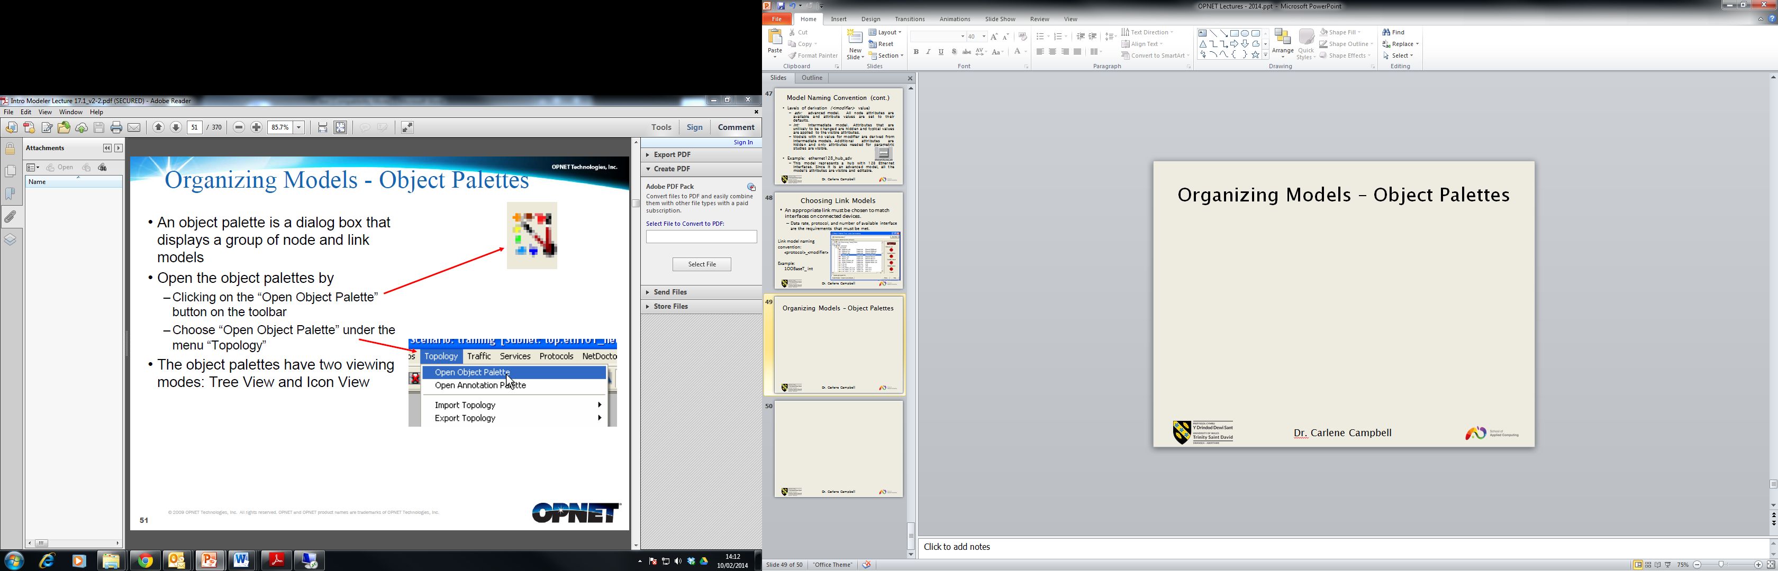
Organizing Models – Object Palettes

Slide 50
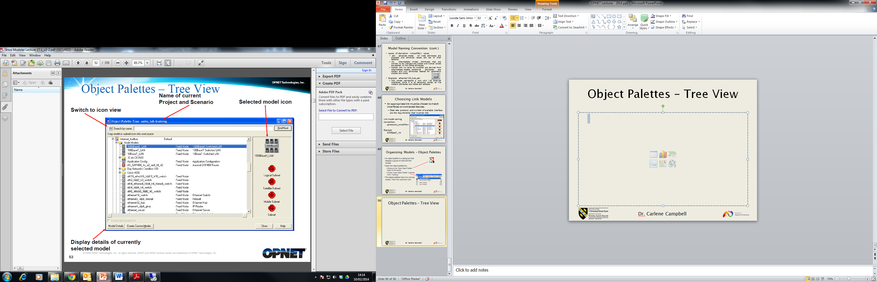
Object Palettes – Tree View

Slide 51
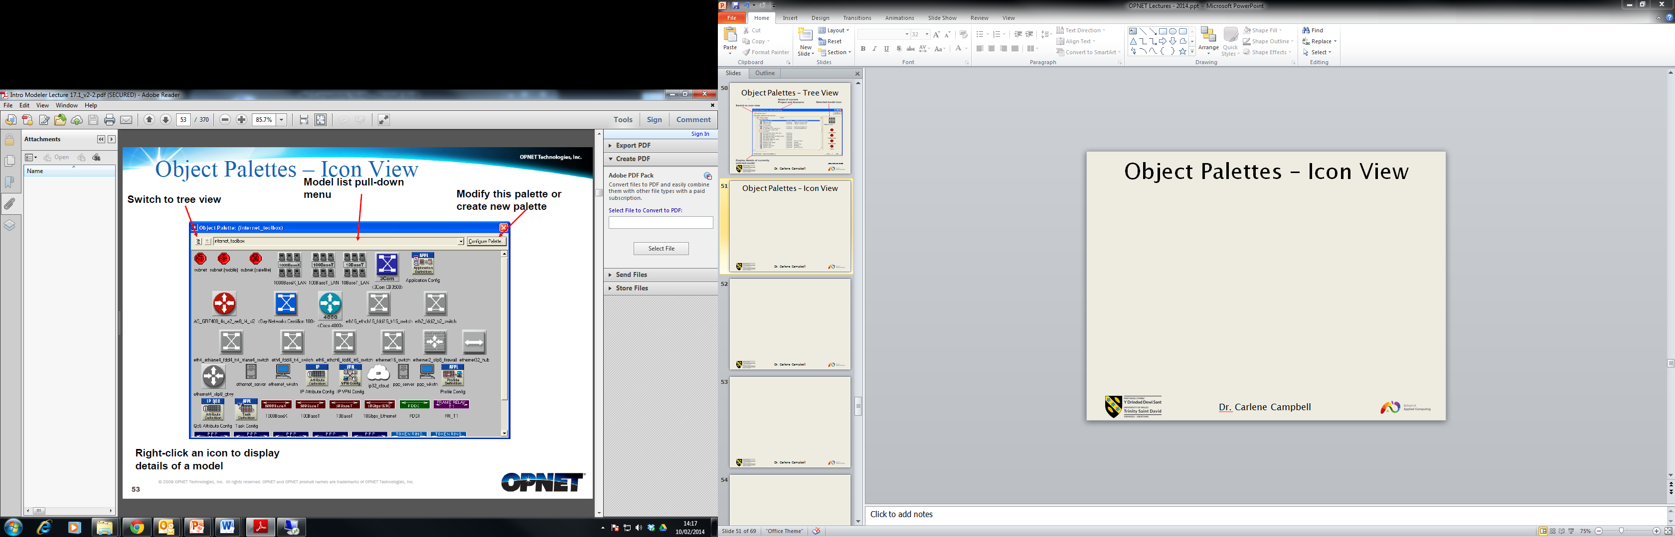
Object Palettes – Icon View

Slide 52
Customising Object Palettes
The palette always contains subnet objects
Object palettes can be customized to contain only the nodes and links that you require
There are several different methods for customizing palettes

Slide 53
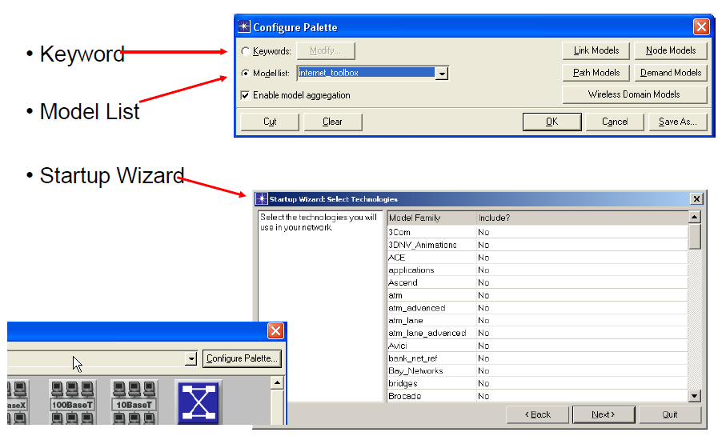
Customizing Palettes

Slide 54
Creating a New Device
Although OPNET Modeler includes hundreds of standard and vendor devices, you may need to customize models.
There are several ways to create new devices or derive models from the existing database to custom specifications.
  Two methods discussed here to change an existing model
    Deriving a new model
    Using Device Creator
  Modeling new devices and protocols discussed later in course

Slide 55
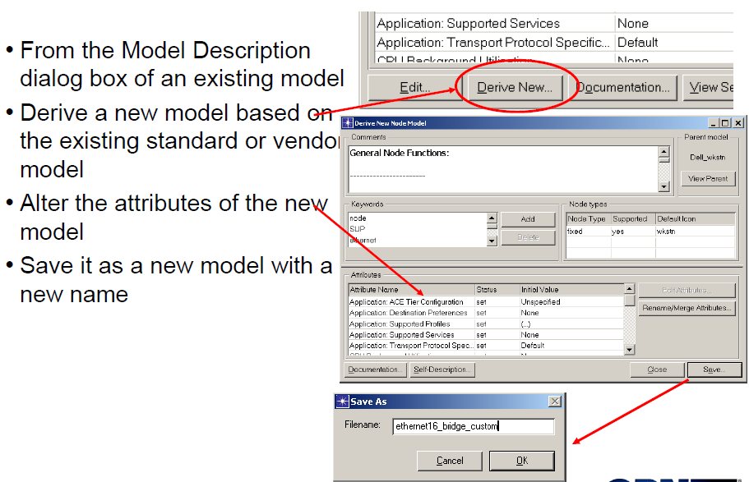
Deriving New Models

Slide 56
Advantages of Deriving Models
Makes it easy for you to configure and integrate models for specialized needs.
Allows you to benefit from past work by basing new, specialized models on previously created ones.
Gives you benefit of control over certain aspects of a new model while preserving its essential structure.
Allows creation of a new device that has preset and possibly hidden attributes.

Slide 57
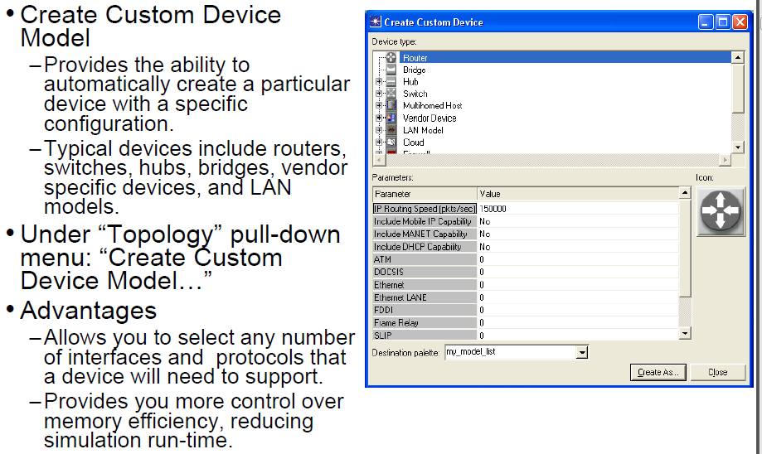
Device Creator

Slide 58
Derive New vs Device Creator
Both start with an existing model
Using "Derive New'' is for creating a different device with different attribute settings, like the configurations of protocols
Using the Device Creator is for creating a different device by customizing the number of ports or interfaces it has

Slide 59
Object Attributes
All Modeler objects have attributes
Attributes define the object and control its behavior
  All devices have a "model" attribute - this is the filename of the object
  Attribute values may vary between objects of the same model
    Example: Two routers of the same model may have different routing parameters, two demands may represent different amounts of traffic
    Attributes may have sub-attributes
To view or change an object's attributes
  Right-click on the object
  Select "Edit Attributes" or "Edit Attributes (Advanced)"

Slide 60
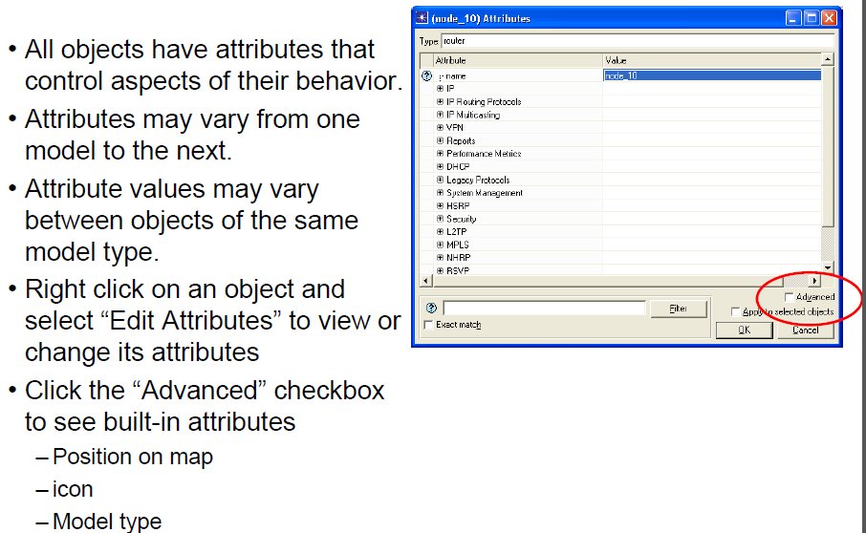
Object Attributes (cont.)

Slide 61
Selecting Objects
Select objects to modify, cut, delete, move, or copy them
Several methods to select multiple objects:
  Shift-click or Control-click
  Right-click and choose Select Similar Nodes/Links/Demands
    Selects all objects with the same model name
  Edit I Select Objects
    Advanced object selection used to select objects with certain attribute values
    Excellent way to explore configuration of an existing network model
  Edit I Find Node/Link
    Select objects based on object name
  Draw a selection box around a group of objects
Click on empty workspace to deselect all objects
You can save and recall a selection set from the "Edit" menu

Slide 62
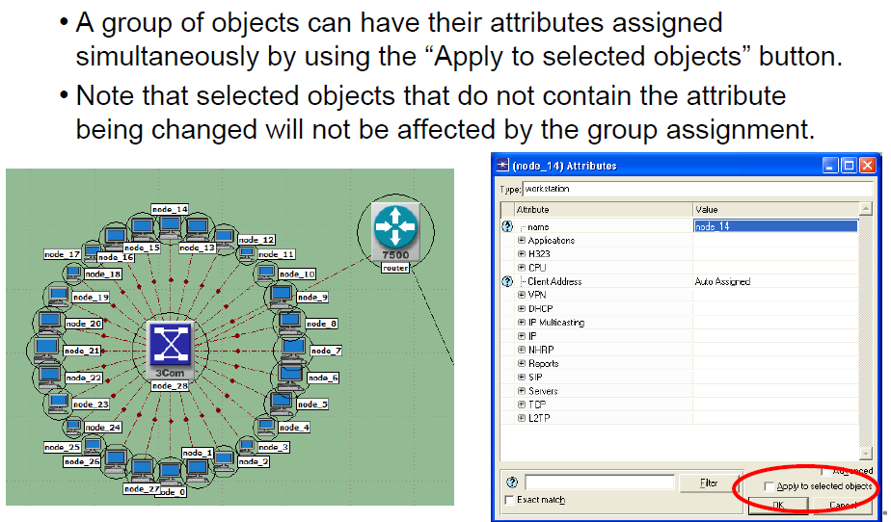
Group Attribute Assignment

Slide 63
Where to Get Help
To view the manual, choose Product Documentation from the Help menu.
Model help is accessed by right-clicking icons in the object palette or by right clicking objects in the Project workspace and selecting "View Node Description."
Click the question mark in attribute dialog boxes to view the description of that attribute.
Tool Tips: place your cursor over any object and wait one second to get a brief description of that object.

Slide 64
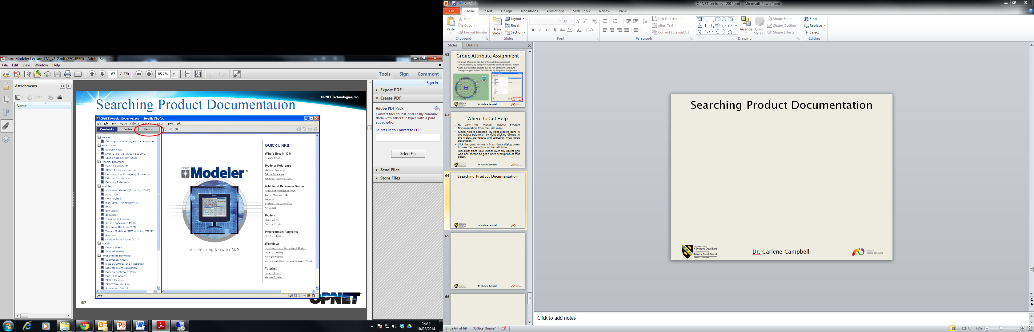
Searching Product Documentation

Slide 65
LAB: Using the Project Editor
Log onto Moodle and access the lab file “Labs 2014 OPNET”

