Slide 1
Independent Project
40 credits
Semester 1 + 2

Slide 2
Brief overview of module
40 credits
Overseen by supervisor – 20 minutes/week
Culmination of your degree

Slide 3
Supervisor’s role
Work independently with the supervisor to oversee
The supervisor’s role is to use their experience to guide you, make suggestions, make sure you meet deadlines.
It is not the job of the supervisor to do your project
It is not the job of the supervisor to give you weekly tasks

Slide 4
Assessment
Assessment points
5% Proposal – Monday 18th October
10% Interim Viva – January 19th/20th
55% Report – Friday 28th April 3pm (approx. 10,000 words)
20% Final Viva – 4th/5th/6th May
10% Exhibition poster + materials – Friday 6th May 3pm
Degree show – around 20th May

Slide 5
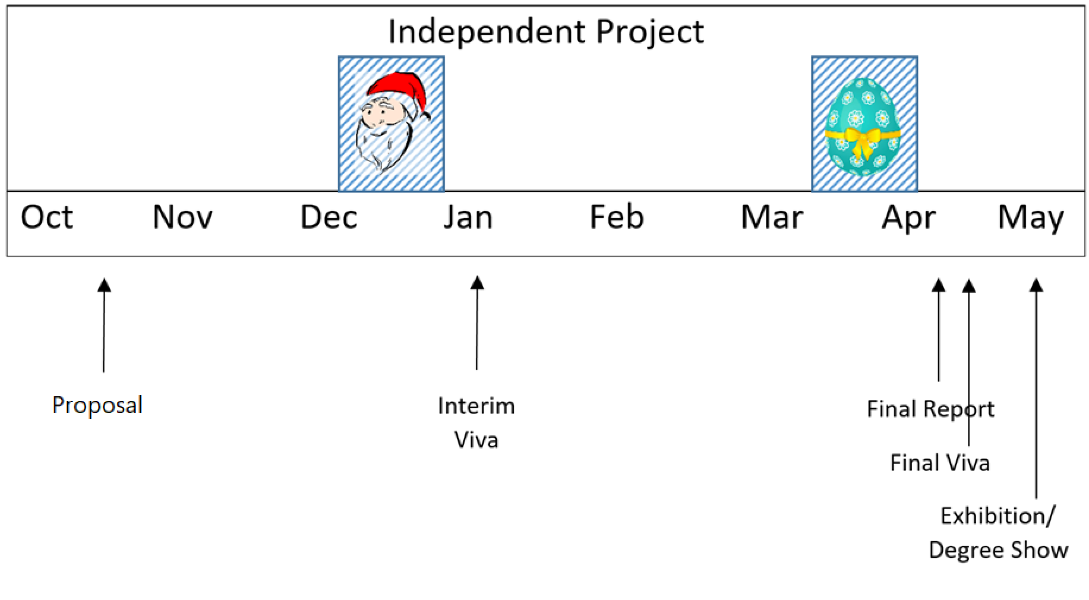
Summary

Slide 6
Moodle – can we all see the module(s)?
There are two modules on Moodle – one is labelled
“University wide material” and the other “Computing/Electronics Specific”
There is also BA Games Design/BA Animation specific

