Slide 1
Personality & Stress.
Afsana Begum

Slide 2
Personality
Extraversion
Conscientiousness
Neuroticism
Agreeableness
Openness to Experience
What is personality?
Personality is the effective combination of a person's behavioral patterns and subjective experiences. Subjective experiences is comprised of consciousness, habitual behavior, habitual desires and fears etc. whereas behavioral patterns consist of internal states, and experiences and views (Kernberg, 2016).
According to Costa and McCrae (1991), there are five main traits that are associated with personality:

Slide 3



Neuroticism
Neuroticism is a personality trait that is related to the unchanging disposition to respond with loss, negative emotions to threat, or frustration.
Individuals with neuroticism react differently depending on the level of neuroticism an individuals has (Lahey, 2009).
Trait of Neuroticism: Anxiety, depression, hopelessness, and their rating and satisfaction relating to quality of life (Chochinov, 2006).

Slide 4




Stress
Stress can be regarded as an individual being in a state of worry or nervousness and/or restlessness which can be caused by a difficult situation.
Stress involves change that has the ability to nearly effect the whole body.
High stress can reduce the quality of life.
Stress can also contribute to physical and psychological disorders such as chronical stress.
(APA, 2023)

Slide 5

Research
Study on the influence of neuroticism in different types of daily life, use of certain types of coping strategies, primary and secondary appraisal of events, and negative mood at the end of the day.
The results found that when highly neurotic individuals reported their most stressful incident in the day, it was reported to relate to personal stresses. Furthermore, they had more negative primary and secondary appraisal, and individuals where more distressed when responding to progressively negative primary and secondly appraisal.
Compared to individuals with low neuroticism, highly neurotic individuals were much less flexible with coping strategies (e.g., hostile reaction) and with some types of coping strategies, individuals acted with more distress.
(Gunthert, 1999)

Slide 6
Link between stress and neuroticism
High Neuroticism
More adverse reaction to stress
Less effective coping skills
Lack of protection from dangerous impacts of chronic stress
Individuals with high levels of neuroticism is suggested to have more of a reaction to stressful situations, and because of this they are less equipped with coping skills which could have helped them protect themselves from the dangerous health impacts of chronic stress
(Mohiyeddini, 2015).

Slide 7
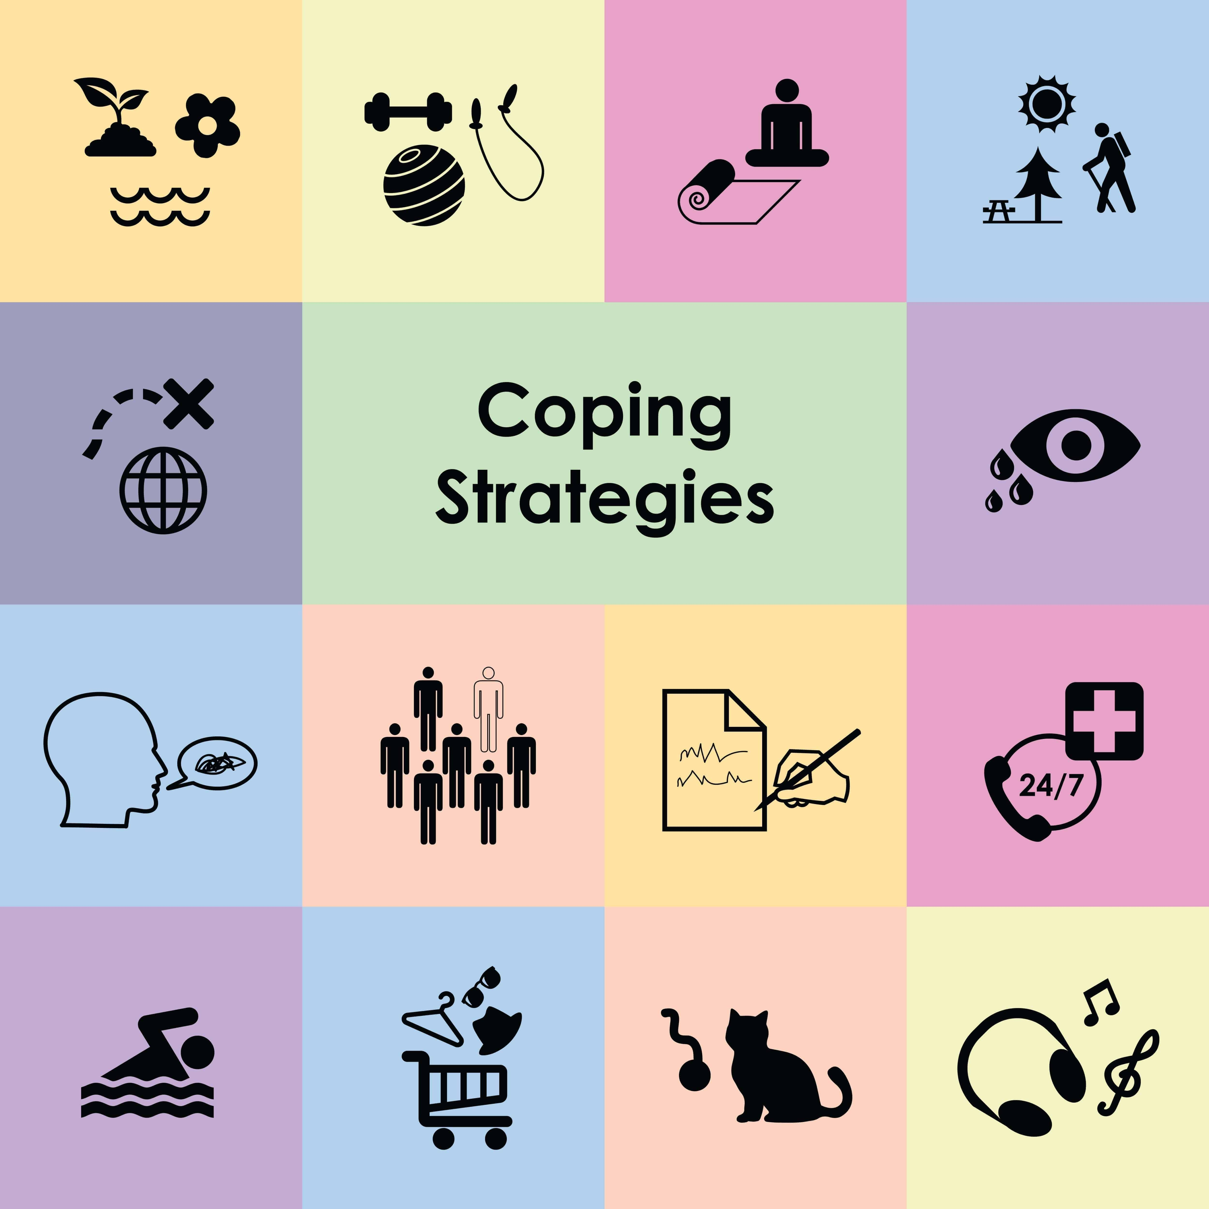
Neuroticism and coping
Coping
Individuals with different levels of neuroticism have different coping strategies. Research found that individuals with high levels of neuroticism are more likely to engage in emotion focused coping and avoidance coping, whereas individuals with low neuroticism engage in problem focused coping which is much more effective in relation to dealing with stress (Boyes, 2010).

Slide 8
References:
APA. (2023). Stress. American Psychological Association. https://dictionary.apa.org/stress
Boyes, M. E., & French, D. J. (2010). Neuroticism, Stress, and Coping in the Context of an Anagram-Solving task. Personality and Individual Differences, 49(5), 380-385. https://doi.org/10.1016/j.paid.2010.04.001
Chochinov, H. M., Kristjanson, L. J., Hack, T. F., Hassard, T., McClement, S., & Harlos, M. (2006). Personality, Neuroticism, and Coping towards the end of Life. Journal of Pain and Symptom Management, 32(4), 332-341. https://doi.org/10.1016/j.jpainsymman.2006.05.011
Gunthert, K. C., Cohen, L. H., & Armeli, S. (1999). The Role of Neuroticism in Daily Stress and Coping. Journal of Personality and Social Psychology, 77(5), 1087-1100. APA PsycNet Buy Page
Hohiyeddini, C., Bauer, S., & Semple, S. (2015). Neuroticism and Stress: The Role of Displacement Behaviour. Anxiety, Stress, Coping, 28(4), 391-407. https://doi.org/10.1080/10615806.2014.1000878
Kernberg, O. F. (2016). What is personality?. Journal of Personality Disorders, 30(2), 145-156. https://doi.org/10.1521/pedi.2106.30.2.145
Lahey, B. B. (2009). Public Health Significance of Neuroticism. American Psychology, 64(4), 241-256. https://psycnet.apa.org/doi/10.1037/a0015309

Slide 9
McCrae. R. R., & Costa, P. T. J. (1991). Adding Liebe und Arbeit: The full Five-Factor Model and Well-Being. Personality and Social Psychology Bulletin, 17(2). https://doi.org/10.1177/014616729101700217
Zilling, L. M. P., Hemenover, S. H, & Dienstbier, R. A. (2002). What do we assess when we assess a Big 5 Trait? Content Analysis of the affective, behavioral, and cognitive processes represented in bog 5 personality inventories. Personality and Social Psychology Bulletin, 28(6), 847-858. https://journals.sagepub.com/doi/pdf/10.1177/0146167202289013?casa_token=Ax_-1GRd- cIAAAAA:tbyV77xhwhrW0YMPaOhhjxykxmLSc3BUGh-qzpwC9vrnN3niSi3hYzwHDhkR_F-q4qG5JvaVYOuMKw

