Slide 1
Assessing the Impact of Zero Trust Security Models on Organizational Risk Reduction and Data Protection in Cloud Environments

Slide 2
Introduction and Research Background
The Cloud data paradigm has transformed the way that data is stored, processed, and manipulated in the organisation through its ability to scale, be flexible, and be low-cost.
In addition, today's cloud trends also pose significant cybersecurity threats like ransomware, lost credentials, phishing, and unauthorized access.
New perimeter-less security models aren't holding up to the distributed cloud.
It's driven a new zero-trust security model, which focuses primarily on continual verification, identity verification, and access management measures.
Notes:
This research focuses on exploring and analyzing new security challenges that occur in the cloud era and already existing challenges in cloud computing. As the ever-changing landscape of cyber attacks has developed, traditional security practices are no longer working. The modern concept of Zero Trust Architecture is highlighted, and the role these principles play in improving the security of organizations, reducing risks, and protecting data.

Slide 3
Research Problem and Motivation
Cloud-based environments continue to be targeted for cyber attacks, theft, data entry or connectivity breaches, and insider threats as ever more organizations deploy cloud computing to fuel their business.
While traditional security models work well with a perimeter-based approach, this option doesn't work well in a distributed cloud architecture [1].
This challenge has led to the need for greater agility in security models.
The research motivation is to investigate the feasibility of re-establishing security measures and reducing risks in organizations through the use of ZTA measures, and to increase data protection in cloud applications.
Notes:
This study focuses on the need to change traditional security solutions to meet the present security needs of the cloud. Cloud adoption increases security risks. The concept of Zero Trust is prompted by the need to investigate whether it can be more effective at securing against emerging and evolving digital attacks.

Slide 4
Research Aim and Objectives
Aim
Objectives
The purpose of the following research is to evaluate the role Zero Trust models play in reducing the risks within organizations and protecting data in the cloud, and to demonstrate their implementation in practice with Microsoft Entra ID.
To analyze and critically evaluate current literature dealing with Zero Trust Architecture, Cloud Security, Cloud Environmental Risk Reduction, and Cloud Data Protection.
To understand identity-based authentication and access control policies and the benefits of continuous monitoring to improve cloud security with Zero Trust.
To analyse and set up conditional access and a system reaction in the Microsoft Entra ID solution for Zero Trust to test the scenarios and how they are handled.
To understand and show how important the results were and how a Zero Trust security solution helped to mitigate risk within the organisations and data in the cloud.
Notes:
The research will attempt to "do this" or "achieve this" and will include the general purpose and goal of the research on this slide. The study assesses the merits of Zero Trust Architecture (ZTA) in reducing risks that are associated with the organization and cloud data. This covers everything from practical examples to literature analysis and Microsoft Entra ID, as well as an analysis of authentication and access control, ongoing monitoring, and the impact of Zero Trust on security.

Slide 5
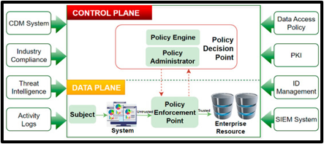
Zero Trust Architecture (ZTA) Fundamentals
The concept of Zero Trust Architecture (ZTA) is relatively new and is based on the principle "Never Trust, Always Verify" in cybersecurity.
ZTA is not like the perimeter-based security models, where no user, device, or application is trusted by default. Continuous authentication, device validation, and contextual risk assessment are ongoing to validate access.
Some of the fundamental elements of ZTA to enhance the security of the cloud include multi-factor authentication, least privilege access, continuous monitoring, micro-segmentation, and automated policy enforcement.
Notes:
This slide gives an overview of the fundamentals of Zero Trust Architecture. This framework eliminates implicit trust and requires logging all access made. Least privilege access, identity-based authentication, and continuous monitoring are just a handful of options that enable this level of security and help protect against today's most common cloud security risks, which is Zero Trust.

Slide 6
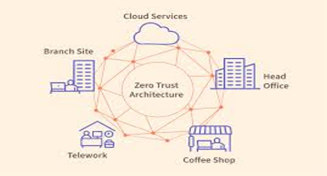
Zero Trust for Organizational Risk Reduction
In ZTA, organisations continuously verify users, devices, and applications prior to granting resource access to minimize risk.
The principle of least privilege is enforced; users only get the permissions they need to do their jobs [2].
Additional access prevention features include suspicious activity detection and prevention, user identification, and automated policy (enforcement) features throughout continuous monitoring.
Future entry of lateral movement into the network is prevented by the controls, attack surfaces are reduced, and an organization's security posture is enhanced.
Notes:
This slide illustrates how Zero Trust is helping to mitigate risks for organizations. The framework continually validates access requests, applies least-privilege access rights, and monitors the actions of the user to reduce any security vulnerabilities, ensure security control, and protect access rights as well as enhance detection and response to cyber threats.

Slide 7
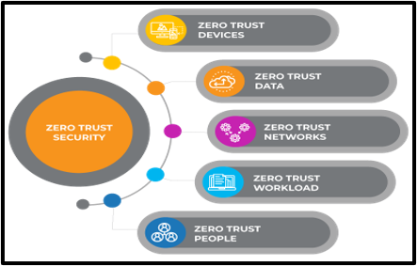
Zero Trust for Data Protection in Cloud Environments
The ZTA approach provides reinforced data security in the cloud with ongoing logins, such as via one-time codes, and user authorizations for accessing data.
The overall framework can be broken down into identity-based access security, multi-factor authentication, encryption, and monitoring in the security of distributed systems.
Cloud Access Security Broker (CASB) and Secure Access Service Edge (SASE) technologies offer even higher security, while allowing secure access to applications and data; data security policies are uniform, and unauthorized access to data is prevented.
Notes:
This slide underscores the advantages and threats of an internet that has developed to be fully trust-free and how such an environment can help to protect cloud data. Companies can be better secured against leakage of sensitive data with proper access management, continuous auditing, encryption, and supervision. This approach means there's less unauthorized access, and data can be at rest assured in terms of protection for confidentiality, integrity, and compliance in cloud environments.

Slide 8
Research Methodology
The research methodology used in this study was interpretivist, which has a qualitative approach and an inductive design.
This research was conducted to gain a deeper understanding of the value contribution to reduce organizational risks and protect cloud data by using the concept of ZTA [3].
The design of the research was based on qualitative research with a format of literature study and a demonstration phase.
The secondary information was collected from academic papers, conference and industry papers, reports, etc.
In addition, the ZT environment was simulated with Microsoft Entra ID, and the authentication, access, and monitoring mechanisms were tested.
Notes:
The method in this study was qualitative, which used the technique of literature analysis and practical experimentation. Both the interpretivist and the inductive approaches helped to gain insight into the principles of Zero Trust. A closed network was set up by Microsoft Entra ID to showcase capabilities of authentication, access control, and continuous monitoring.

Slide 9
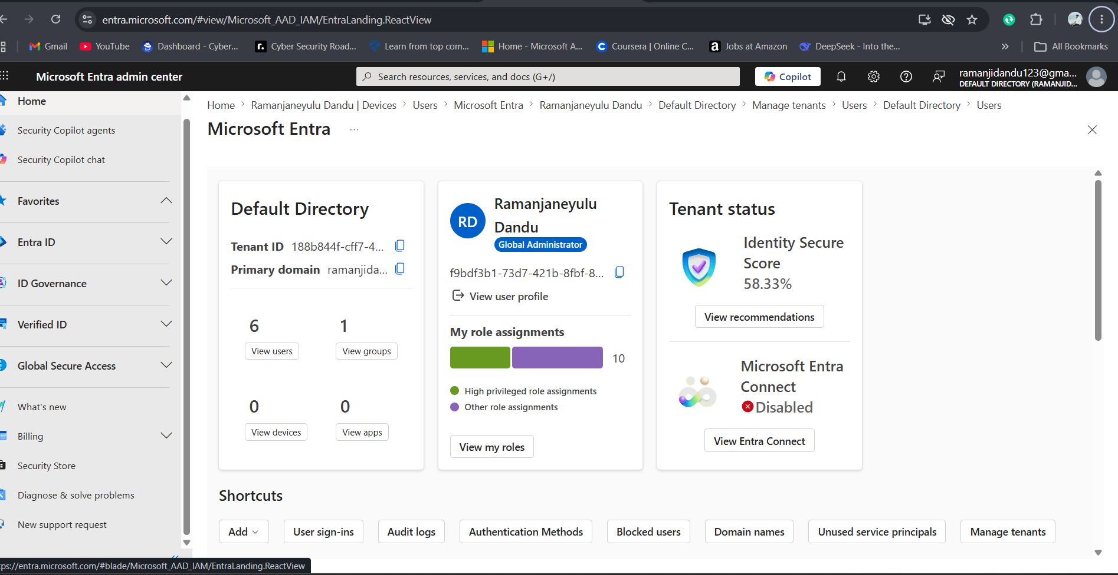
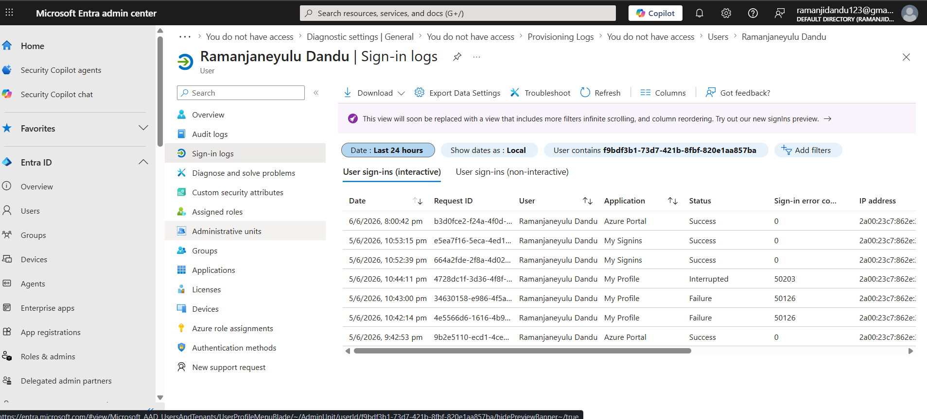
Practical Implementation Using Microsoft Entra ID
A hands-on scenario was demonstrated with Microsoft Entra ID (Free Tier) to demonstrate a Zero Trust scenario within the cloud.
The users had been provisioned in a cloud-based identity directory, and different roles had been configured for the users; Conditional Access (CA) policies and Multi-Factor Authentication (MFA) had been enabled.
Various login scenarios were simulated to evaluate the authentication, access, policy, and system responses to varying levels of security [4].
Notes:
For this slide, consider some scenarios that apply to the real world in which can apply Zero Trust security in conjunction with Microsoft Entra ID. RBAC Policies, MFA Policies, and Conditional Access Policies have been used to simulate each of the real-life user access scenarios. The implementation highlighted the importance of identity verification and automated security measures and provided insights into their role in facilitating access management in a cloud environment.

Slide 10
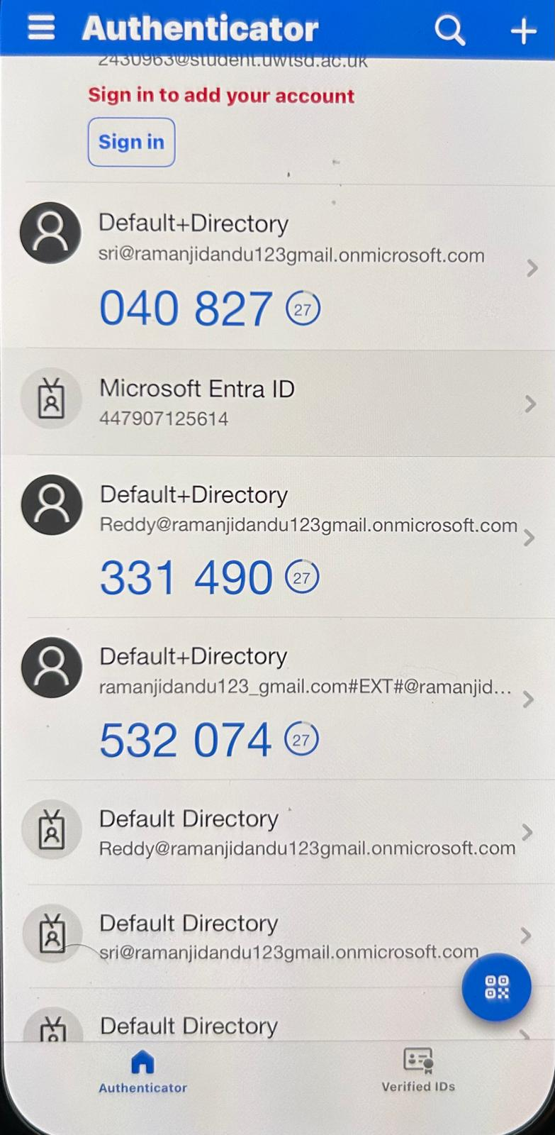
Authentication and Access Control Findings
The security of the cloud was also simulated, and the results confirmed the positive effect obtained when implementing the authentication and access control system in the simulated Zero Trust environment.
Multi-Factor Authentication (MFA) was added to enhance the identity verification process using a variety of approaches other than passwords.
Access to relevant resources was given only when appropriate to users' roles and was accomplished via Role-Based Access Control (RBAC).
The Conditional Access policies assessed user identity, authentication, and user risk dynamically to mitigate the risk of unauthorized access attempts and provide more granular control of security policy.
Notes:
The findings indicate authentication and access control are key aspects of Zero Trust Architecture. When taken together, MFA, RBAC, and Conditional Access policies enabled ongoing identity checks, access based on least privilege, and security for the cloud resources, making it impossible to be compromised by unauthorised users or even the lurking danger of security.

Slide 11
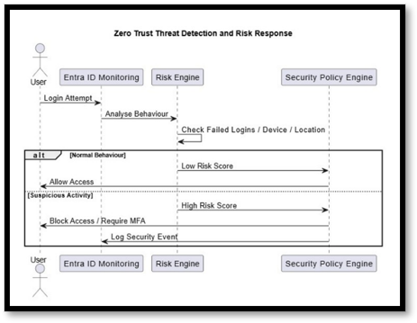
Threat Detection, Risk Reduction and Security Monitoring
ZTA is useful to bolster threat detection and risk thresholds through continuous monitoring and automated response actions to threats in real-life situations [5].
When users logged on several times but failed to log on, or logged on using a device not seen in the file history record, Microsoft Entra ID detected the suspicious logon attempts.
Further testing was performed on further risks and/or access denied because of security policy.
Audit logs offered comprehensive user activity logging, enhancing transparency, responsibility, and quick response capabilities of the organization to potential threats.
Notes:
The policies can be enforced by good audit tracking, and they can be automated via continuous monitoring and rules on them, as suspicion could be discovered early. The other features increased organisations' security and made successful exploits of those organisations more difficult.

Slide 12
Key Findings and Discussion
The findings indicate Zero Trust Architecture to be very valuable to the organizations and safeguarding of their cloud information.
With the adoption of Identity-Based, Multi-Factor Authentication, Role-Based Access Control, and Continuous Verification, the risks of unauthorized access were significantly reduced.
For monitoring and audit movements, it was noticed that these movements could be improved to increase visibility, accountability, and threat detection [6].
The ZT principles in the cloud were found to be flexible and extendable, but needed careful planning, technical integration, and readiness of the organization to effectively apply the concepts of ZT.
Notes:
Key findings backing it include the fact that Zero Trust Architecture offers significant security benefits for cloud-based organizations. Results were found to show that access control was enforced, as well as increased risk reduction, threat detection, and data protection. However, organizations must consider deployment scenarios and how it can be integrated in order to maximize the value of Zero Trust adoption.

Slide 13
Conclusions and Recommendations
The findings of this study reveal that the ZTA model is suitable for the implementation of security in the organization to diminish risk as well as cloud data protection.
It discuss examples of the real world in which Microsoft Entra ID can serve as this identity focus, Multi-Factor (MFA) and Conditional Access policies, and how it continues in monitoring.
On an organizational level, it is recommended to slowly change to the principles of Zero Trust and enhanced identity and access management (IAM) protocols, along with investing in continuous security monitoring.
Then it is crucial to consider just how many more can be deployed and what other problems it will help to resolve in the actual world of cloud security.
Notes:
The study reinforces the application of the ongoing verification and verifier access control attribute of ZTA in order to enhance security in cloud environments. Yet companies must develop a plan to build a Zero Trust strategy to enhance their data protection and risk management. This topic should continue to be explored and developed for more widespread deployment and long-term impacts.

Slide 14
References
Mushtaq, S., Mohsin, M., and Mushtaq, M.M., 2025. A systematic literature review on the implementation and challenges of zero-trust architecture across domains. Sensors, 25(19), p.6118. https://www.mdpi.com/1424-8220/25/19/6118
Dori, A., Au, C.H.A., and Thomas, M., 2026. Advancing Cybersecurity Research in Information Systems Research: A Broader Perspective. https://aisel.aisnet.org/pajais_preprints/56/
Teixeira, P., Eusébio, C. and Teixeira, L., 2024. Understanding the integration of accessibility requirements in the development process of information systems: a systematic literature review. Requirements Engineering, 29(2), pp.143-176. https://link.springer.com/article/10.1007/s00766-023-00409-8
Ghasemshirazi, S., Shirvani, G. and Alipour, M.A., 2023. Zero trust: Applications, challenges, and opportunities. arXiv preprint arXiv:2309.03582. https://arxiv.org/abs/2309.03582
Rivera, J.J.D., Muhammad, A. and Song, W.C., 2024. Securing digital identity in the zero trust architecture: A blockchain approach to privacy-focused multi-factor authentication. IEEE Open Journal of the Communications Society, 5, pp.2792-2814. https://ieeexplore.ieee.org/abstract/document/10505915/
Wang, R., Li, C., Zhang, K., and Tu, B., 2025. Zero-trust-based dynamic access control for cloud computing. Cybersecurity, 8(1), p.12. https://link.springer.com/article/10.1186/s42400-024-00320-x

Slide 15


