Slide 1
Welcome to public law
By Zita Draper

Slide 2

Content
Aims and Learning Objectives.
Introductions.
What will be studied?
How will these sessions run?
Assignments
Trip.
Summary
Thank you, any questions?

Slide 3

Aims and Learning Objectives
The aim of today's session is to introduce students to public Law.
By the end of today's session students should be able to understand what will be studied, how these sessions will run and their first assignment.

Slide 4

Introductions
Who am I?
What are my previous qualifications?
What do I want to do when I finish my degree?

Slide 5

What will we study?
Date | Topic
02/10/2023 | Nature and sources of public law
09/10/2023 | Uk Constitution
16/10/2023 | Seperation of powers
23/10/2023 | Parliamentary Sovereignty
30/10/2023 | Rule of law
06/11/2023 | Devolution
13/11/2023 | Industry week
20/11/2023 | Defamation
27/11/2023 | Judicial review
04/12/2023 | Freedom of assembly and Association
11/12/2023 | Police Powers

Slide 6



How will these sessions run?
2 hour lecture
2 hour workshop

Slide 7
What is expected of me?
Listen to the lectures every week before the workshop.
Attend the workshop.
Ask any questions you have during the workshop.
Engage in the lessons.

Slide 8
Assignments
10 Nov. 2023
1 coursework - 10 November 2023 by 23:59pm
12th Jan 2023
1 Exam

Slide 9

Assignment 1
‘’It has long been argued that the House of Lords is a fundamental element of the Uk parliament. However, recent calls have been made abolish the House of Lords. Is it time to abolish the House of Lords?’’

Slide 10
Guidance
All guidance will be posted on Moodle.
Along with the assignment brief.
A few elements to consider including what is the house of lords?

Slide 11
Continuing
Avoid using the following and similar websites;
1. E law resources.
2. Law teacher.
3. BBC Bitesize.
4. A level sources.

Slide 12

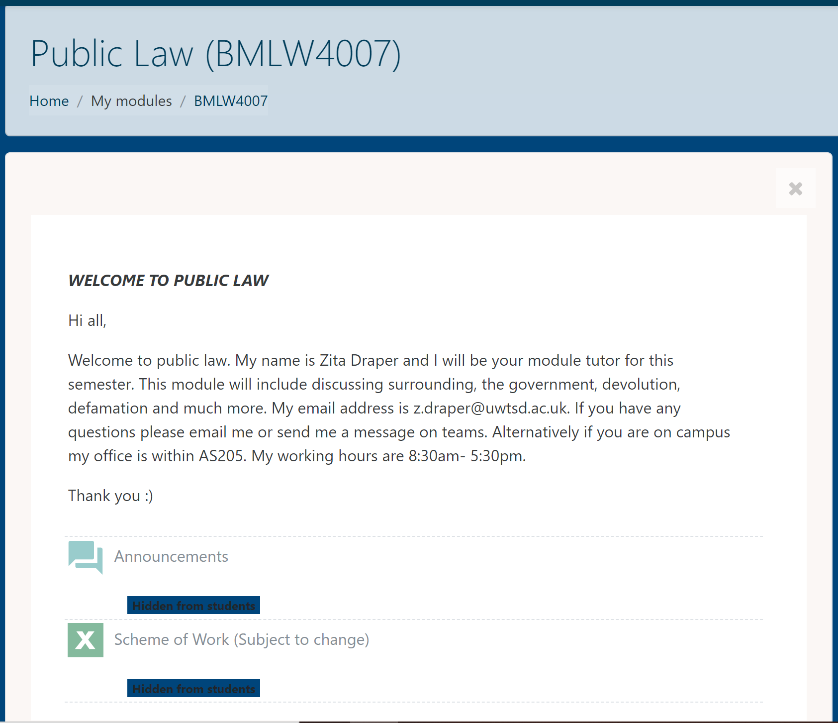

The Moodle page

Slide 13
Trip
On your desk you will have seen a piece of paper which includes information regarding a trip to Cardiff Crown court.
Places are limited.
Please let me know via email asap if you would like to attend.
First come first served basis.

Slide 14

Lets make a start

Slide 15
Question time?
WHAT IS PUBLIC LAW?
In groups or pair discuss and create a definition.
Prepare to share with the class.

Slide 16
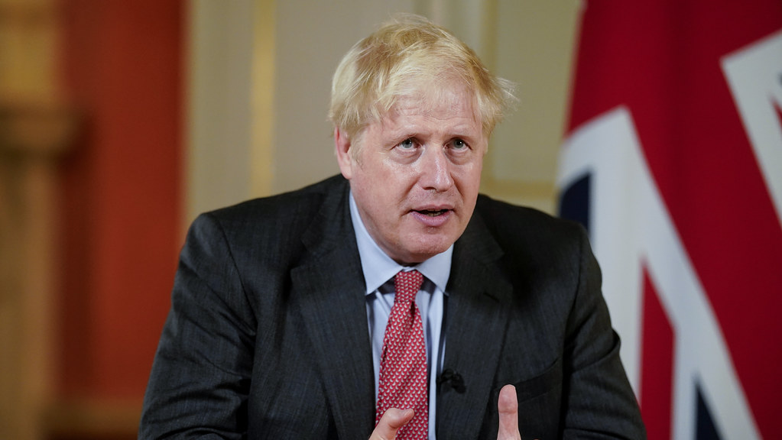
Notes:
He is public law, who is he?

Slide 17

Notes:
We are public law – what does this represent?

Slide 18

Notes:
They are a part of public law.

Slide 19
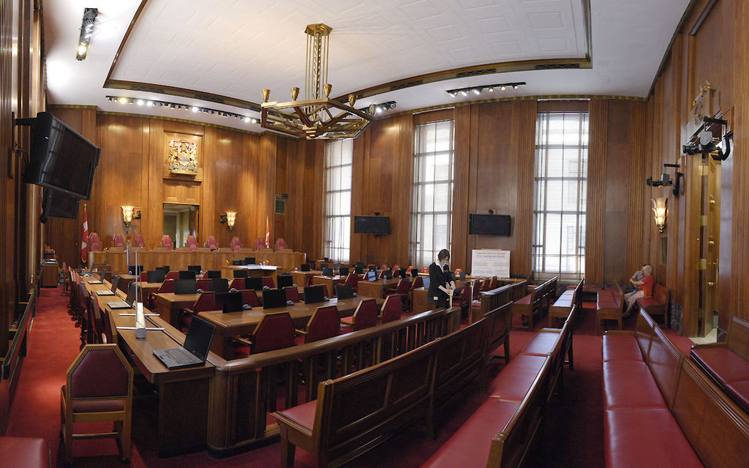
Notes:
This is part of public law.

Slide 20
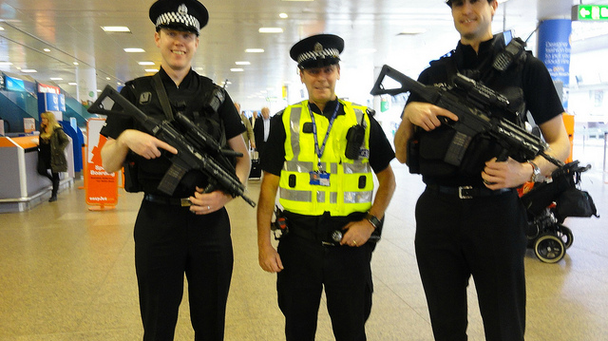
Notes:
These are part of public law.

Slide 21

One example
Notes:
https://www.youtube.com/watch?v=Suzl7ngIc6s

Slide 22
What does public law include?
Rule of law
Separation of powers
Devolution
Freedom of assembly and association
Defamation
Judicial review
Much more.

Slide 23
Research
Research what one of these mean;
I will give one to each groups who will need to provide a definition.
You will have 10 minutes to do this.
Prepare to feedback to the class.

Slide 24
Activity 1
Now you will be placed into groups.
You need to create 5 questions regarding the module that you have.
You have 15 minutes to do this.
Then one member of the group will be asked to feedback to the class.

Slide 25
Trigger warning
A number of elements within these lessons could include difficult topics.
This includes discussion surrounding elements such as euthanasia.

Slide 26
Final notes
When attending the lesson you need to be paying attention.
If you do not you may miss critical information.

Slide 27
My contact information
Email; z.draper@uwtsd.ac.uk
Teams- Zita Draper
Office – AS205 (Monday and Tuesday)

Slide 28

Summary
Module structure.
Assessments.
Scheme of work.
Assignment 1.
Contact information.

Slide 29
Thank you!
Any Questions?

