Slide 1
Declining Profitability at TM Lewin. UK
Module: problem solving and decision making
Module code: bmsw4004
Lecturer name: chijioke uba
Student name: Ana Maria ioana
Student ID: 2130078

Slide 2
Table of content
Introduction
Nature and impact on employees and the organisation
Impact on the employees and the organisation
PESTLE Analysis of the macroenvironmental factors
Fish bone diagram for cause and effect
Alternative Solutions To The Problem
Conclusion
References

Slide 3
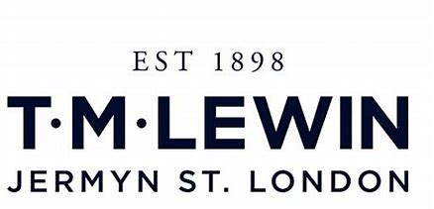
Introduction
The presentation will cover the following objectives:
Discussion on the analysis of the nature and impact of complex tests on employees and their teams.
A PESTLE analysis of macro-environmental components works in a complex environment.
Condition-based research and logical outcomes in the analysis of complex questions using spine diagrams.
The analysis of the problem structure can lead to the selection of the best response among these possible outcomes.
Notes:
In this presentation, The management team of Force Brands understands that if the reasons for the decrease in profits are not investigated and resolved, the business rate may continue to decrease, putting the presence of the organization in the future. On the one hand, they hired them as an expert to help them determine the origin and consequences of the problem (to reduce profits), and to create a solution that will help them improve the situation.

Slide 4

Nature and impact on employees and the organisation
Nature:
Growing expansion is a source of conflict for both consumers and consumers.
Although retailers are making special efforts to reduce the cost of development, the expansion of transportation, energy, material costs, and stoppages motivate them to support costs.
However, the subsidy can lead to the front when customers encounter financial problems such as the problem of the cost of many things every day.
Notes:
The t-shirt maker, which employs about 50 people, has struggled due to a drop in t-shirt purchases as customers work from home in large numbers and large public events. Before the epidemic, the group had spread north to 150 regions around the world. Men's clothing, especially fashion, has been one of the hardest hit business areas during the pandemic as work from home approaches and second hand restrictions have reduced interest in fashion and regulatory reform.

Slide 5
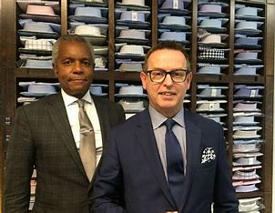

Impact on the employees and the organisation
There is no doubt that the following surge in consumer spending will lead to A decline in business profits that are :
Supply chain issues
Inflation
Current cost-of-living
Notes:
There is no doubt that the following surge in consumer spending will lead to A decline in business profits that are :
Supply chain issues: The company has 68 countries and territories and 89 stores around the world, including Ireland, Australia, the United States and Europe. Freedom, Loro Piano, Albina and Flake are among the brands in the TM Lewin company.
Inflation: Higher costs and transportation costs expect companies to reduce their profits or pass these costs on to buyers as higher business costs. Many companies, especially open partnerships and trust services for entrepreneurs, choose to increase their prices for the sake of their business.
Current cost-of-living : In fact, even those who want to stay in business are looking for new things, the results of which will be used in their current work. If the store can't support the refund, their representatives will leave. This put the shippers in a difficult position. Paying their workers more, in that sense, spreads the benefits to those who are currently weak, or remain unemployed. Both are not good to show the opinion and respect of the buyer.

Slide 6
PESTLE Analysis of the macroenvironmental factors
Political
Economical
Social
Technological
Legal
Environmental
Notes:
Political: Around 650 of TM Lewin's 700 employees have been made redundant under the UK's Covid-19 workforce management plan, with stores closing temporarily throughout the pandemic. The 50 disgruntled agents worked for TM Lewin in the store's computer and network operations.
Economical: In the UK, the inflation was 1.94%. in 2019 is 1.7%. From about 2017, it increased about 3.1%. It should not exceed 2%, according to the guidelines of the Bank of Britain. Despite the fact that a little increase does not mean anything, it is a journey(Bernanke, et al., 2018).
Social: Customers from high-income countries are more likely to buy branded products than gifts. Areas with moderate and low costs. The cost of things is very important. An accurate analysis of the customers and the operating area can help the company to sell.
Technological: Innovation ideas are great for customers, but they don't help small businesses. Since they have limited resources, setting up a secure site using complex innovations based on human intelligence is not practical. As more and more consumers want their goods delivered to their homes, small business establishments are struggling.
Environmental: Retail brands can show their conscience by reducing energy waste. They can reduce waste and follow the organization's internal and external hygiene standards while complying with local government welfare laws. This will help them maintain food quality and avoid bacterial infections.
Legal: Many retail companies that have assembly departments source their raw materials from foreign countries. Also, they ship their products to customers all over the world. In general, issue regulations, product and import regulations, and unknown trade regulations may affect the business. For a retail company that operates worldwide, familiarity with neighborhood standards is important.

Slide 7
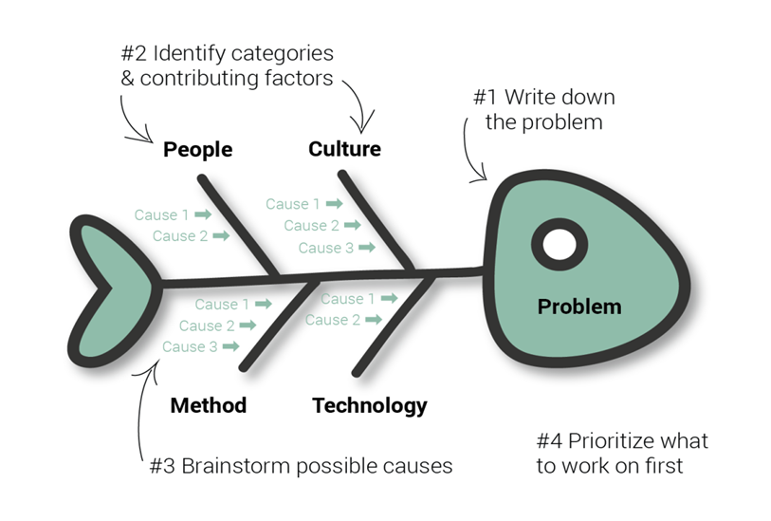
Fish bone diagram for cause and effect
Step 1 The problem: As discussed earlier, the problem for the business is Men's clothing, especially fashion clothing, has been one of the most difficult business areas during this pandemic, as domestic regulation and second-hand restrictions have reduced interest in clothing and regulatory reform.
Regardless of how the company has made great progress in the early stages of the disease, the impact of the epidemic on this well-known English brand is devastating.
The stress of the store network, the expansion and the cost of many things that are done every day affect the consumer spending and will lead to a decrease in profits for the association.
Notes:
The t-shirt maker, which employs about 50 people, has struggled due to a drop in t-shirt purchases as customers work from home in large numbers and large public events. Before the pandemic, the group had spread north to 150 regions worldwide. Men's clothing, especially clothing, has been one of the hardest hit businesses during the pandemic as work from home approaches and temporary restrictions have reduced interest in suits and legal reforms(Zhang, Nakamura, and Sakurai, 2019)
Regardless of how the company made great changes in the early stages of the disease, the impact of the epidemic on this famous English brand is devastating. The stress of the store network, the expansion and the cost of many things that are done every day affect the consumer spending and will lead to a decrease in profits for the association.

Slide 8
Step 2 The category of causes
Cause Of Problem
Manpower
Machine
Material
Method
Notes:
Manpower:The t-shirt manufacturer, which employs about 50 people, has struggled due to reduced purchases of appropriate t-shirts as customers interact with limited and important social events.
Machinery : Taking more time of the arm and needle alone
A sewing machine
A multi-needle knitting machine
Sewing machine with overlock closure
There are two types of locks: flat and chamber.
Materials: Cotton is a popular material for online shirt printing. Polyester, another popular material for custom shirts, is the most common material used in sportswear. The poly-cotton blend, which is usually a 50:50 blend of polyester and cotton, meets the best conditions - casual text and technology. This is another regular texture that is best suited for summer wear because it is very thick. It rarely seems like other things are talking.
methods-shirt manufacturers receive orders from brands, overseas buyers and retailers. Customers buy fabric and give it to a designer to make them a shirt. Various items, such as sewing thread, buttons and iron inserts, were purchased from the worker. Since pressing the button is not necessary here, no button is bought. Qualified inspectors evaluate texture and aesthetics. Imperfect substances are separated from substances that make drugs. Material reduction begins as soon as the texture is identified and the sample is ready to use. The texture is placed on a flat surface. Designers or tailors use sewing machines to make shirts. To begin with, the shirt section is made. Buttons are placed on the collar, cuffs and front buttons in the last step. In these pages, the button is used. All stations are supported.

Slide 9
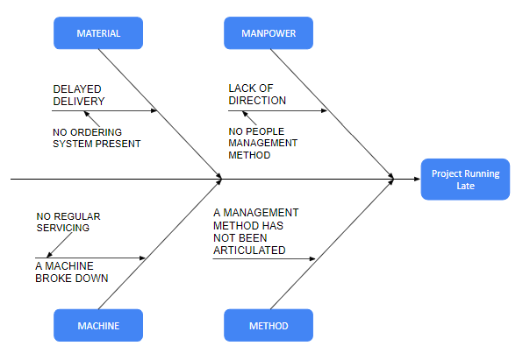
Step 3 Name the causes
Materials: due to the inflation, the import duty is high so there has been a delay in delivery of raw materials.
Manpower: work from home and time limits have reduced the interest in suits and clothes.
Machine: Most equipment requires regular maintenance to function properly, but preventative maintenance is often the only thing that needs to be done when it's not working properly.
Methods: Fast turnaround times can lead to department fatigue and increased demand. Partners may not be useful or try not to participate in class.
Notes:
Resources: Due to expansion, the demand for imports is high, so there has been a period of postponement of natural resources.
Work: Access to mobile phones and limited time has reduced the interest in clothing and apparel. Fast turnaround times can lead to department fatigue and increased demand.
Organization: High turnover can be expensive and burdensome for their business. An incentive payout plan for their affiliates is a shot method to kill this wager.
The problem: the results are reduced in performance
Partners may not be useful or try not to participate in class
Most applications require standard support for good performance, but when you're working hard and overloaded, security is often the most important thing to do. By the time things seem to be running smoothly for everyone, it's tempting to ignore regular support, and many companies are working on why full-time employees will use see potential problems.

Slide 10
Alternative Solutions To The Problem
Explore ways to reduce their costs before they disappear. Invest in precious metals, such as gold, oil, and silver. Stock prices have increased significantly during expansions, and they can profit from this if they buy inventory at low prices and resell them at high prices during expansions.
Taxes, fines and customs processing time, Cannot achieve structure or compatibility, Port restrictions and delays in removing or moving goods
Price control is an important factor to prevent price pressure, which is whiteware strongly interested in rent guidelines and thresholds, as well as the basis of price containment in the foundation. Cutting the tank, which is currently at a height of 20%, will also be a logical step (Glick, Leduc, and Pepper, 2022).
Notes:
Explore ways to reduce their costs before they disappear. Invest in precious metals, such as gold, oil, and silver. Stock prices have increased significantly during expansions, and they can profit from this if they buy inventory at low prices and resell them at high prices during expansions. Whatever frugalists' general assessment of the pros and cons of buying in bulk, this season can be a good opportunity to stock up on non-perishable food while they're on the money.
Taxes, fines and customs processing time
Cannot achieve structure or compatibility
Port restrictions and delays in removing or moving goods
Threats to free development come from economic, environmental and political changes
Price control is an important factor to prevent price pressure, which is whiteware strongly interested in rent guidelines and thresholds, as well as the basis of price containment in the foundation. Cutting the tank, which is currently at a height of 20%, will also be a logical step.

Slide 11
Best Appropriate Solution
Price control is an important factor to prevent price pressure, which is why they are strongly interested in rent guidelines and thresholds, as well as the basis of price containment in the foundation.
Notes:
Companies pay employees high wages and salaries while their employees struggle to earn enough money to cover those costs. This supported the reinstatement of the Labor's original plan of imposing "excessive compensation" on companies whose agents receive disproportionately high or unreasonable compensation.

Slide 12
Conclusion
The presentation had covered the following objectives:
Discussions in preparation for the analysis of the nature and impact of complex tests on employees and their members.
PESTLE Analysis of Macro-Environmental Resources Working in Diverse Situations.
Situation-based research and logical outcomes in the analysis of complex questions using a spine chart.
The analysis of problem solving can be focused entirely on choosing the best solution among the possible outcomes.
Notes:
The management team of Force Brands believes that if the reasons for the decrease in profitability are not investigated and addressed, the business rate may continue to decrease, damaging the presence of the organization in the future. On the one hand, they have chosen an expert to help them determine the source and result of the problem (reduced productivity), and to create a solution or solutions that will enable them to cope with what is happening.

Slide 13
Reference
Zhang, H., Nakamura, T. and Sakurai, K., 2019, August. Security and trust issues on digital supply chain. In 2019 IEEE Intl Conf on Dependable, Autonomic and Secure Computing, Intl Conf on Pervasive Intelligence and Computing, Intl Conf on Cloud and Big Data Computing, Intl Conf on Cyber Science and Technology Congress (DASC/PiCom/CBDCom/CyberSciTech) (pp. 338-343). IEEE.
Bernanke, B.S., Laubach, T., Mishkin, F.S. and Posen, A.S., 2018. Inflation targeting. In Inflation Targeting. Princeton University Press.
Glick, R., Leduc, S. and Pepper, M., 2022. Will Workers Demand Cost-of-Living Adjustments?. FRBSF Economic Letter, 2022(21), pp.1-6.

