Slide 1

MCZ
Business Proposal

Slide 2





Mission Statement
“If it needs a socket, a plug or even a usb - we'll have it!”

Slide 3
Business Overview
Our business proposal is an online shopping website focused on selling electronics, gadgets and accessories.
The company is called MCZ and the website will be www.MCZonline.co.uk

Slide 4

The Team
Founder and CEO: Cezar Sulugiuc
  - Cezar is an aspiring and ambitious young student which set it’s goal to create this online shopping platform without any previous business experience. He previously worked for Amazon and wanted to develop a similar type of business just because he understood the benefits that this type of activity would bring.
Market Research and Advertising: Anca Sulugiuc
  - Anca, as well as Cezar, is a young, ambitious and determined student who wants to help her husband into achieving his goals by developing this platform. By previously having sales and marketing experience, Anca hopes to build the foundation of the platform by bringing her knowledge of sales and customer service.

Slide 5
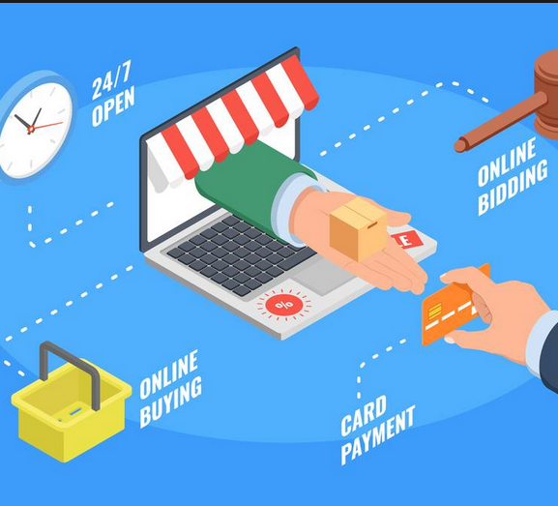
Market Summary
The e-commerce or the e-business refers to the process of buying and selling goods and services over the Internet, and the transfer of money to execute these transactions. (Shopify, 2018)
The UK has one of the largest e-commerce markets in the world, the most recent figures rise up to 533 billion GBP in 2015. E-commerce accounted for approx. 19% of all UK’s business turnover. (Facts, 2018)

Slide 6
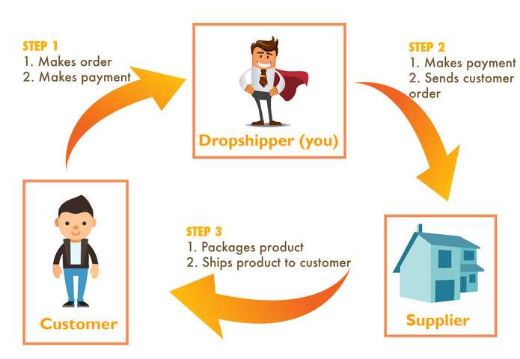
Opportunities
One of the first major advantages to e-commerce is that it can be mainly a clicks-type of business that does not require many resources, like fixed capital. E-commerce can be started at the comfort of one’s home with only a personal computer or a mobile device with Internet access.
One of the easiest way to do e-commerce is to do “dropshipping”. Dropshipping refers to the process of virtually selling an item on a website only to process the actual sale when a customer buys it. This means that you can set up an item which you do not posses on a website and to order it from somewhere else after a customer has placed an order to buy it. It is more or less the process of being a “middle-man”.

Slide 7




Business Description
The business we are proposing is an electronics e-shop, modelled after the site eMAG. eMAG is a Romanian online electronics retailer founded in 2009 which had a rapid development to being one of the largest of its kind in the eastern Europe. The site started in 2001 but later in 2009 it was acquired by a larger investor – Asesoft Distribution and further on, in 2012, it was acquired by Sud African Naspers investment group. (Ro.wikipedia.org, 2018)
MCZ, as an online shopping platform, intends to rise up to eMAG’s potential in what regards figures and development. As the mission statement shows, “If it needs a socket, a plug or even a usb - we'll have it!”, MCZ’s mission is to become an online retailer with a large diversity of products, for all tastes and prices.

Slide 8

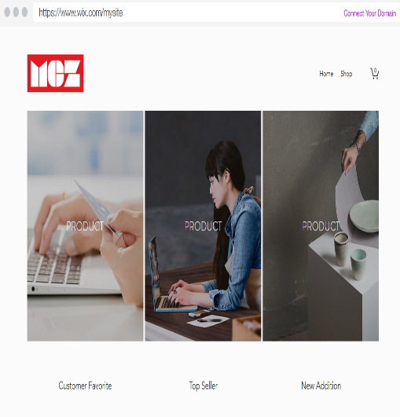
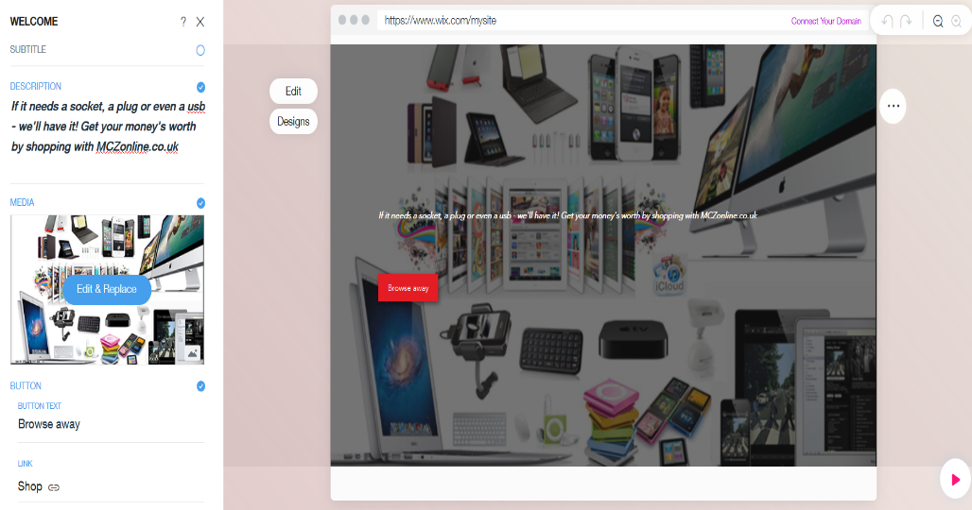
Business Initial Development
One of the main reasons, we decided to start this type of business, is that it is a low-cost option to quickly develop.
The site – the first step in starting the business is the website. We used for this, Cezar’s knowledge in digital skills and an interactive website-building platform called WIX. (www.wix.com)
The main competitor on the market is the well-known retailer – Amazon. Amazon is the second-largest online retailer after Alibaba. (Bloomberg.com, 2018)

Slide 9
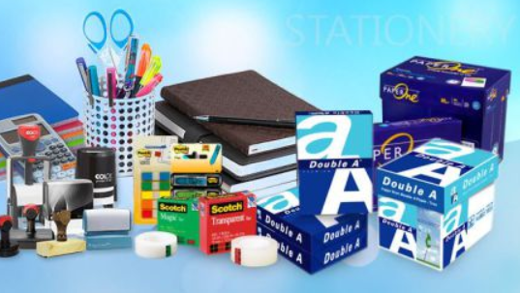
Resources
Website – the WIX platform offers also a free website to create. The only downside would be that the website-s domain cannot be customized – there is, however, the option to rent a domain for 49.90 GBP for 5 years.
The “warehouse” – in the beginning, we will use as space for stocks one of our flat’s bedrooms which we do not use and it is unfurnished.
Fixed capital – we already own a high-end laptop (1150 GBP), a printer and we have also a high speed internet connectivity (34 GBP/month). Further on, packaging supplies will have to be acquired – bubble wraps, standard cardboard boxes, office stationery (folders, staplers, pens)
Legal aspects – once the website has been created, the name MCZonline will be owned by the company and the WIX platform offers copyright protection embedded within the website.
Funding – the start-up funding will be provided by our personal savings. We already opened savings accounts which will be topped up with 200 GBP every month for the next 6 months. Besides using our savings accounts, we are looking into the possibility of applying for a small business loan
The stock – initially, the majority of the items will be purchased in bulk from Asian markets at low cost. The downside with this is that the shipping time is rather lengthy and there might be shipping costs or even customs fees. The second option for acquiring stock is to buy lots from auctions. We have already opened account on the police website which gives access to information about all the auctions happening in Wales. Here as well there are auction fees which will need covering but the advantage is that there will be no shipping costs and we can get the items quickly.

Slide 10

Marketing and Advertising
Advertising – As stated previously – the initial budget will be built through savings, therefore, we chose as a marketing platform, social networks like Facebook. Other low-cost marketing options would be starting-up a blog linked to the website, but in the later stages of the project.
Through Facebook, our website will promote its products using the well-known feature called Facebook Market. In our area, Swansea, on Facebook, there are many selling groups where everybody can sell, buy or even promote their own products. It is a great opportunity to increase the website’s notoriety and to build-up the customer base.
Other options – flyers (average price for 1000 flyers – 12 GBP), business cards (250 pcs. – 10 BGP), public networking events.

Slide 11

Marketing Strategies
Market target – In the beginning, we will focus our products on the younger category of consumers (18 – 40). Our products will focus on this customer segment mainly because the older generation of people are not that accustomed with the ongoing advances in technology.
Pricing – Initially, our prices will have a rather small profit margin, our focus for the first 2 years will be to establish the website on the market and to become popular. The strategy here would be to acquire low cost items from the Asian markets and to adapt the prices here according to the major retailers (Amazon, eBay)
The 7 p’s:
  - product – electronics;
  - promotion – social networks;
  - price – slightly smaller than the direct competition;
  - place – e-commerce;
  - people – the founders;
  - process – parcel shipping;
  - physical evidence – the products themselves;

Slide 12
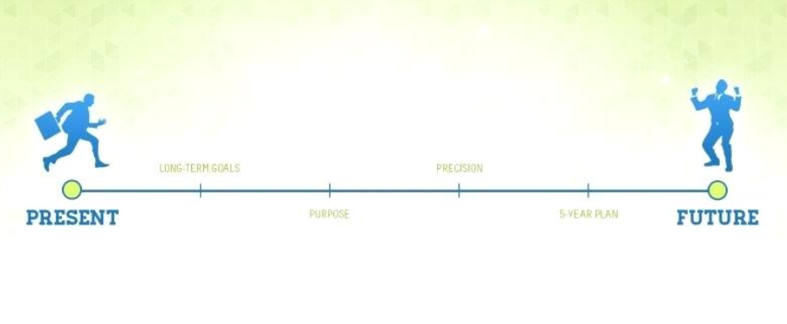
5 Year Plan
Start-up the website (fully built)
Amass diversified stock
Promote the website through social network until the first radio commercial
Become well-known in Swansea area
Future goal – become popular enough to be able to afford a contract with a manufacturer in order to launch our own products under our brand.

Slide 13
Conclusion
SWOT analysis
  - Strengths – one of the main strengths of an e-commerce business is that it can reach a vast number of potential customers easily. No matter how far a potential customer is from the physical location of the business, he can access or buy the merchandise from the comfort of their own home.
  - Weaknesses – one of the major weaknesses of an online business is the fact that the customer cannot hold or check physically the item before buying it; another weakness would be that, websites can be vulnerable from cyber attacks which can affect the websites credibility;
  - Opportunities – the Internet is the biggest and the most diverse space to develop a business; using the world wide web as a platform for a business speeds up the process of building a place on the market;
  - Threats – direct competition would be a major threat to a small start-up online shop. Customers will be difficult to persuade in trusting a new brand when they are already accustomed in using the major retailers.

Slide 14
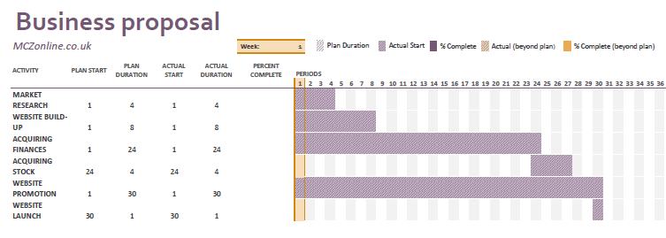
Gantt Chart

Slide 15
Reference list
Shopify. (2018). What is Ecommerce? Definition - What is What is Ecommerce?. [online] Available at: https://www.shopify.com/encyclopedia/what-is-ecommerce [Accessed 3 Nov. 2018].
Facts, E. (2018). Topic: E-commerce in the United Kingdom (UK). [online] www.statista.com. Available at: https://www.statista.com/topics/2333/e-commerce-in-the-united-kingdom/ [Accessed 3 Nov. 2018].
Ro.wikipedia.org. (2018). EMAG. [online] Available at: https://ro.wikipedia.org/wiki/EMAG [Accessed 3 Nov. 2018].
Wix.com. (2018). Free Website Builder | Create a Free Website | Wix.com. [online] Available at: https://www.wix.com/ [Accessed 3 Nov. 2018].
Bloomberg.com. (2018). Bloomberg - Amazon. [online] Available at: https://www.bloomberg.com/research/stocks/private/snapshot.asp?privcapId=18749 [Accessed 3 Nov. 2018].

