Slide 1


Llwybr Datblygu’r Gymraeg
Welsh Language Development Pathway
BA1 – Darlith 12
Chwefror 20fed 2024

Slide 2

Nod y wers heddiw ydy...
The aim of today's lesson is...
Adolygu
Revision
Darllen stori yn Gymraeg
Read a story in Welsh
Methodoleg
Methodology

Slide 3

Amser Cofrestru
Registration Time

Slide 4

Helpwr Heddiw!
Rhif​ | Pwy?​
1​ | Alex
2​ | Amelia
3​ | Amy
4​ | Beau
5​ | Cara
6 | Chelsie
7 | Dominic
8 | Emily
9 | Hannah
10 | Hazel
11 | Isobel
12 | Jacob
Rhif​ | Pwy?​
13​ | Josh
14​ | Lara
15​ | Kelly
16 | Marli
17 | Polly
18 | Storm
19 | Tia
20 | Tilly
21 | Zoe

Slide 5

Bore da, bawb/blant/ddosbarth!
Ydy … yma heddiw?
Cwestiynau
Helpwr Heddiw
Beth ydy dy hoff fwyd/lyfr/raglen/liw/bwnc di?
Sut wyt ti?
Pwy sy'n absennol heddiw?
Wyt ti eisiau cinio
ysgol neu frechdanau?
Pa ddydd ydy hi heddiw?
Sut mae'r tywydd heddiw?
Pa fis ydy hi?
Pa dymor ydy hi?
Sut oedd y tywydd ddoe?
Ydy hi'n heulog heddiw?
Sut bydd y tywydd yfory?
Ydy hi'n ddydd Mawrth heddiw?

Slide 6
Adolygu
Revision

Slide 7


​ Dyma...
(Here is... or This is...) ​
Dyma Tom.
Dyma Mrs Jones.

Slide 8

There is a soft mutation after ‘Dyma’.
p > b
t > d
c > g
b > f
d > dd
g > -
m > f
ll > l
rh > r
Dyma Ddosbarth Miss Morgan.
Here is Miss Morgan’s Class.
Dyma Flwyddyn 3.
Here is Year 3.

Slide 9

pensil
Dyma bensil. ​

Slide 10

creonau
Dyma greonau. ​

Slide 11

pren mesur
Dyma bren mesur. ​

Slide 12

cyfrifiadur
Dyma gyfrifiadur. ​

Slide 13

bachgen
Dyma fachgen. ​

Slide 14

merch
Dyma ferch. ​

Slide 15
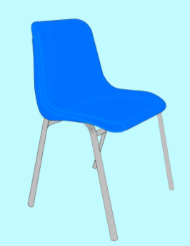
cadair
Dyma gadair. ​

Slide 16
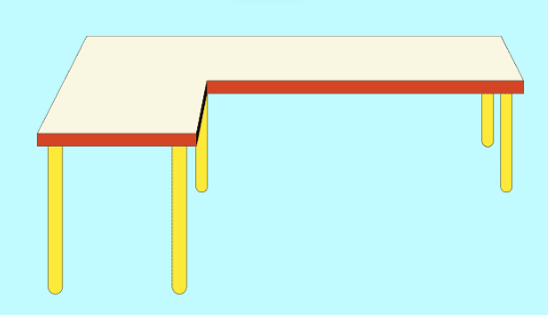
bwrdd
Dyma fwrdd. ​

Slide 17

Pa + Treiglad Meddal
There is a soft mutation after ‘Pa’
p > b
t > d
c > g
b > f
d > dd
g > -
m > f
ll > l
rh > r
Pa liw wyt ti’n hoffi?
Pa fwyd wyt ti’n hoffi?
Pa lyfr wyt ti’n hoffi?
Pa ddillad wyt ti’n hoffi?
Pa chwaraeon wyt ti’n hoffi?
Pa ffilmiau wyt ti’n hoffi?
Dw i’n hoffi…

Slide 18
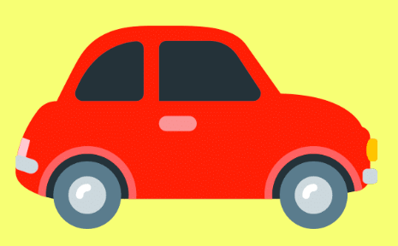
Pa liw ydy’r car?
Mae’r car yn goch.

Slide 19

Pa liw ydy’r afal?
Mae’r afal yn wyrdd.

Slide 20


Pa liw wyt ti’n hoffi?
What colour do you like? (singular)
Dw i’n hoffi…
I like…

Slide 21

Pa liw dwyt ti ddim yn hoffi?
What colour don’t you like? (singular)
Dydw i ddim yn hoffi…
Dw i ddim yn hoffi…
I don’t like…

Slide 22
Darllen stori!
Reading a story!

Slide 23

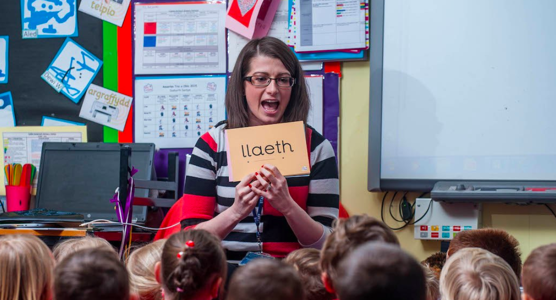
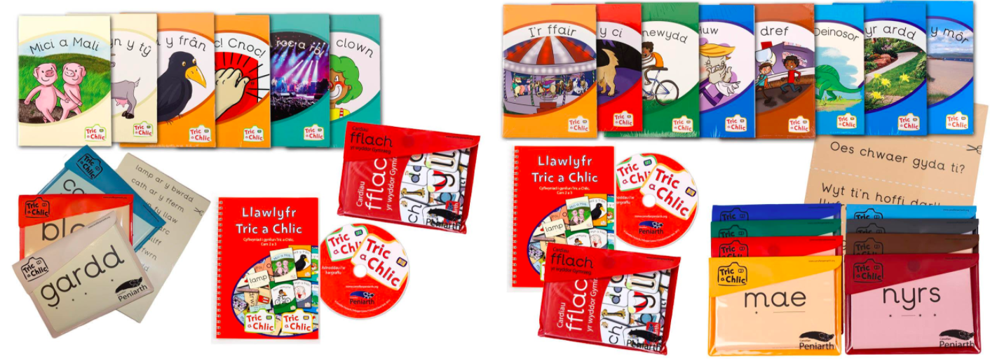

Cyfresi darllen ac adnoddau defnyddiol
Reading series and useful resources
System ffoneg i ddysgu ynganu, sillafu a strwythuro brawddegau.
A phonics system to teach Welsh pronunciation, spelling and how to structure sentences.

Slide 24

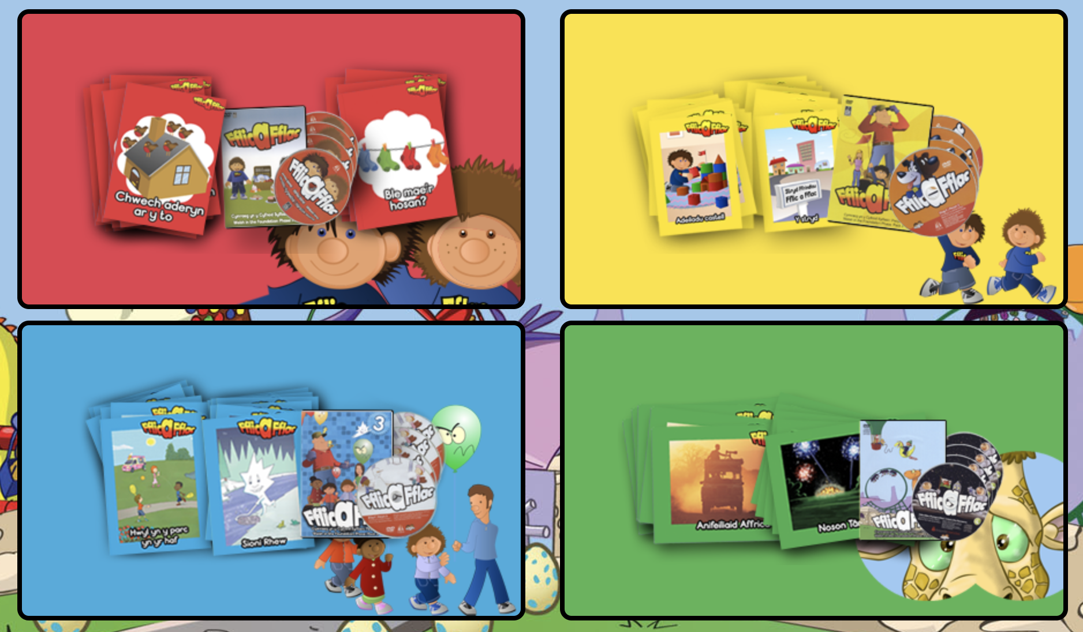
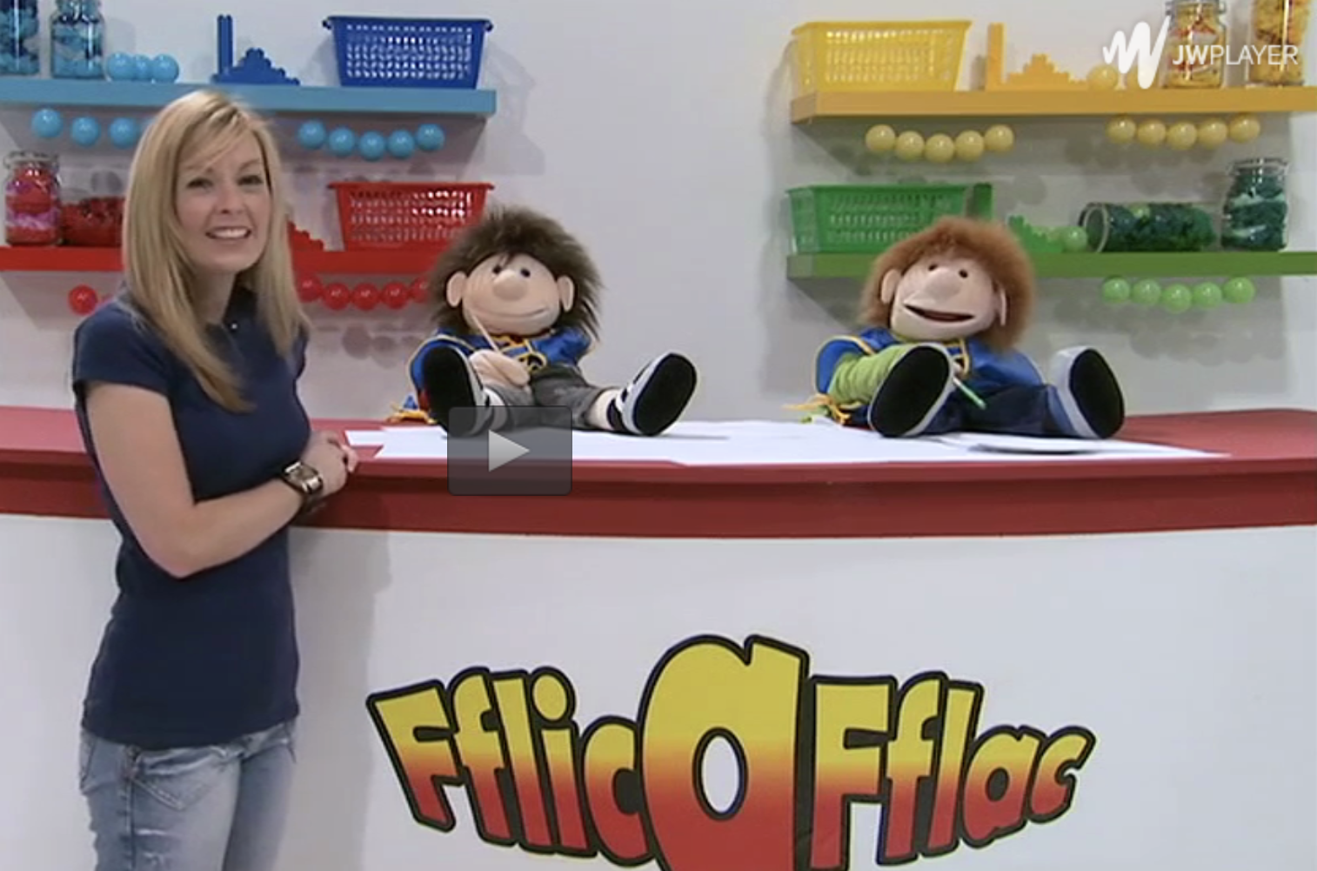
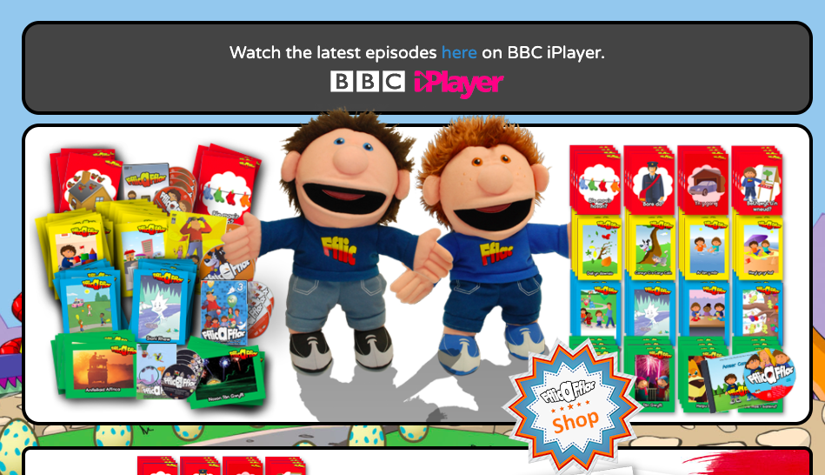

Cyfresi llyfrau a rhaglenni ar bedair haen.
A reading book and television programme series – four different levels. Free resources online.

Slide 25





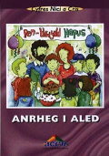
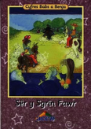
Cyfresi darllen ac adnoddau defnyddiol
Reading series and useful resources
Cyfres Nici a Cris
Llyfrau darllen i ddisgyblion
9 - 11 oed.
Reading books for 9 - 11 year old pupils.
Cyfres Babs a Benja
Llyfrau darllen i ddisgyblion 7 - 9 oed.
Reading books for 7 - 9 year old pupils.

Slide 26

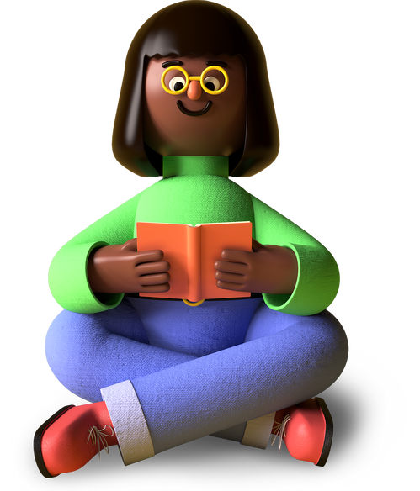
Dewch i eistedd!
(London Bridge is falling down)
Dewch i eistedd ar y mat,
Ar y mat, ar y mat,
Dewch i eistedd ar y mat,
i ddarllen stori!

Slide 27
Dewch i ddarllen!
(Clementine)
Dewch i ddarllen!
Dewch i ddarllen!
Ar y carped gyda fi.
Dewch i ddarllen!
Dewch i ddarllen!
Ar y carped gyda fi.

Slide 28


Mae hi’n amser stori nawr!
(Twinkle, twinkle little star)
Dewch i eistedd ar y llawr,
Dewch i edrych ar y clawr.
Dewch i deithio dros y byd,
Dewch i wlad drysor a hud.
Dewch i eistedd ar y llawr
Mae hi’n amser stori nawr.

Slide 29
Geirfa Ddefnyddiol – Useful Vocabulary
Cymraeg | Saesneg
llyfr | book
clawr | cover
awdur | author
teitl | title
tudalen | page
tudalennau | pages
llun | picture
lluniau | pictures
stori | story
arlunydd | illustrator
cyfres | series
cymeriad | character
Cymraeg | Saesneg
cymeriadau | characters
prif gymeriad | main character
ar y dechrau | at the beginning
canol | middle
diwedd | end
doniol | funny
lliwgar | colourful
diddorol | interesting
cyffrous | exciting
ardderchog | excellent
hapus | happy
trist | sad

Slide 30

Mae hi'n amser stori!
It's story time!
Pwy sy eisiau darllen stori?
Who wants to read a story?

Slide 31
Pwy sy eisiau darllen stori?
Who wants to read a story?
Dewch i eistedd!
Come to sit!
Dewch i wrando ar y stori!
Come to listen to the story.
Gwrandewch! Gwrandewch arna i. Gwrandewch yn ofalus….
Listen! Listen to me. Listen carefully ..
Pawb yn dawel!
Everybody quiet!
Dim siarad!
No talking!

Slide 32

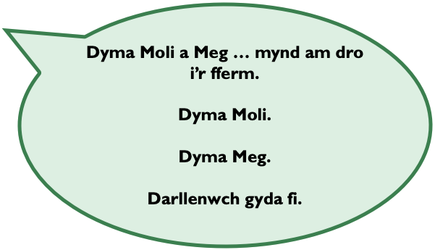
Mae hi'n amser stori!
It's story time!

Slide 33
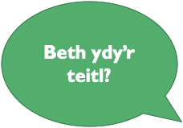

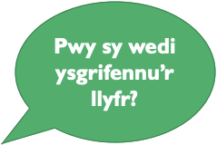
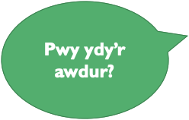
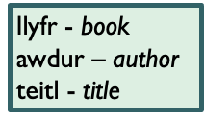
Mae hi'n amser stori!

Slide 34


Edrychwch ar y clawr.
Look at the cover.

Slide 35
Pwy ydy’r awdur?
Who is the author?
Pwy sy wedi ysgrifennu’r llyfr?
Who has written the book?
Beth ydy’r teitl?
What is the title?
Pwy ydy’r arlunydd?
Who is the author?
Pwy sy wedi tynnu’r lluniau?
Who has drawn the pictures?
Beth sy ar y clawr?
What is on the cover?

Slide 36

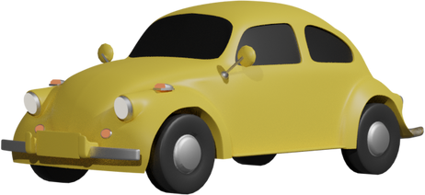
Beth sy ar y clawr?
car
Car sy ar y clawr.

Slide 37

Beth sy ar y clawr?
Roced
Roced sy ar y clawr.

Slide 38

Beth sy ar y clawr?
traeth
Traeth sy ar y clawr.

Slide 39
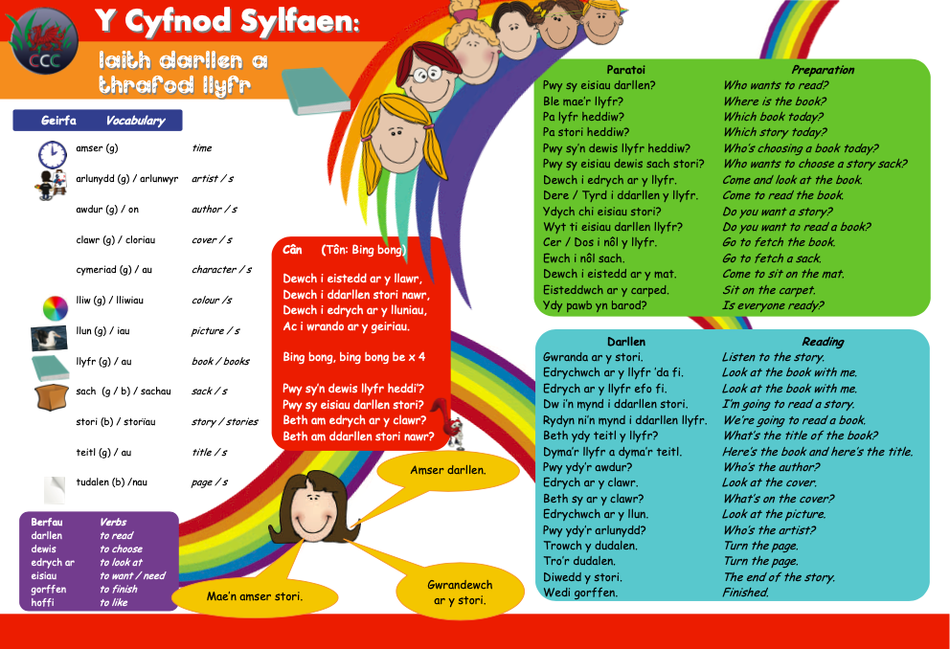

Slide 40
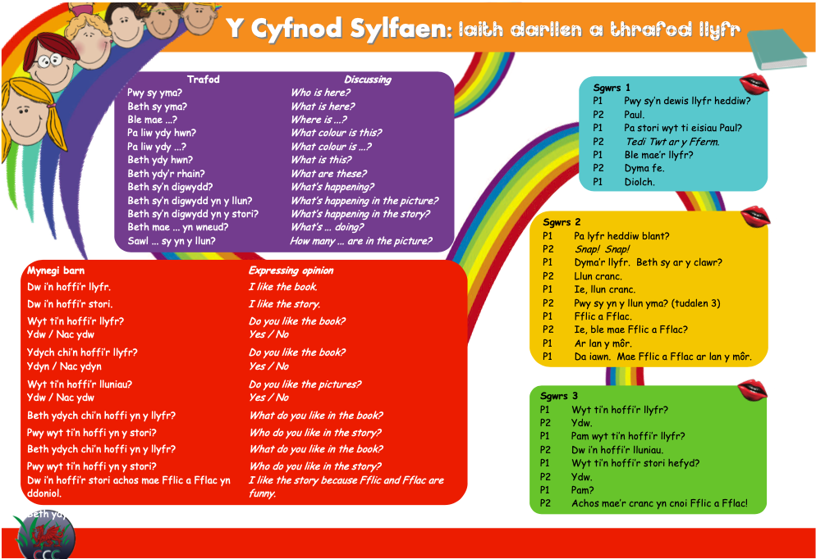

Slide 41



Hoffi?
Wyt ti'n hoffi'r llyfr?
Ydw, dw i'n hoffi'r llyfr.
Nac ydw, dw i ddim yn hoffi'r llyfr.

Slide 42
Hoffi?
Wyt ti'n hoffi'r stori?
Ydw, dw i'n hoffi'r stori.
Nac ydw, dw i ddim yn hoffi'r stori.

Slide 43
Hoffi?
Wyt ti'n hoffi'r llun?
Ydw, dw i'n hoffi'r llun.
Nac ydw, dw i ddim yn hoffi'r llun.

Slide 44

Pam?
Pam wyt ti'n hoffi'r llun?
Achos mae'n ddiddorol.
Pam dwyt ti ddim yn hoffi'r llun?
Achos mae’n drist.

Slide 45


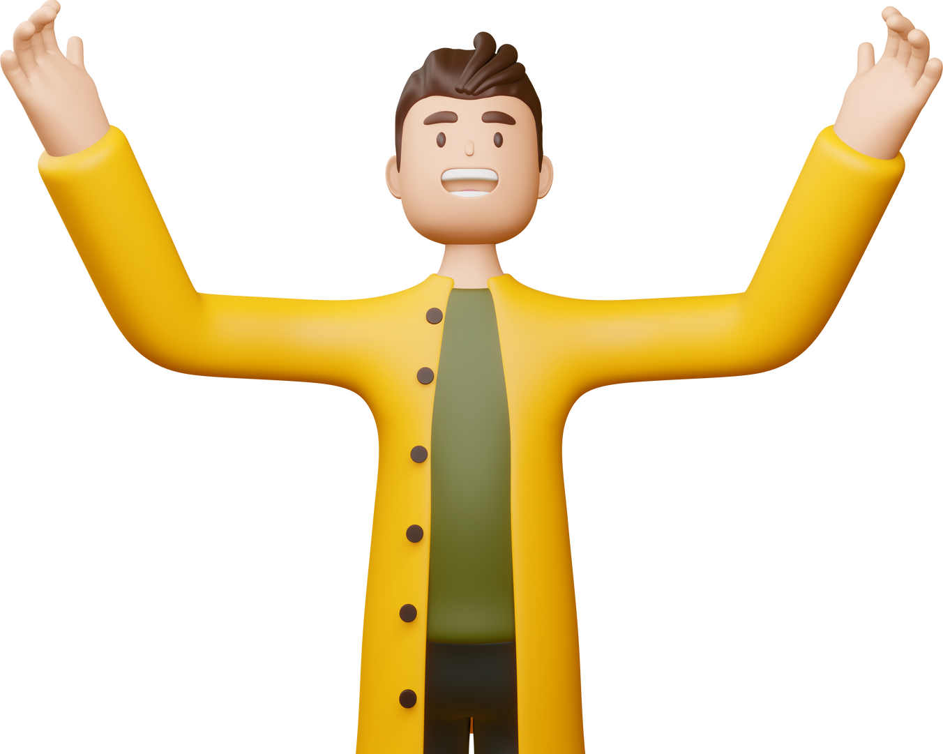
Pam?
Pam wyt ti'n hoffi'r stori?
Achos mae'n gyffrous.

Slide 46
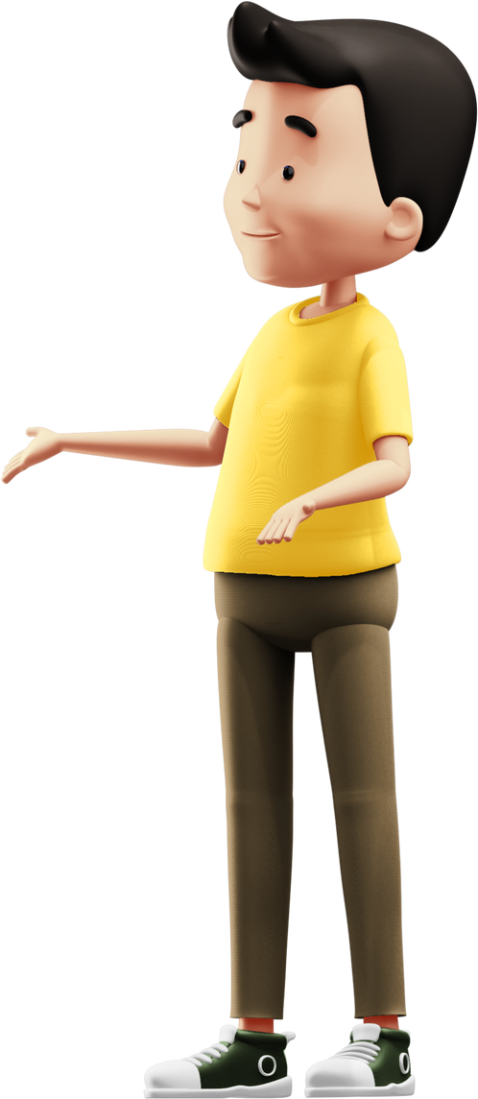
Pwy sy'n....?
Pwy sy'n siarad? Who is talking?
Pwy sy'n dysgu? Who is teaching?
Pwy sy'n canu? Who is singing?
Pwy sy'n mynd i siopa? Who is going shopping?

Slide 47

Gorchmynion
Agor y wers
Yn y canol
Cloi'r wers
Dewiswch lyfr!
Eisteddwch yn dawel.
Darllenwch gyda fi.
Gwrandewch arna i.
Edrychwch ar y clawr.
Edrychwch ar y llun.
Disgrifiwch y llun.
Meddyliwch...
Disgrifiwch y stori.
Ailadroddwch y stori.
Ysgrifennwch am y stori.
Tynnwch lun o Harri.

Slide 48


Geiriau Newydd?
Dim problem!
Beth ydy "world" yn Gymraeg?
byd

Slide 49
Ydych chi wedi mwynhau?
Have you enjoyed?

Slide 50
Wedi gorffen!​
Finished!
Rydyn ni wedi gorffen.​
We have finished.
Mae hi’n amser chwarae!​
It's playtime!
Bant a chi!​
Off you go!
Ewch i chwarae.​
Go to play.
Ewch allan!​
Go outside.

Slide 51
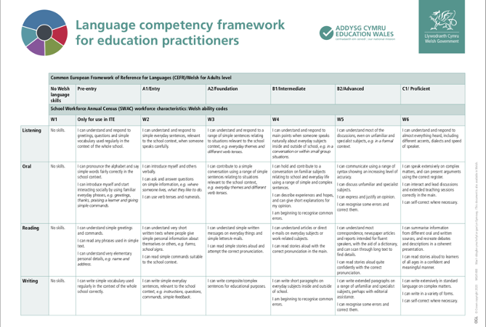



Slide 52
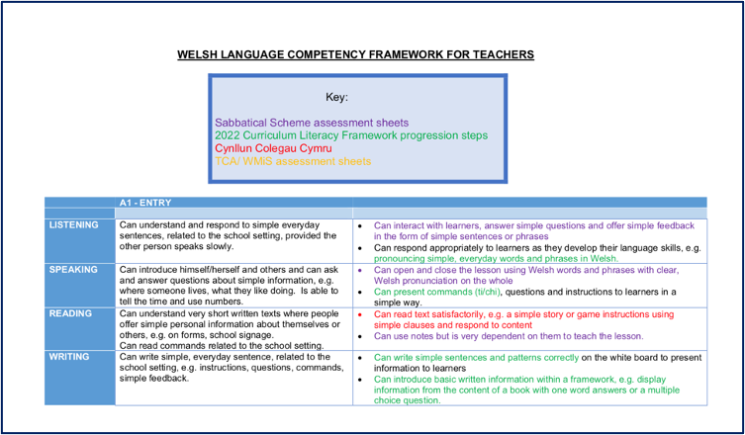


Slide 53
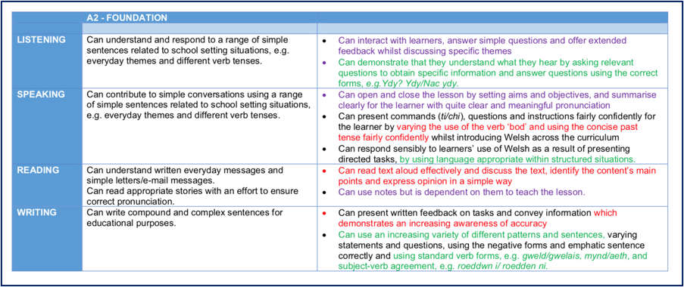


Slide 54
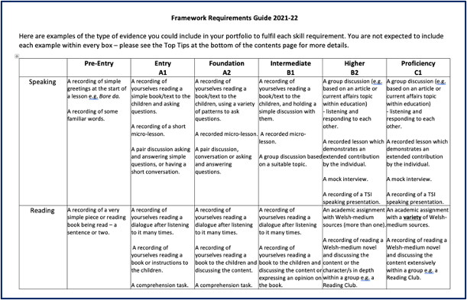


Slide 55
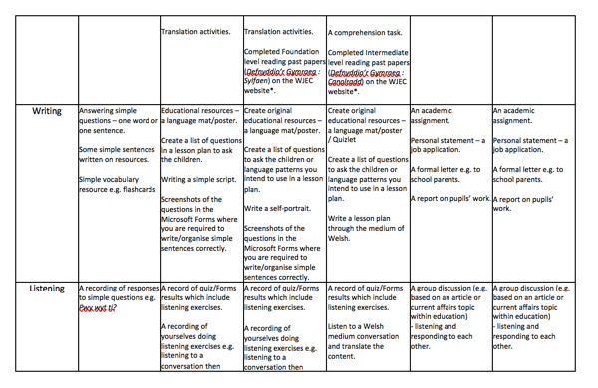


Slide 56
Gweithgaredd: Darllen Llyfr
1. Dewiswch lyfr addas (Tedi Twt / Dewi Deinosôr).
Choose a suitable book.
2. Dewiswch ymadroddion addas i ddechrau’r gweithgaredd.
Choose suitable phrases to use at the beginning of the activity.
3. Defnyddiwch orchmynion.
Use suitable commands.
4. Darllenwch yn uchel ac ynganu bob gair yn ofalus.
Read aloud to practise your pronunciation.
5. Gofynnwch o leiaf 5 cwestiwn gwahanol am y llyfr i’r plant.
Think of at least 5 different questions to ask the children.
Mwynhewch!
Enjoy!

Slide 57


Pa stori?

Slide 58
Darllen stori
Dechrau arni Getting started | Gorchmynion defnyddiol Useful commands | Trafod y clawr Discussing the cover | Cwestiynau wrth ddarllen Questions while reading

Slide 59
Methodoleg
Methodology

Slide 60

Syniadau Methodoleg Dysgu Iaith
Language Teaching Methodology Ideas
Foundation Phase
‘Hearing and understanding are the first important building blocks towards acquisition of any language.
As a first step, children should hear Welsh through incidental Welsh and Welsh rhymes, songs, commands,
greetings, and simple stories in informal play situations.’
(Welsh Language Development within the Foundation Phase p.6)
When planning a unit of work the following need consideration:
  the vocabulary and the patterns to be introduced
  the strategies for drilling them and practicing them
  language modelling by adults
  the opportunities and the activities to practice and consolidate vocabulary and patterns across the learning areas

Slide 61
Foundation Phase
Recall of previous learning at the start of the lesson
Variety in the methods of revising vocabulary and patterns
Use of familiar vocabulary to introduce and practice a pattern / use of familiar patterns to practice new vocabulary
Clearly stating the lesson’s aim / objectives and sharing success criteria when introducing a task
Articulating the vocabulary and the patterns clearly and modelling the use of the language
Preparation and organisation of colourful and attractive resources to introduce language such as:
  flash cards
  pictures
  Powerpoint
  Interactive Whiteboard activities – e.g. resources on the NGfL Cymru website (www.ngfl-cymru.org.uk)
  video
  big book
  story sack / box of objects
  board / card games
  puppets / masks
Ensuring that the language is visible on the classroom walls
Encouraging the pupils to use language learned previously in situations with different themes
Ensuring understanding – using English if necessary – but maintaining the target language as much as possible
Ensuring repetition – as a whole class / groups / individuals to consolidate correct pronunciation and appropriate intonation through:
  Talking partners
  Drilling using songs / a story which repeats a pattern / question and answer, substitution, i.e. changing or adding one element at a time , language games (and doing all this in a lively manner!)

Slide 62

Key Stage 2
Ensuring a safe learning environment to promote pupils’ confidence in contributing by encouraging risk taking
Planning short introductions before moving to pair /group activities
Developing from using closed questions to open questions which would expand answers
Preparation of guidelines or frameworks for oral and written work
Clear direction to ensure that the pupils know exactly what they should do
Creating a meaningful / communicational activity
Timing a task – use a timer / music / clock on the interactive whiteboard
Rotating around the classroom offering support / suggestions / encouraging expansion
Sharing good examples
Earmarking a focus group to provide additional support or to challenge groups to expand
Providing opportunities to record pair work / group work
Ensuring sufficient variety within a lesson
Interweaving the language skills including elements of listening, reading, oral work – including drilling, performance and discussion – and writing in each session
Using ICT e.g. Beebot, Roamer, listening stations, digiblue cameras
Including opportunities for assessment / self assessment / peer assessment
Concluding the lesson by revising / summarizing / consolidating understanding / celebrating the learning and noting any general weaknesses
Ensuring much fun and plenty of humour!

Slide 63

Oes cwestiwn?
Any questions?

Slide 64


Hwyl fawr a
phob lwc yn yr ysgol!

