Slide 1
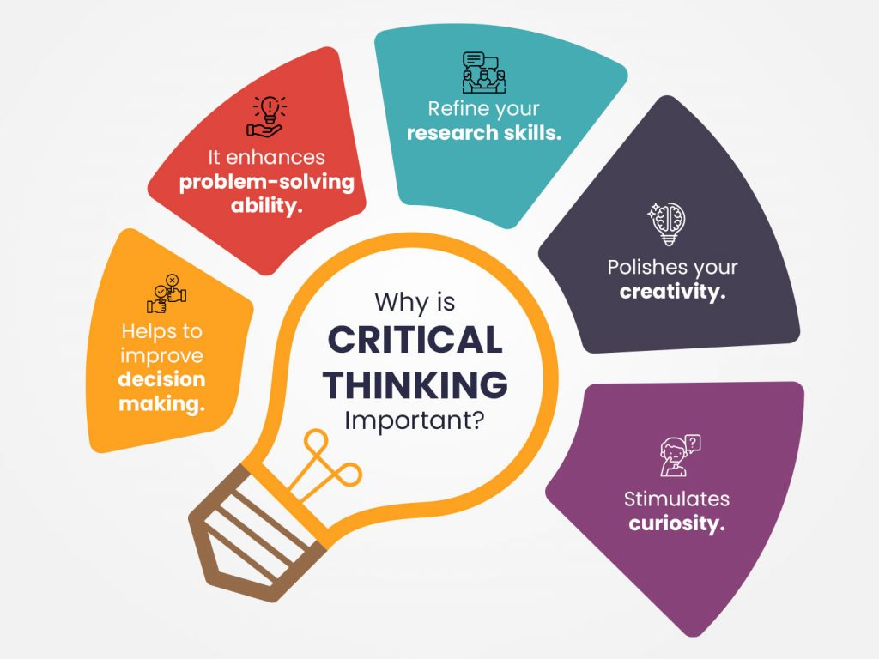
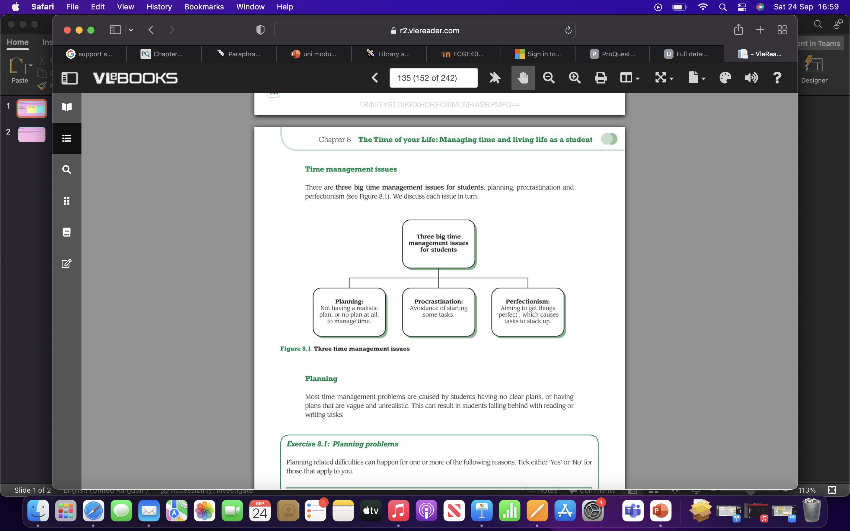
Laura Lenihan 2207534 Academic Study Skills ECGE4005P/C
What is Critical Thinking?
Critical thinking- supporting theories with evidence. Judge et al. (2013, p.2) claims that a good critical thinker will question the views of others as well as their own, while remaining open-minded to the opinions of others. Critical thinking is a beneficial tool to have in everyday life, as Cottrell (2017) suggests we can make much more specific and accurate judgements of our own interests, thought processes and abilities when effectively applying good critical thinking skills. Critical thinking is especially fundamental during academic studying; when thinking critically as a student Cottrell (2017) points out, you should be finding where the best evidence is located, evaluating how the evidence can support different arguments based on it's strengths and providing evidence to exemplify your argument. A critical thinker will differentiate opinion from fact while understanding the information from a neutral/ unbiased perspective.
Time management, note taking and referencing/paraphrasing are all essential skills in which assist a person's development to critical thinking.
(Source: TSCFM, 2022)
Referencing/ paraphrasing :
Referencing and paraphrasing are significant skills to learn when developing a critical thinking mindset. When correctly referencing and paraphrasing you are avoiding plagiarism, plagiarism is "the process or practice of using another person's ideas or work and pretending that it is your own" (The Cambridge Advanced Learner's Dictionary, 1995). In addition to avoiding plagiarism; paraphrasing is a useful technique as Godfrey (2013) claims, portraying what you have read into your own words demonstrates your personal interpretation of it, whilst allowing you to support your argument/point by adapting your reading. Referencing in academic work is required by all students. Bottomley et al. (2018) states the importance of referencing, referencing allows the reader to easily find the source of information used while also acknowledging the writers work; by referencing the sources used correctly the reader recognizes the facts written have been researched, giving them confidence in the information written.
Time management :
When studying in higher level education having good time management skills is crucial. Cotrell (2019) claims that when managing time effectively to meet deadlines, study time will be more controlled. Time can be managed effectively by creating a timetable. Not only does this help to keep organised, it allows a work-life balance to be established. According to Wilson and Bedford (2009, p. 11) it is shown by experience, that a large amount of time tends to be wasted as people believe the time given is not enough to be practical. By producing a timetable wasted time can be avoided, by scheduling in everyday activities and commitments it will be evident in which free time will be useful to use as study time. When studying, managing time around tasks and deadlines is necessary. Cotrell (2019, p. 133) claims that tasks can be completed more efficiently when well developed project and task management skills are applied accurately, with minimal stress.
Note taking:
Note taking is a necessary skill to grasp during academic study. Day (2018, p. 81) states, taking notes effectively can allow captured features of the original material read to be substituted into useful content for an assignment. Day (2018, p. 82) also suggests notes that do not contain long sentences and paragraphs, but instead using key/ abbreviated words and shortened phrases is effectual. Although note taking may seem a simple task which can be completed quickly and effectively. Westrup and Barrow (2019) claim a positive impact can be made on the quality of notes taken when applying technique to note taking, this can further outcome in a valuable asset to further learning.
(Source: Moore, 2010).
Conclusion:
Critical thinking is a beneficial and essential tool to have in everyday life, but more importantly during academic study. Developing a critical thinking mindset is made up of many aspects. Referencing/paraphrasing, time management and note taking are all fundamental skills which aid the development of critical thinking. Referencing is a required skill to acquire a knowledge of as a student to avoid plagiarism. As Bottomley et al. (2018) states the importance of referencing is to acknowledge the writers work that has been used. As well as this , Cotrell (2019) claims that when managing time effectively to meet deadlines study time will be more controlled. While Day (2018, p. 81) states, taking notes effectively can allow captured features of the original material read to be substituted into useful content.

Slide 2
Laura Lenihan 2207534 Academic Study Skills ECGE4005P/C
Reference List:
Cottrell, S. (2017) Critical thinking skills : effective analysis, argument and reflection. Third edition. London: Macmillan Education/Palgrave.
Cottrell, S. (2019) The Study Skills Handbook. London: Bloomsbury Publishing Plc.
The Cambridge Advanced Learner's Dictionary (1995) Plagiarism. Available at: https://dictionary.cambridge.org/dictionary/english/plagiarism (Accessed: 16 September 2022).
Godfrey, J. (2013) How to Use Your Reading in Your Essays. 2nd edition. Basingstoke :, Palgrave Macmillan.
Moore, S. (2010) The ultimate study skills handbook. Berkshire: Open University Press , pp. 135, figure.
Bedford, D. and Wilson, E. (2009) Study Skills for Part-time Students. Harlow: Pearson Education UK.
Day, T. (2018) Success in academic writing. Hampshire: Palgrave Macmillan.
Cottrell, S. (2015) Skills for success : personal development and employability. 4th edition. London : Red Globe Press .
Judge, B. et al. (2013) Critical thinking skills for education students. Second edition. London: SAGE publications.
Bottomley J. et al. (2018) Academic writing and referencing for your education degree. St Albans: Critical publishing
Barrow, C. and Westrup, R. (2019) Writing skills for education students. London: Red Globe Press.
TSCFM (2022) The benefits of critical thinking & How to develop it. [Image]. Available at: https://tscfm.org/blogs/the-benefits-of-critical-thinking-for-students/ (Accessed 27 September 2022).

