Slide 1

Working with Others in Health and Social Care: My Experiences and Development
Georgiana Andrada Luca

Slide 2
Introduction
Personal background
Overview of experiences and development in health and social care

Slide 3
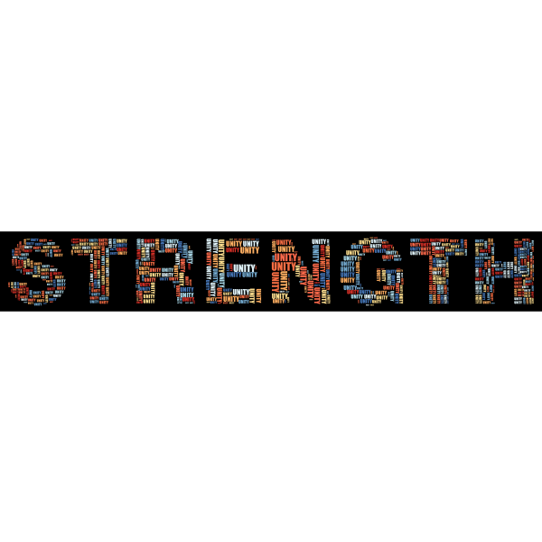
Strengths
Communication skills
Empathy and patient care
Interview feedback highlights
"Effective communication is critical in healthcare for ensuring patient safety and delivering high-quality care" (O’Daniel and Rosenstein, 2008).

Slide 4
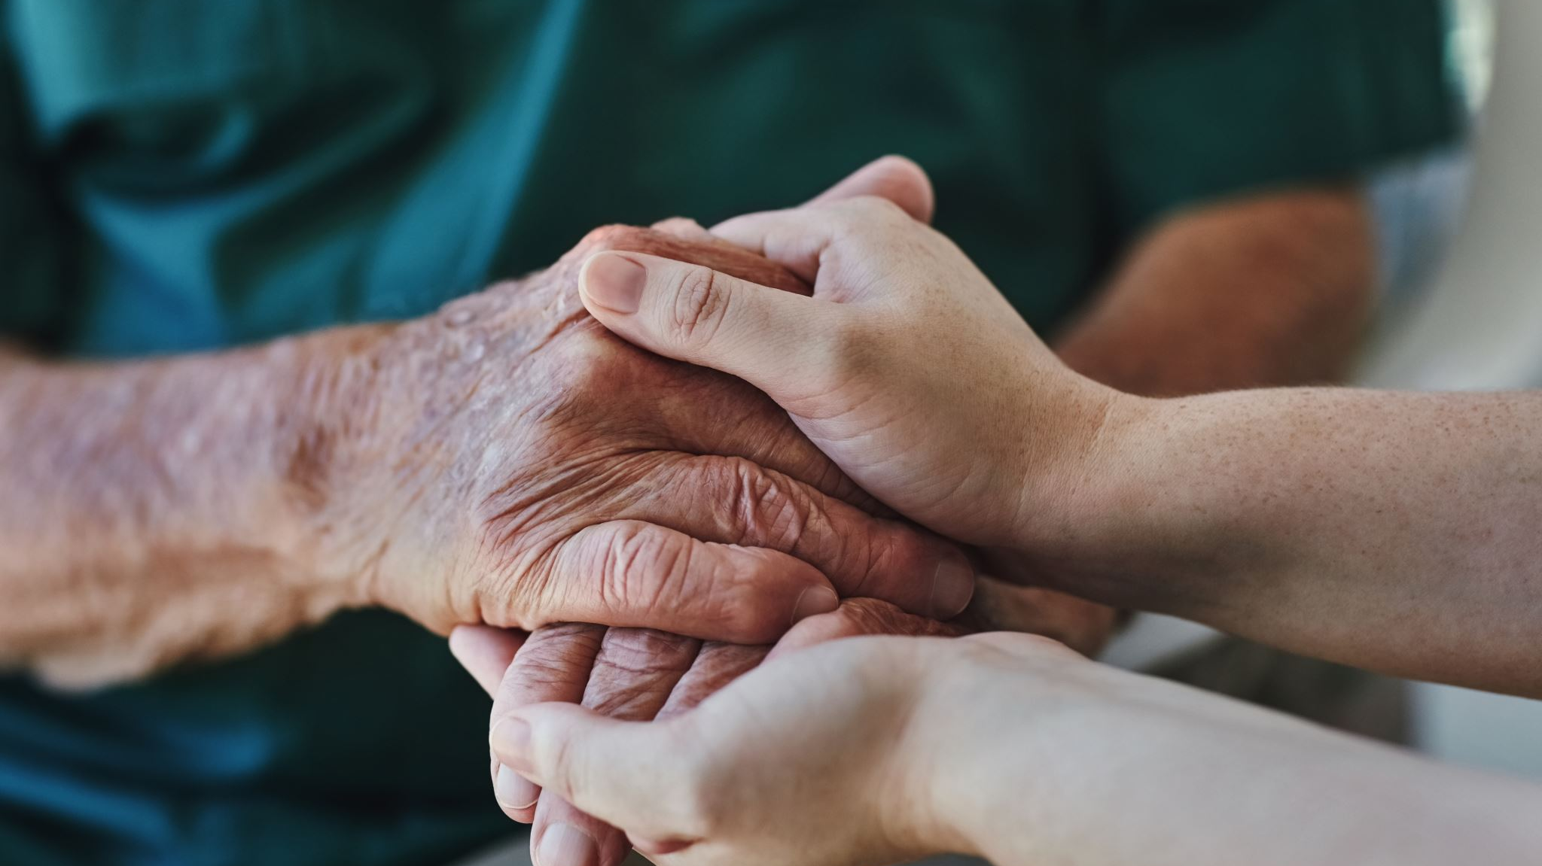
Strengths (Continued)
Reflective practice and personal awareness
Building relationships with patients and families
"Empathy and the ability to connect with patients are crucial in establishing trust and delivering compassionate care" (Hojat et al., 2011).

Slide 5

Weaknesses
Need for further development in healthcare knowledge
Limited experience in early childhood development
To keep up to date with best practices and enhance patient outcomes, healthcare workers must engage in continuous professional development according to Pool et al (2015)
This Photo by Unknown Author is licensed under CC BY-NC-ND

Slide 6

Weaknesses (Continued)
Addressing areas for growth proactively
Importance of continuous learning and adaptation
"Proactively identifying areas for growth ensures that healthcare professionals remain effective and knowledgeable in their practice" (Institute of Medicine, 2010).

Slide 7


Opportunities
This Photo by Unknown Author is licensed under CC BY-SA-NC
Current studies and future courses
Workshops and seminars on relevant topics
"Continuous education and training are vital for healthcare professionals to stay updated with medical advancements and improve their skills" (Institute of Medicine, 2010).

Slide 8

Opportunities (Continued)
Networking and professional communities
Leveraging strengths for professional development
Working with associations of professionals and participating meetings may offer an opportunity for exchanging information and excellent approaches (Salas et al.,2008)

Slide 9

Threats
Balancing professional and personal responsibilities
Staying updated with healthcare policies and practices
To avoid burnout and guarantee continued effectiveness in the healthcare industry, maintaining a work-life balance is essential (Shanafelt et al., 2012)
This Photo by Unknown Author is licensed under CC BY-SA-NC

Slide 10

Threats (Continued)
Importance of time management and support networks
Proactive approach to learning and development
According to Kohn, Corrigan, and Donaldson (2000), productive organising of time and assistance from both work and private contacts are crucial in reducing such concerns.

Slide 11
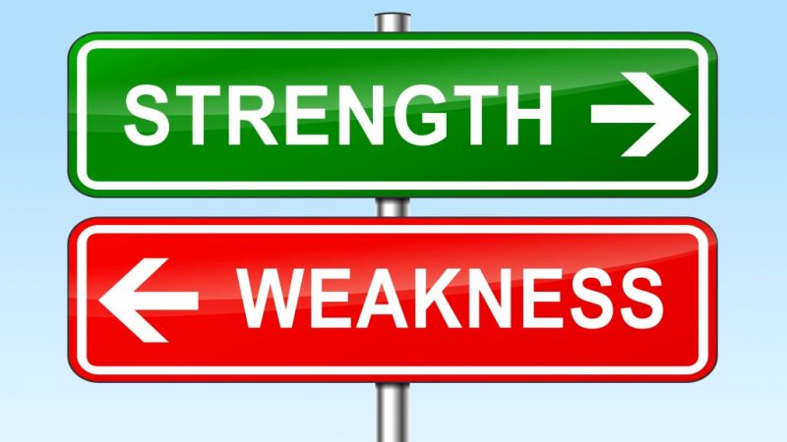
Building on Strengths and Minimizing Weaknesses
Engaging in reflective practice
Seeking feedback and mentorship
Continuous professional development
Reflective models, such as Gibbs' Reflective Cycle, can help critically analyse experiences and identify areas for improvement (Gibbs, 1988).
This Photo by Unknown Author is licensed under CC BY-NC-ND

Slide 12


Impact on Others
Collaboration with colleagues
Building relationships with patients and families
Productive collaboration depends on open dialogue and respect for each other, allowing medical professionals to organize service successfully (Salas et al., 2008)

Slide 13

Conclusion
Summary of experiences and development
Commitment to providing high-quality care
Future goals and professional growth

Slide 14
References
Berwick, D. (2013). A promise to learn – a commitment to act: improving the safety of patients in England. London: Department of Health.
Fletcher, R. H., & Fletcher, S. W. (2003). Evidence-based medical education: can it be sustained? Journal of the Royal Society of Medicine, 96(12), 599-601.
Gibbs, G. (1988). Learning by Doing: A Guide to Teaching and Learning Methods. Oxford: Oxford Further Education Unit.
Hojat, M., Louis, D. Z., Markham, F. W., Wender, R., Rabinowitz, C., & Gonnella, J. S. (2011). Physicians' empathy and clinical outcomes for diabetic patients. Academic Medicine, 86(3), 359-364.
Institute of Medicine. (2010). Redesigning Continuing Education in the Health Professions. Washington, DC: The National Academies Press.
Kohn, L. T., Corrigan, J. M., & Donaldson, M. S. (2000). To err is human: building a safer health system. Washington, DC: National Academy Press.
O’Daniel, M., & Rosenstein, A. H. (2008). Professional communication and team collaboration. In Hughes, R. G. (Ed.), Patient Safety and Quality: An Evidence-Based Handbook for Nurses. Rockville (MD): Agency for Healthcare Research and Quality (US).
Pool, I. A., Poell, R. F., Berings, M. G., & ten Cate, O. T. J. (2015). Strategies for continuing professional development among younger, middle-aged, and older nurses: A biographical approach. International Journal of Nursing Studies, 52(5), 939-950.
Rogers, C. R. (1961). On Becoming a Person: A Therapist's View of Psychotherapy. Boston: Houghton Mifflin.
Salas, E., DiazGranados, D., Klein, C., Burke, C. S., Stagl, K. C., Goodwin, G. F., & Halpin, S. M. (2008). Does team training improve team performance? A meta-analysis. Human Factors, 50(6), 903-933.
Shanafelt, T. D., Boone, S., Tan, L., Dyrbye, L. N., Sotile, W., Satele, D., ... & Oreskovich, M. R. (2012). Burnout and satisfaction with work-life balance among US physicians relative to the general US population. Archives of Internal Medicine, 172(18), 1377-1385.
Shonkoff, J. P., & Phillips, D. A. (Eds.). (2000). From Neurons to Neighborhoods: The Science of Early Childhood Development. Washington, DC: National Academy Press.

