Slide 1

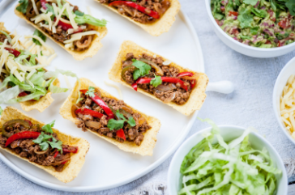
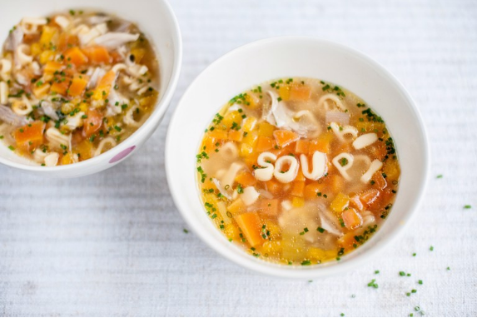
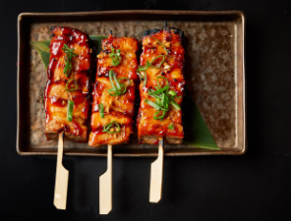
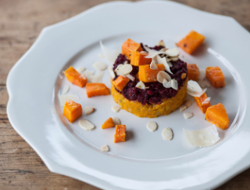
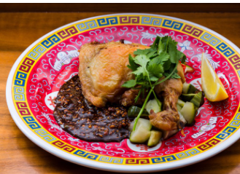
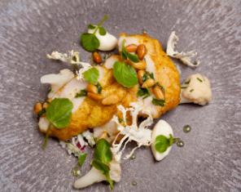
HOTEL TRINITY
Swansea, South Wales
MAIN DISHES
STARTER
Service Timing: 25:00-2:00
Contact Details: All time telephone administration is accessible, albeit through web-based stage the client can contact
Payment Method: All techniques are acknowledged here including cash, card, Visa so on.
Delivery Time: For the situation of the in house dinning following 20 minutes of submitting the request, the fundamental food will be served. Then again, on account of the home conveyance it has been noticed that the it rely upon the distance yet at the same time we have made a reach, as inside 1 - 1:30 hour the food will be conveyed too.
Disclaimer
while requesting the food make a point to give your guidelines connected with testicle in any case in the wake of serving the food the protests won't be thought of.
Spicy Veggie Tacos
will be served with red wine and Guacamole
£12.25 (0.22 Oz)
Chicken Soup with Pasta Shape
£10.25 (0.22 Oz)
Filipino Sticky Brabecue
will be served with red wine
£12.25 (0.22 Oz)
Orange and Pink Risto £9.25 (0.22 Oz)
while referencing the food attempt to give your principles related with testicle in any case just subsequent to serving the food the battles won't be thought of. The broadcasting vibes and show of Josh Eggleton's veggie lover dish make sure to make it a new go-to #1. With layers of carrot and beetroot grain risottos, fragile cooked butternut squash 3D shapes and crunchy almond
Chicken-Fried Chicken
it will be served with the red wine as well as pickle cucumber as well as peanut soy
£14.25 (0.22 Oz)
Veal sweetbreads with ras el hanout, cauliflower purée, watercress and coriander
£11.25 (0.22 Oz)
Notes:
Great British Chefs. 2022. Lechon Belly Recipe. [online] Available at: <https://www.greatbritishchefs.com/recipes/lechon-recipe> [Accessed 31 May 2022].
Great British Chefs (2022). Turbot with cucumber beurre blanc. [Online Image] Great British Chefs. Available at: https://www.greatbritishchefs.com/recipes/turbot-cucumber-beurre-blanc-recipe.
Leeavison (2022). English Crumpets. [Online Image] Leeavison. Available at: https://www.123rf.com/photo_15840389_three-english-crumpets-with-butter-and-jam-isolated-on-a-white-background.html.
Great British Chefs. 2022. Filipino Sticky Barbecue Pork Skewers Recipe. [online] Available at: <https://www.greatbritishchefs.com/recipes/filipino-sticky-barbecue-pork-recipe> [Accessed 31 May 2022].

