Slide 1


Slide 2
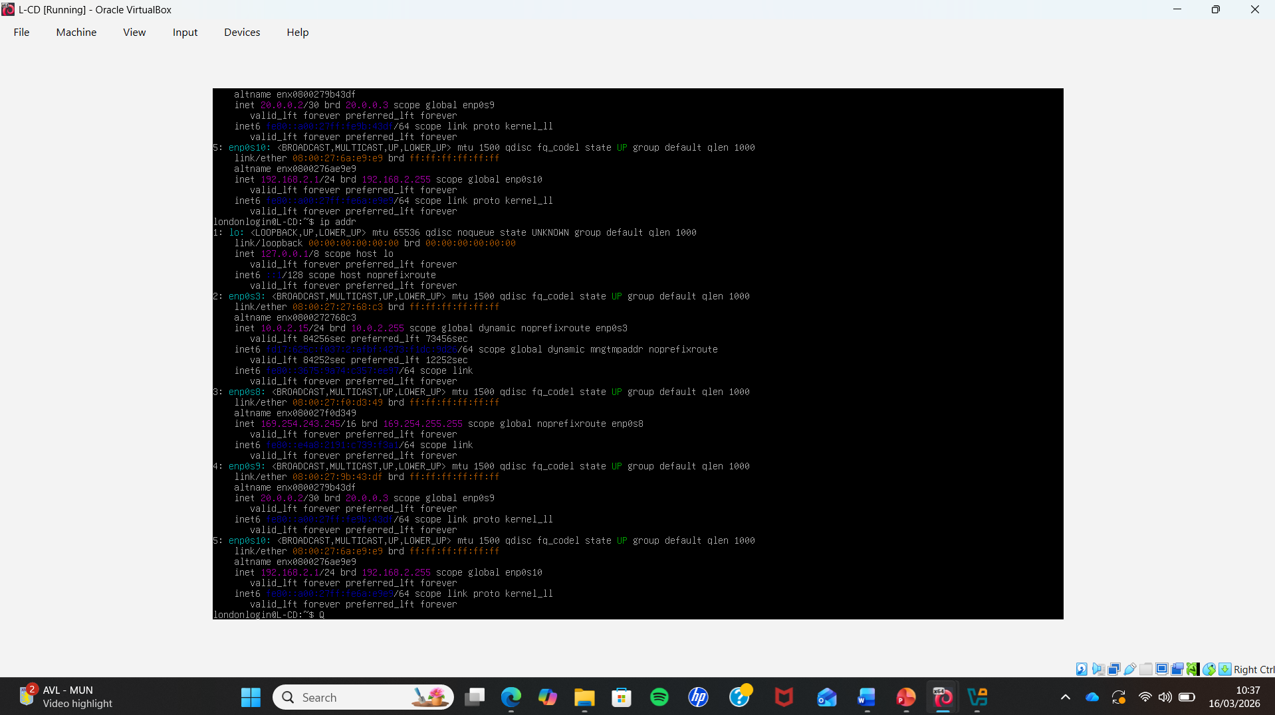
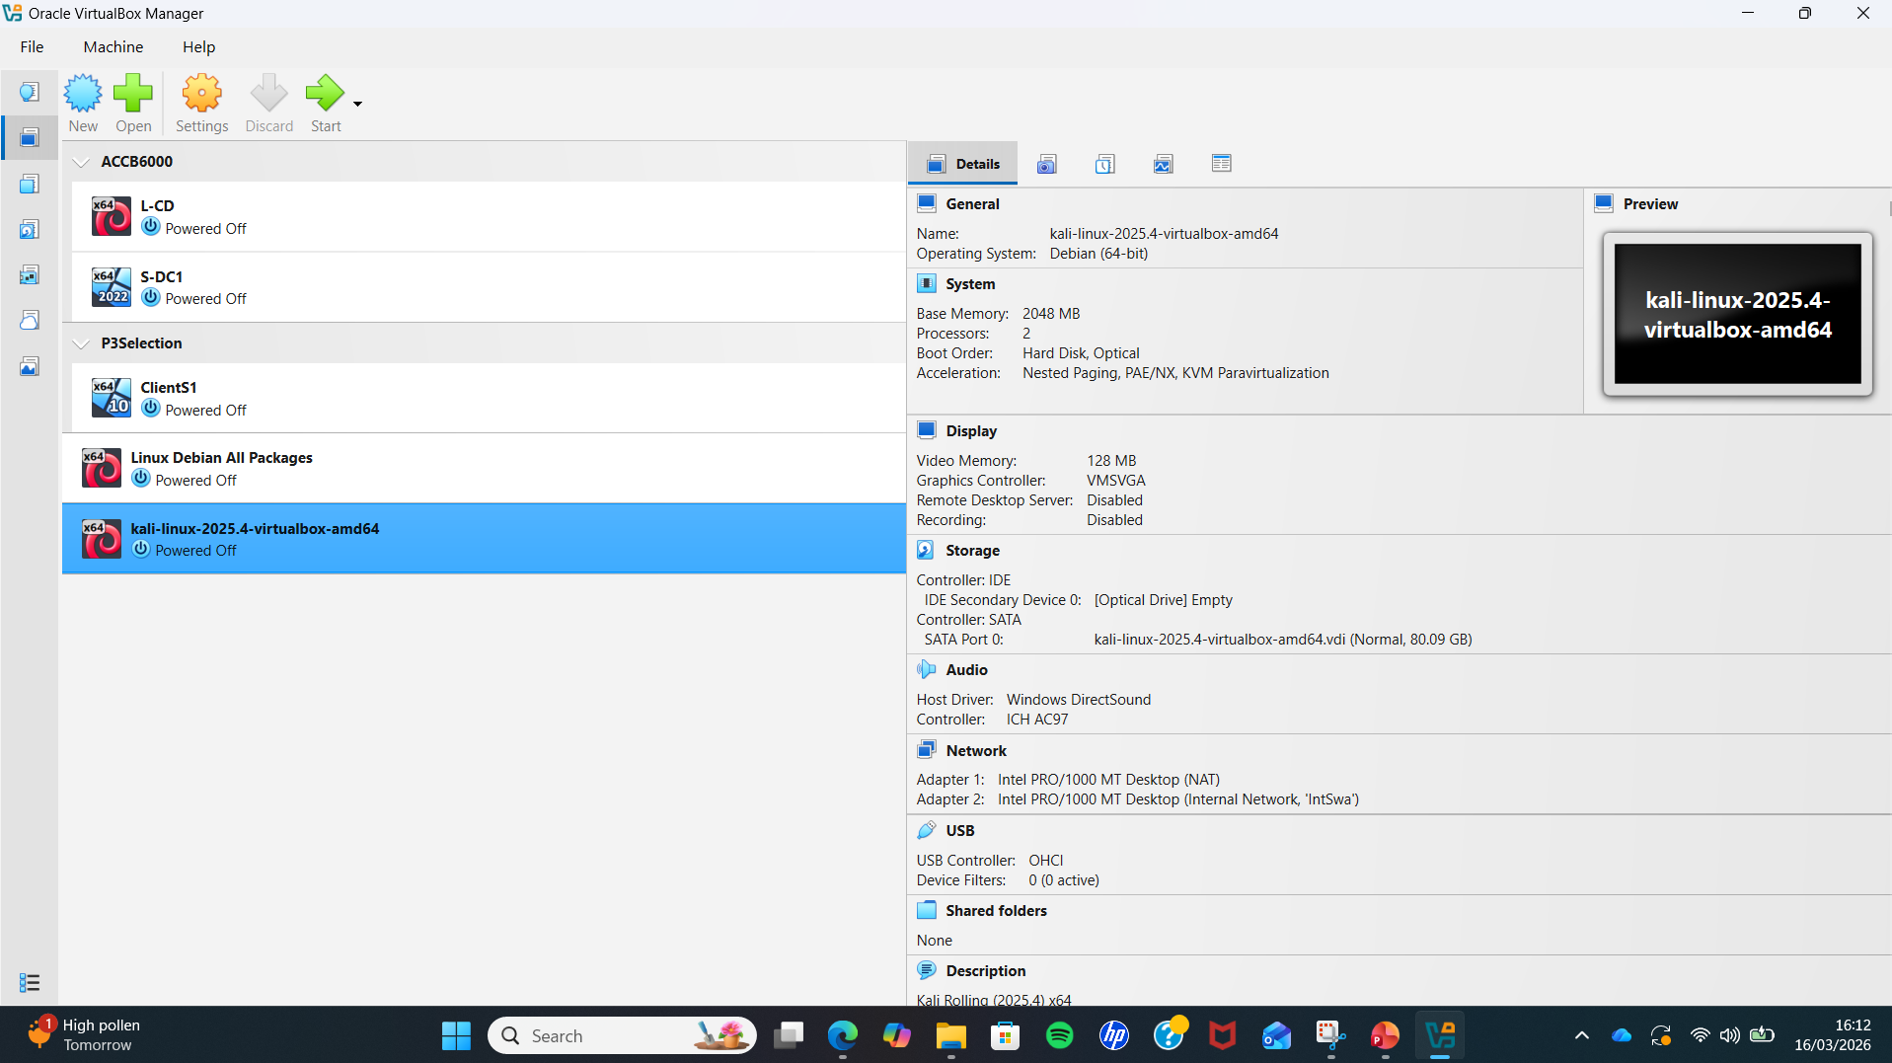
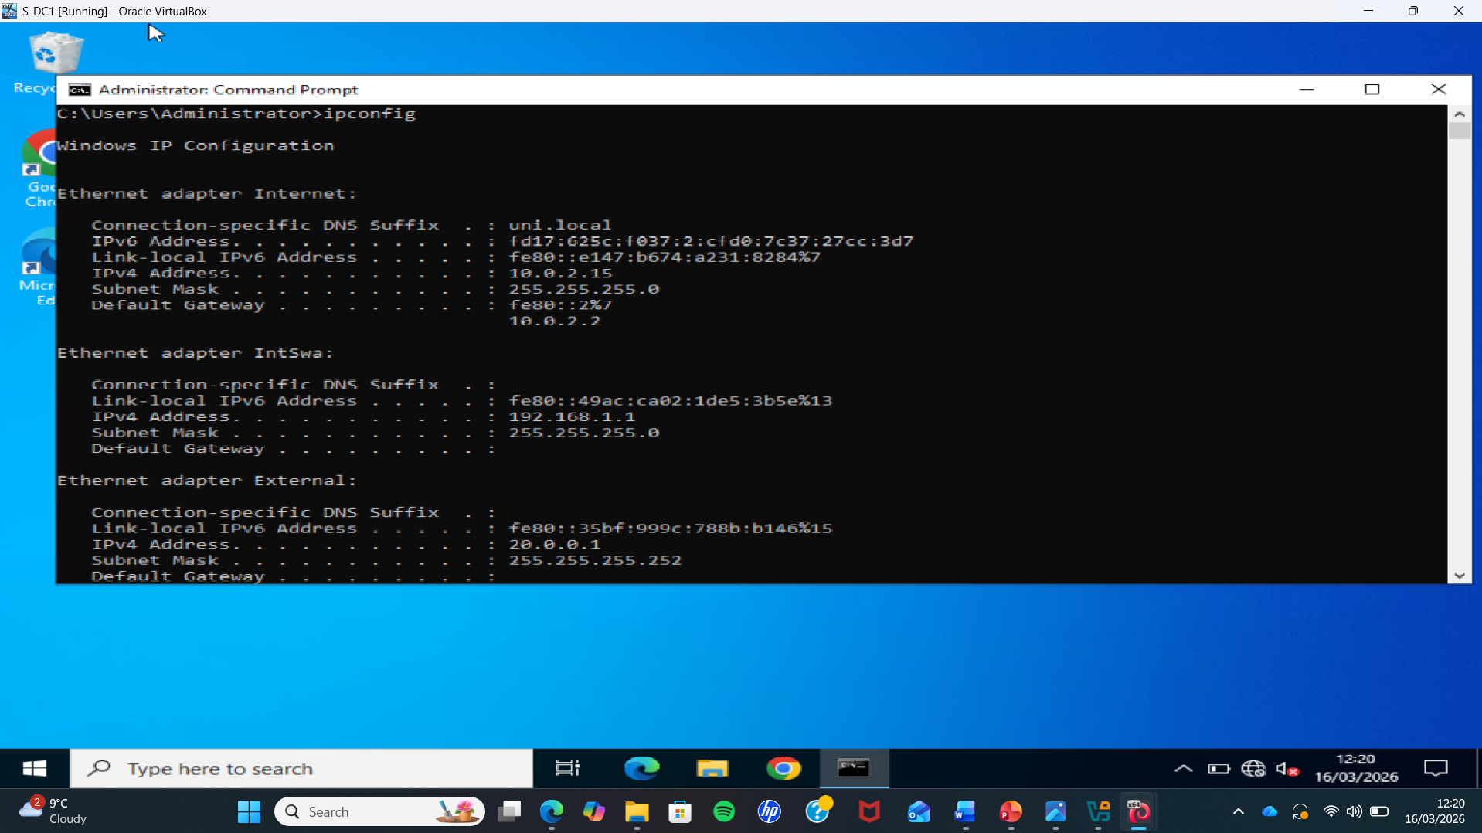
Virtual Lab Environment
Virtual Machine Infrastructure
• The penetration testing lab was built using Oracle VirtualBox.
• Multiple virtual machines (VMs) were created to simulate a real network environment.
• Kali Linux is used as the attacker machine.
• Windows Server (Domain Controller) is used as the target system.
• All machines are connected through an internal virtual network.
Network Configuration
• Network settings were verified using ip addr on Kali Linux.
• Network settings were verified using ipconfig on Windows.

Slide 3
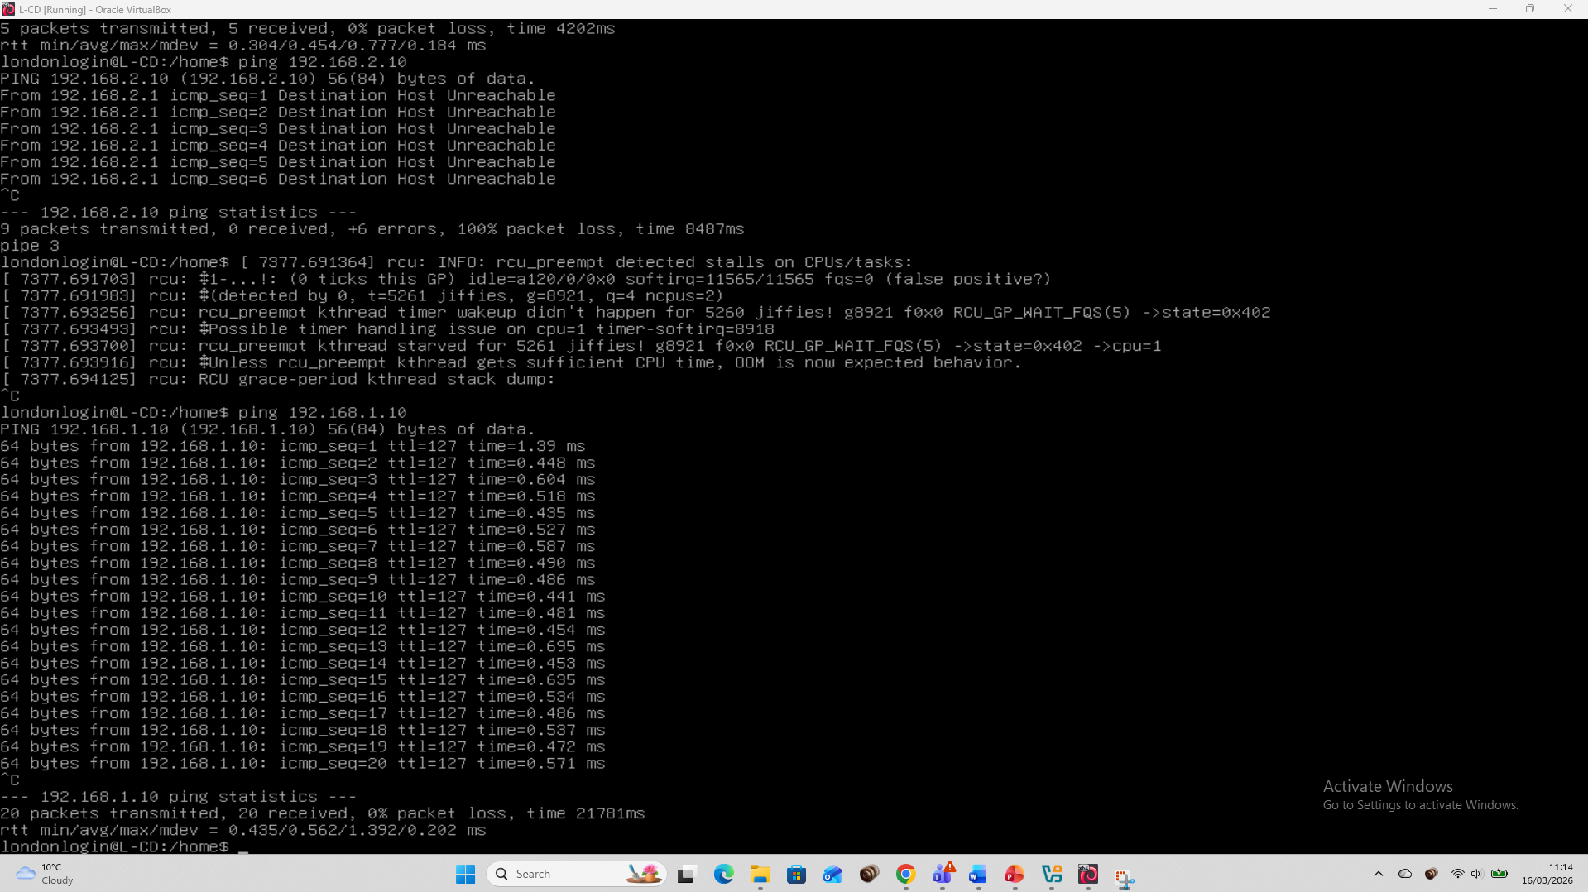
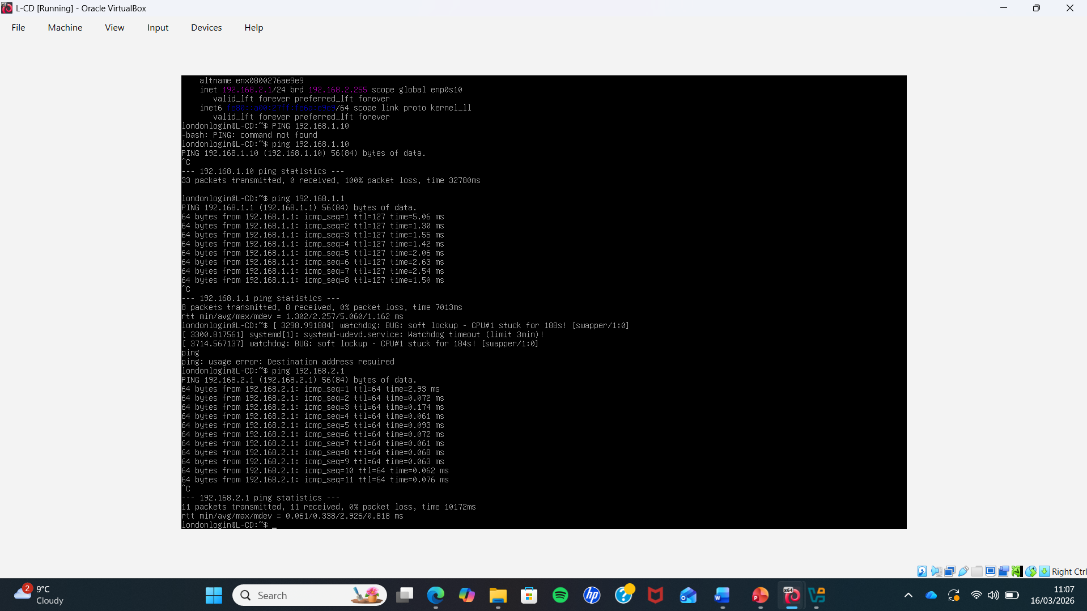
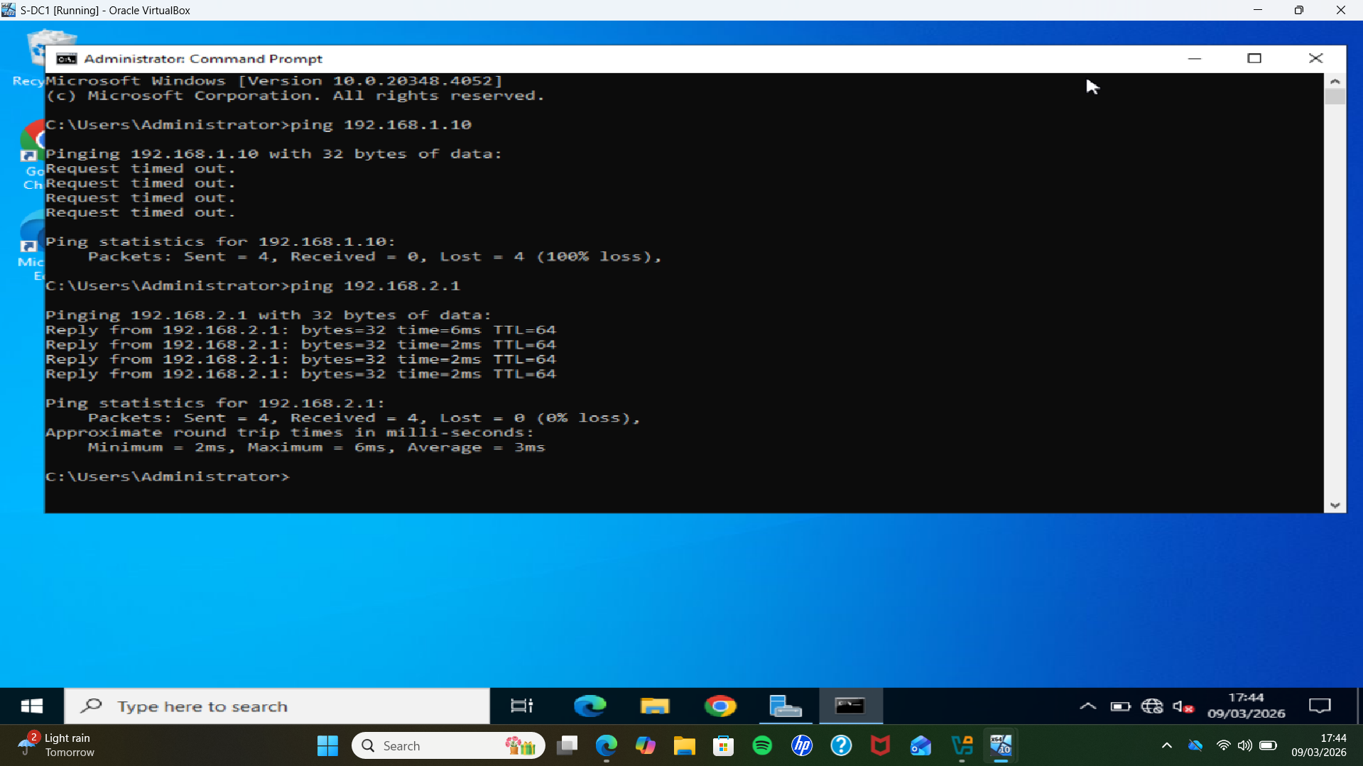
Network Connectivity Verification
Connectivity Verification
• The ping command was used to test network communication between machines in the lab environment.
• The Kali Linux machine successfully sent ICMP requests to 192.168.2.1 and 192.168.1.10.
• The Windows system attempted to ping 192.168.1.10, but the request timed out.
• The Windows system successfully pinged 192.168.2.1, confirming network connectivity.

Slide 4
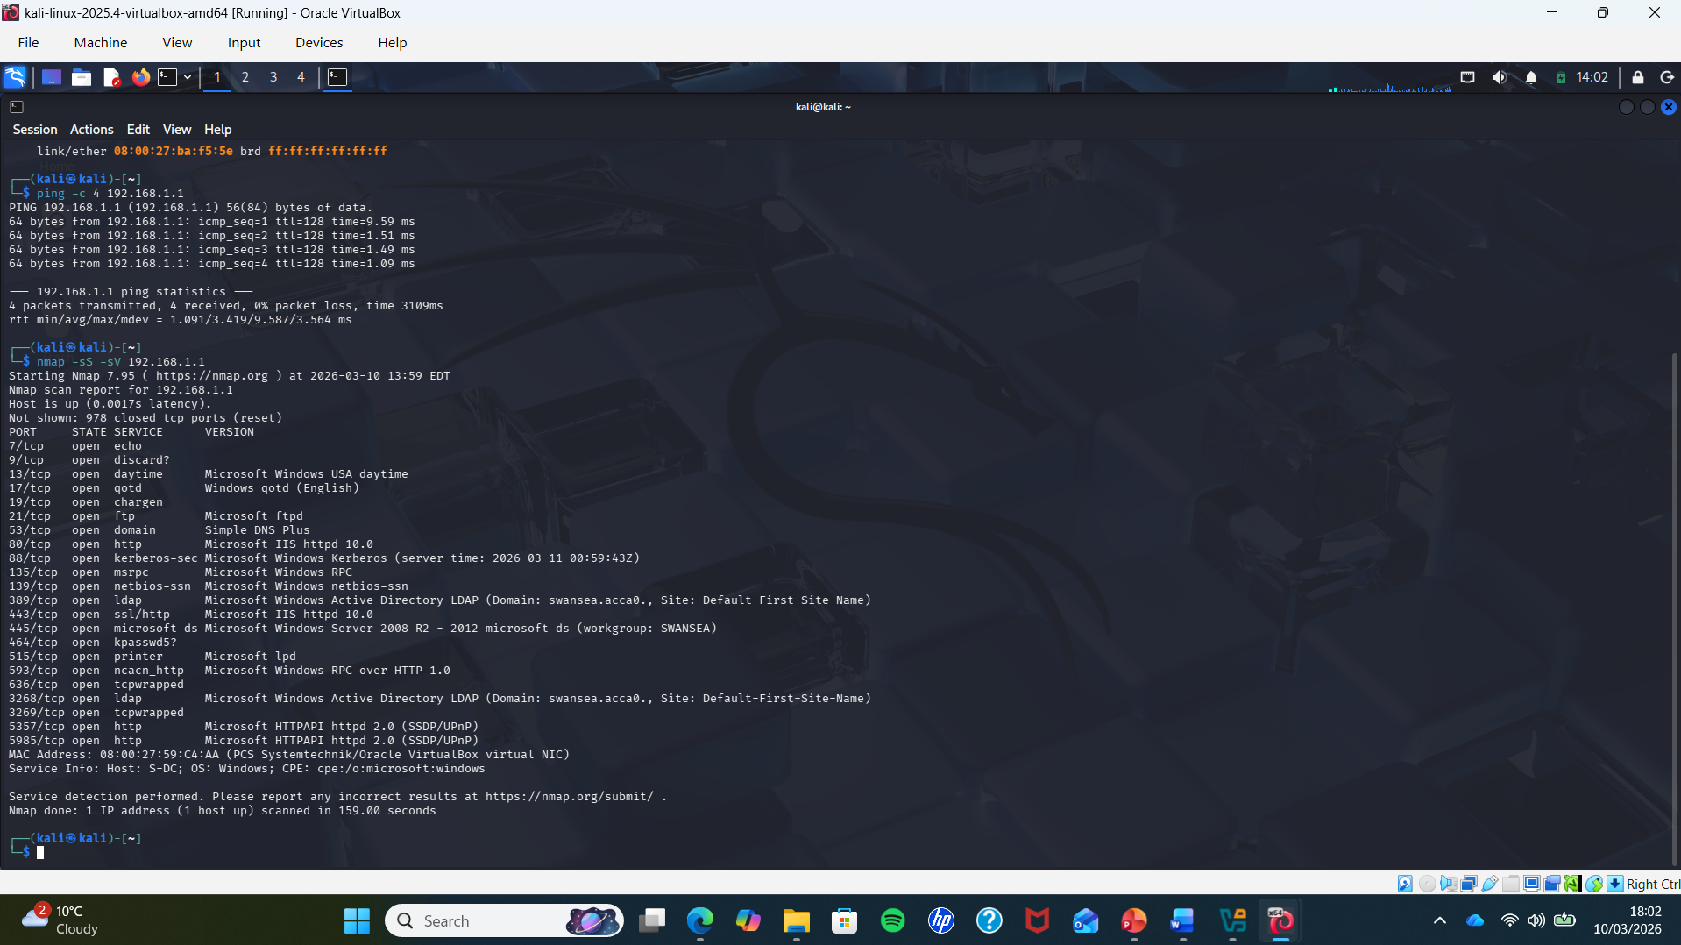
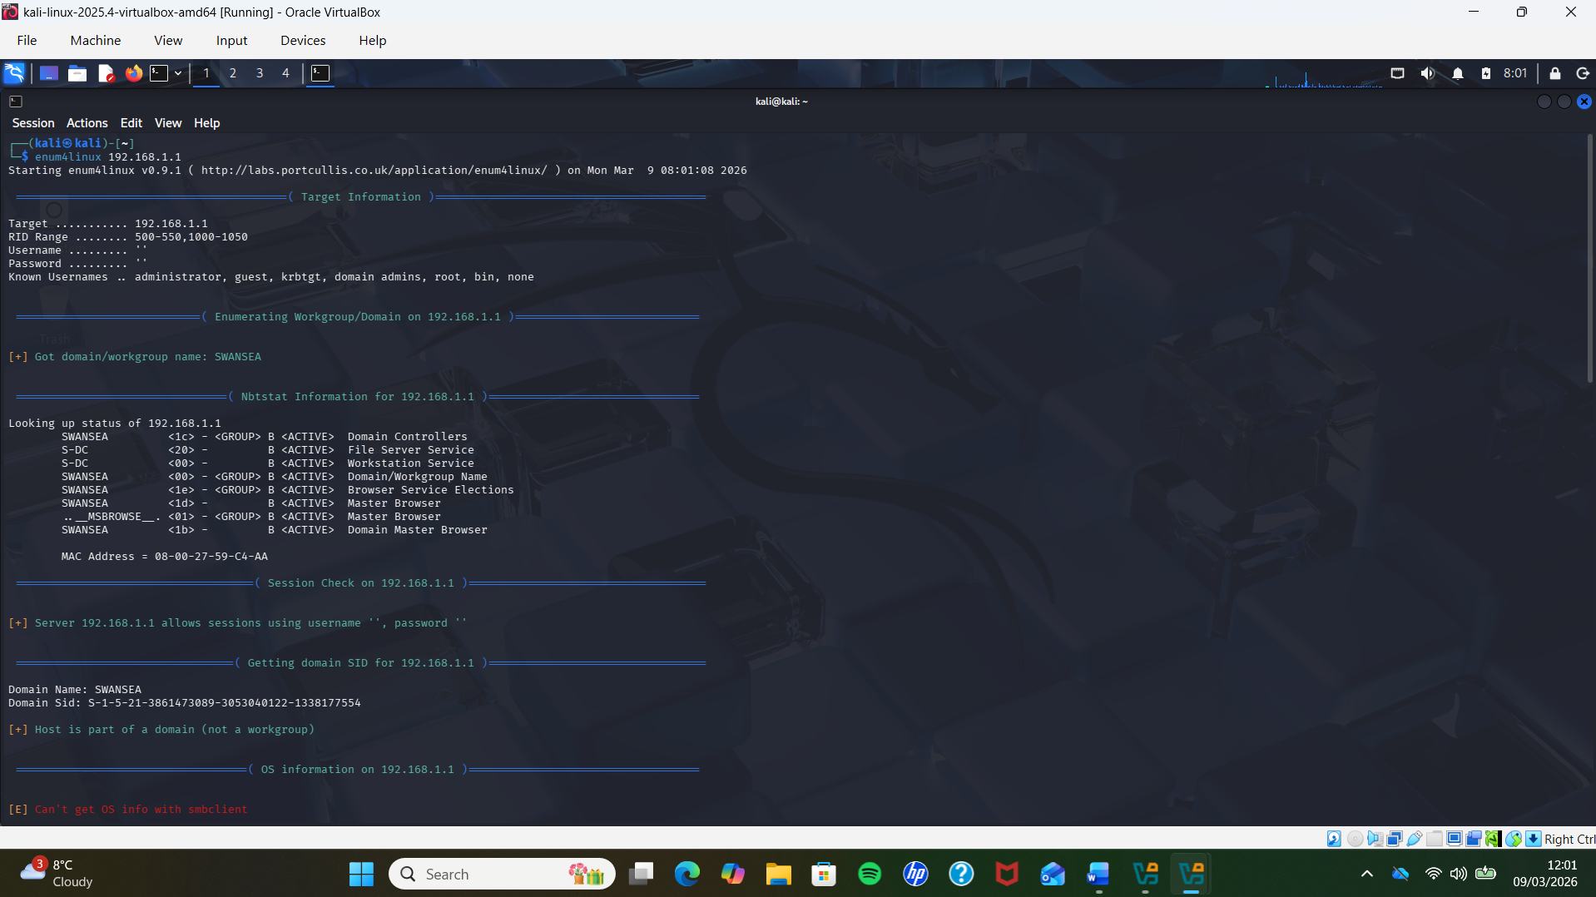
Network Information Gathering
• Connectivity to the target was verified using ICMP (ping)
• Nmap was used to identify open ports and services
• Command: nmap -sS -sV 192.168.1.1
• Open ports included FTP (21), HTTP (80), SMB (445), and LDAP
• Service versions and OS details were identified
• Enum4linux was used for SMB enumeration
• Command: enum4linux 192.168.1.1
• Retrieved domain name (SWANSEA) and Domain SID
• Identified users, groups, and network shares
• Confirmed a Windows Active Directory environment
nmap -sS -sV 192.168.1.1
enum4linux 192.168.1.1

Slide 5
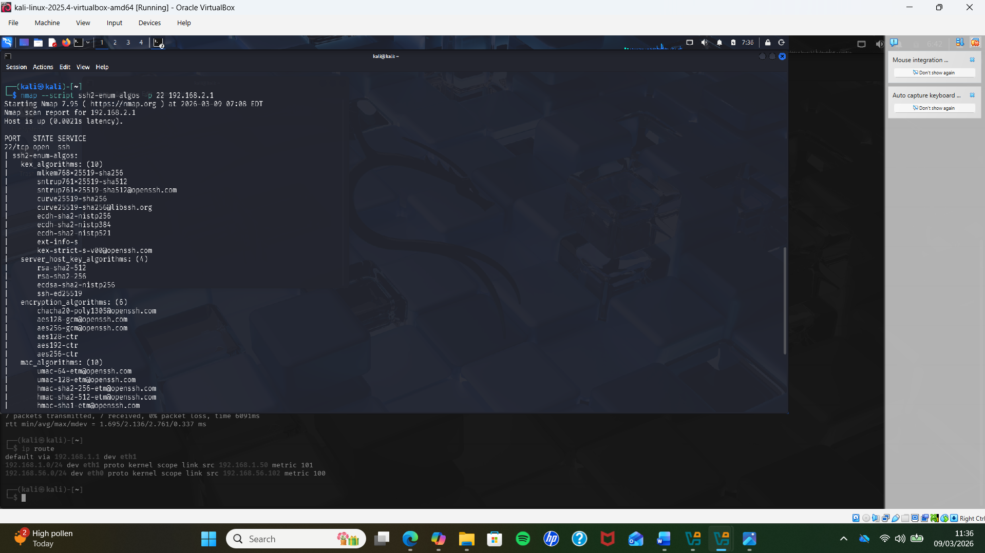
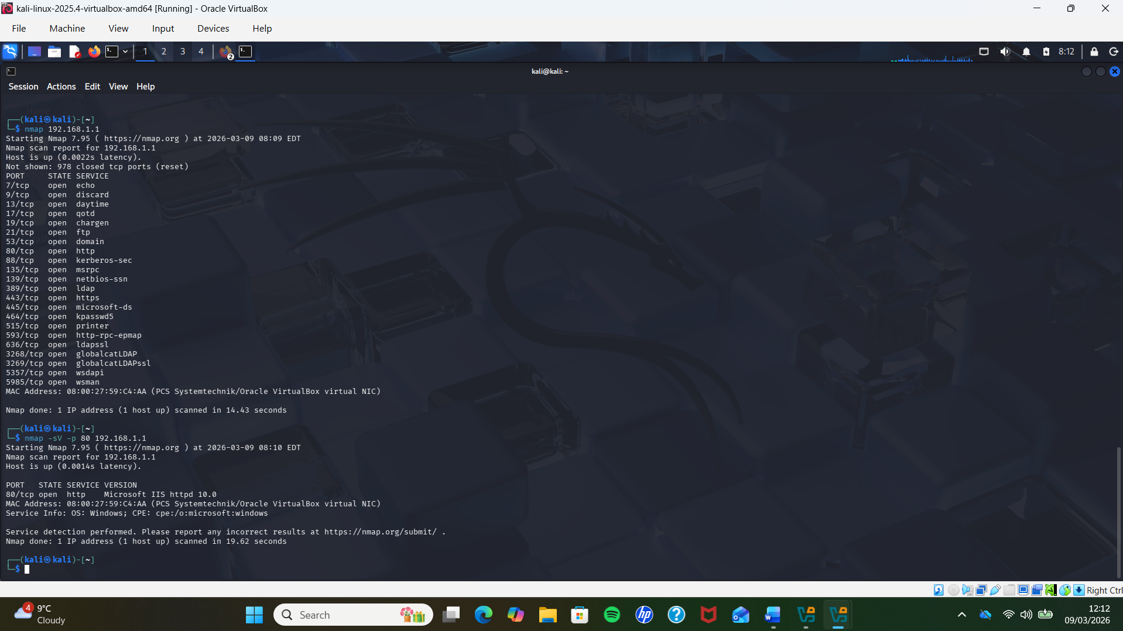
Identified Network Vulnerabilities
Low Severity Vulnerabilities
• SSH enumeration revealed supported encryption algorithms and configurations
• This exposes system details but does not allow direct exploitation
• HTTP service version disclosure identified Microsoft IIS 10.0 and Windows OS
• Revealing software versions can help attackers identify potential targets
• These findings represent information disclosure vulnerabilities
• They provide useful reconnaissance data but have low impact on their own
nmap --script ssh2-enum-algos -p 22 192.168.1.1
nmap 192.168.1.1
nmap -sV -p 80 192.168.1.1

Slide 6
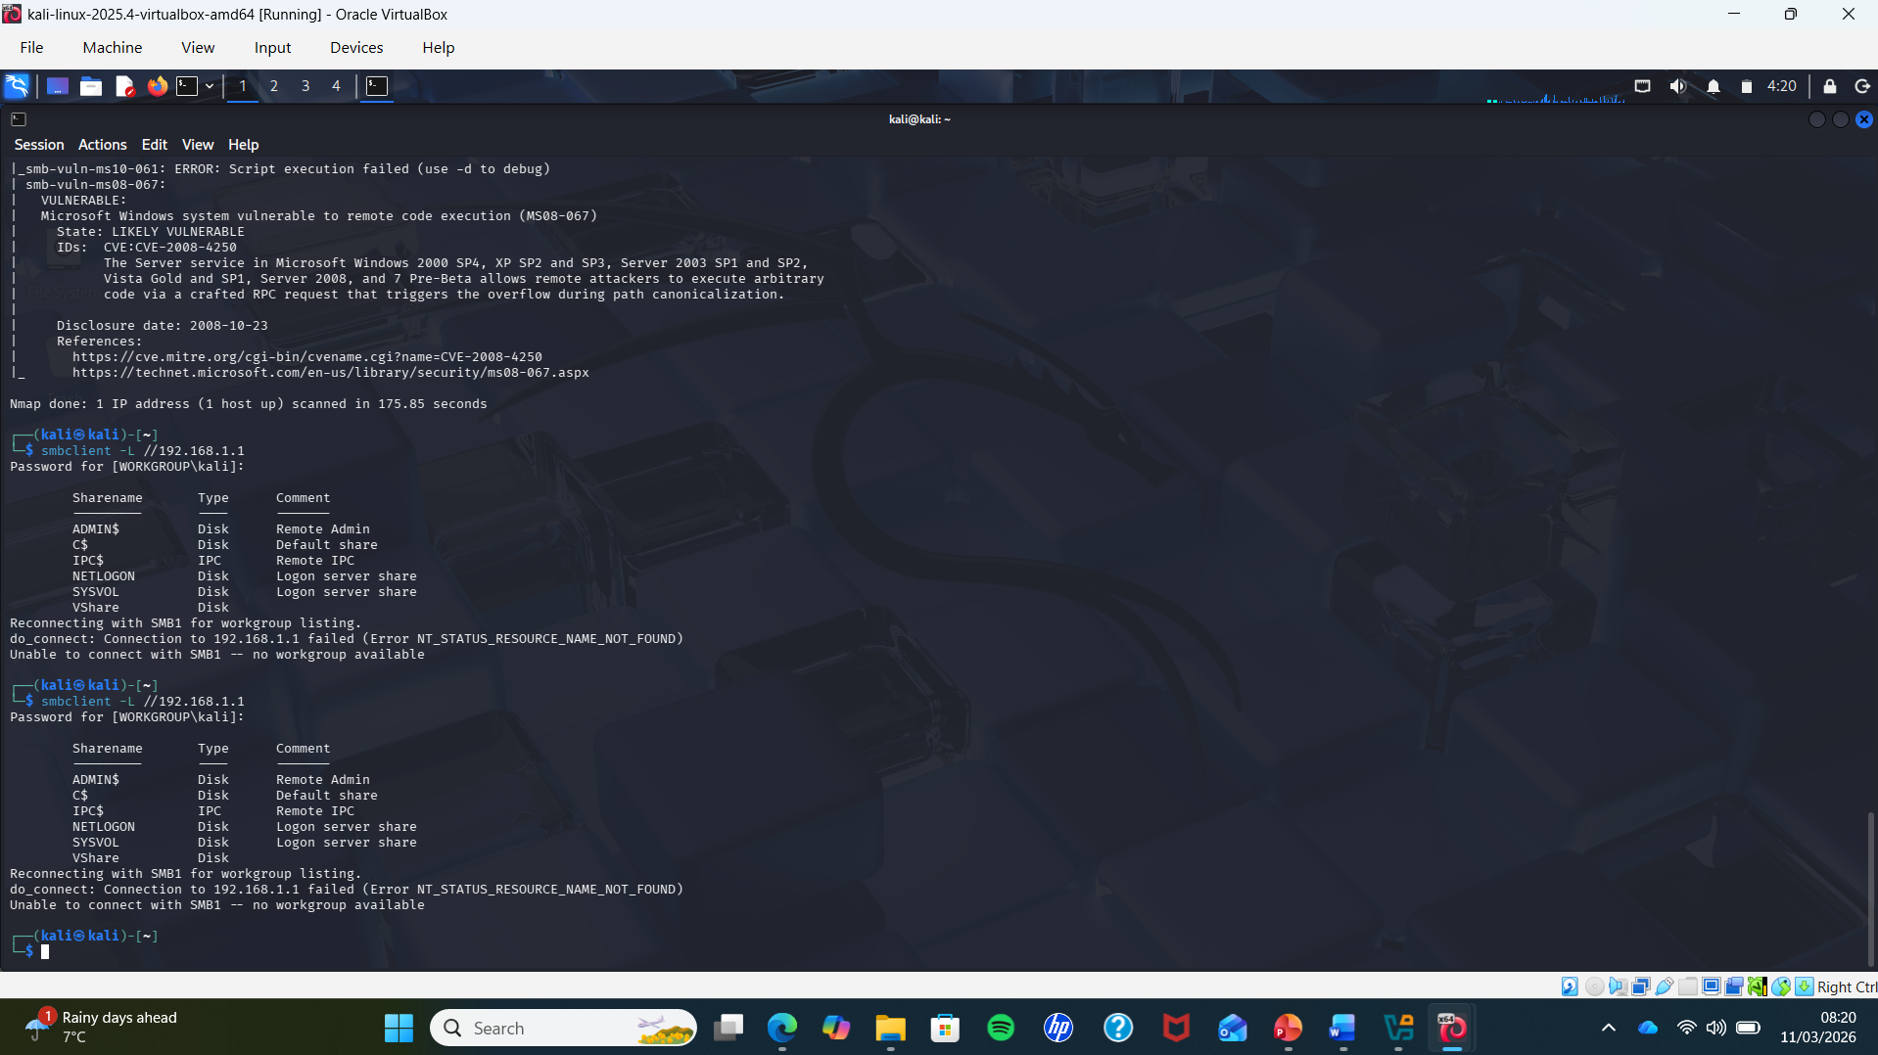
Identified Network Vulnerabilities
MEDIUM SEVERITY
• SMB enumeration was performed using smbclient to identify available network shares
• The command smbclient -L //192.168.1.1 revealed shares such as ADMIN$, IPC$, NETLOGON and SYSVOL
• Further SMB enumeration using enum4linux exposed domain information, including SWANSEA domain and Domain SID
• It also identified user accounts, groups, and system details
• These findings represent medium severity vulnerabilities
• They expose sensitive internal information that could support further attacks
smbclient -L //192.168.1.1
enum4linux 192.168.1.1

Slide 7
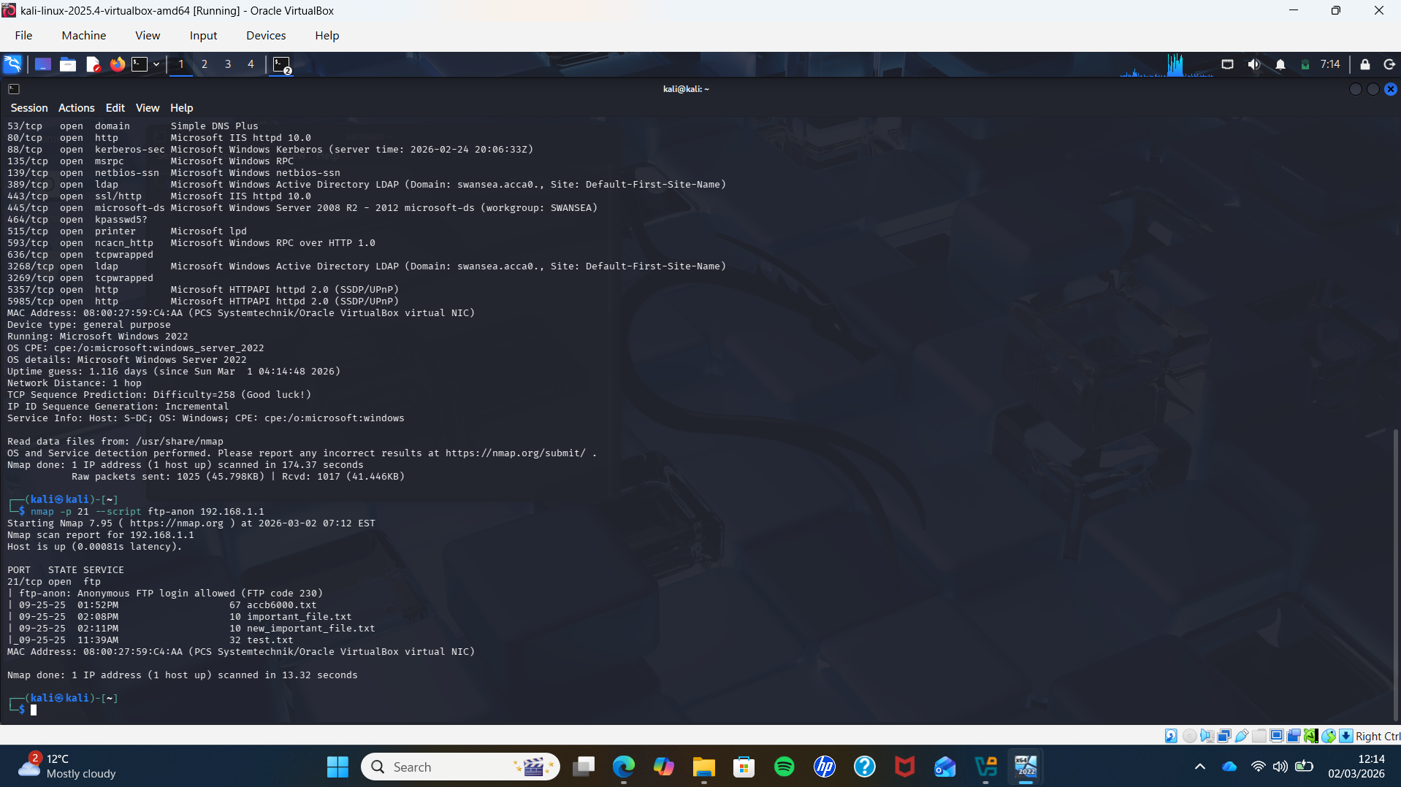
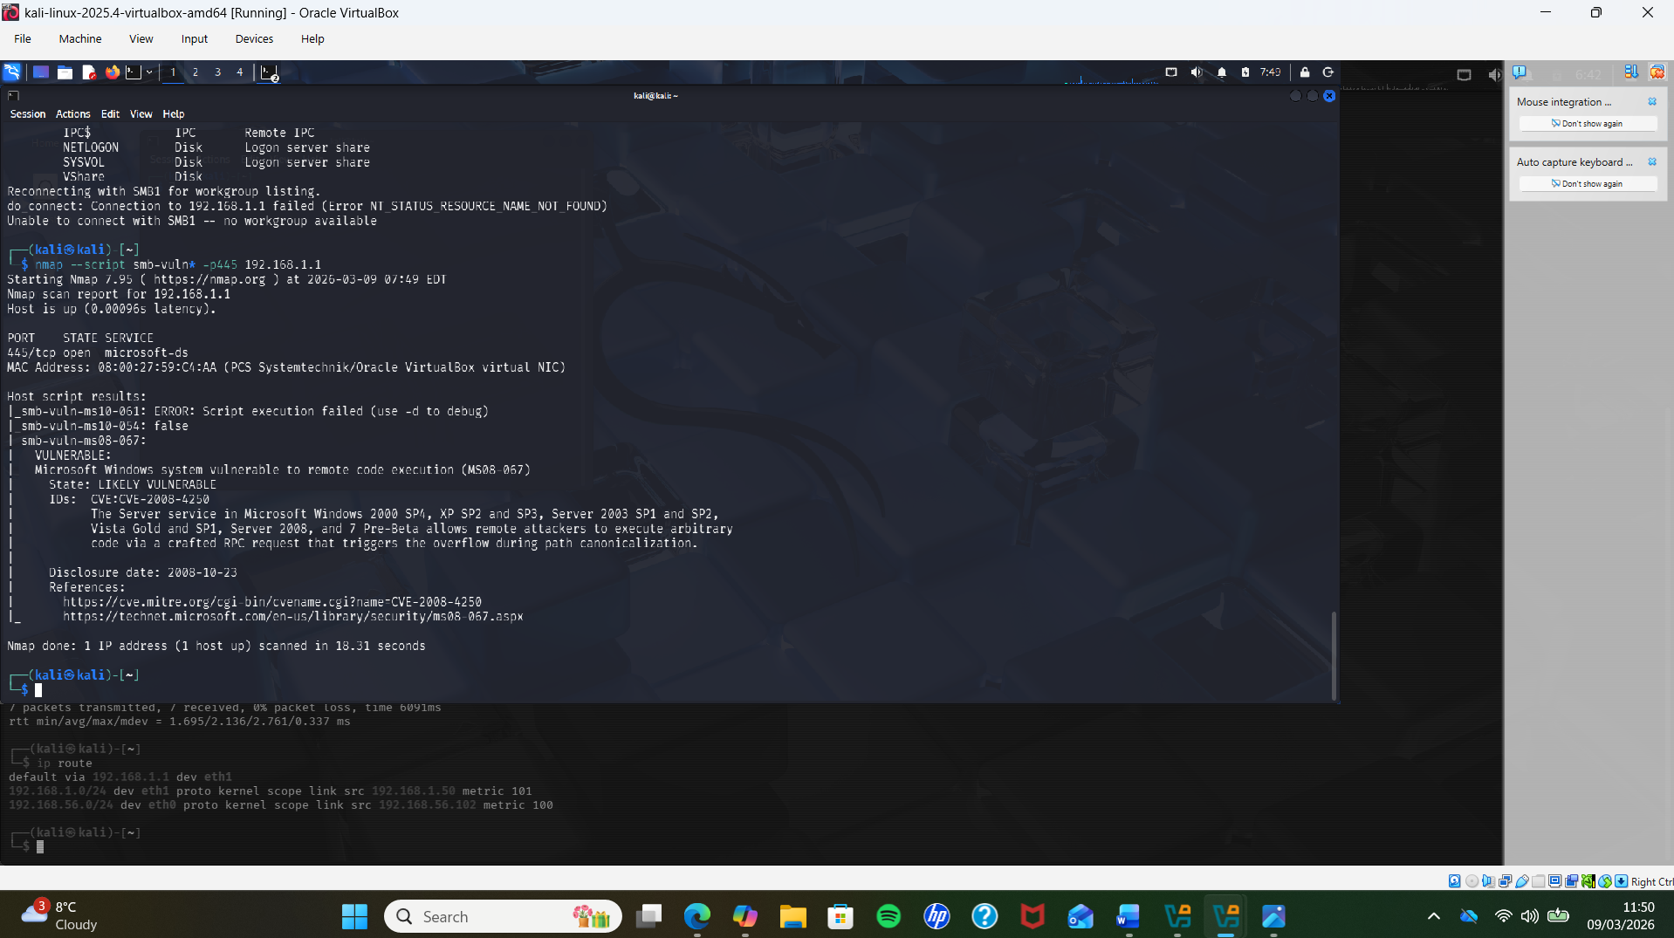
Identified Network Vulnerabilities
HIGH SEVERITY
• An FTP service vulnerability was identified allowing anonymous login
• This exposed files on the system and allowed unauthorised access
• A critical SMB vulnerability (MS08-067) was detected using Nmap scripts
• The system was identified as vulnerable to remote code execution (RCE)
• These vulnerabilities represent a high security risk
• They could allow attackers to gain full system access
nmap --script ftp-anon 192.168.1.1
nmap --script smb-vuln* -p 445 192.168.1.1

Slide 8
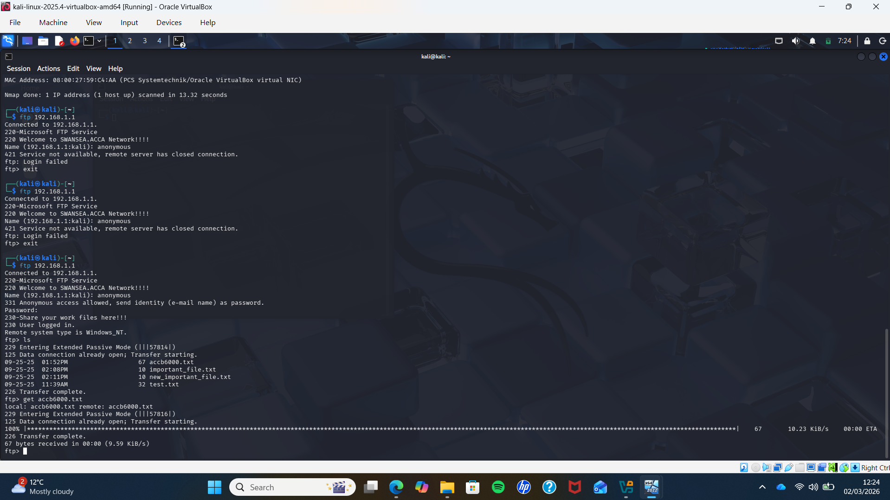
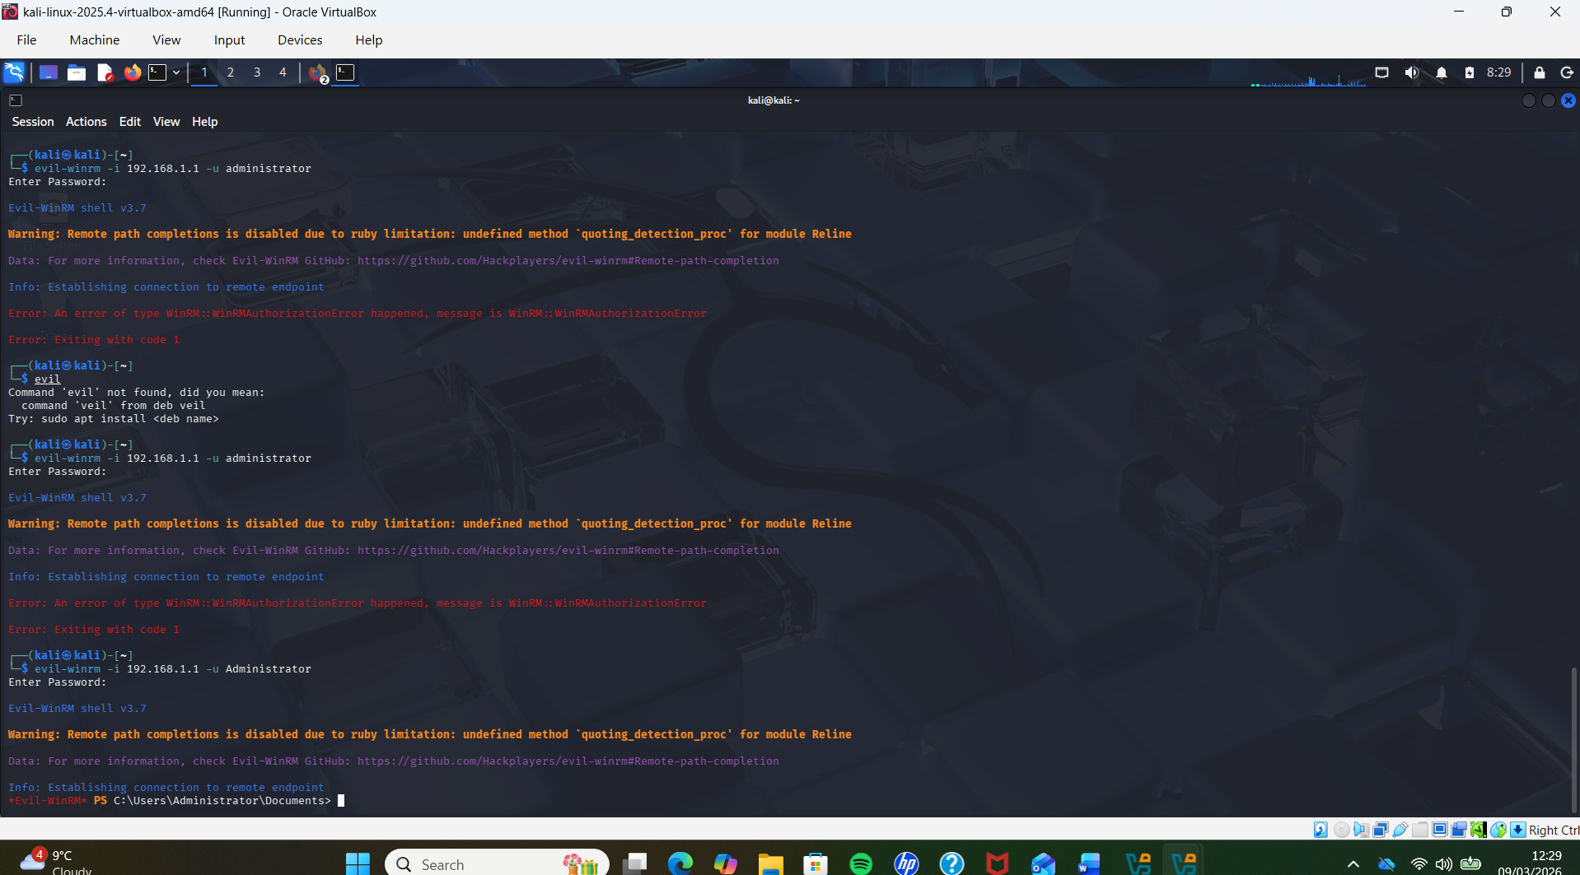
Exploitation and Post-Exploitation
• The FTP vulnerability was successfully exploited using anonymous login
• The attacker was able to access the FTP service without authentication
• Files were listed and downloaded from the target system
• This demonstrates unauthorised data access and potential
Further access was gained through remote command execution
• The tool Evil-WinRM was used to establish a remote session
• This provided interactive access to the target system
• Attackers can execute commands, access files, and control the system
evil-winrm -i 192.168.1.1 -u Administrator

Slide 9
Recommended Security Measures
• Disable anonymous FTP access and enforce strong authentication
• Regularly update and patch systems to prevent vulnerabilities such as MS08-067
• Restrict access to SMB services and apply proper network segmentation
• Use firewalls to block unnecessary ports and limit external access
• Implement strong password policies and user access controls
• Monitor systems using intrusion detection systems (IDS) and security tools
• Nmap Documentation – https://nmap.org/docs.html
• OWASP Top 10 – https://owasp.org/www-project-top-ten/
• Microsoft Security Bulletin MS08-067 – https://learn.microsoft.com
• Kali Linux Tools Documentation – https://www.kali.org/tools/

Slide 10
ANALYTICAL SUMMARY
• The assessment identified multiple vulnerabilities across the target system with varying severity levels
• Low severity issues revealed system and service information that could support reconnaissance
• Medium severity vulnerabilities exposed internal network details such as shared resources and user information
• High severity vulnerabilities, including FTP anonymous access and SMB remote code execution (MS08-067), posed a significant security risk
• These vulnerabilities demonstrate how attackers can progress from information gathering to full system compromise
• Implementing appropriate security controls and patching is essential to reduce risk and protect systems

