Slide 1



Name: Jeneba Echeverria Dominguez
Module: Psychology in Health and Social Care
Student ID: 2438504
Code: LCHS4010
Lecture Name: Lou Wells

Slide 2

Introduction
This work looks at the situation of a young carer and how her past experiences have affected her development. It shows how caring at a young age can impact relationships and overall wellbeing. It also suggests ways to support her and improve her quality of life in the future.

Slide 3
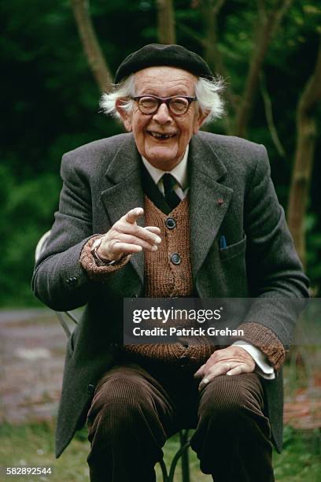
The Piaget’s Cognitive Theory
Piaget's theory of cognitive development explains how children and adolescents improve their capacity for thought and learning as they mature. When a person reaches the age of sixteen, they are in the formal operational stage, which allows them to solve issues, think logically, and make future plans (Jean Piaget, 1952). Piaget's theory is applicable to Jenny's circumstances because he thought that cognitive development occurs through interaction with the environment and life experiences.

Slide 4
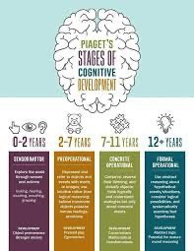
Relevance to Jenny’s experience
Jenny has been caring for her mother since she was very young, after her father passed away. Because of this, she had to take on adult responsibilities early, which may have reduced her time for school, learning, and personal development. Piaget’s theory explains that children learn best when they have time to explore, learn, and practise problem-solving skills (Piaget, 1952). Ongoing stress and responsibility may affect Jenny’s ability to concentrate, plan ahead, and feel confident in her education (McLeod, 2018).

Slide 5

Impact on Development and Well- Being
Because of her responsibilities, Jenny may not have been able to focus fully on her schoolwork and learning opportunities, which could have affected her thinking development (Aldridge, 2018). Emotional stress can also reduce motivation, memory, and decision-making, making it harder for young people to engage well in education (McLeod, 2018). Although caring may have helped Jenny develop problem-solving and responsibility skills, a lack of balance between studying and caring could place her at risk of academic difficulties and emotional exhaustion (Joseph et al., 2020).

Slide 6
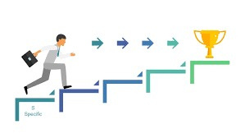
Theory Strategies
Jenny should receive support that helps her develop her thinking and learning skills in a healthy way (Piaget, 1952). Educational support such as flexible learning, tutoring, and extra time for assignments can help her cope better with school work and improve her learning outcomes (Aldridge, 2018). Reducing her caring responsibilities with help from social and community support services can give her more time and mental energy to focus on learning (Becker and Sempik, 2019). Activities such as goal setting, future planning, and problem-solving discussions can help build confidence and support her thinking development (McLeod, 2018).

Slide 7
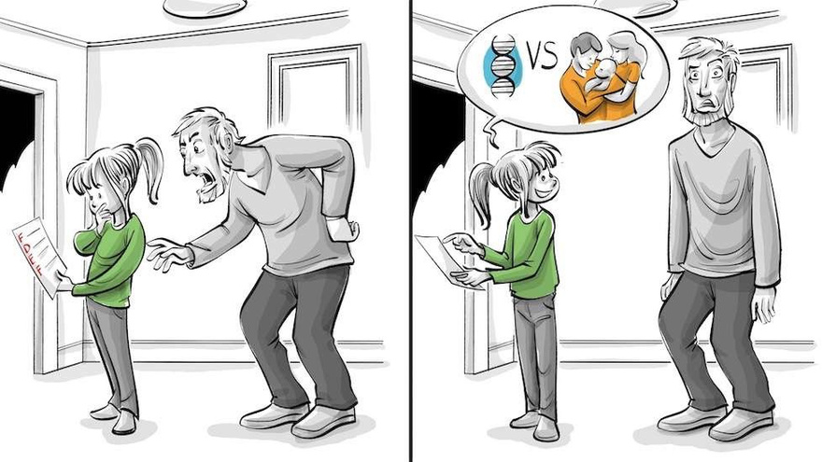
Nature and
Nurture
Jenny’s ability to think and understand as she grows is supported by biological factors such as brain development and mental ability (Piaget, 1952). However, environmental factors like caring responsibilities, ongoing stress, and fewer learning opportunities can strongly affect how these thinking skills develop (McLeod, 2018). Research shows that young carers often face emotional and learning difficulties because of these pressures (Becker and Sempik, 2019). By improving Jenny’s environment through education support and reducing her caring duties, her thinking skills and overall wellbeing can be improved.

Slide 8

Usefullnes on Piaget’s theory in Jenny’s situation
Health and social workers can better comprehend Jenny's learning and thought processes by using Jean Piaget's theories. Knowing Jenny's stage can assist carers and educators explain things in a way that she can comprehend, as Piaget explained that children develop their thinking in stages (Piaget, 1952).
The idea that kids learn via experiences and activities is another advantage. Professionals can assist Jenny by teaching her about everyday activities or health through play, drawings, and straightforward explanations (Piaget, 1972).
Professionals can also use Piaget's theory to plan the appropriate kind of support. To prevent confusion and tension, they could, for instance, assign Jenny activities that are appropriate for her skill level (Piaget, 1952).

Slide 9

Limitations on Piaget’s Theory in Jenny’s situation
Piaget's hypothesis does, however, have many flaws. Its lack of emphasis on social ties is one of its weaknesses. The hypothesis does not adequately explain how Jenny's family, friends, and carers may potentially have an impact on her growth. According to Lev Vygotsky, social connection is crucial for learning (Vygotsky, 1978).
The stages may be very rigid, which is another flaw. Not every child develops at the same rate. Professionals shouldn't evaluate Jenny's ability just based on her age because she may exhibit abilities from multiple stages at the same time (Piaget, 1952).
Additionally, the idea ignores emotions and feelings, which can also have an impact on a child's growth, in favour of concentrating primarily on thinking and learning abilities.

Slide 10

Conclusion
I choose Piaget’s theory because it clearly explains how young people develop their thinking and problem-solving skills through everyday experiences. It is useful for Jenny’s situation because helps me understand how her caring responsibilities may have limited her time for learning, planning, and concentrating at school. The theory also helps me identify her strengths, such as practical problem-solving skills gained through caring. However, I found this theory useful in health and social care, especially when combined with support that also focuses on emotional wellbeing and the environment around the young person.

Slide 11
References
Aldridge, J. and Becker, S. (2018) Young carers and young adult carers: Research, policy and practice. Bristol: Policy Press.
Becker, F. and Sempik, J. (2019) Young adult carers at university and college. Leicester: University of Leicester / Carers Trust.
Becker, S. (2007) ‘Global perspectives on children’s unpaid caregiving in the family: Research and policy on “young carers” in the UK, Australia, the USA and Sub-Saharan Africa’, Global Social Policy, 7(1), pp. 23–50.
Joseph, S., Becker, F. and Becker, S. (2020) Young carers, mental health and education. Bristol: Policy Press.
McLeod, S. (2018) Piaget’s theory of cognitive development. Simply Psychology. Available at: https://www.simplypsychology.org/piaget.html (Accessed: 1 March 2026).
Jean Piaget
Piaget, J. (1952) The origins of intelligence in children. New York: International Universities Press.
Jean Piaget
Piaget, J. (1972) The psychology of the child. New York: Basic Books.
Lev Vygotsky
Vygotsky, L.S. (1978) Mind in society: The development of higher psychological processes. Cambridge, MA: Harvard University Press.

Slide 12
Thank You for Your Attention
Questions and discussion are welcome.

