Slide 1

Ecology in the New Age
TRRS5008 Sects, Self and Society

Slide 2
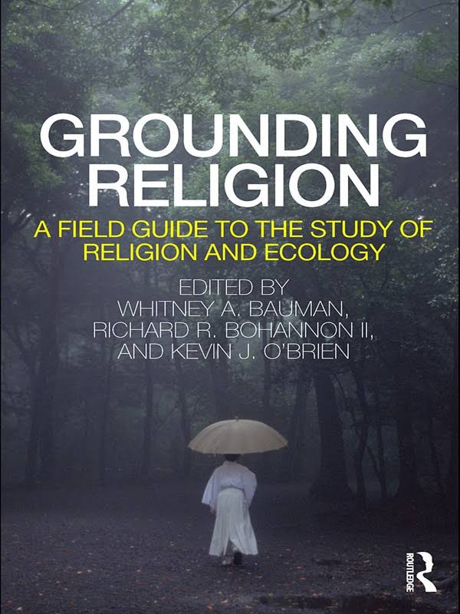
According to the Oxford English Dictionary, ecology is “The branch of biology that deals with the relations of organisms to one another and to their physical surroundings”.
So, it’s a branch of a science (a hard science), ‘based on careful observation and repeatable research. Most broadly, ecology in this sense is the study of organisms in their living and nonliving contexts’ (Bauman et all, 2011, 51).

Slide 3
οἶκος
Ecology comes from the Greek oikos – household. The study of organisms in their ‘houses’ (Bauman et al, 2011, 49).
‘ology’ – study of
Bauman notes that oikos also led to ‘ecomonics’ (how humans’ manage households and systems’) and ‘ecumenism’ (attempt to promote understanding between belief systems) And, says Bauman, ‘ecology is and always has been both a project of scientific research and a broader pursuit with social and religions implications’ (2011, 49).

Slide 4
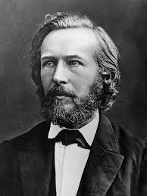
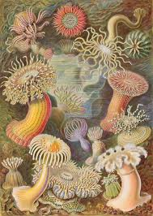
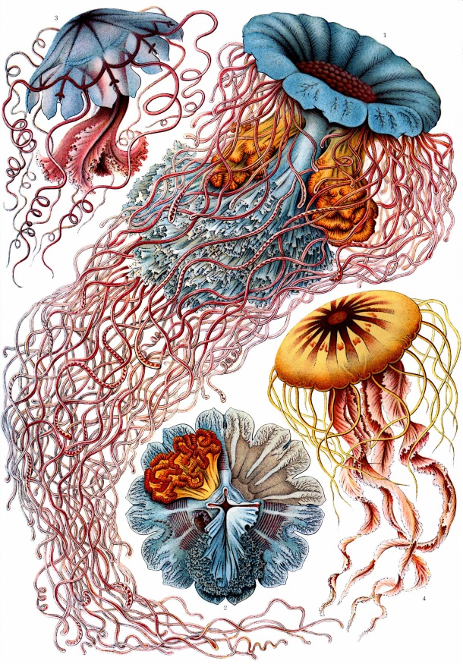
“Like religion, ecology is best understood as a broad idea that covers a lot of territory and can be bent and shaped in various ways” (Bauman et al, 2011, 49).
German biologist - Ernst Haechel (1895) - need to think, post Darwin, of the relationship of organisms with their environments. But went a step further – yes ecology gives us data but it will also teach us about the order of the cosmos.
Christianities’, “Hinduisms”, etc, we need to think in terms of “ecologies”.

Slide 5
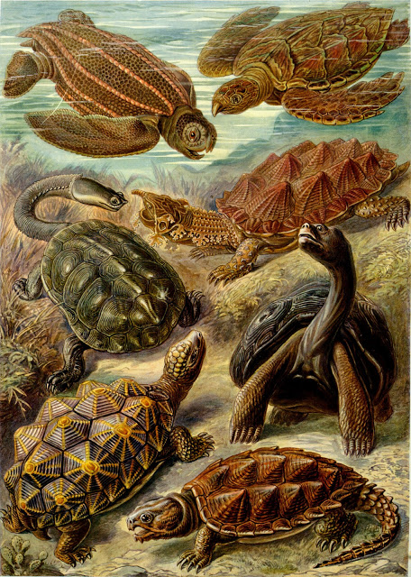
Who has the authority to ‘do ecology’? (Bauman et al, 2011, 51).
What does ecology tell us about nature?
How does ecology influence religion? Is ecology something within religions or is it a challenge to religion (Bauman et al, 2011, 51).
Tackle environmental problems through religion or despite religion?

Slide 6
Ro (1998 in Bauman) says that ‘Ecology, thus, must be based on a reciprocal receptivity with nature and the universe by “seeing” and “listening” to the wonder, mystery and pain of the universe… [H]uman beings must be understood in light of the universe rather than the human rationality or logos being imposed on the universe’.

Slide 7
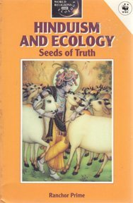
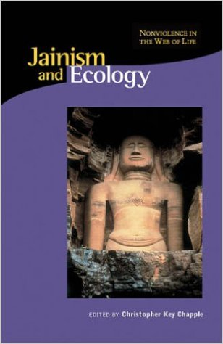
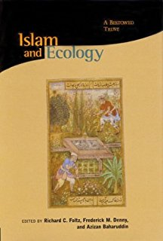
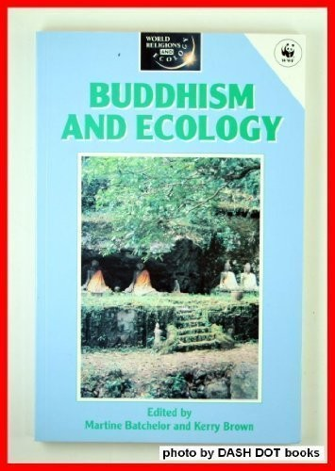
We can also think in terms of what different religions have to say about ecology (and ‘nature’)
about humanity’s relationship to the environment
of the responses to the ‘environmental crisis’. World-wide religions, indigenous religions and new religious movements, and differences within them. So, lots of possible aspects to look at.
Yale Forum on Religion and Ecology: http://fore.yale.edu/religion/

Slide 8
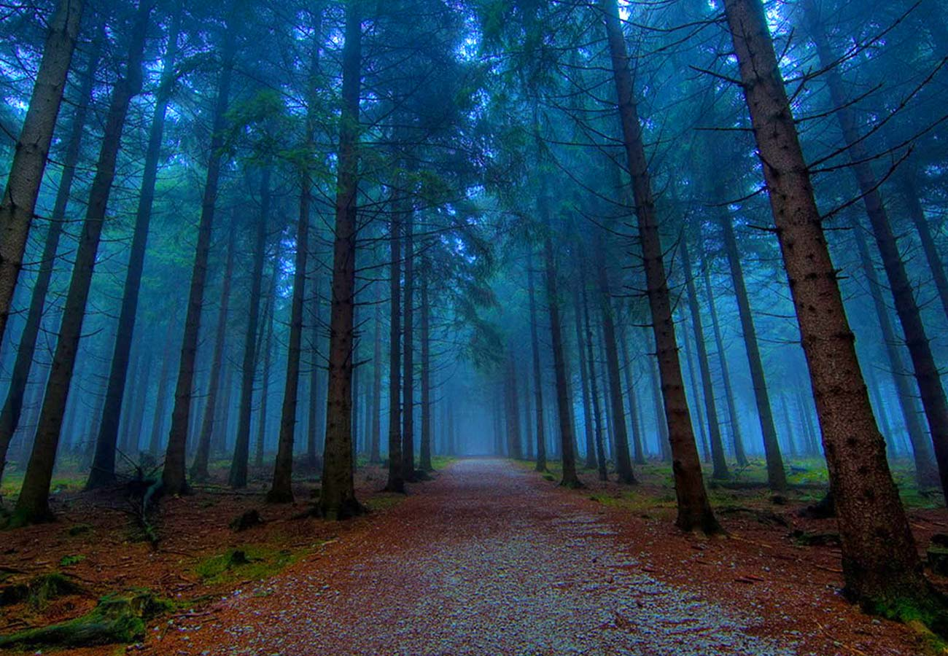
The earth once existed without human beings. “’…trees fell and made sounds long before humans appeared’ (Bauman et al, 2011, 57).

Slide 9
So there are environmental issues to address – through science or through religion? Solve through science or solve through changing the way that people think? If religions respond do they ‘recover’, ‘reform’ or ‘replace’? (Bauman et al, 2011, 59)

Slide 10
What is nature and what is natural?
Are humans natural or separate form what is natural? (Bauman, 2011, 55). ‘… there are important differences between our species and all others We have taken a dominant role on the planet in a way no other creature has managed. Human beings create technologies and profoundly transform the world and its materials in unprecedented ways… we are capable of self-reflection…’

Slide 11
Deane-Drummond (1996, 70):
Human beings are a part of ‘nature’ in that we share in the biochemical and physiological processes in common with animals and all living beings. We are also ‘apart’ from nature in that we are self-aware and have the power to make conscious decisions about how to chance the natural world around us. The debate in environmental ethics is how we, as human beings, should give value to the natural world. If we regard nature as a resource to be managed for human interests, it has instrumental value. If we regard nature as having value in itself and of itself it has inherent value…If we regard nature as having intrinsic value, this is independent of humans…

Slide 12
Bauman et al note that ‘…the idea of nature is indisputably a product of human culture. When we talk about the natural world, we reflect the values and assumptions of our societies. This means that nature has social implications, and that discussions of nature reveal much about the ways we justify and understand cultural systems and human actions. “Nature” … is a word which has been frequently misunderstood by those with power against those without it’ (Bauman et al, 2011, 56).

Slide 13
Christianity in the nineteenth century
Ecofeminism
‘natural’ equated with ‘uncivilized’, justification for doing harm
A view that some people are ‘closer to nature’?

Slide 14

Steve Bruce (2005, 210) New Agers are Green and that New Age environmentalism and its “mundane counterpart” differ in 2 respects, first, environmental problems are linked to personal problems and second, the planet is seen as an organism. “The secular Green protects the environment out of self-interest; the New Age Green does so out of respect for a superior being”.
Partridge (2005, 42), “There can be little doubt that there has been a significant greening of the Western consciousness”. Environmentalism is a key part of occulture, and increasingly not for selfish reasons.

Slide 15
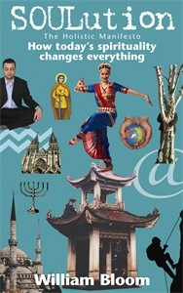
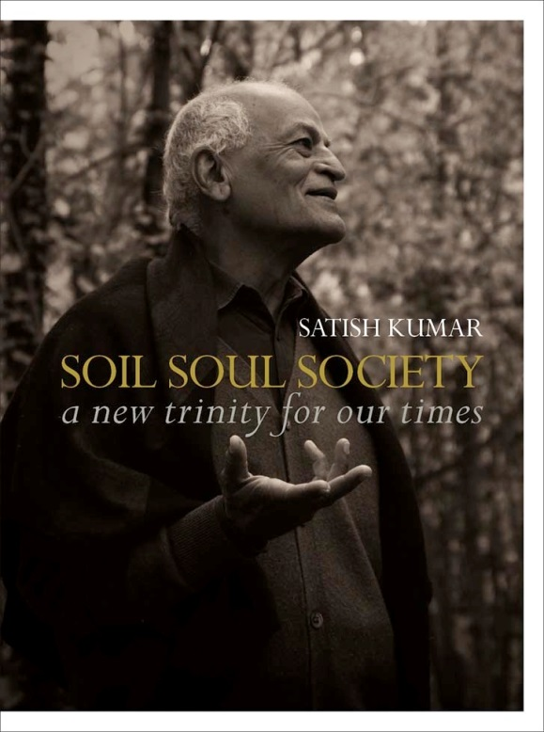
Bloom (2005, 105) write of “deep ecology”, and our “cellular and emotional solidarity with landscape, soil and all living creatures”. “Biophilia” – the instinct to connect with the natural world.
Satish Kumar’s (2005) notion of “soil, soul and society”.

Slide 16
Kemp says that there is an overlap between the New Age and the environmental or ecological movement, although now it is inaccurate to think of environmental concerns as “alternative”.
Barker says that ecological issues take a high priority for New Agers. She says that most tend to be vegetarian, (cf Marion Bowman) they are involved in back-to-the-earth communes, organic farming, home-spun textiles, cottage industries, alternative technology, emphasis on the feminine and their politics are green.
Kemp, D (2004) New Age: A Guide, Edinburgh, Edinburgh University Press, 31.
Barker, E (1992) New Religious Movements: A Practical Introduction, London, HMSO.

Slide 17
Bloom says
Many…tribal peoples have demonstrated a high level of ecological morality, recognizing their intimate communion with the web of life…In this ‘primitive’ environment, all aspects of life – plant, animal, rock, river – have character and importance…Many religions caution against the killing and eating of animals, but in tribal societies animal flesh is often a necessity of survival. Even this hunting and killing is done with a full acknowledgement of the interdependence and the sanctity of the animal. Grateful and respectful prayers are communicated to the souls of the animals. In some cultures, the hunters sense that the animals’ souls reincarnate to be hunted by them again.
Bloom, William (2005) Soulution, The Holistic Manifesto, London, Hay House UK Ltd, 138.

Slide 18
Heelas notes
With regard to more obviously counter-cultural renderings of right livelihoods, an indeterminate number of people (not all of whom will be fully-fledged New Age spiritual seekers) endeavour to make their living by engaging in practices which are good for nature (and the soul). They might live – as much as possible – directly off the land, working smallholdings, practicing permaculture or living in green communities. They might produce arts and crafts, using natural products when feasible. They might work for the New Age, enlightening people, and, in the process, often encouraging them to revere nature. Then there are all those New Agers who practise green consumption, are involved in new Social Movements such as Friends of the Earth, who are involved with local exchange or ‘barter’ schemes, or who use ethical investment companies. And finally, there are those who perform rituals to energize or otherwise affirm the earth.
Heelas, P (1996) The New Age, Oxford: Blackwell, 86-7.

Slide 19
Heelas (1996, 84): ‘Counter-cultural New Agers seek new ways of relating to the environment: ways which will save the earth from the ravages of capitalist modernity, through adopting ways of living that are environmentally sound or nurturing.
He argues that the 1970s saw a number of significant contributions to the development of New Age environmentalism.

Slide 20
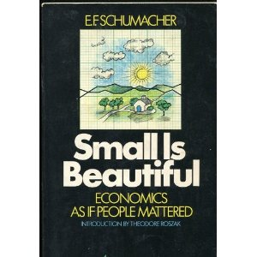
Heelas:
1 Arne Naess’ 1972 lecture coined “deep ecology”.
2 EF Schumacher’s Small is Beautiful. A Study of Economics as if People Mattered, in 1973. “Intermediate Technology”. “Production by the masses, not mass production”. Schumacher, EF (1993) Small is Beautiful: a study of ecomonics as if people mattered, London, Vintage (1st pub 1973), 126.
3 Françoise d’Eaubonne’s coining of the term ‘eco-feminism’, in 1974.

Slide 21

1996

Slide 22
James Lovelock’s (1979) Gaia hypothesis, or theory. Lovelock adopted the term “Gaia” to refer to his belief that the planet is a living system, behaving as a unified organism.
Thanks to the concept of Gaia we now see that our planet is entirely different from its dead siblings Mars and Venus. Like one of us, it controls its temperature and composition so as always to be comfortable, and it has done this even since life began three billion years ago. To put it bluntly, dead planets are like stone statues, which if put in an oven and heated to 80˚C remain unchanged. I would die and so would you if heated that hot and so would the earth (2006, 2).

Slide 23
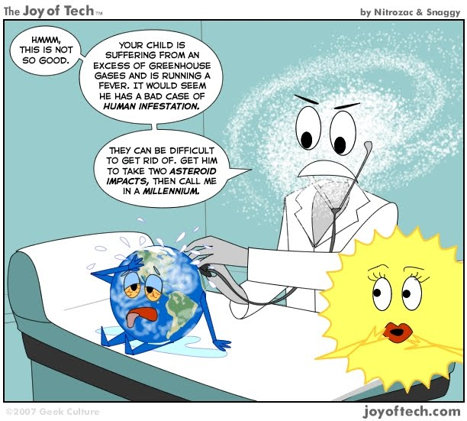

Slide 24
2006, The Revenge of Gaia in which he argues that Gaia will look after itself and do what is necessary to survive, even destroy humanity. He talks of hearing of the 2004 tsunami when writing this book and says
That awful event starkly revealed the power of the Earth to kill. The planet we live on has merely to shryg to take some fraction of a million people to their death. But this is nothing compared with what may soon happen; we are now so abusing the Earth that it many rise and move back to the hot state it was in fifty-five millions years ago, and if it does most of us, and our descendants, will die (2006, 1).

Slide 25
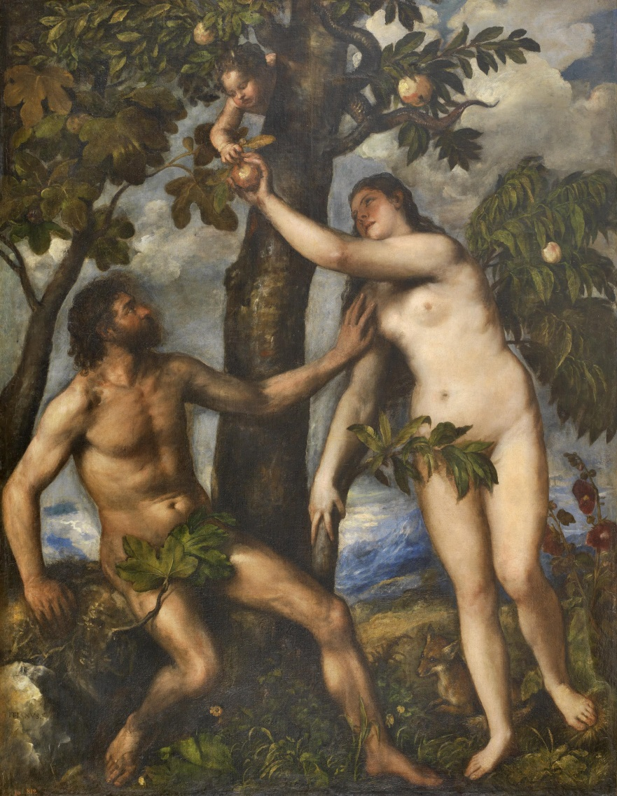
Christianity and Ecology
RECOVER?
REFORM?
REPLACE?

Slide 26
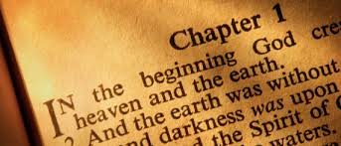
Partridge (2005, 45) with monotheism (Judaism first) came a distinction between the sacred and the profane, a dualism, a “them and us” attitude:
…a single system of religious ethics evolved, humanity was ‘liberated’ from a dependence on magic and the natural world, which in turn was evacuated of animistic spirits and sacred forces, becoming simply the physical arena in which one obeyed God. The natural world was the creation of a good and loving God, but it was not itself sacralizing (2005, 45).

Slide 27
Richard Roberts (1998, 65) - Genesis 1:28 –has been used to legitimate the destructive exploitation of nature.
New International Version
God blessed them and said to them, "Be fruitful and increase in number; fill the earth and subdue it. Rule over the fish in the sea and the birds in the sky and over every living creature that moves on the ground.”
English Standard Version
And God blessed them. And God said to them, “Be fruitful and multiply and fill the earth and subdue it, and have dominion over the fish of the sea and over the birds of the heavens and over every living thing that moves on the earth.”
King James Bible
And God blessed them, and God said unto them, Be fruitful, and multiply, and replenish the earth, and subdue it: and have dominion over the fish of the sea, and over the fowl of the air, and over every living thing that moveth upon the earth.

Slide 28
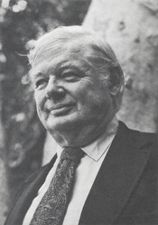
Lynn White - professor of medieval historian at Princeton - entitled, ‘The Historical Roots of Our Ecological Crisis’ (1967), is usually identified as inaugurating modern eco-theological discourse.
“exploiter of nature”.
Christianity - removed the lingering vestiges of a pagan animism, replacing a deep reverence for the natural world with distinct indifference
“Especially in its Western form, Christianity is the most anthropocentric religion the world has seen”. Christianity “bears a huge burden of guilt” for the contemporary ecological crisis.

Slide 29
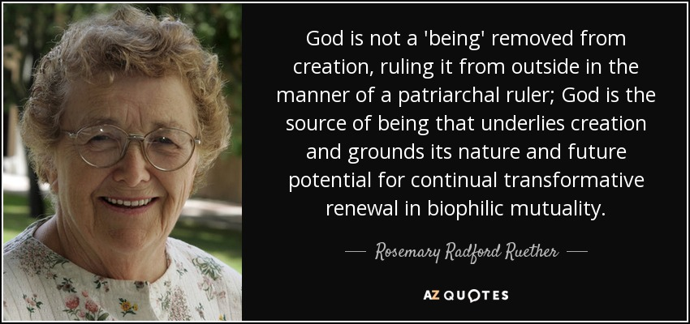
Reform -
Rosemary Radford Ruether (1994) - Christianity forbids us from seeking knowledge of nature outside of the Church's control.
Feminisation of nature. ‘Mother nature’
Eco-feminism

Slide 30

Recover -
Calvin DeWitt (2000, 297) if we look carefully at the Bible we will see it tells us how to treat creation – ie not to harm it (but this is because he thinks creation isn’t humanities but God’s). ‘… disgrace to their Creator’. Also, that within the Bible is the guidance on how to heal earth.

Slide 31
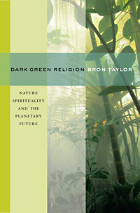
Replace -
Bron Taylor ‘dark green religions’ ‘new spirituality’ – replace Christianity. ‘…develop from a deep sense of belonging to and connectedness in nature, while perceiving the earth and its living systems to be sacred and interconnected’ (2009, 13).

Slide 32
Starhawk (2000, 217)
Our relationship to the earth and the other species that share it has also been conditioned by our religious models. The image of God as outside of nature has given us a rationale for our own destruction of the natural order, and justified our plunder of the earth’s resources. We have attempted to ‘conquer’ nature as we have tried to conquer sin.

Slide 33
Vivianne Crowley (1998)
a nature religion implies a nature to worship. The idea that nature was being exploited, desouled and desacralised and that our environment was in danger was not new to the 1970s. This was a common theme of artists, writers, poets, philosophers, religious thinkers and others from the eighteenth century onwards. However, with the increased pace of industrialisation throughout the nineteenth and into the twentieth centuries, it was a matter of increasing concern.

Slide 34
In earlier times, when plague and famine regulated our numbers , it seemed fair and fitting to try by every means to heal the sick and preserve human life. This attitude later crystallized into the rigidly uncompromising belief that the Earth was made for man and his needs and desires were paramount. In authoritarian societies and institutions, it seemed absurd to doubt the wisdom or propriety of razing a forest, damming a river, or building an urban complex. If it was for the material good of human beings, then it must be right. No moral question was involved, other than the need to prevent bribery and corruption and to ensure fair shares among the beneficiaries (Lovelock, 1995, 136).

Slide 35
‘Is ‘nature’ separate from or part of human culture? Is ecology for science or everyone? Is the best approach a pluralistic one or is one approach better as we try to address the environmental crisis? Further, they emphasise the need to ‘ recognize the strength of each position and therefore the complexity of thinking about how diverse groups of believers and scholars are responding to ecological realities. Recognizing the appreciating the diversity of responses available to ecology, the natural worldm and environmental degradation is a vitally important part of understanding both religion and ecology’ (Bauman et al, 2011, 62).

Slide 36
Bibliography
Barker, Eileen (1992) New Religious Movements: A Practical Introduction, London, HMSO.
Bauman, Whitney A, Richard R Bohannon II and Kevin J O’Brien eds (2011), Grounding Religion: A Field Guide to the Study of Religion and Ecology (Abingdon: Routledge).
Bloom, William ed (2000) The Penguin Book of New Age and Holistic Writing, London, Penguin. Bloom, William (2005) Soulution, The Holistic Manifesto, London, Hay House UK Ltd.
Bruce S (2005) Religion in the Modern World, from Cathedrals to Cults, Oxford: Oxford University Press.
Crowley, Vivianne, ‘Wicca as Nature Religion’, in in Pearson, Roberts & Samuel eds (1998), Nature Religion Today, Edinburgh: Edinburgh University Press.
Deane-Drummond, Celia (1996) A Handbook in Theology and Ecology, London, SCM Press Ltd.
DeWitt, C (2000) “Behemoth and batrachians in the Eye of God: Responsibility to Other Kinds in Biblical Perspective”, in D Hessel and R Reuther (eds) Christianity and Ecology: Seeking the Well-Being of Earth and Humans, Cambridge, HA: Harvard University Press.
Henderson, Hazel, “Beyond the Information Age: Paradigms in progress”, in Bloom, W ed (2000) The Penguin Book of New Age and Holistic Writing, London, Penguin.
Heelas, Paul (1996) The New Age, Oxford: Blackwell.
Kemp, Daren (2004) New Age: A Guide, Edinburgh, Edinburgh University Press.

Slide 37
Kumar, Satish (2005) You Are Therefore I Am, Totnes, Green Books.
Lovelock, James (1995) Gaia, A New Look at Life on Earth, Oxford, Oxford University Press (1st pub 1979).
Lovelock, James (2006) The Revenge of Gaia, London, Allen Lane.
Macy, Joanna, “Greening the Self – A Buddhist Approach”, in Bloom, W ed (2000) The Penguin Book of New Age and Holistic Writing, London, Penguin.
Partridge, C (2005) The Re-Enchantment of the West, vol 2, London, T&T Clark.
Pearson, Roberts & Samuel eds (1998), Nature Religion Today, Edinburgh: Edinburgh University Press.
Richard Roberts, ‘Gender, Religion and the Battle for the Earth’, in Pearson, Roberts & Samuel eds (1998), Nature Religion Today, Edinburgh: Edinburgh University Press.
Ruether, Rosemary Radford (1994) Gaia and God, San Francisco, Harper.
Schumacher, EF (1993) Small is Beautiful: a study of ecomonics as if people mattered, London, Vintage (1st pub 1973).
Starhawk, “Feminism and Witchcraft”, in Bloom, W ed (2000) The Penguin Book of New Age and Holistic Writing, London, Penguin.
Taylor, B (2009) “From the Ground Up: Dark Green Religiona nd the Environmental Cuture” in DK Swearer (ed) Ecology and the Environment: Perspectives from the Humanities, Cambridge MA: Harvard University Press.
White, Lynn (1967) “The Historic Roots of our Ecologic Crisis”, Science, 1203-1207, in Deane-Drummond, C (1996) A Handbook in Theology and Ecology, London, SCM Press Ltd.

