Slide 1
Time Management
An Essential Skill For Students Success In Higher Education
Abduqadir Hassan
2435829

Slide 2
What is time management and why does it matter?
It is the process of planning how you will divide your time to achieve a goal in the most efficient and productive way.
It is done through planning, prioritising and then executing said plan to achieve said goal.
Time management is important as it can reduce stress, increase quality of work and promote a better environment for work-life balance.

Slide 3
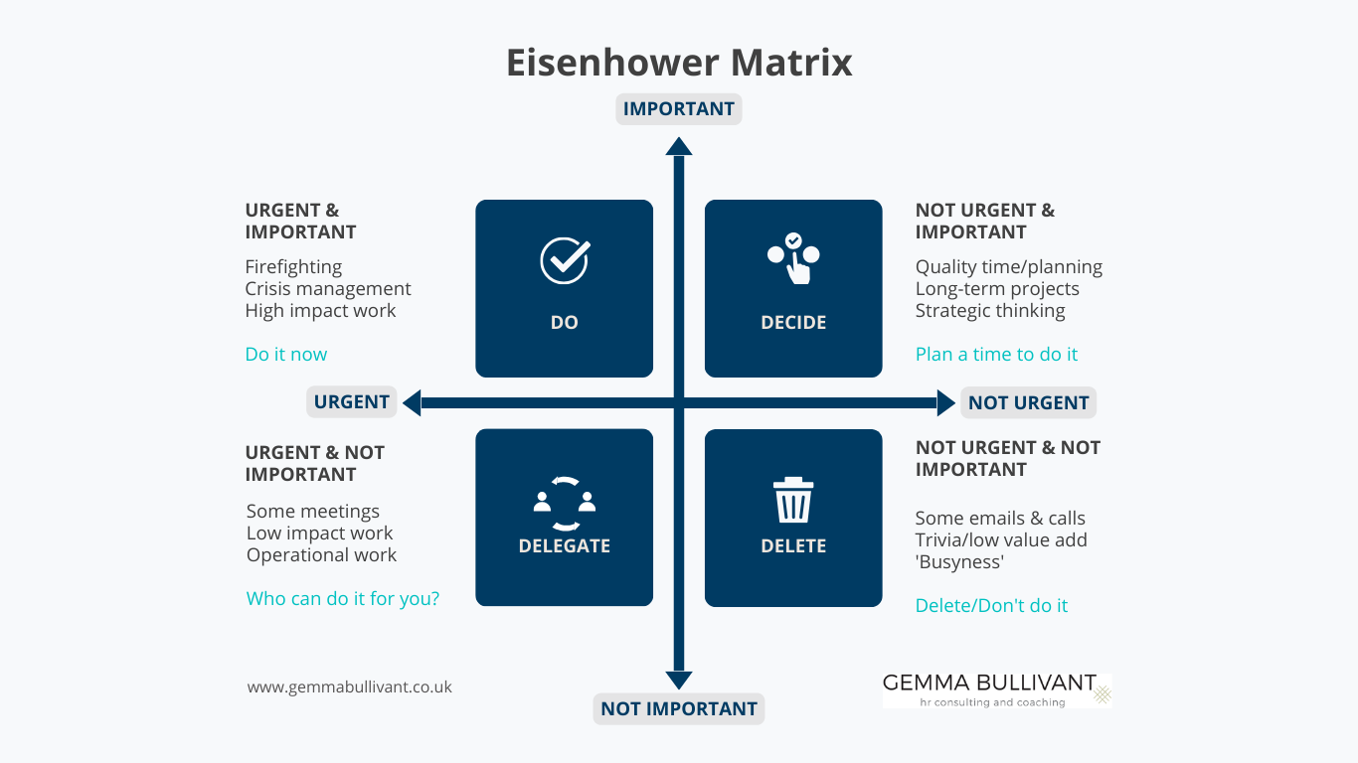
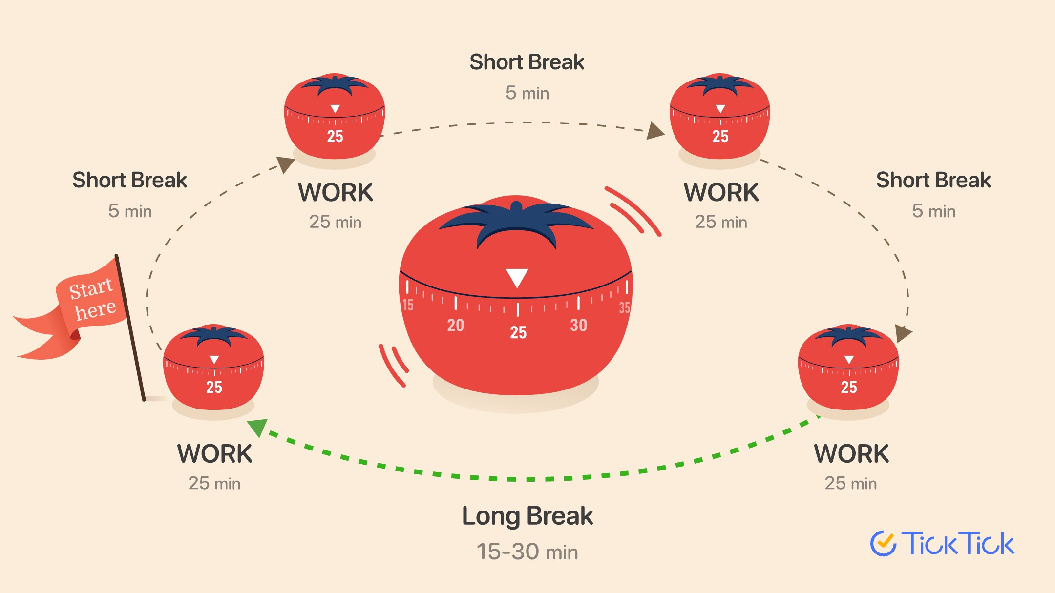
Types of time management strategies
This technique works well for people that have ADHD as it can reduce hyper focusing one 1 specific task.
Reduction of mental fatigue can increase productivity.
Categorising tasks into importance increases productivity and reduces distractions.
Having an idea of what task is a priority can reduce procrastination.

Slide 4
Examples of time management in the digital world
Phone calendar
Timers and stopwatches
Phone applications; Toggle Track or Clockify

Slide 5
How does this relate higher education studies
According to studies, 47.7% of students spend less than an hour on coursework per day
Roughly 80-85% of students procrastinate
With the development of technology it is easy to get distracted through scrolling on social media or watching videos and movies. Add to that students who are parents or carers, having time to focus on education be it assignments or revision allocating time to do it can seem difficult.
Incorporating time management techniques can allow higher education students to better balance their studies and personal life.
This is will increase productivity and quality of said work

Slide 6

conclusion
Time management is a key tool for higher education students to add to their toolbox
Pomodoro technique is perfect for when carrying out any education related studies (revision or assignment)
Eisenhower is best used for categorising tasks from most urgeent and important to less urgent an important.
When used together tasks can become easier focus on and attacked with confidence

