Slide 1
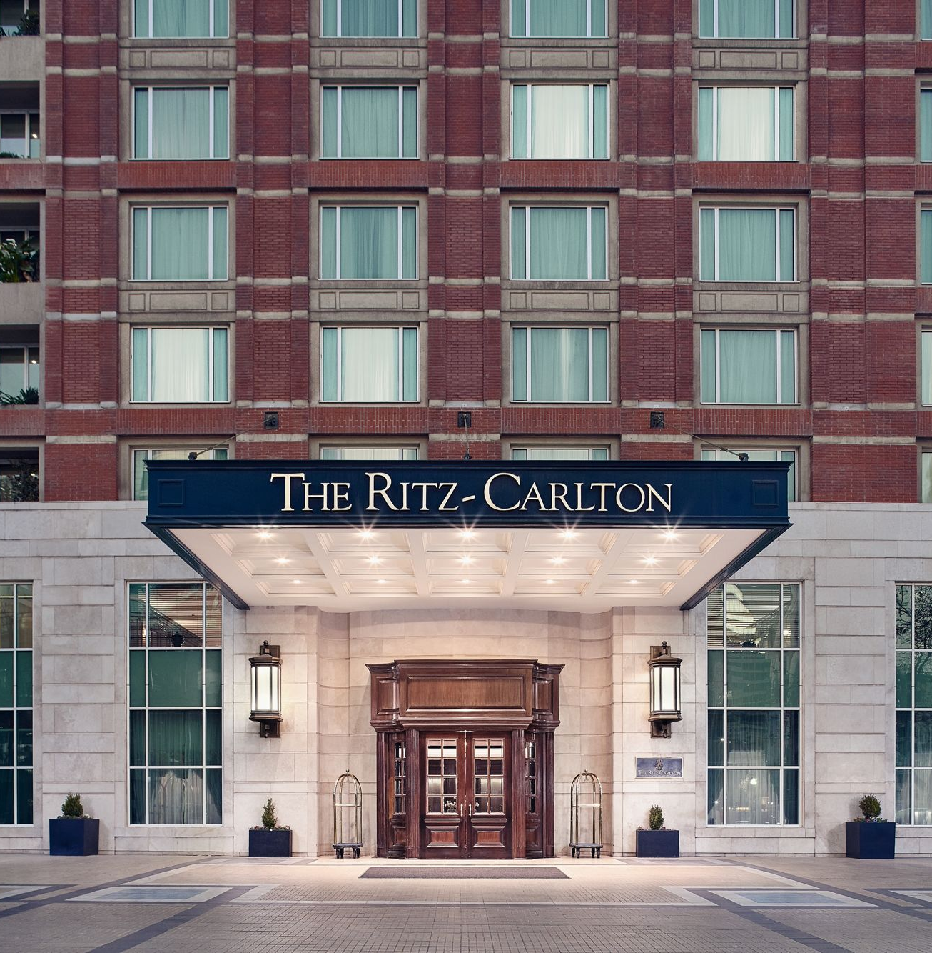

The Role & Importance of quality services, Hospitality & Guest Services within the Hotel Industry
BA International Hotel Management
Module: Hospitality & Guest Services (BMIH4003) LEVEL 4
Student: Catalina Trasc​​
Tutor: Kathryn Flynn

Slide 2
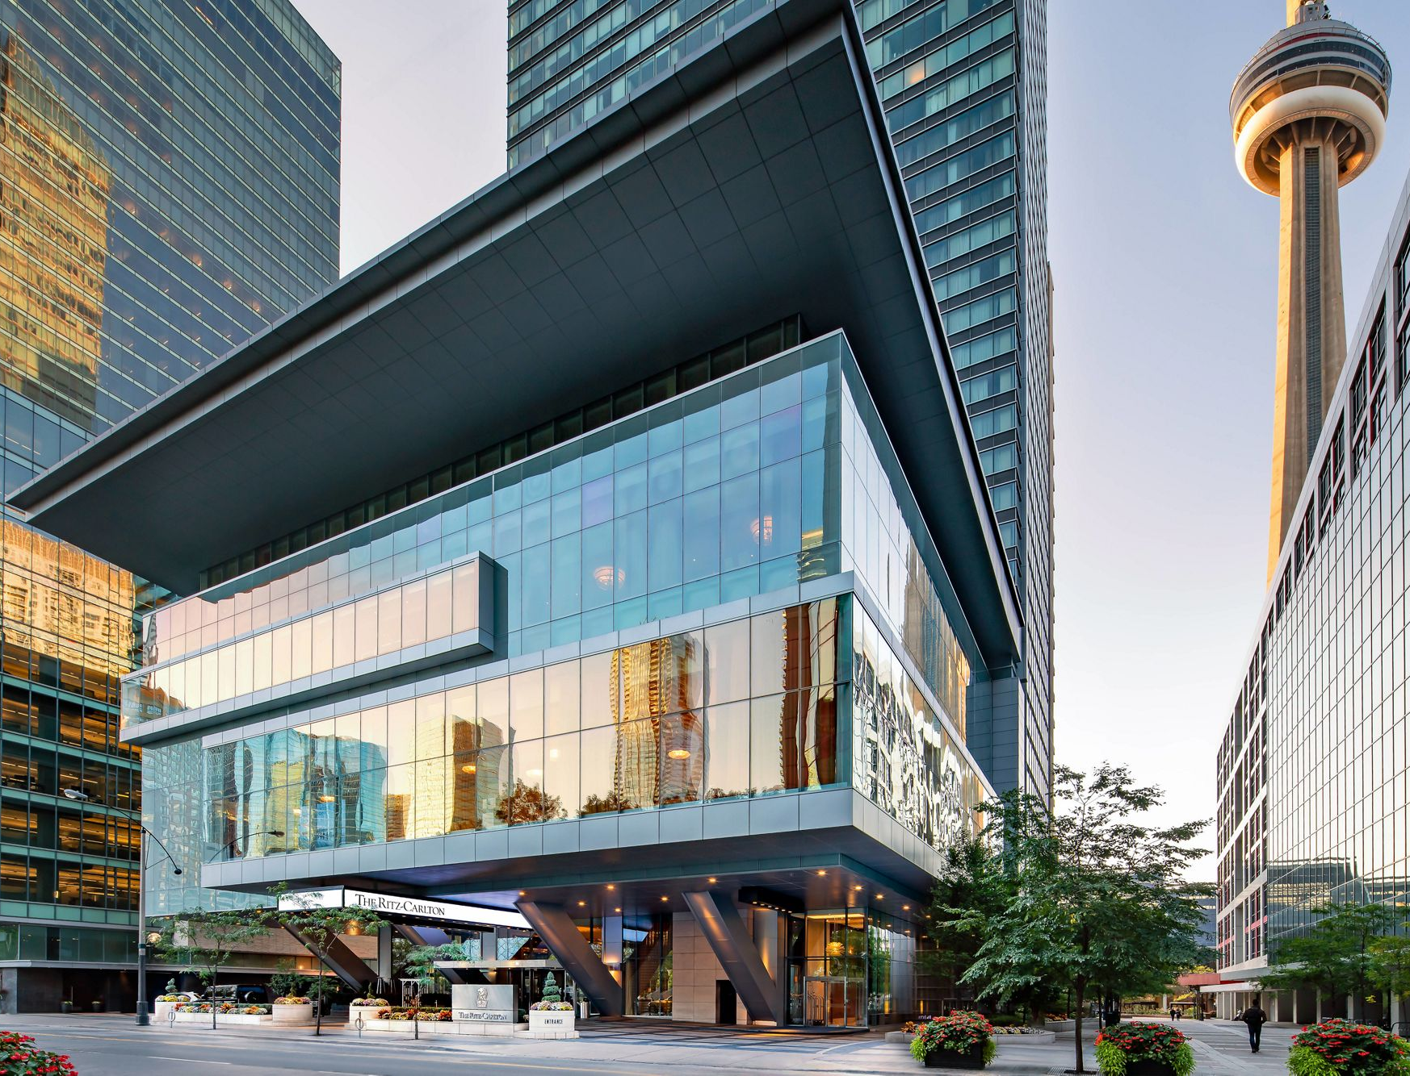
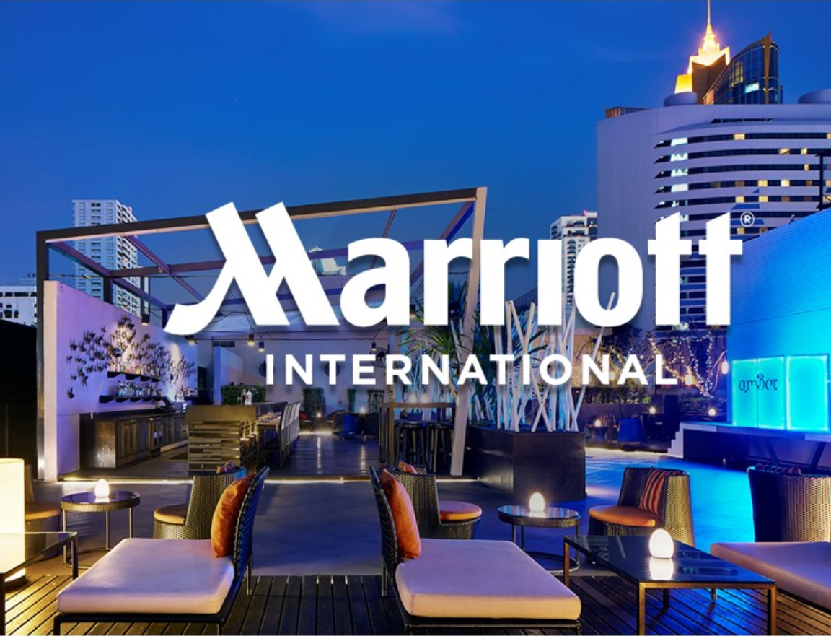
Table of content:
About Marriott International
Ritz –Carlton brand
Main consumers of the hotel
Nature, scope and role of the guest services within the brand
The role and function of guest services
Importance of hospitality and how the hotel meet guest expectations

Slide 3

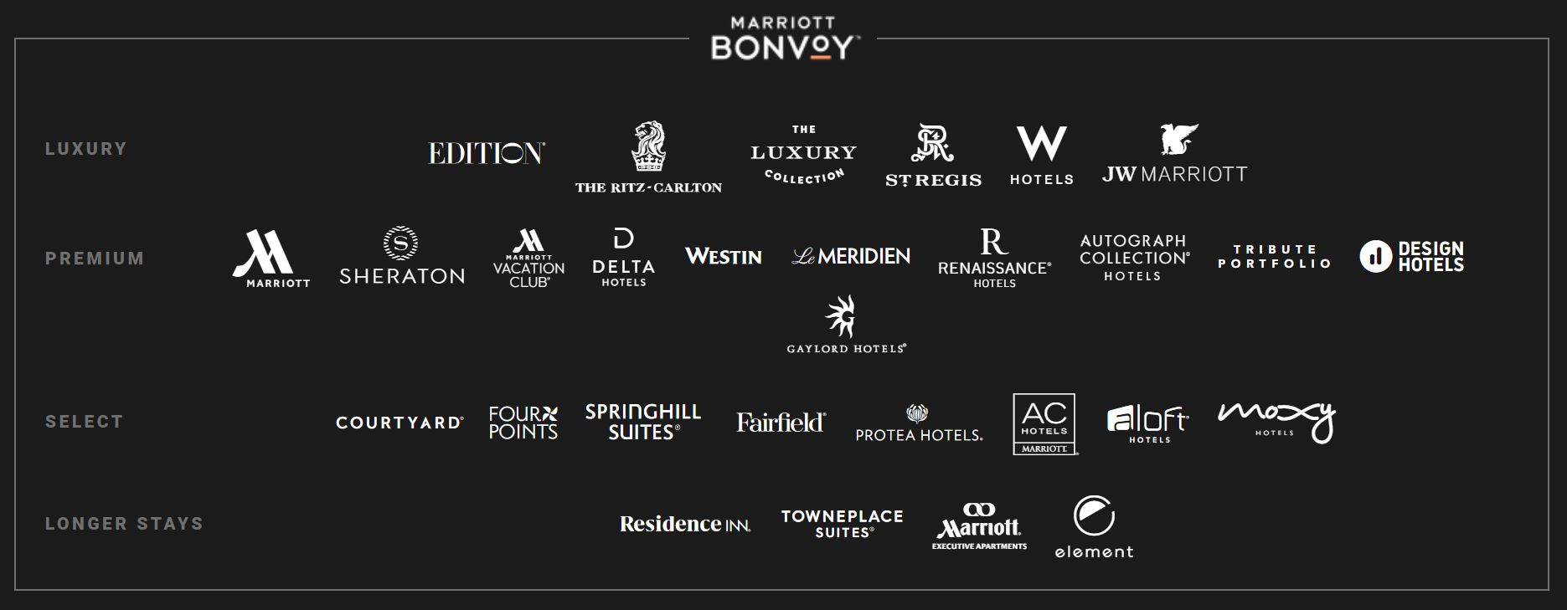
About Marriott International
Founded in 1927 by J. Willard Marriott and Alice Marriott
30 brands
Over 8,000 properties
Across 139 countries
Policies and Position Statements : Human Rights Policy, Sexual Harassment Policy, Sustainability Policy, Supplier Conduct Guidelines, Animal Welfare Position Statement, Responsible Seafood Position Statement

Slide 4
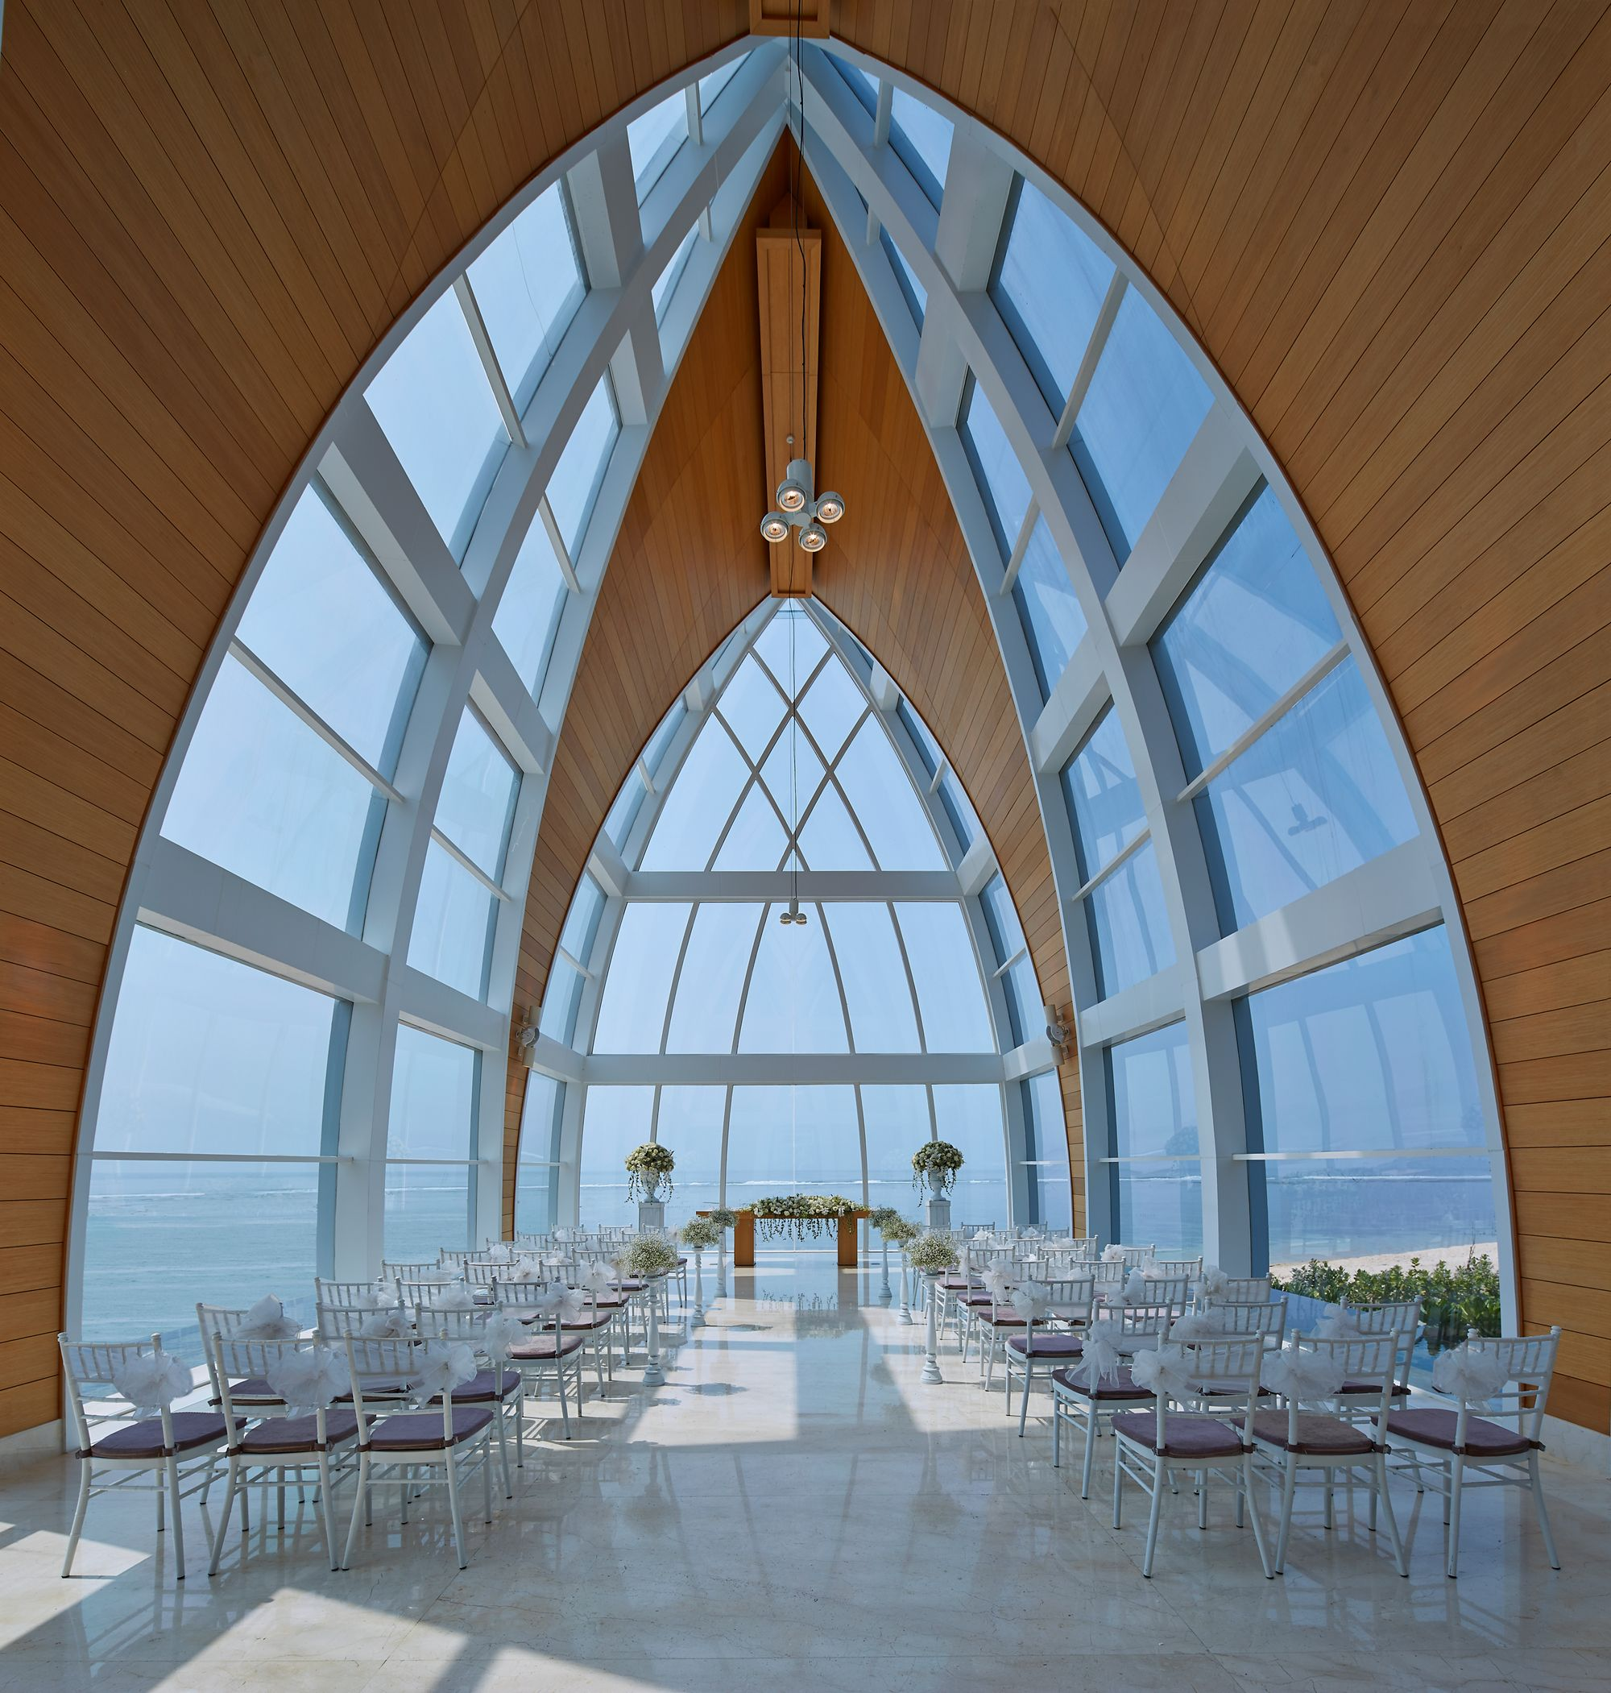
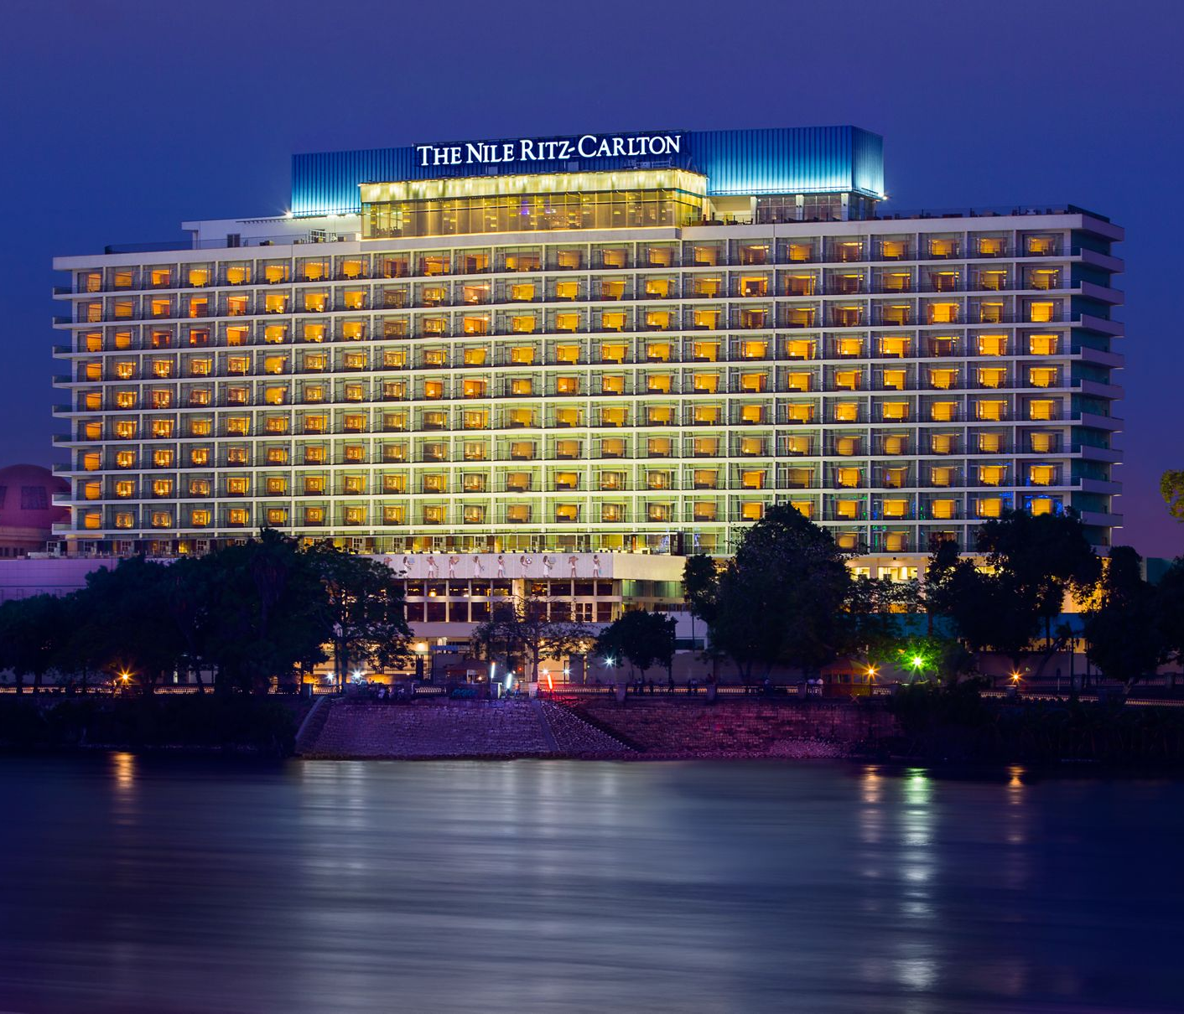
RITZ-CARLTON:
- Luxury Hotel of Marriott International
- Over 100 years of history
- Funded in US in 1906
- 108 hotels ( USA & CANADA, MEXICO, CARIBBEAN & LATIN AMERICA, EUROPE, ASiA-PACIFIC, MIDDLE EAST & AFRICA )
- finest amenities
- attentive and polished staff
- finest restaurants
RITZ-CARLON OFFERS:
● HOTELS & RESORTS
● YACHTS
● WEDDINGS
● MEETINGS
● RESIDENCES

Slide 5
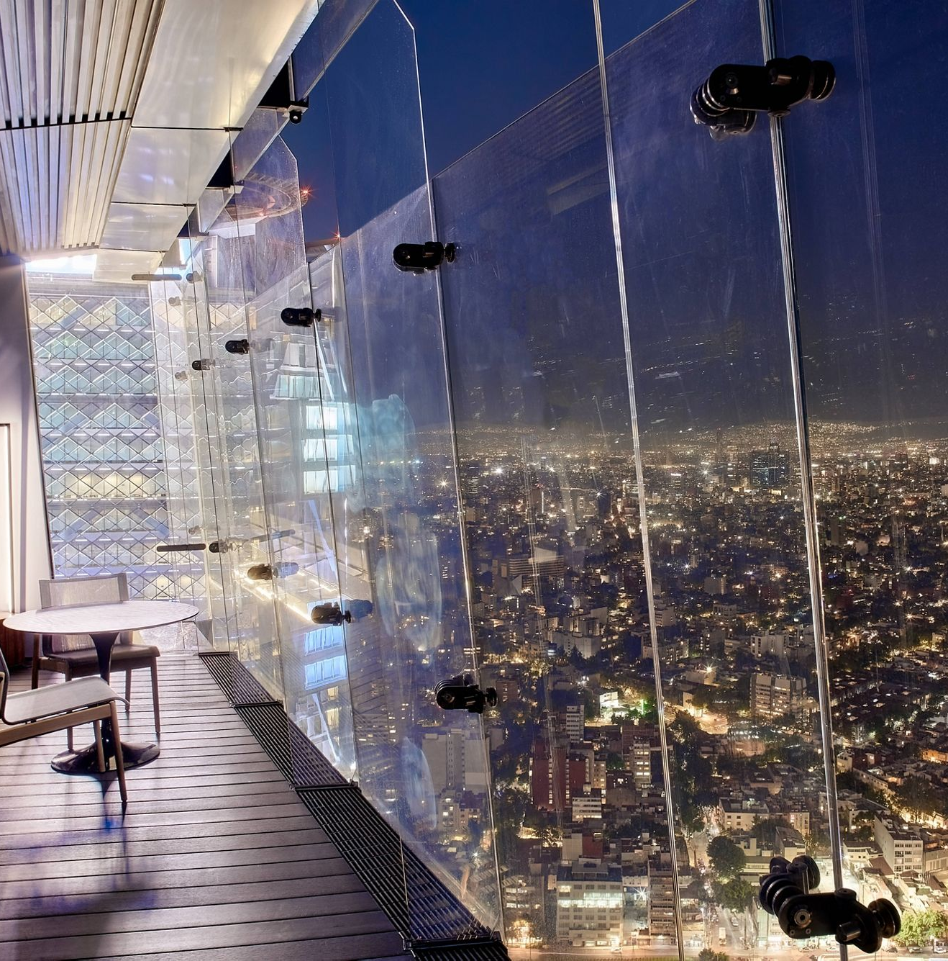
Ritz –Carlton Gold Standards
MOTTO
THE CREDO
The Ritz-Carlton experience enlivens the senses, instills well-being and fulfills the unexpected wishes.
3 STEPS OF SERVICE
SERVICE VALUES
1. A warm and sincere greeting. Use the guest's name.
Create Ritz-Carlton guests for life.
“ We are ladies and gentlemen serving ladies and gentlemen.”
Empowered to create unique, memorable and personal experiences.
Seek opportunities to innovate and improve The Ritz-Carlton experience.
3. Fond farewell.
2. Anticipate their needs.

Slide 6
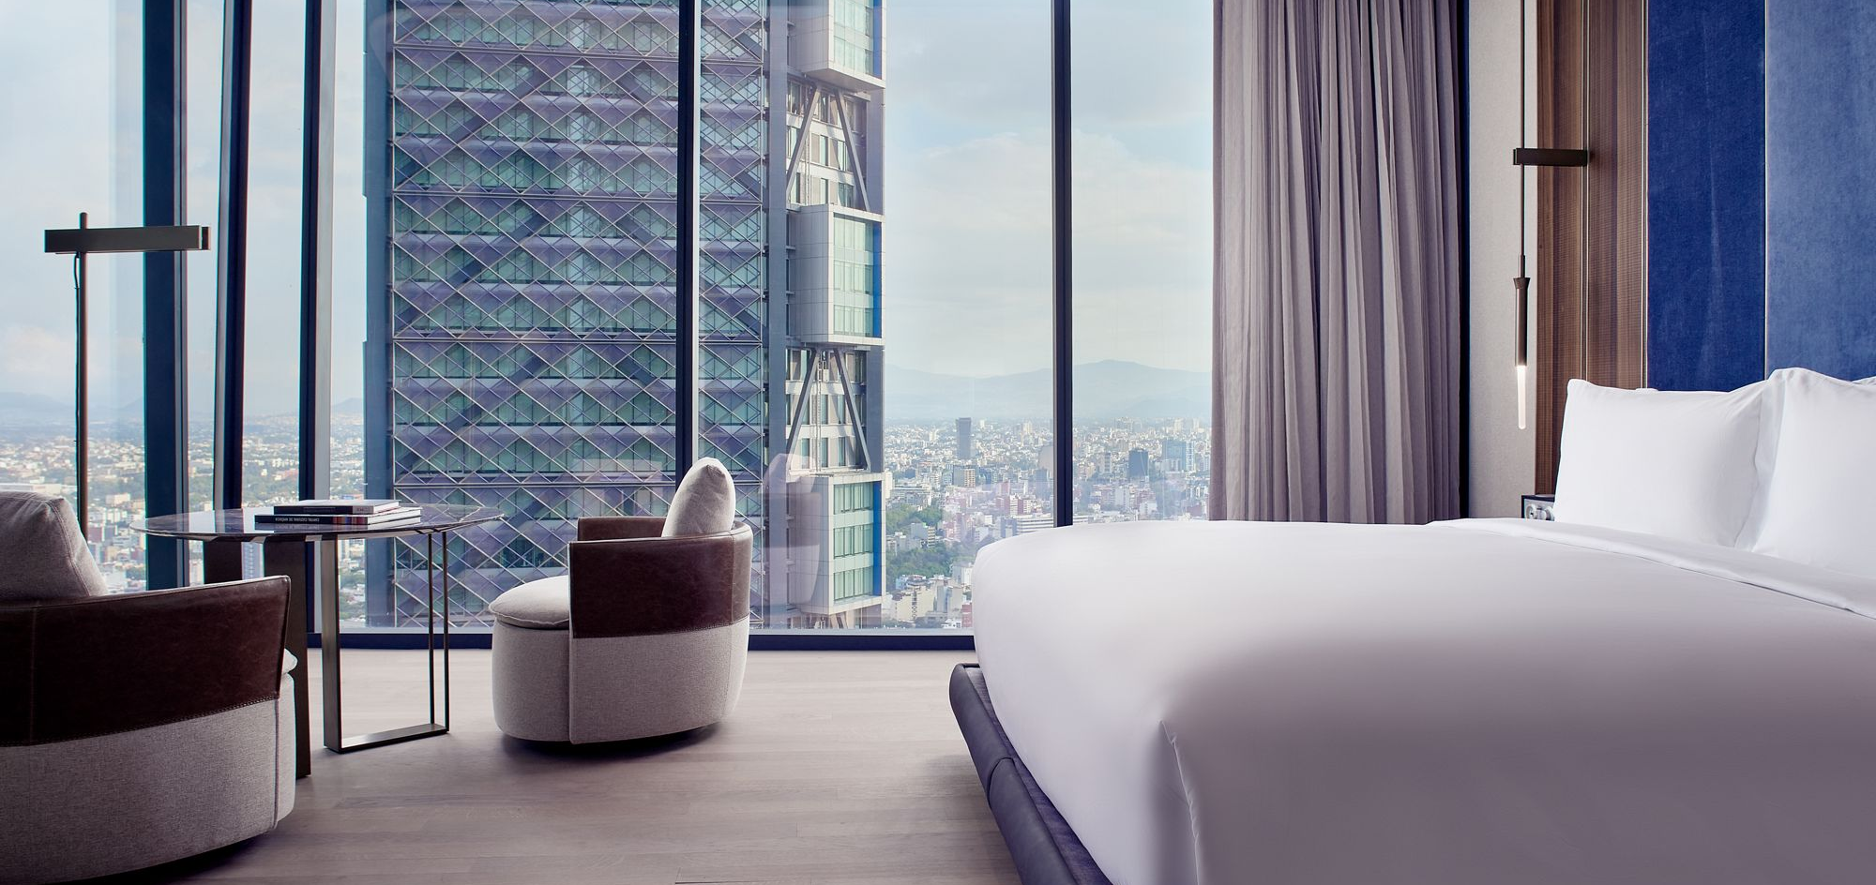
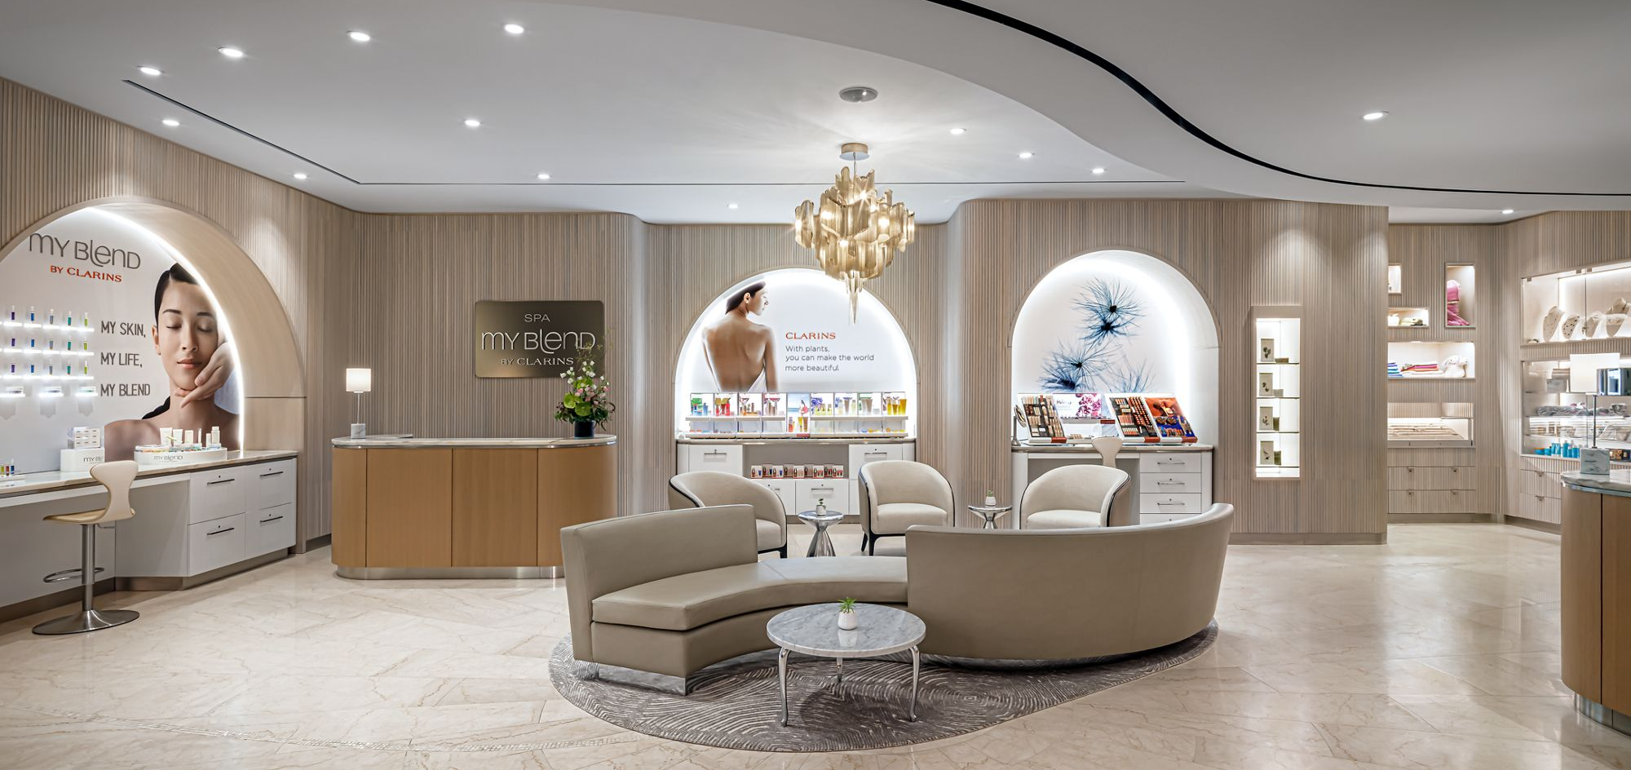
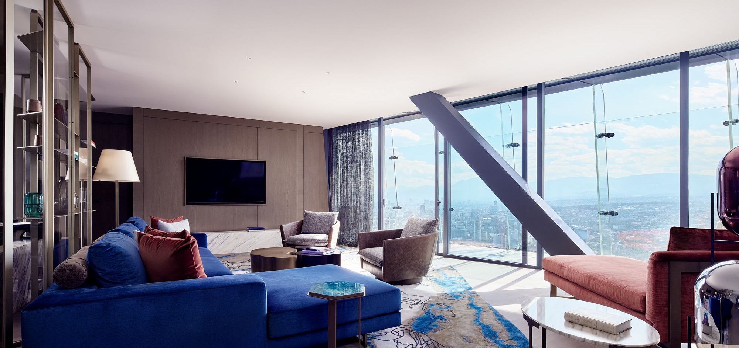
Main consumers of the hotel:
Luxury clients : ● leisure travellers
● corporates
● celebrities
Upper/middle class category and those consumers who pay for unique experiences.
RITZ-CARLTON

Slide 7
Nature, scope and role of the guest services within the brand
The main scope of their services is to exceed customer expectations.
Guest services provided by Ritz-Carlton:
TANGIBLE | INTANGIBLE
Generous, comfortable living space indoors and outdoors Fireplaces iHome entertainment system Fitness center, sauna, spa The Ritz-Carlton Gift Shop Floor to ceiling windows Luxury Ballrooms: Sunken, marble bath with double vanity and marble shower Meeting rooms Variety of culinary excellence | 24-hour in-room dining Twice-daily housekeeping Babysitting service available on request Business Services Overnight laundry and dry cleaning services Multi-lingual staff Kids program Chauffeured limousine service Packing and unpacking services

Slide 8



The role and function of guest services
Unique guest services
MAKE YOUR STAY EXTRAORDINARY
8 Rooms with a Gorgeous View
Unique experiences: Bangalore you can use restaurants: Ganache, The Market: world gastronomy, The Lantern: modern Cantonese cuisine, Riwaz : Northwest Indian cuisine, Bang: rooftop bar, The Pool Bar, The Ritz-Carlton Bar, The Lobby Lounge
​Ritz- Carlton Toronto offers: kids master class pastry chef 1, kids urban safari, kids scavenger hunt, Master class: cheese and Wine, Movie night, Billiard & fire place, Master class: Cocktail and Mixology
The Ritz-Carlton, Hong Kong -panorama from the hotel's rooftop bar at floor 103.

Slide 9
How the customers made their expectations
Internet
Hotel reputation
Reviews
Family and friends, other’s experience
Other experiences in similar hotels

Slide 10
How the hotel meet guest expectations:
- special rooms
- finest services
- creating unique, memorable, and personal experiences for their guests
Special rooms
Finest services: fine dining, spa, fitness, meeting, weeding
WOW factor
Experiences at The Ritz-Carlton Club
Personalization
2000$ policy

Slide 11
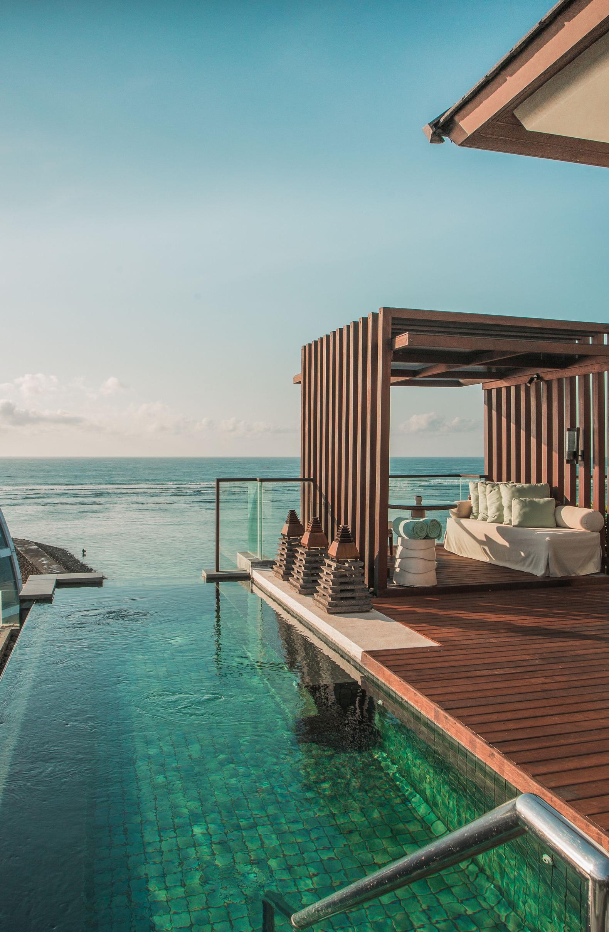
Reference list:
EXCEPTIONAL SERVICE, EXCEPTIONAL PROFIT: The Secrets of Building a Five-Star Customer Service Organization, The Canadian Manager, 2010, Vol.35 (2), p.28
Heppell, M. (2015) Five Star Service: How to deliver Exceptional Customer Service, Pearson, London
Ritzcarlton(2023)cocktails-views. Available at: Cocktails With a View | Journey Into The Ritz-Carlton (ritzcarlton.com) ( Accessed at: 01 February 2023)
Ritz-Carlton (2023) ClubLevel. Available at: Club Level | The Ritz-Carlton, Tysons Corner (ritzcarlton.com) ( Accessed at: 30 January 2023)
Ritz-Carlton (2023) GoldStandards. Available at: Gold Standards (ritzcarlton.com) (Accessed at: 28 January 2023)
Ritzcarlton(2023)hotel-overview. Available at: https://www.ritzcarlton.com/en/hotels/canada/toronto/hotel-overview ( Accessed at: 30 January 2023)
Ritz-Carlton (2023) FineDiningRestaurantsinBangalore. Available at: Fine Dining Restaurants in Bangalore | The Ritz-Carlton, Bangalore (ritzcarlton.com) ( Accessed at: 01 February 2023)
Solomon, M. (2018) The Heart of Hospitality : Great Hotel and Restaurant Leaders Share Their Secrets. New York: SELECT Books INC
Theritzlondon (2023) History. Available at: https://www.theritzlondon.com/about-the-ritz/history/ ( Accessed at: 02 February 2023)
Wood, R.C., (2015). Hospitality Management: a brief introduction, Sage, London

Slide 12
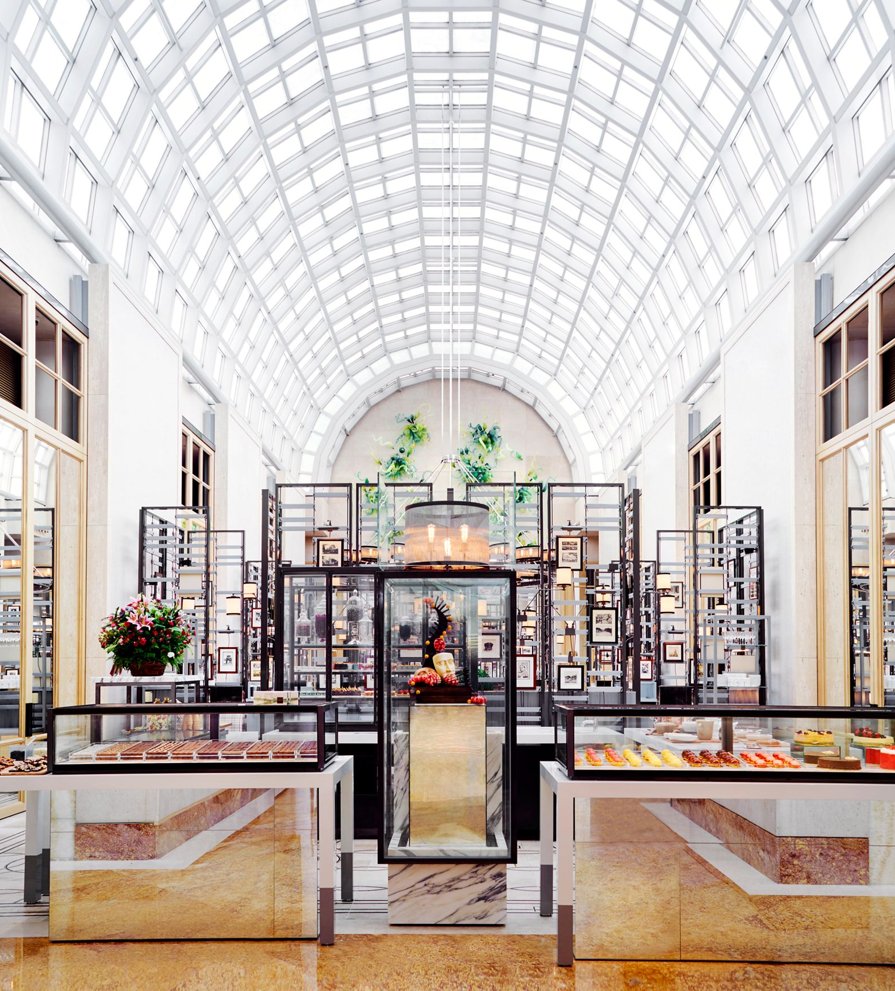
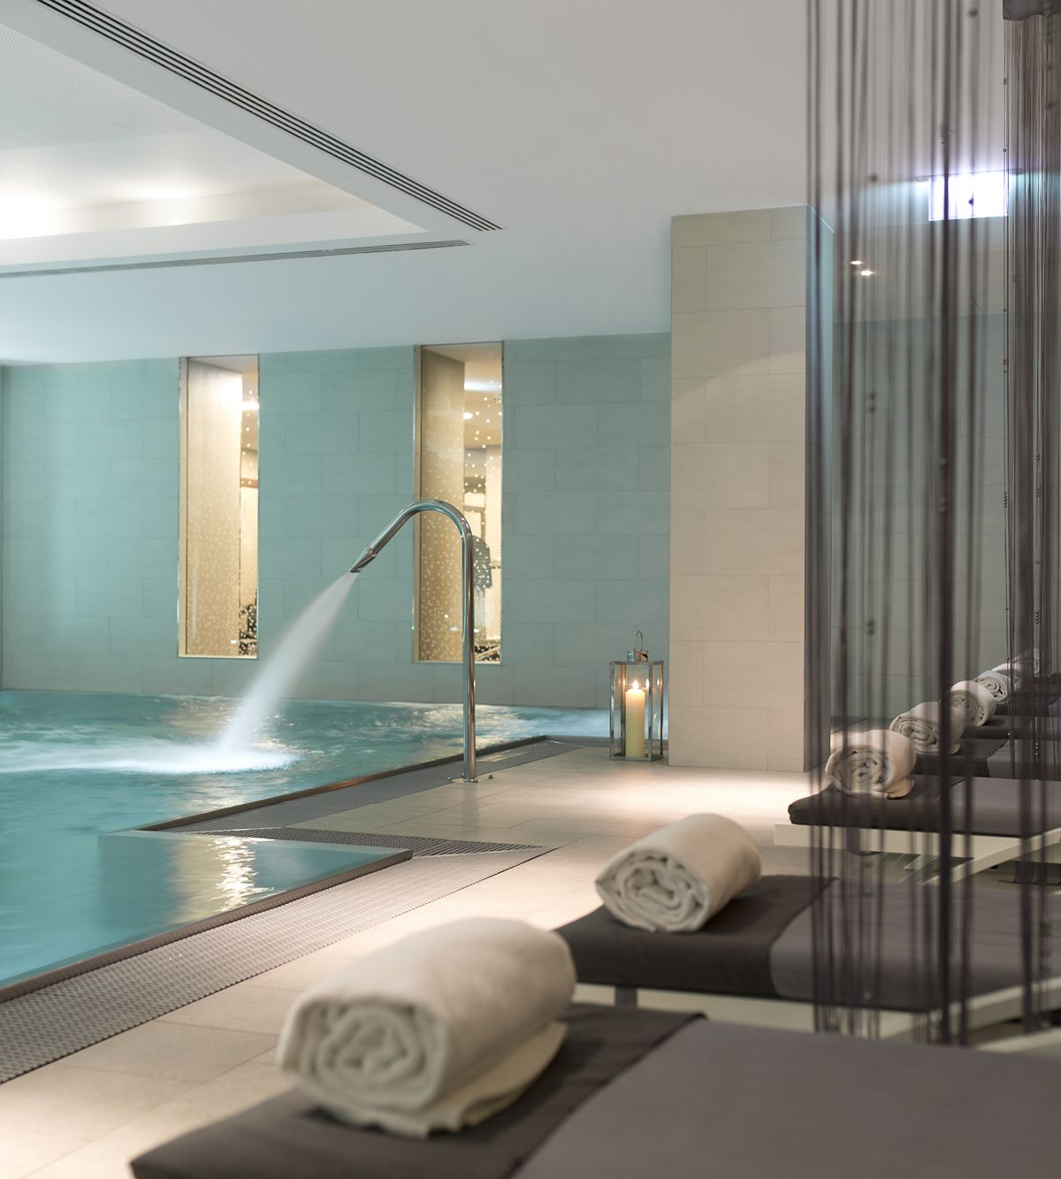
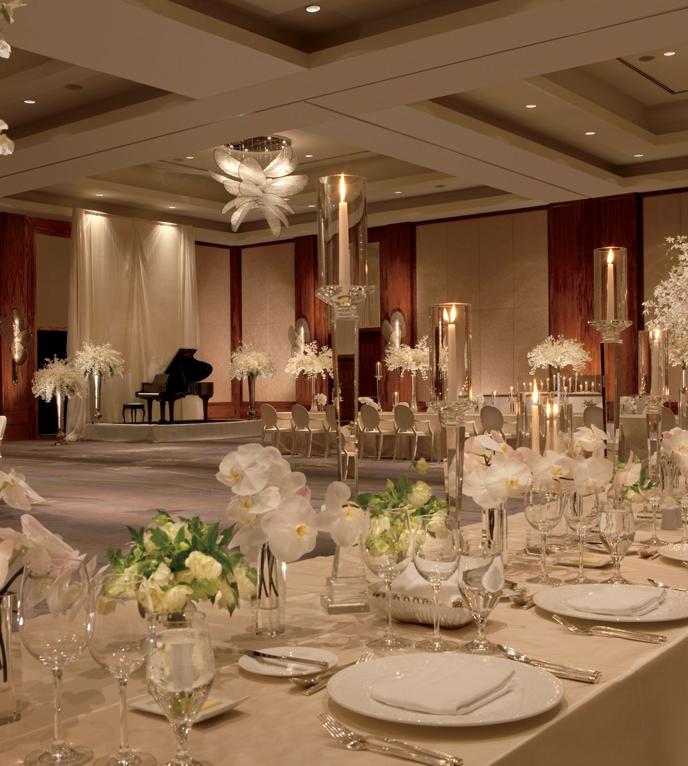

Thank you
Student: Catalina Trasc

