Slide 1


Welcome to the Presentation
LCBB5004 Managing People Presentation
Assessment Component 1
This Photo by Unknown Author is licensed under CC BY-SA

Slide 2

Introduction
The modern organisation is more dependent on Human Resource Professionals. As they play a vital role in Hiring to firing and contribute to organisational development strategy. They also play an impactful contribution in internal and external factors.
\
Notes:
The modern organisation is more dependent on Human Resource Professionals. As they play a vital role in Hiring to firing and contribute to organisational development strategy. They also play an impactful contribution in internal and external factors.

Slide 3
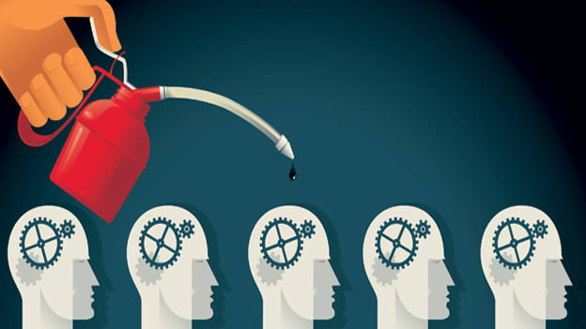
Role of Human Resource Professional
A human resource professional is the person who superintended the employees and circulated the employee lifecycle of any sort of organization. Along with employee lifecycle, this professional is also responsible for performance management, compensation and benefits and terminating any employee from the current position (Fahed-Sreih, 2018).
Notes:
A human resource professional is the person who superintended the employees and circulated the employee lifecycle of any sort of organization. Along with employee lifecycle, this professional is also responsible for performance management, compensation and benefits and terminating any employee from the current position (Fahed-Sreih, 2018).

Slide 4

Job Responsibilities and Functional Areas
Human Resource Planning
Recruitment and selection
Performance management
Learning, training and career planning
Function evaluation and feedback
Rewards and punishment.
Compensation and benefits.
Compliance
\
Notes:
Job Responsibilities and Functional Areas
Human Resource Planning: The HR professional need to concern about the future needs and target of the organization. To ensure the goal and need- HR will create effective planning (Fombrun, Tichy and Devanna, 2015).
Recruitment and selection: The HR professional will be responsible and take the initiative in hiring the most potential candidate for the needed positions. They will run and post particular job posts in most traffic-generated places to attract the suited candidate and would select them with the most competitive exam with transparency.
Performance management: Performance management is considered an instrument to fill the gap from the end of the HR professional among the workers and officials in the workforce to stay productive and create strong leadership, clear goal setting and constructive feedback.
Learning, training and career planning: Learning and training may consider one of the major important functional roles to provide for the HR team. The HR provide IT, technical skill, emotional intelligence and soft skill to the employees.
Function evaluation and feedback: This is a technical phenomenon that involves the HR operation. This involves identifying the quality, worker available number, job location, and working hours. They also provide written and software-generated feedback to their employees to sort out the gap and improvement (Oh et al., 2016).
Rewards and punishment: To providing reward and punishment to employees boost them to motivate and rectify their performance.
Compensation and benefits: The HR team is involved intensively to determine the compensation and benefits for their employees.
Compliance: Compliance is another important functional job role to ensure the employees about the health and safety security and to maintain laws and regulations imposed by the country.

Slide 5
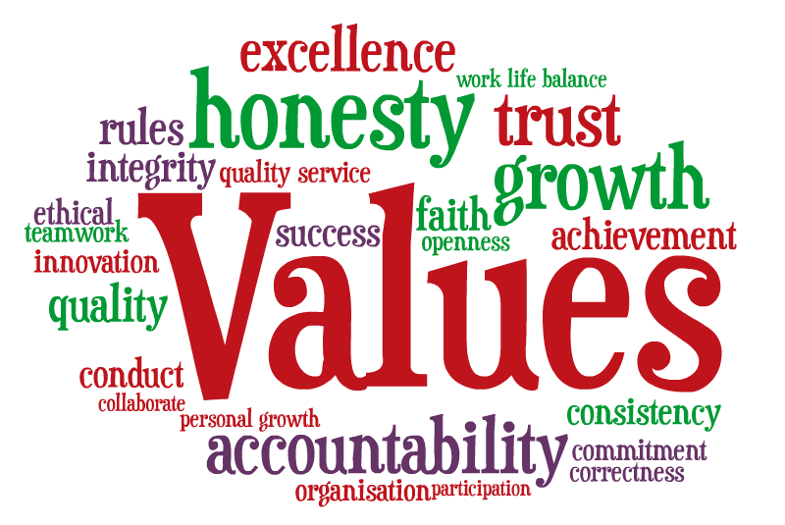
The important values that HR should follow
  Integrity and accountability
  Fairness, Equality and professionalism
Notes:
The important values that HR should follow:
Integrity and accountability: The HR personnel should maintain integrity with honesty and faith in dealing with employees and all stakeholders of the company. Also they need to be accountable for the actions and decisions in every situation to every level of workers in the workplace (Reilly and Williams, 2017).
Fairness, equality and professionalism: HR should treat all related personnel with a fair attitude. And everyone would be valued equally in general without any means of discrimination. Confidentiality of every piece of information would be maintained from the end of HR professionals (Lalbabuprasad et al., 2022).

Slide 6
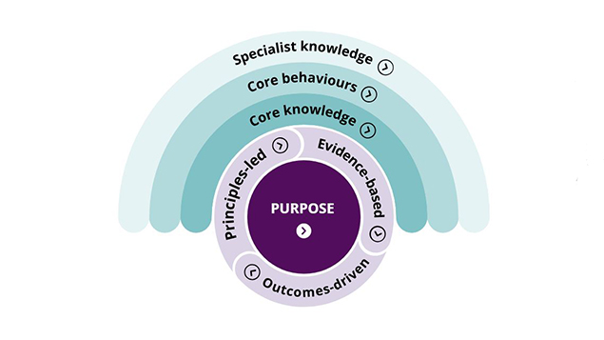
Current CIPD Profession Map
The CIPD map will help the HR professional to make better decisions and act confidently to get the specialist knowledge to play an effective role in progress (Peacock, 2017). The CIPD reference is discussed below:
Core knowledge
Purpose and Values
Specialist knowledge
\
Notes:
References to the current CIPD profession map:
The CIPD map will help the HR professional to make better decisions and act confidently to get the specialist knowledge to play an effective role in progress (Peacock, 2017). The CIPD reference is discussed below:
Core knowledge: The CIPD map determine the core knowledge of HR practices and development strategies like HR law and regulations, culture and behaviour, and technical aspects. Using this CIPD map, the HR professional can practised without less error and informative way (Salin et al., 2020).
Purpose and Values: This CIPD map demonstrates the values and purpose of the profession. So HR can easily follow the map to guide and motivate the employees.
Specialist knowledge: The CIPD map features a wide range of specialist areas like employee experience and relations, diversity and inclusion, analytical aspect, talent management and organisational development to create a positive impact and to run the HR team to fulfil the company goal (Precious, 2021).

Slide 7

The factors to influence a positive relationship between the employer and the employee.
Many factors like two-way trust, strategy, structure, culture, respect, employee engagement rate, effective communication, work-life balance, economic climate, regulatory factors benefits and compensation are directly responsible to influence a positive relationship between the employer and employees (Rees and French, 2016).
Notes:
The factors to influence a positive relationship between the employer and the employee.
Many factors like two-way trust, respect, employee engagement rate, effective communication, work-life balance, benefits and compensation are directly responsible to influence a positive relationship between the employer and employees (Rees and French, 2016).

Slide 8

Types of relationships that can develop between the employer and employee
The relationship between employee and employer should be interrelated and will maintain the two trait benefits at a time (Rees and French, 2016).
Transactional Relationship
Partnership Relationship
Collaborative relationship
Notes:
Types of relationships that can develop between the employer and employee
The relationship between employee and employer should be interrelated and will maintain the two trait benefits at a time (Rees and French, 2016).
Transactional Relationship: This sort of relationship depend on the exchange of service and money from both side.
Partnership Relationship: In this relationship, the employees and the employer will participate to gain a common goal with trust, respect and commitment from both sie.
Collaborative relationship: The employees will be counterparts with employees to share ideas, information and creative view on the account of effective communication and blending during the decision-making (Taylor, 2014).

Slide 9

Practical examples of what factors can influence the relationship
Jaguar Land Rover is a technological company in the UK. JLR has strong HR practices in the workplace. The HR team focus on the factors to maintain the relationship in the workplace (Gülcan, 2017).
Communication
Trust and respect
Fairness and benefits
\
Notes:
Practical examples of what factors can influence the relationship
Jaguar Land Rover is a technological company in the UK. JLR has strong HR practices in the workplace. The HR team focus on the factors to maintain the relationship in the workplace (Gülcan, 2017).
Communication: Effective communication is widely practised in JLR to draw maximise productive rate in exchange for support and consultancy from the employers to the employees.
Trust and respect: The employees feel motivated and boosted if they receive trust and respect from employees. Similarly, the lack of trust and faith drives the employees to be less productive and frustrated (Taylor and Woodhams, 2016).
Fairness and benefits: When the employees are not treated fairly and not getting proper benefits drive them to lose morale and think of turnover. Also the external and interna factors derive them to motivated and productive towards workforce.

Slide 10


My personal experiences to outline some positive practices
Employee development concern.
Employee engagement rate
Work-life balance
Notes:
Here outlining some positive practices based on my personal experience:
Employee development concern: The HR team offers a variety of programmes to develop their current roles to convert them into skilled workers.
Employee engagement rate: The HR team of JLR corporate surveys, resource group and recognition program to ensure engagement rate.
Work-life balance: JLR offers various flexible work systems to maintain the work-life balance like flextime, office gym, health screening and stress management programme (Wikipedia, 2013).

Slide 11
Conclusion
The job of an HR professional is challenging and interesting at a time. As they need to deal with diverse people or employees in the workplace. Finally, they have to ensure resource usage through the CIPD map and to focusing on influencing factors (Williams et al., 2020).

Slide 12
References
Armstrong, Michael.T. and Taylor, S. (2023) Armstrong’s Handbook of Human Resource Management Practice: A Guide to the Theory and Practice of People Management. Kogan Page.
Fahed-Sreih, J. (2018) Human Resource Planning for the 21st Century. BoD – Books on Demand.
Fombrun, C.J., Tichy, N.M. and Devanna, M.A. (2015) “Strategic human resource management,” in Routledge eBooks, pp. 28–42. Available at: https://doi.org/10.4324/9781315881881-10.
Gülcan, E. (2017) An Analysis of the Partnership Between Jaguar Land Rover and Chery Automobile Company Ltd. GRIN Verlag.
Lalbabuprasad, G.S. et al. (2022) Human Values And Professional Ethics. AG PUBLISHING HOUSE (AGPH Books).
Oh, I.-S. et al. (2016) Human Capital Factors Affecting Human Resource (HR) Managers’ Commitment to HR and the Mediating Role of Perceived Organizational Value on HR.
Peacock, M.J. (2017) The Human Resource Professional’s Guide to Change Management: Practical Tools and Techniques to Enact Meaningful and Lasting Organizational Change. Business Expert Press.
Precious, M.G. (2021) The Role of Human Resource Professionals in Business Improvement.
Rees, G. and French, R. (2016) Leading, Managing and Developing People. Kogan Page Publishers.
Reilly, P. and Williams, T. (2017) How To Get Best Value From HR: The Shared Services Option. Routledge.
Salin, D. et al. (2020) “Prevention of and interventions in workplace bullying: a global study of human resource professionals’ reflections on preferred action,” International Journal of Human Resource Management, 31(20), pp. 2622–2644. Available at: https://doi.org/10.1080/09585192.2018.1460857.
Taylor, S. (2014) Resourcing and Talent Management. Kogan Page Publishers.
Taylor, S. and Woodhams, C. (2016) Studying Human Resource Management. Kogan Page Publishers.
Wikipedia, S. (2013) Jaguar Land Rover: Jaguar, Land Rover, Jaguar Cars, Land Rover Engines, Jaguar Independent Rear Suspension, Jaguar Racing, Castle Bromwich Assembly, L. University-Press.org.
Williams, J. et al. (2020) Professional Practice in Human Service Organisations: A practical guide for human service workers. Routledge.

