Slide 1

Gerald of Wales
“The Description of Wales”
By Alin Maties
(Student Number: 2000471)

Slide 2
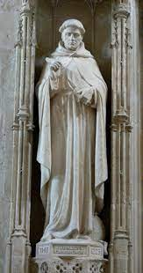
Who was Gerald of Wales?
Very well connected – English Court
Secular Clerk in Wales – Desired to become Archbishop of St David’s
1194 – The Description of Wales
One of the first ever ethnographers

Slide 3
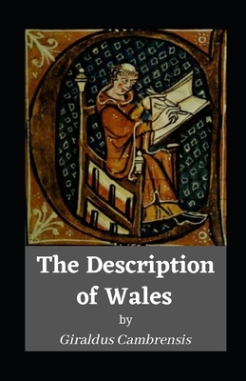
The Description of Wales
“So much does hospitality here rejoice in communication …” (Chapter X Book 1)
– very welcoming and hospitable people
“cut their hair close round to the ears and eyes.” … “Both sexes exceed any other nation in attention to their teeth” … “by constantly rubbing them with green hazel and wiping with a woollen cloth.” (Chapter XI Book 1)
- very clean and orderly

Slide 4
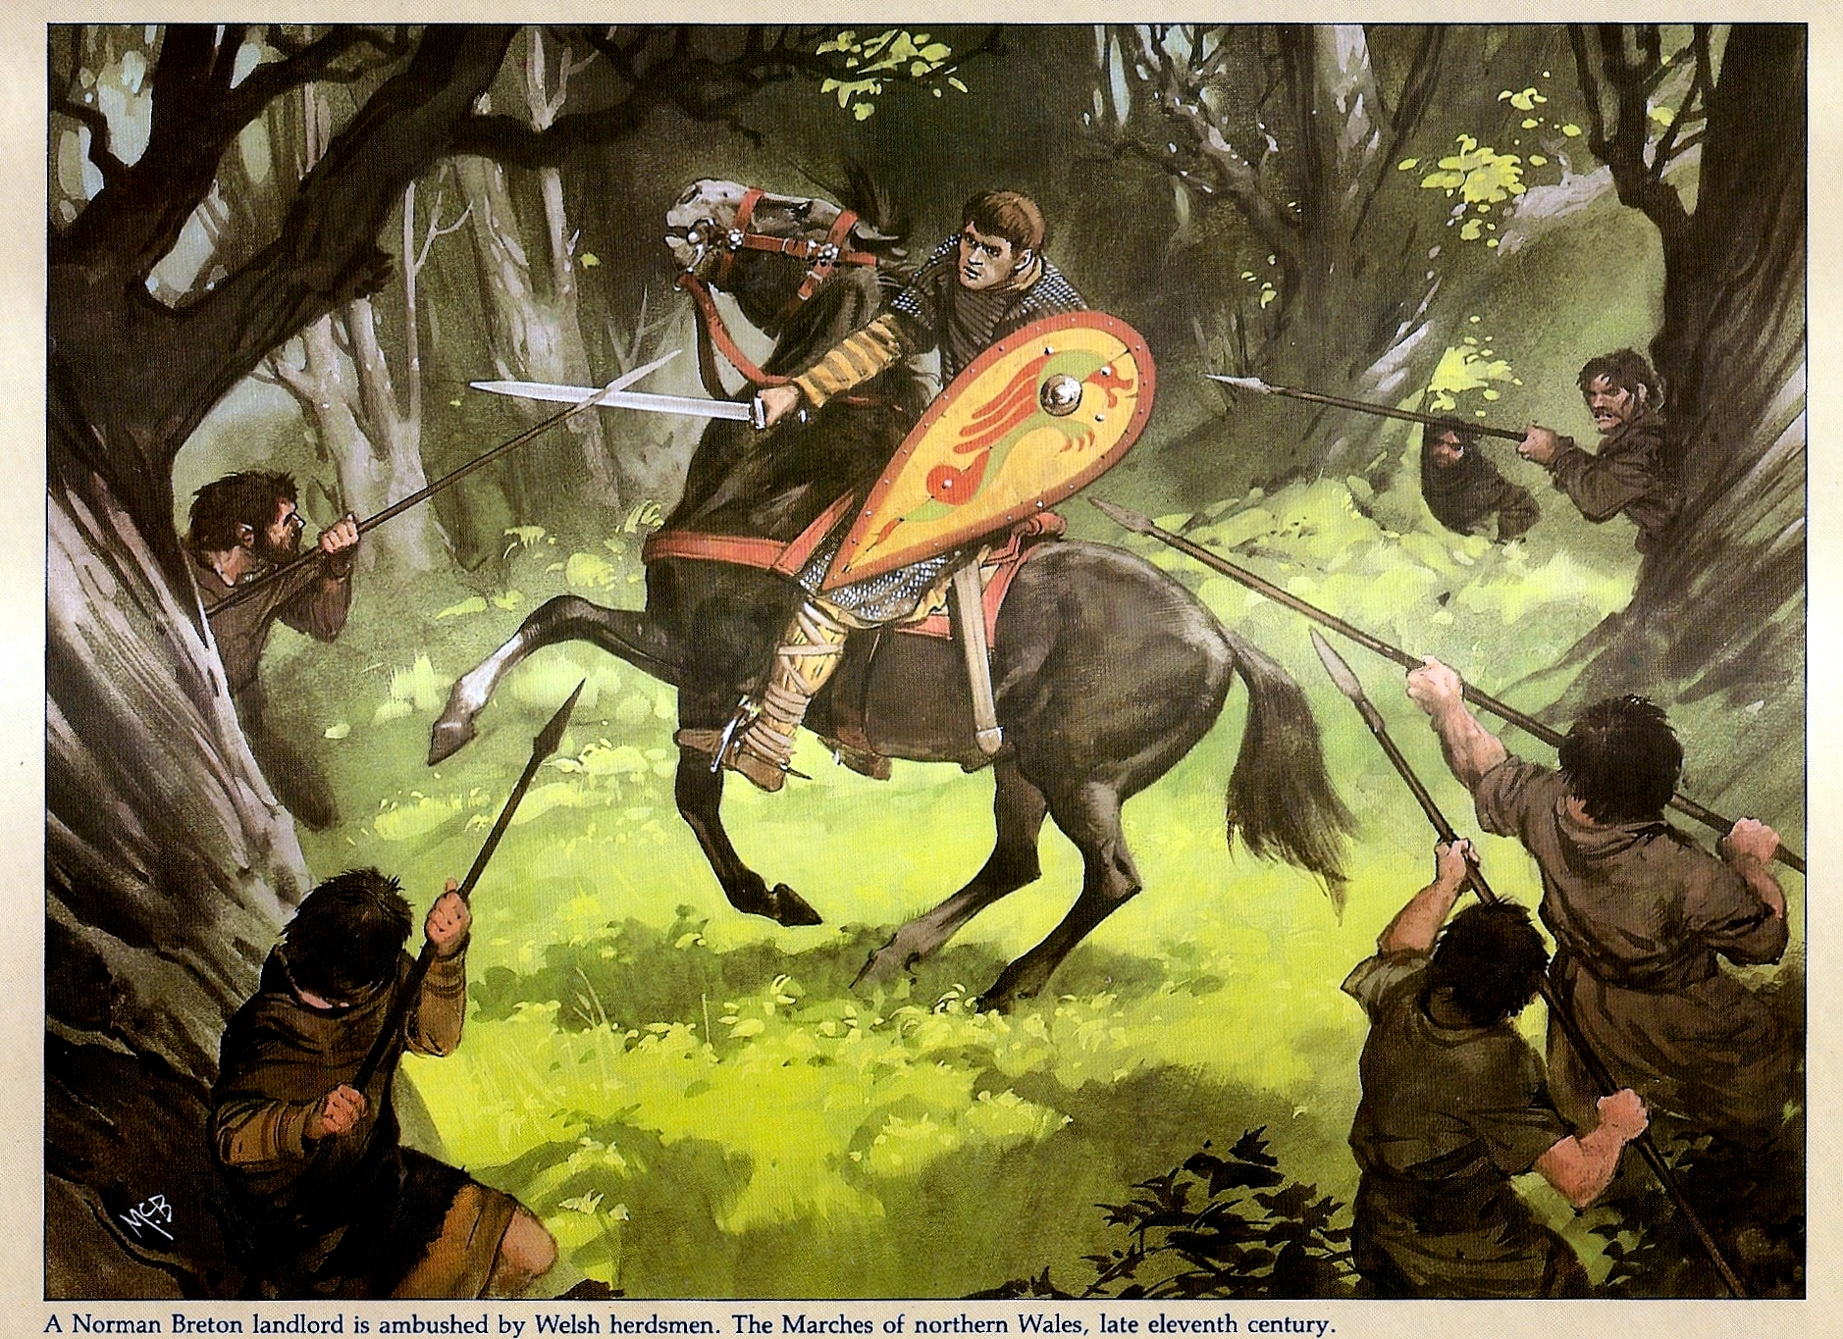
The Description of Wales – Contradictions or Irony?
“…they patiently wait till the next evening; and, neither deterred by cold nor hunger, they employ the dark and stormy nights in watching the hostile motions of their enemies.” (Chapter IX Book I) – Portrays the Welsh as a proud warrior like nation
“The prince who would wish to subdue this nation, and govern it peaceably, must use this method.” (Chapter VIII Book II) – Does he contradict himself?

Slide 5

Hypocrisy?
“For like other nations in a barbarous state, this people, although they are strangers to the principles of honour, yet above all things desire to be honoured.” (Chapter IX – Book II)

Slide 6
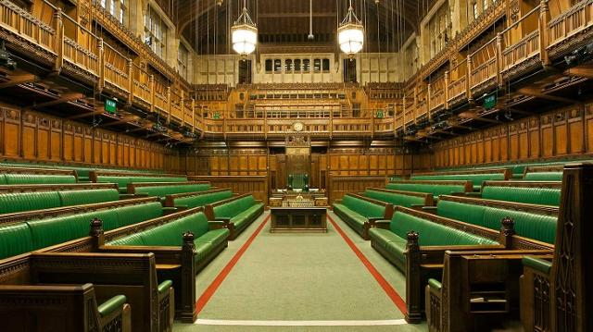
Purpose?
Wales is full of good people
Who wrote it? - What is there agenda?
Target audience = English Court and English rulers
But why the twist of words?

Slide 7
Bibliography
Britannica, Giraldus Cambrensis < https://www.britannica.com/biography/Giraldus-Cambrensis > [accessed 27/10/21]
Echa, Question Mark Character, < https://echamicrobiology.com/products/test-kits/microbmonitor2/attachment/question-mark-character > [accessed 02/10/21]
Good Reads, The Description of Wales (2021) < https://www.goodreads.com/book/show/56194669-the-description-of-wales-illustrated > [01/10/21]
PDFCOOKIE (2019) < https://pdfcookie.com/documents/celtic-warriors-5lq3w50py8v7 > [accessed 01/10/21]
UK Parliament, Coming up in the Commons: 12-16 July, (2021) < https://www.parliament.uk/business/news/2021/july/coming-up-in-the-commons-12-16-july/ > [accessed 02/10/21]
Wikipedia, Gerald of Wales (2021) < https://en.wikipedia.org/wiki/Gerald_of_Wales > [accessed 01/10/21]

