Slide 1
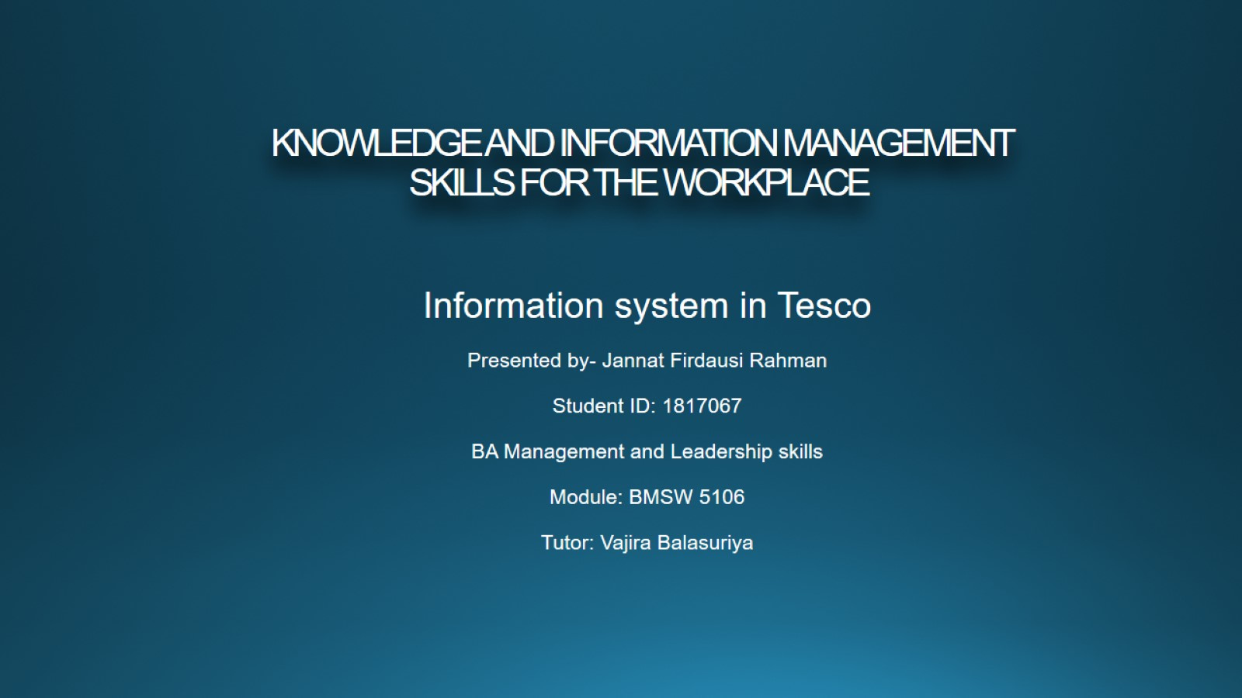
KNOWLEDGE AND INFORMATION MANAGEMENT
SKILLS FOR THE WORKPLACE

Slide 2
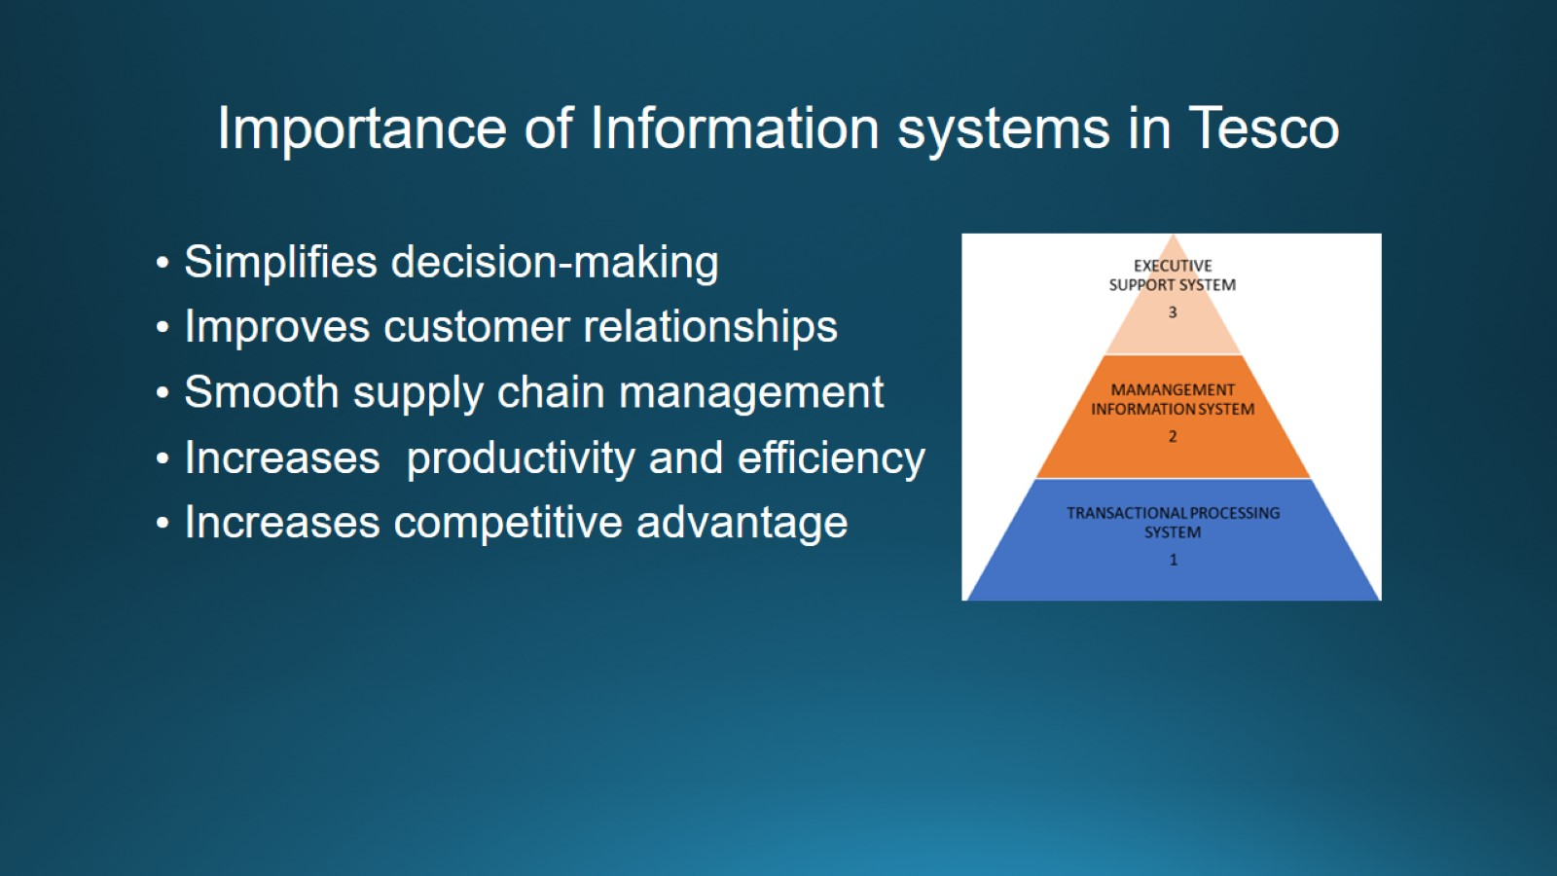
Importance of Information systems in Tesco

Slide 3
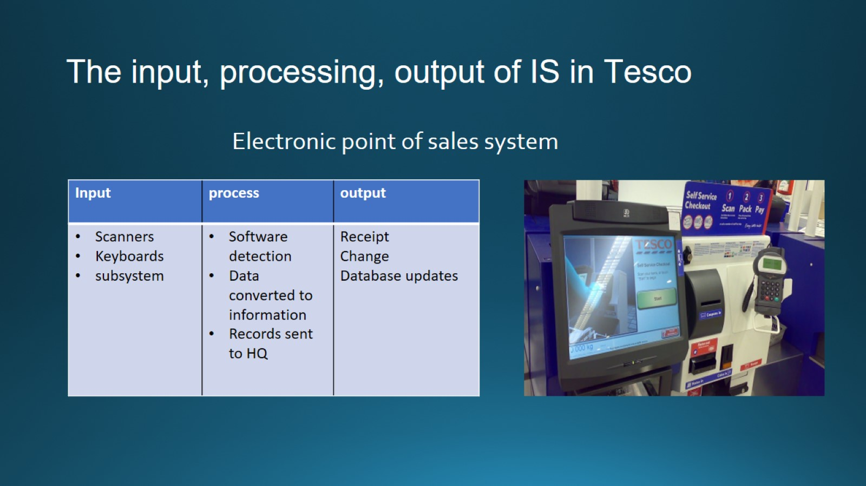
The input, processing, output of IS in Tesco

Slide 4
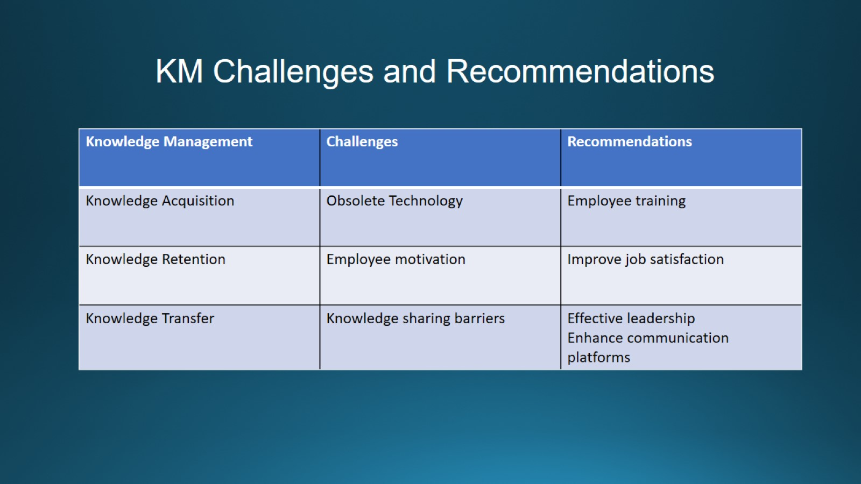
KM Challenges and Recommendations

Slide 5
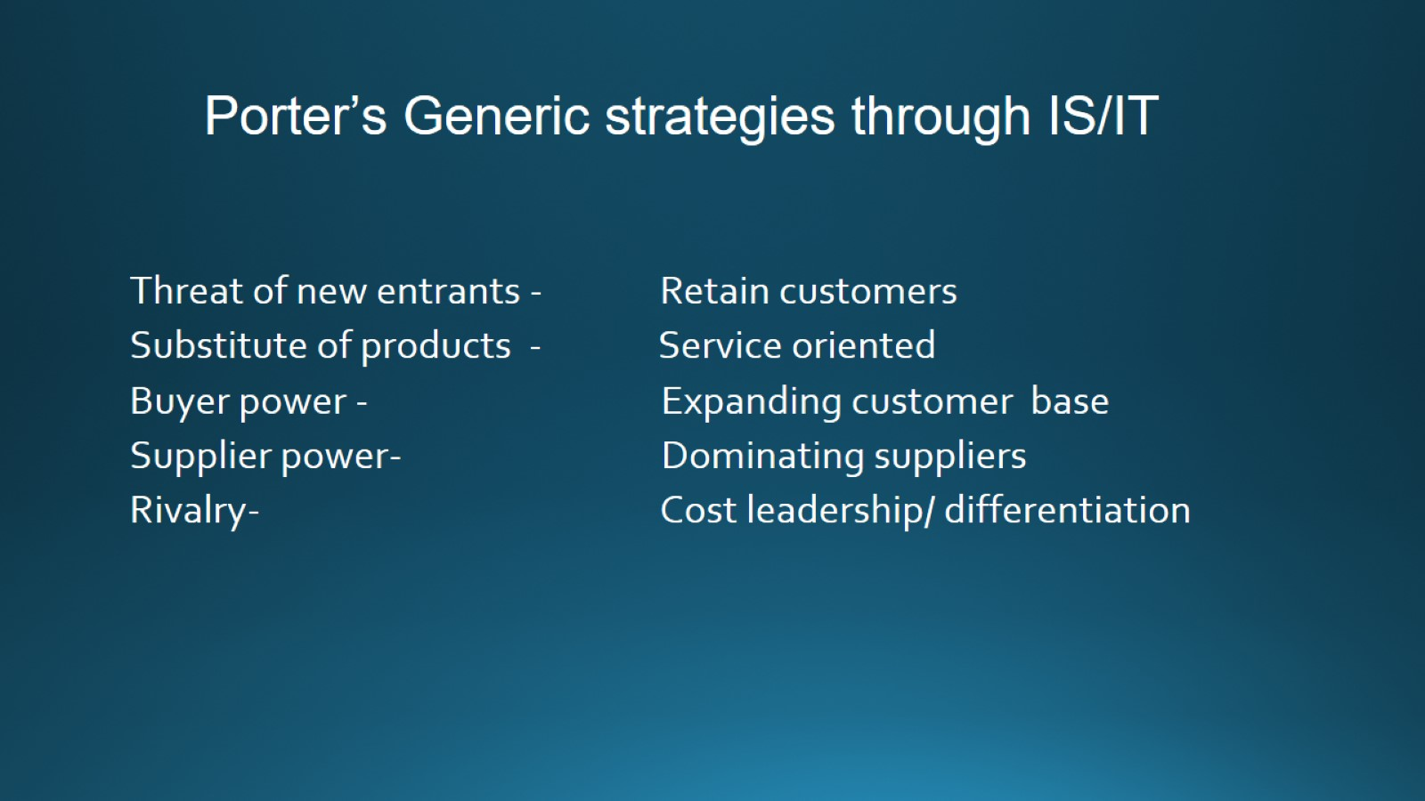
Porter’s Generic strategies through IS/IT

Slide 6
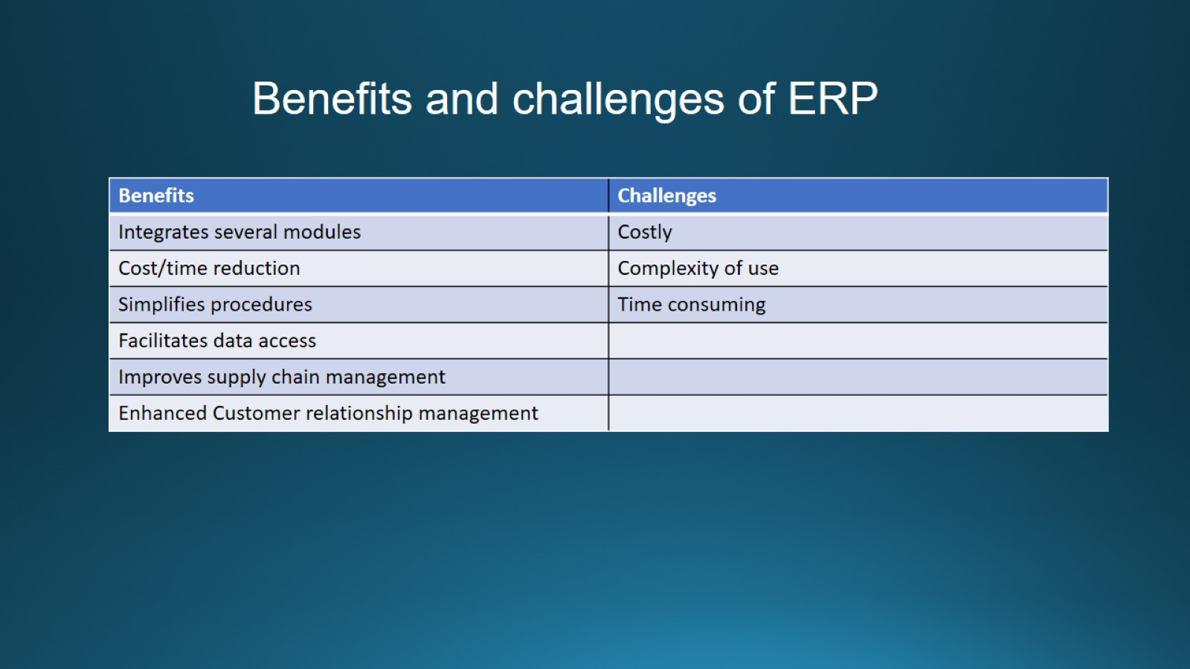
Benefits and challenges of ERP

Slide 7


