Slide 1
Taxation
BMMB5019
BA Accounting – Level 5
Institute of Management and Health

Slide 2
INTRODUCTION TO TAXATION
INCOME TAX COMPUTATION

Slide 3
There are 2 main parts to the Income Tax computation
Computation of the Taxpayers Taxable Income
Calculation of the Income Tax Liability and/or Income Tax Payable thereon

Slide 4
Taxable income will be divided into three possible analysis columns
Dividend Income Savings Income (which is interest income) Non-savings income (employment income, trading profits of the self employed and property income)
An Income tax computation is prepared for each taxpayer and records the income to be taxed for that individual for a tax year
The tax year runs from April 6 to the following April 5
In the computation, each source of taxable income requires its own basis of assessment to determine how much of that income is to be assessed to tax in each such tax year.

Slide 6
Income Tax Computation
Exempt Income
The following are the main examples of sources of income that are exempt from Income Tax
Interest or bonuses on National Savings & Investment Certificates
Interest and dividends within and Individual Savings Account (ISA)
Gaming, lottery and premium bond winnings

Slide 7
Tax Liability and Tax Payable
Having calculated the taxable income, the next part of the computation is to compute the Tax Liability and/or the Tax Payable of the taxpayer
Tax Liability = Income tax on taxable income
In calculating the Tax Liability, it is necessary to take each part of the Taxable Income in order, non savings income followed by savings income and finally and dividend income as these sources of taxable income have different tax rates that apply to them and rates that also change depending on how much taxable income the taxpayer has
Tax Payable = Tax Liability
LESS
tax already deducted at source, Pay As You Earn (PAYE) on employment income

Slide 8
Taxation of non-savings income

Slide 9
Non-savings Income consists of:
Trading Profit
Employment Income
Property Income

Slide 10
Activity
Band | Taxable income | Tax rate
Personal Allowance | Up to £12,570 | 0%
Basic rate | £12,571 to £50,270 | 20%
Higher rate | £50,271 to £125,140 | 40%
Additional rate | over £125,140 | 45%
Mr Smith has been working for many years and received a salary of £62,500 per annum in 2021/22 (PAYE deducted in 2021/22 is £12,000). He has no other source of taxable income
Calculate the income tax payable by Mr Smith for 2021/22

Slide 11
Method
We use the tax bandings to calculate the percentage of tax that must be paid within each band
Up to £12,570 = 0
£12,571 - £50,070 = £37,700 (difference between £50,070 and £12,571 – HMRC round up and down) x 20%
£50,071 to £62,500 = £12,230 (difference between £62,500 and £50,071)

Slide 12
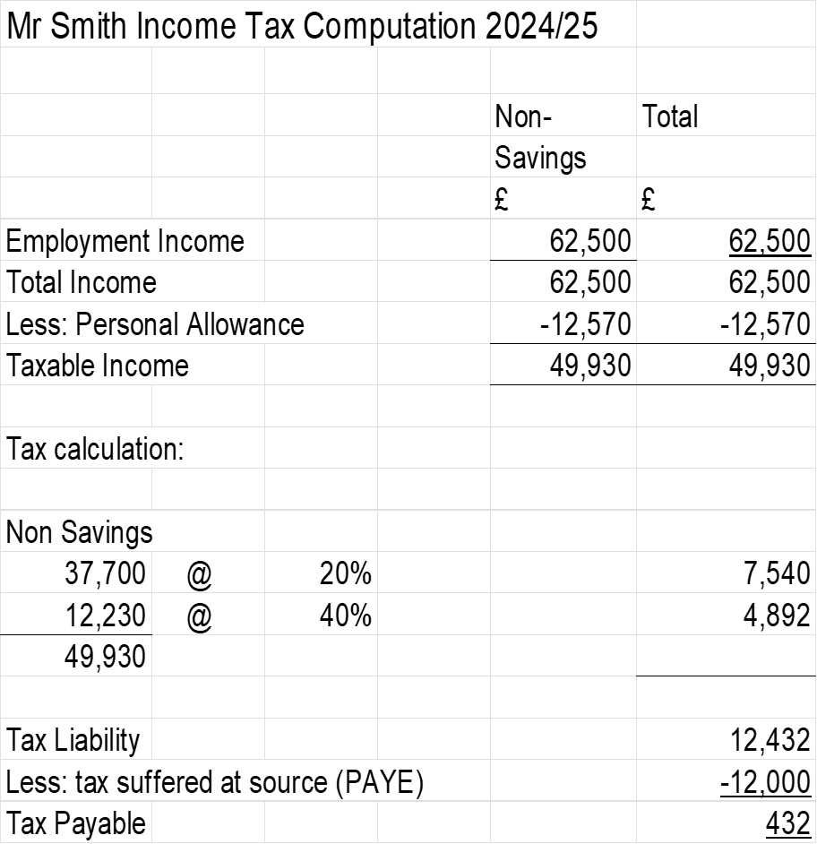

Slide 13
Activity
Mr Jones has been working for many years and received a salary of £72,000 per annum in 2024/25 (PAYE deducted in 2024/25 is £16,000). He has no other source of taxable income
Calculate the income tax payable by Mr Jones for 2024/25

Slide 15
Afternoon Session
Savings Income

Slide 16
Savings Income
Savings Income is interest income which is received on gross without any deduction of tax at source by the payer
Savings income is assessed in the tax year that it is received
This will include interest from:
  Banks
  Building Societies
  Government Securities
  Corporate Bonds

Slide 17
Calculation of Tax on Savings Income
Taxable interest received is included in the saving income column of the computation
Any deductions in the income tax computation (personal allowance and reliefs) are for purposes of exams deducted first from non-savings income, then savings income, then dividend income
Non savings income is treated as the first slice of the taxable income to be taxed followed by savings income then dividend income. The total of this tax is the Tax Liability of the taxpayer
Tax suffered at source (PAYE) is deducted from the tax liability in order to arrive at tax payable
The different types of taxable income are taxed as follows and in this order:

Slide 18
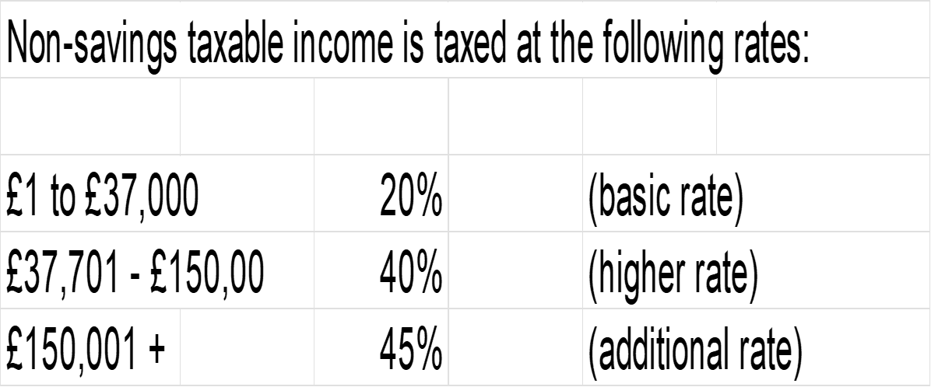

Slide 19
Savings
The tax savings of income is more ‘interesting’ due to the introduction of a nil rate band of £1,000 for basic rate taxpayers and £500 for higher rate taxpayers
  Additional rate taxpayers do NOT benefit from any savings income nil rate band
The savings income nil rate band counts toward the basic rate and higher rate thresholds
This supplement of 0% starting rate of tax that is ONLY available to taxable savings income that falls within the first £5,000 of total TAXABLE income
  Savings income is taxed using the same rates as non-savings income, but the starting rate of tax of 0% will apply to a maximum £5,00 of taxable savings income where any part of the taxable savings income falls within the first £5,000 of the total taxable income
  If therefore the first £5,000 of taxable income consists of non-savings income, then the 0% will not apply
  If applicable the starting rate is applied first to taxable savings income followed by the savings income nil rate band if available and thereafter normal rates.

Slide 20
Dividends
After taxing the non-savings and savings income the taxable dividend income will also firstly benefit from a 0% rate on the first £2,000 of dividend income received
  0% rate is available irrespective of whether dividends fall within the basic rate, higher rate or additional rate bands, AFTER which the dividend tax rates are as follows:

Slide 21
Activity
Billy had a trading profit of £27,500 and received bank deposit interest of £10,000 in 2021/22
Calculate Billy’s income tax liability in 2021/22
Then recalculate Billy’s income tax liability, assuming the bank deposit interest is now £25,000

Slide 22
  Billy is a basic rate payer, so his savings income nil rate band is £1,000. The 0% starting rate for savings is not applicable as non savings taxable income (£14,930) exceeds £5,000

Slide 23
Tax Calculation
Non-savings
14,490 @ 20% 2,986
Savings
1,000 @ 0% 0
9,000 @ 20% 1,800
Tax Liability 4,796

Slide 24
(b)
  Billy is a higher rate payer, so his savings income nil rate band is £500 towards the basic rate threshold of £37,700. The 0% starting rate for savings is not applicable as non savings taxable income (£14,930) exceeds £5,000

Slide 25
Tax calculation
Non-savings
14,490 @ 20% 2,986
Savings
500 @ 0% 0
22,270 @ 20% 4,454
2,230 @ 40% 892
Tax Liability 8,332

