Slide 1
LCBB4009
Understanding Organisational Structure and Culture (UOS)
Week 1: Session 2
Introduction to Organisation, Management, Organisational Structure, and Organisational Culture

Slide 2
Lesson Aims
By the end of this session, students should be aware of:
Organisation
Management
Organisational structure
Organisational culture
Notes:
Getting to know one another:
Each student takes turn to introduce himself or herself. The introduction should include the following:
Your full name.
How you want to be called (e.g., first name, nickname, etc.)
Your country of origin.
What you are good at.
Your working experience (if any).
Your future career intention.
What you expect to learn from this module and this semester.

Slide 3


Organisation – what is it?
Notes:
Are these organisations? What do they have in common? What is an organisation?

Slide 4
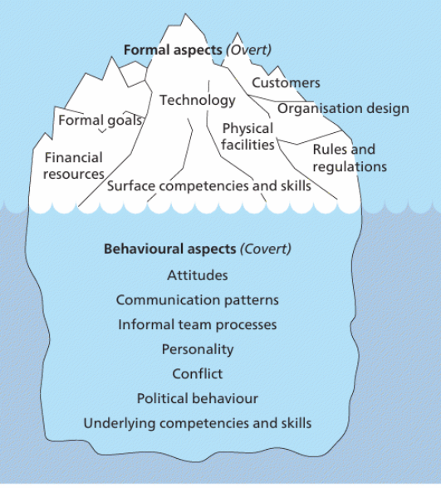
Organisation - definition
Group of people
Structure
Common goals
Source: Mullins and McLean (2019, p. 9)
Notes:
Source: Robbins & Coulter (2020)
Why it is important to work in organisation, rather than work individually, or in group/team?

Slide 5
Organisation - types
A formal organisation:
  is deliberately planned,
  is created with stated objectives,
  is a pattern of roles, hierarchy of authority and responsibility
Notes:
“A formal organisation is deliberately planned and created with stated objectives. It is a pattern of roles, hierarchy of authority and responsibility” (Mullins and McLean, 2019, p.7)

Slide 6
Organisation - types
The informal organisation:
  is flexible,
  loosely structured,
  relationships may be left undefined,
  membership is spontaneous with varying degrees of involvement
Notes:
Question to the students: are you currently a member of any formal/informal organisations?
“The informal organisation arises from the interaction of people working in the organisation, their psychological and social needs, and the development of groups with their own relationships and norms of behaviour, irrespective of those defined within the formal structure. The informal organisation is flexible and loosely structured, relationships may be left undefined, and membership is spontaneous with varying degrees of involvement” (Mullins and McLean, 2019, p.7)

Slide 7
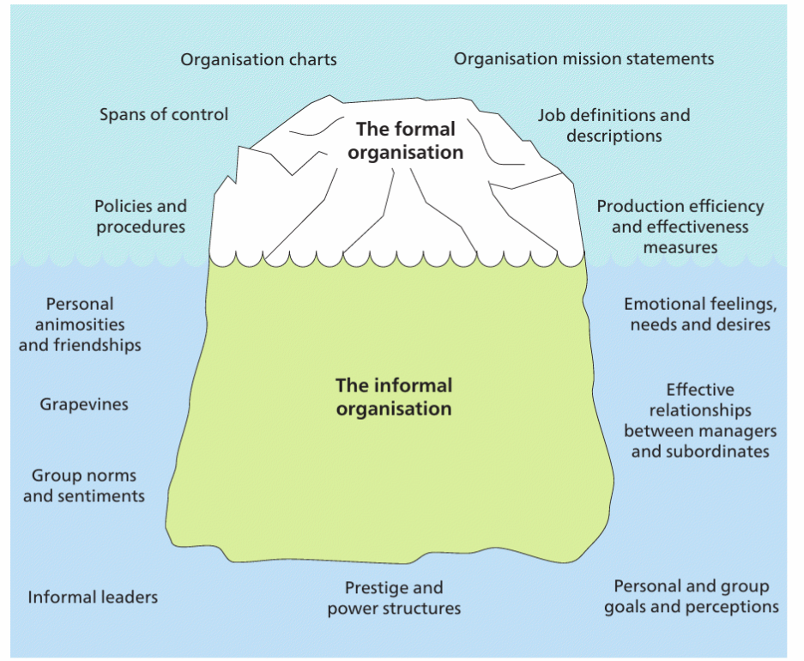
Organisation – formal and informal
Source: Mullins and McLean (2019, p.73)
Notes:
Question to the students: what are the important components of an organisation? Why do we need to understand them? Provide one example for each item shown in the illustration.

Slide 8
Organisation - types
Private organisations: work is directed towards a commercial nature such as profit, return on capital employed, market standing or sales level.
Public organisations: work is directed to the provision of a service to, and the well-being of, the community.
For-profit and not-for-profit organisations
Notes:
There are different types of organisations. How are these types differentiated from one another?
(Mullins, 2019, pp. 68-70)

Slide 9
Management – what is it?
An integrating activity permeating all organisation’s operations.
Is fundamental to the effective operation of work organisations.

Slide 10
Management - definition
Taking place within a structured organisational setting with prescribed roles;
Directed towards the attainment of aims and objectives;
Achieved through the efforts of other people;
Using systems and procedures.
Management is the art of getting things done through others.
Notes:
From this definition, compare the notions of management and organisation. What is their relationship?
(Mullins, 2019, p. 376)
If there is no organisation, is it needed to have management? What are the differences between managing an organisation and managing something else (which is not an organisation)?

Slide 11
Organisational structure - definition
Organisational structure is the formal system of task and authority relationships that controls how people are to cooperate and use resources to achieve the organization’s goals.
Organisational chart is the visual description of the organizational structure.
Notes:
From this definition, compare the notions of management and organisation. What is their relationship?
(Mullins, 2019, p. 376)
If there is no organisation, is it needed to have management? What are the differences between managing an organisation and managing something else (which is not an organisation)?

Slide 12
Organisational structure - purposes
economic and efficient performance of the organisation and level of resource utilisation;
monitoring activities of the organisation;
accountability for areas of work undertaken by groups and individual members of the organisation;
co-ordination of different parts of the organisation and different areas of work;
flexibility in order to respond to future demands and developments, and to adapt to changing environmental influences;
and social satisfaction of members working in the organisation.
Notes:
Mullins and McLean, 2019, pp. 451-452

Slide 13
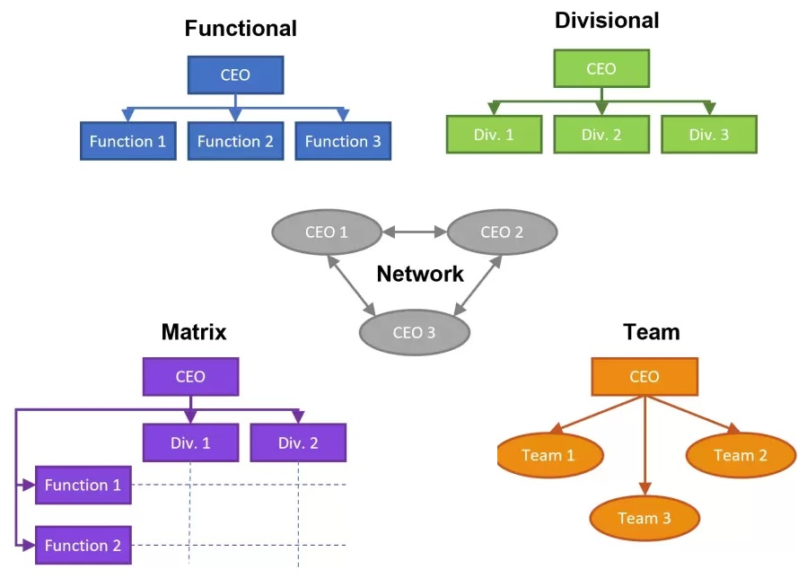
Organisational structure - examples

Slide 14
Organisational structure
Activity
Activity: Individual work. 10 minutes.
Identify an organisation that you would like to establish, or to work for.
How do you like its organisational structure to be? Why?

Slide 15
Organisational culture - definition
‘how things are done around here’.
the shared values, principles, traditions, and ways of doing things that influence the way organizational members act and that distinguish the organization from other organizations
Notes:
From this definition, compare the notions of management and organisation. What is their relationship?
(Mullins, 2019, p. 376)
If there is no organisation, is it needed to have management? What are the differences between managing an organisation and managing something else (which is not an organisation)?

Slide 16
Organisational culture
Activity
Activity: Individual work. 10 minutes.
Identify an organisation that you would like to establish, or to work for.
How do you like its organisational culture to be? Why?

Slide 17
The importance of organisational structure and culture
Organisational structure and culture significantly impact organisational performances.
They are considered the key factors that affect the organisation’s ability to execute their strategies effectively and efficiently.
They influences how management is practiced.

Slide 18
Case study
Activity
Activity: Groupwork. 40 minutes.
Read the assigned case study and answer the questions in written form. Prepared to share your answers with the class.

Slide 19

Key terms
Organisation
Private organisation
Public organisation
For profit organisations
Not-for-profit organisations
Management
Organisational structure
Organisational chart
Organisational culture

Slide 20

Homework
Review the key terms. Be prepared to explain them in the next class.
Select one real organisation. Describe the its organisational structure and culture. Draw its organisational chart. Save your answer in an MS Word file named as Your full name_Your student ID_OSC_Week 1_intro.
Email the lecturer to introduce yourself. Your email should have the subject as: Your full name_Your student ID_OSC_Week 1_intro. Attached your file to the email.

Slide 21
References
Mullins, L. J. and McLean, J.E. (2019) Organisational behaviour in the workplace. 12th edn. Harlow: Pearson Education Limited.
Huczynski, A. and Buchanan, D.A. (2019) Organizational behaviour. 10th edn. Harlow: Pearson
Robbins, S. and Coulter, M. (2021) Management, Global Edition. 15th edn. Pearson.
Cole, G. A. and Kelly, P. (2020) Management theory and practice. 9th edn. Hampshire: Cengage Learning EMEA.

Slide 22

I have a question…

