Slide 1

Internship and Volunteerism
Jessica Shore

Slide 2
What does Internship mean?
“An internship is a temporary position in a company that is held by a student or trainee. It is sometimes without pay and completed in order to gain work experience or to meet educational requirements. An internship is a beneficial experience for anyone wanting to gain real-life exposure to the professional world. It can help you gain experience, make professional connections and give you an idea about what to expect from a certain industry. Completing an internship is a great starting point for individuals just entering the workforce or even people seeking a career change” (Indeed, 2023).

Slide 3
What does Volunteerism mean?
Volunteering is when someone spends unpaid time doing something to benefit others.
Helping your close friends or relatives isn't volunteering. But doing something to benefit the environment (and through that, other people) is.
Volunteering can be formal and organised by organisations, or informal within communities. It should always be a free choice made by the person giving up their time.

Slide 4
Discussion
What is the difference between internship and volunteerism?

Slide 5
What are you being asked to do?
Find yourself a placement
Decide with your placement provider what your tasks and objective will be, then write assignment 1.
Complete all the relevant paperwork and placement forms
Participate in an internship post for a total of 90 hours before the final assignment date
Complete assignments 2 & 3

Slide 6
Activity
Using any experience you may have of a previous job, placement of volunteer post, consider your answers to the following questions.
1. What were you responsible for or what were you key tasks?
2. Why did you undertake the position/what was your motivation?
3. What did you learn from the experience?

Slide 7
Why are placements useful to University students?
Graduate positions are fiercely fought over
It gives students the opportunity to add practical experience to their academic achievements
It also allows students to ‘try before they buy’, try a completely different career path
Build a network of contacts
Show perspective employers what you can do.

Slide 8
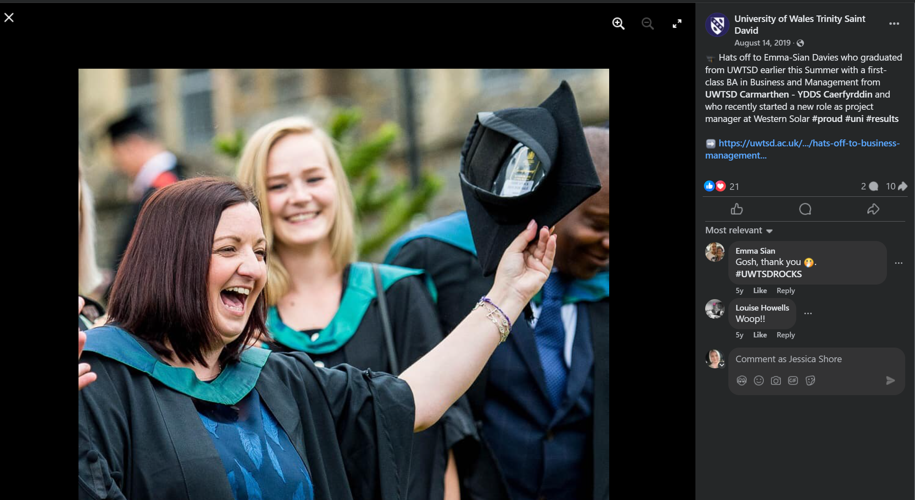

Slide 9

Placements from previous years…
Carmarthen Town Council
Building Carmarthenonline
Carmarthenshire County Council
Mapping Social Enterprises across the county
Canolfan Carwyn
Creating a programme of activity for the over 50’s
Carmarthen Business School
Marketing

Slide 10
What makes a placement so important to employers?
80% OF Employers believe that current graduates do not arrive fully equipped with the skills they need to be work-ready
Employers are increasingly looking for skills to work in a hybrid working environment
Employability skills should form part of every course – hence the addition of this module in the course.
Connection between students and employers is immeasurable

Slide 11
Video
Finding a Work Placement or Internship: 7 Top Tips - Study in the UK | Cardiff Met International

Slide 12
Discussion
In Pairs, consider your future career path? What sort of placement/organisation would support you work toward this?

Slide 13
Process
Start to give thought to potential placements
Create your CV
Contact potential placement companies
Start applying
Send CVs and Covering letters
Complete Assignment 1
Once your placement is agreed complete the preplacement paperwork
Complete your pre-placement skills audit
Practise Interview Techniques
Start your placement
Keep a diary during your placement
Complete placement
Complete assignments 2 & 3 and your post placement skills audit

Slide 14
Research
Spent the next 20 minutes researching on your laptops, organisations locally that you would like to apply to for a placement.
We shall then discuss

Slide 15
Timings
You have now been given all the information about this module, including key dates, deadlines and placement time. For this activity you will need to write a list of the actions that you will need to take on this module, then create a ghantt chart detailing the key deadlines you need to hit. I have placed a turnitin link in this section of moodle for you to upload it.

