Slide 1
Perspective

Slide 2
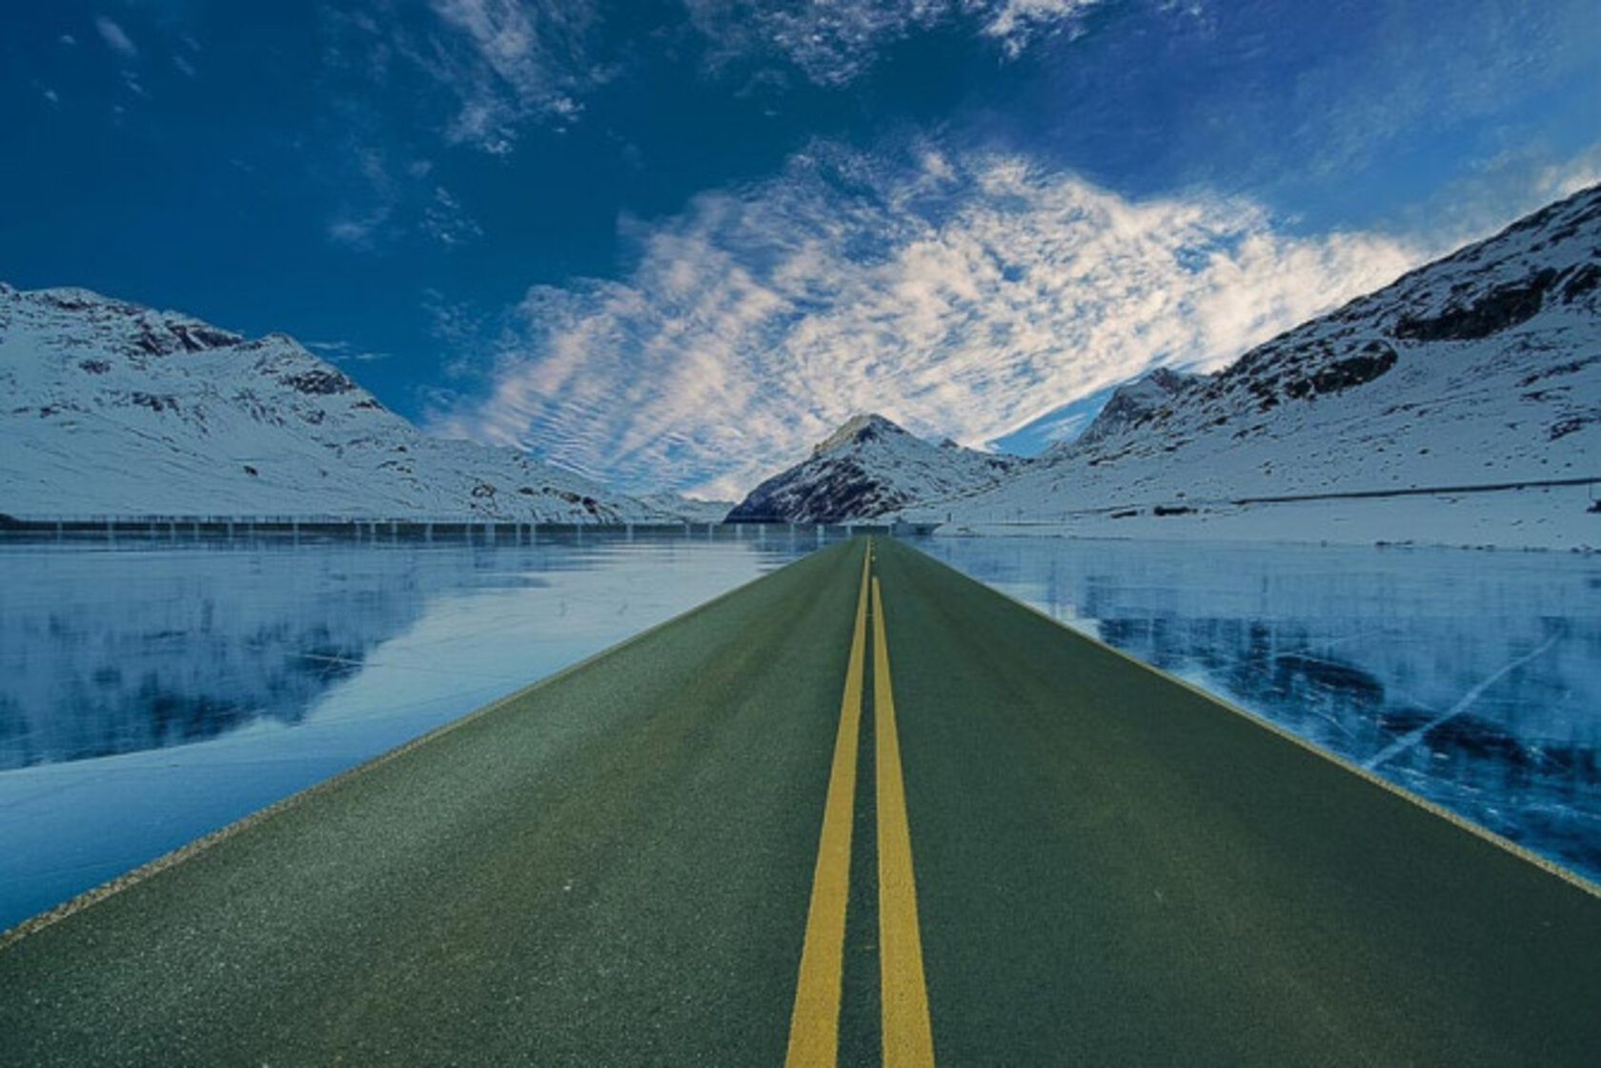

Slide 3
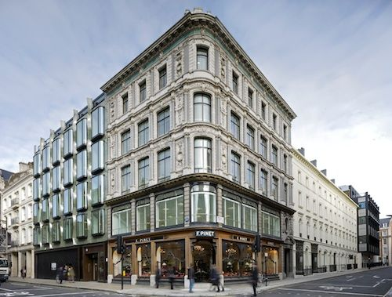

Slide 4


Slide 5
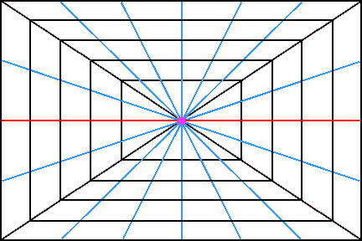
1 point perspective

Slide 6
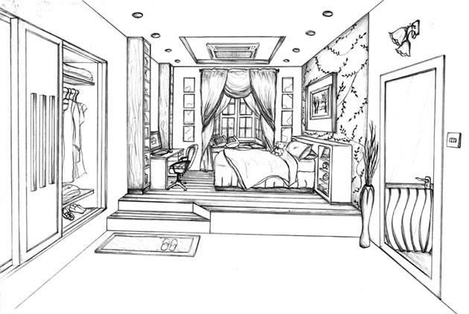

Slide 7
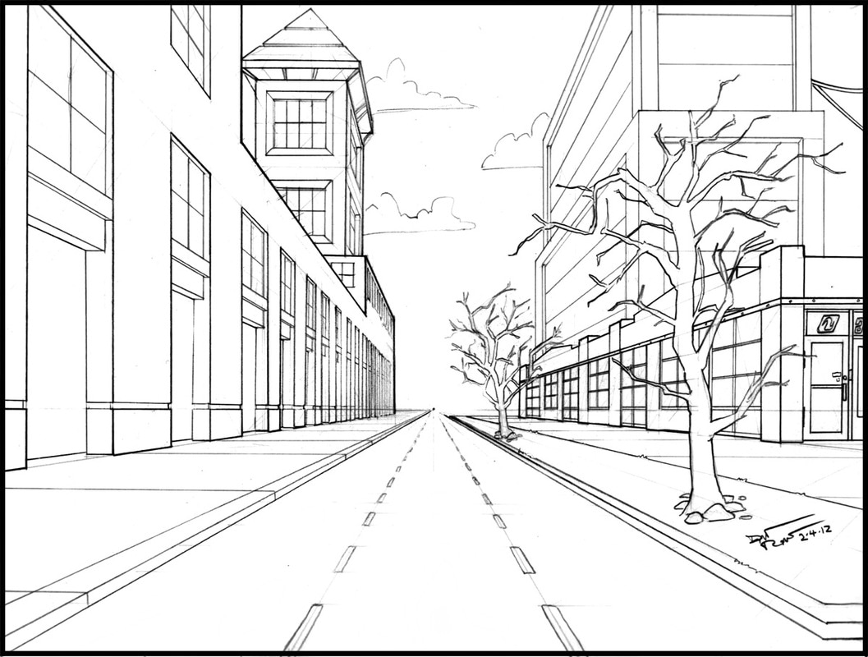

Slide 8
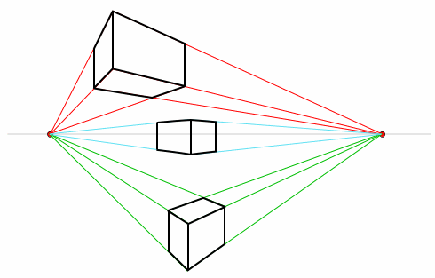
2 point perspective

Slide 9
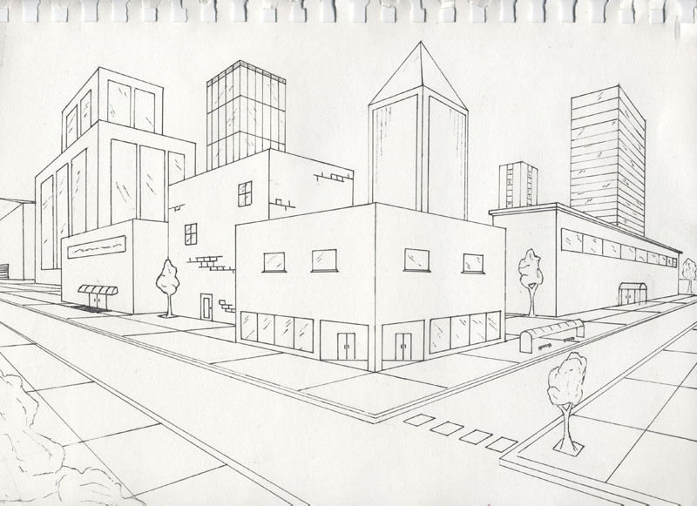

Slide 10
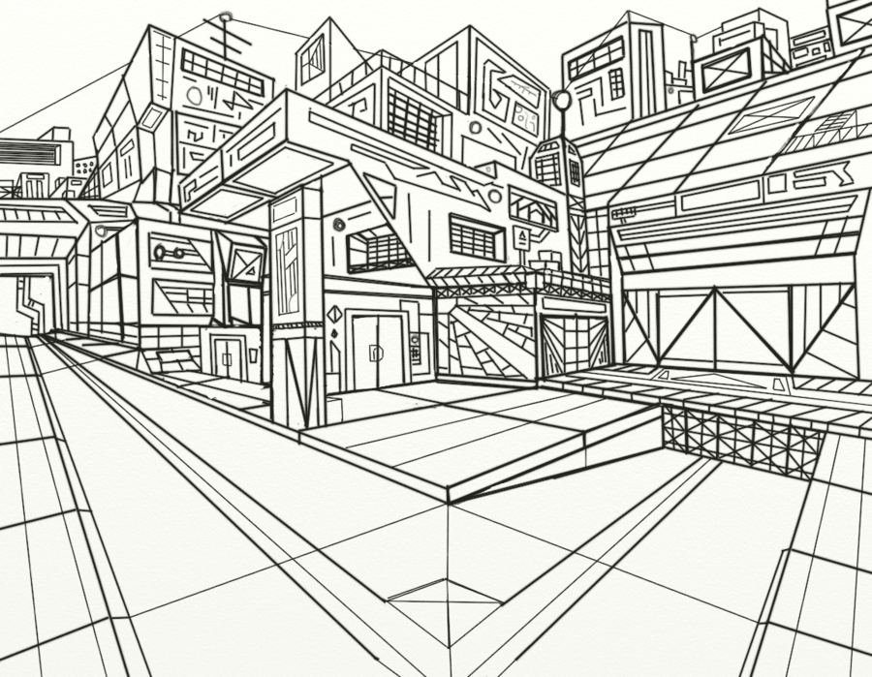

Slide 11
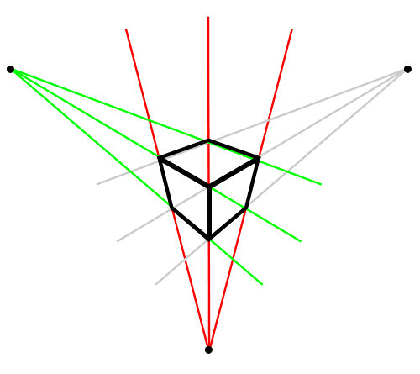
3 point perspective

Slide 12
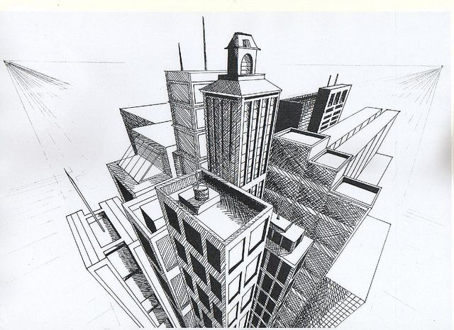

Slide 13
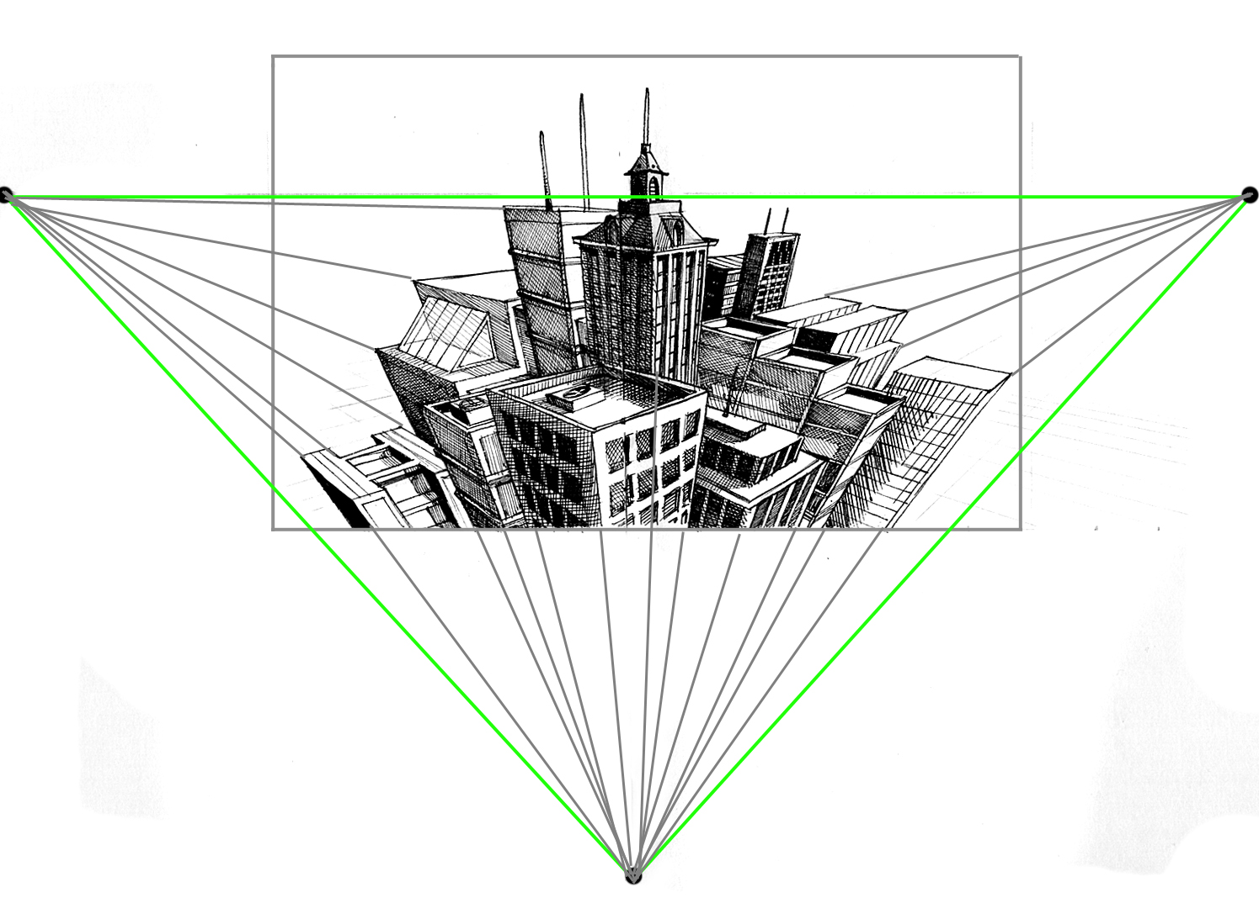

Slide 14
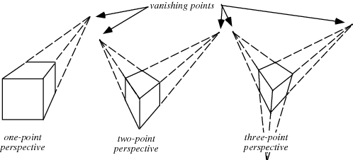

Slide 15
Depth

Slide 16
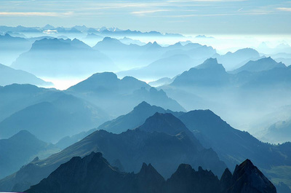

Slide 17
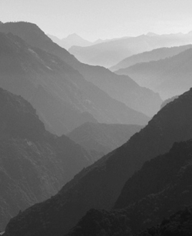

Slide 18
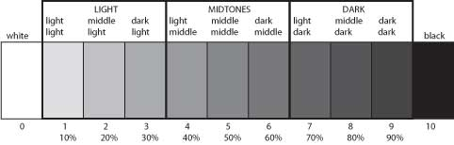

Slide 19
History

Slide 20
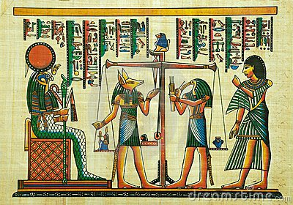

Slide 21
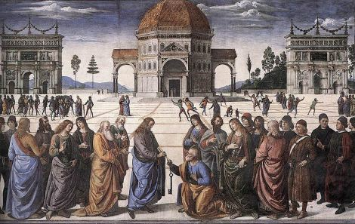

Slide 22
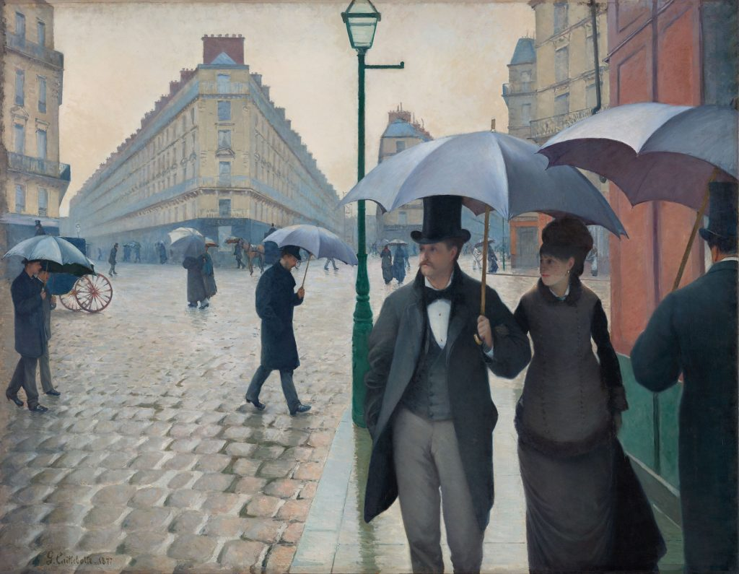

Slide 23


Slide 24
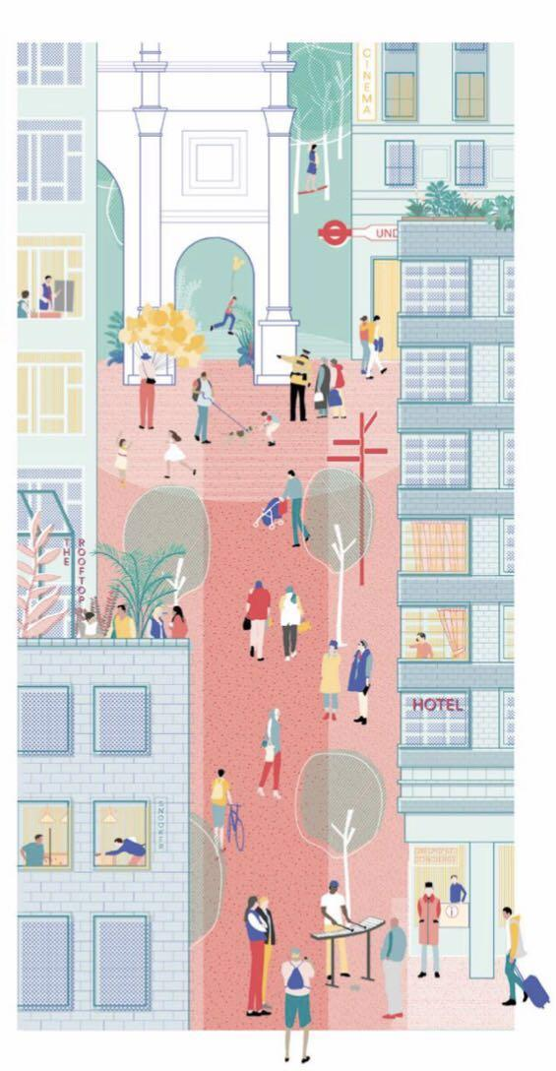

Slide 25
Task 1
Create three detailed drawings using the the three principles of 1,2 and 3 point perspective.
Task 2
Create 1 full colour illustration (A4 landscape) using the techniques you have learned during
this week’s workshop, on the theme of ‘My Perspective’
Use your environment (and from studies done during your walk-about in Swansea), to create a world (fictitious or real). Research and observation is key to any conceptual piece of illustration/art work.

