Slide 1
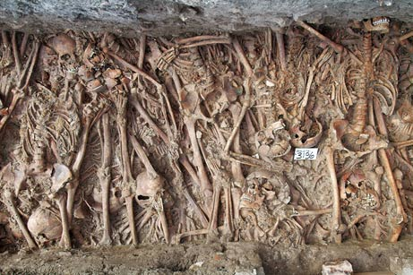
War, plague, famine and death
The Crisis of the Later Middle Ages

Slide 2
Fourteenth-century themes
Crisis, what crisis?
  Debates and sources
Famine
  Climate change
  Food shortages and animal mortality
  Questions to think about and theories
Plague
  Historical and scientific debates
  Immediate and long-term consequences
Political unrest
  Rebellions and social change
  War and religious schism

Slide 3
Crisis, what crisis?
General agreement that there are serious problems in 14th century, at least in northern Europe but historians cannot agree on the causes and consequences
  What do historians mean by ‘crisis’?
  Scholars divided into those who prefer economic, biological or ecological causes
Major topics of debate
  famine, war, religious schism (1378), plague, social unrest, increasing intolerance, increased religiosity and impiety, economic change, political expansionism
  Was life worse than before or just better recorded?
Sources: do we accept medieval accounts of crisis, including their high mortality rates and religious fervour? (e.g. Jean de Venette)

Slide 4
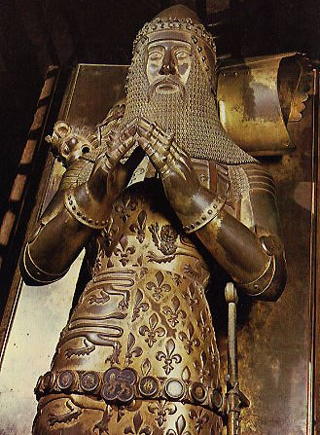
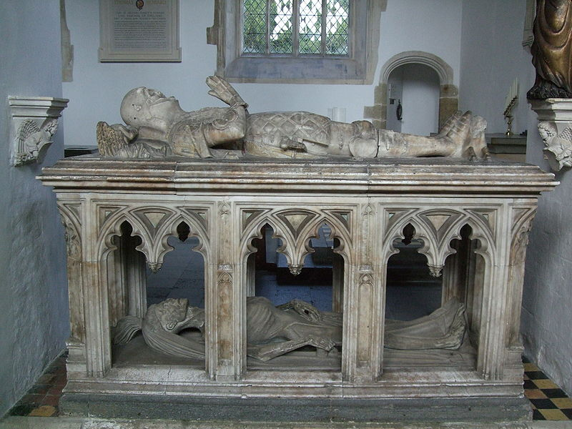
Tomb of John Fitzalan, Earl of Arundel, d.1435, Arundel Castle
Tomb of the Black Prince,
d.1376, Canterbury Cathedral
Artistic changes: why?

Slide 5
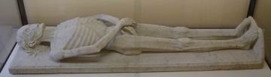
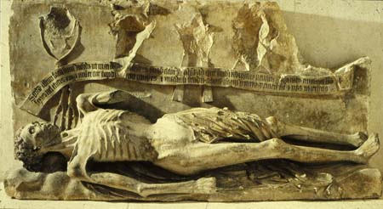
tomb of Guillaume de Harcigny (d. 1393), physician of Charles VI of France, Laon Museum
tomb of Cardinal
Jean de Lagrange,
Avignon (d. 1402)

Slide 6
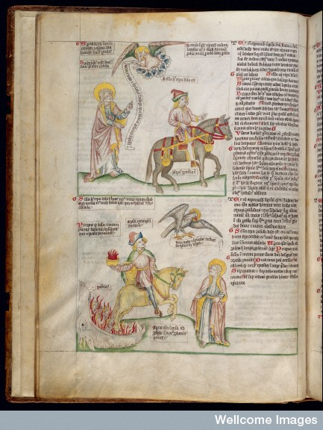
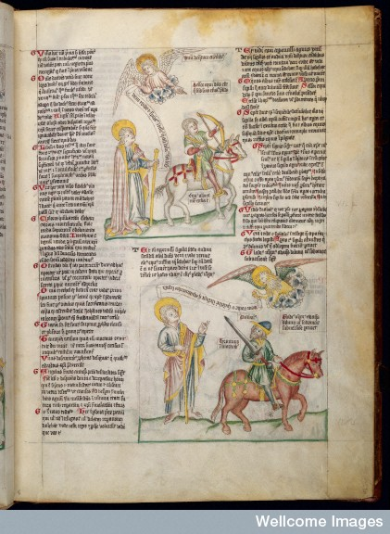
DEATH
Images of the four horses of the Apocalypse from the biblical book of Revelations
FAMINE
WAR
PLAGUE
Wellcome
Apocalypse,
c.1420

Slide 7
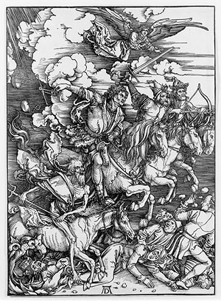
Albrecht Dürer, 1497-8

Slide 8
Famine
Climate change from late 13th c. → Europe cools down
  But how much effect did this have?
1315-1322: Great Famine of Northern Europe (mortality: 7-10% mainly from disease)
1333 and 1375 food shortages in Southern Europe
Animal mortality (sheep and cattle murrains [infections] esp. in 1319)
Questions
  was the famine exacerbated by political problems and the break-down in entitlements (as today)?
  did the famine increase vulnerability to plague?
  was Europe over-populated and over-stretched?
The problems with Malthusian theories of population

Slide 9
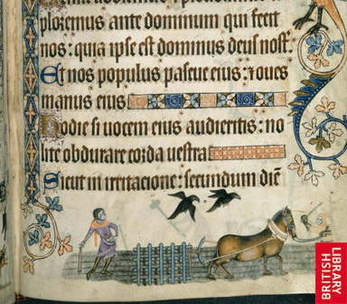
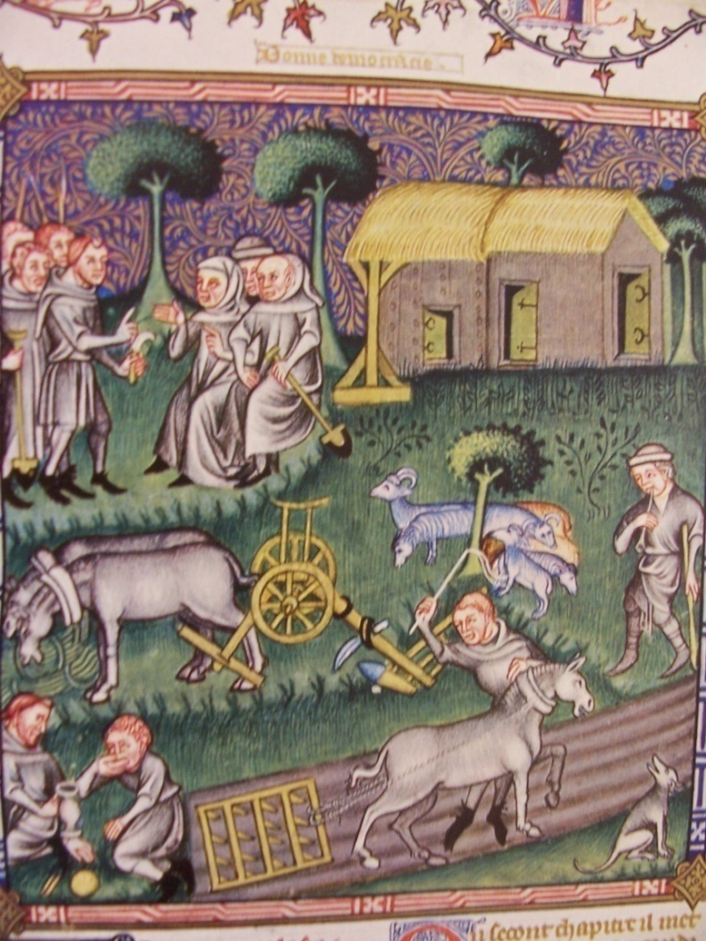
Getting enough to eat
Luttrell Psalter (1320-40),
British Library
Ideal view of peasants:
Royal Library of Belgium

Slide 10
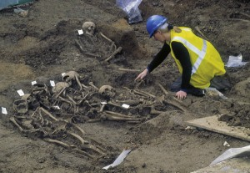
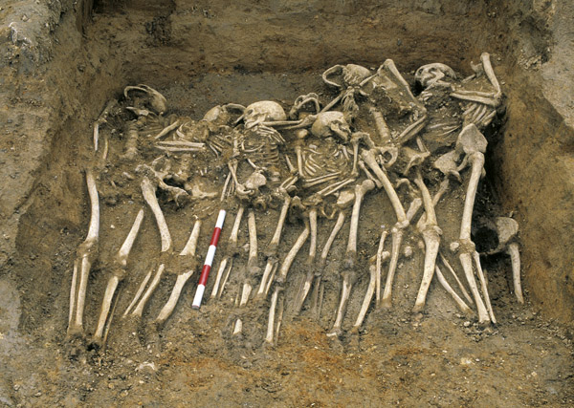
Famine always a threat even
in times of prosperity due to dependency on cereals
Excavating mass graves, Spitalfields, London – possible result of volcanic eruption somewhere in the world in 1250s © Museum of London Archaeology MOLA

Slide 11
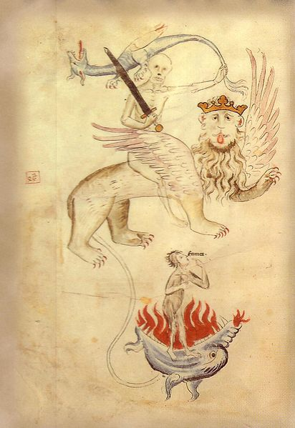
Image of Death, hell and
famine from a Bible produced
in Erfurt in c. 1315

Slide 12
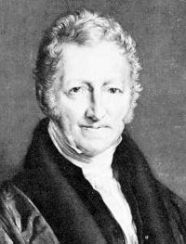
The Malthusian Question
http://www.bbc.co.uk/programmes/b011zzh6
Was Europe over-populated?
  Population already struggling to feed itself by 1300? How can we know?
  Idea of a Malthusian deadlock?
  Neo-Malthusian idea of Michael Postan (see Dyer, Making a Living, p. 246ff)
  from 1930s v. Robert Brenner’s
  neo-Marxist approach
Criticisms of these idea
  Trade in grain?
  Populations fairly stable
  Population did not boom after the 14th century despite all the ‘positive checks’
  Problem of role of weather and disease
  Malthus did not respect human ability to practise charity and develop forms of social welfare and other strategies
Thomas Malthus
(1766-1834),
author of An Essay
on the Principle of
Population (1798)

Slide 13
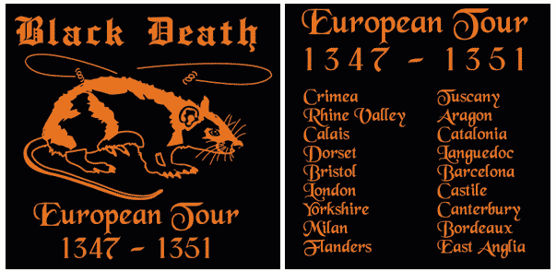
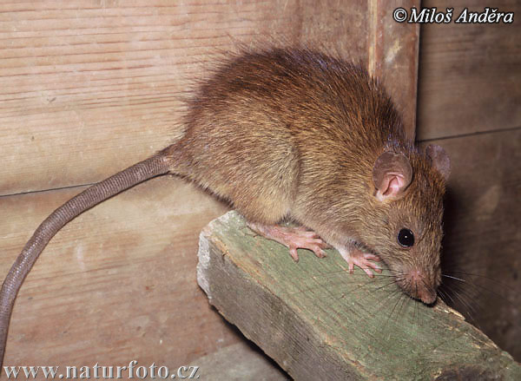
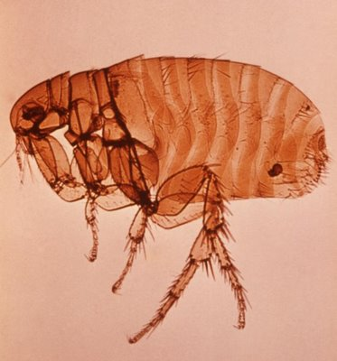
Plague
Rattus rattus (Black Rat or Ship Rat)
Xenopsylla cheopis (rat flea)

Slide 14
Plague
    Disease pattern (epidemiology)
      Arrives in Italy in October 1347 (from Crimea); arrives in France in January 1348 and southern England before the end of that year and Yorkshire/Scotland in 1349
      Also affects Middle East and North Africa
      Boils in groin and armpits (buboes); fever; spots; spitting blood; death within 3-5 days
      Returns most decades until well into the fifteenth century and does not disappear from Western Europe completely until 1720 (Marseilles); continues later in Ottoman Empire and Russia
      Mystery over why it disappeared and why it seemed to behave differently in northern and southern Europe
      Not fussy about location or temperature
      Death rate: 30-60% but depends on the historian!

Slide 15
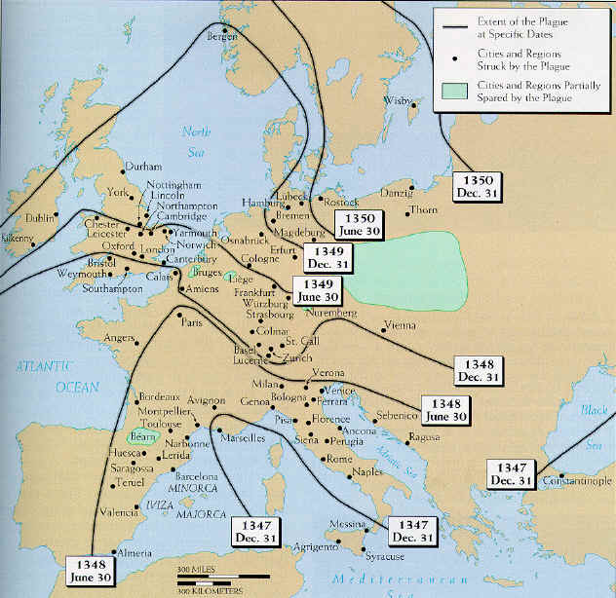
Spread of the
Black Death
For more on this
map see David C.
Mengel, ‘A Plague
on Bohemia?
Mapping the Black
Death’, Past &
Present 211 (2011),
3-34

Slide 16
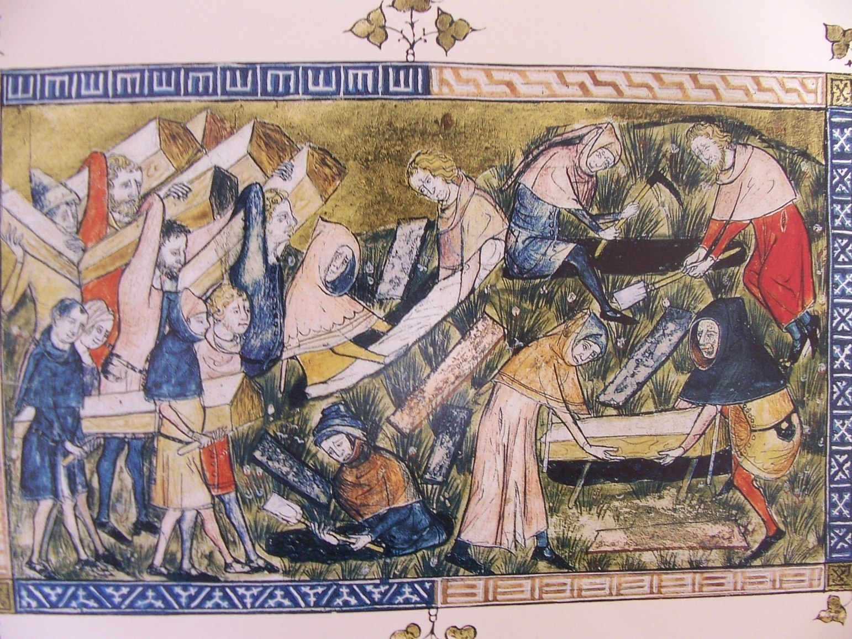
Burial of plague victims, Tournai (1349),
Chronicle of Gilles li Muisis

Slide 17
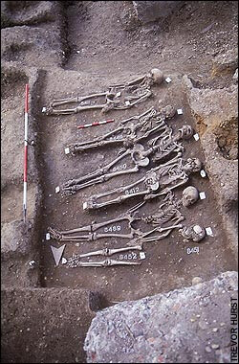
mass graves,
East Smithfield, London
mass graves,
Lazaretto Vecchio,
Venice

Slide 18
    Medieval theories about causation
      divine will (punishment for sin), astrology, miasma (bad air), earthquakes, humoural imbalance, human agency
        We need to take these seriously!
        Medical treatments were attempted as were religious methods such as processions and masses
    Immediate consequences
      mass burials, flight and abandonment, chaos??
      flagellants, attacks on Jews, impiety, increased piety?
    Longer-term consequences
      mid-term effects: high prices/wages, labour laws, public health regulations such as cleaning streets and segregation of the sick
      long-term effects: quarantine measures, greater prosperity and freedom for peasants, reduced tax base, lack of pastoral care
      Possible effects: macabre art, changes in fashion, technological change, improved status for women?

Slide 19
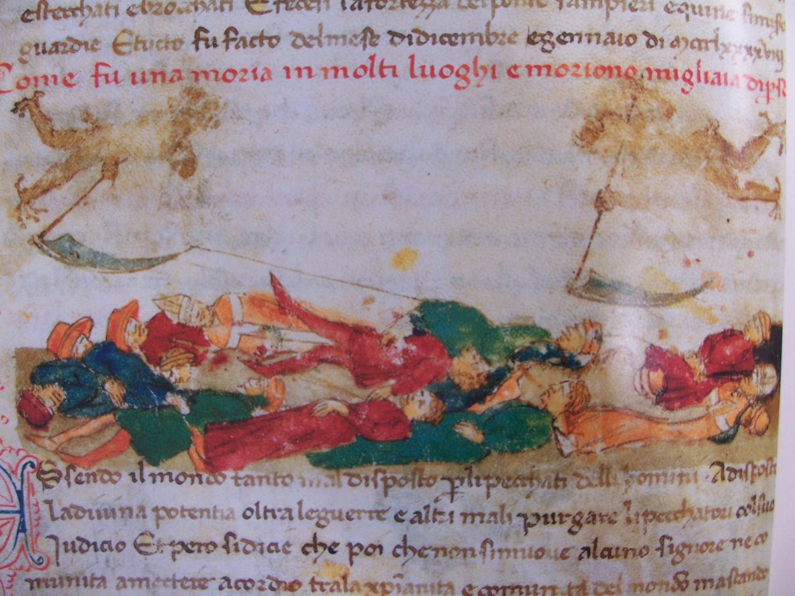
scythes of death in chronicle of Giovanni
Sercambi of Lucca (d. 1424)

Slide 20
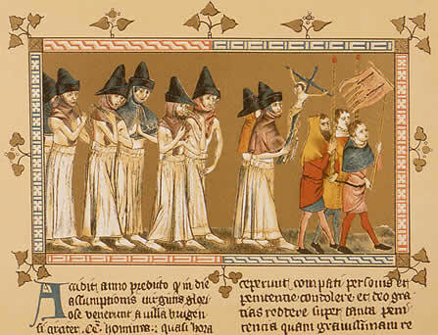
The Flagellants of Doornik (Netherlands), 1349: a short-lived and not widespread phenomenon

Slide 21
Political unrest
    The debate
      Were there links between plague and the many rebellions that affected several regions of Europe after 1350?
    Jacqueries in France (1350s), Ciompi in Florence (1378), Peasants’ Revolt in England (1381), civil war in Portugal (1383-4), attacks on Jews in Castile and Aragon (1391)
      Some rebellions pre-dated the plague e.g. urban revolts in the Low Countries (1320s), 13th century attempts by people of St Albans to secure freedom from abbey
    Revolts must also be linked to warfare, weak leadership, high taxation and food shortages
      Wars to some extent linked to conflicts over finite resources
      Other political problems e.g. depositions, succession crises

Slide 22
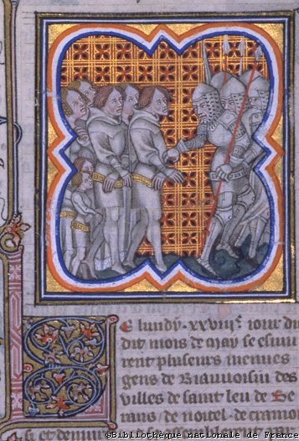
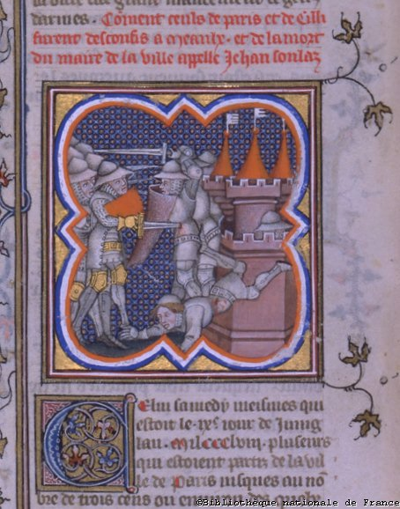
The Jacques take prisoners and are later themselves
killed at Meaux: Grandes Chroniques de France (14th c.)

Slide 23
Case studies
    Iberian Peninsula
      decline of Barcelona and Catalan trade and industry
      civil war in Castile and Portugal; involvement of France and England due to Hundred Years War; popular revolt in Portugal in support of usurper João I (1383-5)
      attacks on Jews (1391): as much socio-economic as religious? Increasing intolerance? (did not happen in Portugal)
      Portugal and Castile both recover very quickly from crisis during 15th c. and begin to expand into North Africa and the Atlantic
    England
      Statute of Labourers (1351)
      War with France going badly → poll taxes (1377-81)
      Senile king followed by a child on the throne (Edward III: 1326-77; Richard II: 1377-99)
      Peasants’ Revolt (1381)

Slide 24
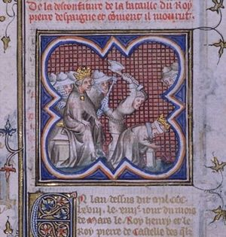
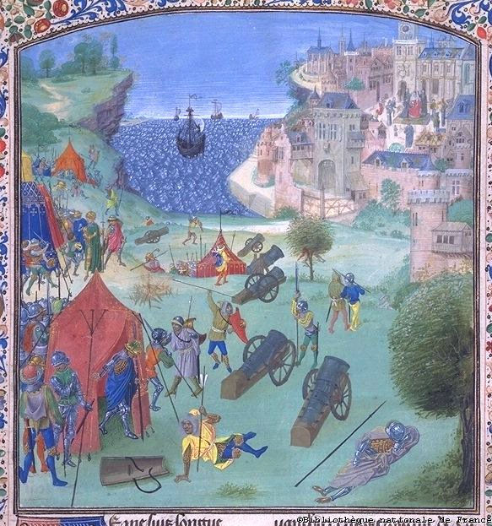
Execution of Pedro I of
Castile at his brother’s orders
(1369), Grandes Chroniques
de France (14th c.)
Siege of Lisbon (1384),
Froissart’s chronicles, (15th c.)

Slide 25
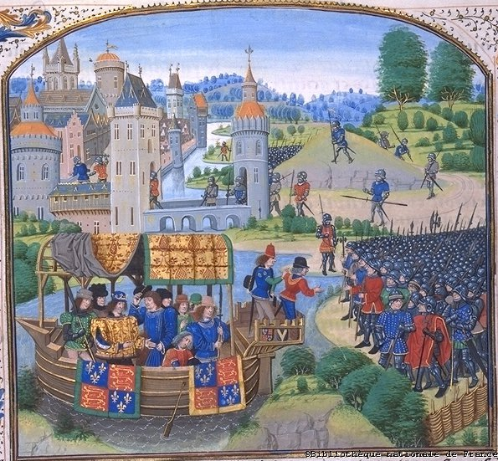
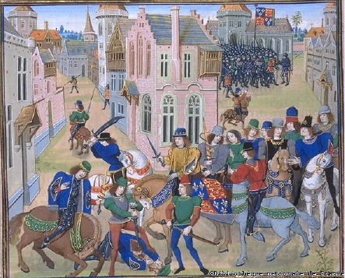
England: Peasants’ Revolt (1381)
Chronicle of Jean Froissart, 15th century manuscript
Richard II speaks to
the Kentish rebels,
Greenwich,13 June
Death of the rebel leader,
Wat Tyler, at Smithfield, 15 June

Slide 26
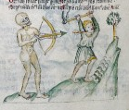
    Massive mortality has a huge effect on Europe but long-term social and political change probably a result of a combination of factors
    Europe could have recovered from plague of 1347-52 but its return over next two centuries roughly every decade had most impact on society
    Afterwards, Europeans were perhaps more prosperous but also more politicised, competitive, nationalistic and intolerant
      could global expansion have occurred without this crisis?
      What about the Renaissance and Reformation?
Conclusions
Death shooting at a
labourer with his bow,
Wellcome Apocalypse, c. 1420

