Slide 1


Research Proposal Presentation
Investigating the Factors Influencing Food Safety and Hygiene Compliance
Among Night Shift Hygiene Staff in the UK Meat Processing Industry
Daniel-Mihai Naica
Student ID: 2411629
Module: BMSW5014 Developing a Research Proposal
Date: 26 June 2026
Notes:
Opening (about 45 seconds): Introduce the research title and explain that the presentation focuses on the method, ethics and limitations for a proposed study of food safety and hygiene compliance among night shift hygiene staff in the UK meat processing industry. State that the project is based on workplace experience but is not an audit of the employer or an assessment of individual workers. It is an academic investigation into a wider management issue.

Slide 2

Introduction
02
Why this research matters
Night shift hygiene work is a critical control point between production days.
!
Public health
✓
Workplace impact
Foodborne pathogens are estimated to cause around 2.4 million UK illness cases each year (Food Standards Agency, 2024).
Compliance protects legal standards, audit readiness, customer trust and the reputation of the business (BRCGS, 2022).
A
Research aim
?
Central question
To investigate the main factors that influence food safety and hygiene compliance among night shift hygiene staff in the UK meat processing industry.
What factors influence food safety and hygiene compliance among night shift hygiene staff in the UK meat processing industry?
Key idea: HACCP and standards create structure, but culture, training, supervision, fatigue and resources shape what happens in practice (Food Standards Agency, 2017; Griffith, Livesey and Clayton, 2010).
(FSA, 2017; FSA, 2024; BRCGS, 2022; Griffith et al., 2010)
2/9
Notes:
Slide 2 (about 1 minute): Explain the background. Meat processing hygiene is important because poor cleaning can create contamination risks and damage public health, retailer confidence and legal compliance. Refer to the Food Standards Agency estimate of 2.4 million foodborne illness cases in the UK each year. Then introduce the workplace context: night shift hygiene teams prepare areas for the next production day. The study matters because procedures such as HACCP are important, but the way people work is also affected by fatigue, time pressure, communication, training, resources and management support.

Slide 3
Methodology
03
Research design: qualitative and exploratory
A design that captures staff experiences, meanings and workplace realities.
Interpretivist
philosophy
Inductive
approach
Qualitative
case study
Semi-structured
interviews
Thematic
analysis
Understand meanings and experiences
Build themes from staff accounts
Depth within a real workplace context
Follow-up questions and clarification
Identify patterns across responses
Why not a questionnaire?
A survey could count opinions but would not give enough depth to understand how night-shift staff interpret training, communication, workload and compliance in real working conditions.
(Saunders, Lewis and Thornhill, 2023; Creswell and Creswell, 2023; Braun and Clarke, 2006)
3/9
Notes:
Slide 3 (about 1 minute): Explain that the research is qualitative because the aim is to understand experiences, not to measure compliance statistically. The interpretivist position is appropriate because staff may interpret the same procedure differently depending on training, workload, supervision and culture. The approach is inductive because the study does not start with a fixed hypothesis. The case study design gives depth in one real setting, and semi-structured interviews are more suitable than questionnaires because they allow follow-up questions. Thematic analysis will then be used to identify patterns in the interview data.

Slide 4

Methodology
04
Data collection, sampling and research quality
The method follows a clear flow from participants to evidence-based themes.
1
Data collection
2
Sampling
• Semi-structured interviews
• Around 30–40 minutes
• Face-to-face or online
• One short pilot interview
• 8–10 participants
• Night shift hygiene staff
• Purposive sampling
• Direct experience required
3
Analysis
Reliability / trustworthiness
• Familiarise with data
• Code responses
• Develop and review themes
• Report themes with evidence
Same broad themes for each interview; pilot testing; simple audit trail of coding decisions; consistent thematic process.
Validity / credibility
Questions are linked to the aim; interviews allow clarification; themes must be supported by participant evidence.
I
Interview
Code
Theme
Evidence
(Bryman and Bell, 2023; Braun and Clarke, 2022)
4/9
Notes:
Slide 4 (about 1 minute 10 seconds): Cover the practical method. Interviews will last around 30 to 40 minutes and may be in person or online. A pilot interview will check clarity and reduce leading wording. The sample is 8 to 10 participants selected purposively, because participants must have direct experience of night shift hygiene tasks. Thematic analysis is used because it provides a clear process for identifying repeated patterns across qualitative data. Explain reliability as consistency: the same broad interview guide, pilot testing and coding audit trail. Explain validity as making sure the study captures what it aims to study: questions link to the aim, participants can clarify answers and themes are supported by evidence.

Slide 5

Ethical Considerations
05
Consent and voluntary participation
Ethics are especially important because the researcher has an insider workplace role.
1
Information sheet
Purpose, topics, time commitment and data use are explained before participation.
2
Informed consent
Participants give consent before the interview begins.
3
Right to withdraw
Participants can withdraw before analysis begins without penalty.
4
Academic purpose
Clear statement that the study is not a workplace audit, disciplinary process or performance review.
Ethical message: participation must feel genuinely voluntary, not linked to job security, pay, promotion or discipline.
(Saunders, Lewis and Thornhill, 2023)
5/9
Notes:
Slide 5 (about 1 minute): Explain informed consent. Each participant would receive an information sheet explaining the research purpose, the topics to be discussed, time required and how data will be used. Consent would be gained before the interview starts. Participants would also be told that they can withdraw before analysis begins. Because the researcher is a team leader, it must be clear that participation is academic only and not linked to performance management, discipline, promotion or pay. This helps reduce pressure and protects the voluntary nature of participation.

Slide 6

Ethical Considerations
06
Confidentiality, anonymity and protection from harm
Safeguards reduce risk for participants and the organisation.
C
Confidentiality
A
Anonymity
!
Avoid harm
Interview data will be stored securely and only used for the academic project.
No names, payroll numbers or identifiable workplace details will appear in the report.
Questions will focus on systems, support and barriers—not blaming individual workers.
Managing the insider role
University approval
The invitation must make clear that participation is voluntary and not connected to workplace authority. The researcher will avoid leading questions and report data transparently.
No recruitment or interviews will begin until university ethical approval is granted and consent procedures are in place.
Illustrative
Consent
Anonymise
Secure data
Approval first
Report safely
(Bryman and Bell, 2023; Saunders, Lewis and Thornhill, 2023)
6/9
Notes:
Slide 6 (about 1 minute): Explain confidentiality, anonymity and harm prevention. Interview data should be stored securely, and names, payroll numbers and identifiable details should not be included in the report. The study should focus on systems, support and practical barriers rather than blaming individual workers. The insider role needs active management, including clear communication that participation is voluntary and not linked to workplace authority. No data collection should begin until university ethical approval has been granted.

Slide 7

Limitations & Recommendations
07
Challenges and improvements for future research
Limitations are acknowledged and managed transparently.
Timeline, shift access and workload are part of the research design risk.
Illustrative photo: time, access and planning in a food-processing workplace
Potential limitations
Future improvements
• Small sample of 8–10 participants
• Access may depend on shift patterns and workload
• Time limits for data collection and analysis
• Self-reported answers may be socially desirable
• Insider role may influence what participants say
• Use a broader sample across several meat processing sites
• Allow more time for recruitment and follow-up
• Triangulate interviews with observations or documents
• Compare night shift with day shift experiences
• Turn findings into practical training and communication improvements
(Creswell and Creswell, 2023; Williamson et al., 2011)
7/9
Notes:
Slide 7 (about 1 minute 10 seconds): Explain that the study is useful but not perfect. The small sample means findings cannot be generalised to all UK meat processing workplaces. Access might also be affected by night shift availability, workload and staff time. The research depends on self-reported views, so participants may give socially acceptable answers. The insider role helps understanding but may also influence responses. Future research could use a broader sample across several sites, allow more time, compare shifts and triangulate interviews with observations or documents. The recommendations also point towards practical improvements in training, communication, supervision and resources.

Slide 8
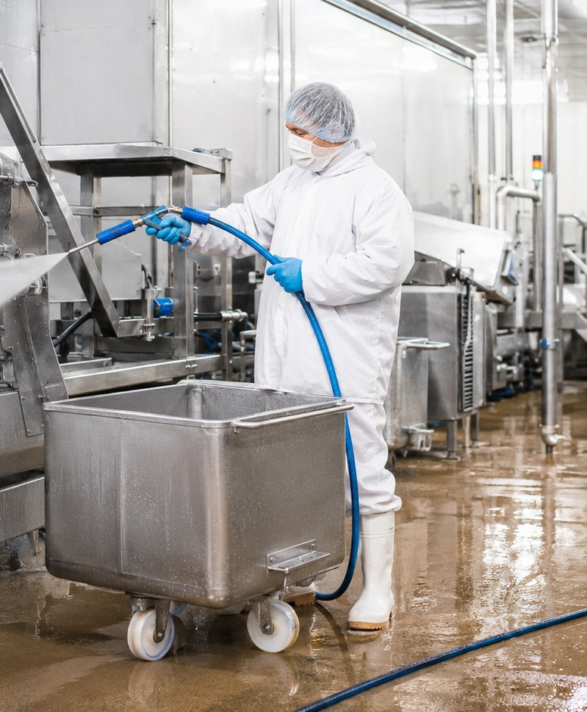
Conclusion
08
Conclusion: what the study contributes
The proposal links method, ethics and limitations to a practical workplace problem.
M
Method fit
D
Data fit
A qualitative case study provides depth about night-shift experiences and workplace meanings.
Semi-structured interviews allow follow-up questions on training, communication, fatigue and resources.
E
Ethical fit
L
Limitations fit
Consent, anonymity and university approval are essential due to the insider role.
Small sample and access issues limit generalisation but keep the project realistic.
Overall contribution
The study can support practical recommendations for stronger food safety culture and more consistent hygiene performance in UK meat processing workplaces.
(Griffith, Livesey and Clayton, 2010; Zanin et al., 2017)
8/9
Notes:
Slide 8 (about 1 minute): Summarise the key points. The method is a qualitative case study because it gives depth and fits the exploratory aim. Semi-structured interviews are appropriate because they allow participants to explain the real barriers and supports they experience during night shifts. Ethics are central because the researcher is an insider and participants must not feel pressured. The limitations are manageable as long as they are reported honestly. The contribution is practical: the findings could help improve training, communication, supervision and food safety culture in meat processing workplaces.

Slide 9
References
09
References
BRCGS (2022) Global Standard Food Safety, Issue 9. London: BRCGS.
Braun, V. and Clarke, V. (2006) 'Using thematic analysis in psychology', Qualitative Research in Psychology, 3(2), pp. 77–101.
Braun, V. and Clarke, V. (2022) Thematic Analysis: A Practical Guide. London: SAGE.
Bryman, A. and Bell, E. (2023) Business Research Methods. 5th edn. Oxford: Oxford University Press.
Creswell, J.W. and Creswell, J.D. (2023) Research Design: Qualitative, Quantitative and Mixed Methods Approaches. 6th edn. London: SAGE.
Food Standards Agency (2017) Hazard Analysis and Critical Control Point (HACCP). Available at: food.gov.uk/business-guidance/hazard-analysis-and-critical-control-point-haccp (Accessed: 24 June 2026).
9/9
Notes:
Slide 9 (about 20 seconds): Close by noting that all sources cited in the slides are listed in Harvard style. Mention that the references support the food safety background, the qualitative methodology, thematic analysis, ethical research practice and the limitations related to fatigue and self-reported data.

