Slide 1
Link Aggregation
Lecture 7

Slide 2
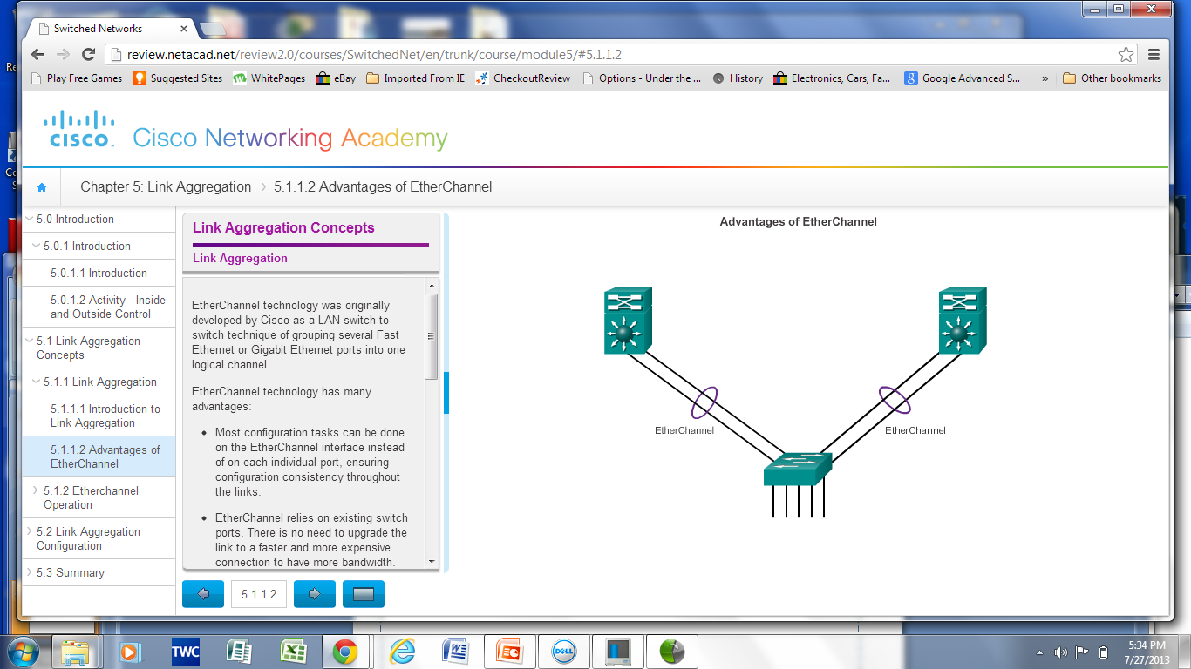
Link Aggregation
Introduction to Link Aggregation
Link aggregation allows the creation of logical links made up of several physical links.
EtherChannel is a form of link aggregation used in switched networks.

Slide 3
Link Aggregation
Advantages of EtherChannel
Most configurations are done on the EtherChannel interface ensuring consistency throughout links.
Relies on existing switch ports – no need for upgrades.
Load-balances between links on the same EtherChannnel.
Creates an aggregation viewed as one logical link by STP.
Provides redundancy because the overall link is viewed as one logical connection. If one physical link within channel goes down, this does not cause a change in the topology and does not require STP recalculation.

Slide 4
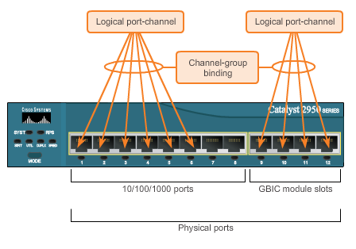
EtherChannel Operation
Implementation Restrictions
EtherChannel implemented by grouping multiple physical ports into one or more logical EtherChannel links.
Interface types cannot be mixed.
EtherChannel provides full-duplex bandwidth up to 800 Mb/s (Fast EtherChannel) or 8 Gb/s (Gigabit EtherChannel).
EtherChannel can consist of up to 16 compatibly-configured Ethernet ports.
The Cisco IOS switch currently supports six EtherChannels.

Slide 5
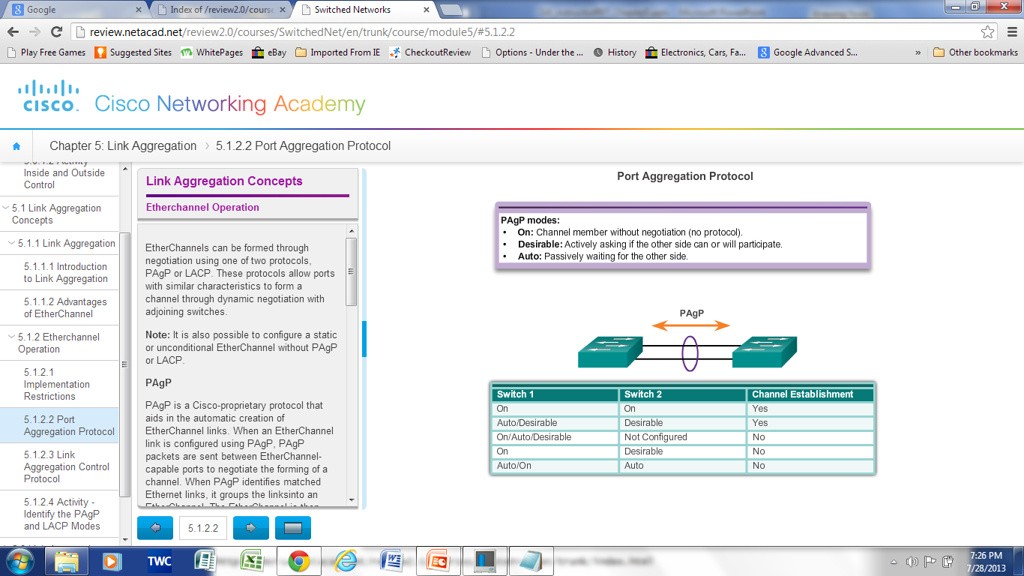
EtherChannel Operation
Port Aggregation Protocol (PAgP)

Slide 6
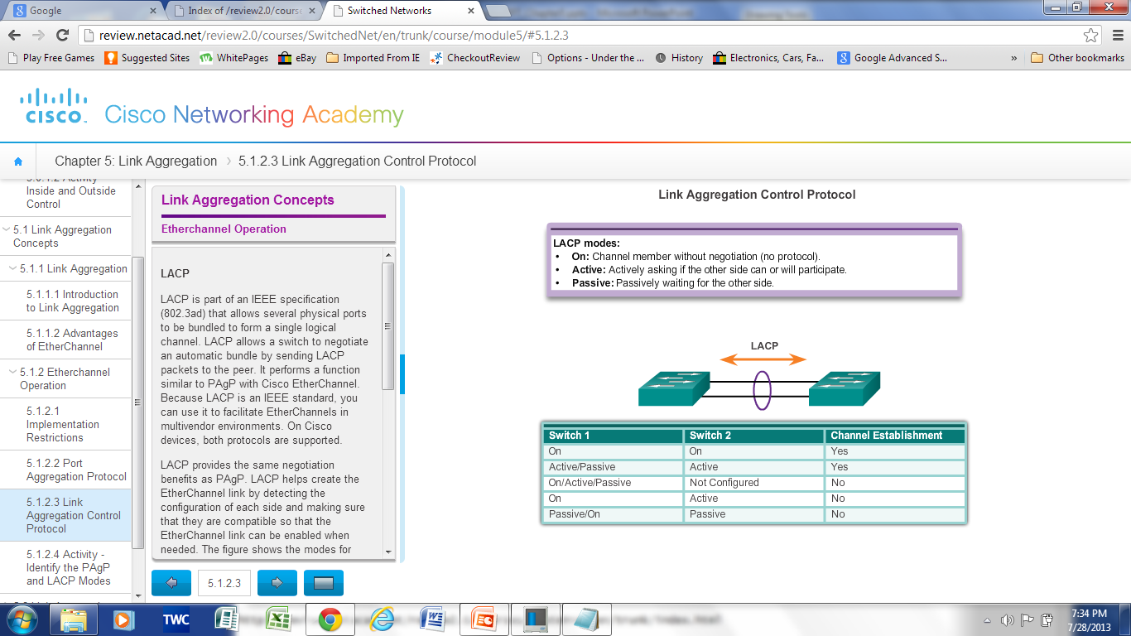
EtherChannel Operation
Link Aggregation Control Protocol (LACP)

Slide 7
Link Aggregation Configuration

Slide 8
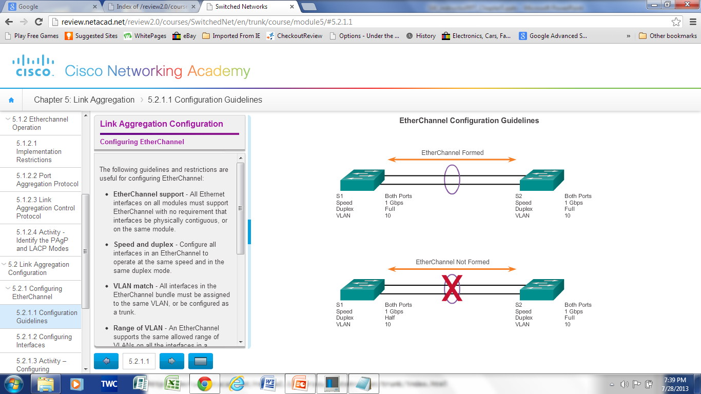
EtherChannel
Configuration Guidelines
EtherChannel must be supported.
Speed and duplex must match.
VLAN match – All interfaces are in the same VLAN.
Range of VLAN – Same range on all interfaces.

Slide 9
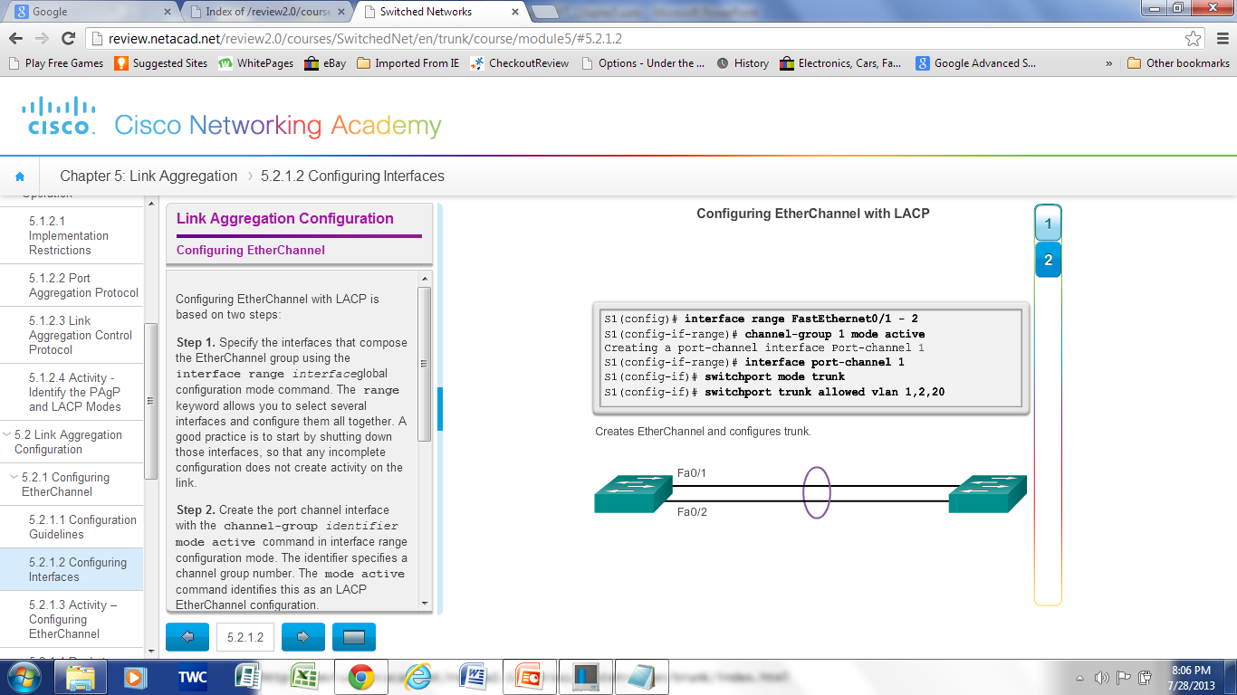
Configuring EtherChannel
Configuring Interfaces

Slide 10
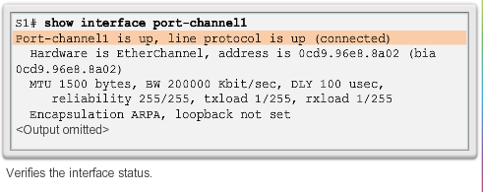
Verifying EtherChannel
show interface Port-channel – Displays the general status of the EtherChannel interface.
show etherchannel summary – Displays one line of information per port channel.
show etherchannel port-channel – Displays information about a specific port channel interface.
show interfaces etherchannel – Provides information about the role of the interface in the EtherChannel.

Slide 11
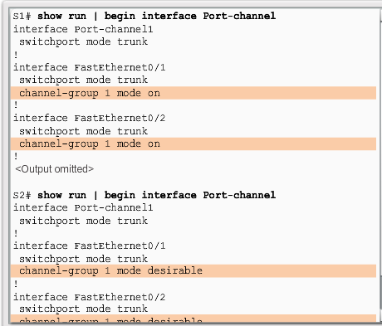
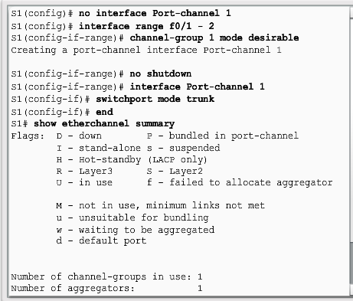
Troubleshooting EtherChannel

Slide 12
First-Hop Redundancy Protocols

Slide 13
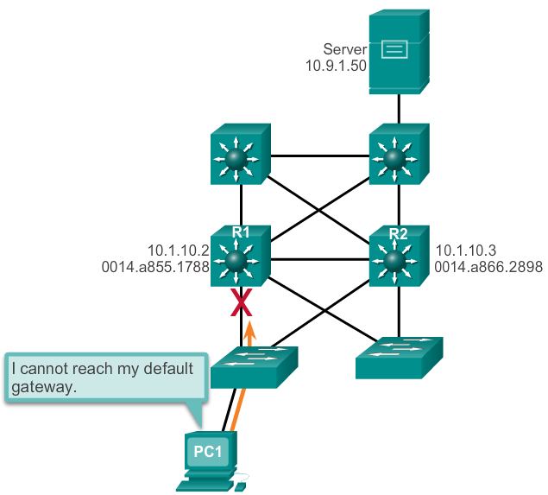
Concept of First-Hop Redundancy Protocols
Default Gateway Limitations
If the default gateway cannot be reached, the local device is unable to send packets off the local network segment.
Even if a redundant router exists that could serve as a default gateway for that segment, there is no dynamic method by which these devices can determine the address of a new default gateway.

Slide 14
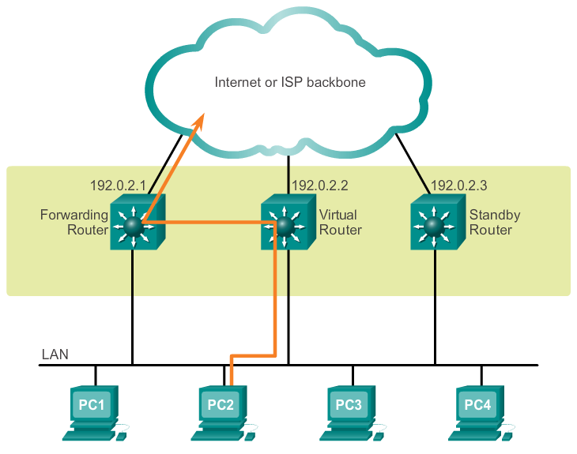
Router Redundancy
Multiple routers are configured to work together to present the illusion of a single router to the hosts on the LAN.
The ability of a network to dynamically recover from the failure of a device acting as a default gateway is known as first-hop redundancy.

Slide 15
Router Redundancy
The ability of a network to dynamically recover from the failure of a device acting as a default gateway is known as first-hop redundancy.
To implement this type of router redundancy, multiple routers are configured to work together to present the illusion of a single router to the hosts on the LAN.
By sharing an IP address and a MAC address, two or more routers can act as a single virtual router.
The IP address of the virtual router is configured as the default gateway for the workstations on a specific IP segment
When frames are sent from host devices to the default gateway, the hosts use ARP to resolve the MAC address that is associated with the IP address of the default gateway
A redundancy protocol provides the mechanism for determining which router should take the active role in forwarding traffic. It also determines when the forwarding role must be taken over by a standby router.

Slide 16
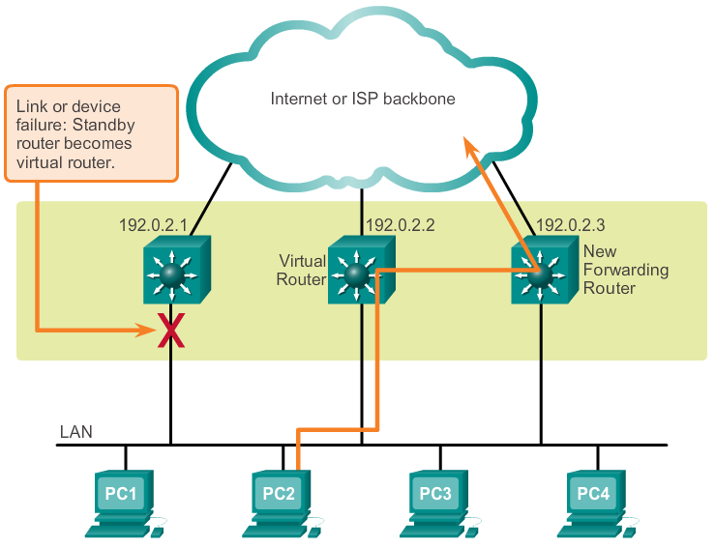
Steps for Router Failover

Slide 17
Varieties of First-Hop Redundancy Protocols
Hot Standby Router Protocol (HSRP)
HSRP for IPv6
Virtual Router Redundancy Protocol version 2 (VRRPv2)
VRRPv3
Gateway Load Balancing Protocol (GLBP)
GLBP for IPv6
ICMP Router Discovery Protocol (IRDP)

Slide 18
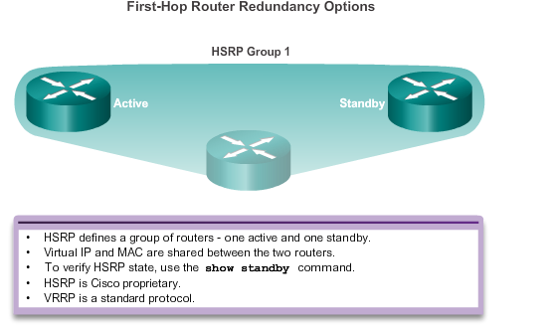
HSRP

Slide 19
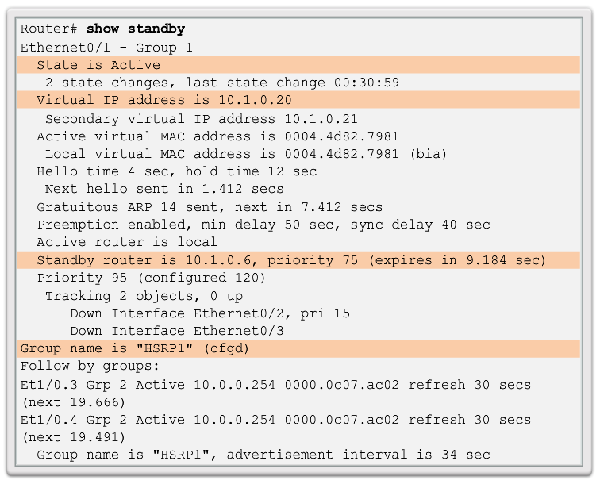
HSRP Verification

Slide 20
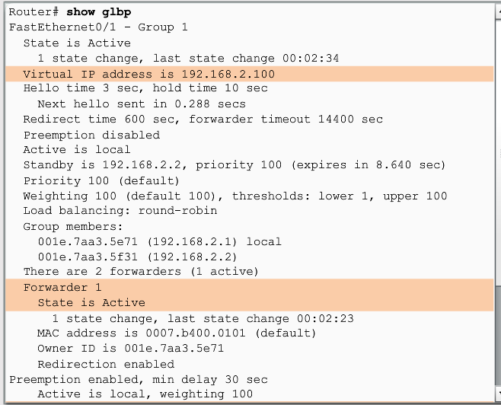
GLBP Verification
Gateway Load Balancing Protocol (GLBP) is a Cisco proprietary solution to allow automatic selection and simultaneous use of multiple available gateways in addition to automatic failover between those gateways.

Slide 21
Summary
EtherChannel and how to encompass both the PAgP-based and the LACP-based link aggregation methods
EtherChannel technologies and the various means available to implement them
The configuration, verification, and troubleshooting of EtherChannel
First hop redundancy protocols, such as HSRP, VRRP, and GLBP provide alternate default gateways for hosts in the switched environment.

