Slide 1


SOUND
WISA – BUILT PORTFLIO
Allan Nantel
January 2020

Slide 2
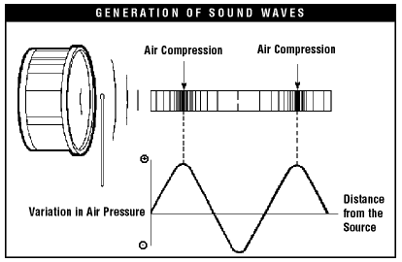
WHAT is SOUND ?
Sound is defined as ‘any pressure variation that the human ear can detect’.
Sound in the air can be caused by a variety of vibrations, such as the following.
Moving objects: examples include loudspeakers, guitar strings, human vocal chords.
Moving air: examples include horns, organ pipes, mechanical fans and jet engines.
Rarefaction
Pressure and pressure variations are expressed in Pascal, abbreviated as Pa, which is represented as units:
N/m²(Newton per square metre).

Slide 3
WHAT is SOUND ?
Sound waves spread through adjacent particles and move further away from the source.
Depending on the medium, sound propagates at different speeds.
In air, its speed is approx. 340 metres /second.
Notes:
Bob smith

Slide 4
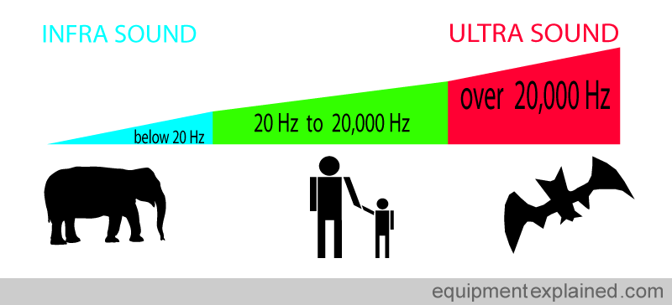
WHAT is SOUND ?
Disturbances in the air with frequencies of vibration which are:
Too low (infrasound) or
Too high (ultrasound)
to be heard by the human ear are also regarded as sound.

Slide 5
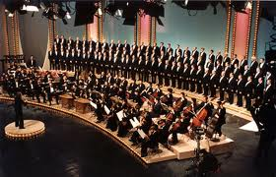
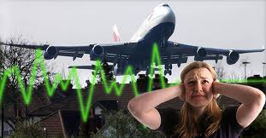
WHY Measure Sound ?
Measurements provide definite quantities which describe and rate sound. Benefits of sound measurements :-
improved building acoustics & loudspeakers,
hence better enjoyment of music
permits precise, scientific analysis of
annoying sounds
provides clear indications of when a sound
can cause damage to hearing and permit
corrective actions to be taken
provides a powerful diagnostic tool in noise
reduction programmes e.g. In airports,
highways etc, hence improving our quality of
life

Slide 6
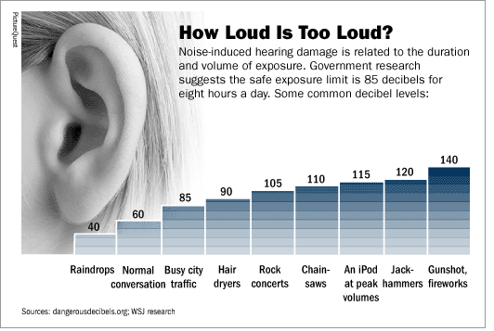
What do we hear ?
Human ear can perceive a very wide range of sound pressure.
The softest sound a young healthy human ear can detect has a pressure variation of 20 micro Pascals, abbreviated as µPa, which is 20 x 10⁻⁶ Pa ("20 millionth of a Pascal") and is called ‘the Threshold of Hearing’.
Amazingly, the ear can tolerate sound pressure more than a million times higher.
That is up to 20Pa (120dB) which is the level at which pain is felt termed:
‘ the Threshold of Pain’.

Slide 8
Decibel scale
Source of Sound/Noise | Approximate Sound Pressure in µPa
Launching of the Space Shuttle | 2,000,000,000
Full Symphony Orchestra | 2,000,000
Diesel Freight Train at High Speed at 25 m | 200,000
Normal Conversation | 20,000
Soft Whispering at 2 m in Library | 2,000
Unoccupied Broadcast Studio | 200
Softest Sound Human can Hear | 20
To express sound in terms of Pa is quite inconvenient because we have to deal with numbers from as small as 20 to large , unmanageable numbers.
To avoid this, another scale is used – the decibel or dB scale
It is a logarithmic scale for the loudness of sound or noise, using 10 as the base.
The Decibel range (dB) makes the numbers more manageable

Slide 9
Decibels – A logarithmic Scale
The Decibel is a sub-unit of a larger unit called the Bel.
As originally used, the Bel represented the power ratio of 10 to 1 between the strength or intensity...that is ‘the Power’ of two sounds, and was named after Alexander Graham Bell.
Thus a power ratio of 10:1 = 1 Bel,
100:1 = 2 Bels,
1000:1 = 3 Bels.
and so on.
The concept of Bels represents a logarithmic relationship since the logarithm of 100 to the base 10 is 2 (corresponding to 2 Bels), the logarithm of 1000 to the base 10 is 3 (corresponding to 3 Bels), etc.
The exact relationship is given by the formula : Bels = log(P2/P1)
where P2/P1 represents the power ratio.
Since the bel is a rather large unit, its use may prove inconvenient.
Usually a smaller unit, the Decibel or dB, is used.

Slide 10
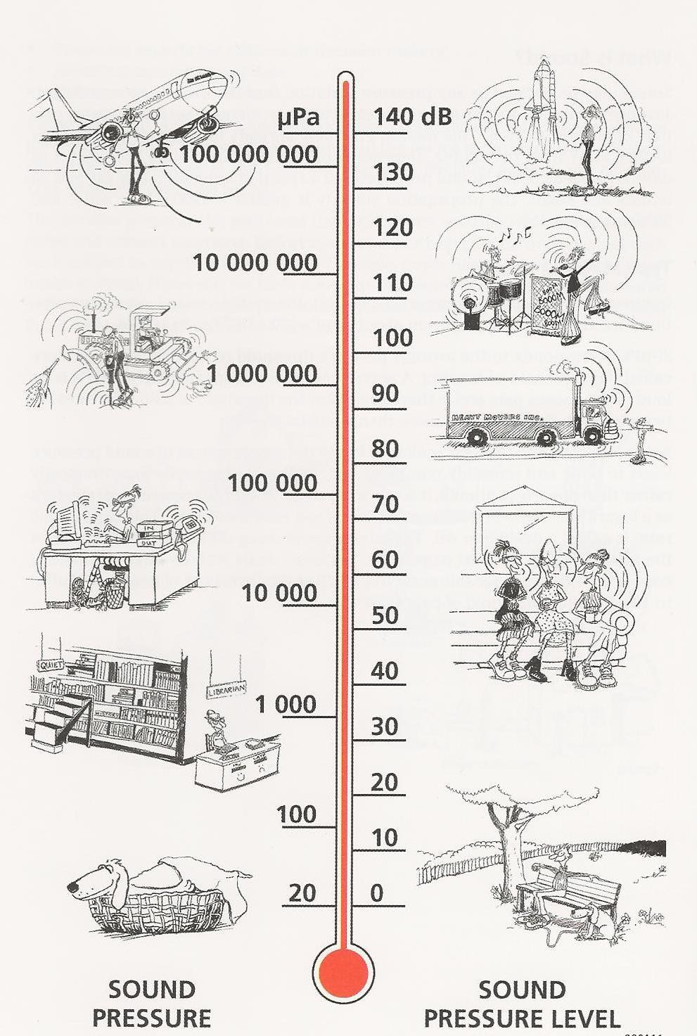
Decibel scale
The decibel or dB scale uses the hearing threshold of 20 µPa as the reference level. This is defined as 0dB.
When we multiply the sound pressure level in Pa by 10, we add 20dB to the dB level.
Therefore
20 µPa = 0 dB
200 µPa = 20 dB
2000 µPa = 40 dB
20 Pa = 120dB
Threshold
of Pain
(20Pa)

Slide 11

Sound Pressure Level
Sound pressure level, which is often abbreviated as SPL, in decibels (dB), can then be obtained using the following formula.
Where SPL = sound pressure level (in dB)
P = measured sound pressure
P ref = reference sound pressure (20 µPa )
This is done for us within a DECIBEL metre

Slide 12
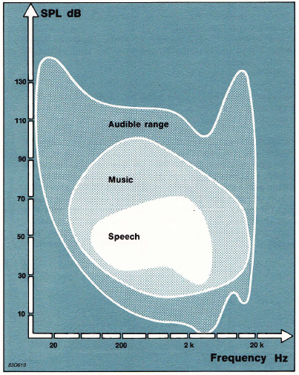
The Sensitivity of the Human Ear
The range of frequencies that can be detected by young healthy human ear is from 20 Hz to 20,000 Hz.
The smallest change we can hear is about 3dB.
Although an increase of 6dB represents doubling of the sound pressure, an increase of about 10dB is required before the sound subjectively appears to be twice as loud.
Human ear is not equally sensitive at all frequencies. It is most sensitive to sounds between 2000Hz and 5000Hz.

Slide 13
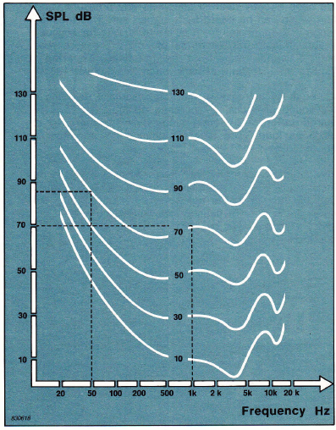
The Unequal Sensitivity of the Human Ear
The difference in sensitivity to different frequencies is more noticeable at low Sound pressure levels than at high Sound pressure levels.
The equal loudness contours indicate the sound pressure level in dB required at any frequency in order to give the same apparent loudness as a 1kHz tone.
E.g. A 50 Hz frequency tone must be 15dB higher than a 1kHz frequency tone sounded at a level of 70dB in order to give the same subjective loudness
The equal loudness contours

Slide 14
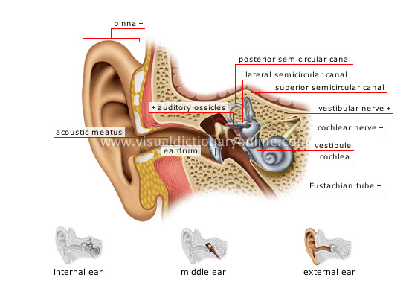
Structure of the Human Ear
http://youtu.be/0jyxhozq89g

Slide 15
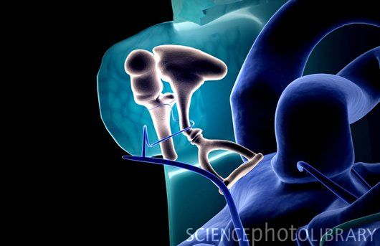

Slide 16
Outer ear
The outer ear is the part of the ear that can be seen. It collects the sound waves and funnels them to the eardrum, a membrane which vibrates when sound waves fall upon it. Sound waves between 2 and 5 kHz can resonate most efficiently within the ear canal, causing higher pressures and therefore making these frequencies the ones to which we are most sensitive.

Slide 17
Middle ear
The middle ear is an air-filled cavity, connected to the throat, which passes the vibrations of the eardrum to the inner ear. This transfer is achieved by means of the three small bone levers, the ‘hammer ’, the ‘ anvil ’ and the ‘stirrup ’.
The mechanical link between the bones amplifies the vibrations to adjust for the difference between the air of the middle ear and the fluid of the inner ear.
The middle ear also has an aural reflex mechanism which reacts to loud sounds and tightens the eardrum, thereby lessening the force which is transmitted into the inner ear.
This defence mechanism reacts too slowly to protect against sudden loud sounds such as gunshots or some impulsive effects from recorded music.

Slide 18
Inner ear
The inner ear converts the mechanical vibrations of sound into electrical impulses which are transmitted to the brain.
The cochlea is a hollow coil of bone, filled with liquid, in which the sound waves vibrate. Dividing the cochlea along its length is the basilar membrane, which contains approximately 25,000 nerve endings.
The fine hairs attached to these nerves detect the sound vibrations in the fluid, and the information is transmitted to the brain by the auditory nerve.
The inner ear is situated near the three semicircular canals which contain fluid and are associated with the sense of balance.

Slide 19
Characteristics of Sound
There are two important characteristics of sound - frequency and loudness.
Frequency of Sound
Sound is the quickly varying pressure wave travelling through a medium. When sound travels through air, the atmospheric pressure varies periodically.
The number of pressure variations passing a given point per second is called the frequency of sound, and is measured in Hertz (Hz) which is defined as ‘cycles per second’.

Slide 20
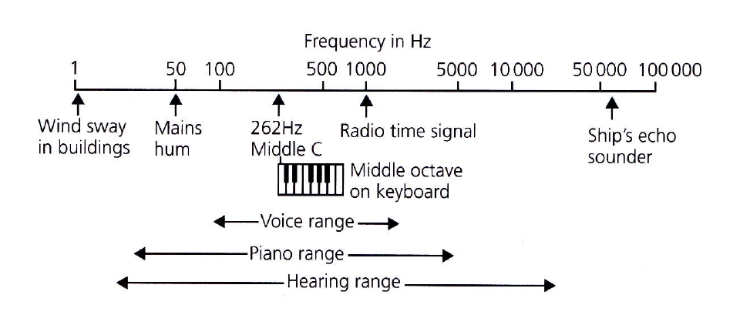
Frequency of Sound
The frequency of some typical sounds are shown below.

Slide 21
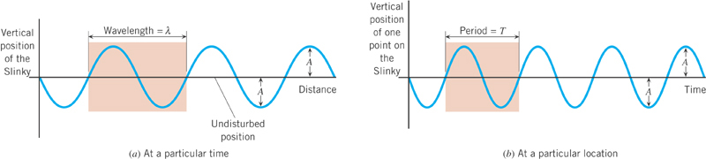
Definitions
Pre
Pre
Pressure
Pressure
In the drawing, one cycle is shaded in colour.
The amplitude A is the maximum excursion of a particle of the medium from
the particles undisturbed position.
The wavelength is the horizontal length of one cycle of the wave.
The period is the time required for one complete cycle.
The frequency is the number of vibrations per second
And is related to the period in units of Hertz, or s⁻¹.
COPY DOWN

Slide 22
Frequency of Sound
If an object that produces sound waves vibrates 100 times a second, for example, then the frequency of that sound wave will be 100 Hz. The human ear hears this as sound of a certain pitch.
Pitch is the frequency of a sound as perceived by human hearing.
Low-pitched notes (BASS) are caused by low-frequency sound waves
High-pitched notes (TREBLE) are caused by high-frequency waves.
(referee’s whistle)
The higher the frequency, the more high-pitched a sound is perceived.
Low frequency sound has significant acoustic energy in frequency range 8 to 100 Hz. It is more ‘annoying’ to comfort level as it is hard to muffle and we perceive it as a pressure more than an a sound.

Slide 23
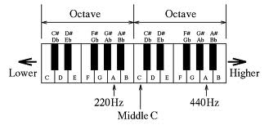
Frequency of Sound
Most sounds contain a combination of many different frequencies.
It is usually convenient to measure and analyse them in ranges of frequencies such as the octave.
An Octave Band is the range of frequencies between any one frequency and double of that frequency. E.g. 880 Hz is one octave above 440Hz.

Slide 24
Quality of Sound
A pure tone is the sound of only one frequency
(example: Tuning Fork )…and is rarely found in everyday noise.
However, most sounds heard are a mixture of more than one frequency, although a lowest fundamental frequency predominates when a particular “note” is recognisable.
This fundamental frequency is usually accompanied by overtones or harmonics.
Examples : The lawn mower
A guitar chord

Slide 25
Quality of Sound
Overtones and Harmonics are frequencies equal to whole number multiples of the fundamental frequency.
Example:-
440 Hz = fundamental or 1st harmonic
880 Hz = 1st overtone or 2nd harmonic
1320 Hz = 2nd overtone or 3rd harmonic etc

Slide 26
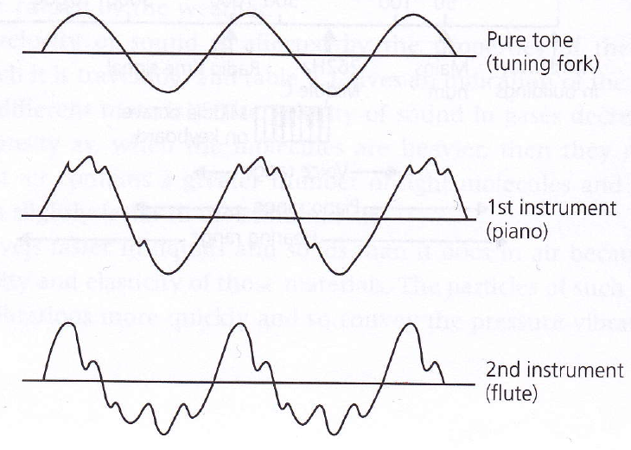
Different waveforms with different overtones

Slide 27

Loudness of Sound
Loudness of Sound
Another property of sound or noise is its loudness.
A loud noise usually has a larger pressure variation and a weak one has smaller pressure variation.

Slide 28
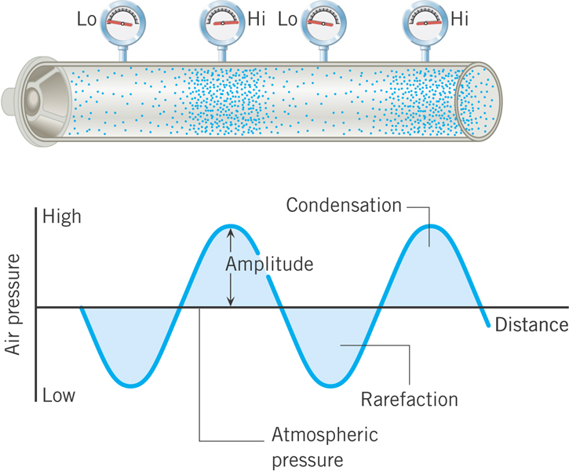
Loudness
THE PRESSURE AMPLITUDE OF A SOUND WAVE
Loudness is an attribute of
a sound that depends primarily
on the pressure amplitude
of the wave.
Larger amplitude = Louder sound

Slide 29
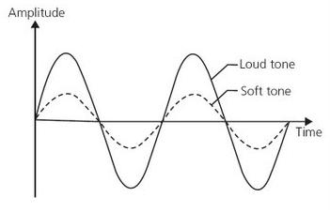
Loudness
Note:
Difference between loud
and soft tone is the height of the amplitude.
However, the frequency or note of the sound remains unaltered.

Slide 30
Animation:
http://www.sciencephoto.com/media/395559/view

Slide 31
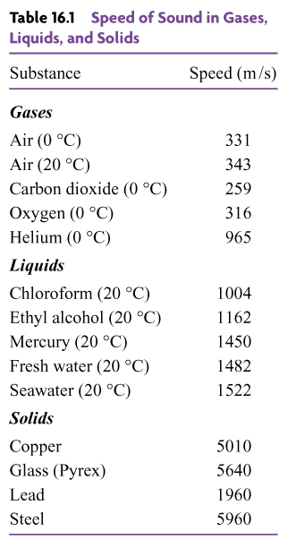
Speed of Sound
(How fast an object is moving)
( A Scalar Quantity )
Different temperature (and humidity) affects the speed of sound
Sound travels through gases,
liquids, and solids at considerably
different speeds.
Sound travels faster in a solid and a liquid than in a gas.

Slide 32
Sound Wave through different media
Animation showed the passage of a sound wave through a gas (top), liquid (middle) and solid (bottom).
As Sound is a compression wave, particles are first pushed forward then return to their original positions as the wave passes.
The speed of sound is a function of the substance's compressibility, that is, how much the substance deforms under pressure.
The greater the compressibility, the slower the passage of the wave.
Gases are easiest to compress, followed by liquids and then solids.
The speed of sound is therefore much faster in solids than in liquids, and faster in liquids than in gases.

Slide 33
Velocity of Sound
(The rate at which an object changes its position)(A ‘Vector ‘quantity)
For every vibration of the sound source the wave moves forward by one wavelength. The length of one wavelength multiplied by the number of vibrations per second therefore gives the total length the wave motion moves in 1 second.
This total length per second is also the velocity.
The relationship between velocity, frequency and wavelength is true for all wave motions and can be written as the formula.
v =f x λ
where v = velocity in m/s
f = frequency in Hz
λ = wavelength in m
The velocity of sound, for any particular material, stays constant.
Therefore any increase in frequency, for example, is matched by a decrease in wavelength

Slide 34
Example
A particular sound wave has a frequency of 440Hz and a velocity of 340 m/s. Calculate the wavelength of this sound.
v =f x λ

Slide 35
Answer
V =340 m/s
f = 440 Hz
λ = ?
V =f x λ
340 = 440 x λ
λ = 340/440 = 0.7727m
Therefore, the wavelength = 0.7727m

Slide 36
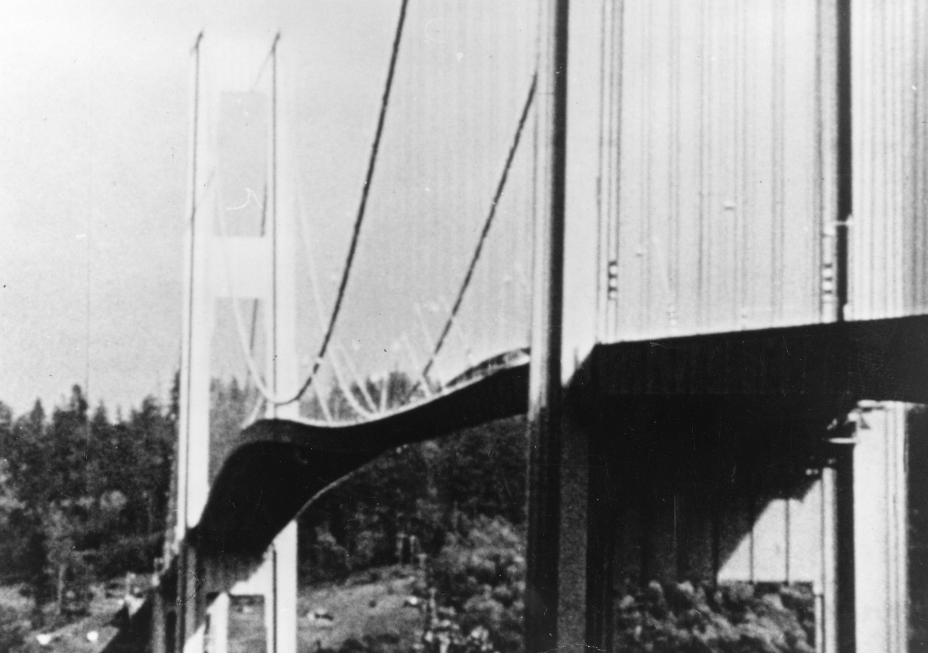
Resonance
Every object has a natural frequency which is the characteristic frequency at which it tends to vibrate when disturbed. For example, the sound of a metal bar dropped on the floor can be distinguished from a block of wood dropped in the same way.
The natural frequency depends upon factors such as the shape, density and stiffness of the object.
(we will look at this again when we study the passage of sound through the fabric of buildings)
Resonance occurs when the natural frequency of an object coincides with the frequency of any vibrations applied to the object.
Example: An older Car
The result of resonance is extra large
vibrations at this frequency
(remember the ‘Tacoma Narrows Bridge’
video?)

Slide 37
Resonance
Resonance may occur in many mechanical systems. For instance, it can cause loose parts of a car to rattle at certain speeds when they resonate with the engine vibrations.
The swaying of a suspension bridge can resonate with footsteps from walkers (New London bridge)
Less dramatic, but of practical application in buildings, is that resonance affects the transmission and absorption of sound within partitions and cavities.
The Laundry next door !

Slide 38
Intensity – Pressure relationship
The intensity of a sound is proportional to the square of its pressure and is expressed by the following formula
I = p ²
ρ ν
where I = intensity of the sound (W/m ² )
p = pressure of the sound (Pa)
ρ = density of the material (kg/m ³)
ν = velocity of sound (m/s)

Slide 39
Sound Intensity Level
If the sound strength is considered in terms of intensity, then a sound intensity level (SIL) is given by the formula :-
SIL = 10 log₁₀ Ι
Ι _{ref}
where Ι = intensity of sound being measured (W/m²)
Ι _{ref}
= intensity of the threshold of hearing taken as
1 x 10⁻¹² W/m²

Slide 40
Assignment 1 general feedback:
Question 1 : asked for you to ‘compare and contrast’ the two types of
framework, not just give a summary of the materials or just a listing of advantages and disadvantages.
Read the question...to understand what is expected by way of an answer.
This is vitally important in exams.
2. In written assignment, don’t use the question paper to answer your
questions.
Its lazy and messy. Especially don’t use pencil....always ink or print.
You should be submitting the work as word processed not hand written.
3. Always show full equations / working out for all numerical questions
More marks for how you got to the answer than just stating the answer.
4. Number your pages.
5. Avoid using bullet points if you can – use full descriptive text.

Slide 41
Assignment 1 General Feedback
Note the ‘assessment criteria’.
‘Demonstrate your own research and understanding’ .
Supply a reference list on the last page. Label graphs, diagrams and photo’s with ‘title’ and ‘source’.
Use those references in your text (Question 1.) to support your points and any statistical information that you have included.
2. Written presentation and visual presentation is always important. Demonstrate that you have taken time and care in its preparation.
3. Question 3 : I suggested you make a couple of copies of the graph to practice on before making the final plot. Some were untidy.
Thin straight lines between data points.
Some of you forgot to include the ‘sample size’ when completing the table of particle size distribution. This is important to relate your figures back to the origin.

Slide 42
Referencing within the body of the text
2.3 IMPACTS
There is copious academic evidence to confirm that recreational activity in woodland does have an impact upon soil, water, flora and fauna (Cole, 1998; Hamberg, 2009; Newsome et al, 2002; Ode & Fry, 2005; Rusterholz et al, 2008).
Research substantiates the fact that the activities with greatest impact on the environment are those that:
Affect a wide area.
Are physically intense.
Affect the area under consideration repetitively over an extended time period.
Affect areas that are irreplaceable in terms of their ecosystem, or that contain species that are rare.
Affect the area at seasonal high-risk times, in terms of ecosystem function.
(Cole, 1998; Growcock, 2005; Littlemore, 2001)
The Wildlife and Countryside Act (1981) aims to protect threatened species and habitat, but mountain bike course digging, egg collecting, bluebell and edible fungi collecting pose significant threats, through erosion, trampling and commercial exploitation in the urban woodland context (W.T., 2002).
The Bluebell (Hyacinthoides non-scripta) is a particular target for the sale and trade in wild bulbs, with conservation high in importance as the UK possesses a fifth of the global population of this species (Littlemore & Barker, 2003).
The RSPB (1997) reported that car rallying and orienteering in woodland was shown to cause bird of prey desertion due to the disturbance, while uncontrolled dog walking causes disturbance and a potential mortality increase in ground nesting birds (Miller et al, 2001).

Slide 43
References
De Groot, R.S. & Wilson, M.A. & Boumans, R.M.J. (2002) – A topology for the classification, description and valuation of ecosystem functions, goods and services. Ecology Economics 41 (3), pp.393-408.
Faber, T.A. & Kuo, F. & Sullivan, W. (2001) – Coping with ADD. The Surprising Connection to Green play Setting. Environment and Behaviour. January 2001, pp.54-77.
Growcock, A.J.W. (2005) – Impacts of Camping and Trampling on Australian Alpine and Subalpine vegetation and Soils. Griffith University, Gold Coast, Australia.
Hamberg, L. (2009) – The effects of habitat edges and trampling intensity on vegetation in urban forests. University of Helsinki
Henwood, K. (2001) - Exploring linkages between environment and health: Is there a role for environmental and countryside agencies in promoting benefits to health? Forestry Commission, February 2001.
Hilton, K.J. (1967) – The Lower Swansea Valley Project. Longmans.
Lathrop, J. (2003) – Ecological Impacts of Mountain Biking: A Critical Literature Review. www.wildlandscpr.org/node/39 [accessed: 4th October, 2010]
Natural Environmental and Rural Communities Act (2006).

Slide 44
Animation:
http://www.sciencephoto.com/media/395559/view

Slide 45
Sound Power & Intensity
Sound Power is the rate at which sound energy is produced at the source. It is measured in watt (W).
Sound Intensity is the sound power distributed over unit area. It is measured in watts per square metre (W/m²)
Intensity = Power
Area
Sound
Source
Sound radiates out from a source as concentric spheres
and follows an Inverse Square function

Slide 46
Sound Power & Intensity
Inverse Square means as distance from the source doubles,
the intensity is ¼ of the original intensity.
If distance triples, the intensity
is 1/9 the original and so on.
The surface area of a sphere is given by 4 Π r²
Intensity = Power / Area
I = P
4 Π r²
Intensity = Power / Area
I = P/ 4 Π r²

Slide 47
Question:
A speaker standing in the centre of a hall is emitting music at 100 Watts of Power in all directions.
Calculate the Intensity of Sound that is emitted:
At a distance 3 metres from the source
At a distance 6 metres from the source
Intensity = Power / Area
I = P
4 Π r²

Slide 48
Answer
Intensity = Power / Area
I = P/ 4 Π r²
At a distance 3 metres from the source
2. At a distance 6 metres from the source
I = 100
(4 x 3.142 x 9)
= 100 / 113.112
= .884 W/m²
I = 100
(4 x 3.142 x 36)
= 100 / 452.45
= .221 W/m²
‘as distance from the source doubles, the intensity is ¼ of the original intensity ‘

Slide 49
2. Measuring Sound Outdoors

Slide 50
‘NOISE’ is: Any unwanted sound.
Noise is measured in decibels and the scale is weighted to the range perceived by the human ear.
The decibel system is based on a logarithmic scale.
A rise of 10 dB in sound level corresponds roughly to a doubling of subjective loudness.
Therefore a sound of 80 dB is twice as loud as a sound of 70 dB which is twice as loud as a sound of 60 dB.
Correspondingly, the 80 dB sound is 4 times louder than the 60dB sound.
In the case of nuisance sound, we need to isolate, measure and eliminate (or adjust) a specific noise.

Slide 51
So...
A change in sound level of + or - 10 dB is a useful figure to remember as it makes difference of approximately twice as loud, or half as loud.
We have to say 'approximately' as the experience also depends on individual hearing, on the background noise and on the exact frequencies involved.
For example, there may be a proposal to increase the average sound level of your environment from 60 dB to 70 dB. This seems a relatively small change (after all the scale runs from 0 to 120) but it will make the environment twice as noisy.
The same idea applies to reducing noise.
If the manufacturers of a certain machine / plant can reduce the sound level from 90 dB to 80 dB then the machine will sound approximately half as loud as before.

Slide 52
Impact of Noise on Human body
Noise not only affects hearing. It affects other parts of the body and body
systems.
It is now known that noise causes annoyance / detriment to the body that:
Increases blood pressure
Has negative cardiovascular effects such as changing the way the heart beats
Increases breathing rate
Disturbs digestion
Can cause an upset stomach or stomach ulcer
Can negatively impact a developing foetus and possibly contribute to
premature birth
Makes it difficult to sleep, even after the noise stops
STRESS
MUSIC
MULTIPLE OCCUPANCY FLATS
WHAT ABOUT ECOLOGICAL HARM?

Slide 53
Identifying Noise Source - Definitions
AMBIENT NOISE :
is the noise from all sources combined.
2. SPECIFIC NOISE :
Is the source under investigation. It is a component of the
ambient noise but can be associated with a specific source.
RESIDUAL NOISE :
Is the ambient noise without the specific noise. It is the noise remaining when the specific noise is suppressed
Copy Down

Slide 54
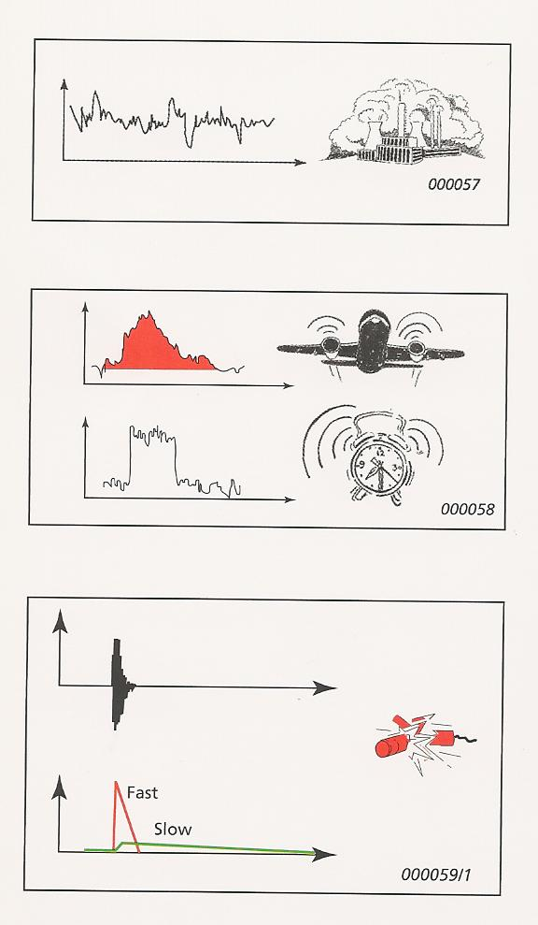
Assessing the Mode of the Noise
1. Continuous Noise - Operates without interruption in the same mode. (pumps, machinery) Measuring for a few minutes with hand held device will be sufficient to determine noise level.
CN
2. Intermittent Noise – Operates in cycles, noise increases then decreases rapidly. Measured as above....but cycle duration must be noted. An ‘event’ is measured by Sound Exposure Level…combining level and duration into a single descriptor. A number of similar events can be measured to establish a reliable average. Important in builds such as Airports as it effects community over different times and intensity
IN
3. Impulsive Noise – Noise from impacts or explosion (pile driver or punch press). Brief and abrupt but often very loud. Quantified by the difference between a quick response and slow response parameter (base graph). Repetition rate is also recorded, because this can greatly exacerbate the annoyance factor. (pile driving)
IM N

Slide 55
Types of Noise
Annoying Tones that cause upset
Machinery with rotating parts
(e.g. Motors, gearboxes, fans etc) often create tones.
Imbalanced machinery (Washing Machine spin)
or repeated impacts (jack hammer, pile drivers)
cause vibration that are transmitted through surfaces into the air,
can be heard as irritating tones.
Pulsating flows of liquids or gases can also create tones, caused
by combustion processes or flow restrictions.
(Radiators or drainage systems or HVAC systems)
Low Frequency Noise –
Has significant acoustic energy in the frequency range 8 to 100 Hz.
such as Large diesel engines in trains, ships and power plants.
Eg: Cross Channel ferries lower decks.
Since low frequency noise is hard to muffle (WHY?) and spreads easily
in all directions, it can be heard for miles.
Eg: Cork Ferry horn.

Slide 56

So.......How loud is a ten tonne truck ??
Many factors affect the answer...results can vary
by 10’s of decibels when taking the measurement
in different conditions.
To reach a value that is accurate and to explain the differences in the values of results in different conditions...what do you think we need to consider?
How the noise is emitted.
How it travels through the various mediums to get to the receiver.
How it arrives at the receiver.

Slide 57
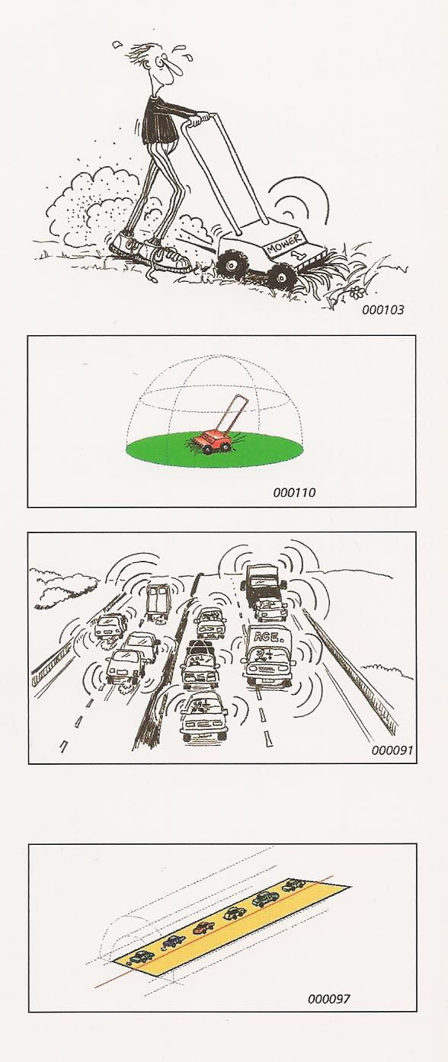
Types of Sources –
1. How is the Noise emitted?
Point Source:
If the dimensions of the noise source are small compared to the distance from the receiver, it is called a point source. The sound spreads out spherically, so the sound pressure is the same for all points at the same distance from the source. (relates to : Sound Power and Intensity calculation)
Line Source:
If the noise source is narrow in one direction and long in another compared to distance from the receiver, it is called a line source. It can be a single source such as a pipe with turbulent flow, or be composed of many separate point sources such as a stream of traffic or construction noise. The sound spreads cylindrically so the sound pressure is the same for all points at the same distance from the line.
http://soundbible.com/tags-traffic.html

Slide 58
Noise Propagation
The most important factors affecting noise propagation:
Type of Source (point or line)
Distance of the receiver from the source
Atmospheric absorption
Wind
Temperature and temperature gradient
Obstacles such as barriers and buildings
7. Ground absorption
8. Reflections
9. Humidity
10. Precipitation
Copy Down

Slide 59
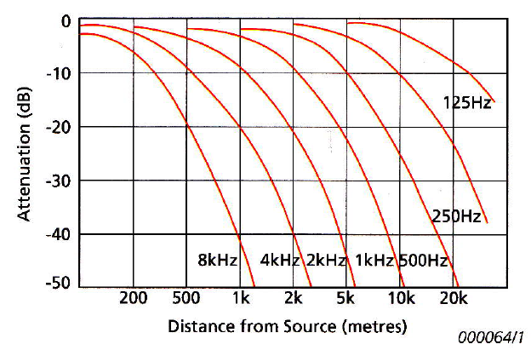
Atmospheric absorption (or ‘attenuation’)
As sound waves spread out from the source their amplitude decreases and
the sound level drops.
‘Attenuation’ is the reduction of the noise as it passes through air
and depends upon:
Distance from the source to receiver
The frequency content of the noise
Air temperatures
Relative humidity
With the first two being the most
influential.
Low frequencies are less well absorbed than high frequencies.
Low frequency...minimal loss

Slide 60
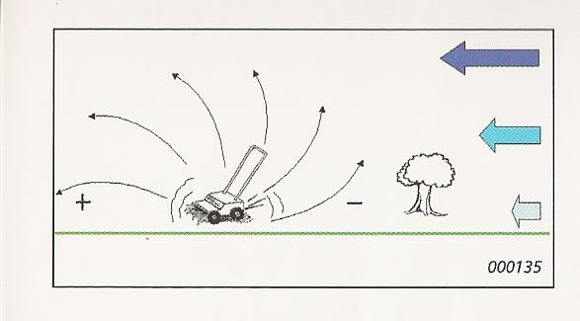
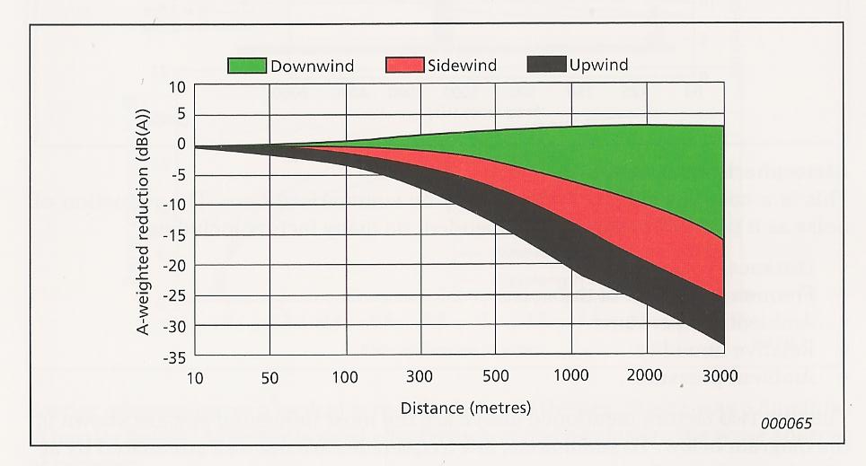
Wind
Wind will ‘bend’ the path of sound to
focus it on the downwind side
and lessen it on the upwind side of the
source.
At short distances (50m) wind has minor effect on measured level. For longer distances the effect increases.
Downwind...the level may increase by a few dB...but upwind or side-wind can drop the levels 20 dB +, depending on wind speed and distance.
Still a loss of sound over distance
This is why down-wind measurement is preferred.

Slide 61
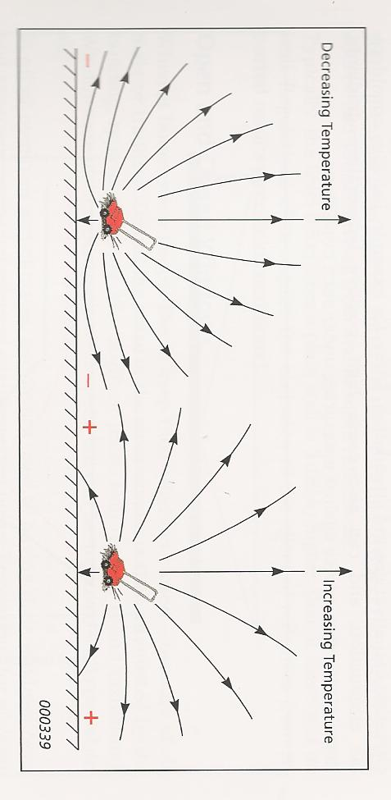
Temperature
An increase in air temperature allows the sound pressure wave to travel more easily. WHY is this ??
This is due to the fact that molecules are ‘excited’ when heated and move around at faster pace.
Temperature gradients create similar effect to wind, except that they are uniform in all directions from the source.
On a normal day with no wind, temperature decreases with altitude, giving a lessening of sound levels.
On a hot summer night , temperature will increase with altitude (inversion) which will focus the sound on the ground surface.
What effect does this have on sound received at ground level on a hot summers night?

Slide 62
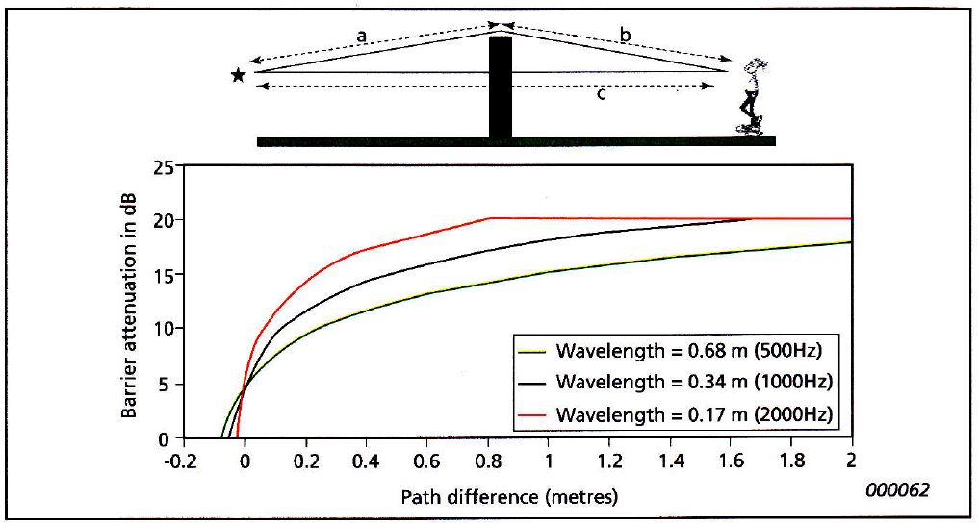
Barriers
The noise reduction caused by a barrier depends on 2 factors :-
The path difference of the sound wave as it travels over the barrier compared with the path of direct transmission to the receiver
(a + b – c, in the diagram)
2. The frequency content of the noise
The combined effect of these two is shown in the diagram. It shows
that low frequencies are difficult to reduce using barriers.
1. The Path + Frequency
‘Attenuation’ is the reduction of the noise as it passes through air.
Lower attenuation at low frequencies
Barrier height increasing

Slide 63
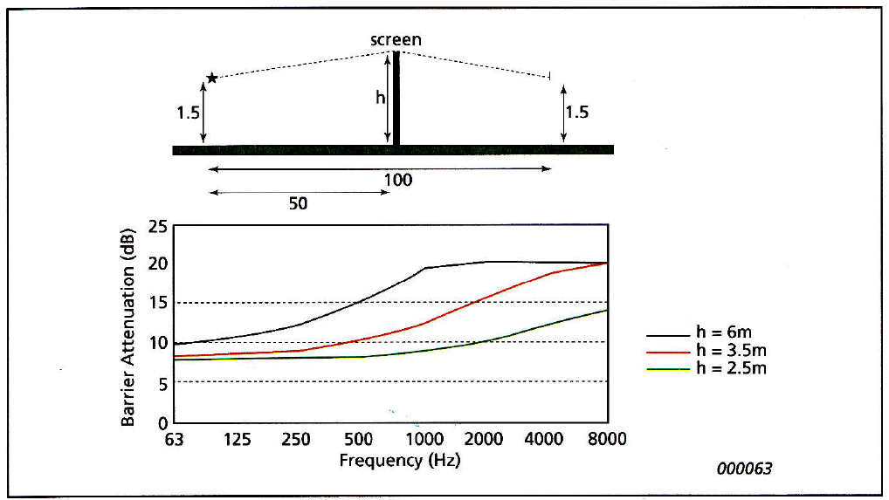
Barriers
Barrier attenuation for a typical screen is shown below as a function of barrier height. A barrier is most effective when placed close to the noise source or receiver.
The three coloured lines indicate increasing barrier height
2. The Height
Low frequency –low attenuation
Higher frequency – higher attenuation
Increasing attenuation with height of barrier, with higher frequencies losing most.
Frequency Increasing

Slide 64
Question:
Bearing in mind what we want a barrier to achieve, what makes a good barrier and why?
Concrete Walls.
Trees.
Berms, cuttings.

Slide 65
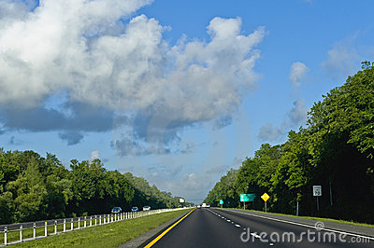
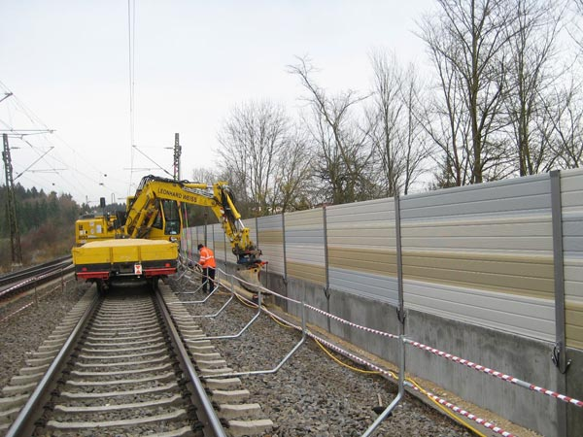
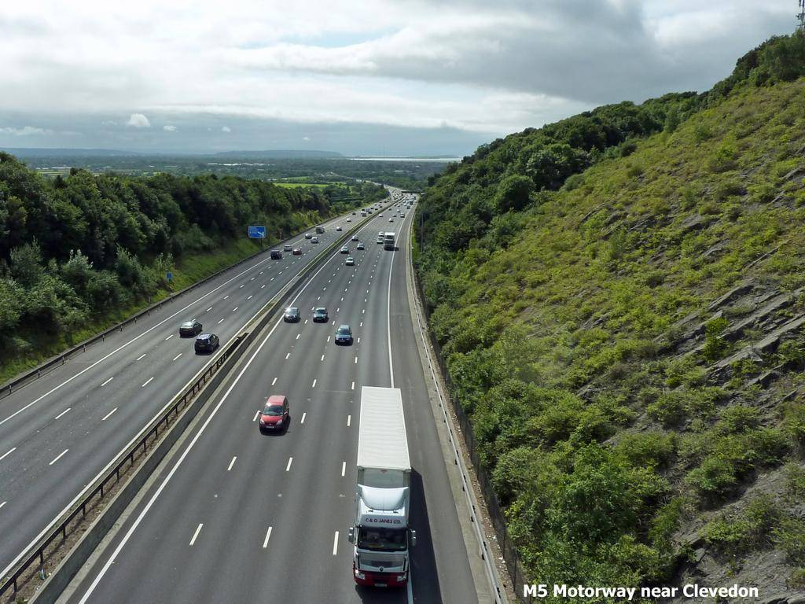
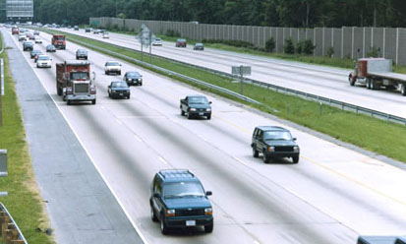

Slide 66
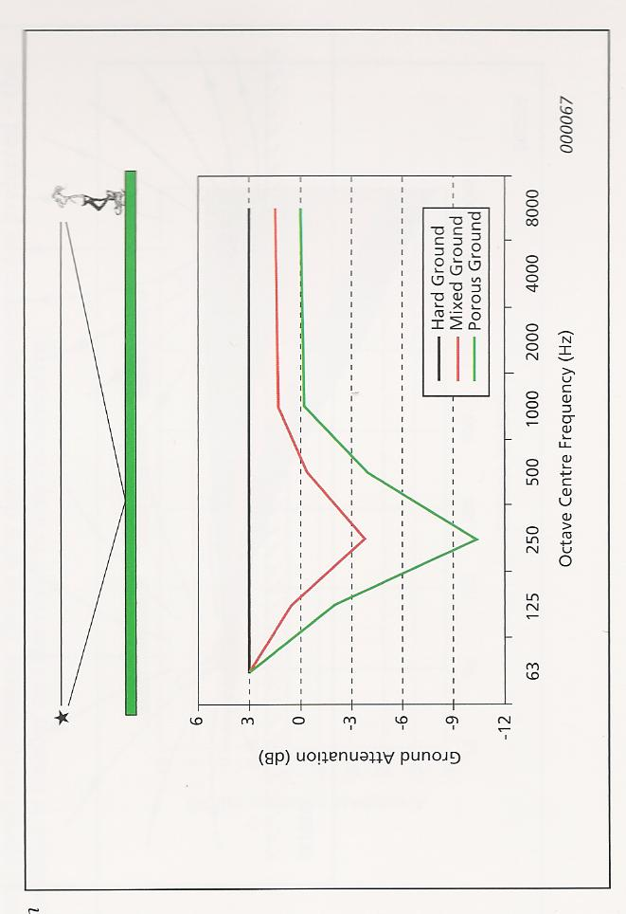
Ground Effect
Sound reflected from the ground interferes with the directly propagated source sound waves.
This effect is different for :
‘Hard’ (concrete and tarmac)
‘Soft’ ( mud, water)
‘Mixed’ surfaces (damp, vegetation)
Ground attenuation takes account of the content of the source frequencies and the type of ground between the source and the receiver.
How does precipitation affect attenuation?
How much attenuation does Snow provide?
Influence at 100m distance from the source at a height of 2 metres above ground level.

Slide 67
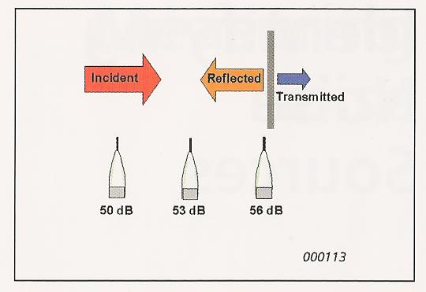
Noise at the Receiver
‘Reflection’ and ‘Transmission’
When sound impacts a surface, part of the acoustic energy is reflected, part is transmitted and part is absorbed.
If transmission and absorption are low...as is generally the case with well built and insulated buildings...most of the energy is reflected and the building is said to be:
‘acoustically hard’.
The sound pressure level near the surface is due to direct reflection and from sound arriving from one or more other reflections.
The meter reading 0.5 metres from a plain solid wall is typically 3dB higher than if there was no wall.
Therefore we position sound level recording to exclude this effect...and this is termed: ‘free-field condition’

Slide 68
‘Reflection’ and ‘Transmission’
How much sound is reflected, transmitted or absorbed will depend on the properties of the object barrier, its size and the wavelength of the sound.
In general, the object must be thicker than one wavelength in order to significantly disturb the sound field.
For example, at 100 Hz frequency (low) the wavelength is 3.4 metres and sound insulation becomes difficult.
Example: You will notice this when music is playing in an adjacent room and the bass notes are very difficult to insulate against.
For internal walls…Suppression of the noise is approximately 1Db per inch of insulation for low frequency ….compared to 4Db for high frequency.

Slide 69
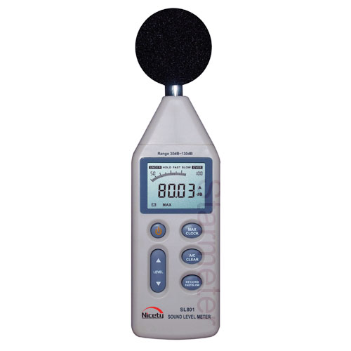
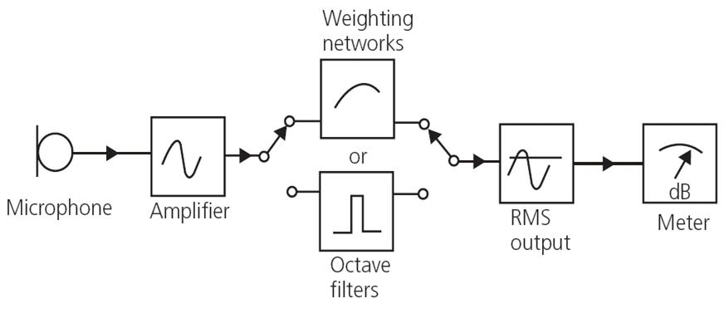
Sound meters
It is relatively simple to make instruments which can measure sound waves and display the results. Most sound meters detect sound with a microphone which converts the sound energy into electrical signals that can then be processed by electronic circuits.
Diagram: Components of a sound level meter

Slide 70
A-scale
We often wish to measure a noise with a single measurement to quantify Comfort level, and this is done by allowing the sound level meter to listen to all the frequencies at one time, in the same way as the human ear does.
An electronic circuit in the meter then emphasises the middle frequencies, as the hearing system is most sensitive at these frequencies.
What were these frequencies?
The results are usually quoted as dB(A) and the 'A' is an important tag telling us how the measurement was made.
Measurements in db(A) are widespread and convenient but you must remember that they are a compromise and tell us nothing about the frequency content of a noise.
For Example: The ear can tell a difference between a washing machine and a telephone buzzer because their sounds have a very different structure in frequency content.
But these different sounds may give identical readings in Decibels when measured.

Slide 71
Weighting network
There exist three additional weighting networks — B, C, and D — which are either used in special circumstances or are obsolete.
When low frequency noise is of concern, C weightings are used because they attenuate low frequencies much less than the other weightings.
D weightings are used for very high frequencies, like those
emitted from jet engines.
The B weightings, emphasising middle frequencies, but are no longer in use.

Slide 72
Calibration
Common practice to calibrate the sound meter before and after each series of measurements to:
Ensure accuracy
Ensure validity in reporting for nuisance noise court cases.
So:
Calibration data is required by legislation and standards

Slide 73
Where to take your outside reading ?
Away from Facades
Away from barriers / obstacles
Downwind
In dry conditions
In wind speed of less than 5m/s
With the microphone 1.2 to 1.5m above ground level
(waist height)
Copy Down

Slide 74
GO TAKE SOME MEASUREMENTS
Adjacent to a fitting
Across a partition
Try to measure a reflection from a hard surface

Slide 75
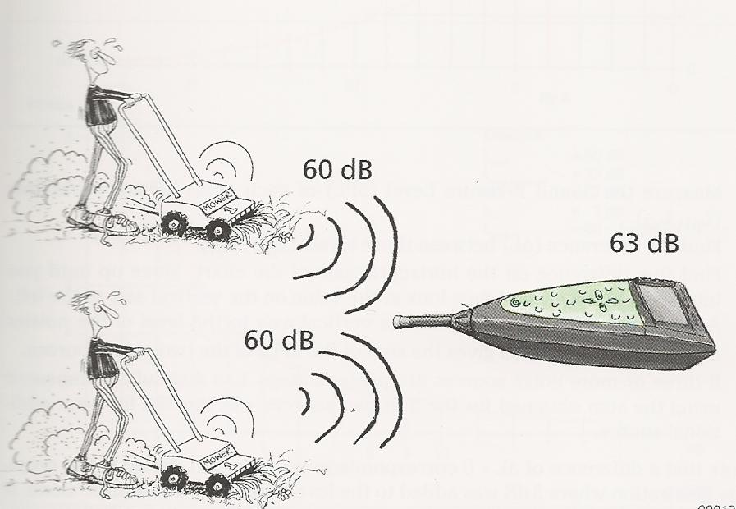
ADDING SOUND LEVELS
If we have two or more sound sources together that we need to combine to measure the joint pressure levels , they have to be measured separately initially.
Due to the fact that dB is a logarithmic scale...we can’t simply add them together.
Addition of dB levels can be achieved simply by utilising the following method.
+
?

Slide 76
Addition of Sound Levels
If the Sound levels from two machines or plant items that have been measured separately and we want to know the total SPL made by the two machines when operating together, we must add the two sound levels.
However, dB is a logarithmic scale.
We cannot simply add the two levels together.
Addition of dB levels can be achieved simply by utilising the following method.

Slide 77
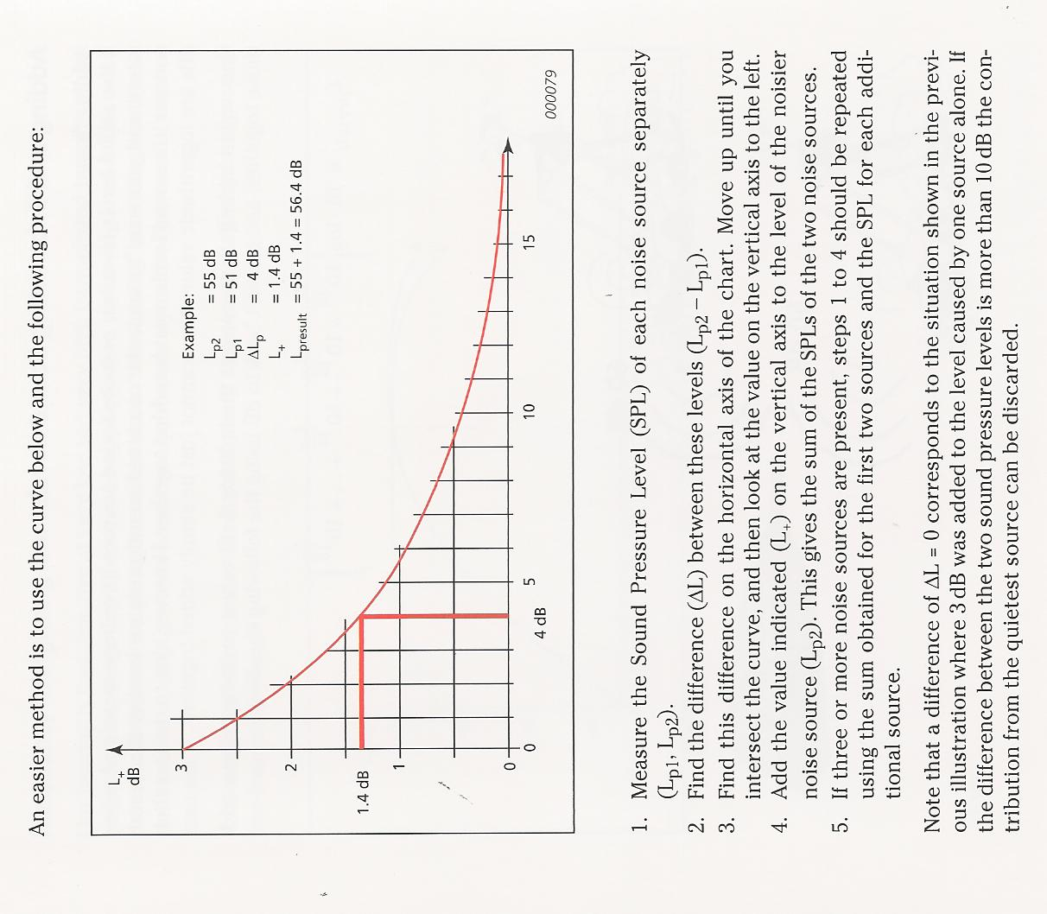
ADDING SOUND LEVELS

Slide 78
Exercise:
Two adjacent point sources are measured
independently and record dB levels of 51 and 58
dB respectively.
Using the graph handout, calculate the combined dB level of the two sounds.
A further piece of machinery is introduced to the work space and records a dB level of 62 dB. What is the combined noise level of the three sounds?

Slide 79
Answers
Machine 1 = 51 dB
Machine 2 = 58 dB
Difference = 7dB
Correction from the chart = 0.8 dB
Total Noise = 58.8 dB
2. Total Noise from first two machines = 58.8 dB
Machine 3 = 62 dB
Difference = 3.2 dB
Correction from the chart = 1.6 dB
Total Noise = 62+1.6 = 63.6 dB

Slide 80
Background Noise – Subtracting Sound levels
One factor that may influence the accuracy of measurement is the level of background noise compared to the level of sound being measured.
The background noise must not drown out the sound level of interest being measured.
In practice...this means that it must be 3dB higher than background noise.
The procedure for measuring the sound level for a machine under conditions of background noise is as follows.

Slide 81
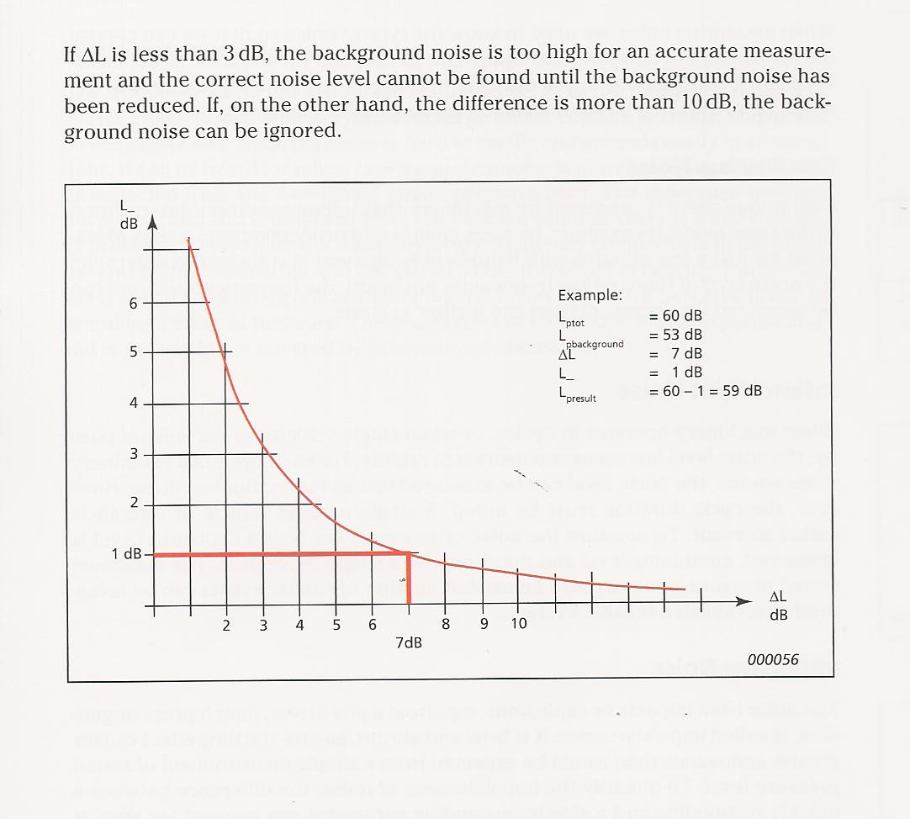
SUBTRACTING SOUND
LEVELS

Slide 82
Exercise:
The total noise in a workshop is measured at
80 dB with a machine under investigation
running.
The machine was turned off, and the
background noise measured at 74 dB
Using the graph handout, calculate the noise level of the machine on its own.

Slide 83
Answers
Total Noise level with Machine running = 80 dB
Background Noise with machine off = 74 dB
Difference = 6 dB
Correction from the chart = 1.2 dB
The noise from the Machine alone =
80 – 1.2 = 78.8 dB

Slide 84
Where to take your outside reading ?
Away from Facades
Away from barriers / obstacles
Downwind
In dry conditions
In wind speed of less than 5m/s
With the microphone 1.2 to 1.5m above ground level
(waist height)
Copy Down

